Slide 1
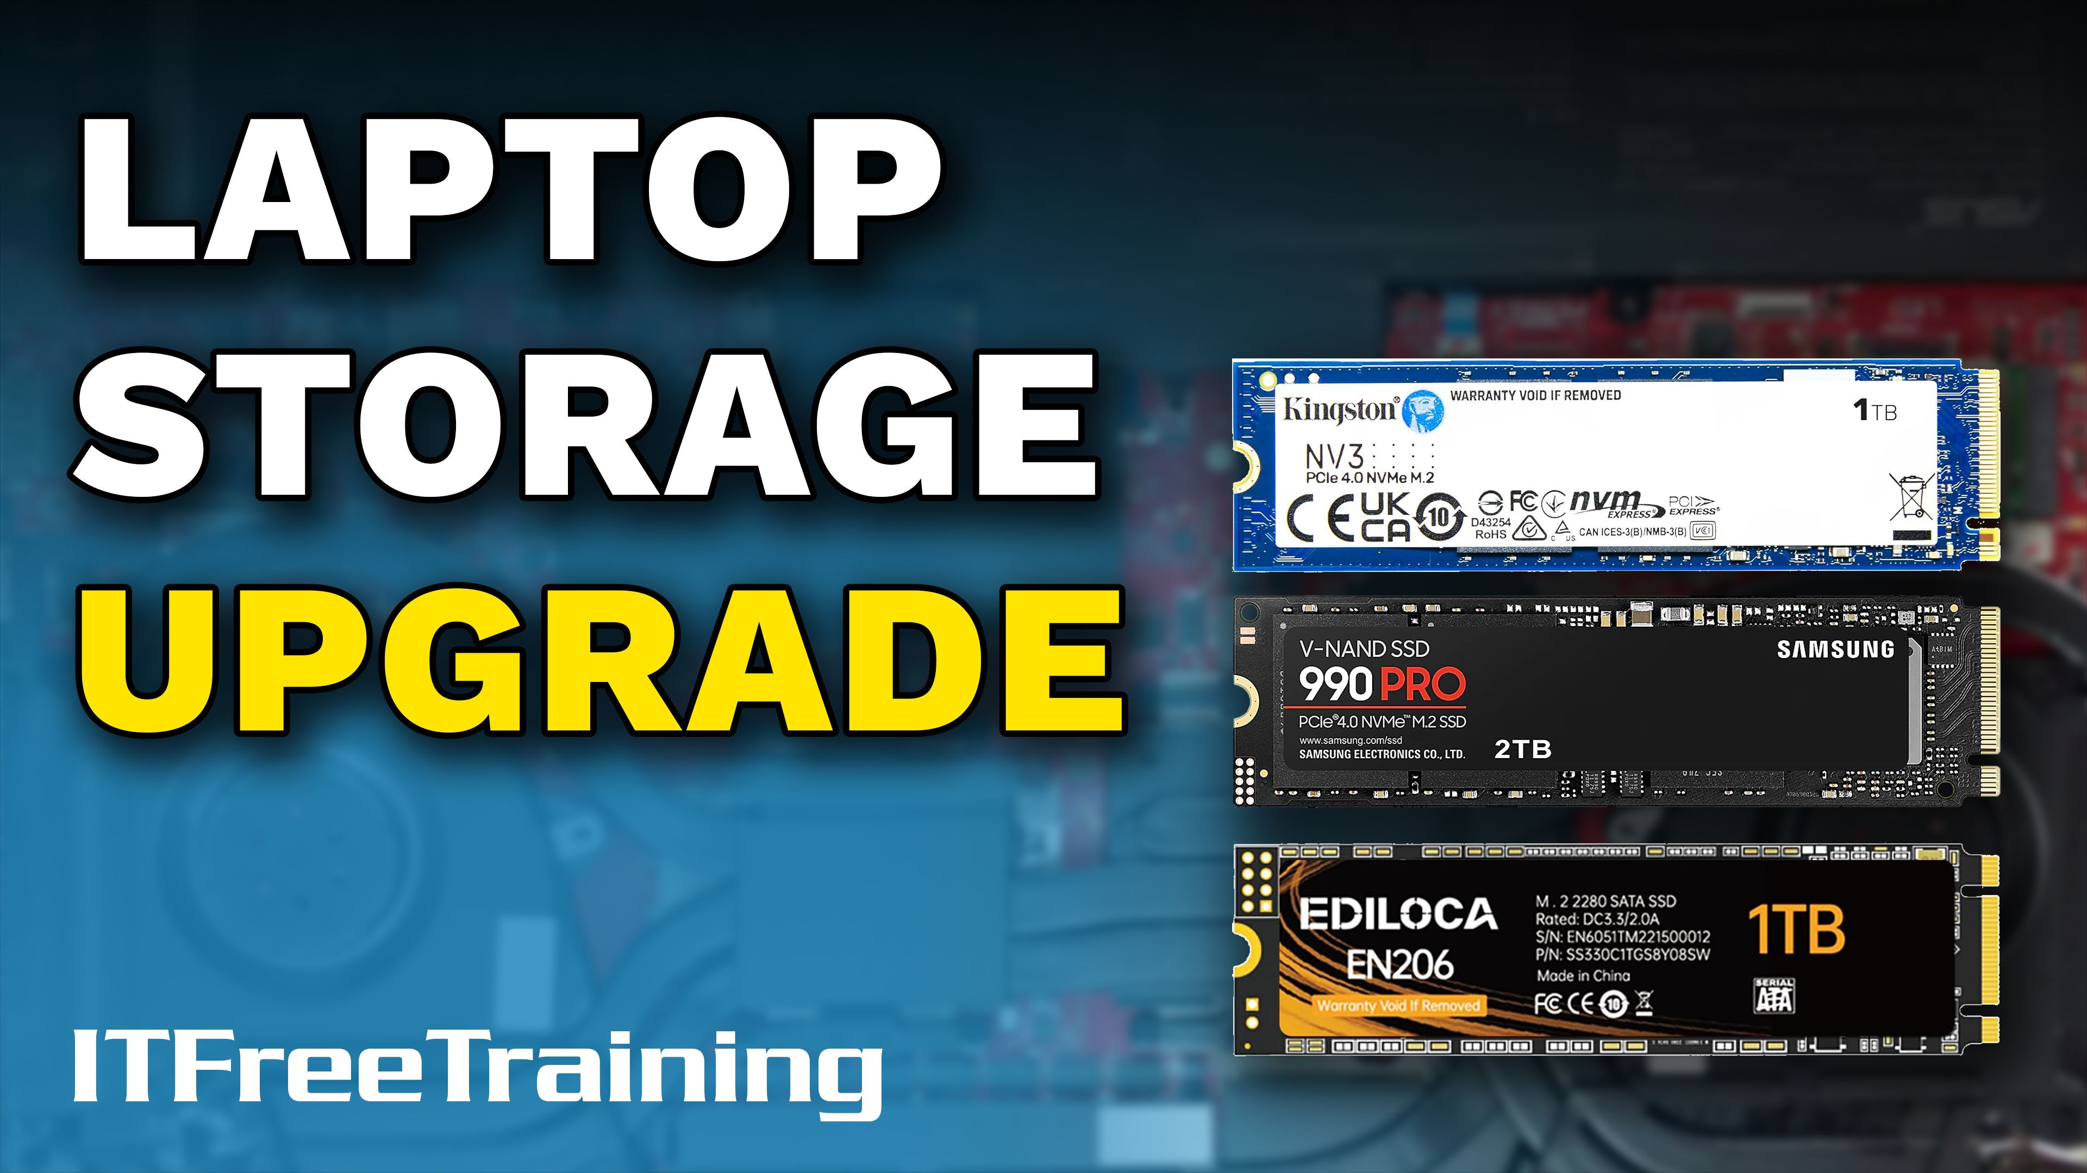
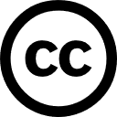

Notes:
Let’s look at upgrading laptop storage.

Slide 2

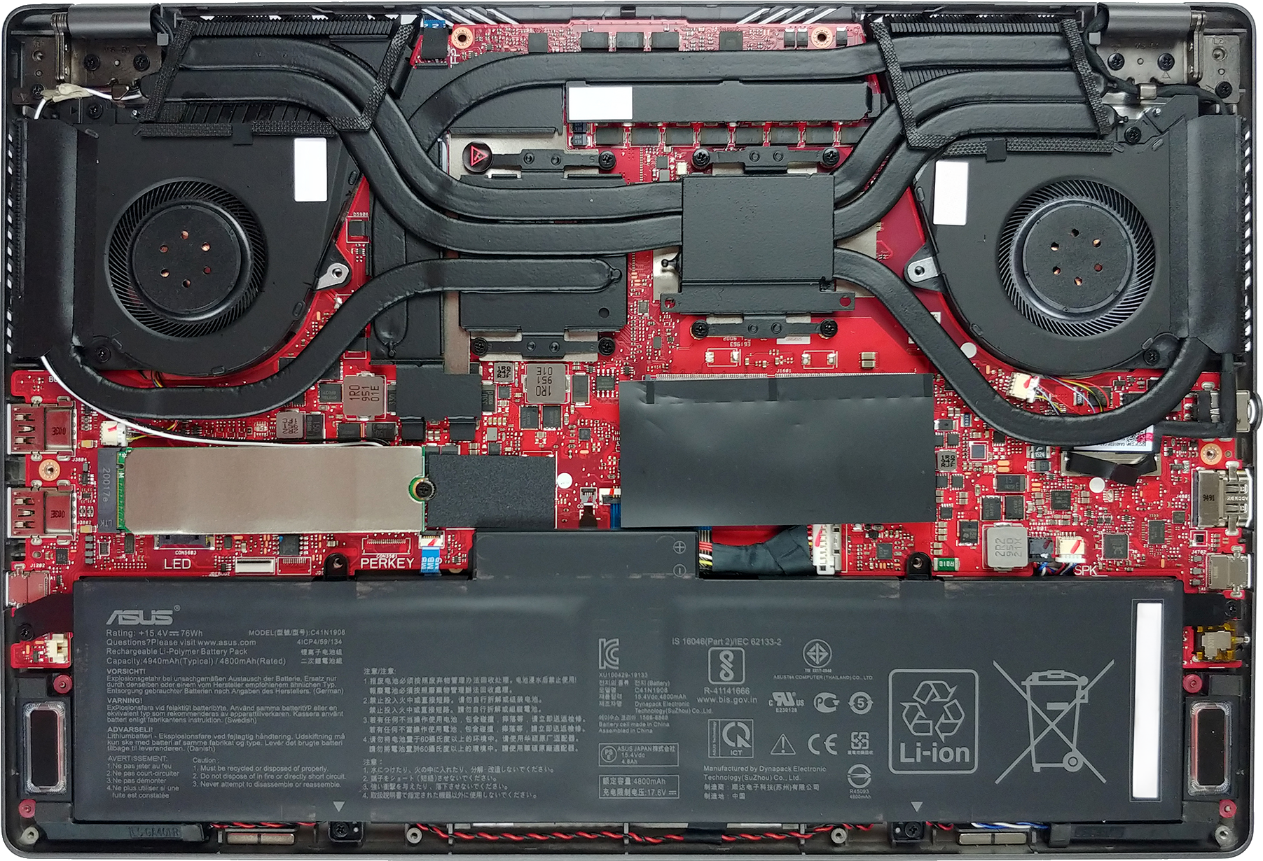
Upgrading Laptop Storage
Laptop may only support single storage
Requires plan of what to do with existing data
Single slot
ITFreeTraining.com
Notes:
00:02 Depending on the laptop, it may support only one internal storage device, with additional storage requiring an external drive or network solution.
In this example, the laptop has a single storage slot, meaning you can’t simply add more storage. Instead, you’ll need to replace the existing drive with a larger one or use external storage options.
Upgrading your fixed disk—whether a hard disk or SSD—requires a plan of what to do with your existing data. Later in the video, I will cover the process of installing storage in a laptop, but first, I will focus on managing the existing data before upgrading.

Slide 3
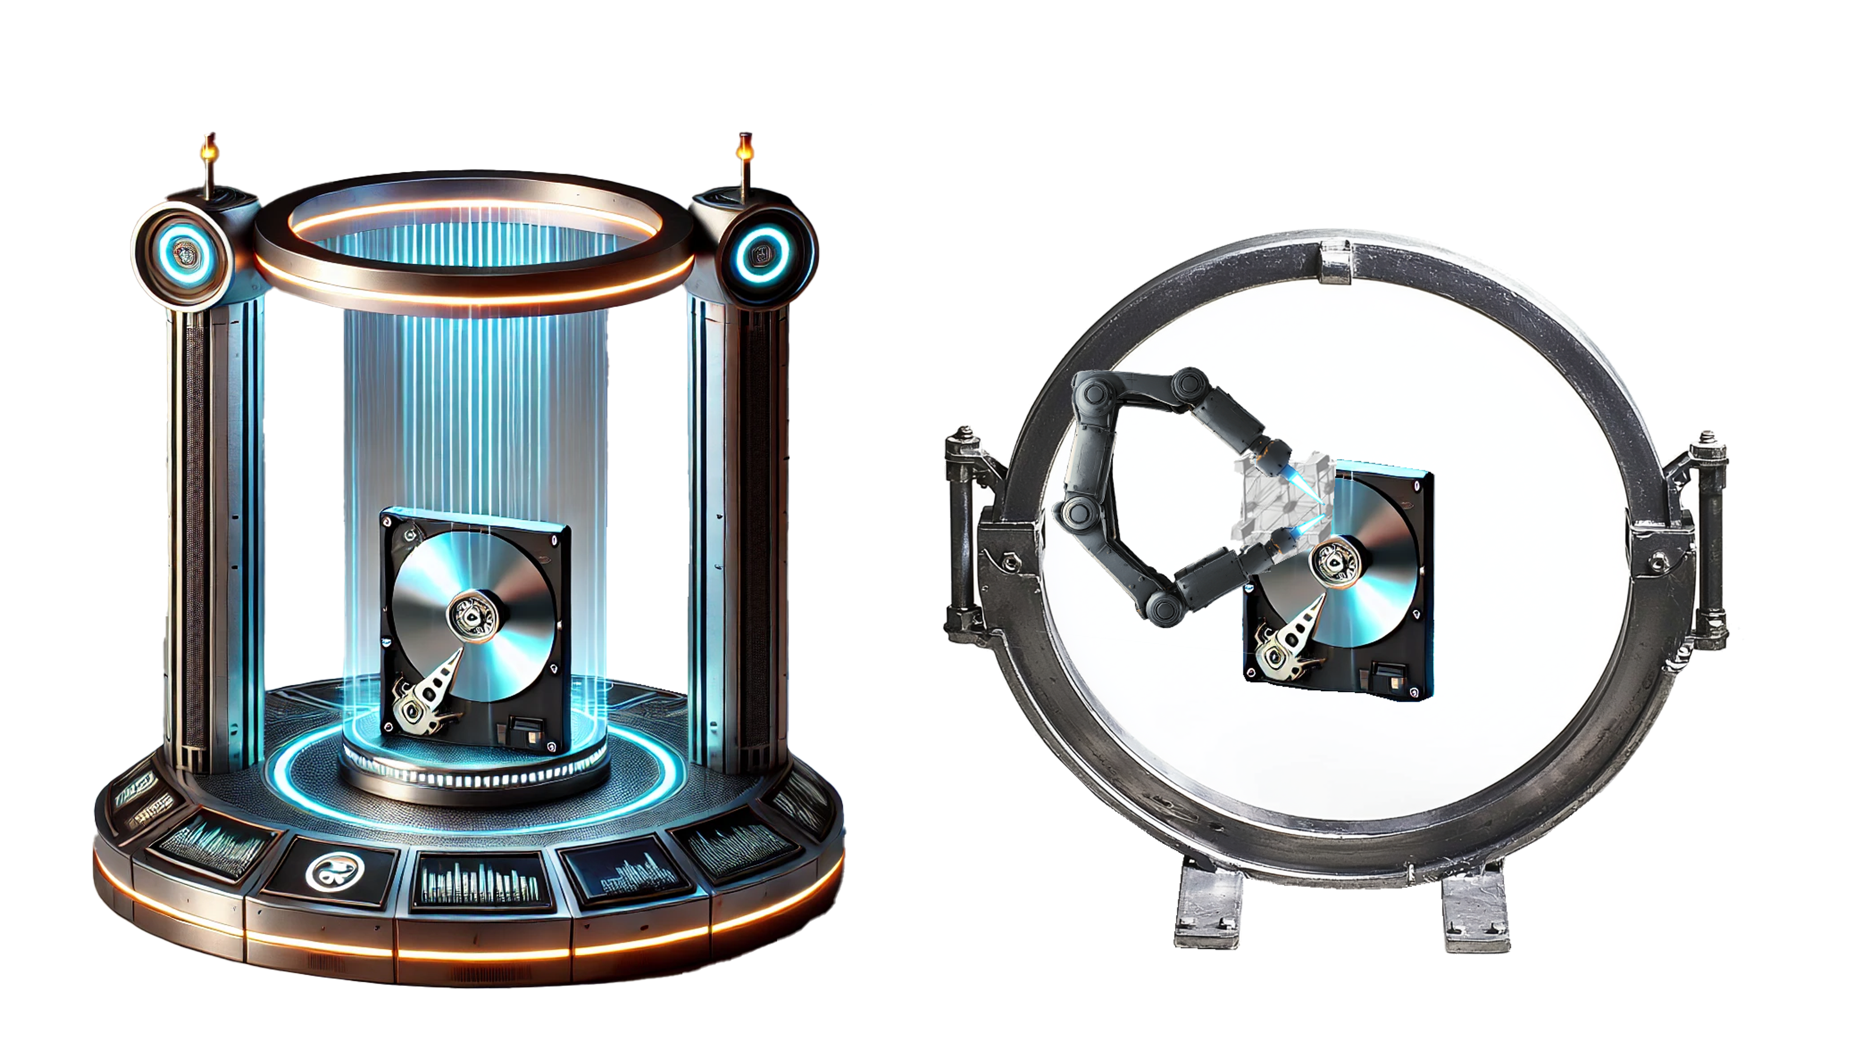
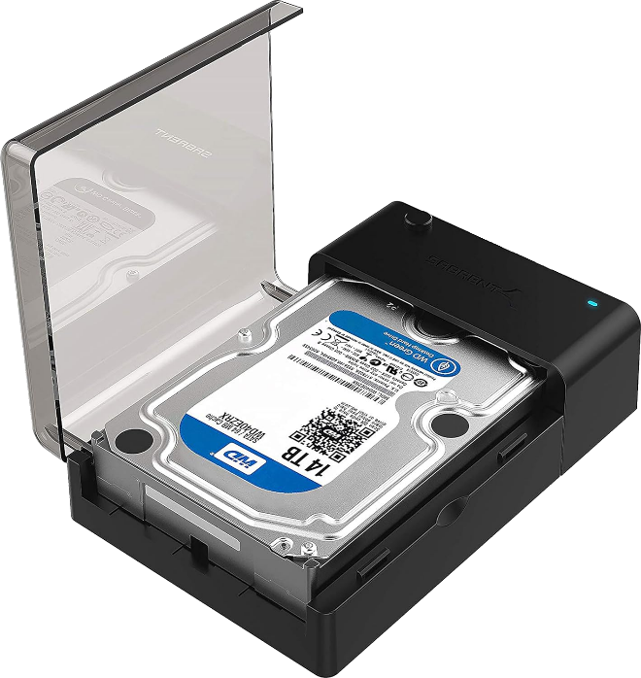
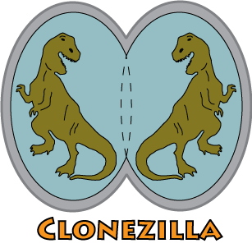
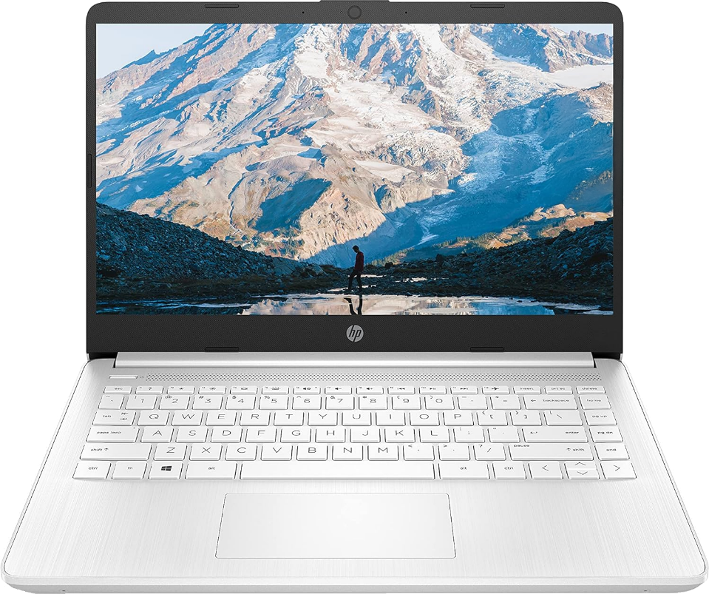
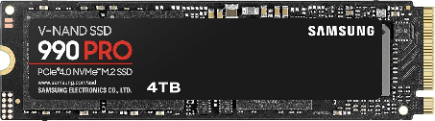
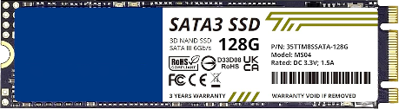
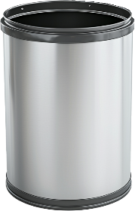
Migration (Cloning or Imaging)
Process of creating a bit for bit copy
Requires new storage to be same size or larger, unless shrinking is supported
Step 1: Image to temp storage
Step 4: Image to new storage
Step 3: Install new storage
Step 2: Remove storage
ITFreeTraining.com
Notes:
00:41 When upgrading storage or the operating system on a computer, CompTIA describes "migration" as a bit-for-bit copy of the storage. However, other vendors may use "migration" to mean copying only user data and settings. Essentially, what CompTIA calls migration is often referred to as cloning or imaging. To avoid confusion in the workplace, I recommend using the terms cloning or imaging. For the rest of this video, I will refer to this process as imaging.
Imaging typically requires the new storage to be the same size or larger than the original. Some imaging software can shrink the image to fit a smaller drive, usually by reducing the partition size. This process requires the drive to be defragmented first so that all free space is consolidated at the end of the partition.
To understand the process better, let’s consider a laptop we want to upgrade by increasing its storage capacity. In this example, because the laptop supports only one storage device, the only option is to replace the existing drive.
The first step is to create an image of the laptop's storage on temporary media. Many software options are available for this purpose, both free and paid. A popular free option is Clonezilla. If you have been in IT for a while, you might remember Ghost, a well-known imaging tool from earlier days. Clonezilla offers the same kind of features of the original Ghost.
The next step is to remove the old storage device from the laptop.
Once the old storage is removed, install the new storage into the laptop. The new drive may be blank or preloaded with data, but I usually erase it first unless it is brand new to ensure no residual data from the previous user remains.
The final step is to image the new storage in the laptop using the image file saved on temporary storage. Depending on your options, the imaging process may delete any existing data on the drive. For faster imaging, areas filled with zeros might be skipped, leaving any preexisting data intact. This is another reason why I prefer to erase the new storage before imaging.

Slide 4



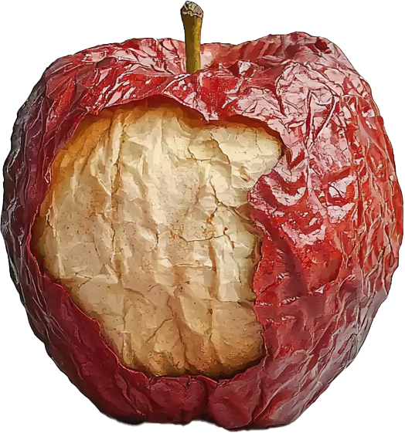
Replacement
Only user data is copied from the old drive
The user data is combined with a new OS rather than using the old OS
Creates a fresh start and hopefully leaves old problems behind
Most vendors refer to this as migration rather than replacement
ITFreeTraining.com
Notes:
03:05 In the CompTIA official guide, transferring only user data is referred to as "replacement."
This process involves combining user data with a new operating system instead of retaining the old one.
This creates a fresh start and ideally resolves previous issues with the old operating system. You will need to install any additional applications that you require. However, some settings and configurations may not transfer and will need to be set up again on the new OS. If your old system was crashing, unstable, or sluggish, this approach can help you start afresh with a new operating system and hopefully leave those problems behind. However, if the issues are caused by the user data, they may be transferred to the new operating system. This method won't resolve problems originating from the user data.
Most vendors call this process "migration" rather than "replacement." CompTIA sometimes uses different terminology from what is common in the industry. Be aware of these differences: in the workplace, use industry terminology, but on the exam, use CompTIA's. However, it's unlikely that you will see exam questions asking directly about the term’s "migration" or "replacement"—you will most likely be tested on the underlying concepts.

Slide 5
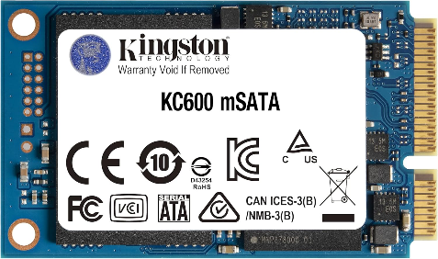
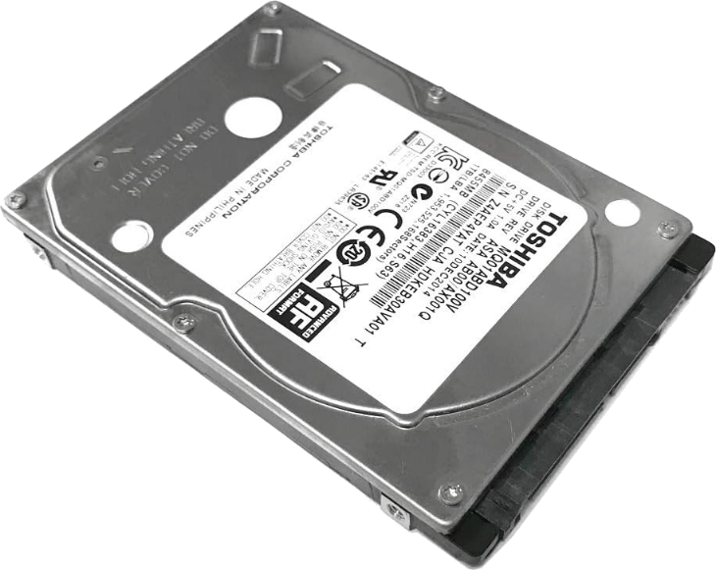
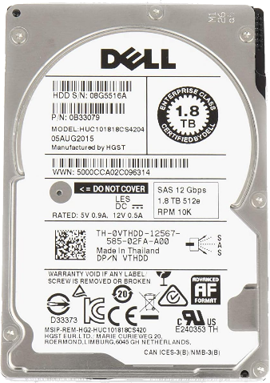
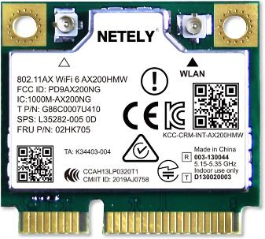
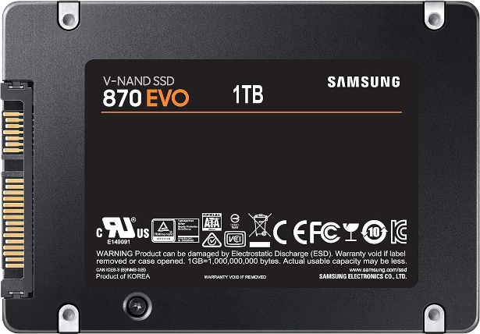
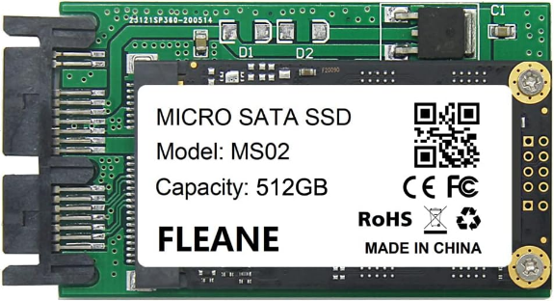
SATA Form Factors
2.5-inch
1.8-inch
mSATA
Common before M.2 storage
Rarely used
Old laptops
Mini PCIe
Older laptops
All uses SATA interface making maximum speed 6 Gb/s
ITFreeTraining.com
Notes:
04:31 Laptops use various storage form factors, which define both the storage dimensions and connector placements. This standardization ensures compatibility with any device that supports the form factor. For example, the 2.5-inch form factor has long been a popular choice in laptops.
This form factor was widely used before the introduction of M.2 storage, which will be discussed next.
There was also a 1.8-inch form factor, though it was rarely used. This smaller size was primarily found in compact devices rather than laptops, and it was overshadowed by more popular form factors, making devices that use it very rare.
All these devices use the SATA interface, which supports speeds of up to 6 gigabits per second. Notably, both hard disk drives and solid-state drives can utilize this interface.
There are also mSATA and Mini PCIe devices. SATA was released in 2000, and mSATA was introduced in 2009 as a more compact alternative to the 2.5-inch form factor. However, mSATA did not gain widespread popularity, and in 2013, M.2 was introduced and quickly became the preferred option. As a result, mSATA was short-lived in the marketplace and is rarely encountered today. Mini PCIe, released in 2005, predates mSATA. It gained little market adoption, and since mSATA was designed to replace it, you are even less likely to come across Mini PCIe devices today.

Slide 6

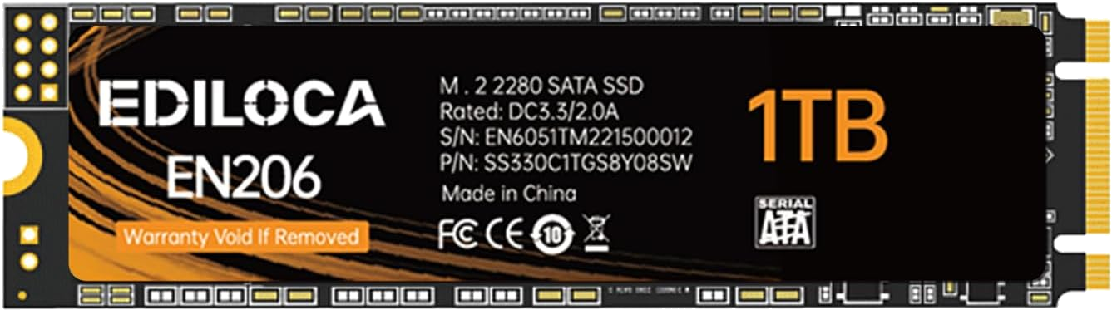

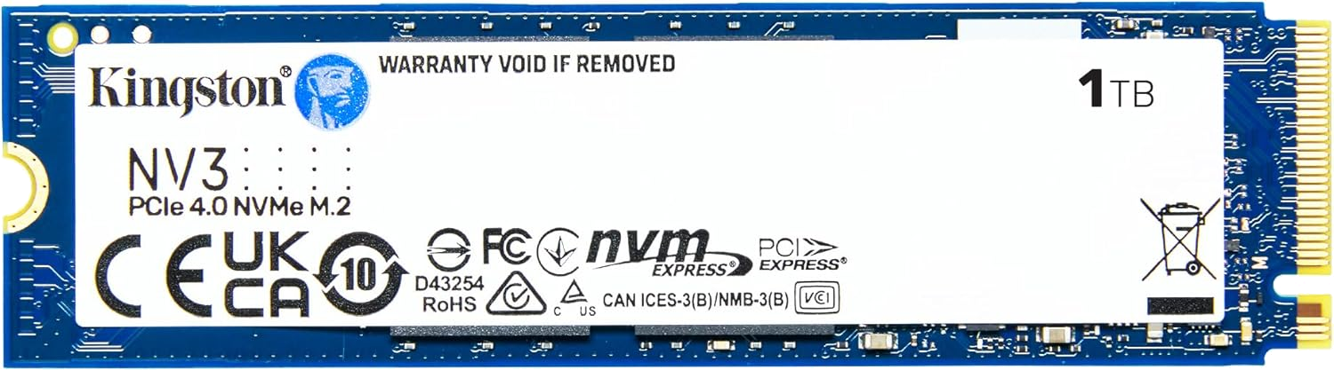
M.2 Form Factor
M.2 supports multiple protocols
One or two notches on M.2 connector determine what protocols are supported
Check laptop to make sure it supports SATA/NVMe or both
SATA
Current market. Two notches (B+M key)
Maximum speed limited to 6 Gb/s
NVMe
Current market. One notch (M key)
Uses PCIe for communication (Up to four lanes)
ITFreeTraining.com
Notes:
06:08 In 2013, the M.2 form factor was introduced, quickly becoming the preferred storage option in laptops due to its compact size and lower storage costs. Unlike the previous storage devices that relied solely on the SATA protocol, M.2 drives support multiple protocols, offering greater versatility.
For M.2 storage devices, the two primary protocols used are SATA and NVMe.
The official M.2 standard allows for a maximum of two notches in the connector. Each notch reduces the pin count, which in turn limits the data transmission capacity. The placement of these notches indicates the supported protocols and prevents the device from being inserted into an incompatible slot.
Currently, SATA M.2 drives feature two notches, known as the B+M key. The position of these notches indicates the key type. Although SATA M.2 drives with only a single B key have existed, they were very rare and are no longer available on the market.
M.2 SATA is limited to 6 gigabits per second due to the protocol's constraints. This explains why the market favors having two notches. Given that 6 gigabits per second is relatively low by today's standards, removing one or both notches does not affect the maximum speed; instead, it broadens compatibility with a wider range of devices. Manufacturers aim to sell their storage solutions to as many customers as possible, so not restricting storage to a single M.2 slot type makes sense.
NVMe devices currently feature a single notch, known as the M key.
NVMe uses PCIe for communication and supports up to four PCIe lanes. Although some early NVMe devices had two notches, this configuration reduces the lane count to two. Modern computers are designed to use only the M slot, ensuring broad compatibility with single-notch NVMe devices and SATA storage. Consequently, there is no need for a second notch.
Before purchasing storage, check your laptop's supported storage types. In the past, only SATA was supported, then both SATA and NVMe became available, and now many high-speed slots support only NVMe. Always verify your laptop's compatibility before buying. Given that NVMe uses a more efficient protocol than SATA, I recommend choosing NVMe when possible.

Slide 7

Subscribe
Next video
Video content: https://ITFreeTraining.com/ap11/8c30
Notes:
08:54 I hope this video has given you insight into the various form factors, interfaces, and approaches you can use. Thanks for watching, and I’ll see you in the next video. Until then, happy upgrading!
References
“The Official CompTIA A+ Core Study Guide (Exam 220-1101)” pages 279 to 280
“License CC BY 4.0” https://creativecommons.org/licenses/by/4.0/
Credits
Trainer: Austin Mason https://ITFreeTraining.com
Voice Talent: HP Lewis http://hplewis.com
Quality Assurance: Brett Batson https://www.pbb-proofreading.uk

