Slide 1



Notes:
Let’s have a look at laptop power and batteries.

Slide 2


Understanding Electricity
Power supply required to convert AC to DC
+
+
Voltage
Voltage
-
-
Alternating Current (AC)
Direct Current (DC)
Efficient over long distances
Electronics require stable power
ITFreeTraining.com
Notes:
00:04 The main two types of electricity required for computers is alternating current or AC and direct current or DC. AC is more efficient over long distances and DC is more stable which is required for electronics.
In order to convert between the two, a power supply is required. This should be supplied with the laptop.

Slide 3

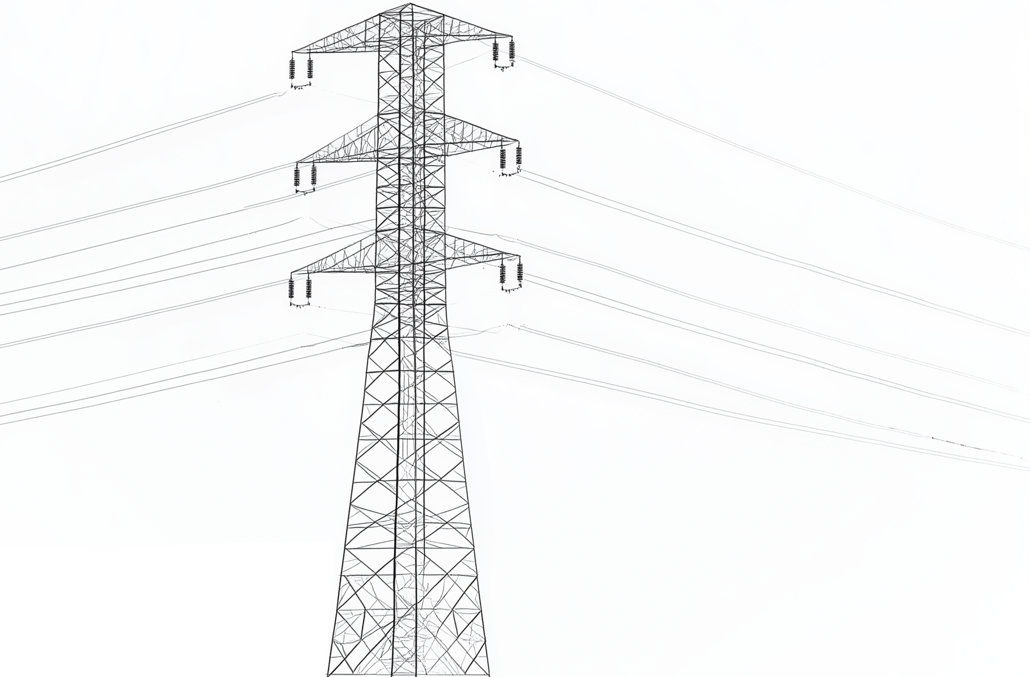

Electricity Supply
Auto-switching power supplies automatically change
The Americas/East Asia/The Caribbean
Voltage varies between 110-130V
Europe/Africa/Asia/Oceania
Voltage varies between 220-240V
ITFreeTraining.com
Notes:
00:28 Electricity supply standards vary worldwide, but they generally fall into two main categories. The first standard is 120 volts, used in regions like the Americas, parts of East Asia, and the Caribbean. Keep in mind that the actual voltage can vary slightly depending on the country, typically ranging from 110 to 130 volts.
The other standard is 230 Volts. Used in areas like Europe, Africa, Asia and Oceania. The voltage typically varies between 220 volts to 240 volts. In reality, whichever standard is used, the voltage you receive can fluctuate anywhere from five to ten percent from the voltage standard. So don’t worry if you have a power supply with a slightly different voltage than what your country uses; it will still work.
If your power supply is an auto-switching power supply, it will automatically change as required to the correct voltage. If it does not, plugging in the wrong power adapter can damage the device. Let’s have a closer look.

Slide 4
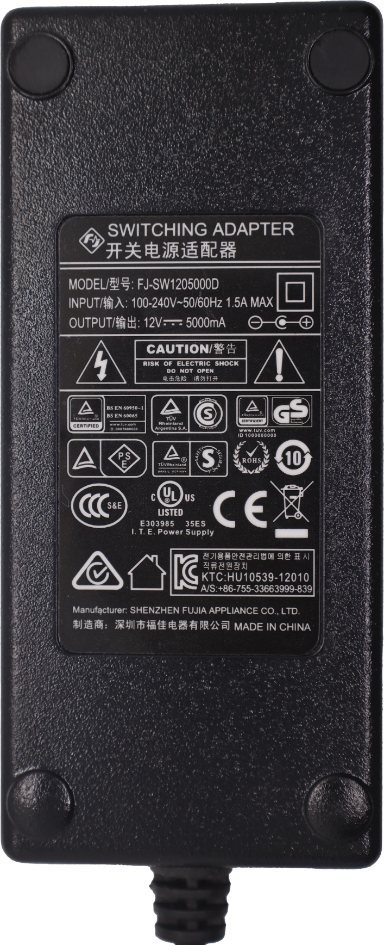
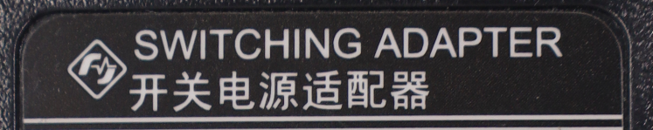
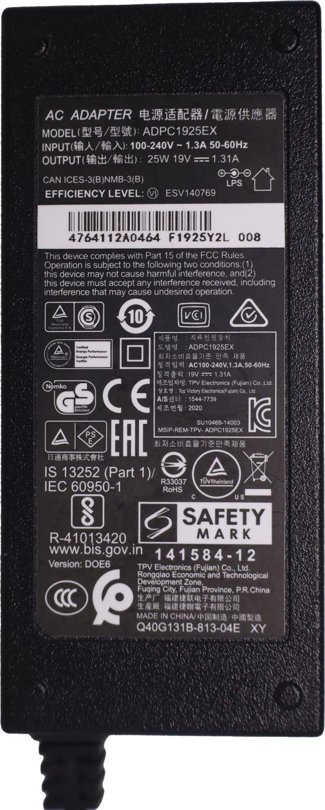
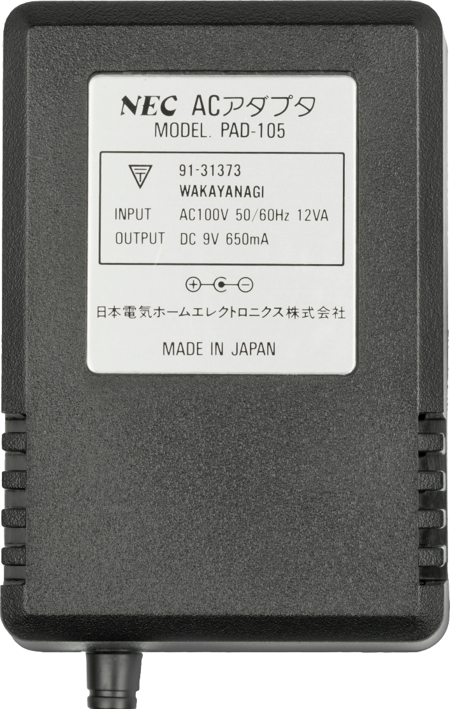

Power Adapter (Input)
11
Labeled as switching adapter
Most adapters will not be labeled like this
Look for input voltage
120V won’t support 240V
240V likely to cause damage
ITFreeTraining.com
Notes:
01:34 It is important to use a power adapter that supports your main power. In some cases, the adapter may be labelled as a switching adapter. Most adapters will not be labelled like this. When this is the case, look for the input voltage. The adapter will generally say the range of 100 volts to 240 volts. Adapters like these can be used with either of the two main standards for electricity.
You will find, particularly with devices like laptops, the adapter will support both standards of electricity since these devices are sold and used all over the world. However, it is good to check because there are power adapters out there that only support one standard.
If you have a power supply that only supports the 120 Volt standard, it will not support the 240 Volt standard. If you use 240V it will likely cause damage. So, If you find an old power adapter, check the label and make sure it is correct. If you plug a 120 volt supply in a 240-volt outlet, it may not cause damage, it probably just won’t work.

Slide 5
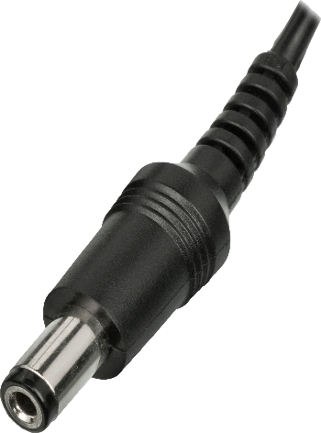
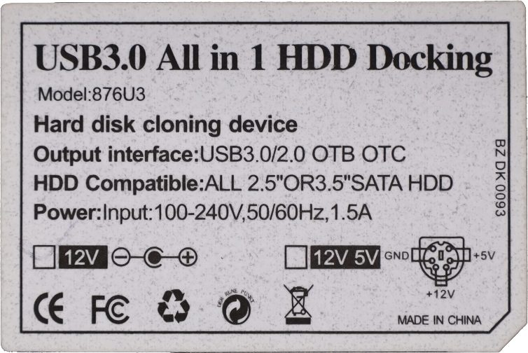
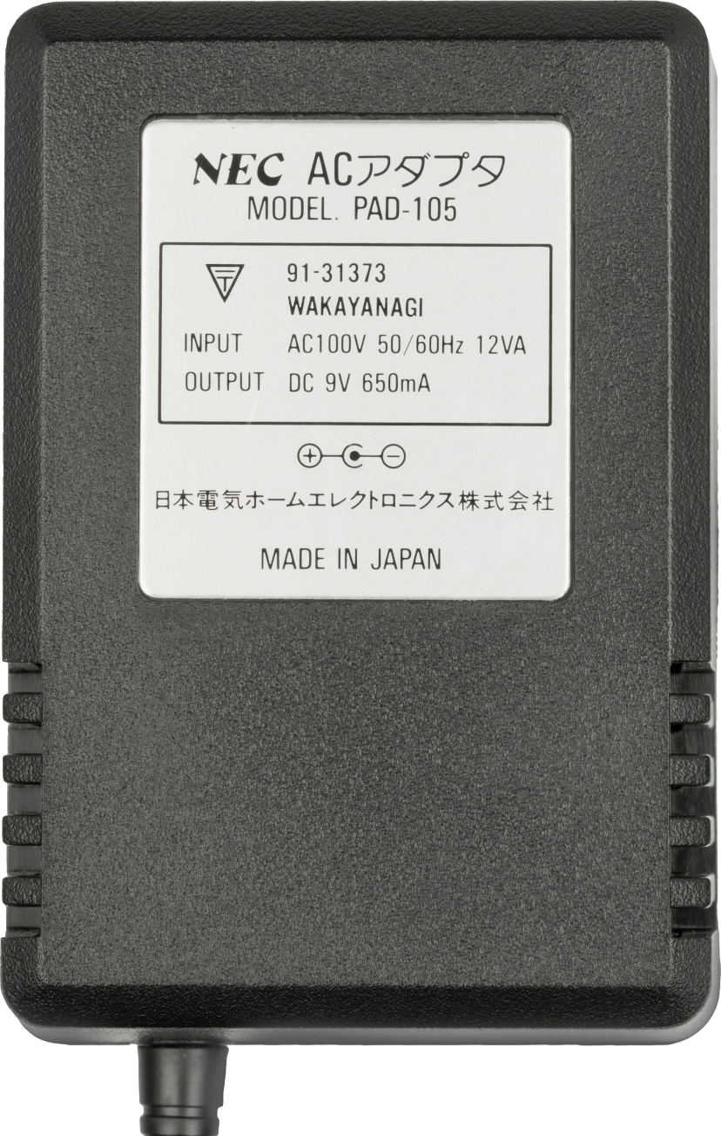


Power Adapter (Output)
Check the polarity diagram matches the device
Shows the positive and negative orientation of the inner and outer parts of connector
Not compatible
ITFreeTraining.com
Notes:
02:46 Before you plug the power adapter into your laptop, check that the polarity diagram matches the device. In this example, you can see the polarity diagram on the label of the power adapter. The diagram shows the positive and negative orientation of the inner and outer parts of the connection.
In this example, you can see the outer connection is positive. The inner part is negative. When you plug in an adapter, check the device to make sure it is the same polarity. In this example, you can see, in the polarity diagram, the orientation is the opposite way. So, this power adapter is not compatible with this device.
The output voltage is higher than that of the other adapter. Using this adapter could easily damage the device. Let’s take a closer look.

Slide 6
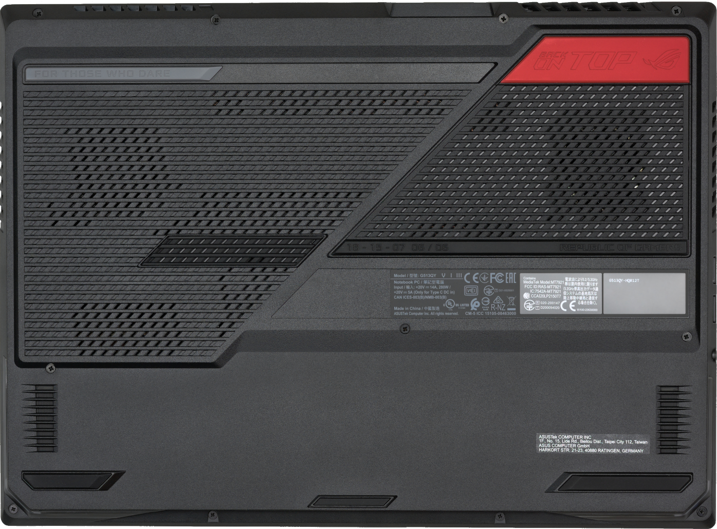
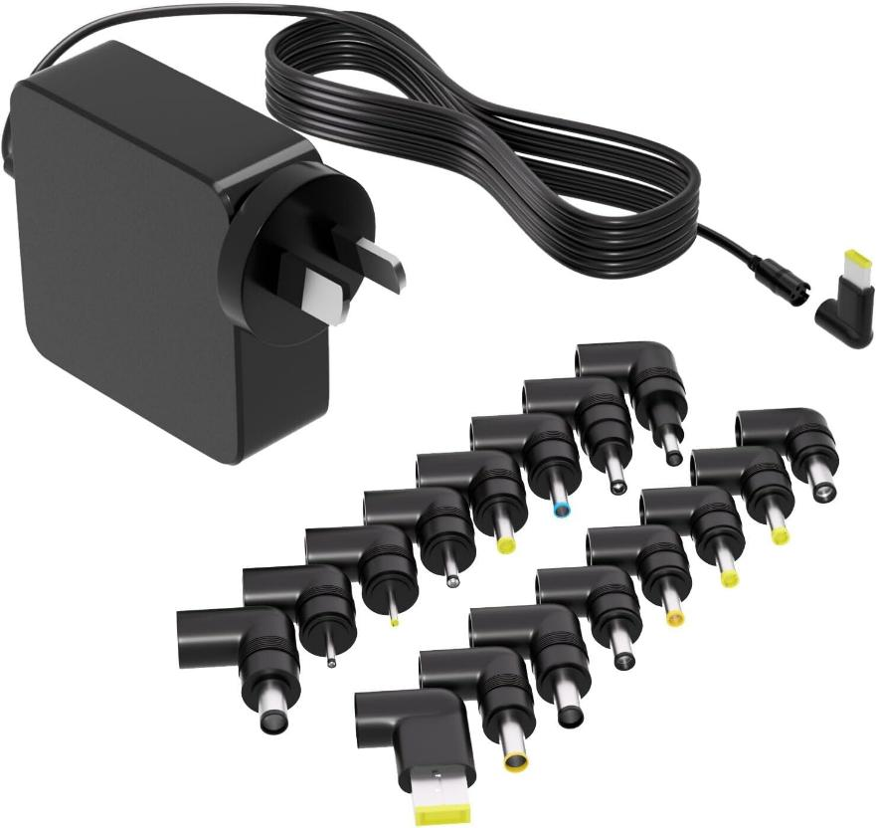
Power Adapter (Volts/Amps/Watts)
Voltage needs to match
Amps/Watts may be higher
Universal adapter
ITFreeTraining.com
Notes:
03:35 When choosing a power adapter for your laptop or any electronic device, look for a label on the device that specifies the voltage and the current in Amps or power in Watts. In some cases, both Amps and Watts will be listed.
It’s best to use the power adapter that came with your device, but if that’s not possible, make sure the voltage matches—such as 20 volts in this case. While the current rating (Amps or Watts) can be higher, it should not be lower than what the device requires. If it is lower the device may not work correctly, randomly crash, or reboot.
There are countless power adapters out there, making it tricky to find the right one. Universal adapters are available and come with a variety of plugs, but if you use one, make sure to match the voltage and check the plug polarity. Although I’ve had some success with universal adapters, they don’t always work—particularly for devices like laptops, which sometimes require the manufacturer’s specific adapter even when the voltage and polarity are correct. Most IT departments have a collection of mismatched power adapters, which can make it challenging to find a compatible one. Fortunately, there’s hope that future devices may standardize adapters to make this easier.

Slide 7

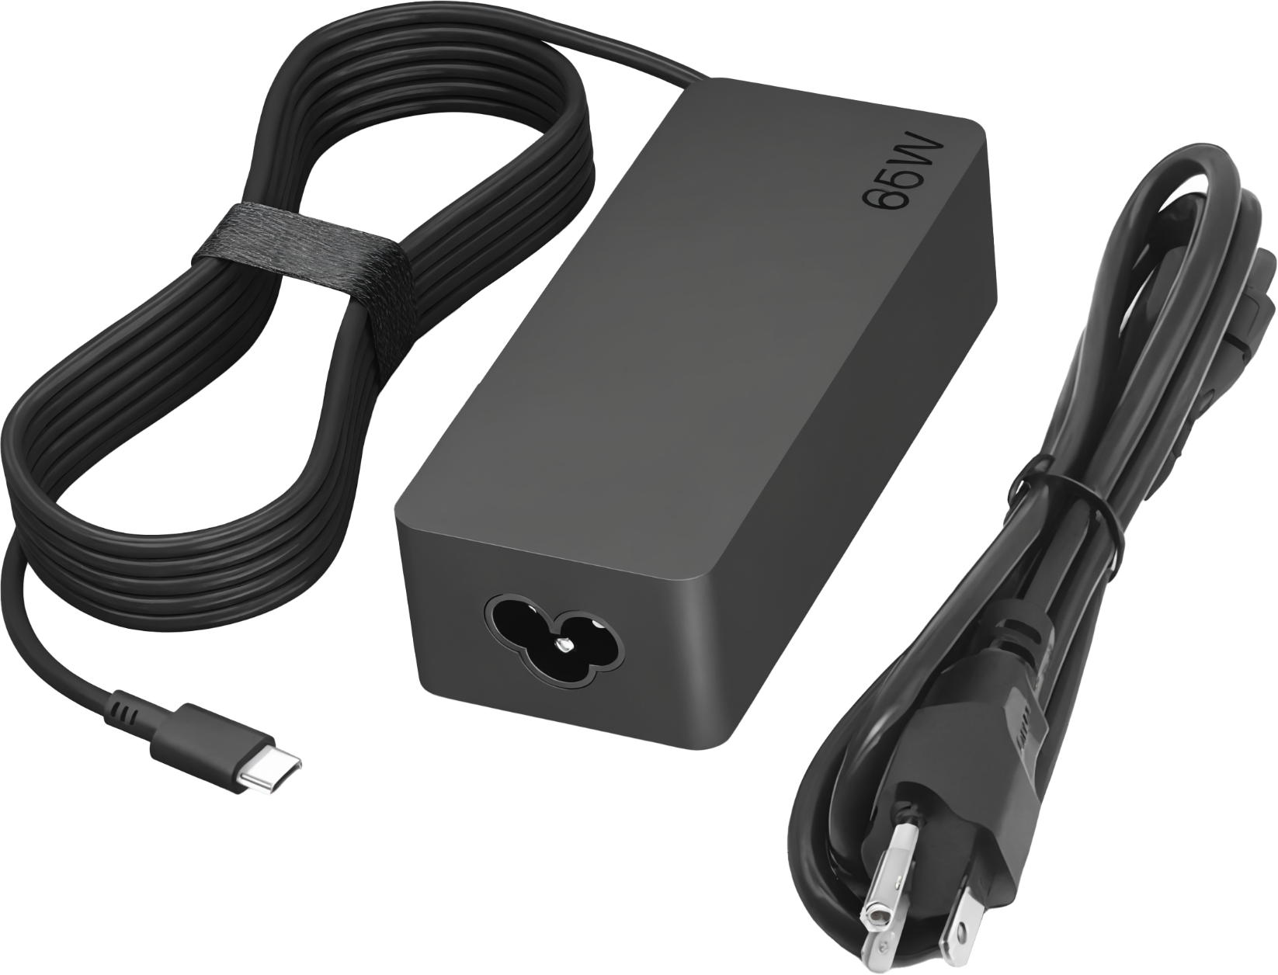
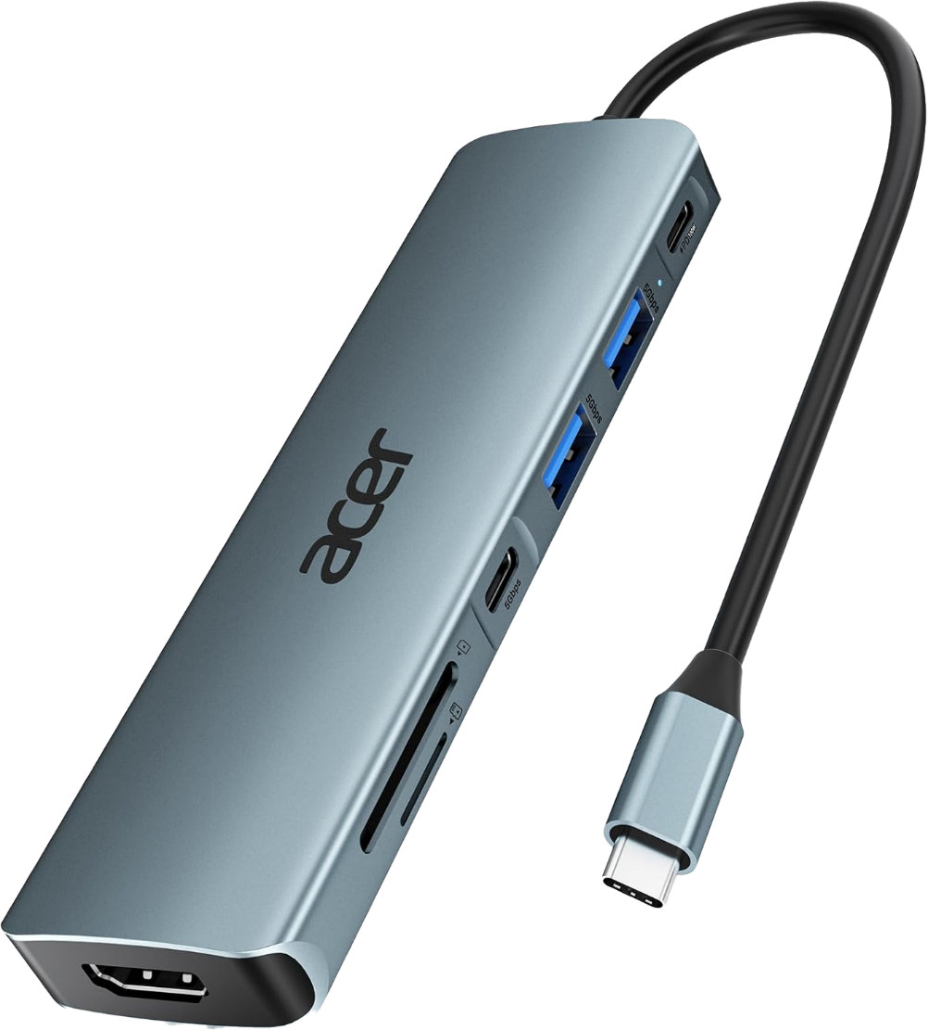
USB-C Power Adapters
Make sure meets or exceeds power requirements
Some laptops use a proprietary USB-C charger, but are rare and being phased out
Laptops can be powered through a powered USB hub
ITFreeTraining.com
Notes:
04:54 USB-C power adapters are not covered in the CompTIA A+ study guide, but I think it is important to cover because the vast majority of modern laptops use USB-C to charge the laptop. Firstly, make sure that your power adapter meets or exceeds power requirements. Some laptops may require a proprietary USB-C charger. These laptops are rare and with the law changes in the European Union, are likely to be phased out or become incredibly rare.
Laptops are mass-produced, and manufacturers aim to maximize sales by reaching a global market. However, modifying laptop designs for different regions adds complexity and increases costs. This is why proprietary USB-C power adapters are likely to be phased out in favor of following the USB-C standard.
Laptops can also be powered through a USB hub. Essentially the USB hub works as a pass-through device. A docking station would also provide the same functionality. So depending on your needs, a USB hub may be a cheaper option. Let’s put all this information together by looking at some examples.
I have a laptop that uses a cylindrical DC connector. I will plug the connector in the laptop. Once plugged in, the Sys Tray battery icon will change to indicate power has been connected. This is what should happen with the correct power supply. Now let’s consider that we have lost the power supply and are trying to use a replacement.
On the bottom of the laptop will be a label with information about the power connector. It has worn off on this laptop so I have recreated the information so it is easier to see. In this case, the connector has the positive connector in the center, the voltage 19.5 volts, and 6.67 Amps.
It is becoming more common for the label to have Watts rather than Amps. If you need to work out the Watts, multiply the voltage and Amps together. In this case, this laptop requires a 130Watt charger.
I have a universal charger which I will use to power the laptop. Universal chargers usually come with a number of different connectors. It is just a matter of selecting the right one and plugging it in. Make sure you get the polarity correct, in this case positive in the middle. The voltage on the universal needs to be set correctly, in this case 19.5 volts. Make sure you get this correct, otherwise you can do damage to the laptop.
To demonstrate a point, I have a USB-c charger. This laptop has a USB-C Thunderbolt port. It is hard to see, but there is a lightning bolt next to the USB port. Thunderbolt ports can be used for charging, so I will plug my USB-C charger into the Thunderbolt port.
I will now switch the laptop on. You will notice I get a message saying this charger can’t provide enough power for this laptop as it is 65 Watts rather than 130 Watts. So just under half of what is required.
A simple work around is to unplug the power, press F1, allow the laptop to start booting and plug the power back in. The laptop will boot up normally. You will notice that once the laptop has booted up, the battery Icon in the System Tray shows the laptop is charging.
This laptop does not have the software installed to warn you when the charger is not providing enough power. So, be aware that if you plug in an underrated charger while the battery is running low, it may not charge properly. I will cover this in more detail later in the video.
Before I look at that, there is another topic that I wanted to look at, and that is the use of USB hubs and other devices that support power, like a docking station. I will unplug the power from the laptop, then plug it into the USB hub. The USB hub will daisy chain the power into the laptop.
You will notice the port I plugged into has a "PD" label and a lightning bolt, meaning it supports Power Delivery which is the most common USB charging standard currently used. If you use a non-PD port or a different standard, it won’t work. With a standard USB-compliant adapter, plugging into the wrong port won’t cause damage. Power Delivery works by starting at the base five volts for USB and changing the voltage as requested by the device.
Some power adapters are device-specific and don’t follow USB standards—for example, delivering 12V instead of the usual 5V. These non-standard adapters can damage other devices and are becoming rare. It’s a good idea to check that any adapter you use follows USB standards before plugging it in.

Slide 8

Underpowered Charging
Occurs when power supplied less than required
Charging will be slow or will not charge at all
Performance may reduce as laptop throttles down features to reduces power draw
Can be great in an emergency
Leave laptop off and allow it to charge slowly
Not recommend for long-term use
May be called trickle charge although incorrect
Trickle charge is a small current applied to maintain a battery at 100%
Modern devices will stop charging at 100% and allow battery to drain a little
ITFreeTraining.com
Notes:
10:12 I will now have a look at underpowered charging. This is not covered by CompTIA, but I think it is useful to understand. Underpowering is when the power is below what is required by the laptop. When this occurs, charging will be slow or will not charge at all.
When a laptop is underpowered, the performance may reduce as the laptop throttles down features to reduce power draw. If you have ever used a laptop without the charger plugged in, you will notice as the battery starts going flat the screen will go dim and other features will be reduced. Using an underpowered charger can cause similar effects. In the case of the laptop in the previous example, it has quite a powerful video card in the laptop. Using an underpowered charger can reduce the amount of performance I can get out of the video card.
However, using a power source that is underpowered can be great in an emergency. If the laptop battery is flat and you need to get one file from the laptop, having an underpowered charger can really save the day. If the charger is not providing enough power to allow the laptop to start up, you can leave the laptop off and allow it to charge slowly. Once it has enough power in the battery you will be able to start the laptop up.
Undercharging like this is not recommended for long-term use. Modern laptops will vary the amount of power that they will draw from the charger for a lot of different reasons. One of the more important reasons is to increase the life of the battery.
You may hear the term trickle charge used for a laptop that is using an underpowered charger. This is technically incorrect. Trickle charge is a small current applied to maintain a battery at 100%. Modern devices will stop charging at 100% and allow the battery to drain a little before charging again. This makes the battery last longer. Before standards like Power Delivery, this was hard to do and why trickle charge was used instead. With modern devices with Power Delivery, it can control the amount of power it receives.
The main take away from this is that it is best practice to use a charger that supplies enough power; however, an underpowered charger can be a life saver in an emergency. I am not too concerned about using an underpowered charger in the short term and have done it many times, but in the long term, you should look at getting a power supply that meets the requirements of the laptop.
Now that we have had a look at how laptops are charged, let’s now look at the battery in the laptop.

Slide 9

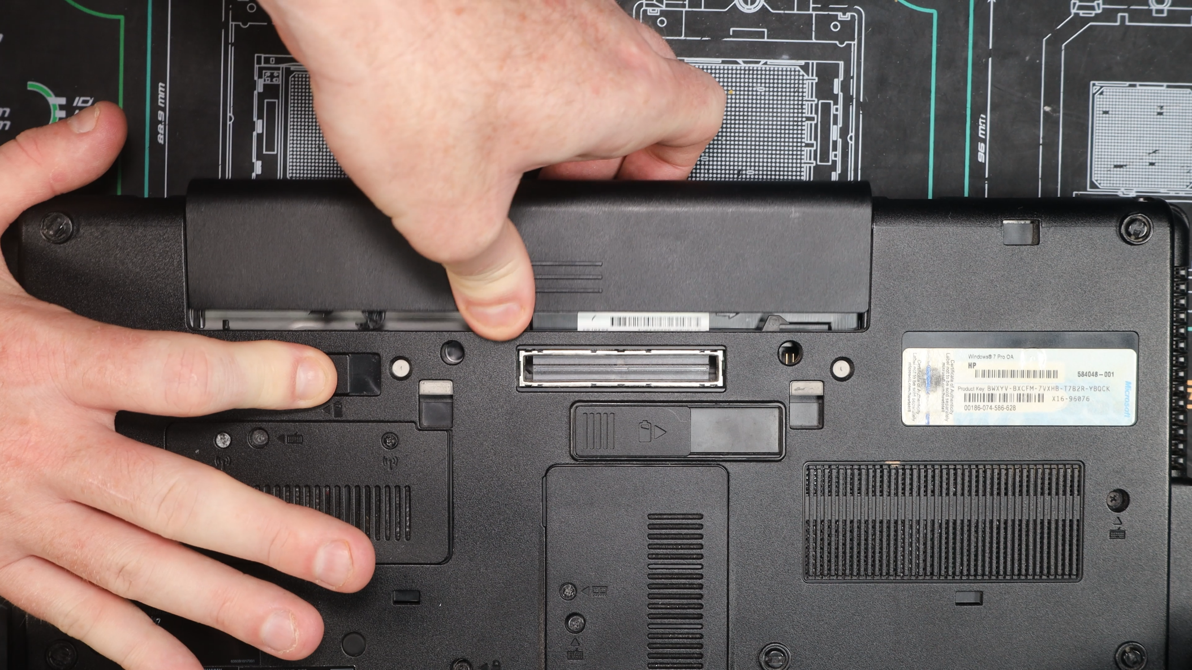
Removable Laptop Batteries
Becoming very rare in laptops
Main reasons: slimmer designs, costs, better cooling and structural integrity
Before removing battery, shut down laptop and unplug
ITFreeTraining.com
Notes:
12:55 In the old days, pretty much every laptop had a removable battery. Nowadays removable laptop batteries are becoming very rare. The main reasons for this are slimmer design, manufacturing costs, better cooling, and structural integrity.
An internal battery allows for an optimized internal layout and thermal isolation, enabling better airflow and more effective cooling systems. This design keeps the battery cooler, enhancing its longevity and efficiency by reducing exposure to heat from other components. Not having it removable means the battery can be screwed or glued into the laptop case making the structure of the laptop case a lot more secure.
I have an old laptop with a removable battery. Before you remove the battery, make sure the laptop has been shut down and unplugged from power. If you have trouble working out where the battery is, the laptop will often have little symbols on the case to indicate where things are. In this case, there is a little battery symbol to help us determine where the battery is.
For this laptop, there is a battery release slider that I need to slide across to release the battery so it can be removed. Once removed, I can put in a new battery. For old laptops like this one, it is not too hard to replace a battery. Let’s now have a look at a more modern laptop.

Slide 10
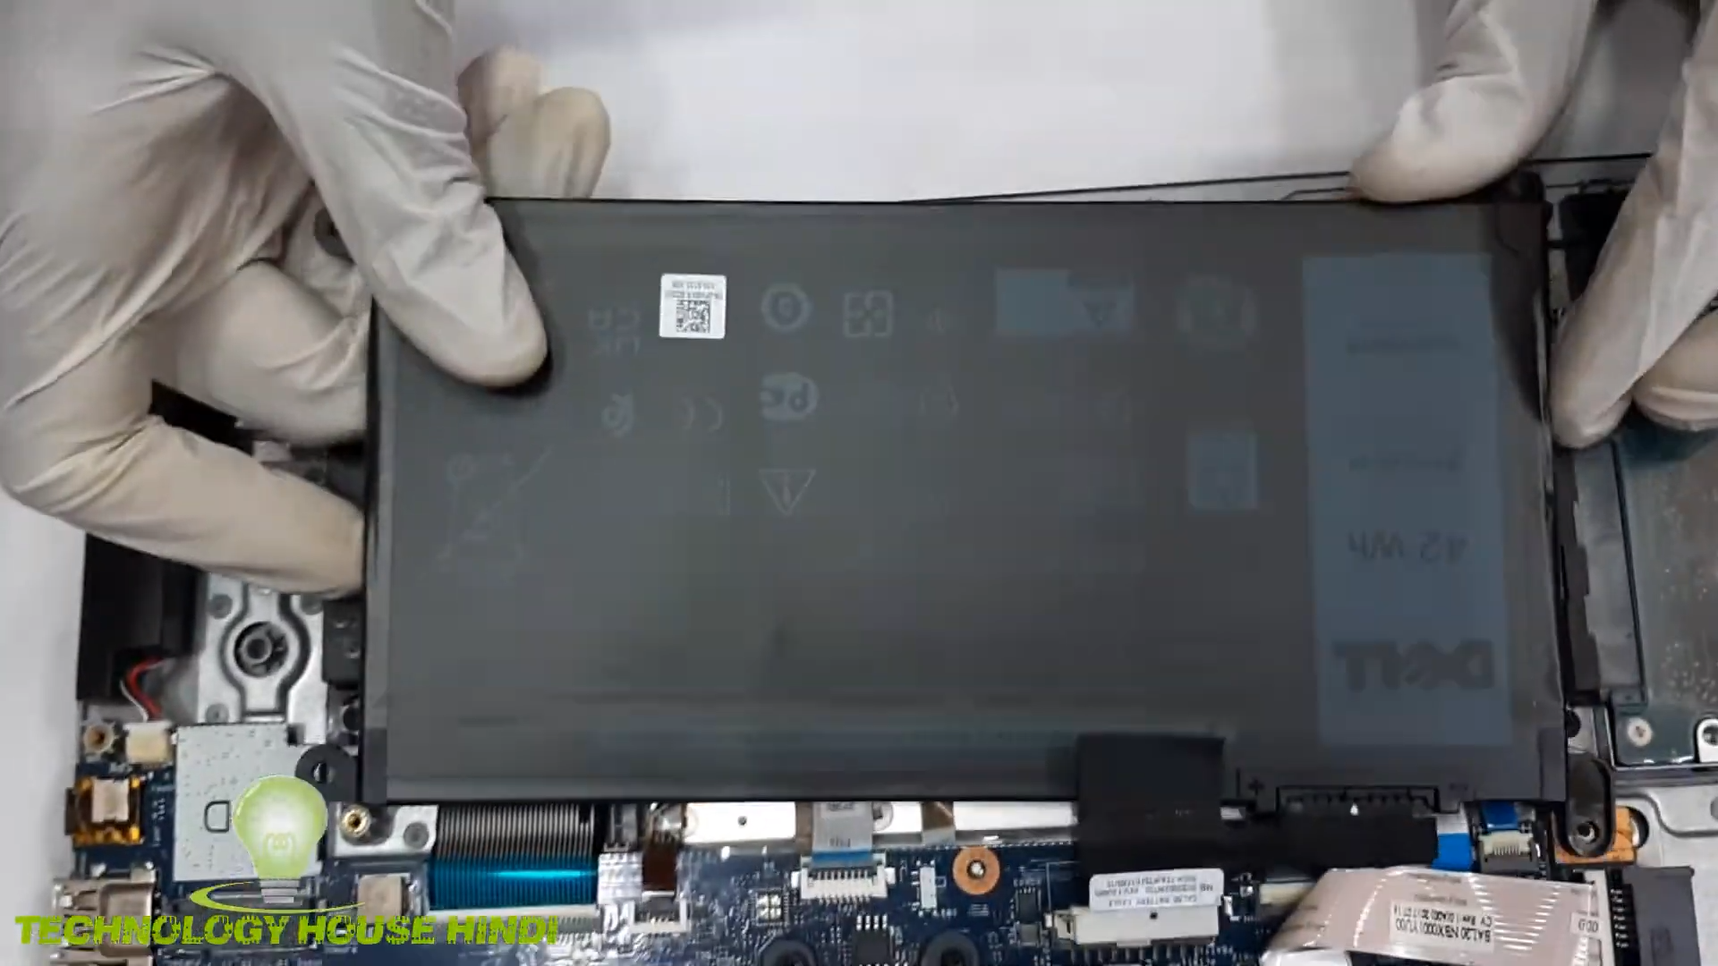
Laptop Battery Replacement
In modern laptops, if possible, can be difficult to replace
Battery can catch fire or explode if damaged
If the battery is swollen it needs to be replaced. Do not use it
ITFreeTraining.com
Notes:
14:22 Modern battery replacement in laptops can be quite tricky, if possible at all. For some laptops, the battery will be physically attached to the main board of the motherboard and cannot be removed. Other laptops, it is possible to open the case and remove the battery and replace it. If you do decide to do this, remember modem laptops use lithium batteries that can catch on fire or explode if damaged. Handle these batteries with care and use protective measures like ESD protection.
If the battery is swollen, it needs to be replaced. Do not use it. A swollen lithium battery indicates it has undergone a chemical breakdown inside, leading to the release of gases that cause the battery to expand. Swelling is a clear sign that the battery is no longer safe to use, as it poses risks of fire, explosion, or leakage of harmful chemicals. A swollen battery should be removed and replaced immediately, and disposed of properly at a recycling center.

Slide 11
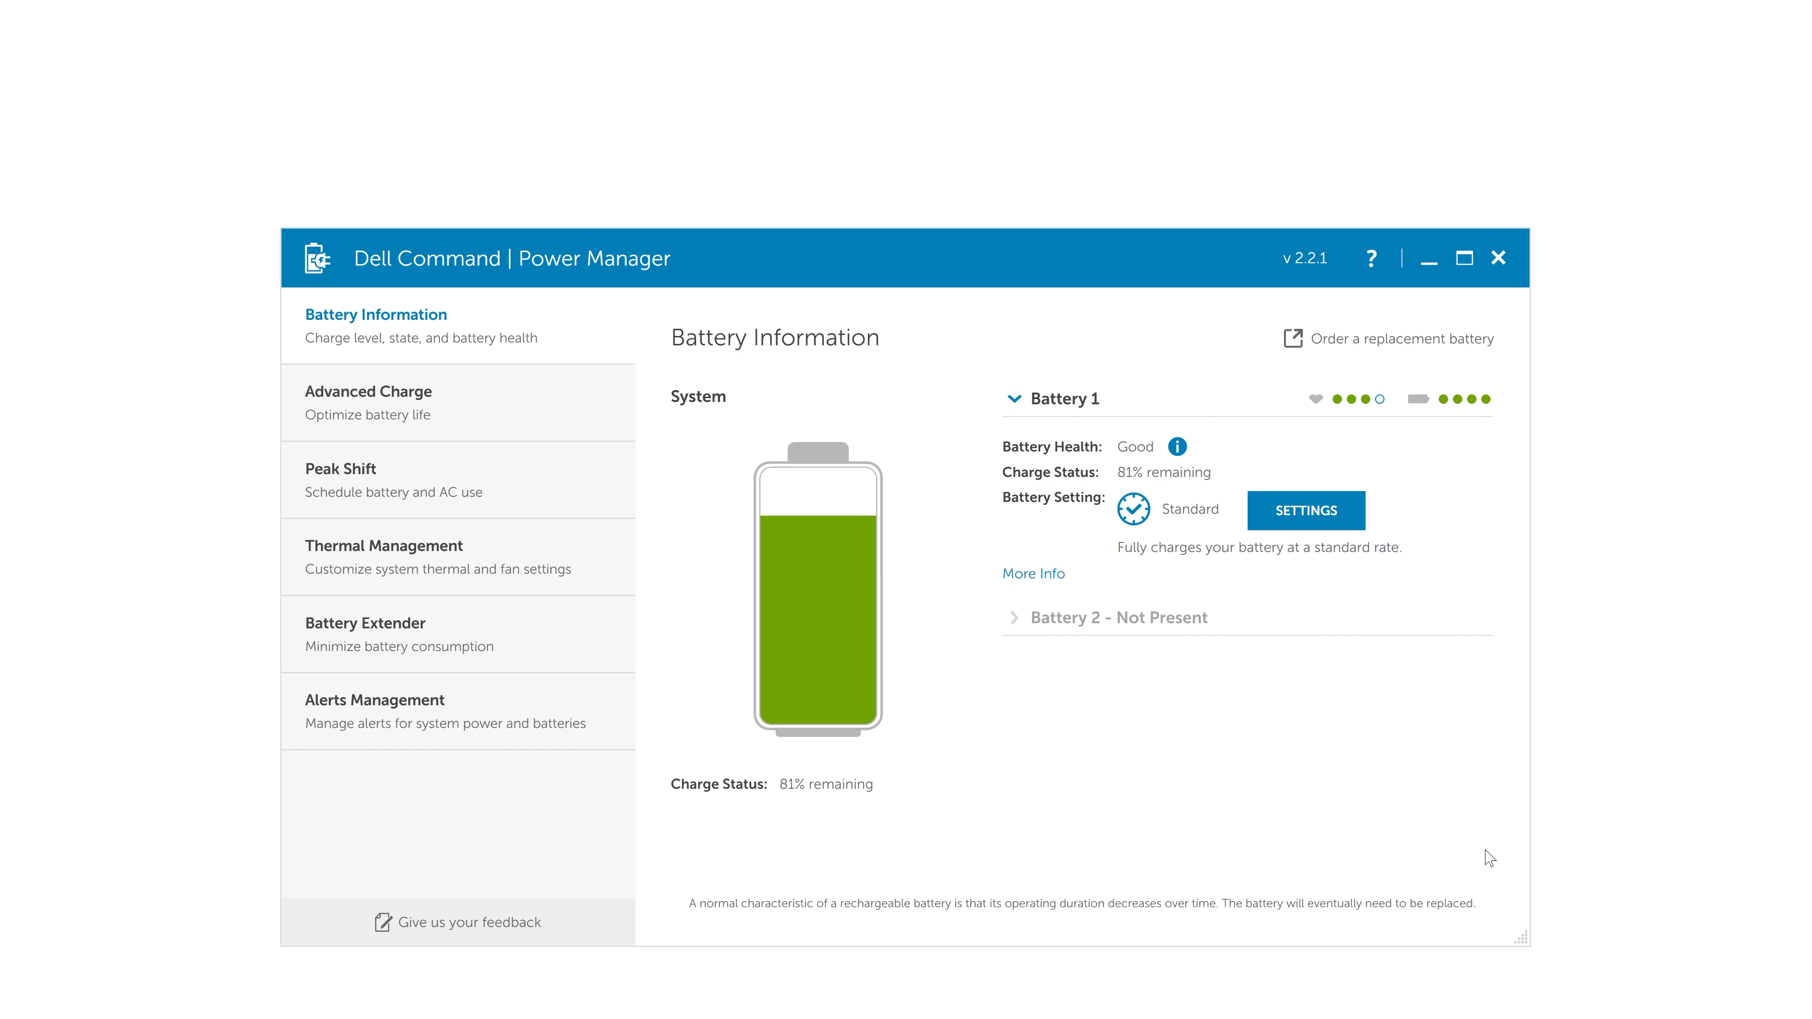
Battery Settings
ITFreeTraining.com
Notes:
15:29 It is worth having a look through the power settings on the laptop. Manufacturers will often include additional software to control the battery settings. You can see an example of this software here. The software may also give you an indication of the current status of the battery. In this case the health of the battery is good.
There are a lot of settings in here, I will only look at the basic settings. To access these, I will press the settings button. Currently the power settings are configured to standard. This is recommended for users that switch between AC and battery.
The next option is if the laptop is primarily used by direct power. Selecting this option will lower the charging threshold. That is, what percentage the laptop battery would need to get down to before the laptop starts charging. Charging a battery when it is at 100% or close to it can reduce the life span of the battery.
The next option is adaptive. This is the recommended setting. Essentially, this setting monitors what the user is doing and changes the settings as required.
The last setting allows you to customize the settings. Manually setting the charging limits helps extend battery life. Lithium-ion batteries last longer when not kept at 100% charge for extended periods. If you use AC power often or plan to store the laptop for a while. Lower charge limits reduce battery stress, particularly in hot environments, and help maintain long-term health.

Slide 12

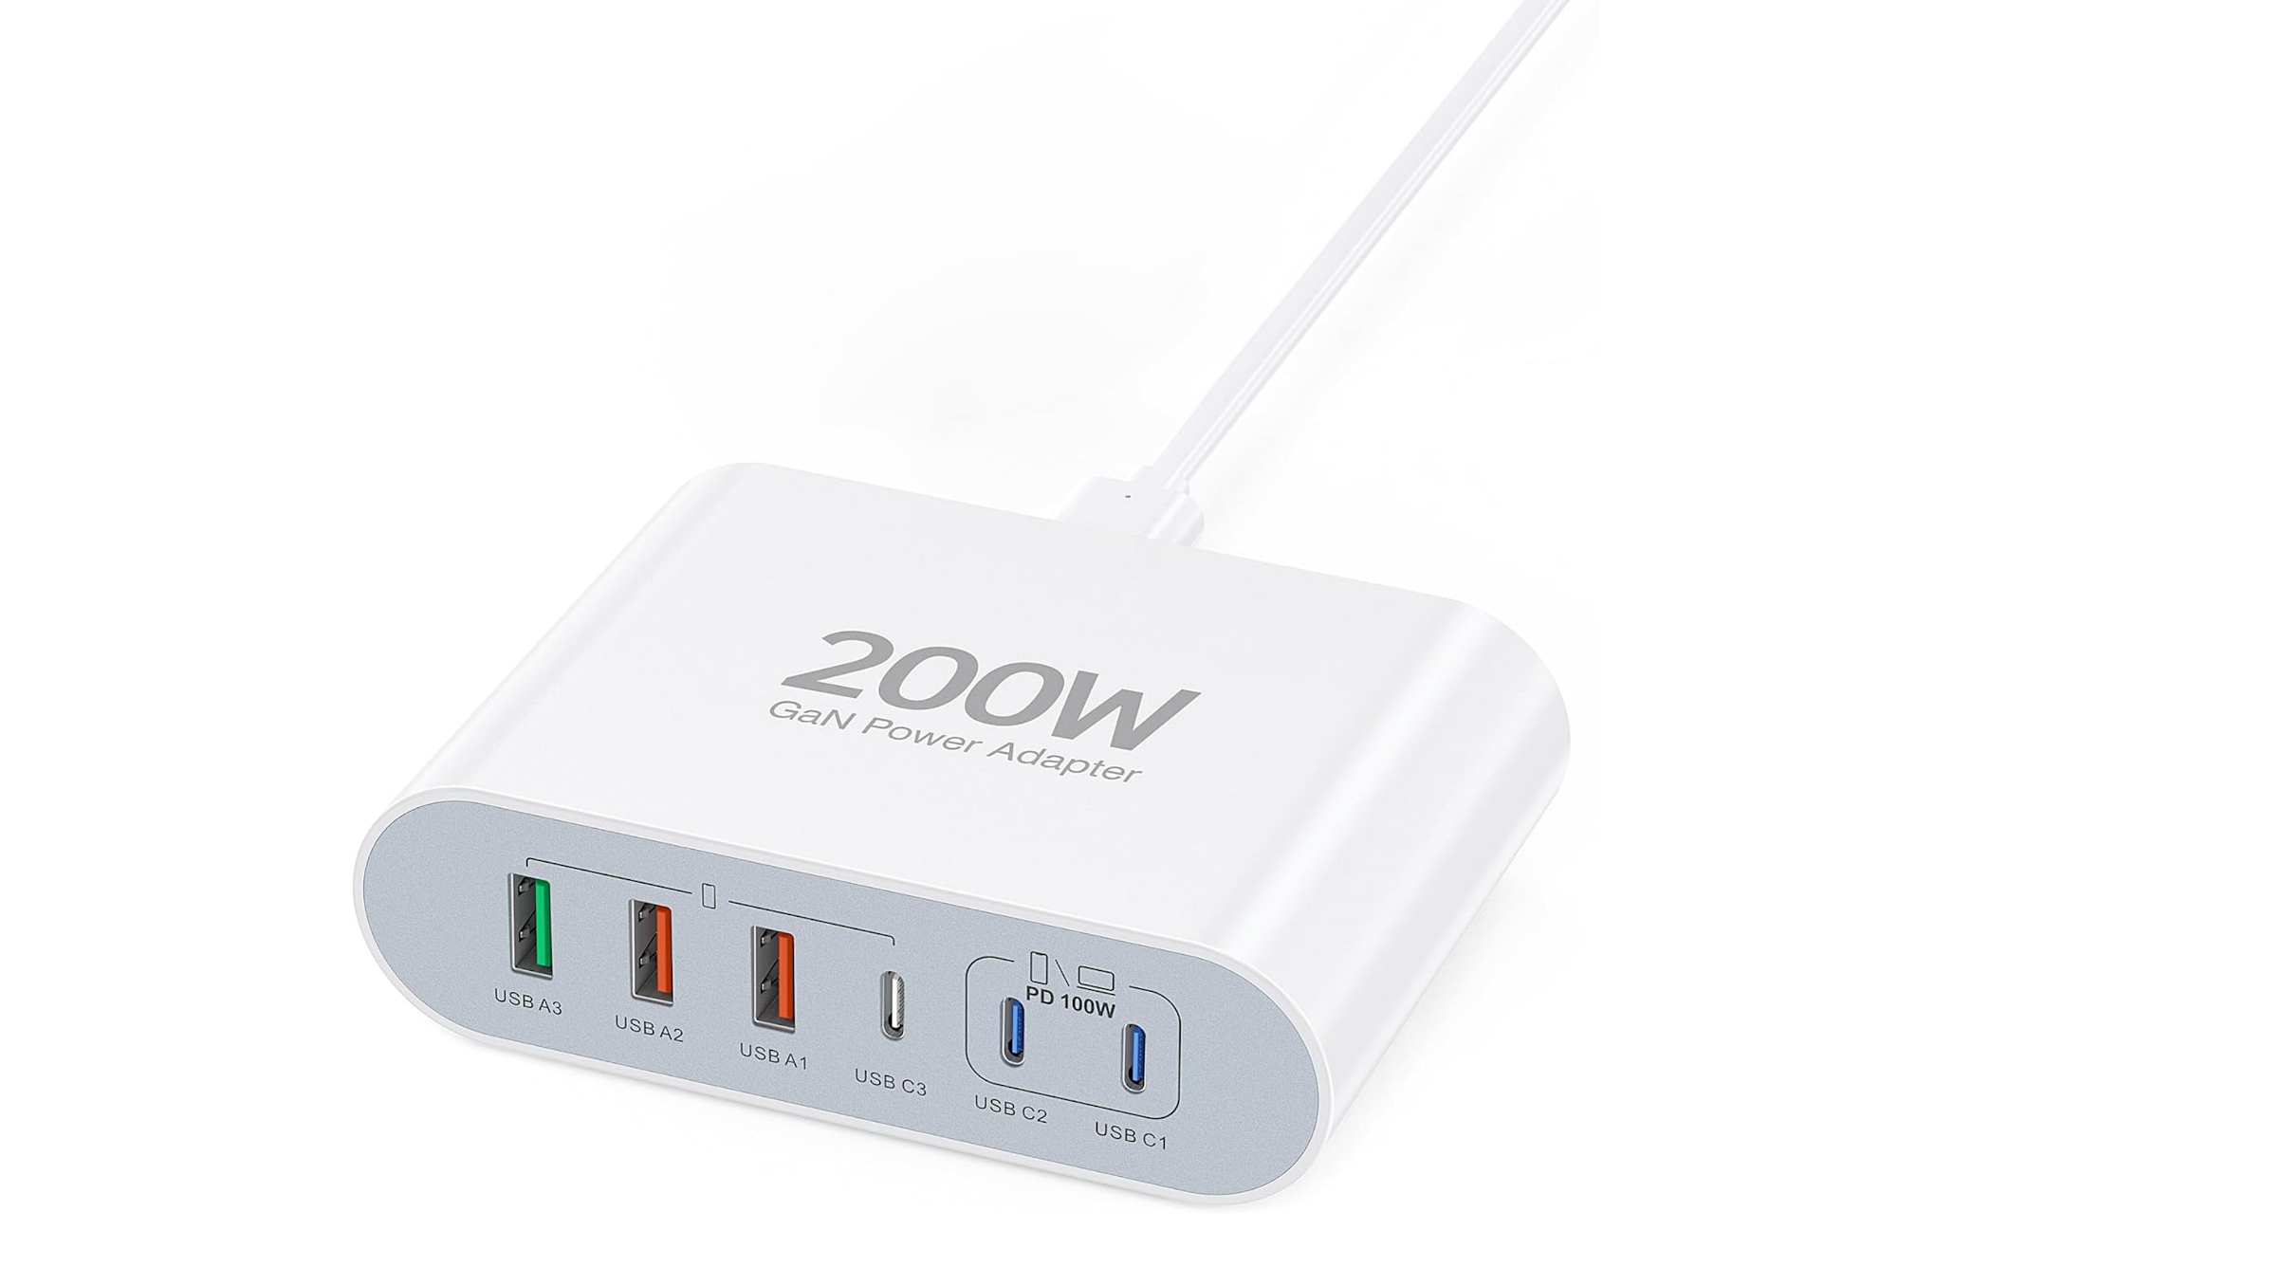
In The Real World
Charging blocks are very helpful
ITFreeTraining.com
Notes:
17:03 In the real world, for my home I purchased a USB charger block. This charging block cost me less than it would for one laptop power supply. Using this charging block, I am able to charge my Macbook, my PC laptop, my iPhone and my Android phone all at the same time. If you find that you ever have to work from home, having one of these at home is very useful if you forget your laptop charger. I also find it more convenient. I have the cable ready to go and I just plug it in.

Slide 13

Subscribe
Next video
Video content: https://ITFreeTraining.com/ap11/8c15
Notes:
17:36 Thanks for watching this video on laptop power and batteries. I hope to see you in the other videos from us, until the next video I would like to thank you for watching.
References
“The Official CompTIA A+ Core Study Guide (Exam 220-1101)” pages 275 to 277
“License CC BY 4.0” https://creativecommons.org/licenses/by/4.0/
“Picture: Power adapter” https://commons.wikimedia.org/wiki/File:NEC-PC-Engine-AC-Adapter.jpg
“Picture: Bottom of laptop” https://commons.wikimedia.org/wiki/File:ASUS_ROG_Strix_G15_(G513QY-HQ012T)-bottom_PNr%C2%B00890.jpg
“video: dell inspiron 15-5570 BATTERY REPLACE , Dell 15-5570 Laptop Battery , dell 15 battery replacement by TECHNOLOGY HOUSE HINDI licensed under CC by 30” https://www.youtube.com/watch?v=xi-Ms39igJE
Credits
Trainer: Austin Mason https://ITFreeTraining.com
Voice Talent: HP Lewis http://hplewis.com
Quality Assurance: Brett Batson https://www.pbb-proofreading.uk

