Slide 1
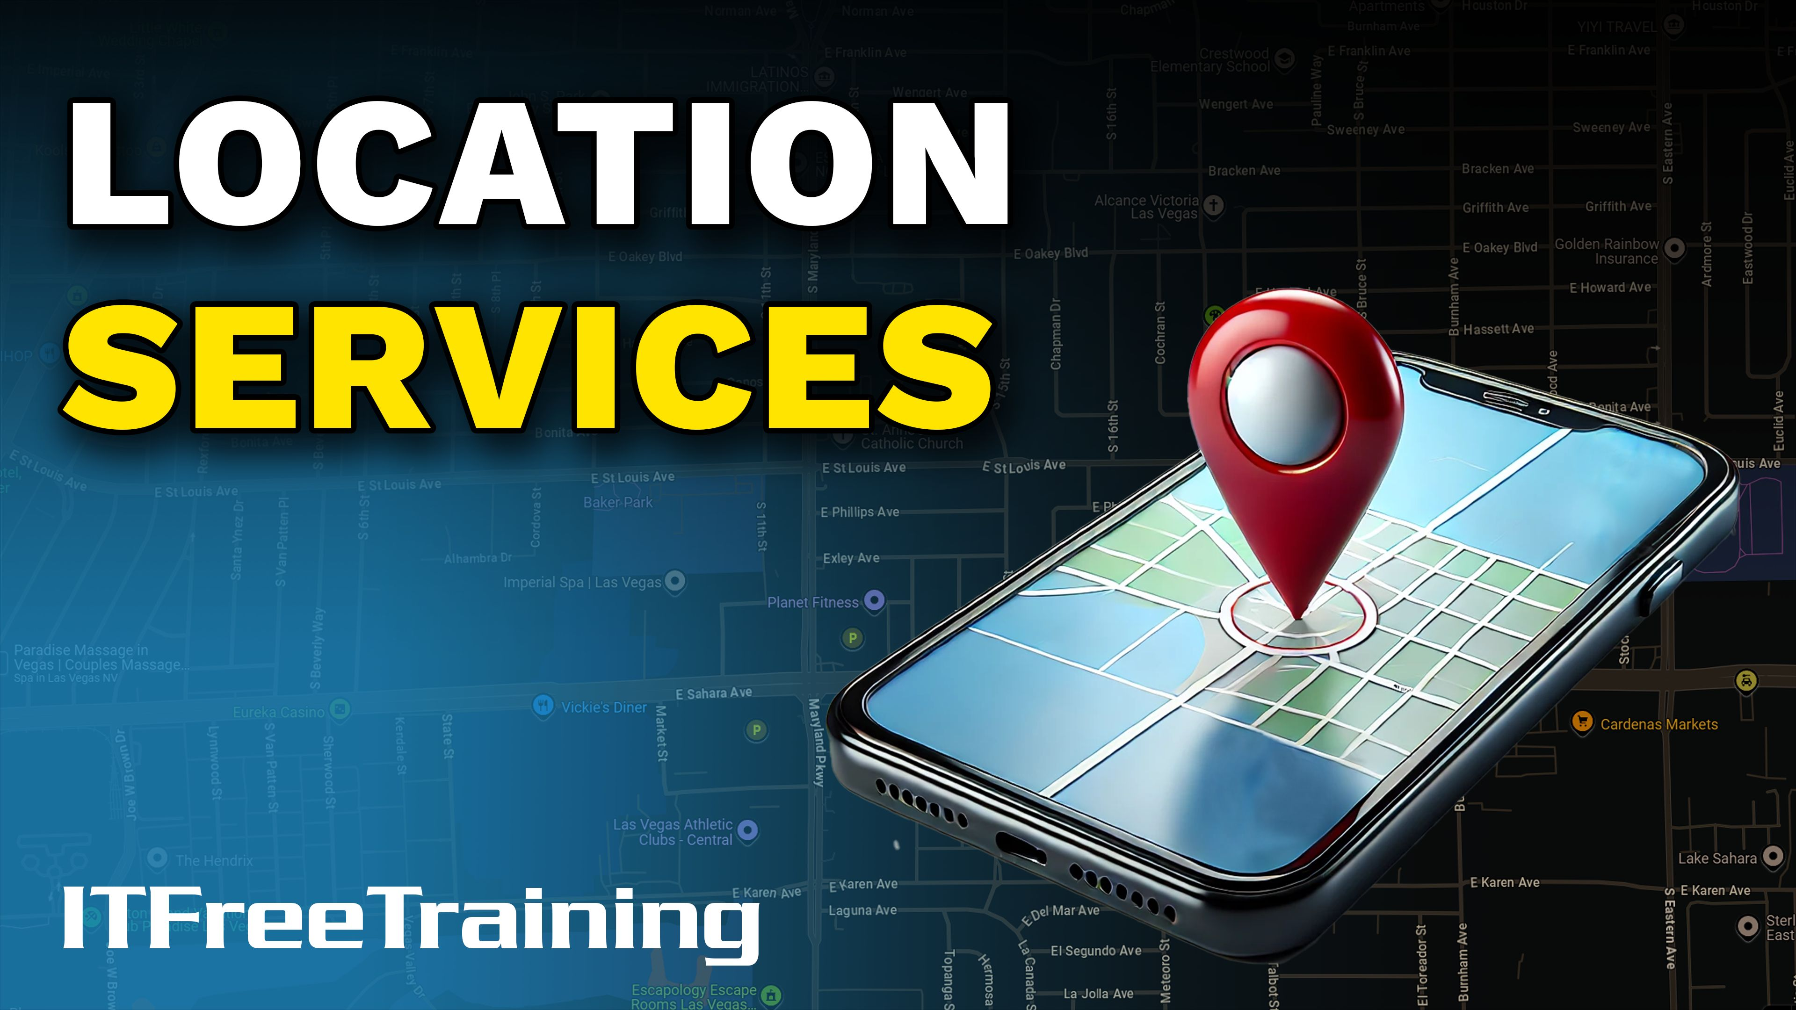


Notes:
Let’s look at location services.

Slide 2

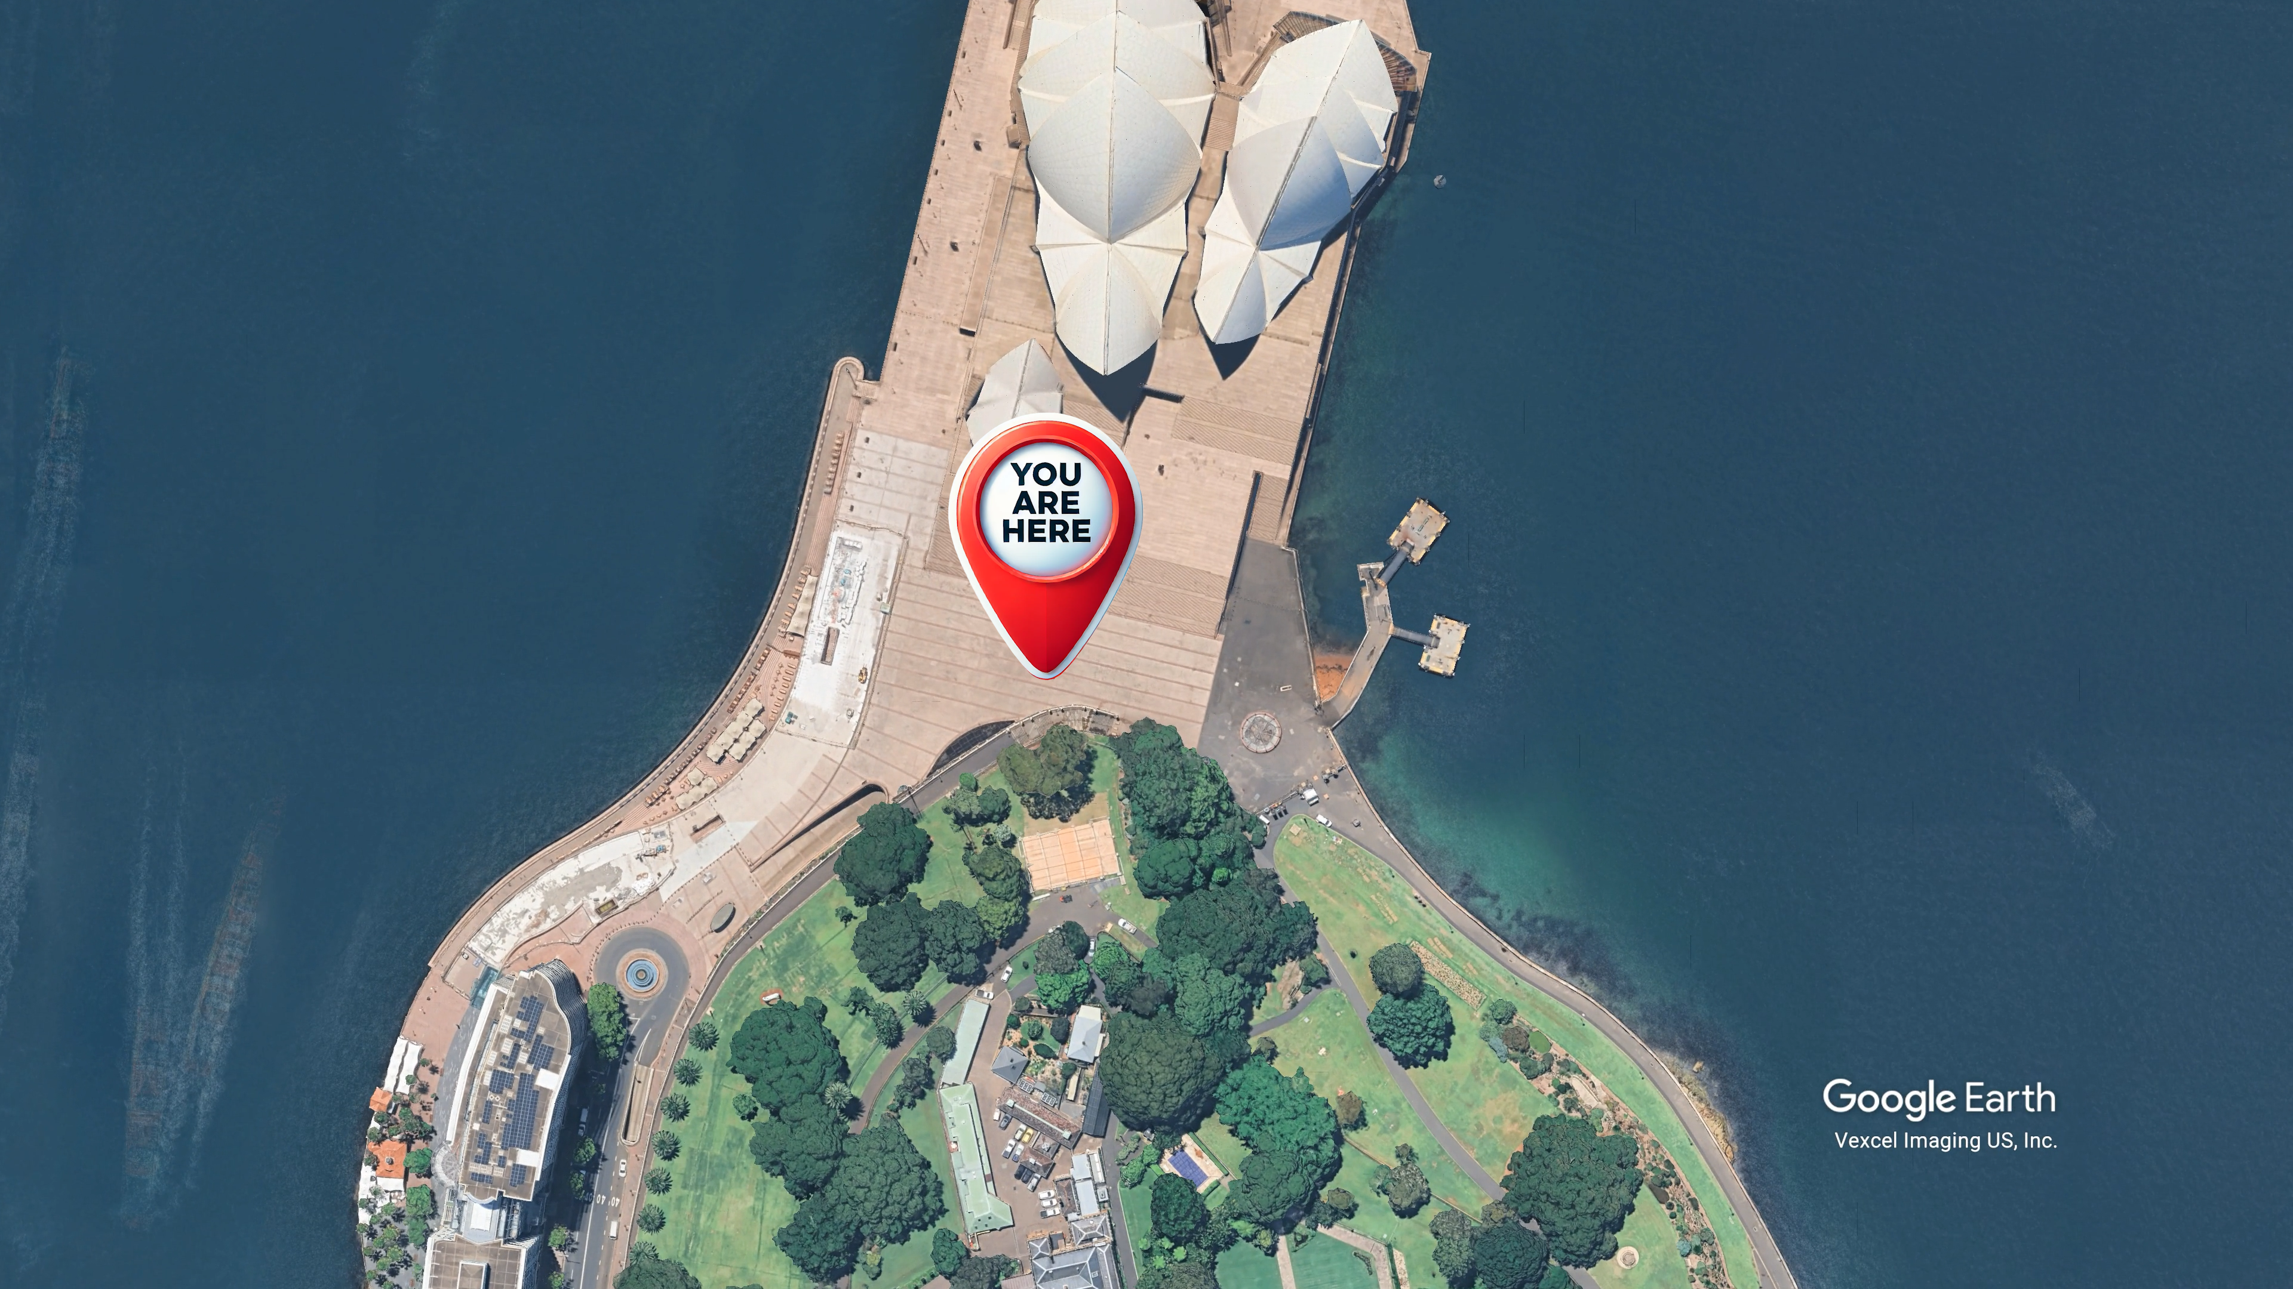
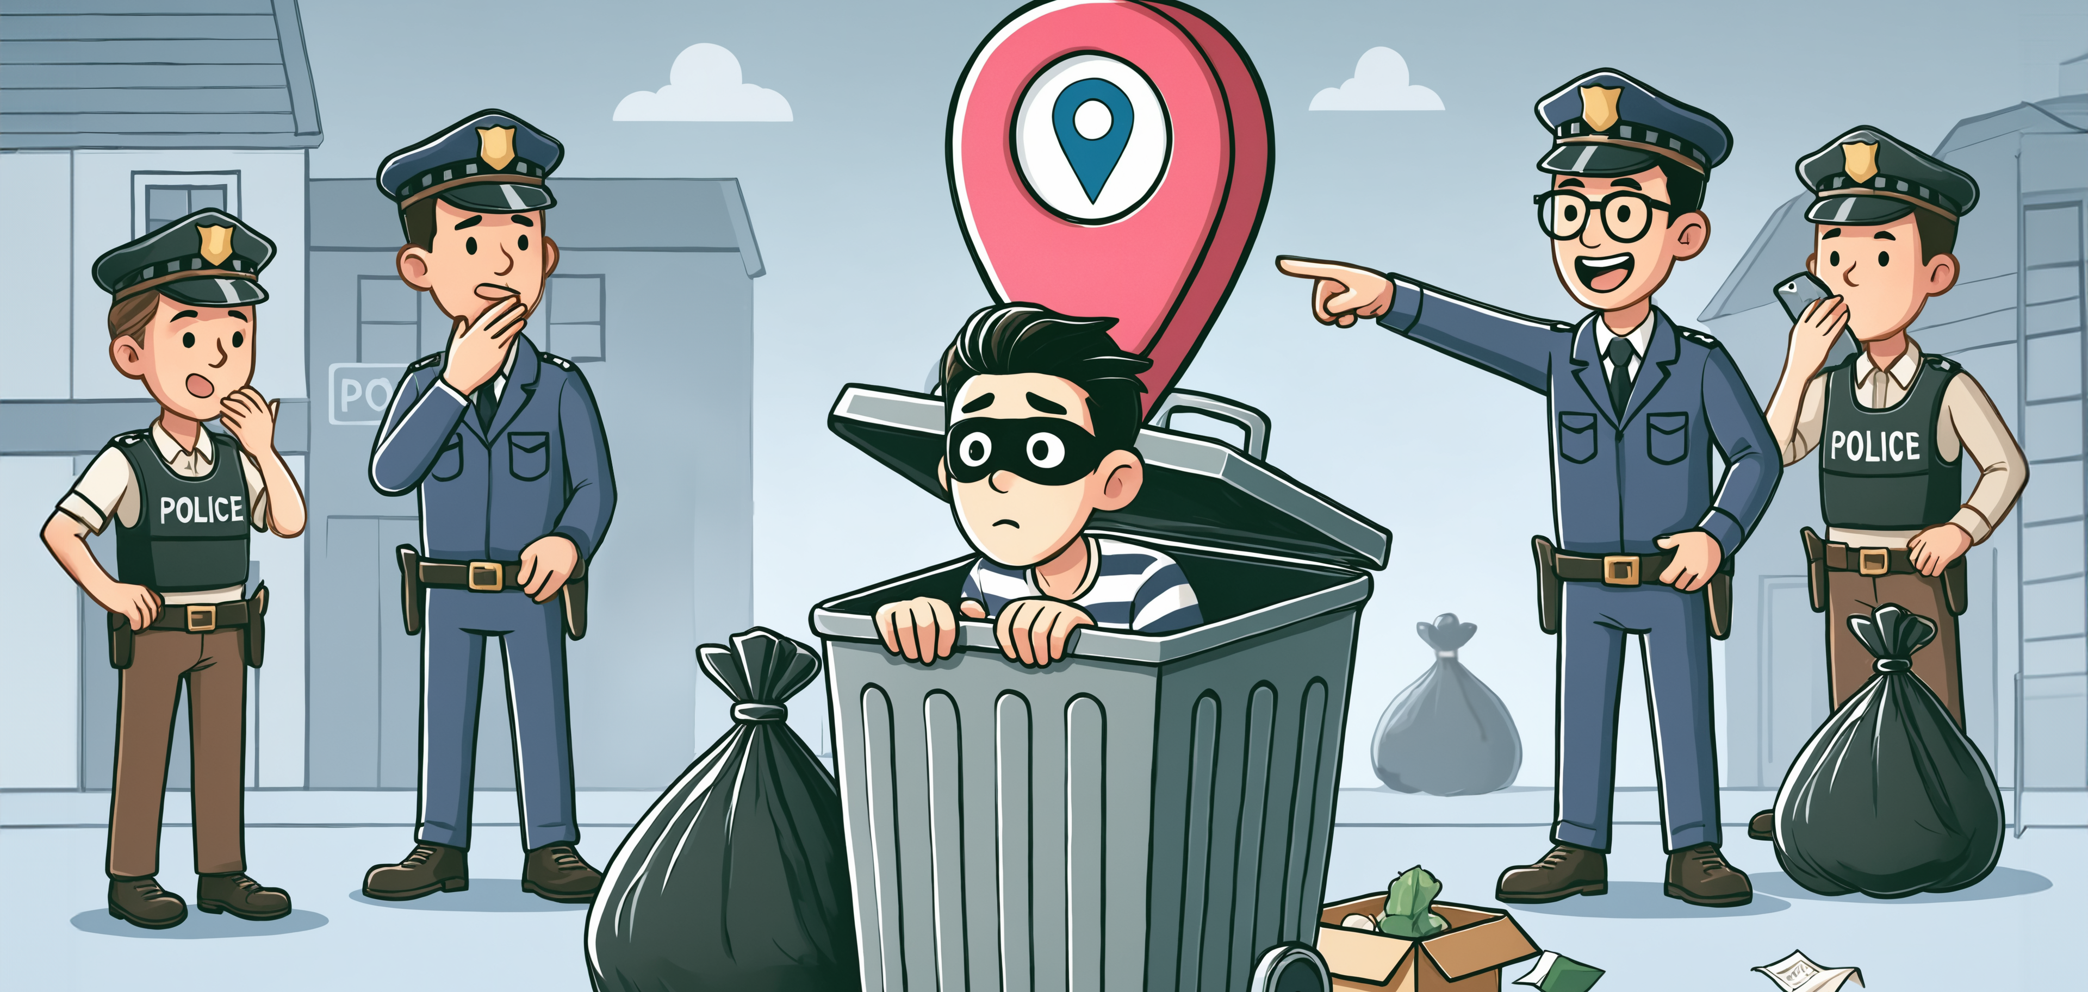
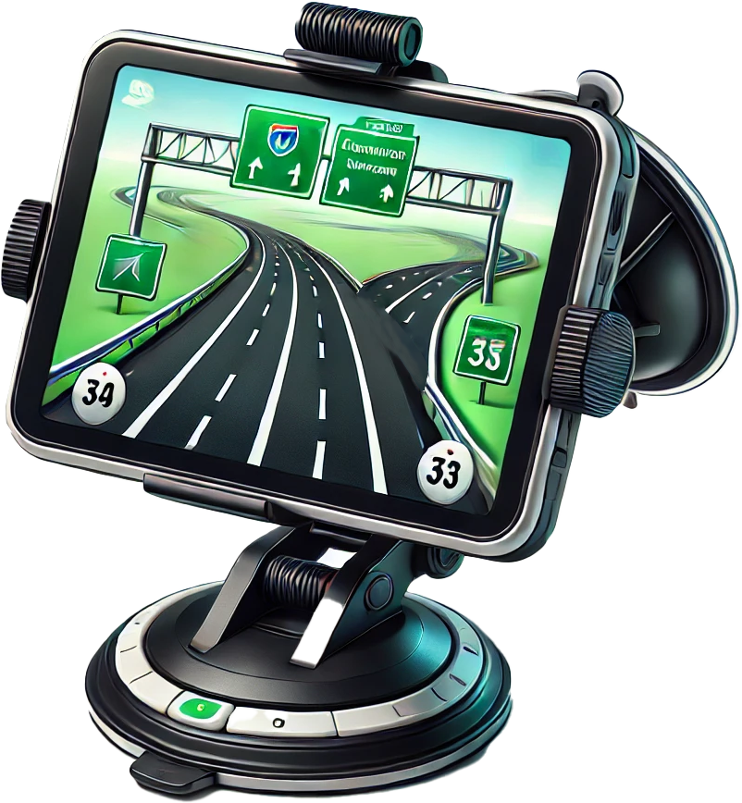
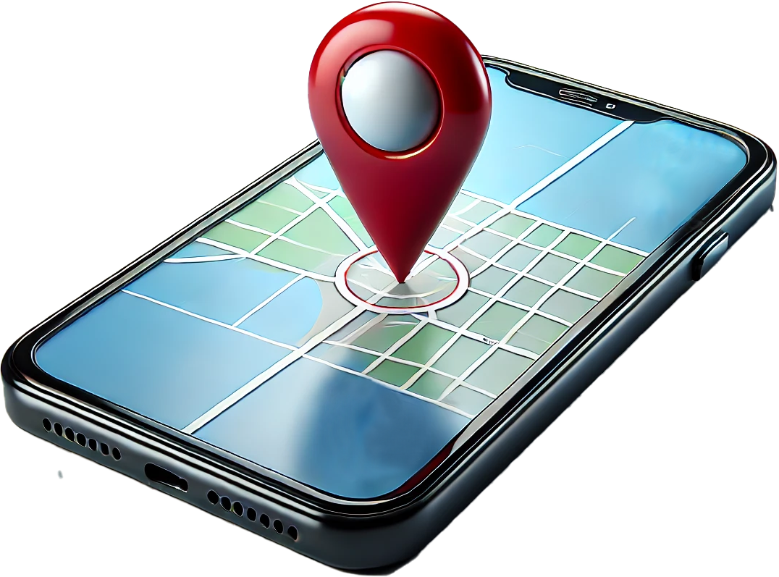
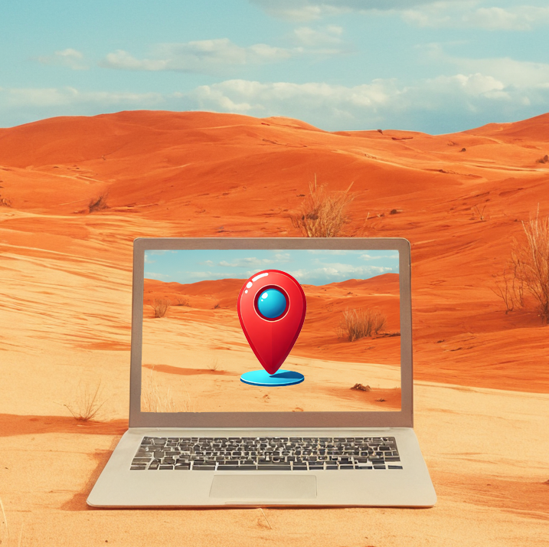
What Are Location Services?
Service that find your geographic location
Use network attributes to identify or estimate the physical location of the device
ITFreeTraining.com
Notes:
00:04 Location services is the technology and features that allow devices, applications, and services to determine the geographic position of a device. These services are widely used across smartphones, computers, tablets, and other connected devices. They enable a wide range of functionalities, from navigation and mapping to location-based reminders and geotagging.
So, what are location services? Any service that helps find your geographic location. They work by using network attributes to identify or estimate the physical location of the device. It is important to understand that location services can get it wrong and have some limitations. To understand how they work, let’s have a look at some.

Slide 3
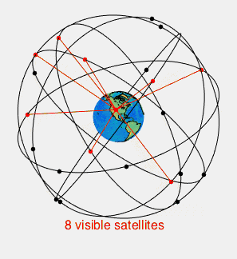
Global Positioning System (GPS)
Most commonly used trilateration system
There are other systems that use the same methods
A lot of the other systems will also support GPS
ITFreeTraining.com
Notes:
00:50 Global Positioning System or GPS is the most commonly used trilateration system used for determining location. You don’t need to understand how GPS works in detail, but I mention it uses trilateration here because CompTIA refers to it as using Triangulation in their official study guide which is incorrect. If you don’t remember the name, don’t worry, you won’t get asked which technology GPS uses in the exam.
There are other systems that use the same methods. These are used in countries like Russia and China. But it should be pointed out these systems are worldwide systems so you could use GPS in any country. A lot of the other systems will also support GPS.
The other systems may give better accuracy than GPS, however GPS is also being upgraded to give better results. Let’s use GPS as an example to understand how these systems work.

Slide 4
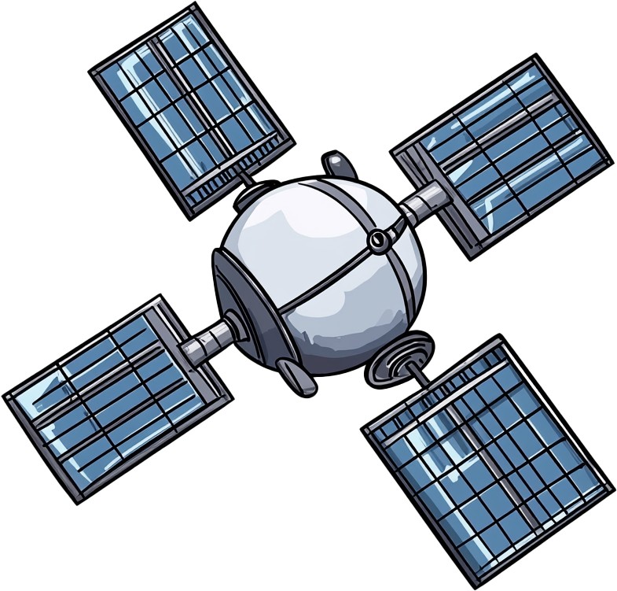
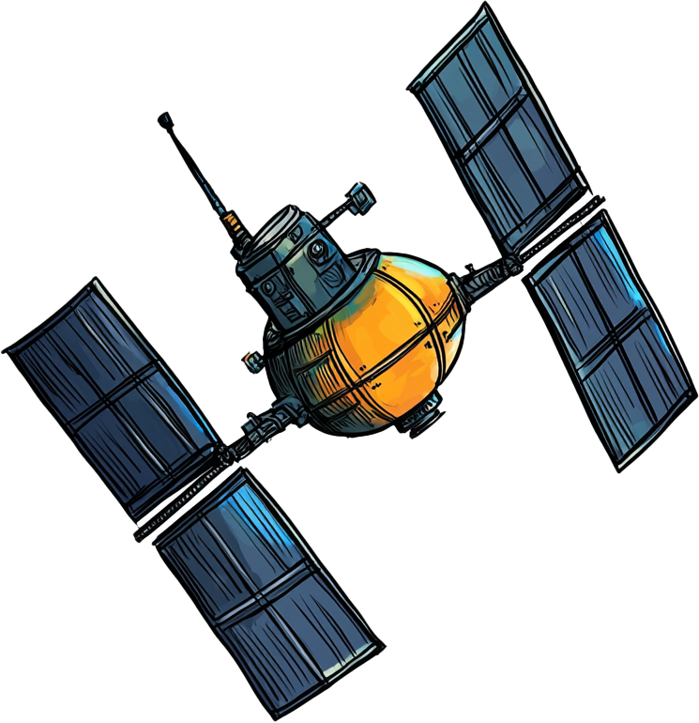
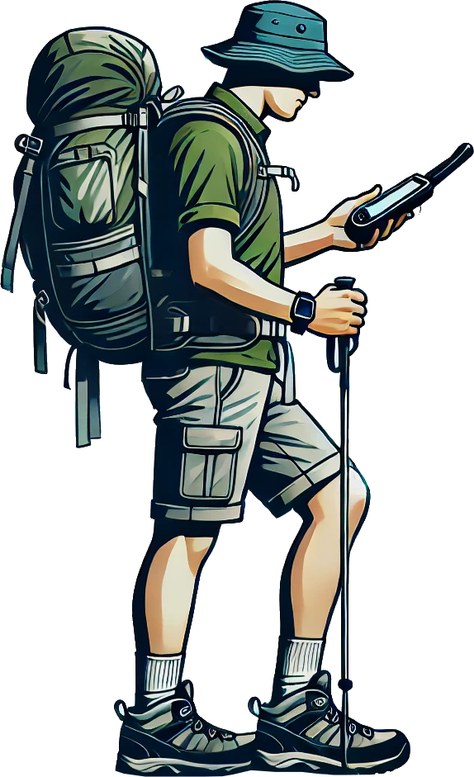
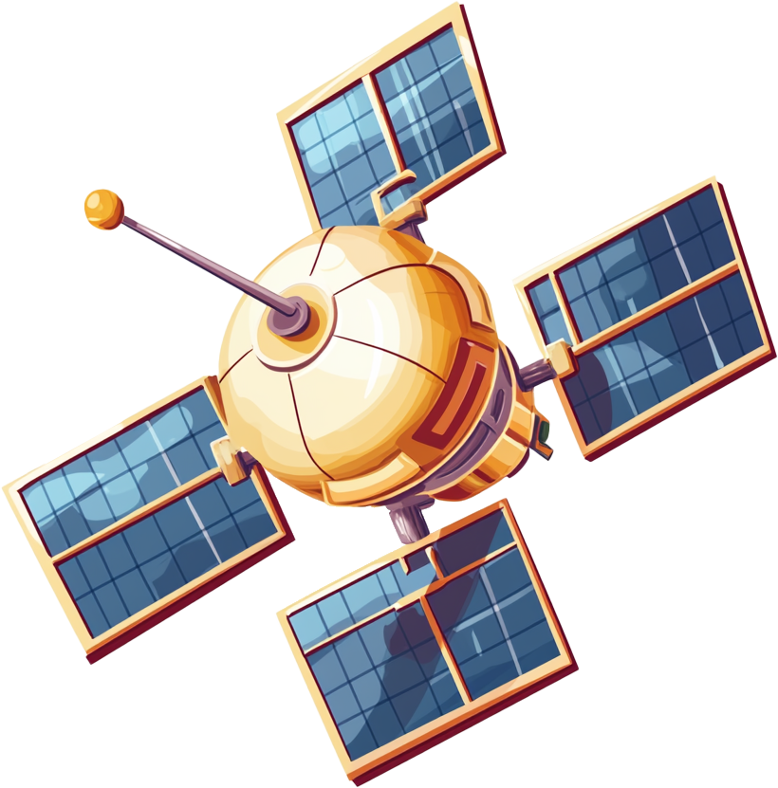
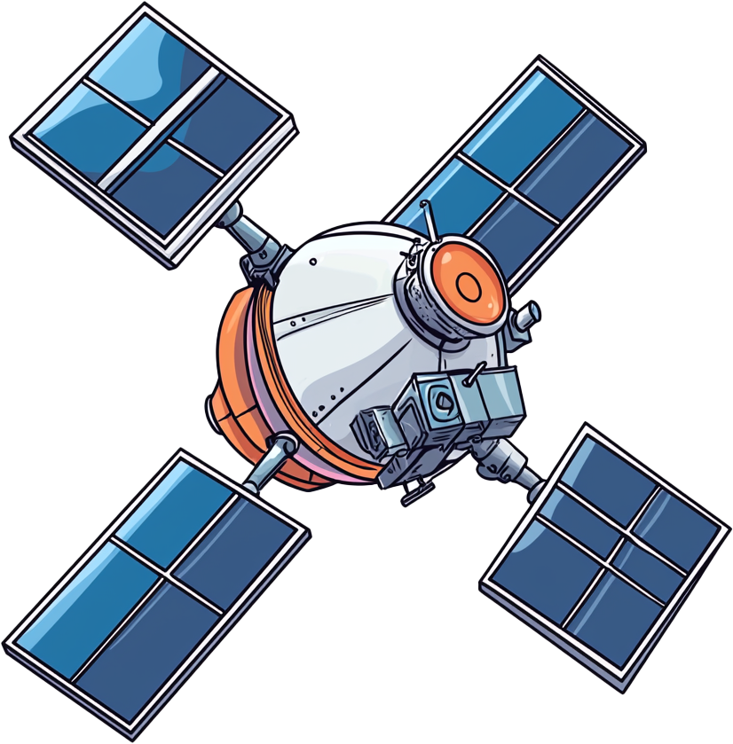

How GPS Works
Measures the time difference between difference satellites
Requires a minimum of four satellites
ITFreeTraining.com
Notes:
01:50 This is a very simple explanation of how GPS works since you don’t really need to know it for the exam, but having a little understanding of it helps you support it better and understand its limitations.
GPS works by measuring the time differences between different satellites called trilateration. If angles were measured this would be called triangulation. GPS is commonly mistaken for using triangulation.
This is a very simple explanation of how GPS works. Essentially a GPS satellite sends out a signal. The signal contains the exact time the signal was sent and the location of the satellite. This is received by the GPS device, however it is not very useful when you have nothing to compare it to.
Another GPS satellite also sends out a signal. The GPS device works out the time difference between the two signals. You can use this to work out your position but there is a problem. If you only know the distance between two points, it tells you the possible locations in a single plane, but not your exact position. This means you could be in multiple places along that plane.
To solve this problem, two more satellites are required. I will spare you all the theory, but essentially having four satellites allows you to work out a 3D position. Thus, GPS requires a minimum of four satellites.
In this example the satellites are in optimal positions to get the best results. Essentially you want them all around the GPS device to get the best results. If the satellites are close to each other, you start losing accuracy.

Slide 5
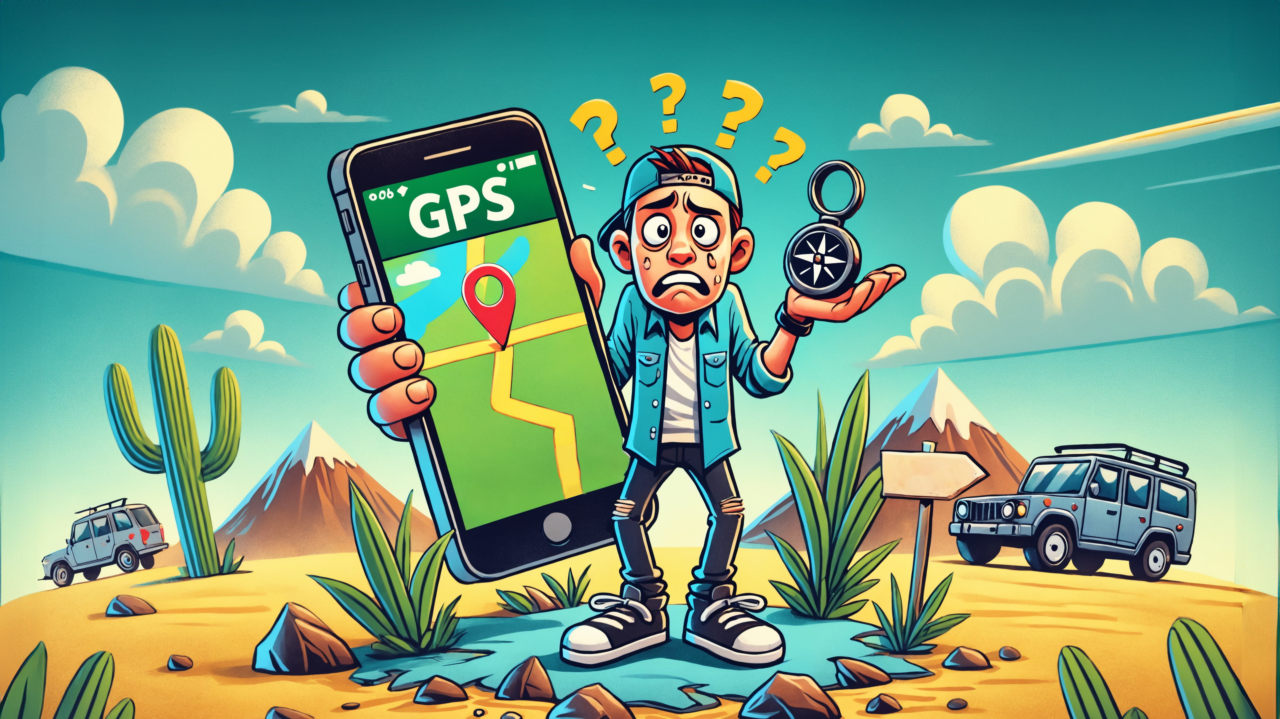
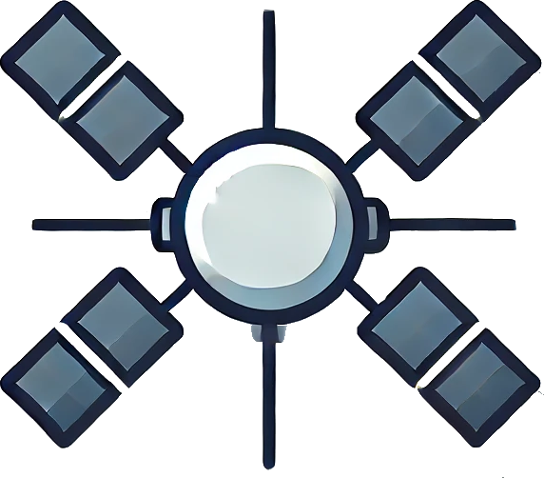
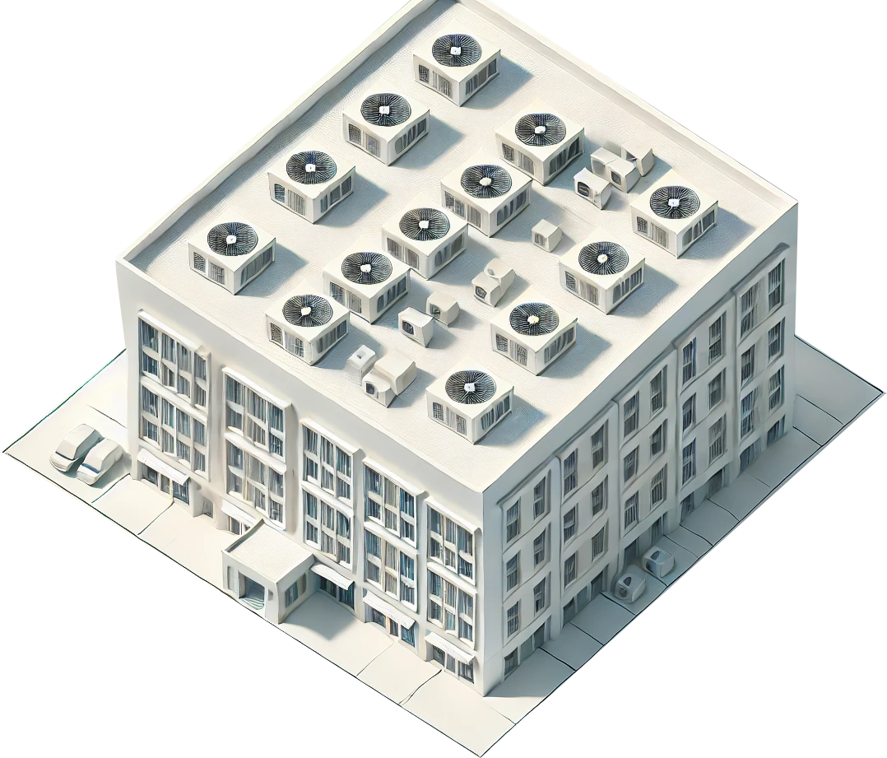
GPS Limitations
Signal can be blocked
Satellites orbit the earth
Different places give better results
Orbits designed to give good coverage
Building blocking one
satellite
Can use another satellite
Reduced accuracy due to position
ITFreeTraining.com
Notes:
03:37 GPS does have its limitations. As we have seen, it requires at least four satellites to work out your position. The GPS signal can be blocked. In this example, we have four satellites in good positions; however, the building is blocking one of the satellites. Obstacles like hills and mountains can block GPS signals. Atmospheric conditions like heavy rain, snow and fog can affect GPS signals. Some GPS devices are more sensitive to others so may work better with weaker signals.
In this case there was another satellite that was not blocked. This makes up the minimum of four satellites we need, but the satellite is not in the best position so the accuracy and reliability may be reduced.
You may find that if you move to another location you will get better results; however, there is something else you should be aware of. GPS satellites orbit around the earth. Thus, you may find one day you get a good signal and another day in the same location you get a poor signal. It just depends on where the satellites were at the time.
The orbits are designed to give good coverage. So, if your signal is not blocked, you should be able to receive signals from at least four satellites.
The key point to remember is that GPS accuracy depends on the strength of the signal and the position of the satellites. This means that just because you had a strong signal in a particular location one day, it does not guarantee you’ll get the same quality signal in that spot on another day. There are some ways that modern devices get around a weak GPS signal.

Slide 6
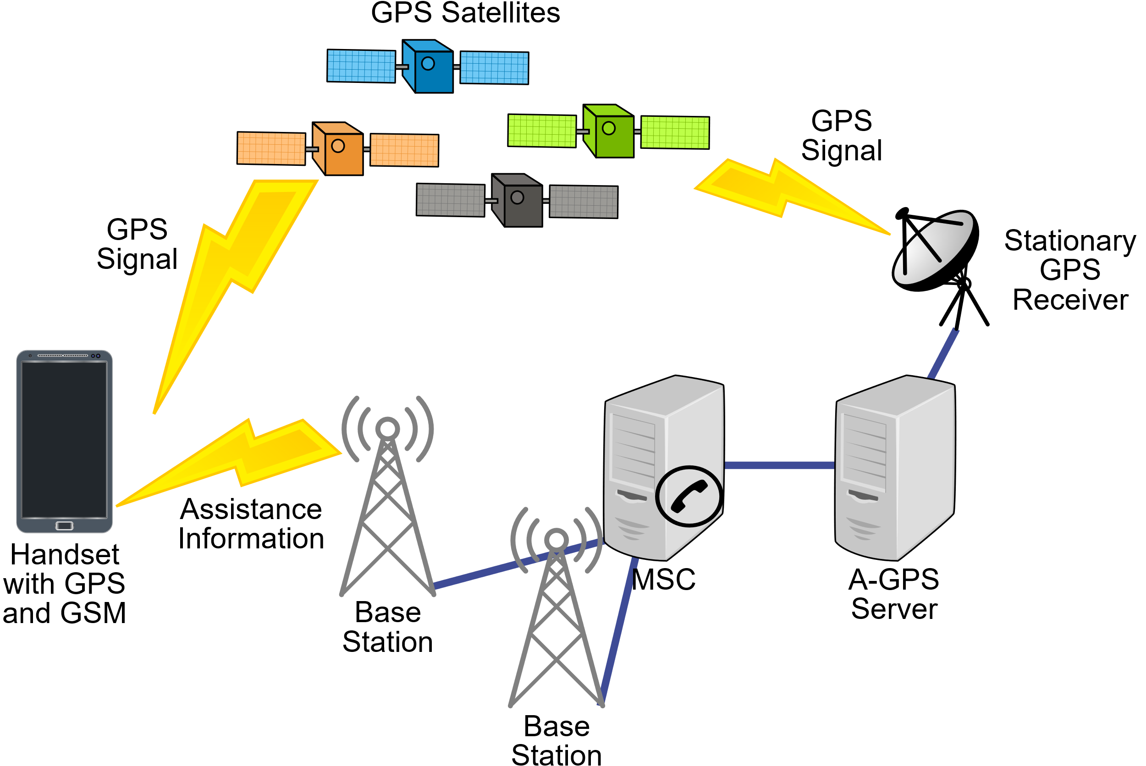
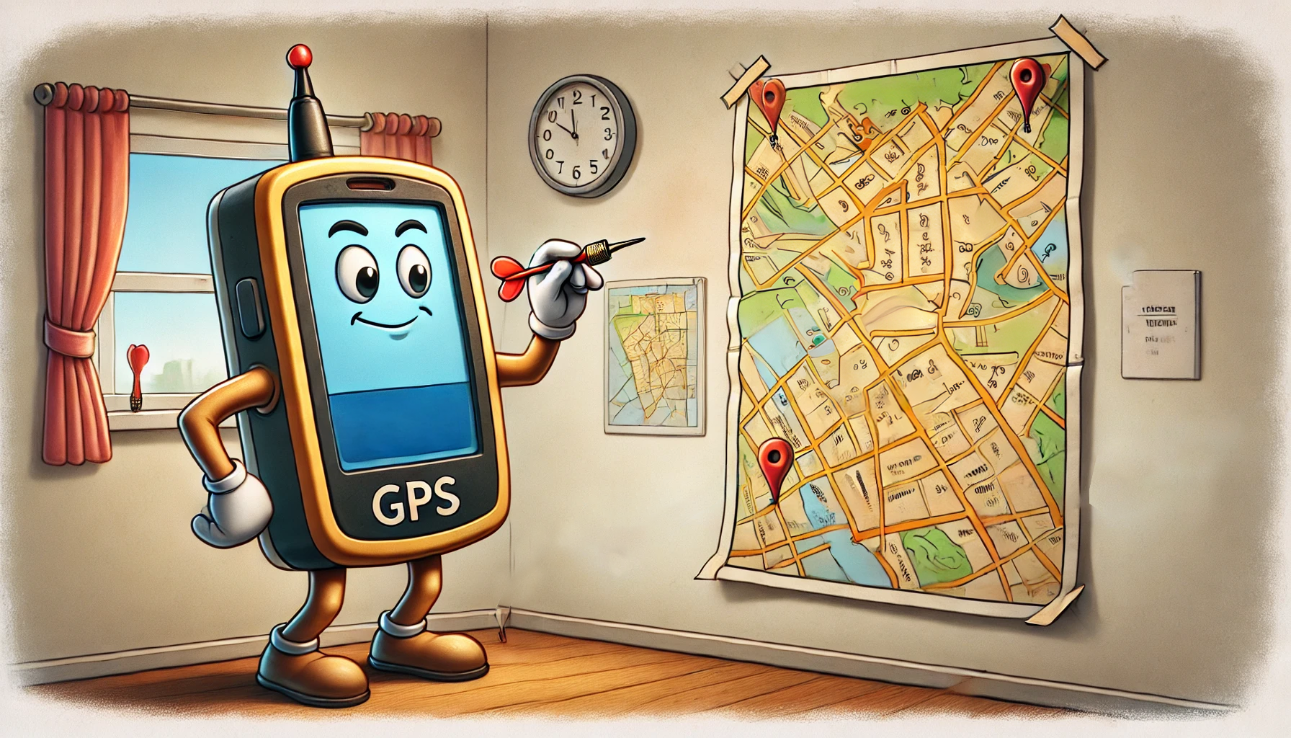
Multi-Layer Approach
Uses multiple techniques, data sources and technology
Improves accuracy, reliability and robustness of locations services
Assisted GPS
Estimate's location
Uses Wi-Fi/cellular
Takes an educated guess
E.g., download GPS satellite data
ITFreeTraining.com
Notes:
05:18 Modern devices use multiple techniques, data sources and technologies to work out where you are. One system is called assisted GPS. Essentially what occurs is the GPS device uses Wi-Fi or cellular to improve speed and accuracy.
For example, if your GPS device has a weak signal to a satellite or the signal is blocked, it can download the satellite data. Essentially the data it would have got from the satellite is downloaded from another source. Assisted GPS can also help obtain the initial data for the GPS device which can take a while to download from the satellite.
Using a multi-layer approach improves accuracy, reliability and robustness of location services. There are, however, times when your GPS device will not be able to get an exact location. When this occurs, your device may estimate its location. The device essentially takes an educated guess.
For the A+ exam you won’t get tested on GPS reliability, but I think it does help to have a little knowledge when supporting the devices with GPS, as you will probably get asked how accurate they are.

Slide 7

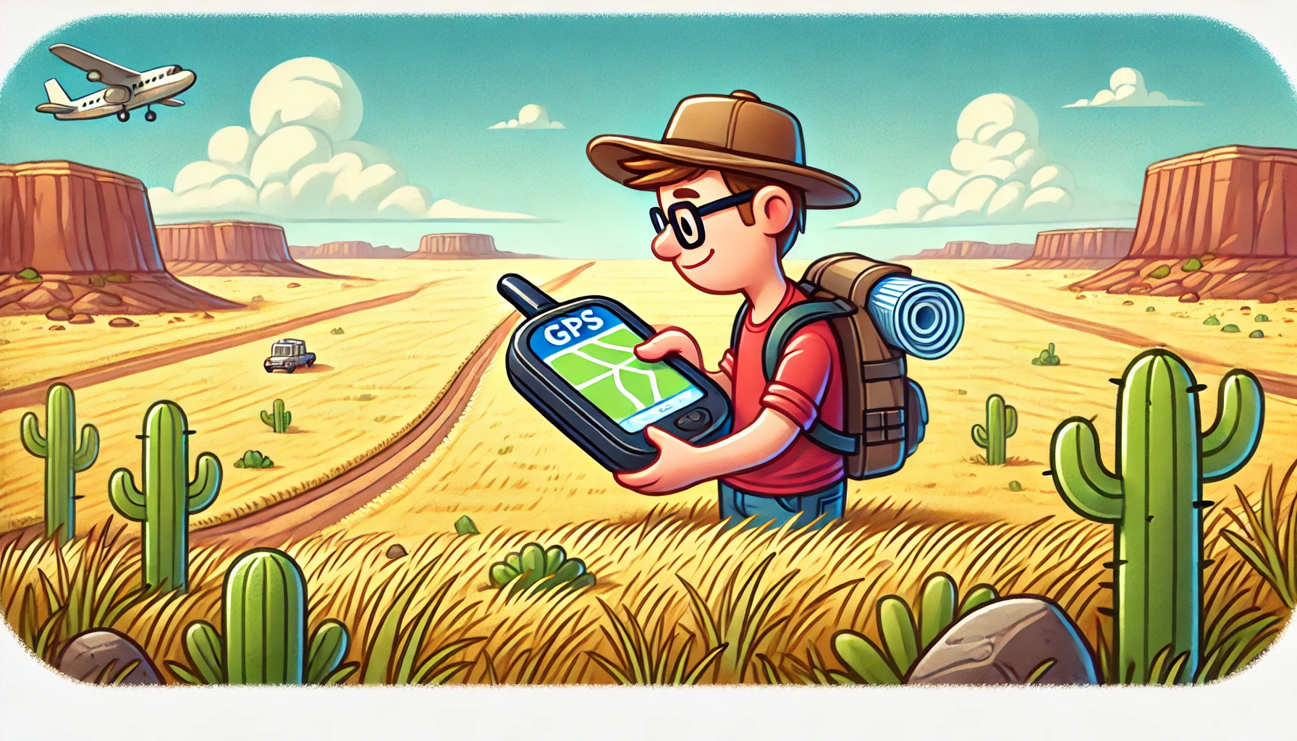
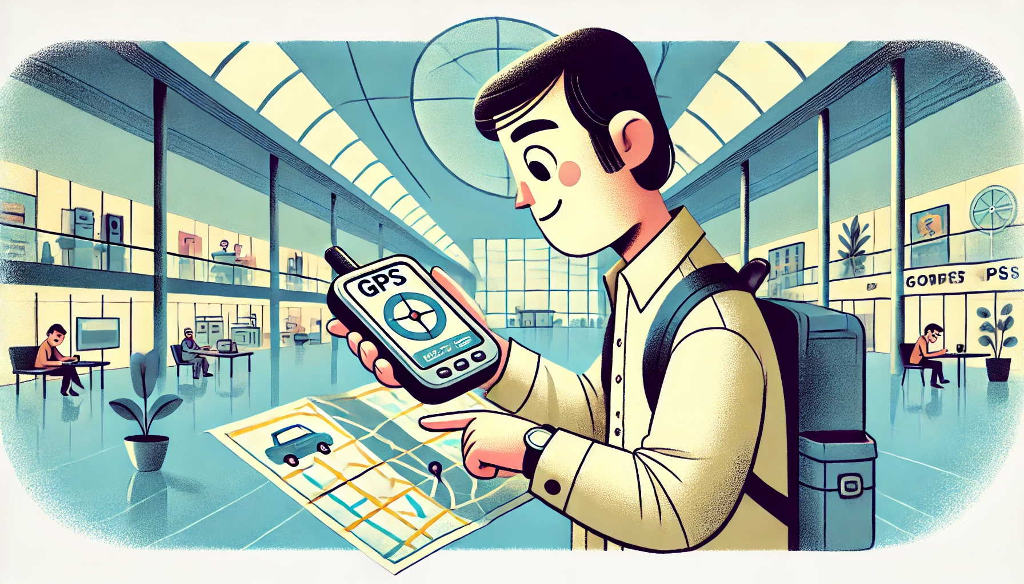
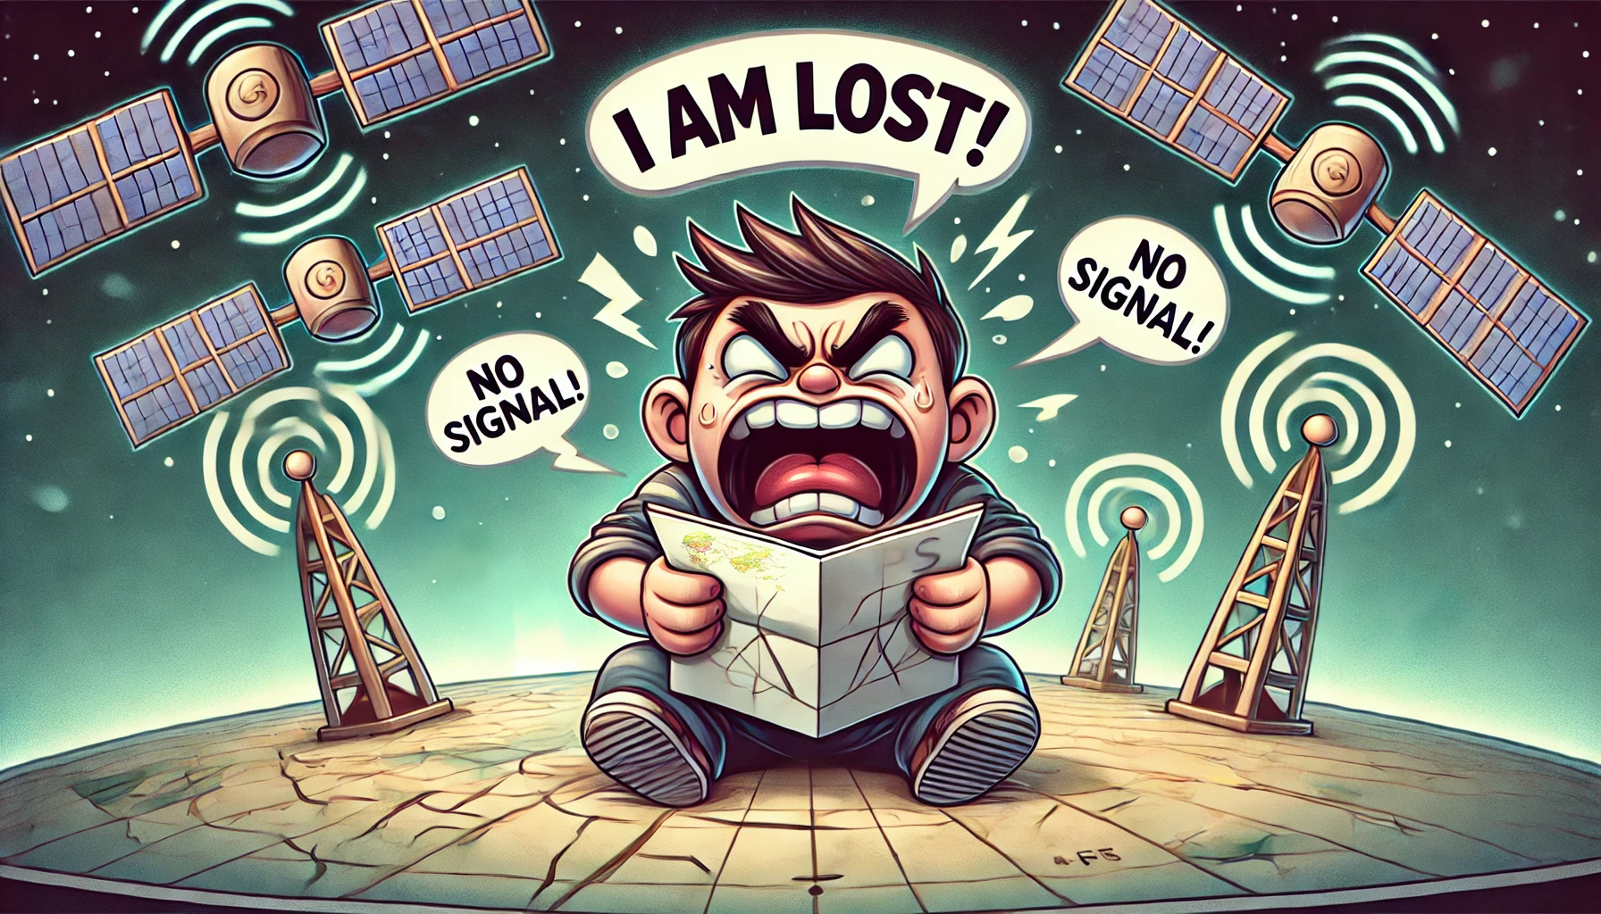
In The Real World
A lot of factors can affect accuracy
E.g., buildings, trees, mountains, weather, solar activity and satellite positions
Optimal
Indoor
No GPS/AGPS only
5-10 meters
20-50 meters
100-500 meters
16-32 feet
65-165 feet
330-1640 feet
ITFreeTraining.com
Notes:
06:31 In the real world your accuracy from GPS can vary. Shown here are the optimal, indoor and when you have no GPS signal and only have assisted GPS. When you have no GPS signal, your location will attempt to be determined using cell tower locations and other technology but the accuracy is significantly less.
Many factors can impact GPS accuracy, such as buildings, trees, mountains, weather conditions, solar activity, and satellite positions. I once worked on a site where staff used portable radios equipped with GPS. We had software to track their locations, and while it was often precise, there were times when it would show a staff member suddenly jumping to a different location hundreds of meters away and then snapping back to their actual position. Other times it could not tell us where they were.
GPS technology has improved a lot, but like many technologies, it works best under the right conditions. Keep in mind that your device will often provide a location, even if it’s only an estimate. There are also a few things you can do to improve accuracy.

Slide 8

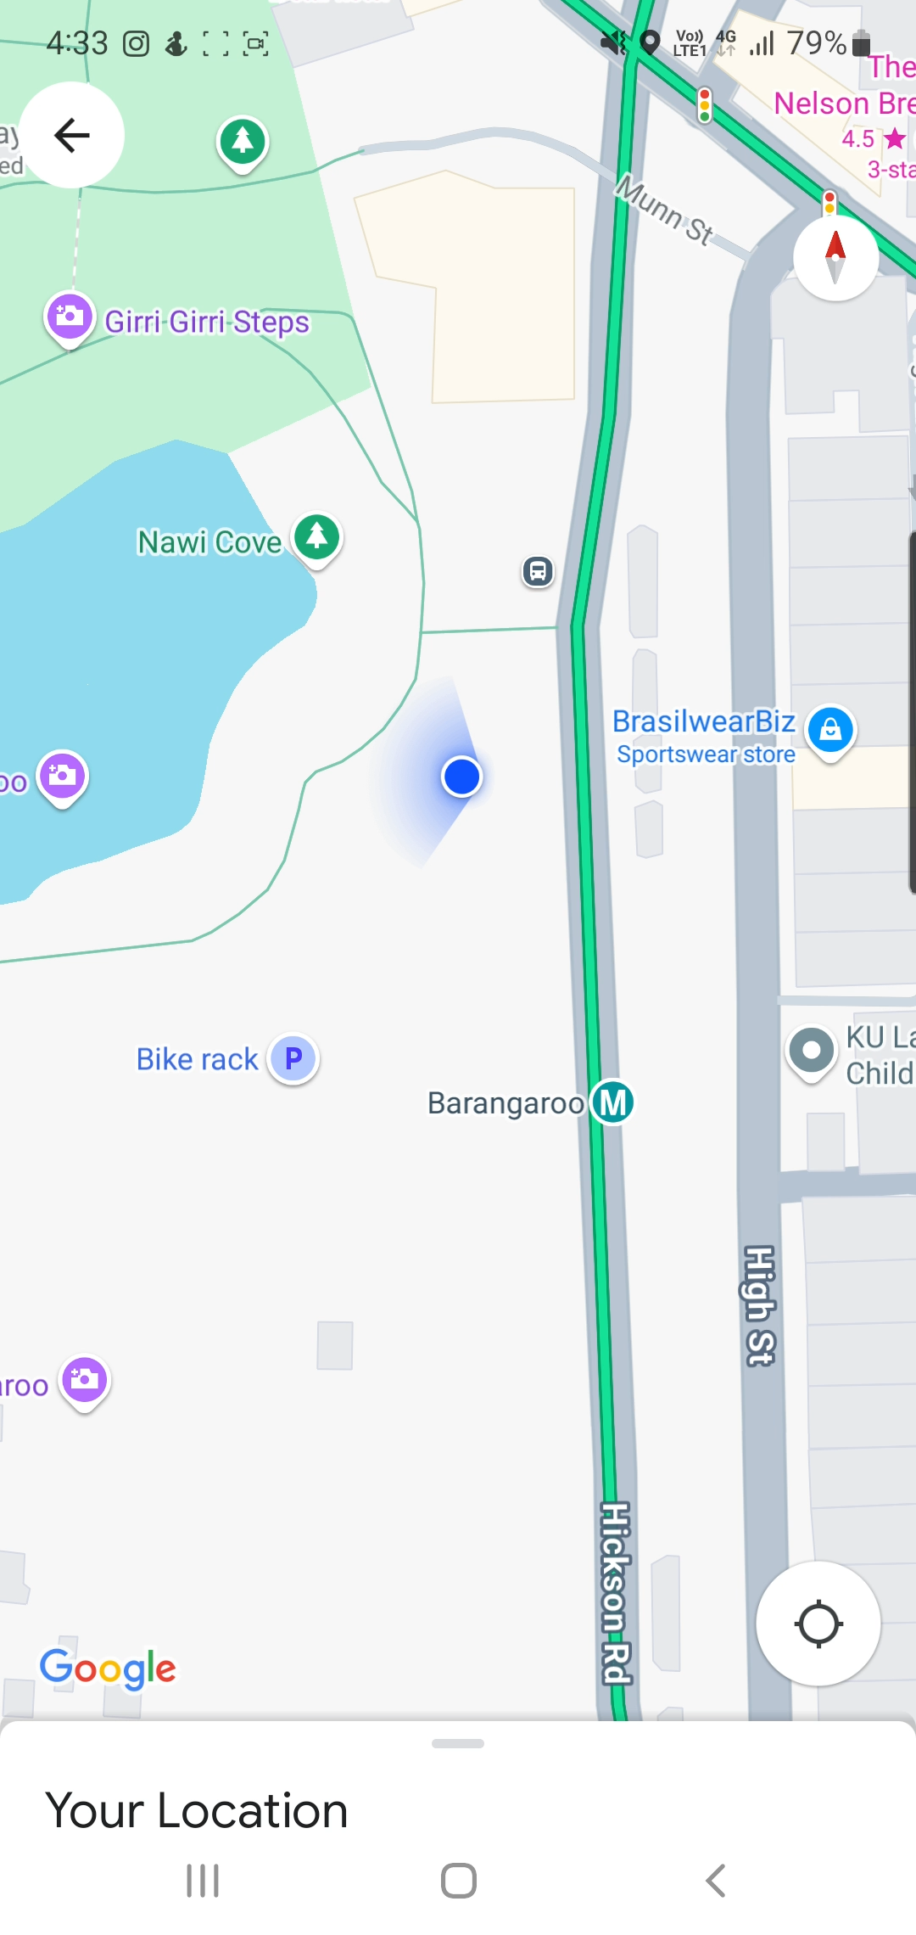
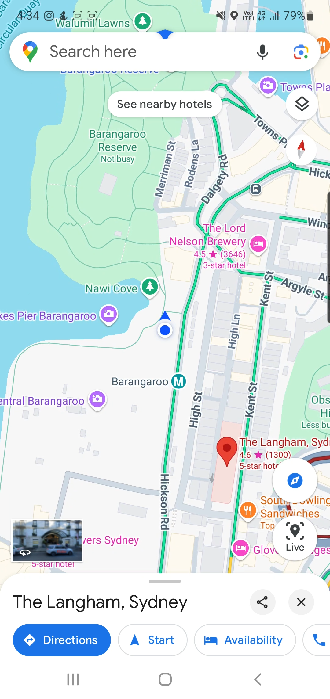
Compass Calibration
Helps device determine facing direction
Reduces drift errors (Gradual deviation from true position over time)
Devices also use accelerometers, gyroscopes and magnetometers
ITFreeTraining.com
Notes:
07:40 Your device may have a compass which helps the device determine facing direction. However, the compass sometimes may need calibration. In this example I am facing the water on the left; however, you will notice my direction is shown as facing more downwards.
I will now turn to face north. On the map, you can see that I am shown as facing the water, which means my compass is about 90 degrees off.
Google maps has an option to calibrate the compass. To do this I will swipe up from the bottom to reveal the calibrate button. Once selected, I will be asked to turn on the camera. Once I turn the camera on, a warning screen will appear reminding you to be aware of your surroundings and stay safe.
I will then move the camera around and you will notice that it will work out from the camera which direction you are facing. You will notice once finished, I am facing North and I am shown as facing North as well.
Having the compass calibrated correctly helps reduce drift errors. Many devices also include sensors such as accelerometers, gyroscopes, and magnetometers. These technologies track movement and adjust your location to improve accuracy. For example, if GPS determines your position and then you take a few steps, the accelerometer and compass can estimate the direction and distance moved, updating your position until GPS refreshes again. Without these sensors, the location may drift or respond slowly when you move.

Slide 9
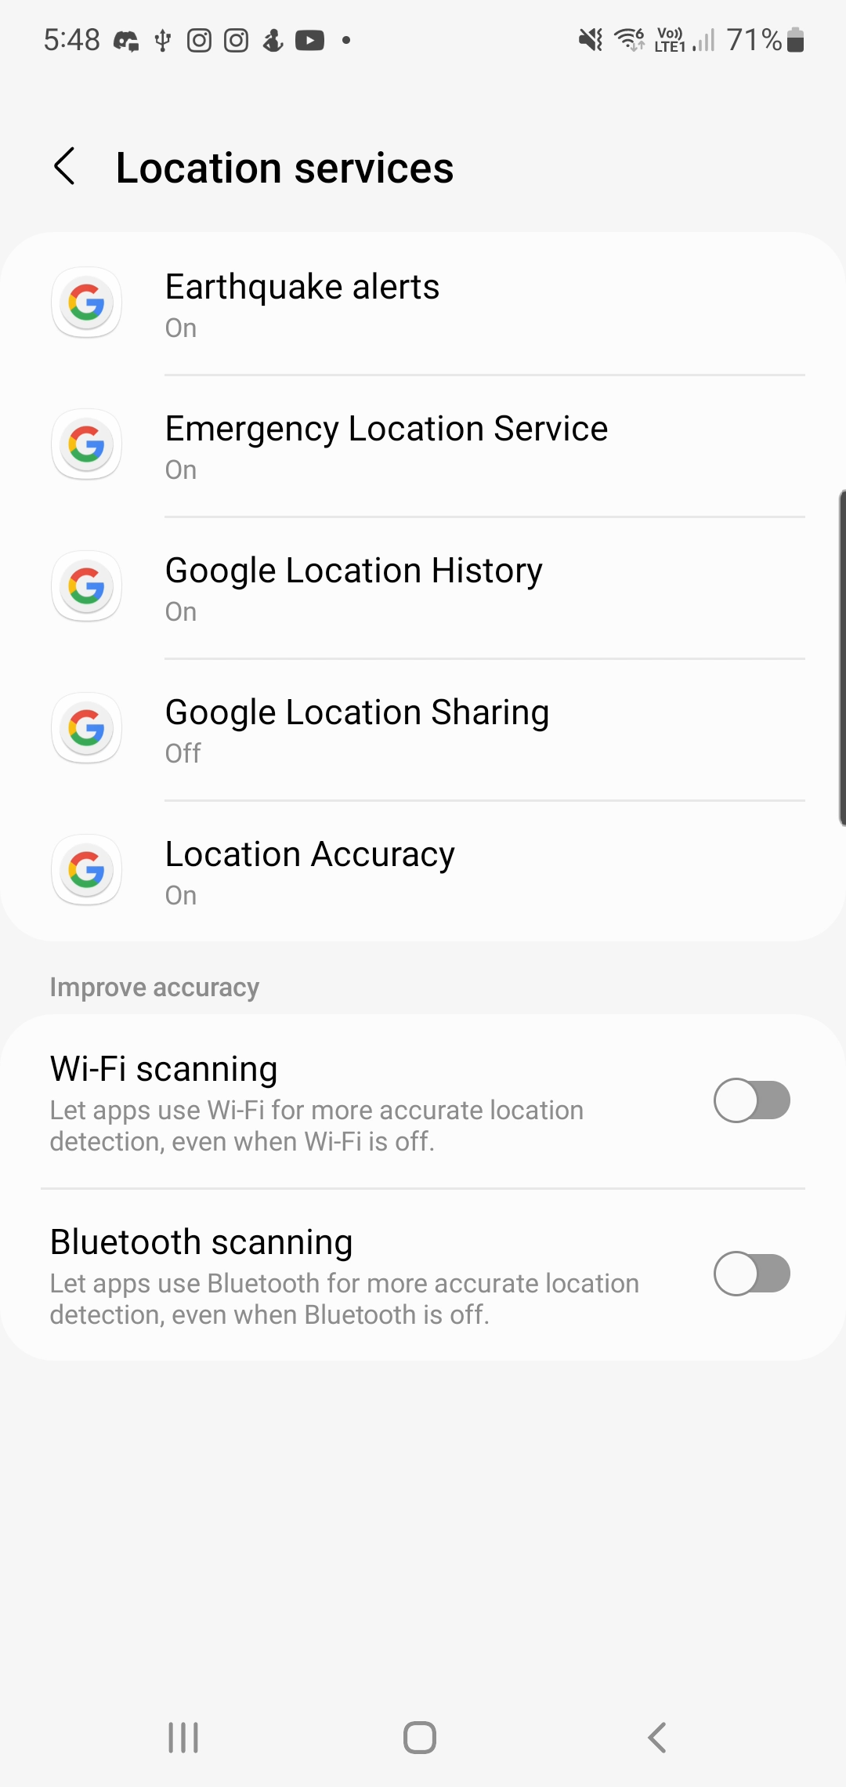
Accuracy And Power
Devices may have options to boost accuracy
Settings will drain more battery power
Wi-Fi/Bluetooth are still used even if Wi-Fi/Bluetooth is switch off
To save power
Switch off settings
Disable location services
ITFreeTraining.com
Notes:
09:16 Your device may have settings to boost accuracy. On this device, in the settings, I need to scroll down to location. In location to access the settings, select location services. You will notice that I have two settings at the bottom for Wi-Fi scanning and Bluetooth scanning.
When these settings are enabled, they consume more battery power because Wi-Fi and Bluetooth are used to enhance the accuracy of location services. Even if you manually turn off Wi-Fi and Bluetooth, they will still be utilized to improve location accuracy if these options remain enabled.
If you want to save power, switch off these settings. Keep in mind these settings work with GPS to improve accuracy. Depending on your needs, GPS by itself may meet your needs. To save even more power, disable location services. Location services enable the GPS which uses a lot of power.
Depending on your device, the settings may have different names and be located in different places.

Slide 10
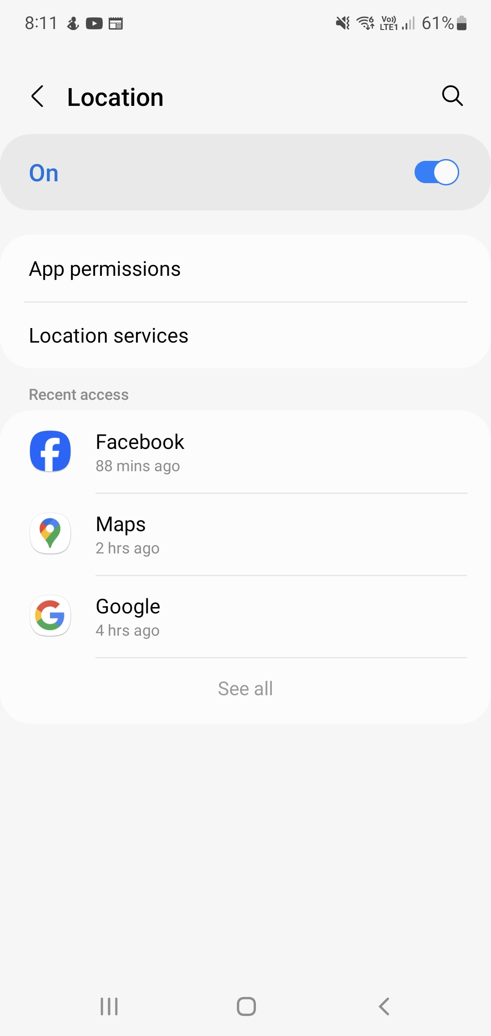
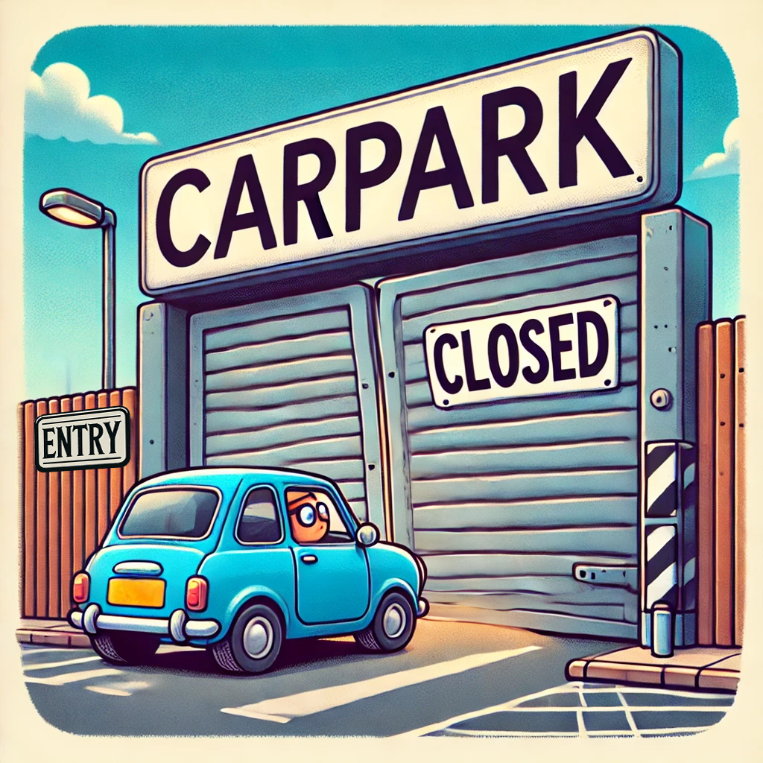

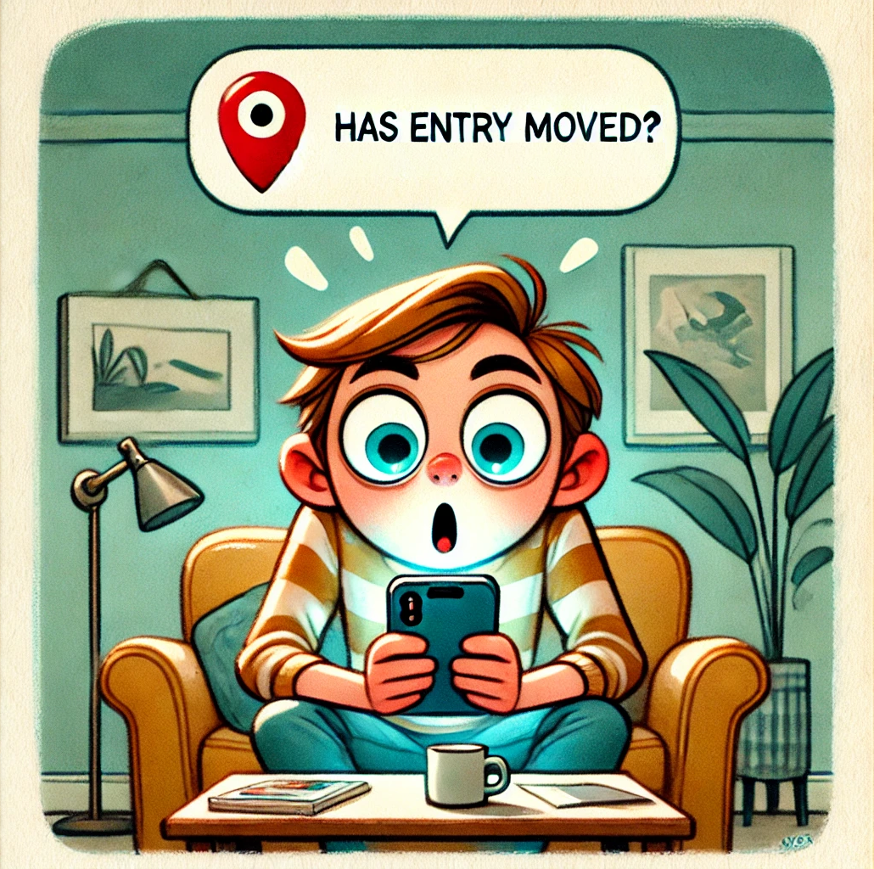
Privacy Concerns
Apps need access to location services
Apps can store your location data
Review and remove unwanted Apps
Real world example
ITFreeTraining.com
Notes:
10:21 Using location services does come with some privacy concerns. To help protect you, Apps on your device need access to your location data in order to access your location. Your device will be able to provide you a list of Apps that have access to location services. You can see in this example the Apps that have access to location services.
It is important to understand that these Apps, when running, can store your location data. It is a good idea to review which Apps have access, and remove unwanted Apps. Depending on the device, you may also be able to prevent the App from accessing location services, unless you are accessing using the App.
I am going to give you a real world example of something that happened to me. It is not to scare you but just help you understand what some of these Apps are capable of doing. I was driving to a store and it was about 15 minutes to closing time. Since the store was about to close, the doors to the entrance to the car park were closed.
There was some parking outside the carpark, but everyone had also decided to turn up to the store before it closed, so all those car spots were taken. I noticed the exit of the carpark was still open, so I drove through the exit to park my car. I am not recommending you do this and obey the laws and rules in your country, but by doing this I was able to find a spot to park my car.
I finished my shopping and drove home. When I got home I got a message asking me has the entrance to the carpark moved. If it has, please move the pin to its new location. I don’t tell you this to scare you into putting on a tin foil hat, but more so you are aware of what these Apps are capable of. If you are concerned about your privacy, make sure only the Apps you want to have access to location services have access. If you have the option, set security on the App to limit its access to location services to only when you are using it.

Slide 11

Subscribe
Next video
Video content: https://ITFreeTraining.com/ap11/8b35
Notes:
12:23 I hope this video has helped you navigate and get correct directions. Speaking of directions, make sure you don’t drive through the exit of the carpark you may get a ticket. Until the next video, thanks for watching.
References
“The Official CompTIA A+ Core Study Guide (Exam 220-1101)” page 272
“License CC BY 4.0” https://creativecommons.org/licenses/by/4.0/
“Video: GPS Satellites licensed under CC” https://commons.wikimedia.org/wiki/File:GPS24goldenSML.gif
“Picture: A-GPS picture” https://commons.wikimedia.org/wiki/File:A-GPS.svg
Credits
Trainer: Austin Mason https://ITFreeTraining.com
Voice Talent: HP Lewis http://hplewis.com
Quality Assurance: Brett Batson https://www.pbb-proofreading.uk

