Slide 1
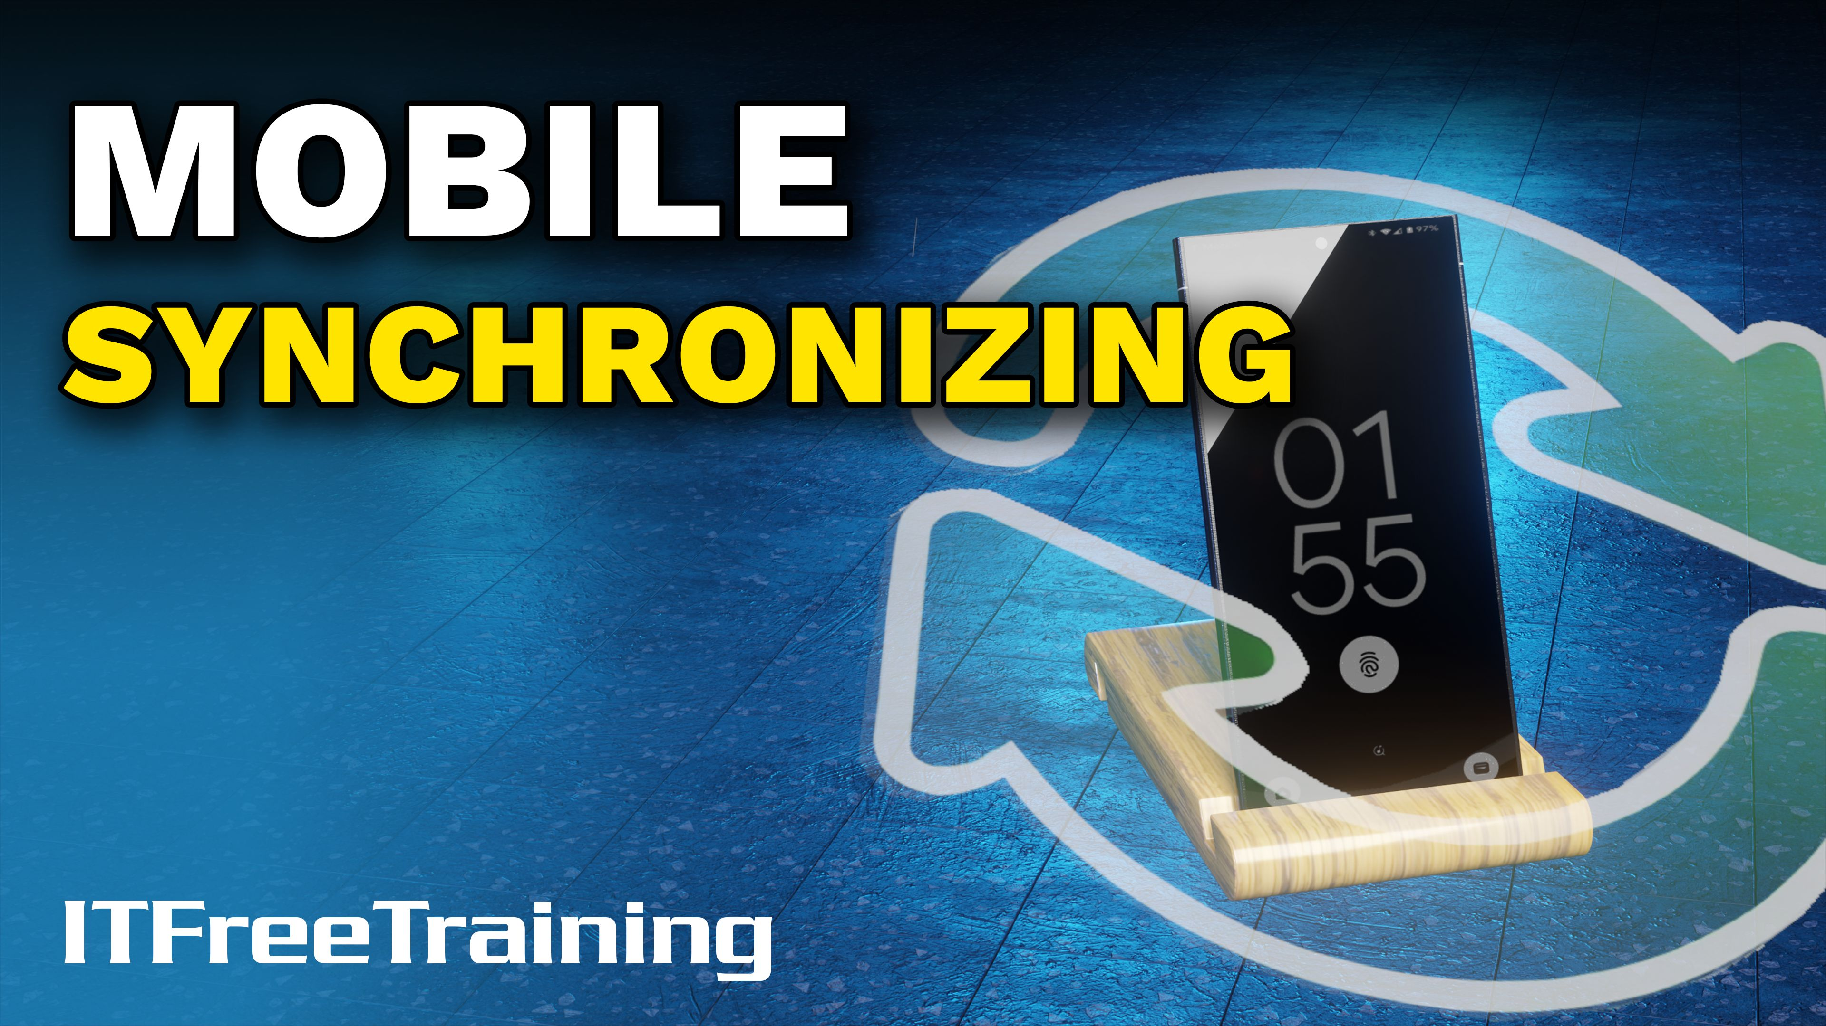


Notes:
Let’s have a look at mobile synchronizing.

Slide 2


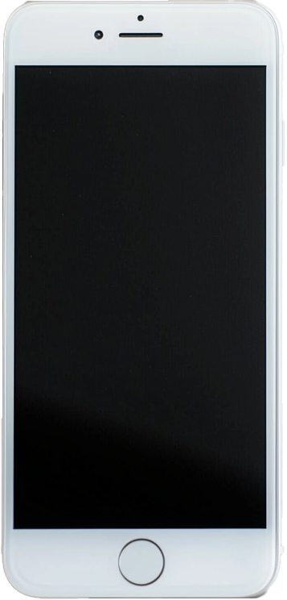
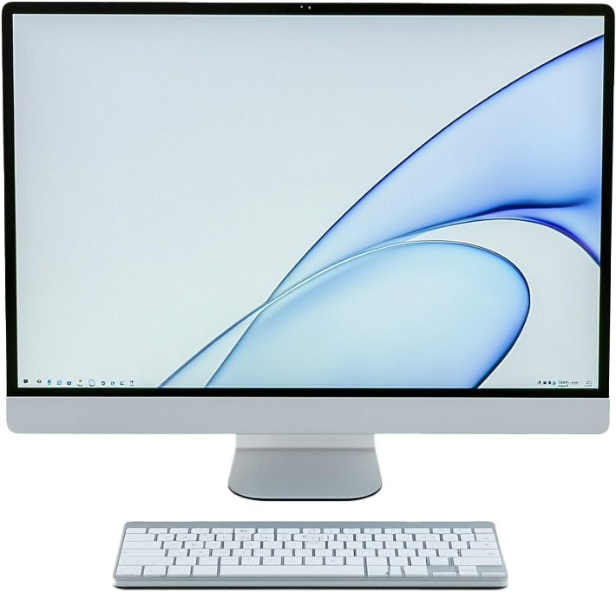



What is Mobile Synchronizing?
Process of synchronizing data across devices
Changes on one device are automatically reflected on others
ITFreeTraining.com
Notes:
00:03 Mobile synchronizing refers to the process of keeping data consistent and up-to-date across multiple devices, such as smartphones, tablets, and computers. When you sync your devices, changes made on one device are automatically reflected on others, ensuring you always have access to the latest version of your data.
This is done by syncing files to a common storage area, often the cloud. If a device is lost, data can be restored to a new device by signing in with the same account, sometimes replicating the old device's setup seamlessly. A useful feature if you like purchasing the latest mobile device each year. Your old contact information and data should sync down to your new device. Let’s have a look at what information is generally synced between devices.

Slide 3
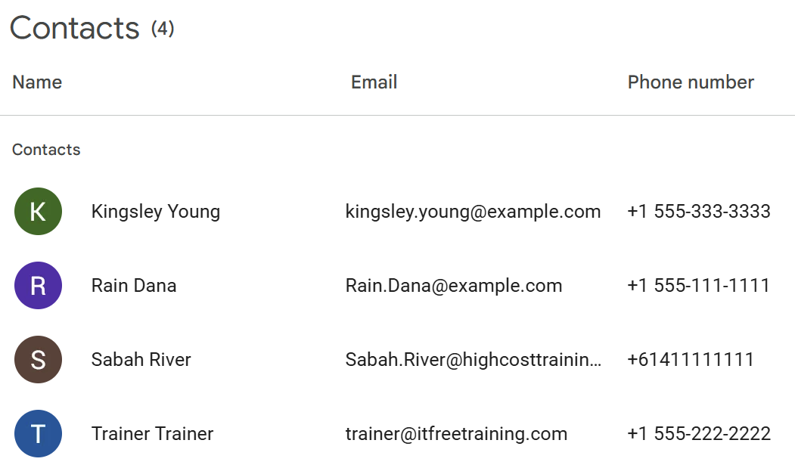
Contacts
Synchronized between all devices
Will often import any existing contacts to the device when setup
ITFreeTraining.com
Notes:
00:52 Contact synchronization keeps your contacts synchronized between devices. This includes names, phone numbers, and emails. When you first set up contact services, you often get a prompt asking if you want to import any existing contacts on your device. Any changes made on one device automatically appear on others linked to the same account even if they are running different operating systems or hardware.

Slide 4
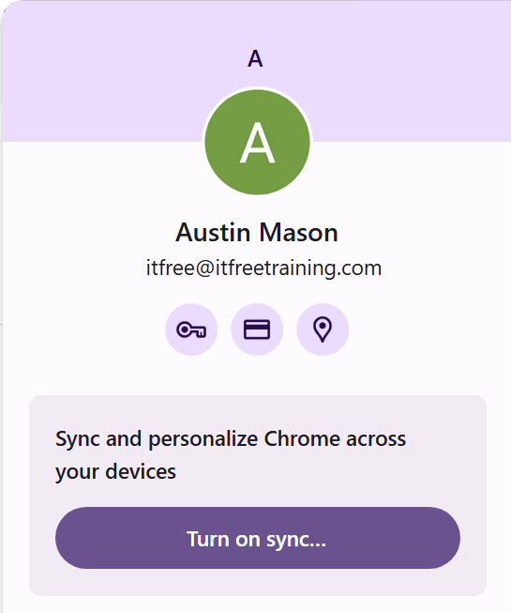
Contacts Syncing Services
Many available on Cloud services
Google Contacts
iCloud
Mail systems
Microsoft Exchange
Outlook
ITFreeTraining.com
Notes:
01:16 Cloud services like Google Contacts or iCloud handle contacts by securely storing and syncing your contacts in real-time. For example, adding a phone number on your smartphone will update on your tablet or laptop very quickly.
Mail systems like Microsoft Exchange and Outlook also provide contact syncing services. Exchange users ActiveSync while Outlook can sync locally or through cloud services.
On mobile devices, it is possible to use multiple contact systems simultaneously. For example, you could manage different contact systems separately and the mobile device will integrate the contacts from multiple services.

Slide 5
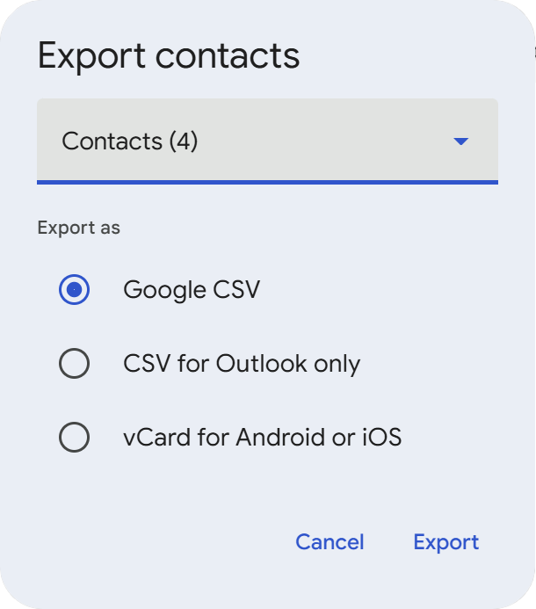
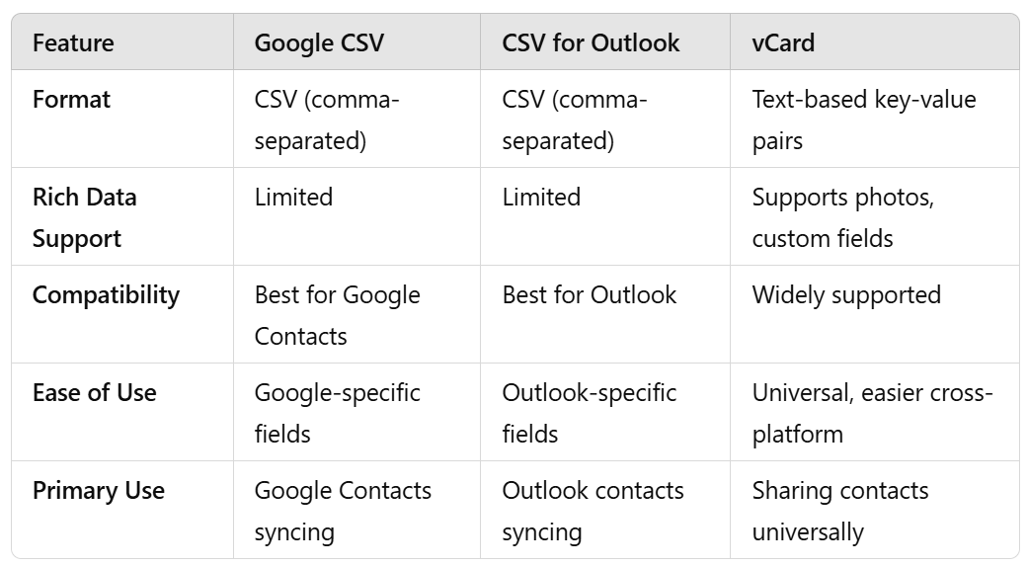
Exporting Contacts
vCard widely supported and has the most features
ITFreeTraining.com
Notes:
01:56 If you want to export the contacts, there are a number of different formats. For Comma-Separated Values or CSV file, you may get a few options. In this example, there is the option to export for Google or for Outlook. Some fields in Google and Outlook differ slightly. If you select the wrong option, some of the fields may not import correctly.
vCard is widely supported and has the most features. This includes supporting photos and custom fields. So if you are not sure which to use, I would use vCard since it has the most options and is widely supported.

Slide 6
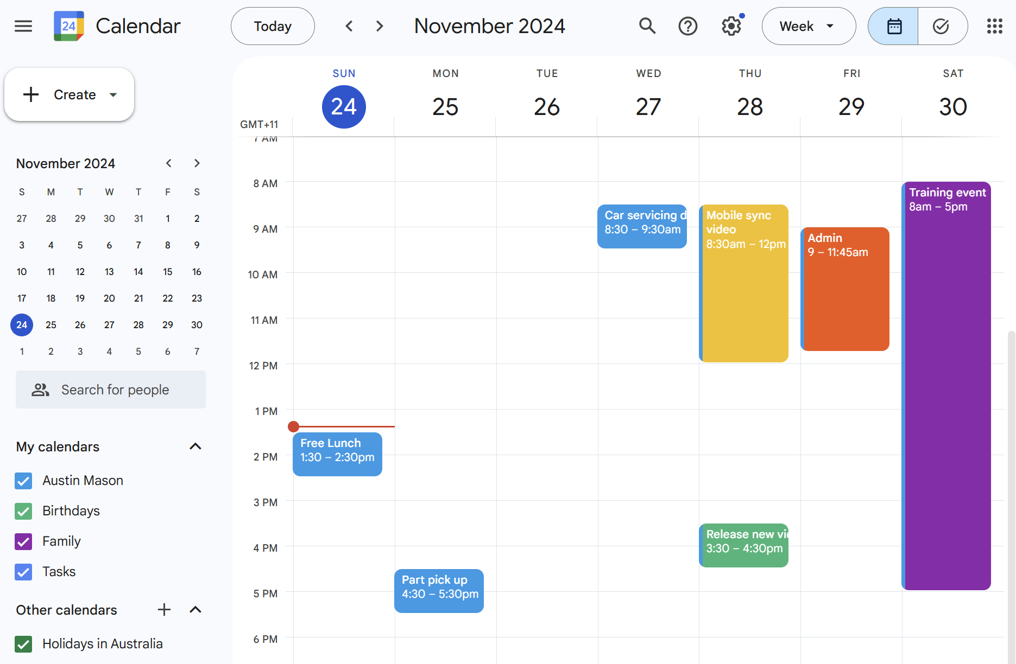
Calendar
Manages appointments, tasks and events
Can schedule meetings and reminders across multiple devices
iCalendar replaces older vCalendar format (iCalendar developed by IETF)
ITFreeTraining.com
Notes:
02:35 Many applications also have a calendar feature. The calendar manages appointments, tasks and events. So, you can schedule meetings and reminders which will sync across all your devices. If you wish to export an entry for a calendar, it is best to use the iCalendar format if available. iCalendar replaces the older vCalendar format.
The iCalendar format was developed by the Internet Engineering Task Force. There is often some confusion that it was developed by Apple as it starts with an i, but this is not true. vCalendar is also well supported, so use iCalendar when you can and vCalendar when iCalendar is not supported.

Slide 7
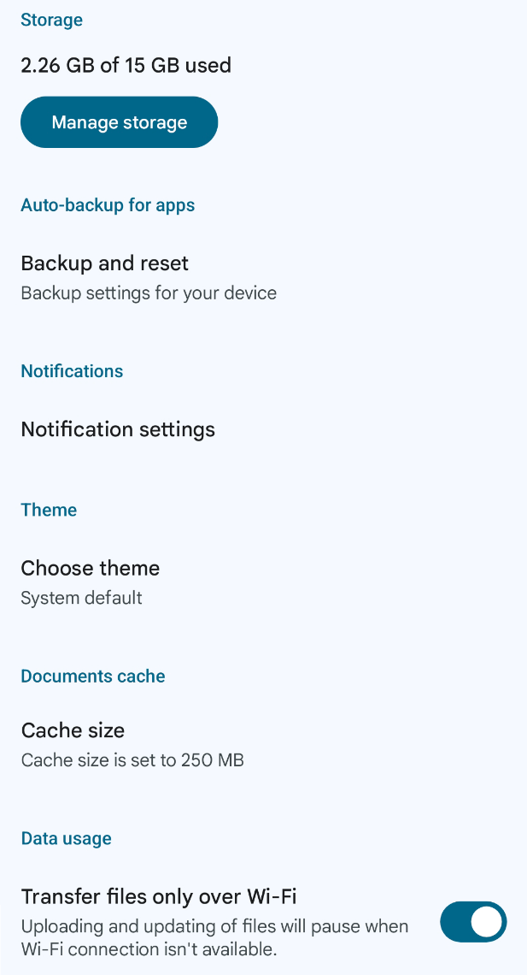
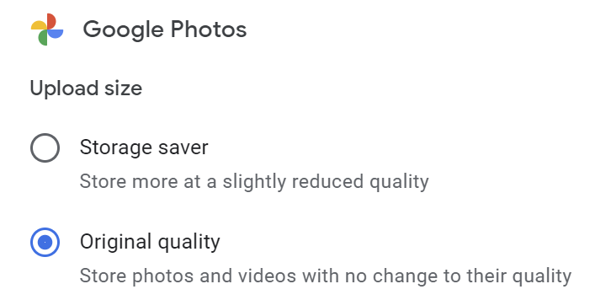
Picture, Music, Video and Documents
Main issue with sync is files can be very large
Devices will often selectively sync files using a cache
Files will be removed from the cache when it gets full
ITFreeTraining.com
Notes:
03:17 Your mobile device can also sync pictures, music, video, and documents. The main issues with files like these compared with contacts and Calander entries is that the files can be quite large. If you have a lot of files, the files may be greater than the amount of storage on the mobile device.
Devices will often selectively sync files using a cache. A cache is an area of the storage dedicated to keeping copies of files. When the cache is full, files will be removed from the cache. To make better use of the cache, there may be settings to download files in lower quality.
Caching files locally consumes both storage space and bandwidth. To conserve mobile data, devices often restrict downloads to Wi-Fi connections. With this setting enabled, files won't be downloaded automatically unless you're connected to Wi-Fi. However, if you attempt to open a file without Wi-Fi, it will begin downloading at that time. The file will then sync to your device, which may take a while if your connection is slow

Slide 8
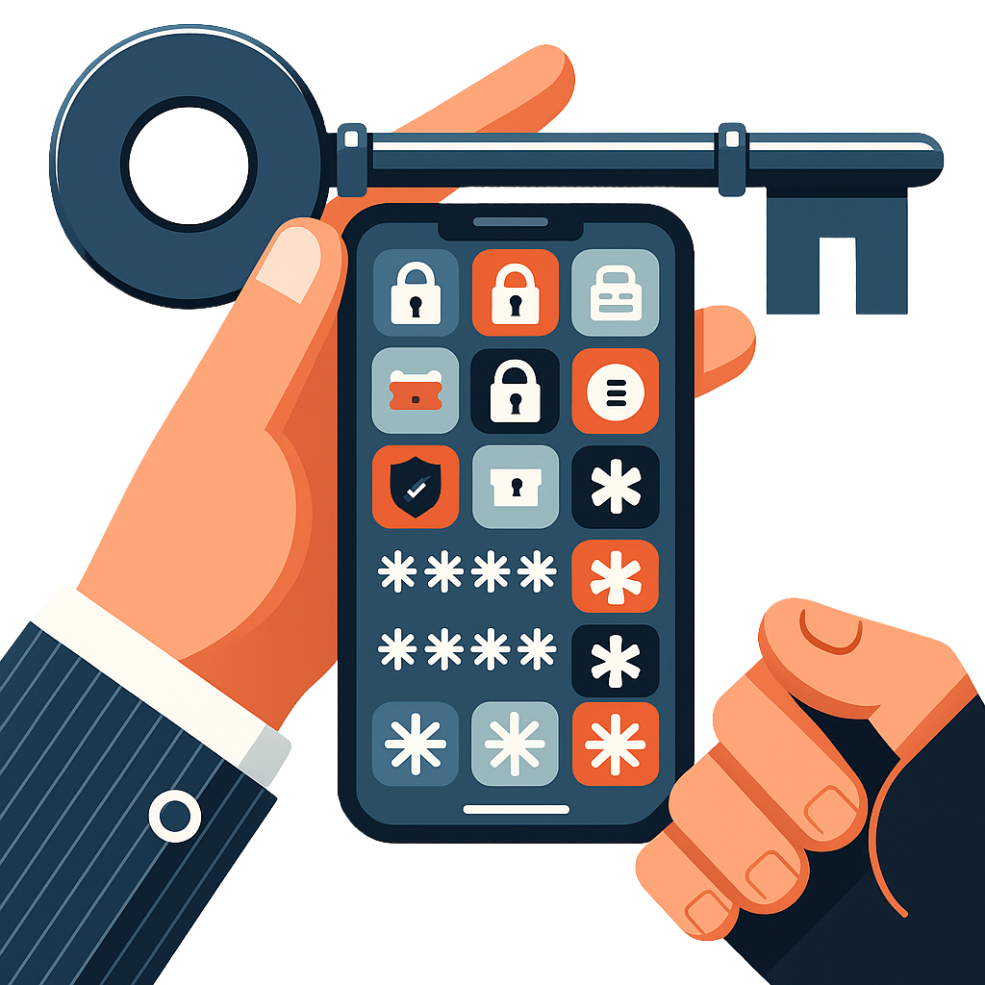
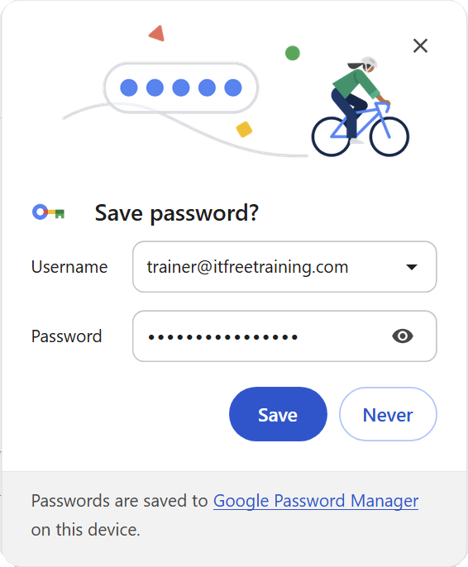
Password Managers
There are many different password managers
When username and password are used, they will prompt you to save them
If you account is compromised, the attacker has access to all your passwords
Consider two-factor authentication (2FA)
ITFreeTraining.com
Notes:
04:24 There are a lot of different password managers available. When you use a username and password, the password manager should detect it and give you the option to save it to the password manager.
Keep in mind that when you use a password manager, if the password manager account is compromised, the attacker has access to all your passwords. So, you may want to consider additional security for your password like two factor authentication.
Password managers offer significant benefits, such as cloud syncing to share usernames and passwords across devices. They enable the use of complex, secure passwords without the need to remember or manually input them. As long as your password manager account is well-protected, they are a highly valuable tool for maintaining security.

Slide 9
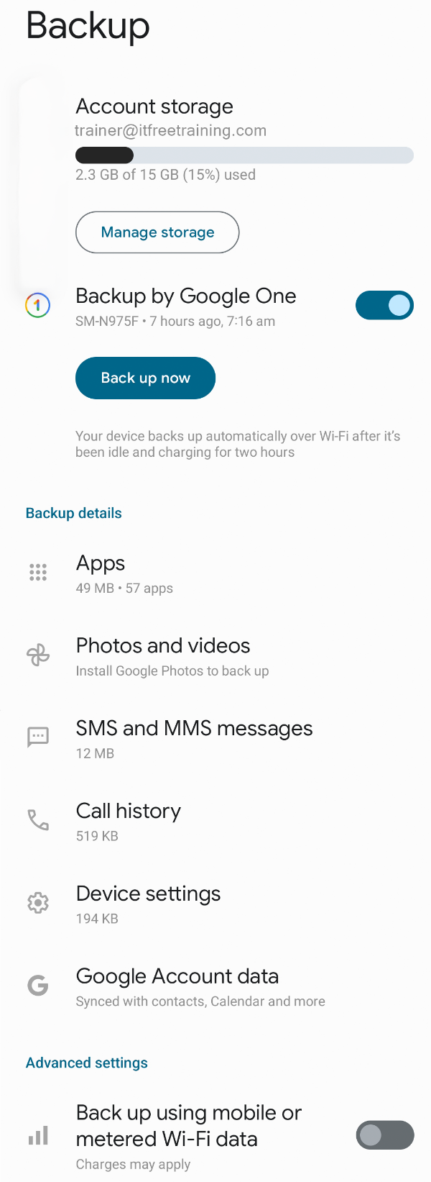
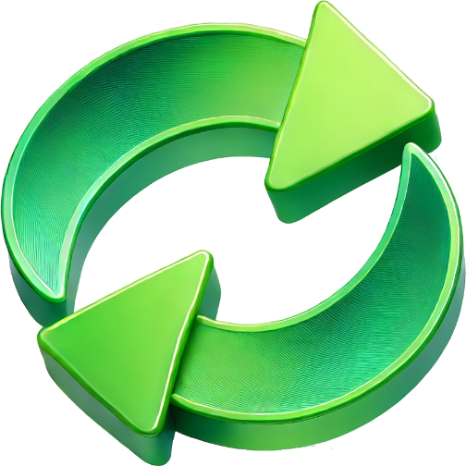
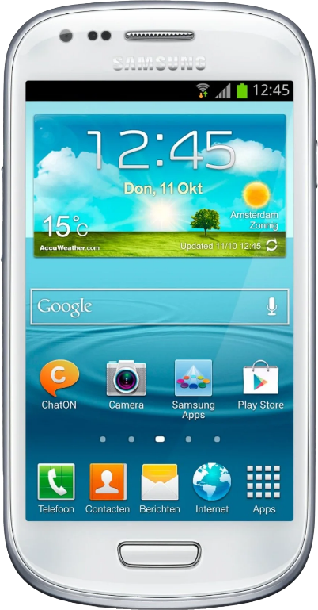
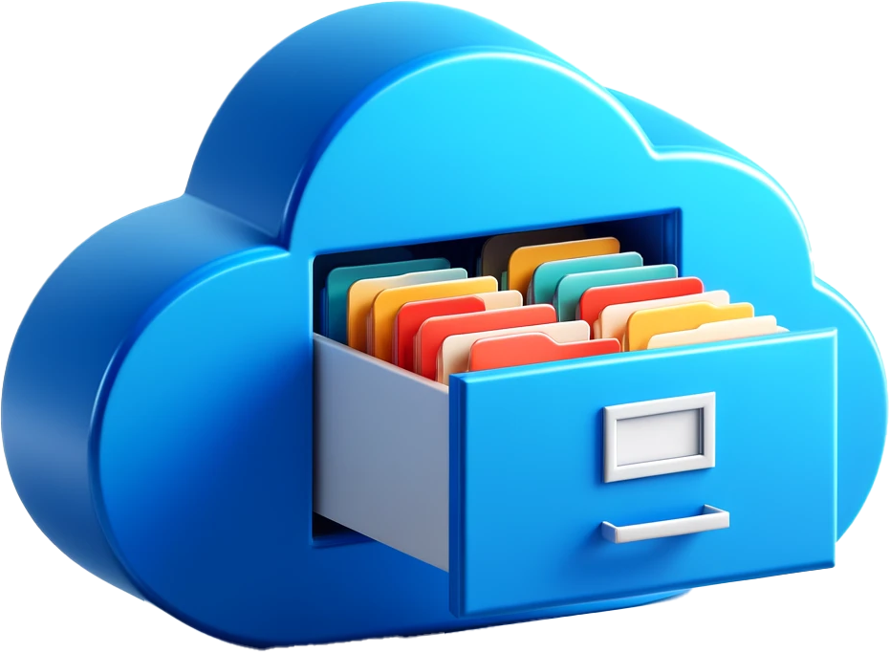
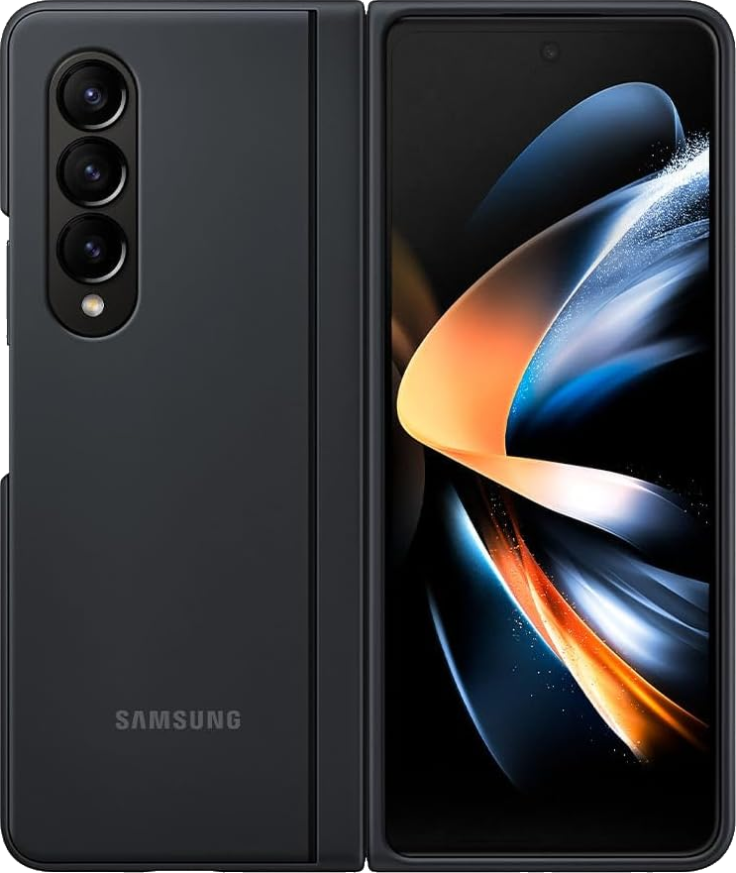
Cloud Synchronization/Backup
Common place on modern devices
Can sync a lot of data on the device (Contacts, call logs, pictures)
Usually, the free account will have a small amount of storage
Can be used when migrating your device or when it is lost
Will often have Wi-Fi only option to reduce cellular use
ITFreeTraining.com
Notes:
05:12 Cloud synchronization and cloud backups are very commonplace on modern devices. A large amount of data can be synced from the device. This includes contacts, call logs and pictures. Usually, the free account will have a small amount of storage space. In this example, the free account has 15 Gigabytes of storage.
This can be used when migrating your devices or when it is lost. If all works well, when you purchase a new device, the data from your old device will be synced to the cloud. Your new device should be able to access this synced data and use it to set up the new device. When everything works properly, your new device should have all your old contacts and files ready to use, with minimal setup beyond connecting the device to your cloud account
Your device will often have a Wi-Fi only option to reduce cellular use. When this is enabled, the device will only perform certain high bandwidth activities when connected to Wi-Fi or when specially requested by the user. In this example, the cloud storage is 15 gigabytes, which is not much over a Wi-Fi network. However, depending on your cellular plan, that could use up a significant portion—or even all—of your data. This is why it's important to restrict large downloads to Wi-Fi, unless you have a lot of cellular data.

Slide 10
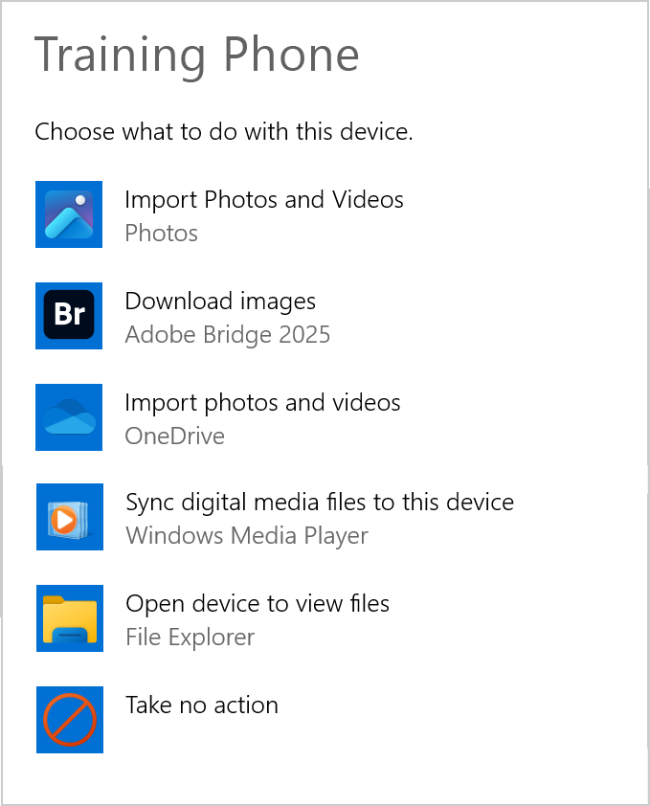
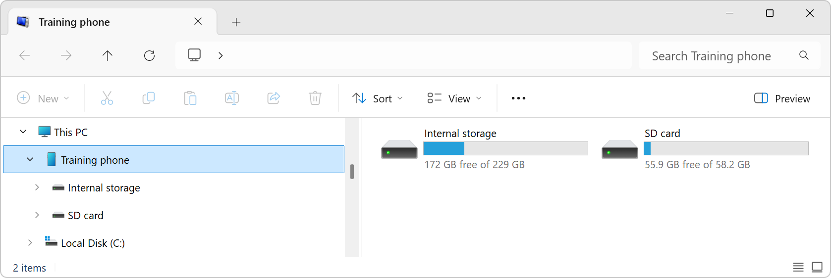
Synchronizing to PC
Mobile devices can be connected using a cable
File transfers can also be done using Bluetooth
Access files in Windows Explorer
Auto play
ITFreeTraining.com
Notes:
06:32 You can also synchronize files to a computer using a cable like a USB cable. When you plug in a new device to Windows, if configured, an Autoplay screen will appear asking you what you want to do. For example, import photos and videos or access the device using Windows Explorer.
You can also use Bluetooth to transfer files to and from the computer; however, the Bluetooth interface is not as easy to use. In my opinion, cloud is the easiest option nowadays, but the choice is there if you want to use it.

Slide 11

Subscribe
Next video
Video content: https://ITFreeTraining.com/ap11/8b10
Notes:
07:04 That concludes this video from ITFreeTraining on mobile synchronizing. I hope you found it interesting. Until the next video I would like to thank you for watching.
References
“The Official CompTIA A+ Core Study Guide (Exam 220-1101)” pages 264 to 265, 268 to 269
“License CC BY 4.0” https://creativecommons.org/licenses/by/4.0/
Credits
Trainer: Austin Mason https://ITFreeTraining.com
Voice Talent: HP Lewis http://hplewis.com
Quality Assurance: Brett Batson https://www.pbb-proofreading.uk

