Slide 1
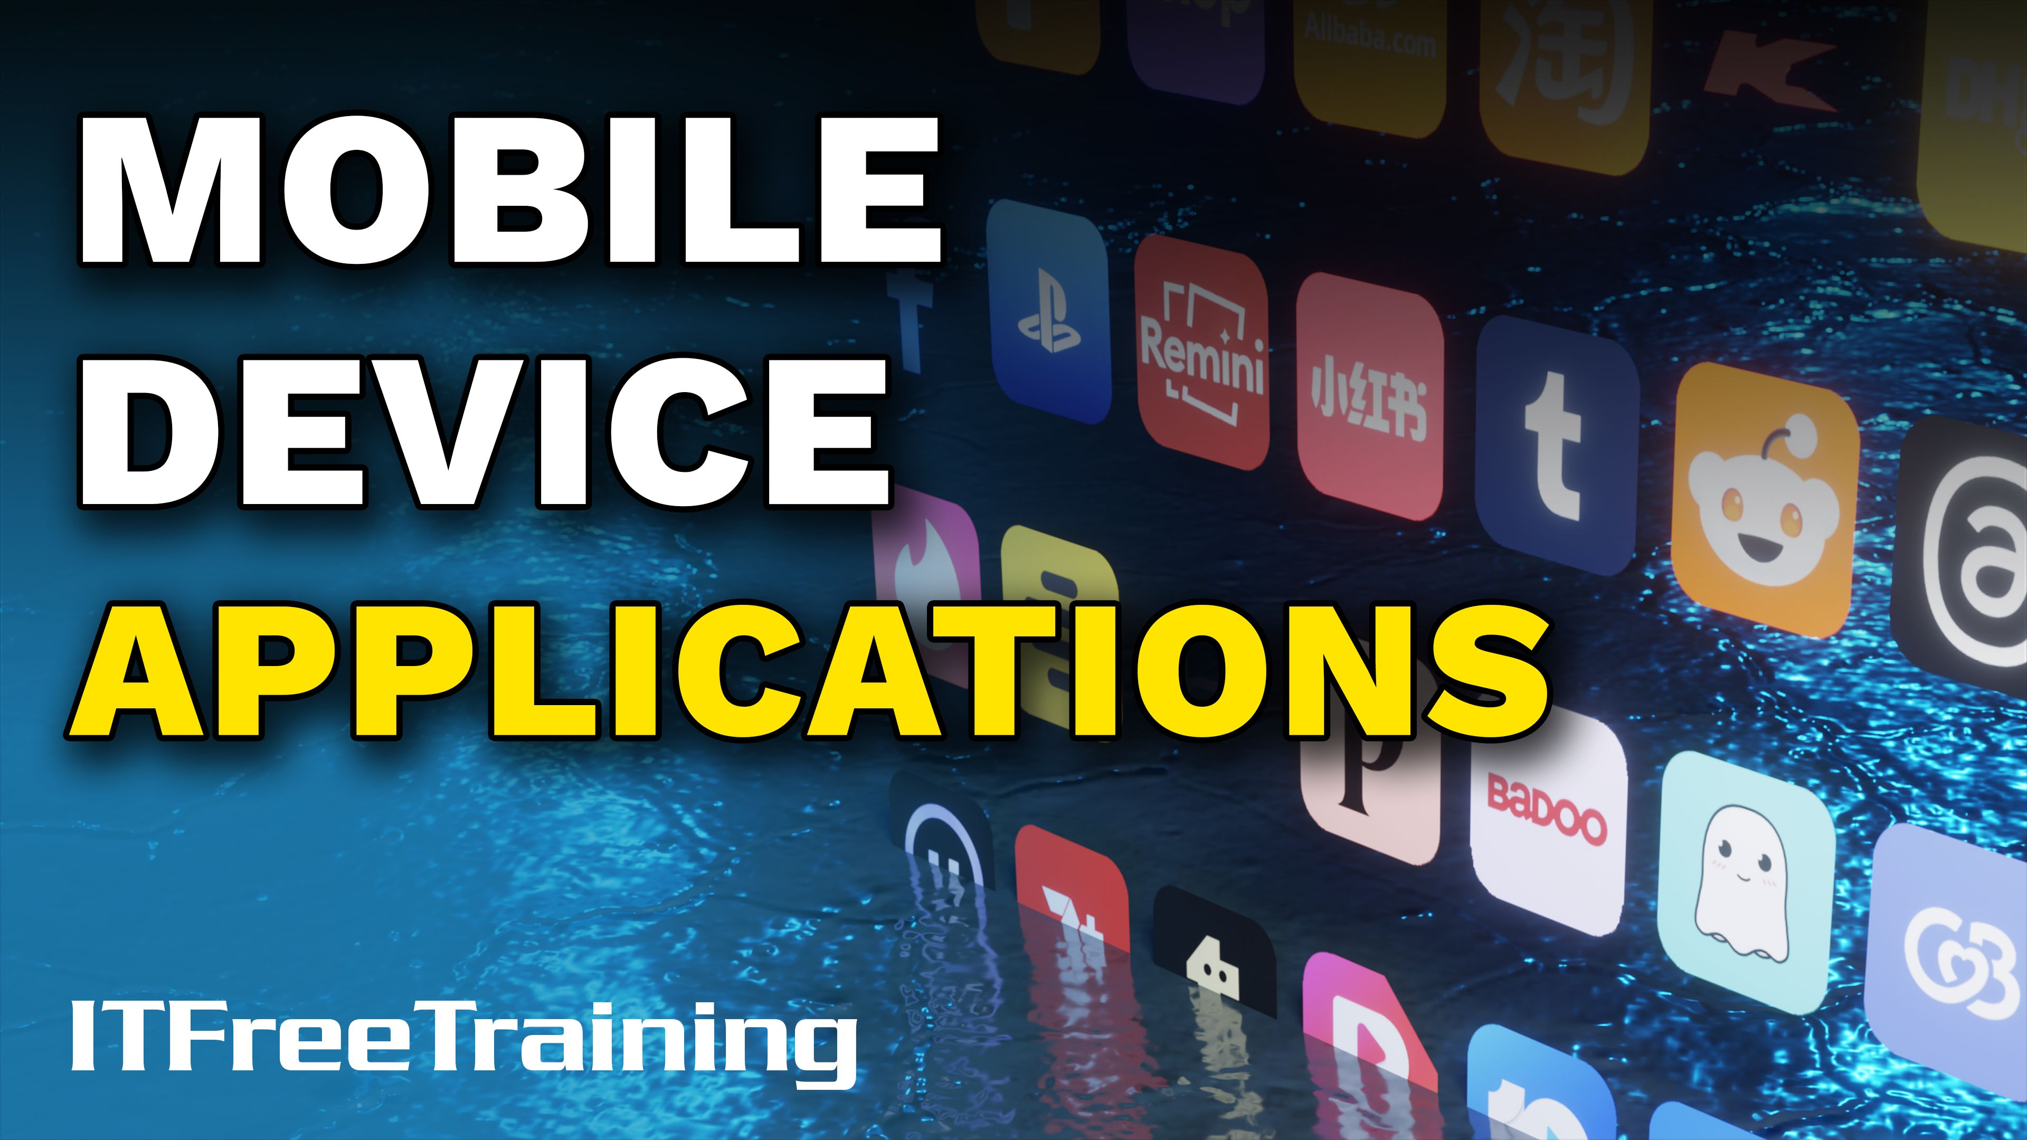


Notes:
Let’s have a look at mobile device applications.

Slide 2

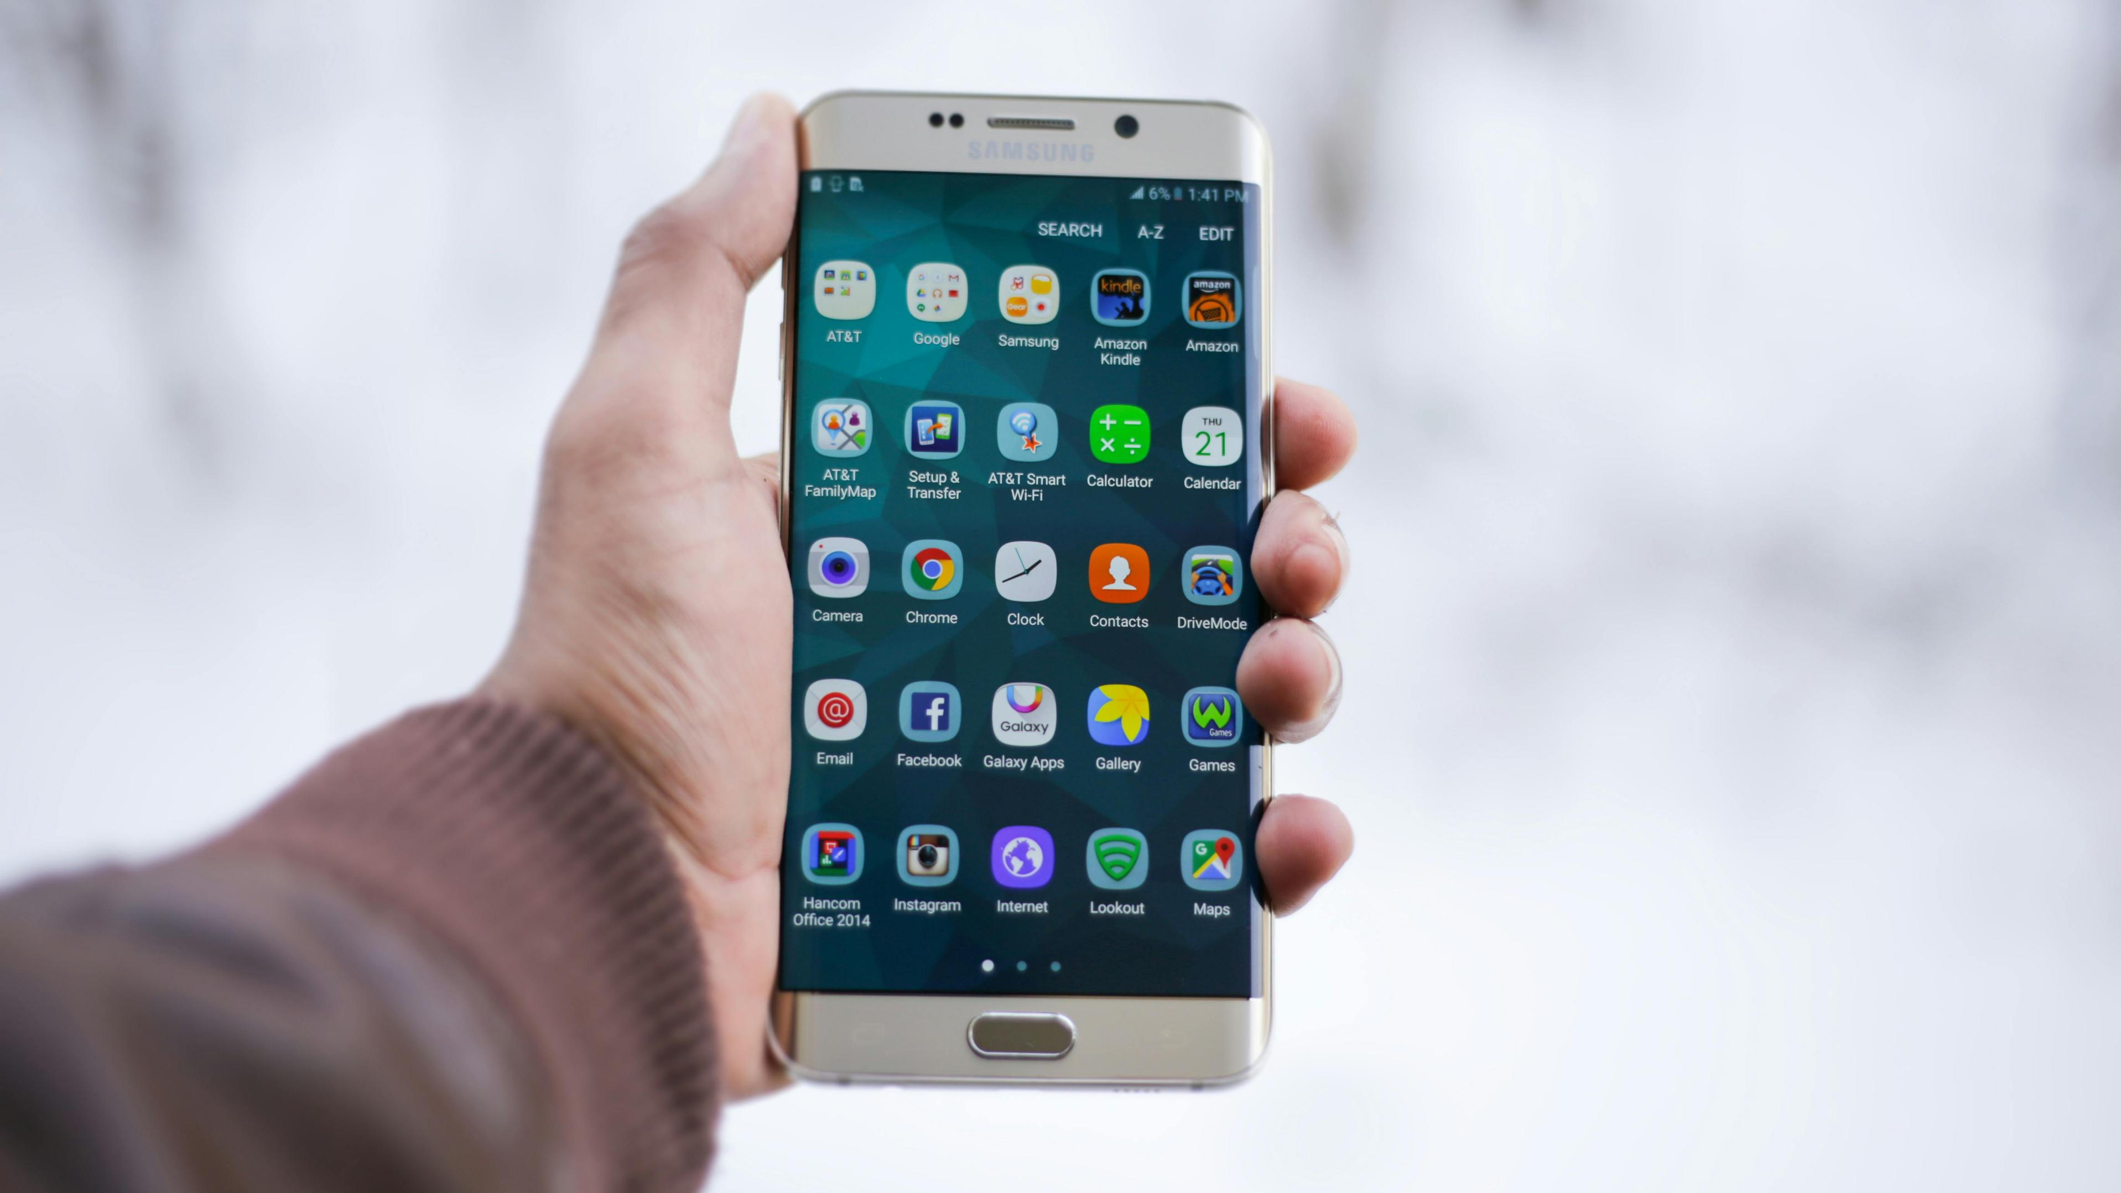

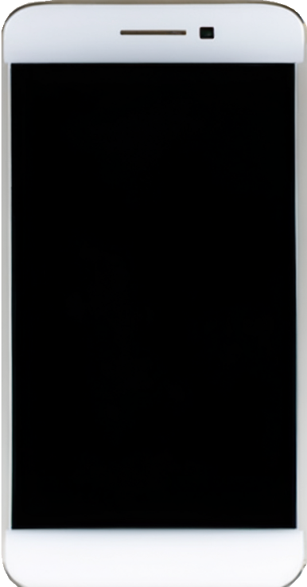


Mobile Apps
Mobile Device Management (MDM)
Extends the functionality of the mobile device
Enroll
An app is compiled for a specific mobile device and operating system
The App store takes care of this, so you don’t need to worry
Collect
Configure
Monitor
Secure
ITFreeTraining.com
Notes:
00:05 Mobile devices are essential tools in today’s digital landscape. They come with a large number of applications (known as Apps) which enhance functionality and user experience.
Organisations will use mobile device management or MDM to manage mobile devices. MDM allows the organization to control which applications are installed on the mobile device and configure the mobile device.
Some organizations use a Bring Your Own Device or BYOD policy. This means that the user can connect their own device to the company's network. In some cases, the company will provide a payment to the user to buy a mobile device from their local store and will simply send a remote erase when the user finishes working for the organization.
Mobile Apps extend the functionality of the mobile device. Apps are different from applications that you would run on your computer as they have fewer features and functionality and are specificially designed for mobile devices.
An app is compiled for specific mobile devices and operating systems, leading to many variations. Unlike computer software, which can run on many computers as long as system requirements and architecture are compatible, mobile apps need to be compiled for the hardware and OS of each mobile device, which can vary quite a bit.
You don’t need to worry about this because, when you download an app from an app store, it handles all these details for you. The developer simply uploads the code and any required files, and the app store compiles the app for the appropriate hardware.

Slide 3

Apple’s App Store
Apps must be submitted and approved
Better quality control, enhanced security and better user experience
Limited user freedom and less choice
ITFreeTraining.com
Notes:
01:41 For the Apple App store, Apps must be submitted and approved before they are added to the App store. This generally means better quality control, enhanced security, and better user experience.
The downside is limited user freedom and less choice. While Apple's approach prioritizes user safety and experience, it comes at the cost of what could otherwise be a more diverse and more innovative app selection.

Slide 4
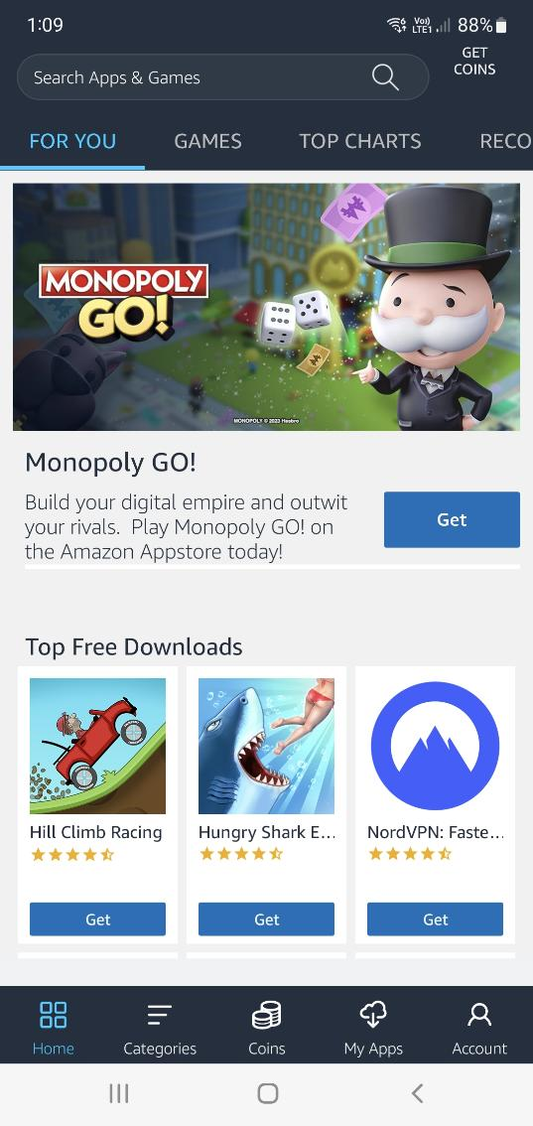
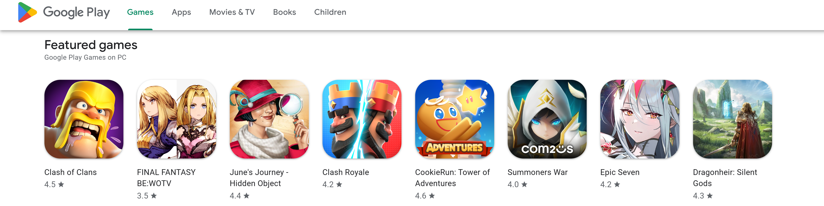
Google Play
Official marketplace for Android devices
Installed by default on most Android devices
Approval process like Apple store, but faster and less strict
Other App stores available
Amazon App Store, Tencent MyApp
Apps can be installed without an Appstore
Sideloading - manually installing using the android package (APK)
Requires package to be compatible
Increased risk of malware since there is no approval process
ITFreeTraining.com
Notes:
02:08 For Android devices, installed by default on most Android devices is Google play. Like Apple's App store there is an approval process, but it is faster and less strict than Apple’s App store. The Google Play Store has more apps than the Apple App Store, but many are of lower quality or offer limited functionality. For example, simple apps like flashlight apps, which don’t add significant features or value, are less likely to be approved on the Apple App Store due to its stricter review process.
There are other application stores that are available. Outside China, usually Google Play will be installed.
On Android devices, apps can be installed without an App store. You can download an App without an App store and install it manually in a process called sideloading. This does require the package to be compatible with the device. App stores automatically provide a compatible package, so you don’t need to worry about this.
Installing Apps not using an App store increases the risk of Malware as the App does not go through any verification process. So generally, it is recommended, unless you have good reasons not to, to use an App store to install on your device.

Slide 5

Sandboxing
Isolates the app to its own private space
Apps runs with minimum permissions
ITFreeTraining.com
Notes:
03:24 Mobile devices run Apps which are designed to isolate the App in its own private space.
In contrast, desktops and laptops can also sandbox applications; however, this is not a mandatory requirement and must be set up. Apps on mobile devices, by default, are designed to be sandboxed.
Mobile device Apps run with minimum permissions. In order for an App to access data and features outside the sandbox, it needs to be granted permission. Let’s have a closer look at App permissions.

Slide 6
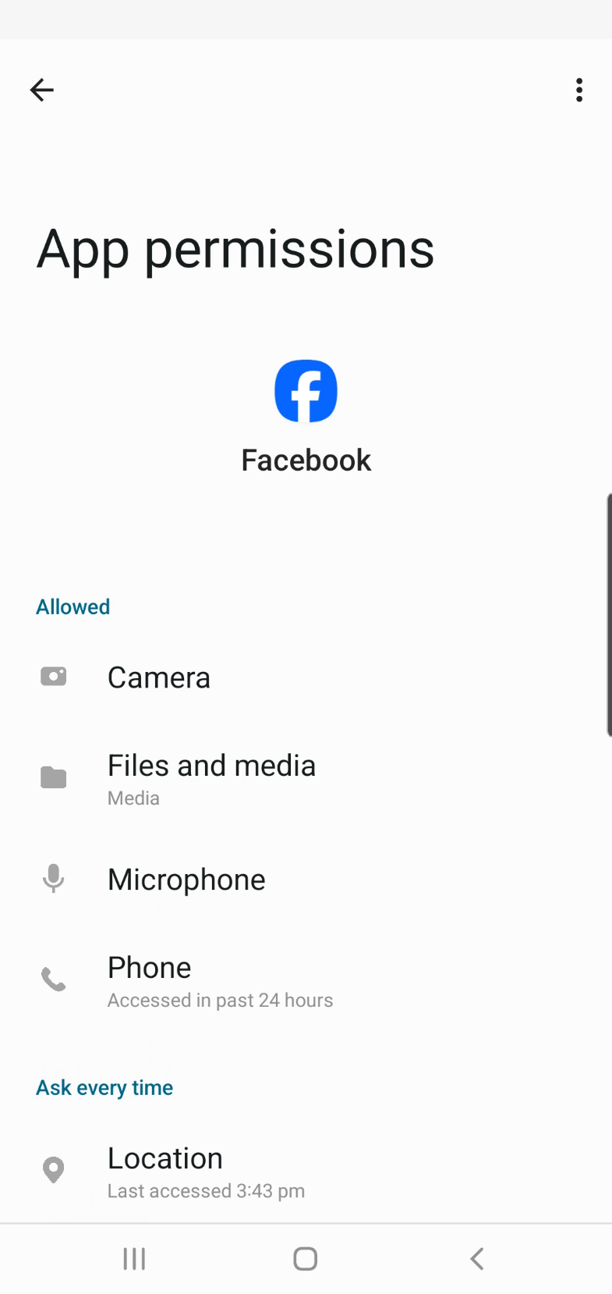

Permissions
App needs to be granted permission
Sometimes requires multiple permissions
E.g., Capturing a photo requires access to the camera and storage
App draining battery quickly
Disable permissions like location services
Or change to only when using app
Set options to reduce accuracy
ITFreeTraining.com
Notes:
03:58 By default, an App will need to be granted permission to access additional features or storage on the device. Sometimes the App may require multiple permissions. For example, to take a photo using the device's camera would require access to the camera and access to storage to save the picture.
To get an idea how permissions work, I will have a look at how some of the permissions are configured on this mobile device. I will start by selecting the option location. This will display all the Apps that are configured to be allowed to use location services.
You may find that you have a mobile device where an App is draining the battery very quickly. When this occurs, you may want to disable permissions like location services. Location services use the device's GPS and may use data connections to work out the location. To keep updating the position all the time drains the battery faster than normal. Depending on the device, this can drain the battery 5 to 15 percent faster than normal.
You may find that some Apps have access to features that you don’t need them to have access to. For example, a Mobile game may have access to your contact list, but the game itself does not require access to the contact list. In the old days, there were a lot of mobile Apps which would copy all your contacts when you installed the App and upload them to their server without your knowledge. As part of the App Store approval process, reviewers check for unnecessary permission requests or other suspicious app behaviour before approving it for listing
On this screen you can see the Apps that recently accessed location services. I will select App permissions at the top. This will show all the Apps installed on the device. At the top are the Apps that are allowed to access location services all the time. Below this are the Apps that are only allowed to access location services when the App is running. Limiting access reduces the amount of power the App can draw and also prevents Apps that may be monitoring your locations even when you are not using the App. If you are concerned about privacy, you may want to limit the use of location services to when you are using the App.
I will scroll down a little and select the Facebook app. You will notice the App is currently set to only allow while using the App; however, I can limit it further by making it ask before it uses location services. This allows me to know when the App is using location services, giving me more control and privacy.
At the bottom of the screen, notice the option for “Use precise location.” When I disable this, the App will only have an approximate location of the device. When this option is enabled, the mobile device increases the accuracy of location services. This causes more drain on the power and also uses other services (such as data services) to assist getting a more accurate location. If you want to reduce power use and are concerned about privacy, you may want to disable this option. Keep in mind that if you are using location services for Apps that require accurate locations (such as ride share applications), you will want to ensure precise location is enabled.
To see all the permissions for the App, I will select the option at the bottom “See all Facebook permissions”. You can see here all the permissions the App has access to. Also listed is when each permission was last accessed. If you are concerned what permissions your Apps have access to, it is worth looking through the list of permissions for that App.

Slide 7
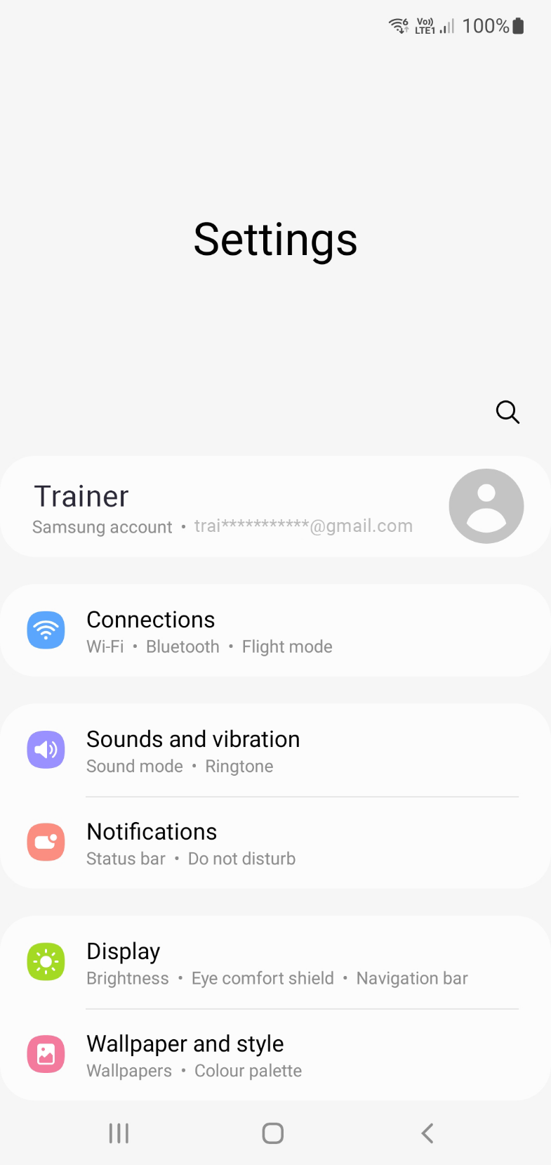
Account Setup
Most devices designed to be single user
Owner account used for device
If not, setup there are limited features or no access
Required for access to App store
Other accounts used for digital identification
Microsoft 365
Google Workspace
iCloud
ITFreeTraining.com
Notes:
07:38 Most mobile devices are designed to be single user. An owner account is generally set up for the device. This is the main account used for the device. If not set up, the device may have limited features or no access. For example, many Apple devices require an account to be set up when the mobile device first starts up. You won’t be able to use the device without it.
The main account is also required for access to the App store. On Android devices, you can manually install Apps. So for test devices or virtual mobile devices this may be manageable, but usually the loss of the App Store makes the device very hard to use.
The mobile device may also have other accounts used for digital identification. These are different from the main account, as they are used for extra services that are not part of the core mobile phone features. For example, they may allow you to access Microsoft 365, Google Workspace, or iCloud. These accounts are often used to access online features and sync data to and from the device. For example, it is common nowadays to have an account linked to the device which syncs usernames and passwords between devices for your internet. If all works well, you can share your data between your mobile device and your desktop computer.

Slide 8

Subscribe
Next video
Video content: https://ITFreeTraining.com/ap11/8b05
Notes:
08:58 That concludes this video for mobile device applications. I hope you have found this video informative. Until the next video, thanks for watching.
References
“The Official CompTIA A+ Core Study Guide (Exam 220-1101)” pages 261 to 264
“License CC BY 4.0” https://creativecommons.org/licenses/by/4.0/
“Picture: Mobile with apps” https://www.pexels.com/photo/person-holding-silver-android-smartphone-50614/
“Picture: Google Play” https://commons.wikimedia.org/wiki/File:Google_Play_2022_logo.svg
“Picture: Apple Store” https://en.wikipedia.org/wiki/App_Store_(Apple)#/media/File:Download_on_the_App_Store_RGB_blk.svg
Credits
Trainer: Austin Mason https://ITFreeTraining.com
Voice Talent: HP Lewis http://hplewis.com
Quality Assurance: Brett Batson https://www.pbb-proofreading.uk

