Slide 1
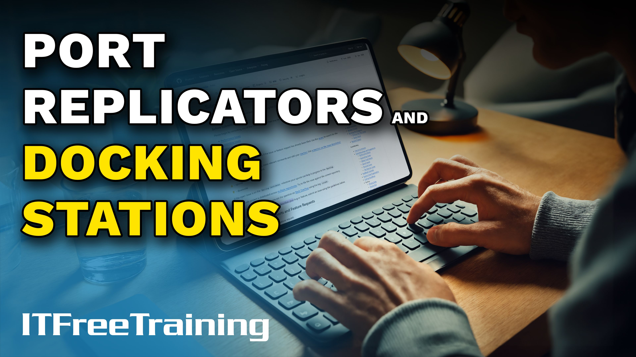


Notes:
Let’s have a look at port replicators and docking stations.

Slide 2
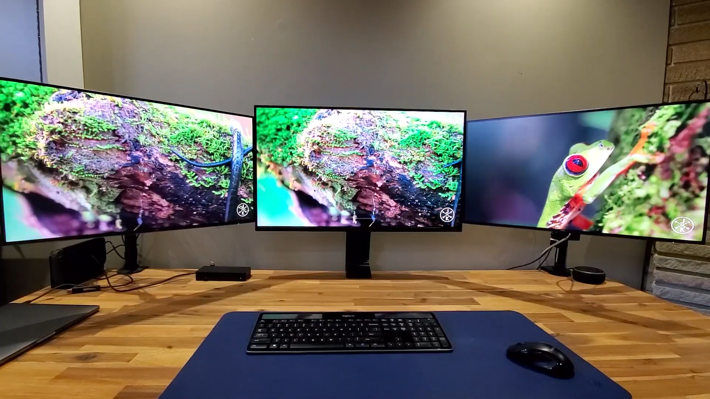

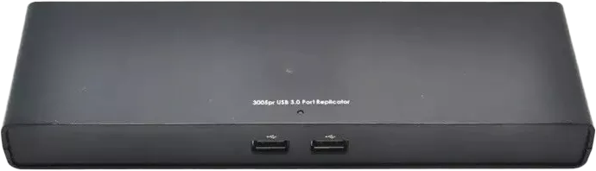
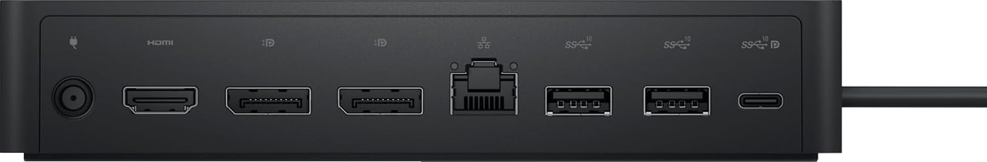
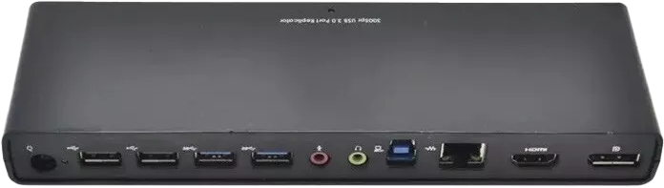
Port Replicator Vs Docking Station
Duplicates your existing ports
Nowadays little difference if any (Maybe marketed as both)
Docking stations provide additional features like monitors or expansion cards
ITFreeTraining.com
Notes:
00:06 Modern day docking stations allow you to plug in all your devices to the docking station. The laptop is connected by a single USB-C connection. The docking station allows you to use your keyboard, mouse, monitors and any other devices you wish.
A port replicator and docking station both duplicate your existing ports. Nowadays there is little difference if any between the two. You may even find that they are marketed as both. But more on that later in the video.
The main difference between docking stations and port replicators is that docking stations provide additional features. For example, monitors or expansion cards. Port replicators are only able to duplicate the existing ports in the laptop. They don’t add additional features.
These days, port replicators are marketed differently than they used to be. To understand why, it's helpful to look back at the history of docking stations and port replicators.

Slide 3
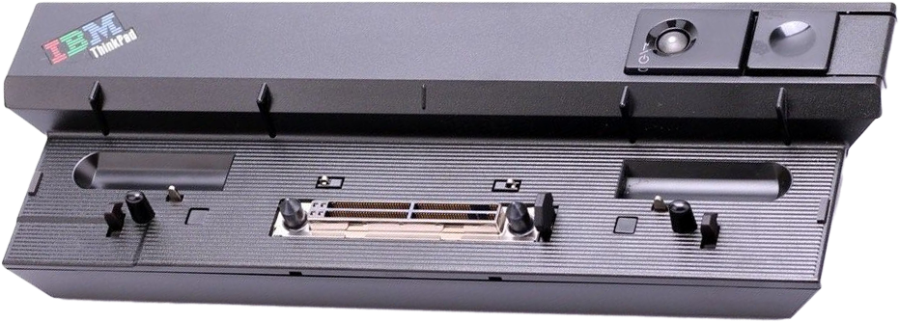
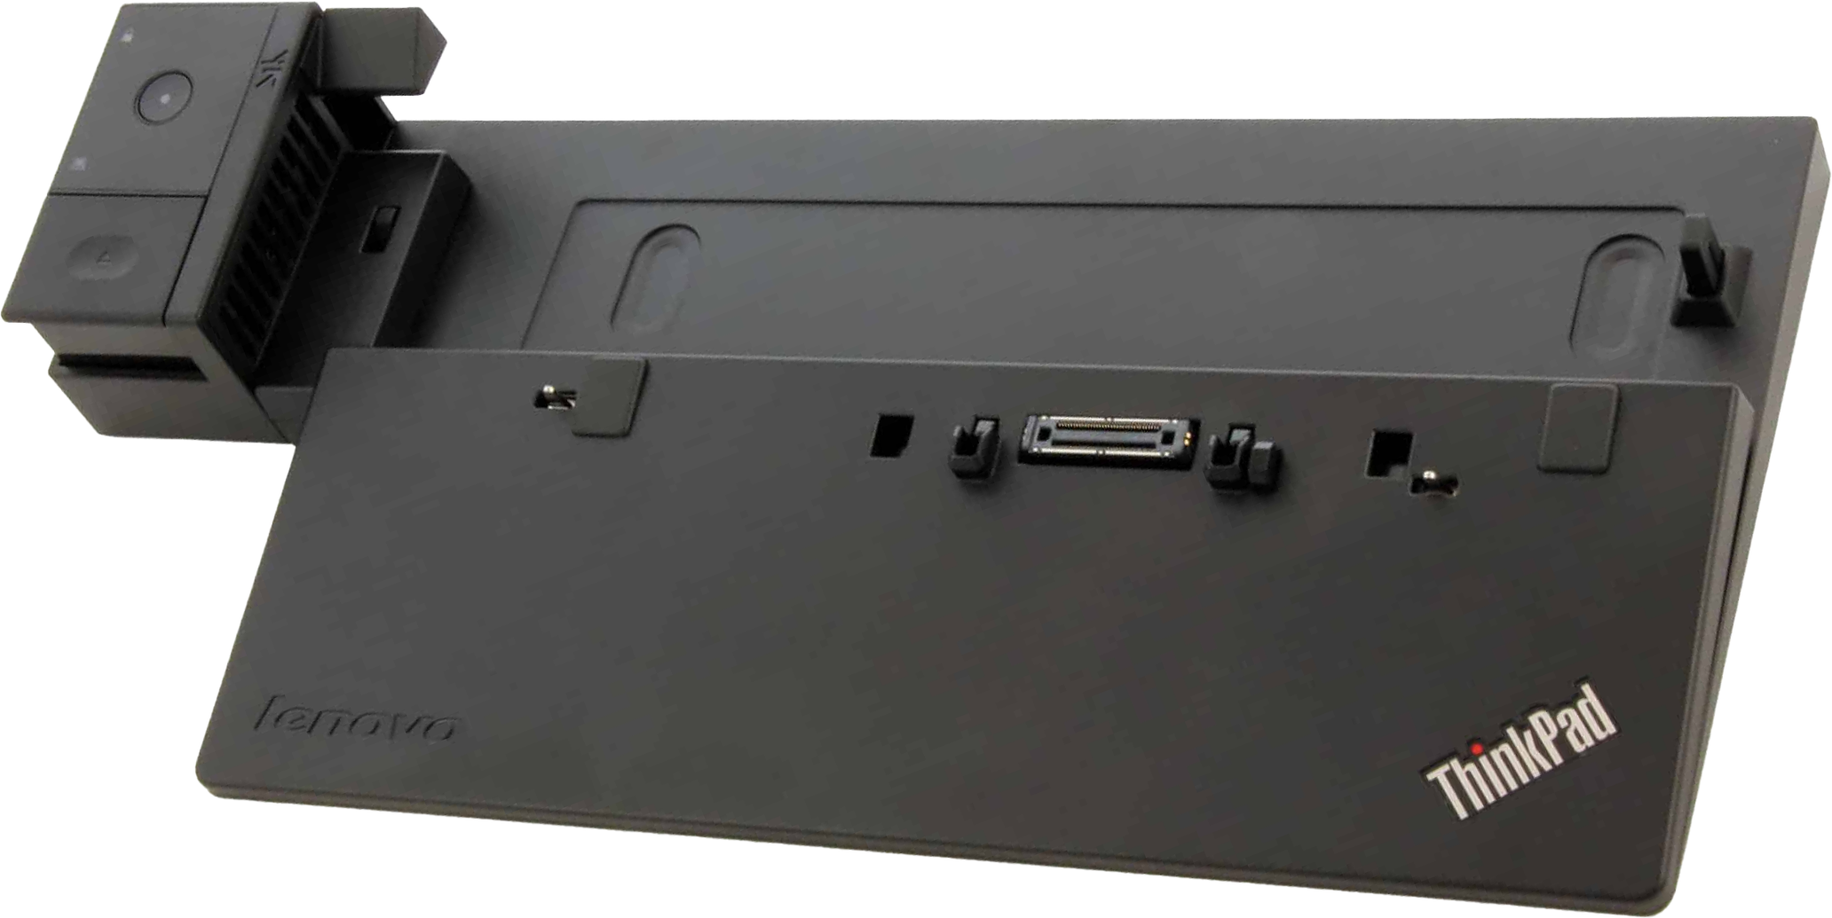
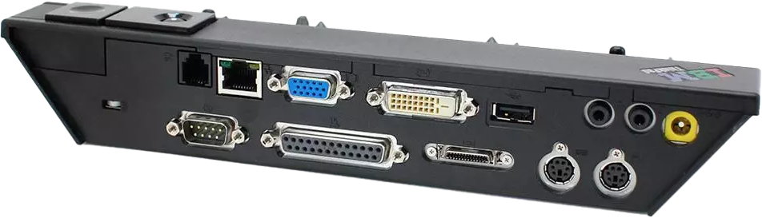
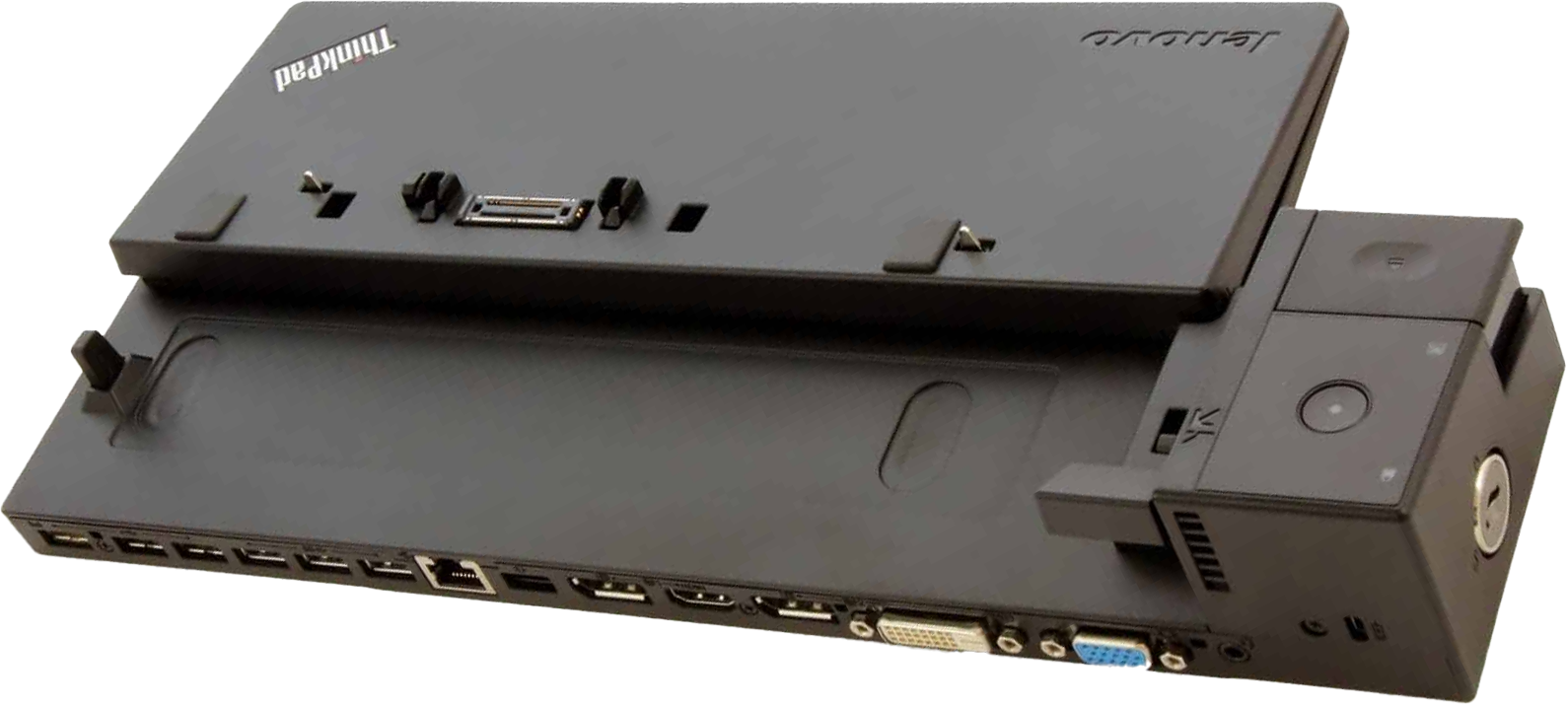
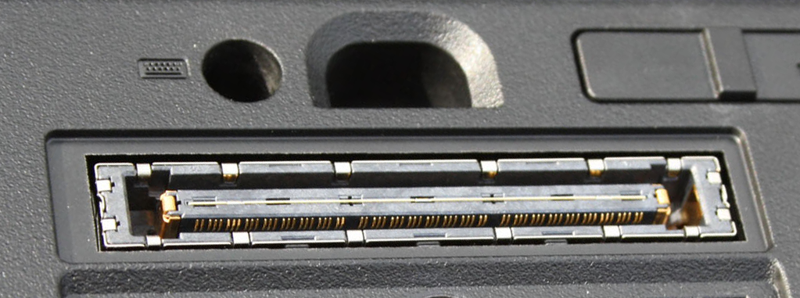
History
Port replicator
Docking station
Smaller and cheaper
More features and generally larger
Used proprietary connector
Different models may have different connectors
ITFreeTraining.com
Notes:
01:03 In the old days, the port replicator was essentially a smaller and cheaper version of the docking station. The docking station had more features and was generally larger. One of the early port replicators I supported did not have a video connector. The user would plug their laptop into the port replicator and have to plug the monitor in. In order to get the video connection, the more expensive docking station had to be purchased.
The port replicators and docking stations back then used a proprietary connector. What made it worse was that manufacturers would often have different types of connectors for different models. Although some would work across multiple models, you ended up often having to purchase a port replicator or docking station for the laptop you purchased driving up the price.
This was from the old days just to give you some context where the name came from. Let’s have a look at where we are today and how things have changed.

Slide 4

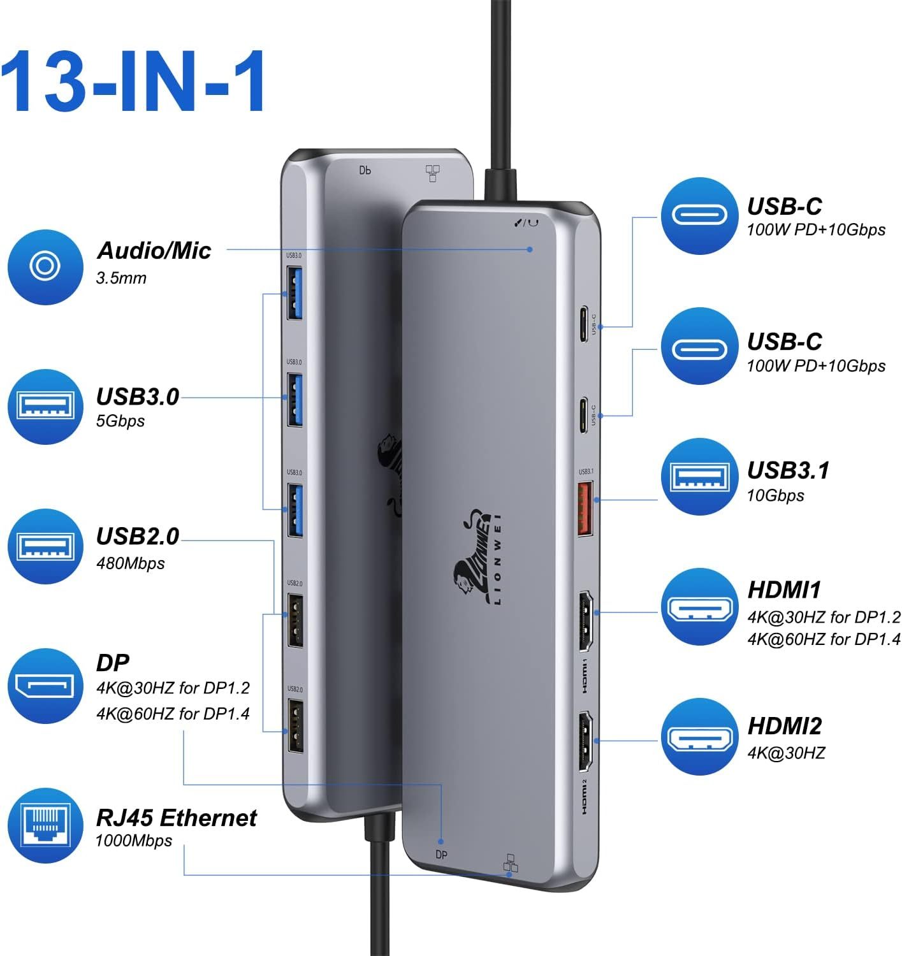
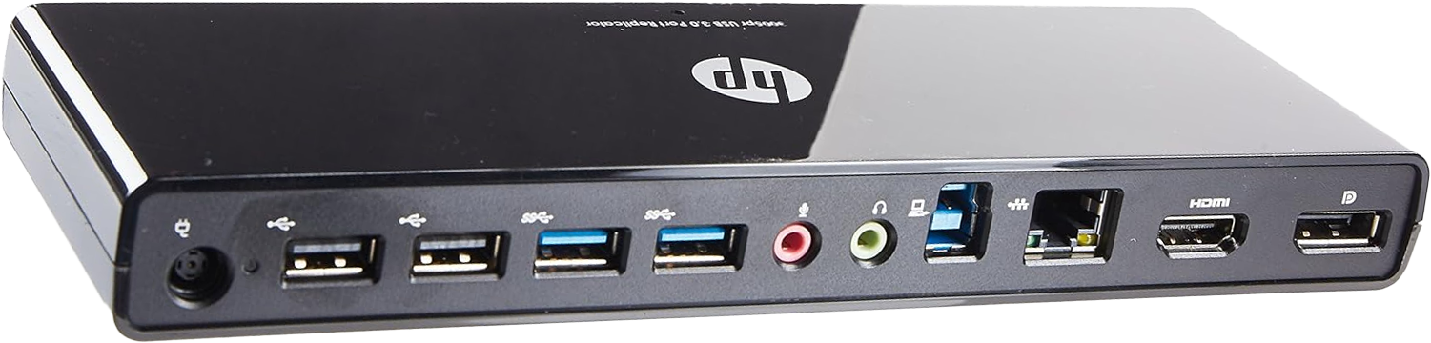
In The Real World
Single USB-C connection
Provides USB/Video/Networking/Audio/Power
Plug in USB-C charger and will charge laptop
USB Port Replicator Docking Station
Modern day port replicators are also docking stations
USB-C docking station
ITFreeTraining.com
Notes:
01:58 In the real world, for not much money, you can purchase a USB-C docking station. In this example, you plug your single USB-C connection into your laptop. The docking station provides USB, Video, Networking, Audio and Power. In order to get power, you need to plug in a USB-C charger which will charge the laptop.
Nowadays, accessories like keyboards, mice and almost everything else use USB. USB is a well-supported standard. In this example USB-C is used; however, there are USB-A options as well. You no longer need the proprietary connection that we used to have. You can also see, due to technology getting better and cheaper, even the most basic devices go above and beyond what a port replicator would do.
This is an example of a device marketed as a USB port replicator docking station. Since it uses USB, it doesn’t depend on the laptop having a specific port type. For instance, if a laptop only has a wireless network adapter, this device can add a wired connection. While this doesn’t fit the traditional definition of a port replicator as it adds features, advancements in technology and decreasing costs have made it harder to find devices that work like the old-style port replicators. That is, only duplicate existing ports and functions. As a result, modern devices marketed as port replicators are really docking stations.
In my opinion, CompTIA should remove port replicators from the course material, as they are no longer particularly relevant. That said, you may still encounter a question about them on the exam.

Slide 5
Exam Tip
Port replicator
Only duplicates existing ports or functions
Does not add anything the laptop does not already do
Docking station
Can add additional ports and functions
In some cases, adds storage and expansion cards
ITFreeTraining.com
Notes:
03:46 If you do get an exam question, despite what the current market is doing, the port replicator for the purpose of the exam only duplicates existing ports or functions. That is, it does not add anything the laptop does not already do.
A docking station can add additional ports and functions. Some docking stations add storage and expansion cards. So, if you see an exam question that requires additional functions or ports the laptop does not have, the answer is most likely a docking station.
Before ending this video, there is one more topic that I want to look at.

Slide 6
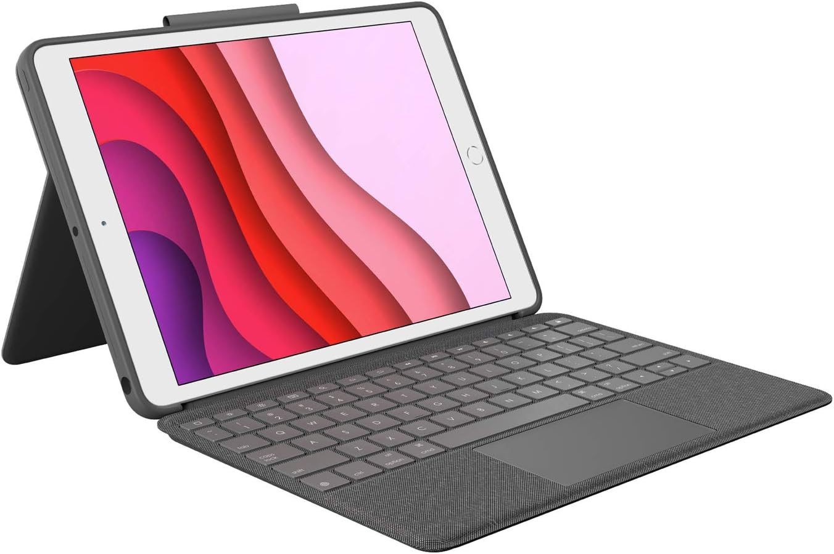
Smartphone And Tablet Docks
Allows a mobile device to be docked like a computer
Can provide keyboard and additional functions
A lot of accessories use Bluetooth nowadays
ITFreeTraining.com
Notes:
04:26 As technology has advanced, smartphones have become increasingly powerful, sometimes even rivalling the processing power of some desktop computers. This has led to the development of smartphone and tablet docks which allow these devices to be used more like a traditional desktop computer.
For example, you can provide keyboard and functions to your device, in this example adding a keyboard to an iPad. In this example a physical connection is used, but nowadays a lot of accessories use Bluetooth to make the connection, rather than a physical connection.
You may also find that your device will plug into an existing docking station. For example, my mobile phone will plug into my laptop's docking station. So, there is an argument you could use your mobile device as a computer. However, you will probably get a result like this.
Keep in mind that mobile devices were designed to be used as mobile devices. Thus, they can be a little tricky to use like a traditional computer. I have found that using the keyboard with a tablet is quite useful. It works well for some applications, like I need to access web applications or write up a document. So it can be useful when you don’t have a computer with you or it is impractical to use a computer. Keep in mind, it is what it is, a mobile device, not a computer so I would not recommend replacing your computer with one.

Slide 7

Subscribe
Next video
Video content: https://ITFreeTraining.com/ap11/8a30
Notes:
05:52 That concludes this video. I hope to see you in other videos from us. Until the next video, thanks for watching.
References
“The Official CompTIA A+ Core Study Guide (Exam 220-1101)” pages 258 to 259
“License CC BY 4.0” https://creativecommons.org/licenses/by/4.0/
“Video: The best 4k Triple Display Dock for Mac and Windows – Dell D600 license under CC BY 3.0” https://www.youtube.com/watch?v=9IuJX-wHxDs
Credits
Trainer: Austin Mason https://ITFreeTraining.com
Voice Talent: HP Lewis http://hplewis.com
Quality Assurance: Brett Batson https://www.pbb-proofreading.uk

