Slide 1
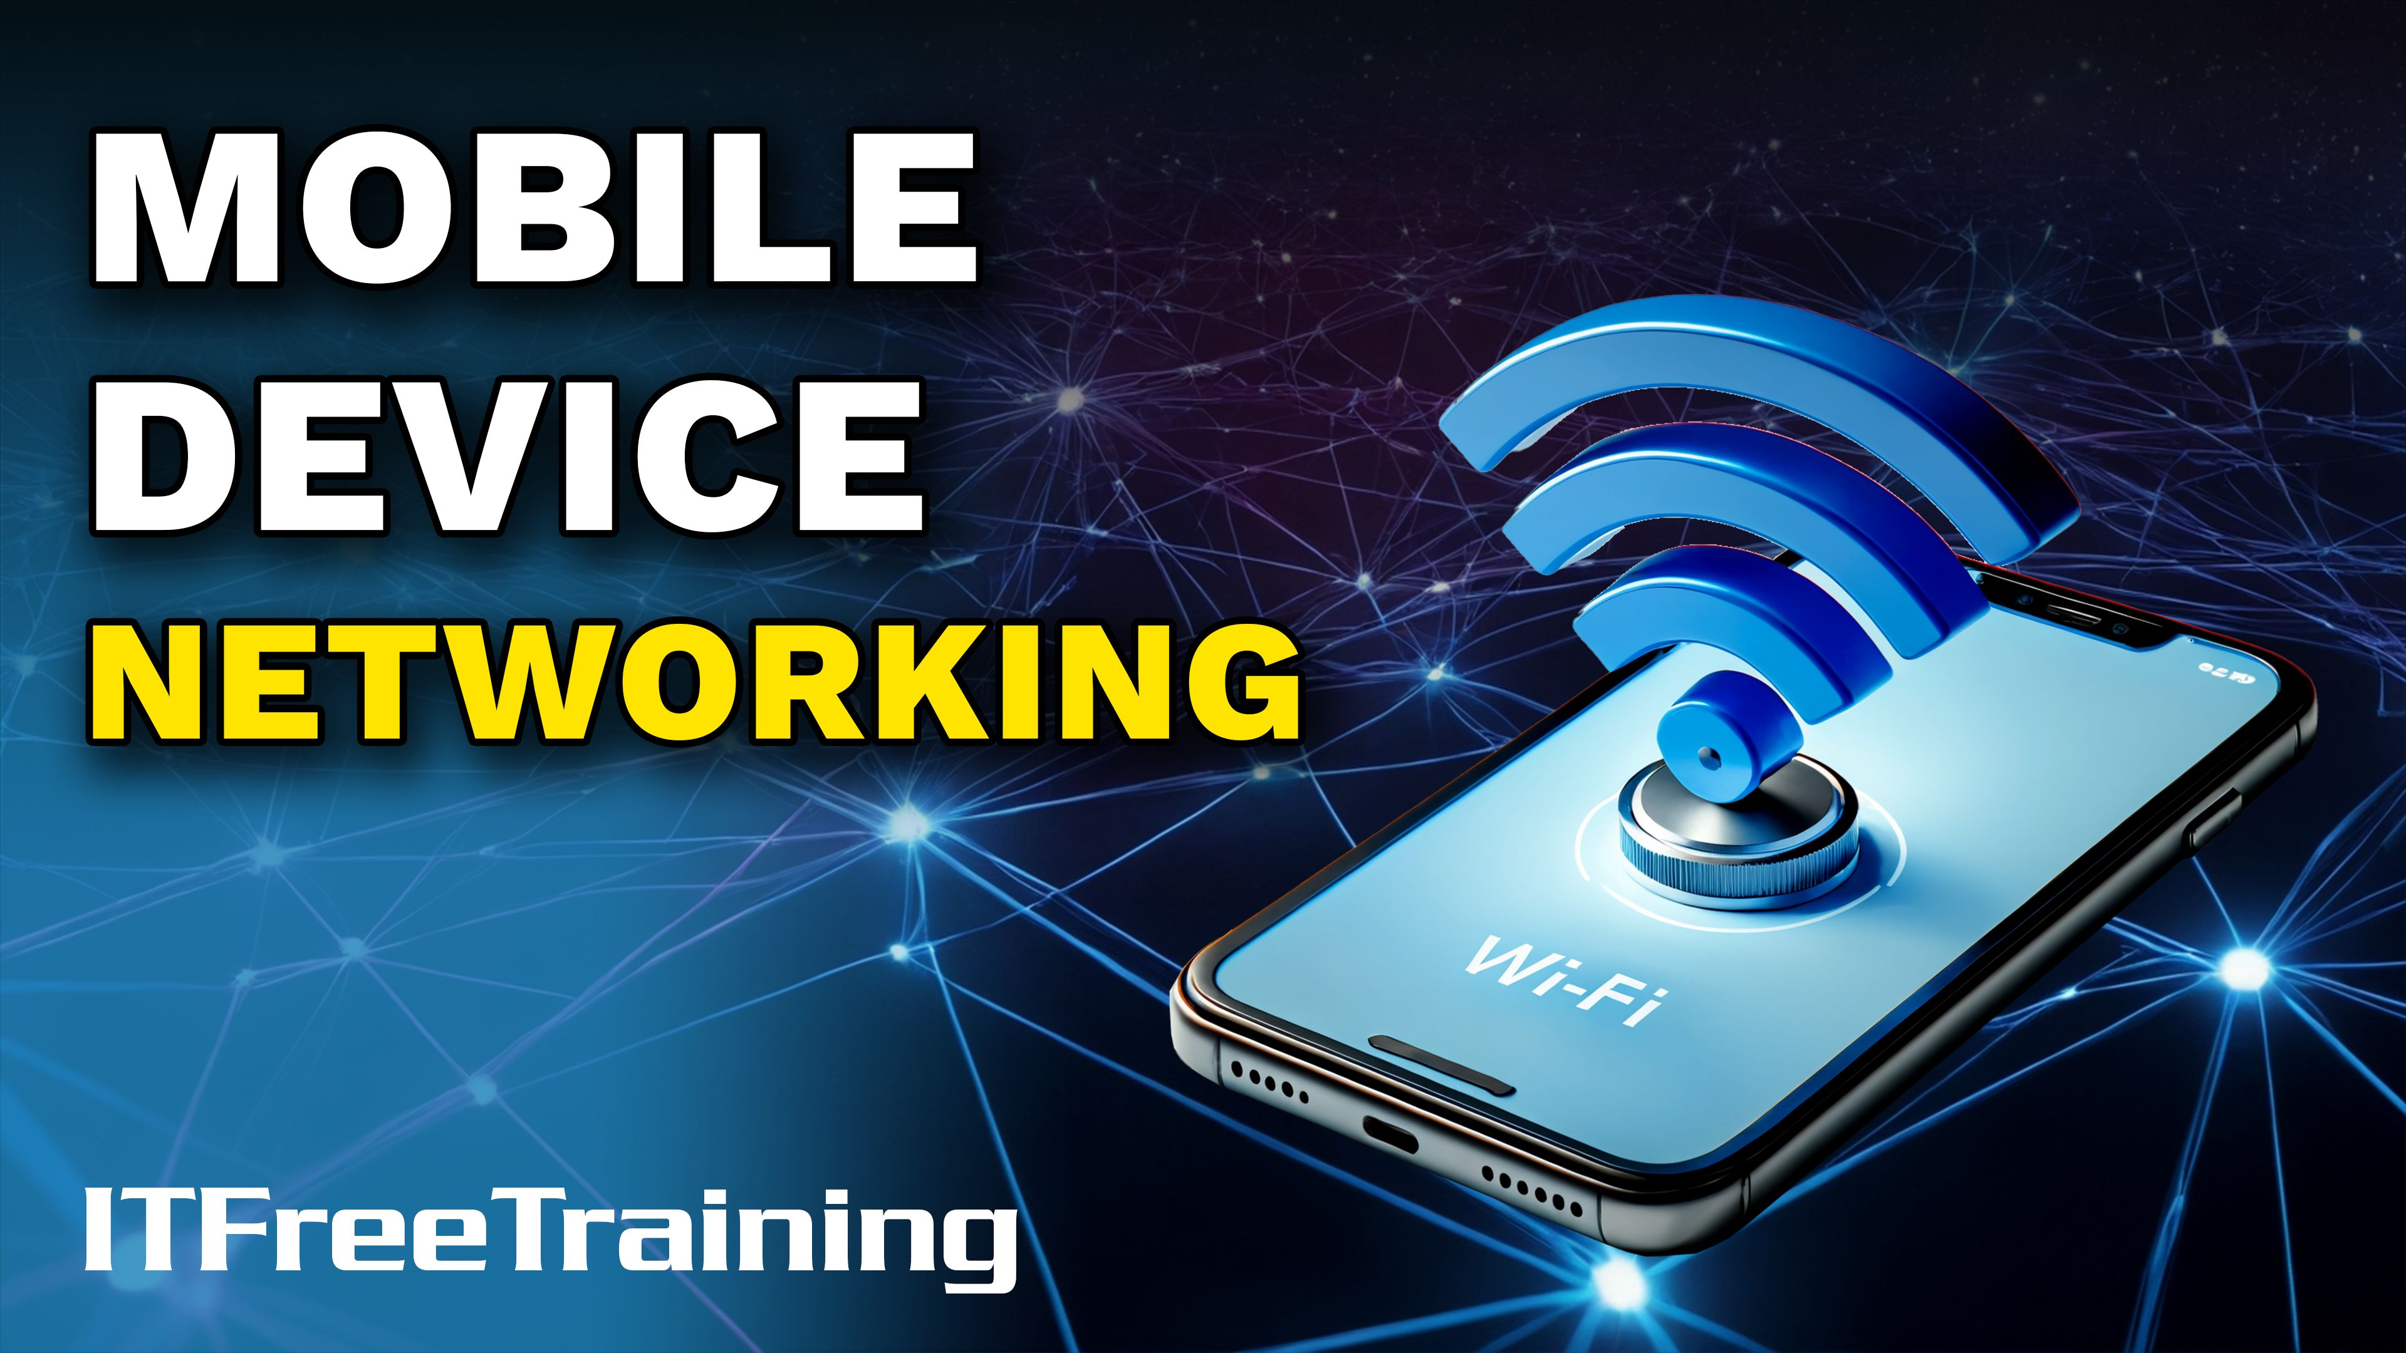


Notes:
Let's take a look at the different ways mobile devices connect to networks and the internet.

Slide 2

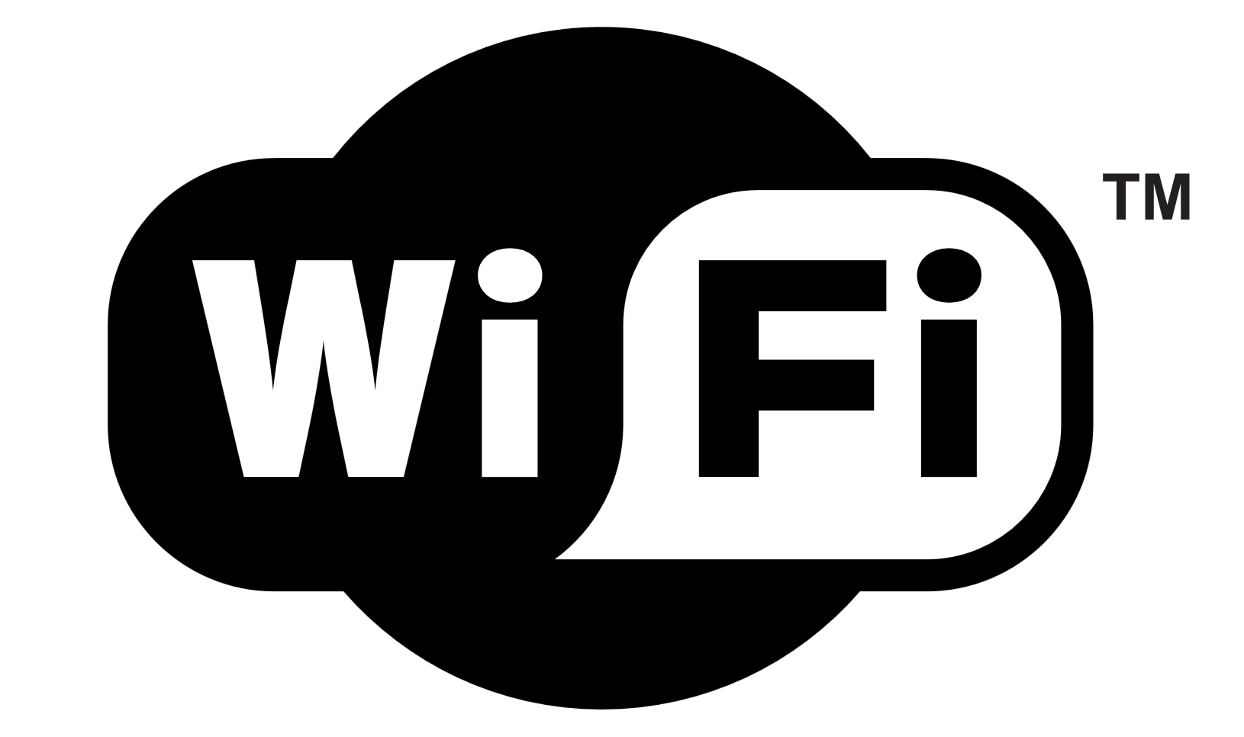
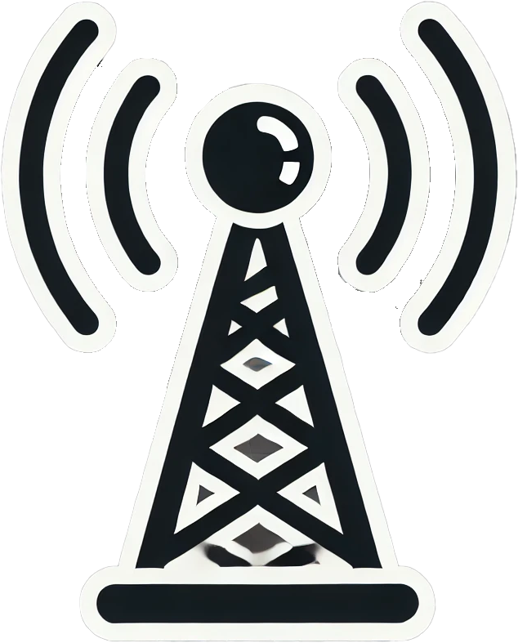


Mobile Device Networking
ITFreeTraining.com
Notes:
00:06 Nowadays, it is pretty common for mobile devices to support Wi-Fi, Bluetooth, and cellular connectivity. It is common for laptops to support Wi-Fi and Bluetooth. It is starting to become more common for laptops to also support cellular connectivity as well.
When connecting to other networks like the internet, generally a mobile device will be configured to connect to Wi-Fi first. Wi-Fi generally is faster than cellular and cellular is more likely to have high costs to use, although not always the case. To start with, I will look at Wi-Fi.

Slide 3
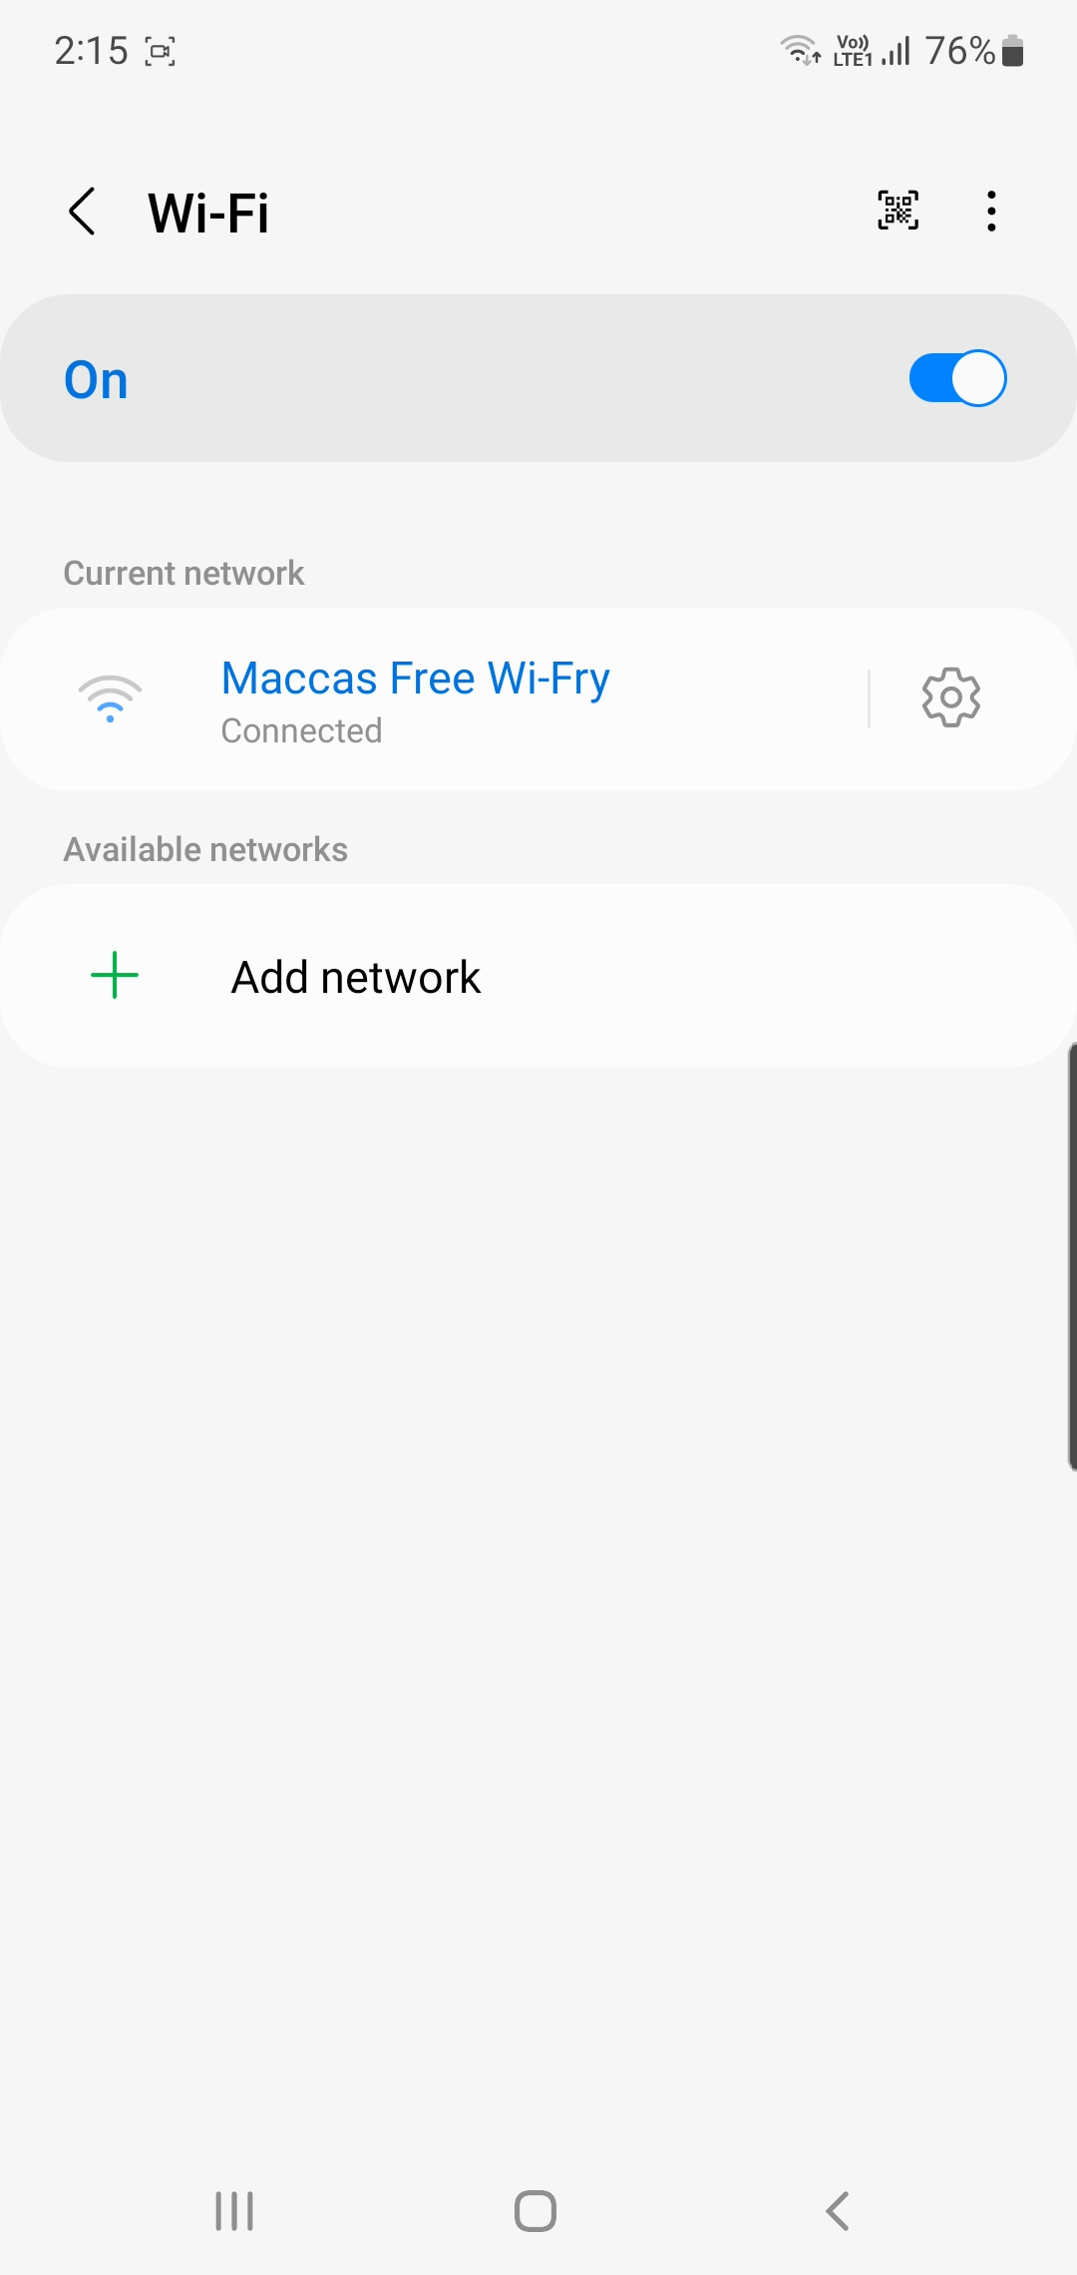
Enabling Wi-Fi
Android
Will connect to previously saved Wi-Fi if available
Wi-Fi may require authentication or agree to terms
Captive portal
Web page displayed before allowing access
Internet problems - open browser to check for captive portal
ITFreeTraining.com
Notes:
00:42 To use Wi-Fi, it needs to be enabled and configured. On Android devices, swipe downwards from the top of the screen. This will display the quick settings panel. In the case of Wi-Fi, press the Wi-Fi icon to enable Wi-Fi.
Once enabled, the mobile device will search for networks it has previously saved that are in range. In this case it has found one network which I will select. If the Wi-Fi network requires a username and password, you will be prompted for one. However, this network requires the user to agree to the terms and conditions before it can be used. You will notice the message at the top of the screen, when I select it, it will open the web browser.
This is called a captive portal. A captive portal is web page that is displayed before allowing access. It is displayed to users when they first connect to a public Wi-Fi network. Before granting access to the internet, the captive portal often requires the user to complete an action, such as agreeing to terms of service, entering login credentials, or providing payment. In this example, I am required to agree to the terms and conditions before I can use the Wi-Fi to access the internet. Once I accept the terms of use I will be able to use the Wi-Fi to access the internet.
Captive portals are commonly used in places like hotels, airports, cafes, and other public spaces to control access to Wi-Fi networks. Technically, the captive portal works by intercepting all network traffic and redirecting it to a local web page where users must authenticate or complete the required task. Only after successful interaction with the portal does the user gain full internet access.
Captive portals will often expire after a certain amount of time. If you find your connection is not working, open a web browser and check to make sure it is not displaying the captive portal. If it is, you will need to go through the captive portal process again before being able to access the internet.
Modern devices are pretty good at detecting captive portals and should prompt you when you first connect. If you are not getting prompted, you can open an internet browser at any time to access the captive portal.
In some cases, you may want to change the Wi-Fi point that you are connected to. To do this, I will open settings.
In settings, I will select connections. At the top, you can see the Wi-Fi point that I am currently connected to. To change the Wi-Fi access point, I just need to select Wi-Fi at the top. From here, I can change the Wi-Fi point or disable Wi-Fi.
If the Wi-Fi is malfunctioning, the internet will stop working, but your device will remain connected to the Wi-Fi even if a cellular network is available. The Wi-Fi may stop due to an outage or if it has a data cap you may have reached the data cap preventing it from working. Modern devices are pretty good at detecting whether a captive portal is blocking the device and changing connections as required. If this does not occur, you can either forget the Wi-Fi connection preventing the device from automatically reconnecting to it or force the device onto a cellular network.

Slide 4
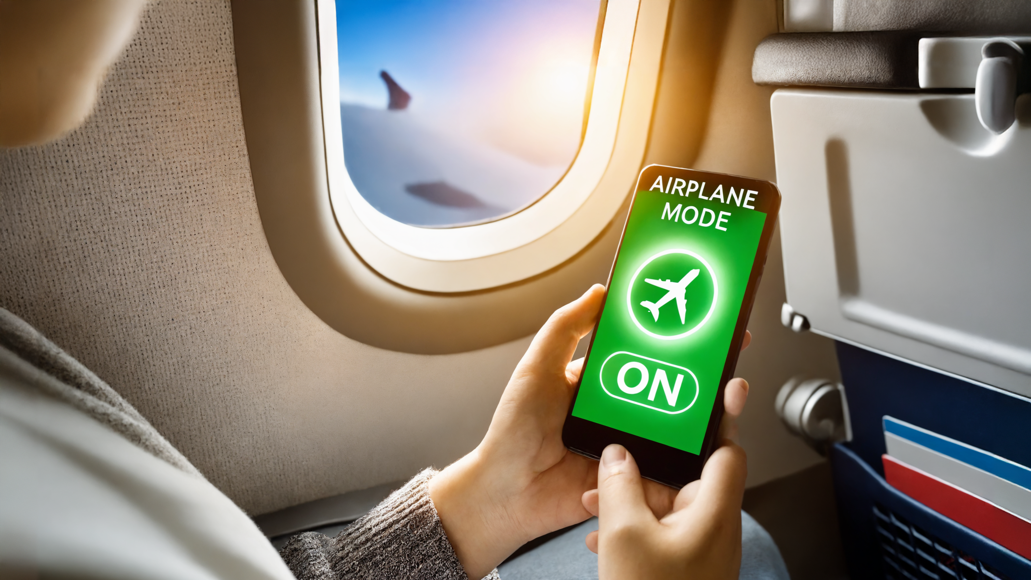

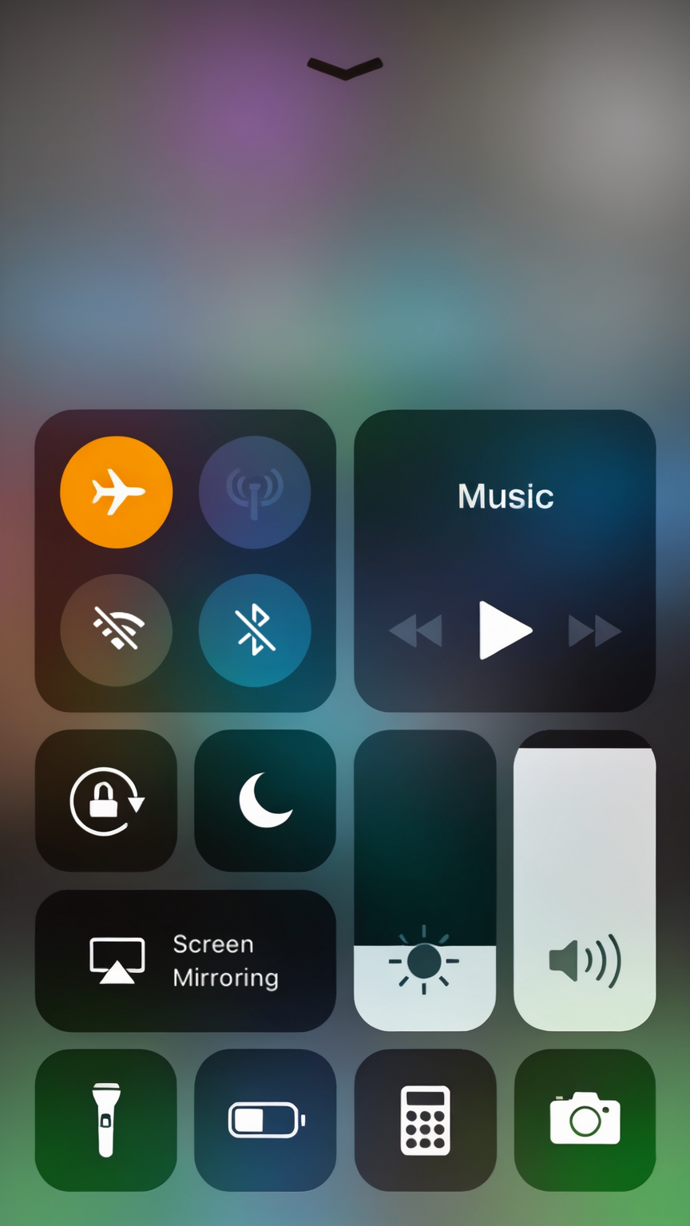
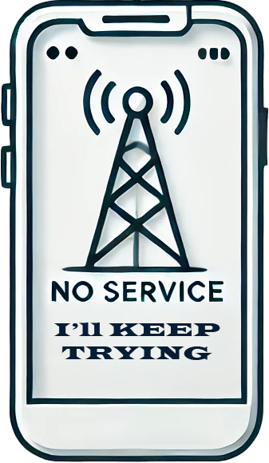
Airplane Mode
Disables wireless communication
Cellular data, Wi-Fi, GPS and Bluetooth
Also reduces power as cellular will keep attempting to connect to the network
New devices
Can enable Wi-Fi and Bluetooth
Some devices may still be able to receive radio
ITFreeTraining.com
Notes:
03:58 When flying, the use of radio-based devices is generally prohibited to prevent interference with airplane systems. To avoid powering devices off completely, most have an airplane mode option.
When you enable airplane mode on your device, this disables wireless communication on the device. This includes cellular data, Wi-Fi, GPS, and Bluetooth. Newer devices when in airplane mode allow you to enable Wi-Fi and Bluetooth.
In the early days of air travel, all wireless signals had to be turned off during flights. Nowadays, many airlines have relaxed these restrictions, allowing passengers to use Wi-Fi and Bluetooth. However, this still depends on each airline's individual policies. The requirements may be more stricter during take-off and landing.
There is another reason that you may want to use airplane mode, even if the airplane company does not require it. Airplane mode reduces power use as it keeps radio related features like cellular disabled. When in-flight, your mobile device will continuously try to connect to a cell tower, even though it’s too high to succeed. This constant searching drains the battery quickly. So when on an airplane even if the airline does not require it, it is a good idea to enable airplane mode.
I once switched my phone to airplane mode at a large event with approximately 100 thousand people because the cellular network was so congested that my phone constantly tried reconnecting, quickly draining the battery. Since free Wi-Fi was available, enabling airplane mode and connecting to Wi-Fi helped preserve my battery life. Although the cellular network remained overloaded, I still had internet access.
Some devices may still be able to receive some radio communication even when it is in Airplane mode. For example, some satellite devices may still keep receiving while in airplane mode. However, your features are very limited when you can only receive and not send.

Slide 5
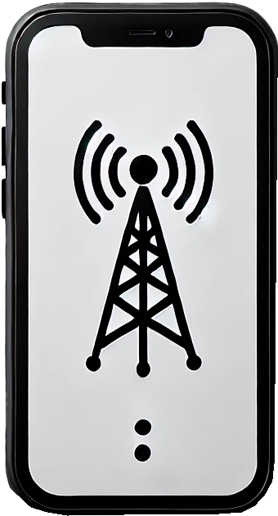
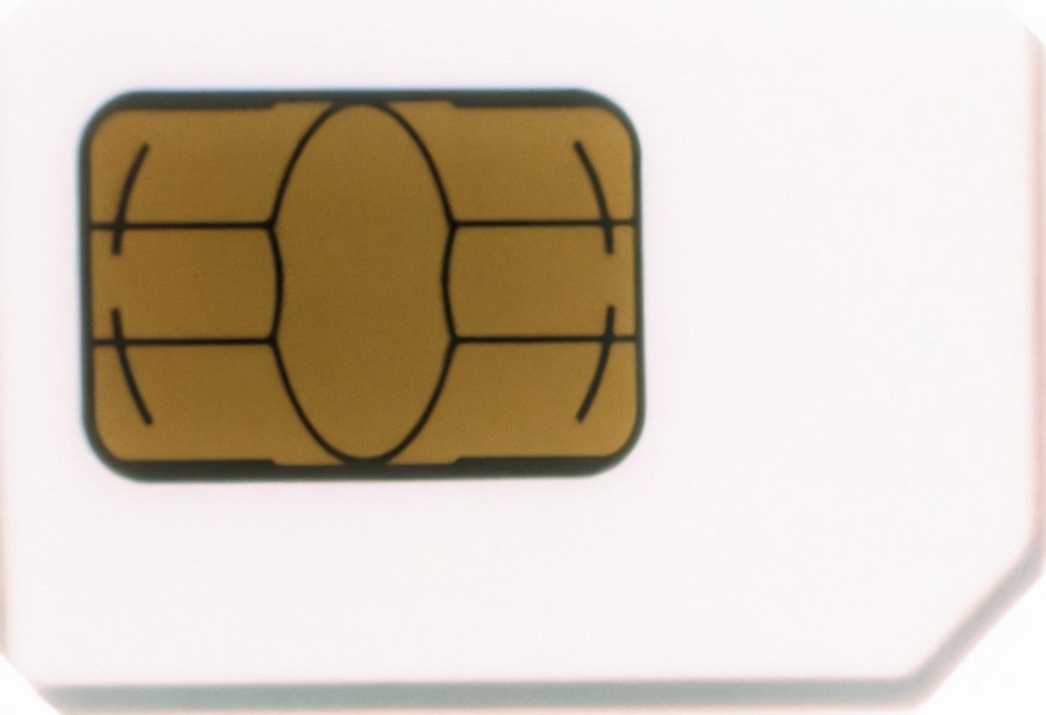

Cellular Networking
2G
3G
4G
5G
GSM
GSM
4G (Data Only)
CDMA
CDMA
Voice calls
50-400 kb/s
3 Mb/s
20-90 Mb/s
50- 300 Mb/s
Older mobile phones may not support VoLTE and will drop to 3G or 2G for voice calls
ITFreeTraining.com
Notes:
06:02 Shown here are the different network standards for mobile devices. These have a number followed by G for generation. Each generation increases the data transfer speed. Your mobile phone supports a specific generation and is backward compatible with earlier generations
Your mobile phone will automatically connect to the highest generation it can. With 4G mobile phones, it is important to understand that not all mobile phones support voice over LTE. If the mobile phone does not support this technology, it will drop to 3G or 2G to make voice calls. Modern mobile phones should support it, however.
What happened is that 4G originally did not have an agreed upon standard for voice calls. Eventually voice over LTE became the standard. If you purchase a mobile phone on the current market, it will probably support 4G over LTE. Older phones may not.
In some places in the world they are switching off networks below 4G. If this occurs, mobile phones that do not support 4G over LTE will not be able to make voice calls. In some cases, the phone provider may offer an application that allows voice calls over data, but there is no guarantee it will be available or compatible with your device.

Slide 6
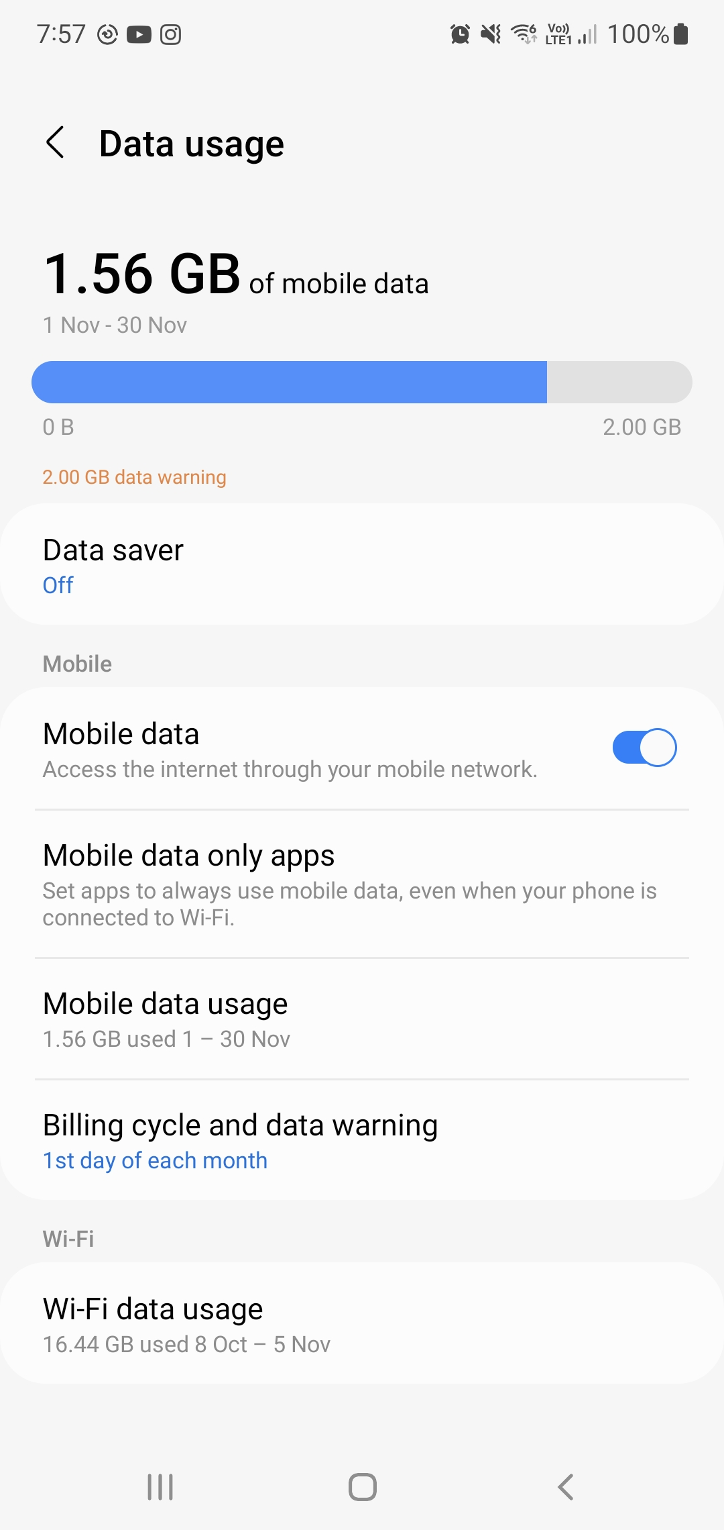
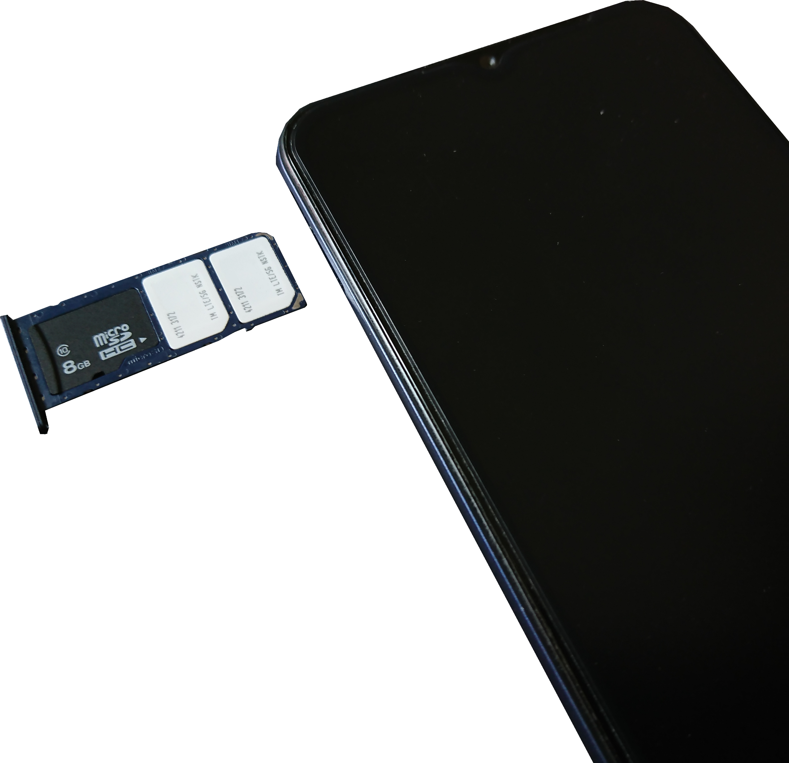
Enabling and Disabling Cellular Data
Data connection can be enabled/disabled
May have additional options like data quotas
Some devices have dual SIM cards or eSIM
Can configure each for phone/data or both
ITFreeTraining.com
Notes:
07:23 Your device will have the option to enable or disable cellular data. That is, using the cellular network to access the internet. Depending on your needs, you may want to change this setting. For example, if data is expensive and you want to only use Wi-Fi.
Some devices may have additional options like quotas. Depending on options, it may give you warning when you go over a certain amount of data usage or disable the data connection. Some devices have dual SIM cards or support eSIMs. eSIMs do not require a physical SIM card to be put into the device.
Multiple SIM card devices can be configured so each SIM card can be configured with phone or data or both. So, you could have a mobile device which uses two phone numbers. Or you could have one phone number on one SIM card and the other SIM card used for data. Your choice will be determined by your circumstances.

Slide 7
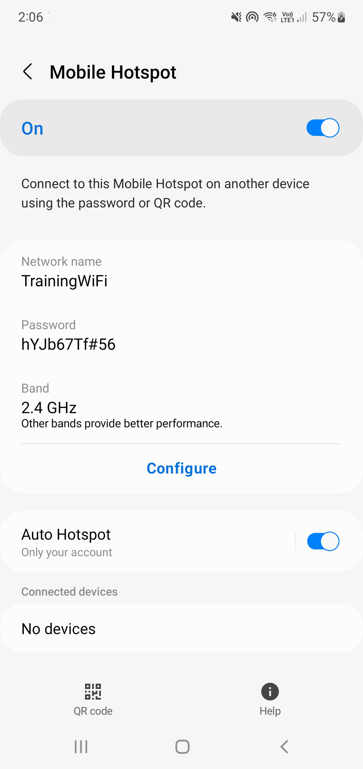
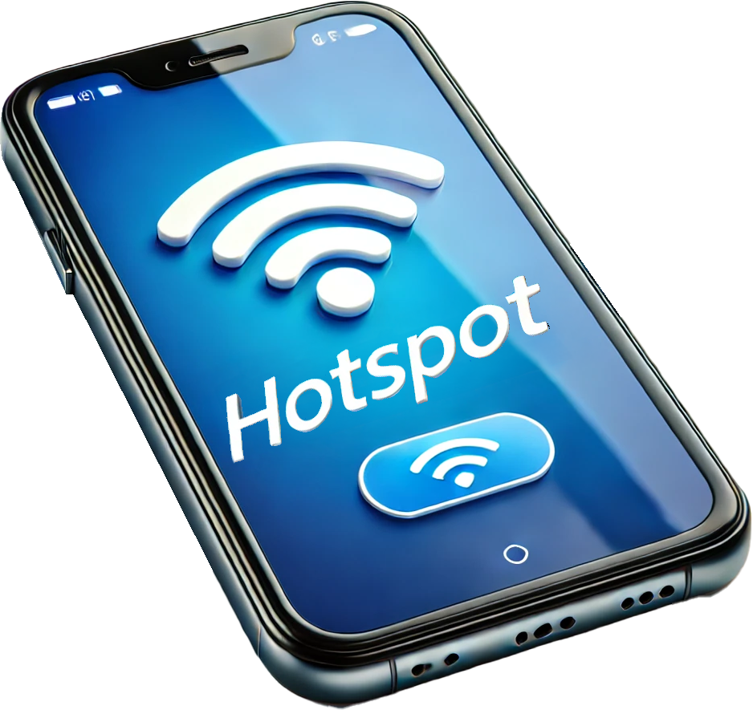
Hotspots
Allows data connection to be shared by Wi-Fi
Works just like a regular Wi-Fi access point
Uses a lot more power (Estimated 10-15% more)
ITFreeTraining.com
Notes:
08:22 Your device may also be able to act as a hotspot. This allows the device to share its data connection over Wi-Fi. This works just like a regular Wi-Fi access point. You just need to configure it on the device just like you would an access point and connect to it just like a Wi-Fi access point.
If you set up a hot spot, keep in mind that it uses a lot more power. Depending on the number of devices connecting to it and other settings it may use 10 to 15 percent or more power than normal. This will deplete the battery on the mobile device a lot faster than usual. So, if you are using a hot spot, you may want to consider connecting it to a power supply.

Slide 8
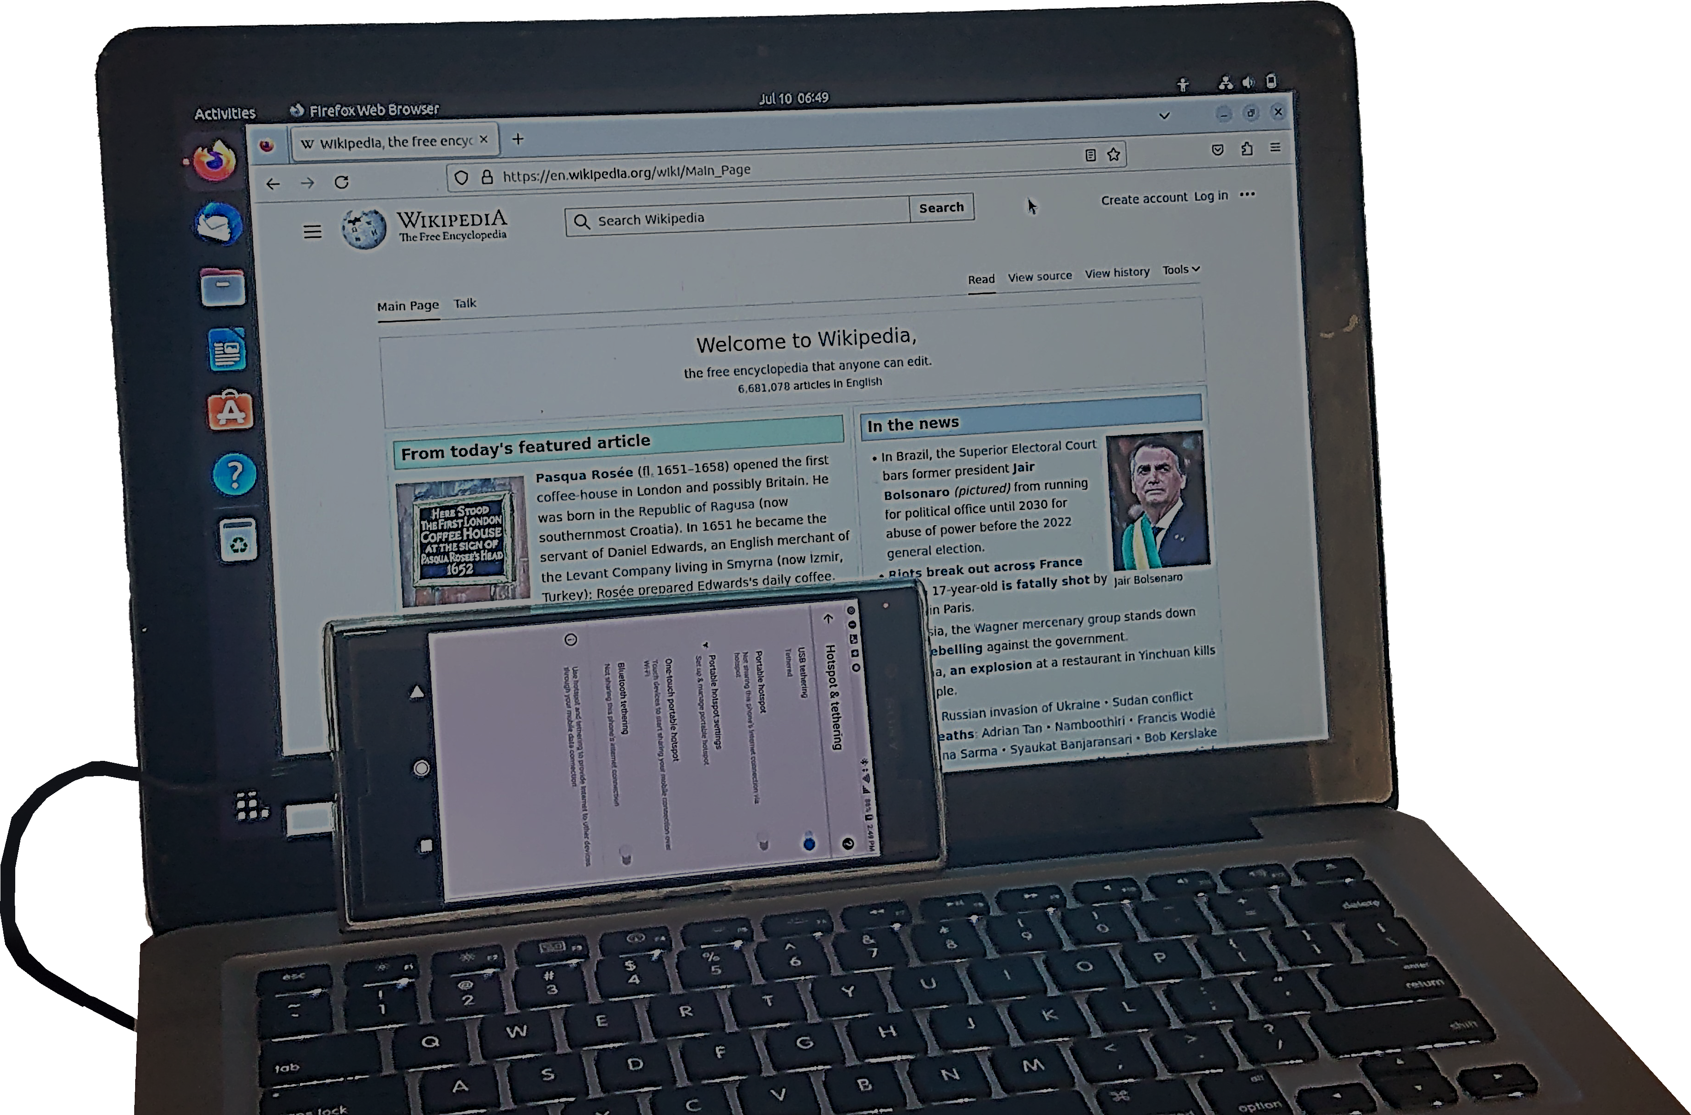
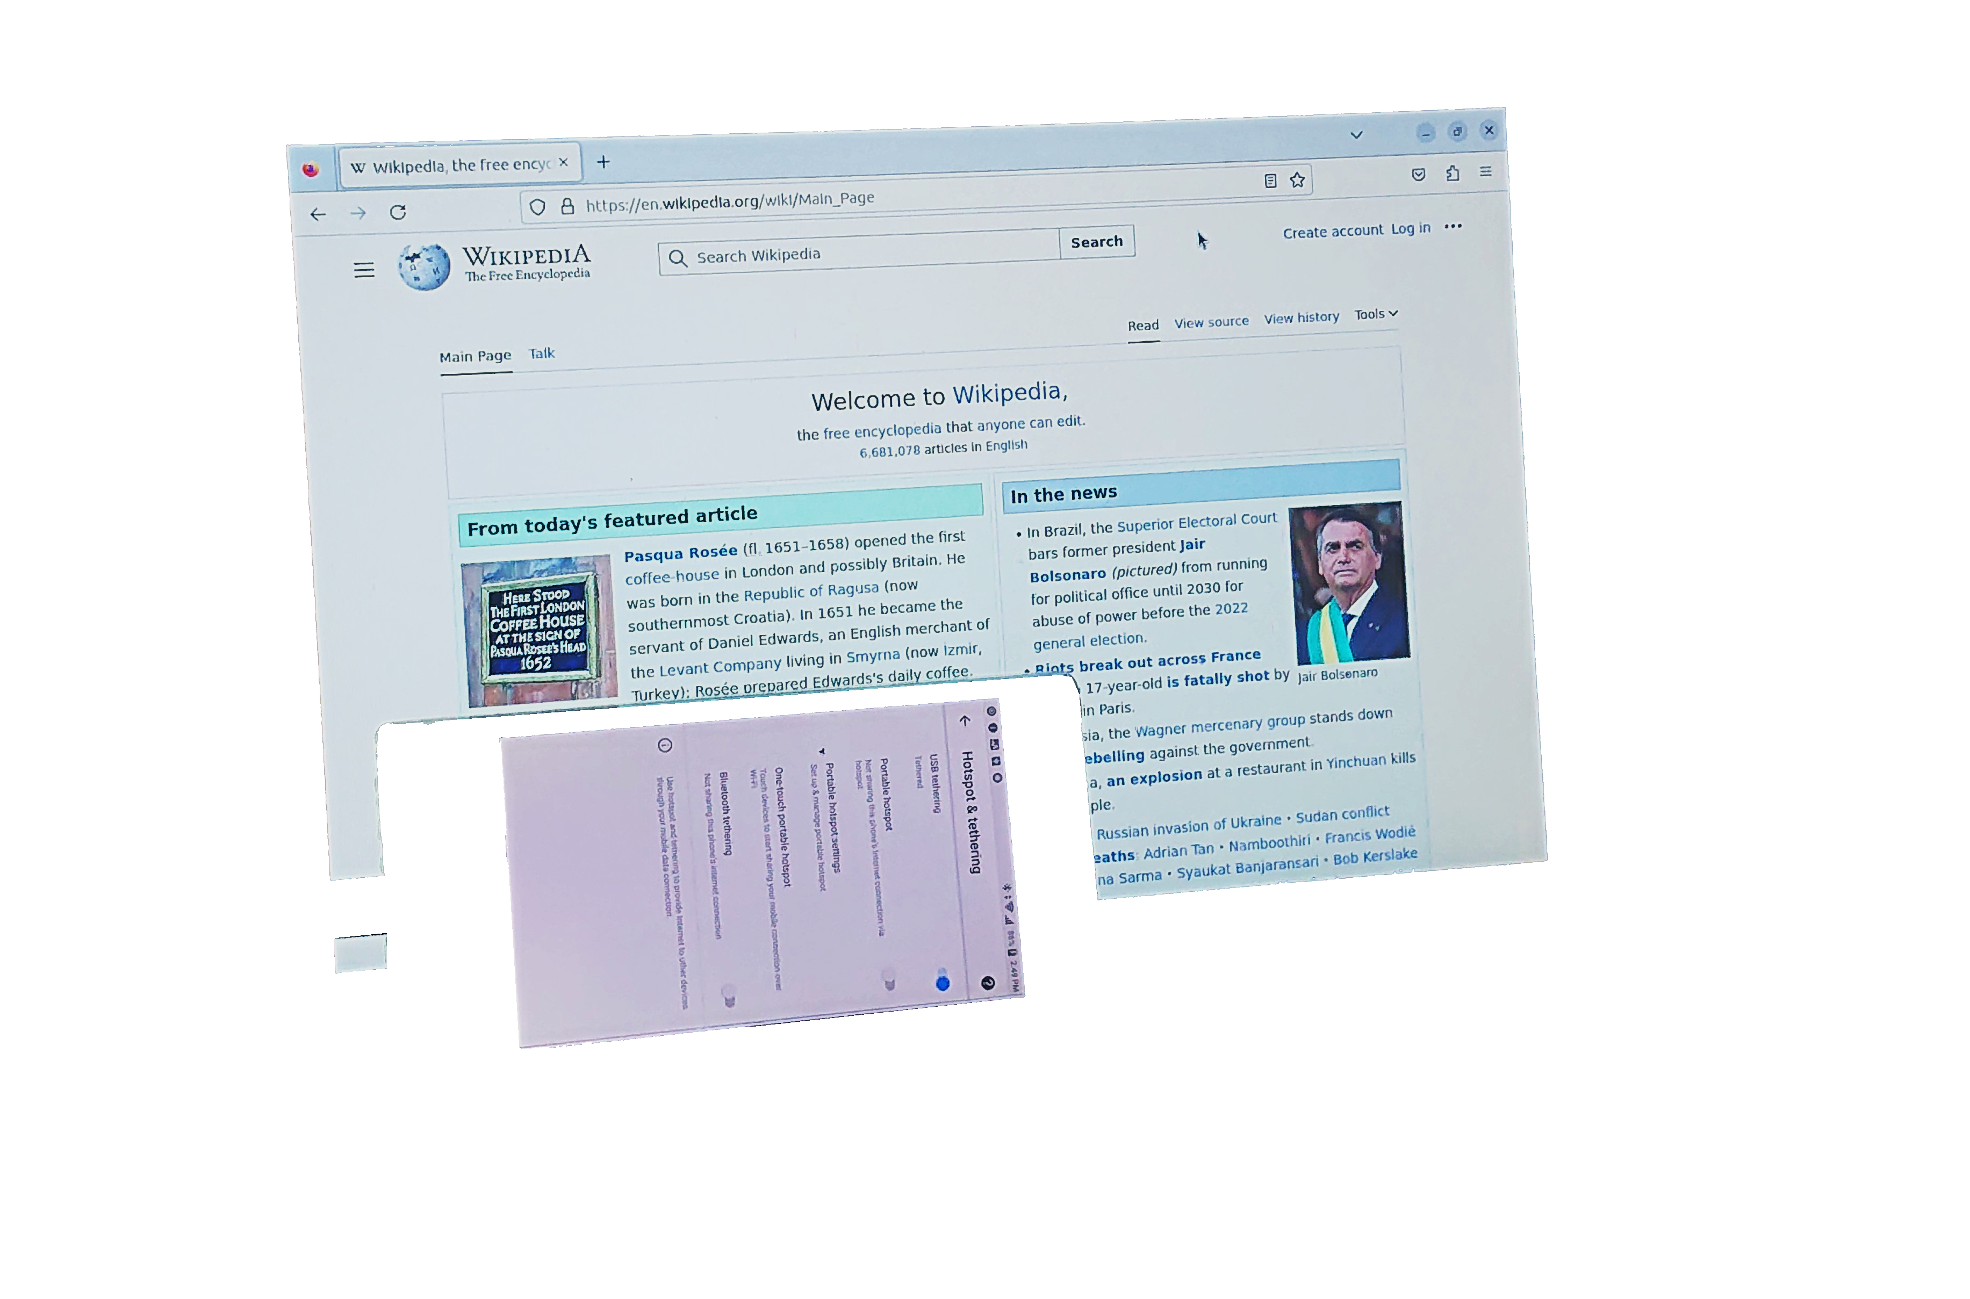
USB Tethering
Connects a computer via USB to a mobile device
Allows the computer to use the mobile device’s cellular connection
ITFreeTraining.com
Notes:
09:02 Another option is to use USB tethering. This is when a USB cable is connected from the device to the computer. This allows the computer to use the mobile device’s cellular connection via the USB cable. The advantage of this method is that it uses a lot less power than Wi-Fi.
The computer should automatically detect the connection, so once it is plugged in and enabled, you should have access to the internet using the mobile device.

Slide 9

Subscribe
Next video
Video content: https://ITFreeTraining.com/ap11/8a20
Notes:
09:30 That concludes this video on mobile device networking. I hope you have found this video helpful. Until the next video, I would like to thank you for watching.
References
“The Official CompTIA A+ Core Study Guide (Exam 220-1101)” pages 249 to 256
“License CC BY 4.0” https://creativecommons.org/licenses/by/4.0/
“Picture: Bluetooth logo” https://commons.wikimedia.org/wiki/File:Bluetooth_logo_(2016).svg
“Picture: Wi Fi logo” https://commons.wikimedia.org/wiki/File:WiFi_Logo.svg
“Picture: Airplane logo” https://upload.wikimedia.org/wikipedia/commons/0/01/Airplane_mode.svg
“Picture: SIM card” https://commons.wikimedia.org/wiki/File:Tf_sim_both_sides.png
“Picture: Dual SIM cards” https://en.wikipedia.org/wiki/Dual_SIM#/media/File:Dual_SIM_on_modern_smartphone.png
“Picture: USB Tethering” https://en.wikipedia.org/wiki/Tethering#/media/File:Phone_tethering_on_laptop.jpg
Credits
Trainer: Austin Mason https://ITFreeTraining.com
Voice Talent: HP Lewis http://hplewis.com
Quality Assurance: Brett Batson https://www.pbb-proofreading.uk

