Slide 1
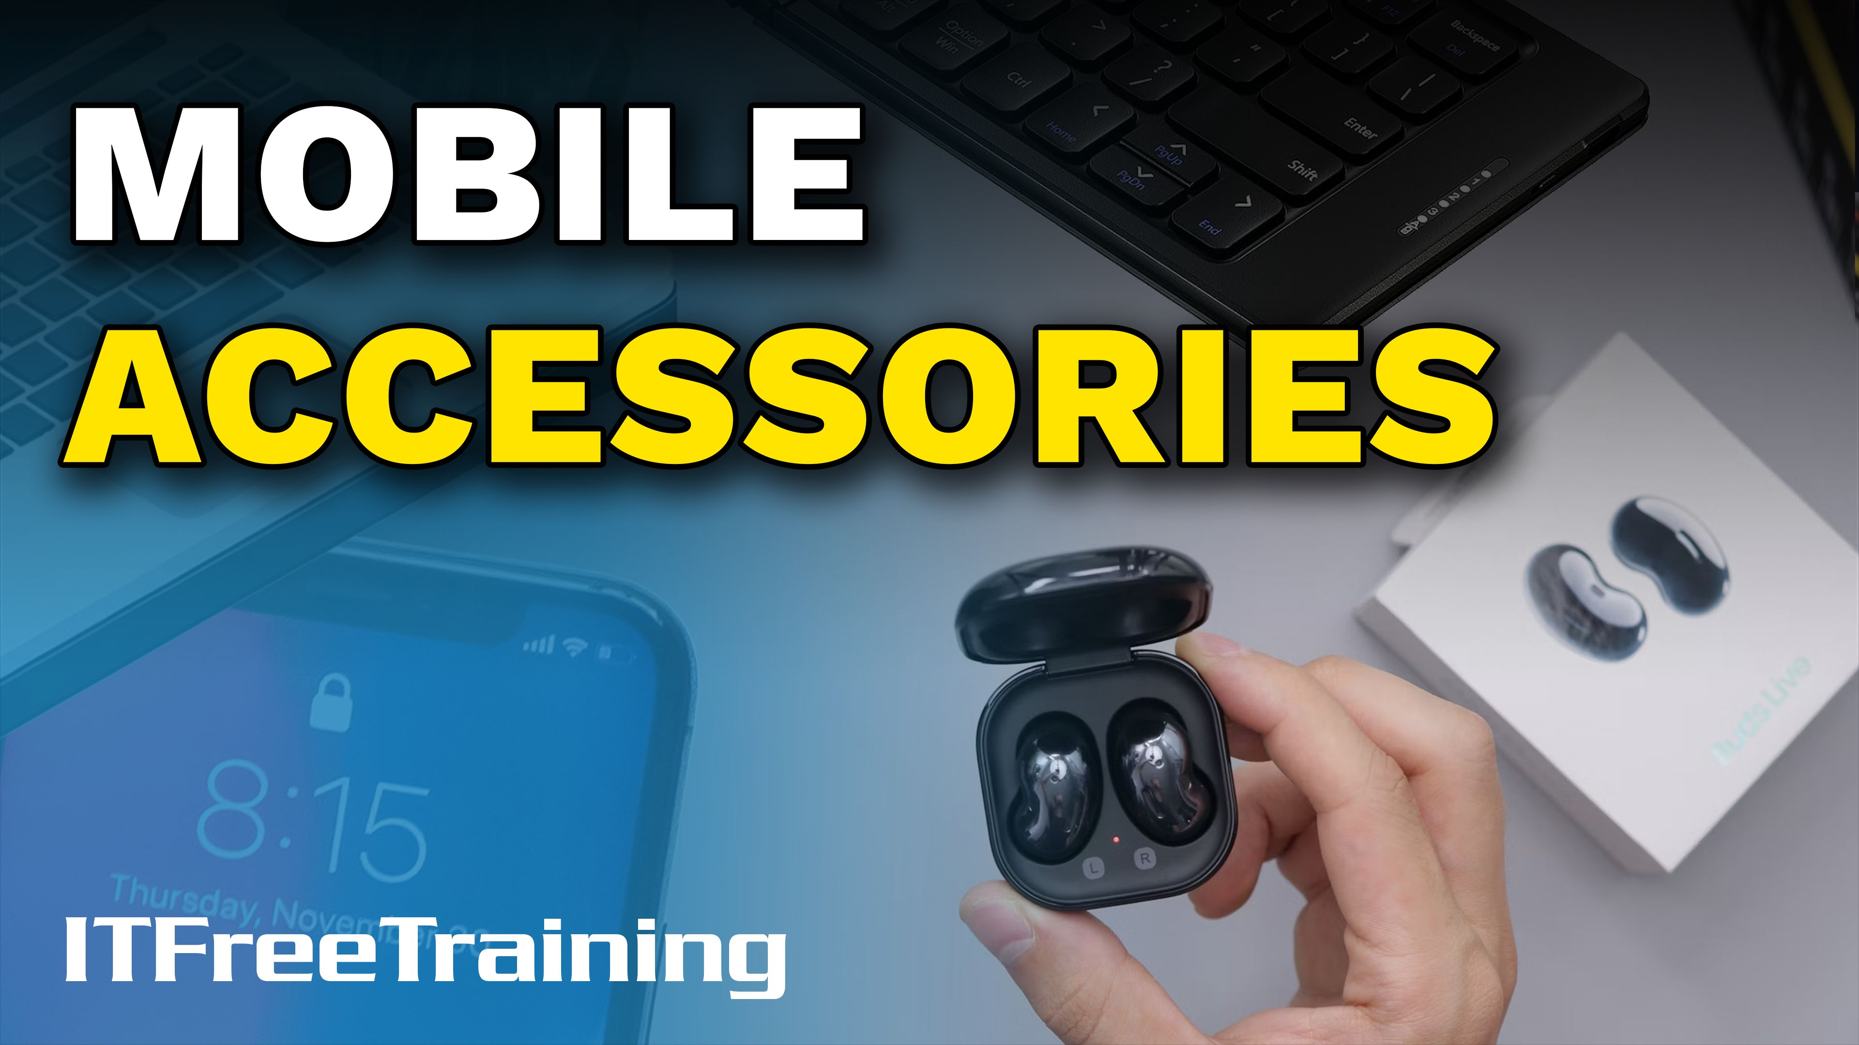


Notes:
Let’s have a look at mobile device accessories.

Slide 2

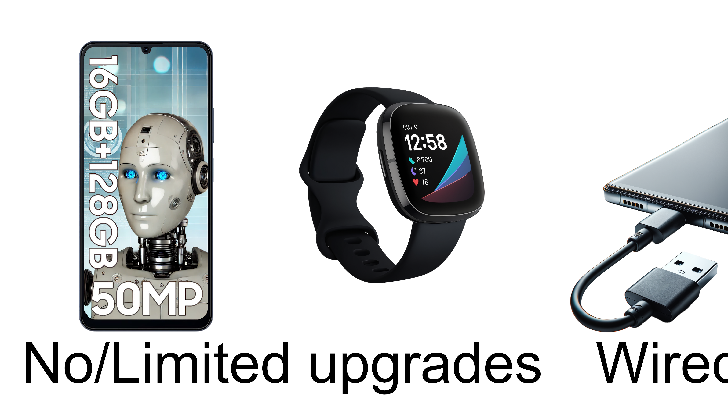
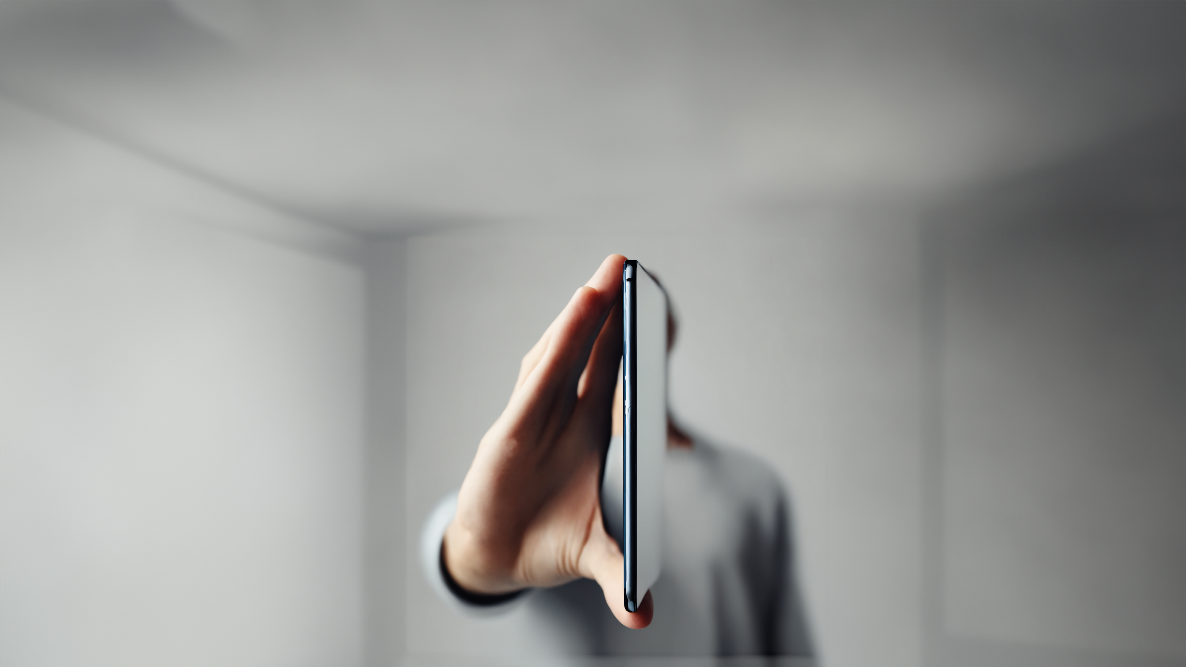
Why They Exist?
Bridges the gap between user needs and limitations
As devices become smaller and slimmer they lose functions. E.g., headphone jacks
Device accessories add the additional features that were lost plus add more features
ITFreeTraining.com
Notes:
00:05 Modern mobile devices typically offer no or very limited upgrade options. If you are fortunate, you might be able to expand storage with a larger SD card, but that's about it. Because of this, most devices depend on a single wired data connection or wireless method for communication. Accessories range from practical additions like keyboards for ease of use, to functional extras like external cameras and protective cases. There are also more unusual options, such as an umbrella attachment to reduce glare while using the device outdoors. Nowadays, there is no limit to how many different types of accessories you can get for your device.
So why do mobile device accessories exist? They bridge the gap between user needs and limitations of the device. As devices become smaller, they typically lose features and functions because there is limited space available for components, reducing their overall capability. Modern devices use special adhesives to hold the parts together which are heated together. This protects the device’s internal components making them more resistant to water and dust. This also means the device is sealed so you will not be able to open it.
Device accessories add the additional features that were lost plus more features. Once you have your device accessory, next is a matter of connecting it.

Slide 3
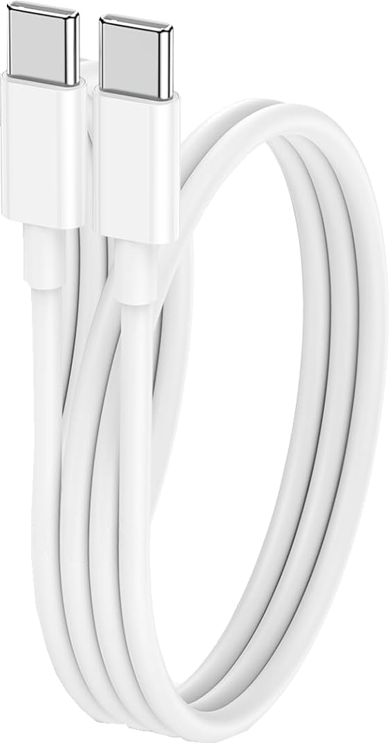
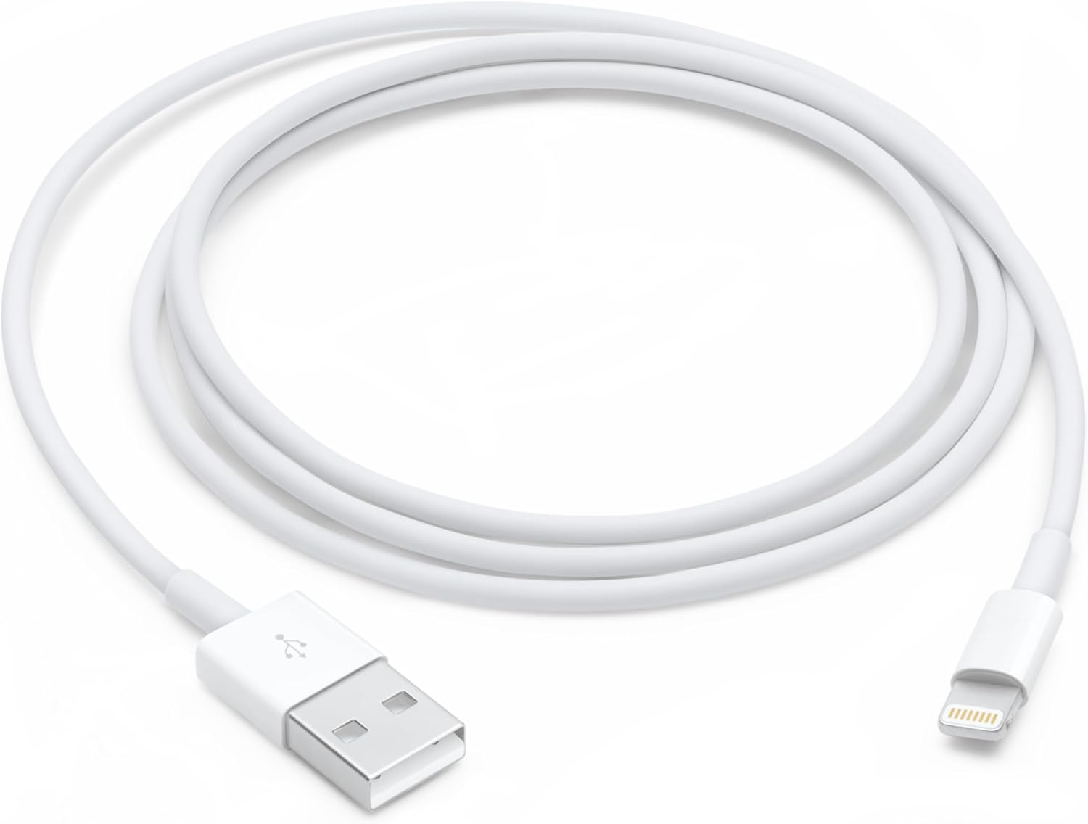
Wired Connections
USB-C
Lightning cable
Becoming the standard
Used with Apple devices
Apple moving to USB-C
ITFreeTraining.com
Notes:
01:32 For wired connections, USB-C is becoming the standard. It is used on most modern new devices. The lightning cable is traditionally used with Apple devices. However, Apple is starting to move towards USB-C.
The decision for Apple to adopt USB-C is most likely due to the European Union decisions to standardize on USB-C for all devices. This regulation aims to reduce electronic waste and increase consumer convenience, by allowing a single charger for multiple devices. This also allows standardizing charging ports across the electronics industry. It could be argued in the short term that it may create more waste, as a lot of device accessories will become obsolete, but in the long term should reduce waste. If you have an old accessory that requires a particular connection, you can always get an adapter.
There is not much to know about wired connections. Make sure you have the right cable and plug it in. Your device may not be compatible with all devices on the market, but you won’t break anything if you give it a try; it simply will not work.

Slide 4
Wi-Fi
Higher Wi-Fi generations support higher speeds
Wi-Fi 5 I would consider as the minimum for devices that need speed
Generation | IEEE Standard | Maximum Speed | Frequency | Year
Wi-Fi 7 | 802.11be | 46Gbps | 2.4, 5, 6 GHz | 2024
Wi-Fi 6 | 802.11ax | 9Gbps | 2.4, 5, 6 GHz | 2019/2020
Wi-Fi 5 | 802.11ac | 6Gbps | 5 GHz | 2014
Wi-Fi 4 | 802.11n | 600Mbps | 2.4, 5 GHz | 2008
** Wi-Fi 3 | 802.11g | 54Mbps | 2.4 GHz | 2003
** Wi-Fi 2 | 802.11a | 54Mbps | 5 GHz | 1999
** Wi-Fi 1 | 802.11b | 11Mbps | 2.4 GHz | 1999
ITFreeTraining.com
Notes:
02:40 Many devices use Wi-Fi to connect. Shown here are the different Wi-Fi standards. Higher Wi-Fi generations support higher speeds. Wi-Fi 5 I would consider the minimum for devices that need speed.
Although Wi-Fi 5 was released in 2014, there are still some Wi-Fi 4 devices on the market. For low-speed devices like headphones, it is not really a problem. If you are planning to do file transfers or watch high resolution video, you probably want at least Wi-Fi 5, otherwise your device will be sluggish.
A few years ago, we purchased a 4K video camera and have been using the USB-C connection for file transfers. However, the camera’s USB-C port is now slightly damaged and unreliable, so we attempted to use the Wi-Fi feature instead. Unfortunately, despite being an expensive model, the camera only supports Wi-Fi 4, making 4K video transfers painfully slow. As a result, we now remove the memory card and use a USB card reader for faster transfers. In hindsight, we wish we had purchased a camera with at least Wi-Fi 5 at the time of purchase.

Slide 5
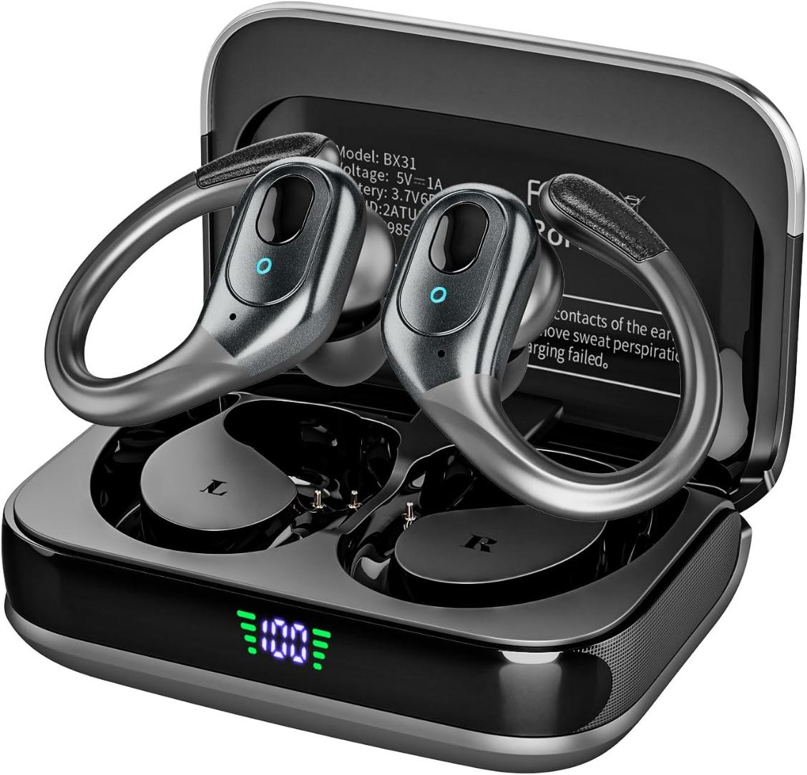
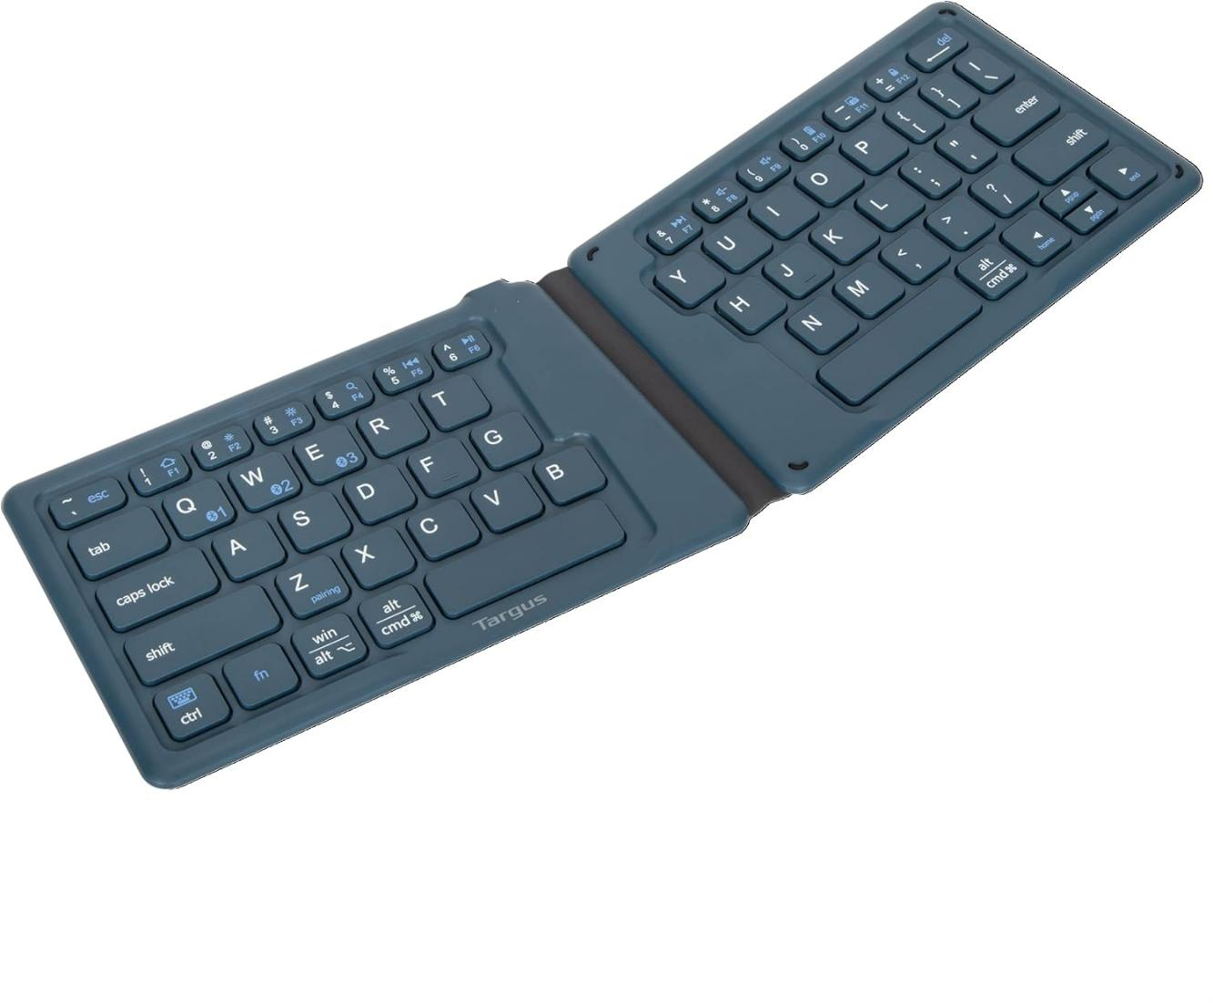
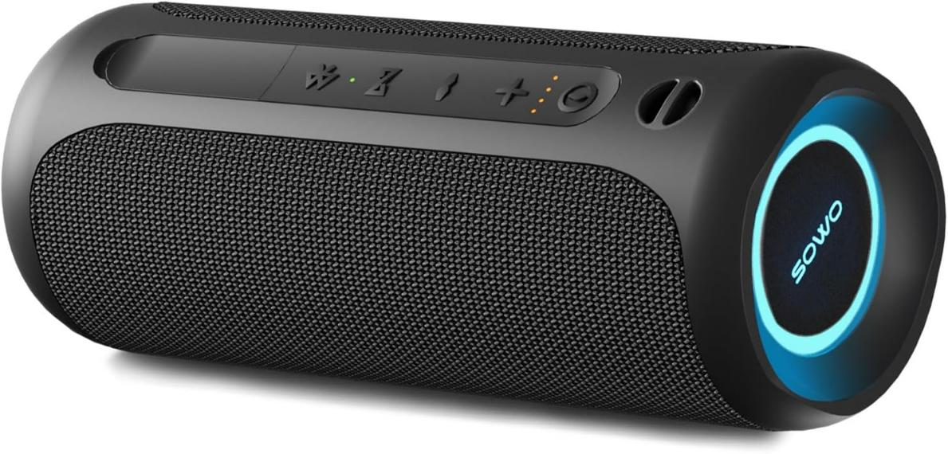
Bluetooth
Bluetooth version 5 released in 2016
Modern devices should support version 5
Some incremental versions released since then E.g., 5.1 – 5.4 (No speed increase)
ITFreeTraining.com
Notes:
03:52 Bluetooth has been around for over 20 years, making it a well-established and mature technology. Version 5, released in 2016, was rapidly adopted and is now supported by most modern devices. While there have been several incremental updates since then, these versions primarily focus on improvements like efficiency and stability, rather than speed increases. Personally, I’m not too concerned about which specific incremental version a device uses. However, it's worth noting that newer versions offer better power-saving features, allowing devices to run longer before the batteries need recharging.
In late 2024, version 6 was released. At the time of the making of this video there were very few devices using it. It does offer improvements over Bluetooth 5 but, at the time this video was made, I would consider it a nice to have, but I would not be too concerned if I purchased a device that uses Bluetooth 5.
Let’s now have a look at some of the device accessories that are available.

Slide 6

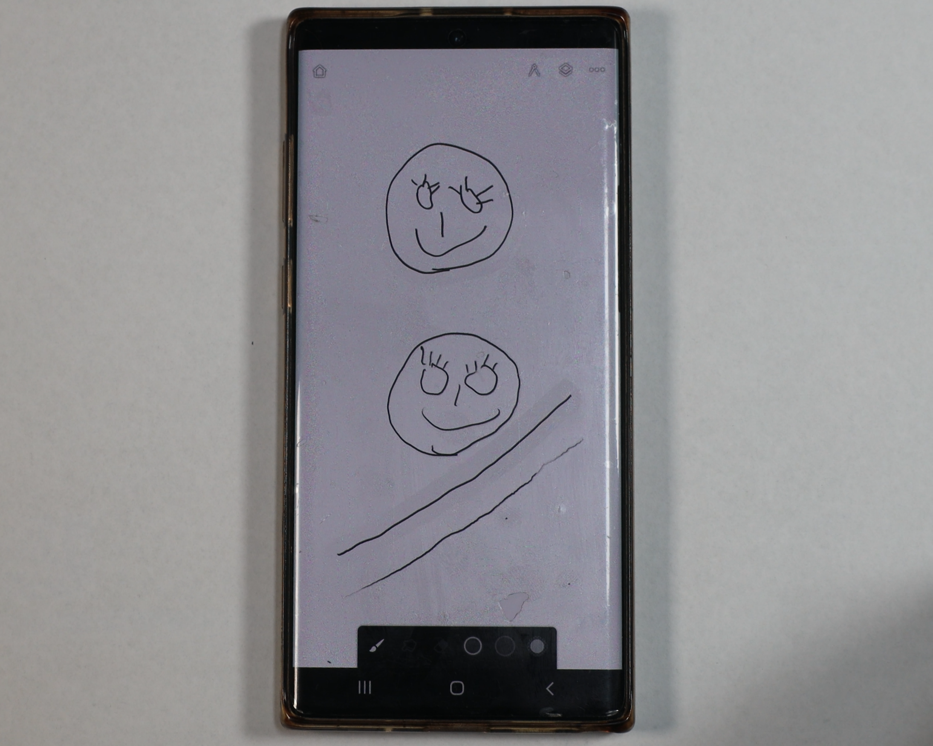
Touch Pens and Styluses
Touch pen
Passive, no power
Better precision than finger
Stylus
Uses power, battery/inductive
Pressure sensitivity/Better accuracy
May be device specific
ITFreeTraining.com
Notes:
04:52 On modern devices, you can use your finger to interact with the screen. The accuracy of modern devices is generally quite good, but there are cases where additional precision is beneficial—for example, when drawing or writing. To achieve better accuracy, you can purchase a touch pen or stylus.
A touch pen is essentially just like a regular pen but does not write anything. It is passive, that is has no power. It offers better precision than a finger.
A Stylus on the other hand, uses power. This comes through a battery or via induction. That is, the Stylus gets power when it is held up against the screen of the device. Styluses offer better pressure sensitivity and better accuracy than a touch pen.
Styluses may be device specific. There are generic ones that work on most devices. The device specific type may have additional features and give better results. The stylus may also have additional options like buttons.
I have a mobile phone that I will demonstrate a stylus on. Firstly, I will draw a face with my finger. On modern devices, even using just your finger will get some good results. I will now use the stylus to draw a face. You will notice that, despite my poor drawing abilities, the results are pretty similar.
I will now add some eye lashes using my finger to the first face. This fine level of detail is hard to do using a finger. I will now do the same using the Stylus to the second face. You will notice the results are much better, as I have more control using the stylus.
A stylus also senses the pressure you are pushing down with. If I use my finger with varying pressure, you will notice that the line appears the same regardless of how hard I press. When I do the same with the stylus, you will notice the line has different levels of darkness, depending on the amount of pressure used. It is a little hard to see, but the end of the line is less dark than the centre.
Styluses are ideal for users who require precise detail or pressure sensitivity. For example, people who are using a tablet for drawing.

Slide 7
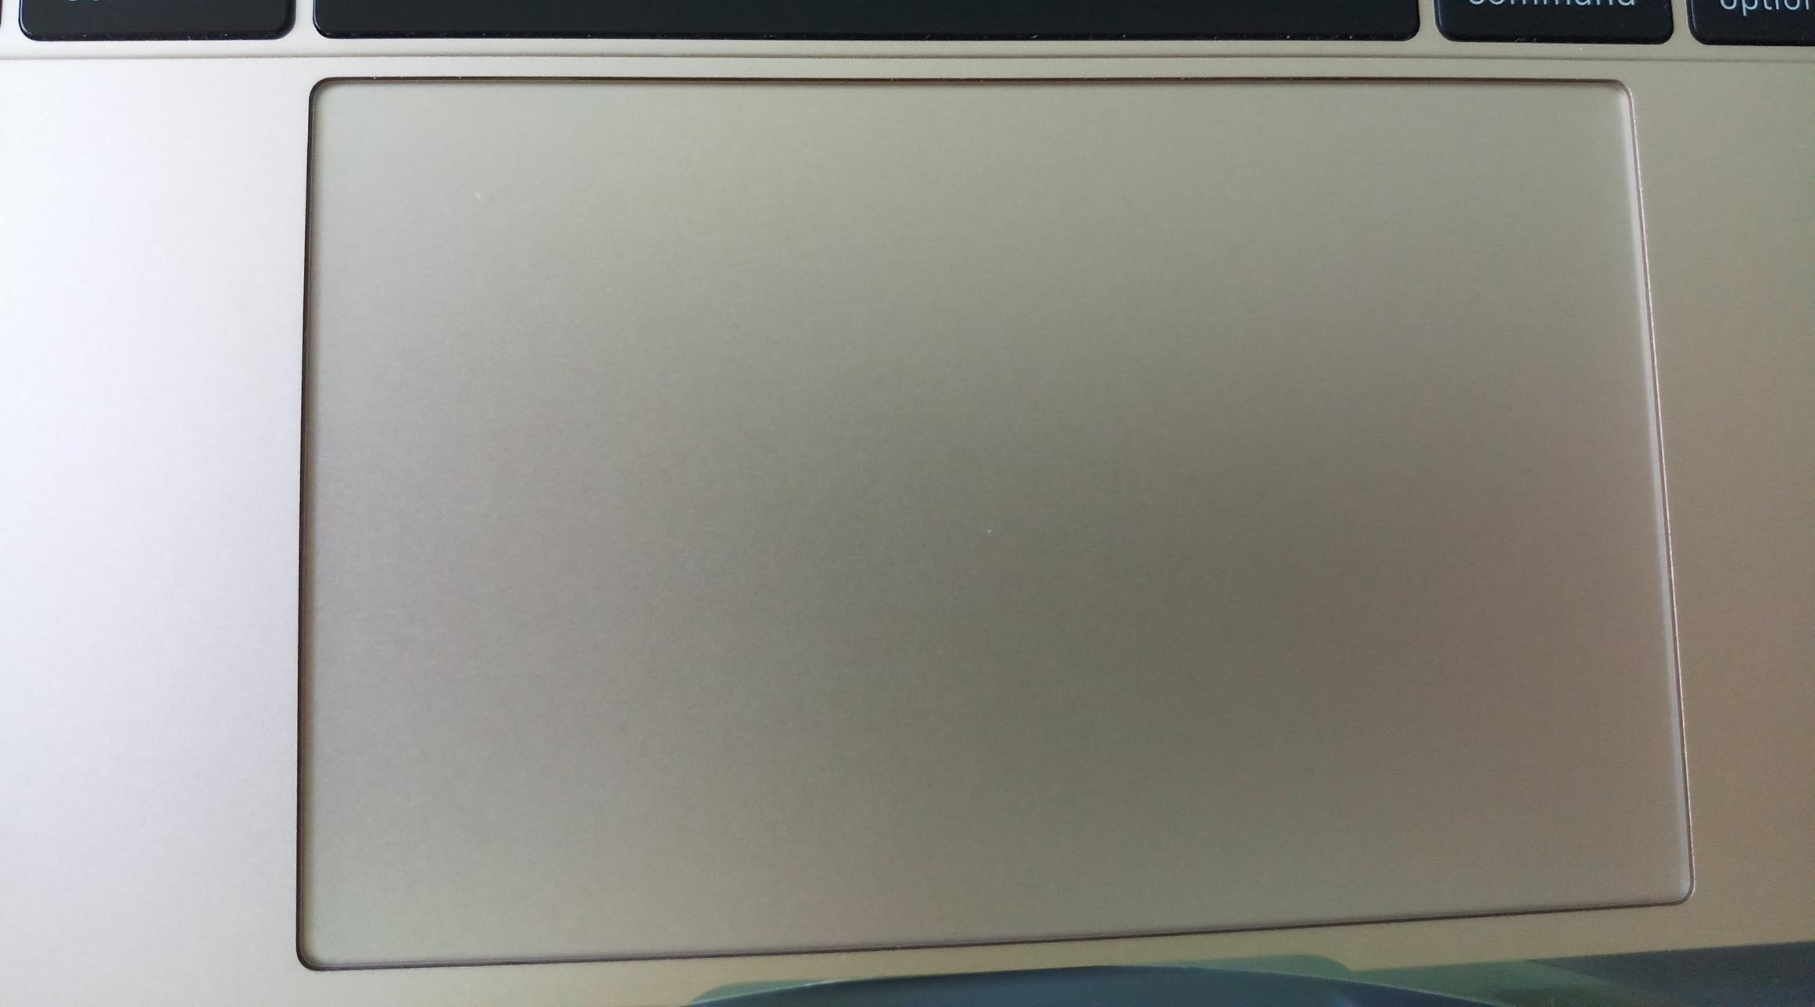
Trackpads
Replaces the mouse
Commonly found in a laptop but can be external
Supports drag, tap and multiple finger input
ITFreeTraining.com
Notes:
07:05 The trackpad replaces the mouse with a pad. These are commonly found in a laptop but can also be external. For example, you could use an external trackpad on a desktop. Trackpads are useful in tight spaces, which is one of the big reasons they are included in many laptops.
Modern trackpads support drag, tap and multiple finger input. There is not too much to know about Trackpads. Just be aware that many support many input features such as pinch to zoom, just like a mobile device would.

Slide 8
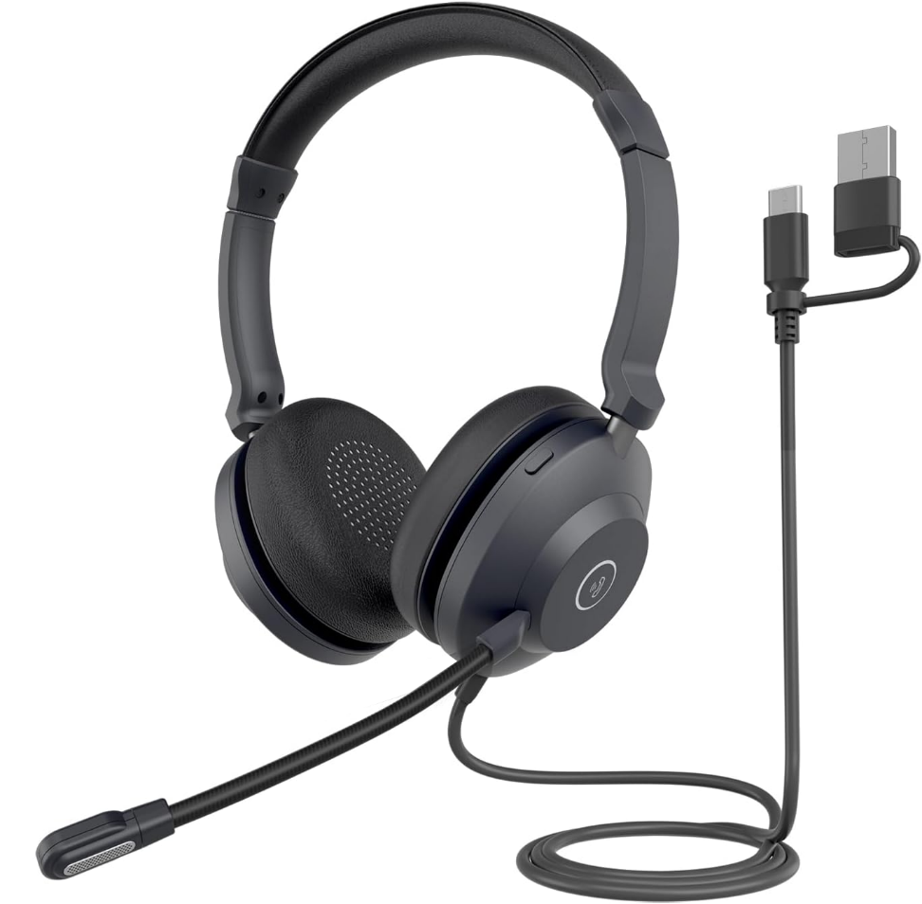
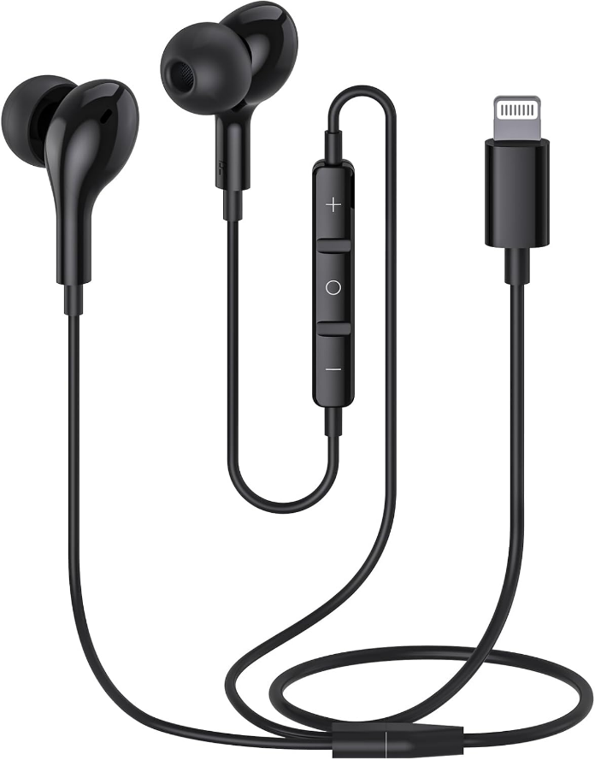
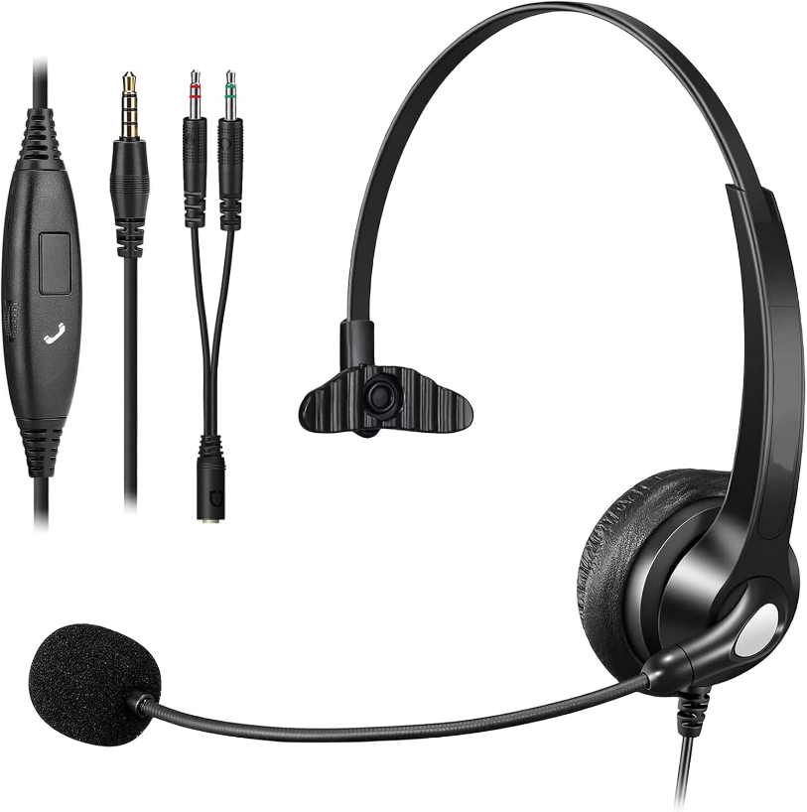
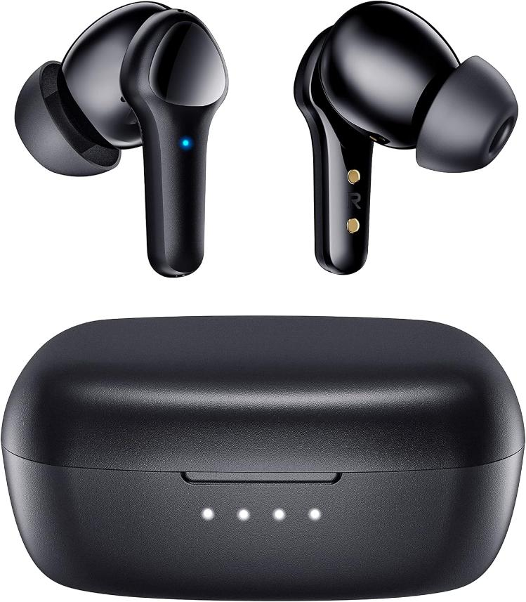
Headsets
USB
Bluetooth
Lightning
3.5mm
Versatile, popular
Wireless, popular
Proprietary, Apple
Analog, fading
ITFreeTraining.com
Notes:
07:38 When using your mobile device for audio and video communication, you might find it helpful to use a headset. Headsets can be either wired or wireless, providing both a microphone for speaking and speakers for listening.
There are almost an unlimited number of headsets on the market, but they fall into different categories. USB are versatile and very popular. There is a trend of everything starting to move towards USB-C.
Bluetooth offers a wireless solution and has become very popular with mobile devices. It seems everyone nowadays has a set of wireless ear buds. There are some headsets that do not use Bluetooth, but these tend to be larger ones you would use indoors.
There are also headsets that use the lightning connection, which is a proprietary connector used by Apple devices.
Lastly, there’s the 3.5mm TRRS connector, commonly known as the audio jack. This is an analog connection while all the others are digital. It is gradually fading from the market and is now considered a legacy option. While it’s still found on computers and various other devices, it’s largely absent from modern mobile devices. It may eventually disappear from computers too, though that shift seems to be taking longer than other legacy connections.

Slide 9

Subscribe
Next video
Video content: https://ITFreeTraining.com/ap11/8a15
Notes:
08:57 That concludes this video on mobile accessories. I hope you have found this video useful. Until the next video I would like to thank you for watching.
References
“The Official CompTIA A+ Core Study Guide (Exam 220-1101)” pages 247 to 248
“License CC BY 4.0” https://creativecommons.org/licenses/by/4.0/
“Picture: Trackpad computer” https://commons.wikimedia.org/wiki/File:Macbook_touchpad.jpg
Credits
Trainer: Austin Mason https://ITFreeTraining.com
Voice Talent: HP Lewis http://hplewis.com
Quality Assurance: Brett Batson https://www.pbb-proofreading.uk

