Slide 1
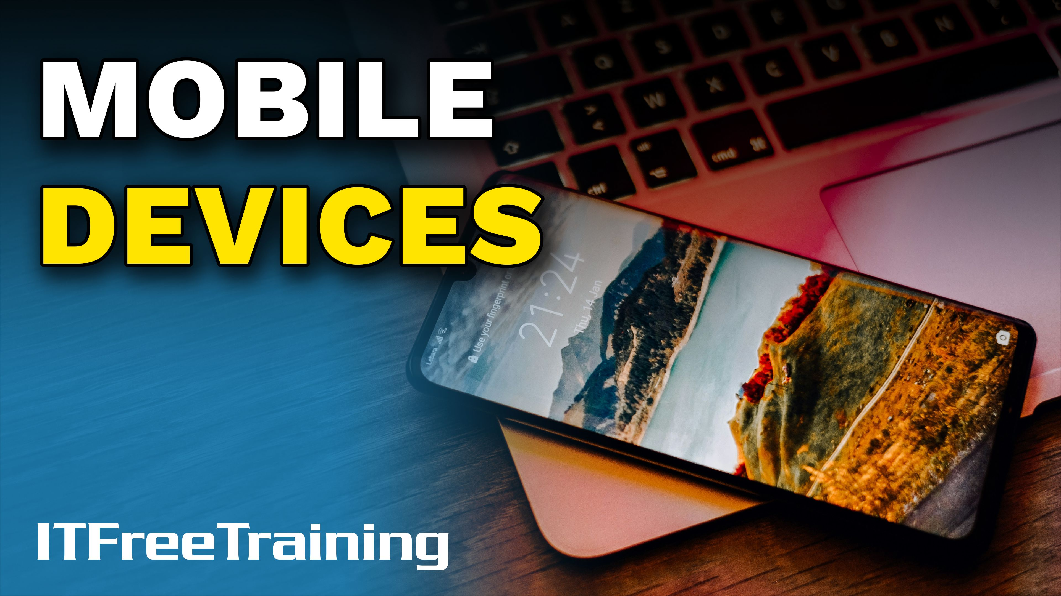


Notes:
Let’s have a look at mobile devices.

Slide 2
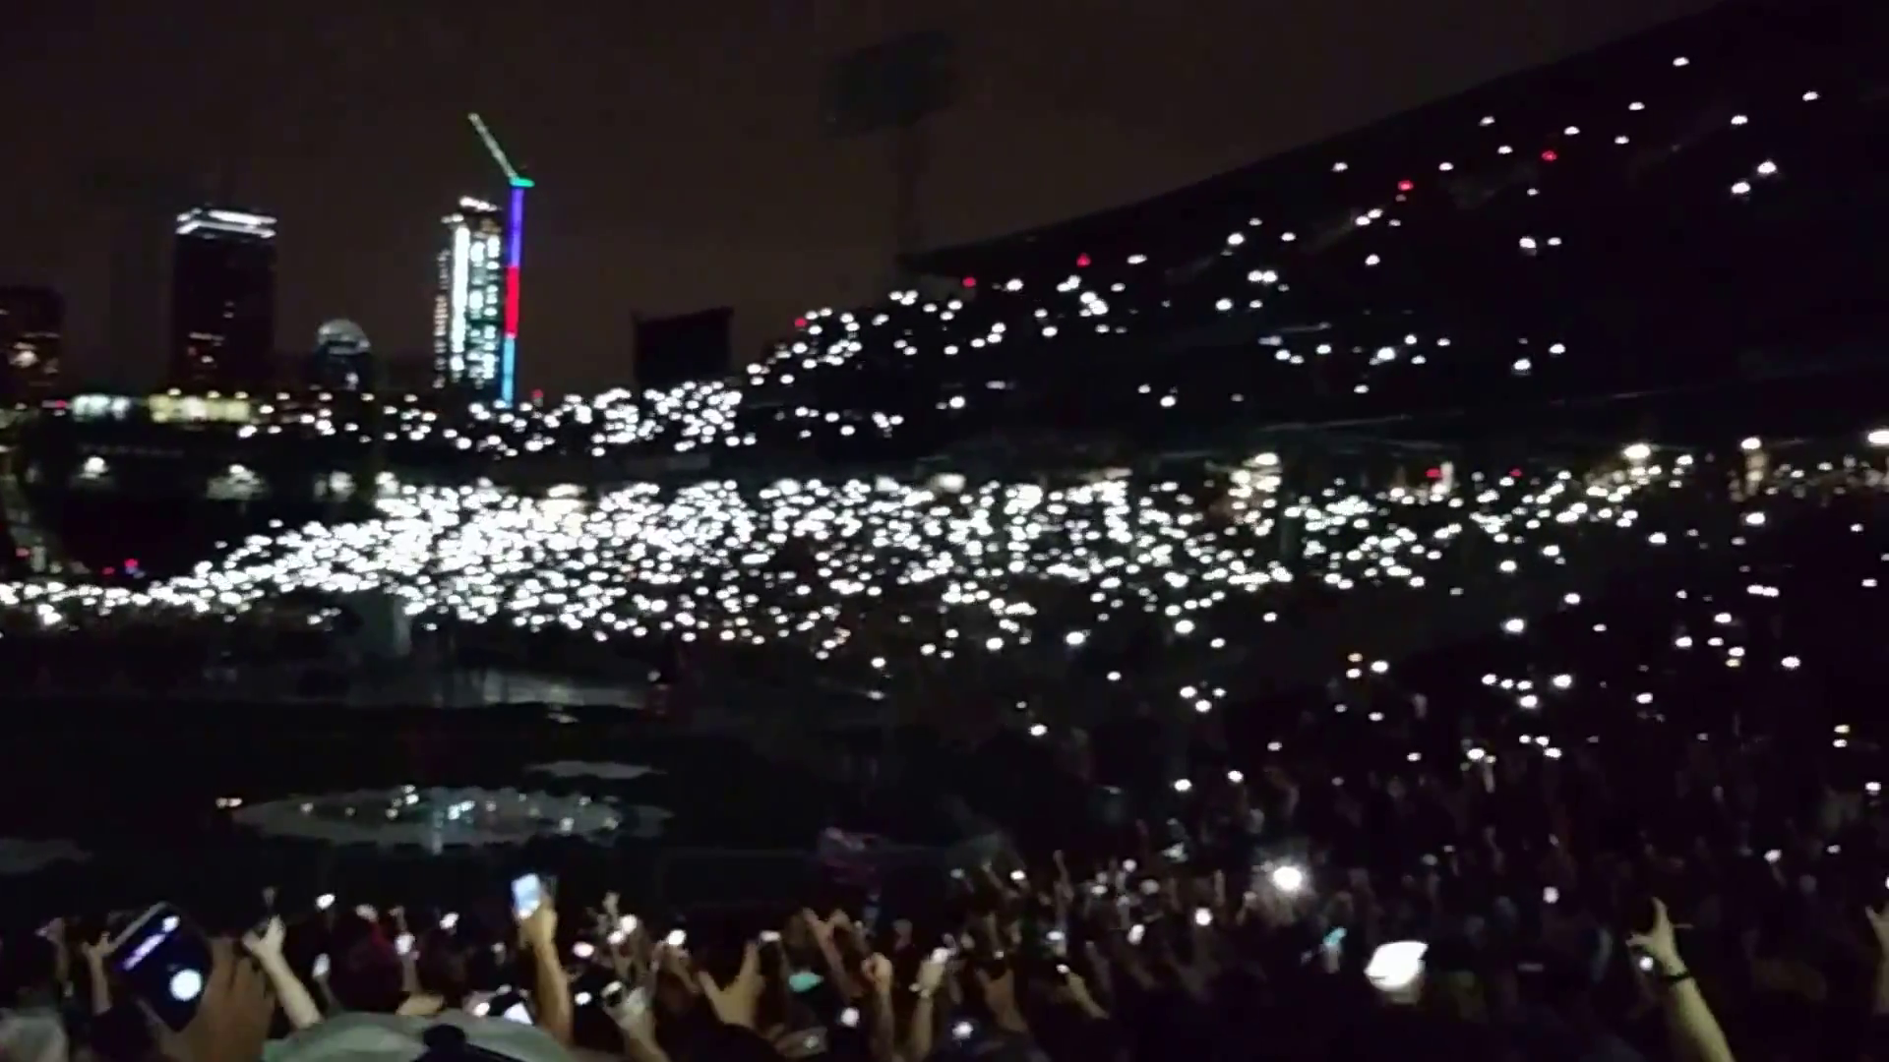

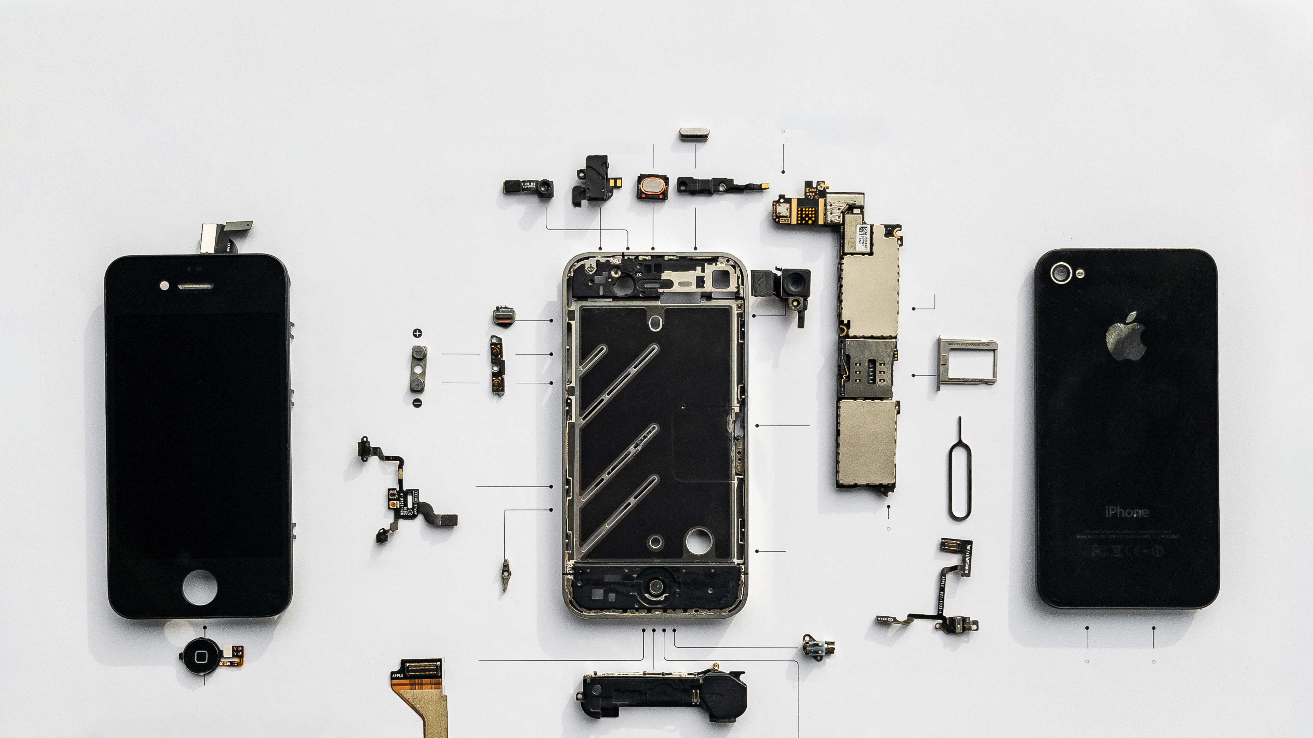
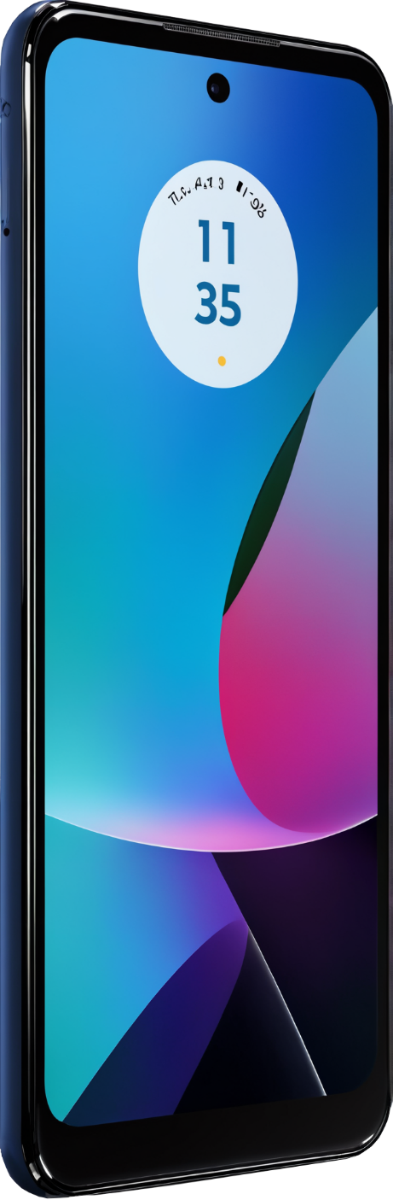
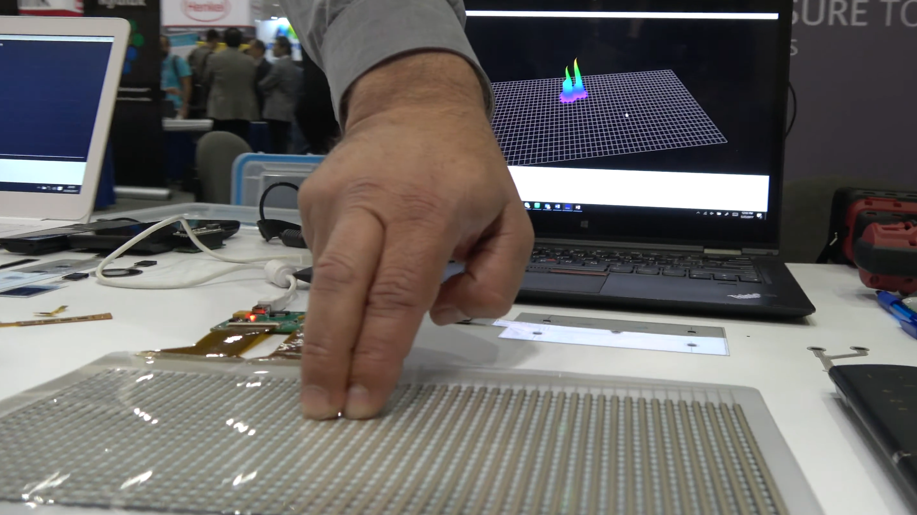
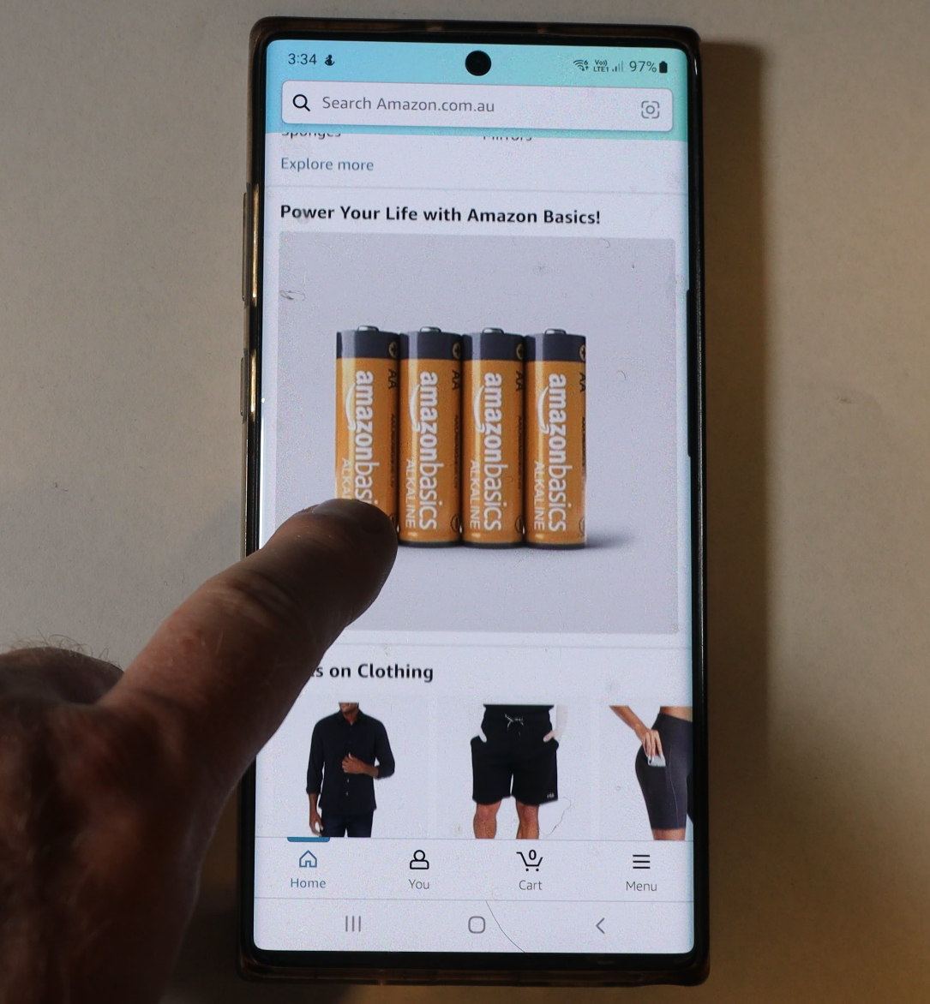
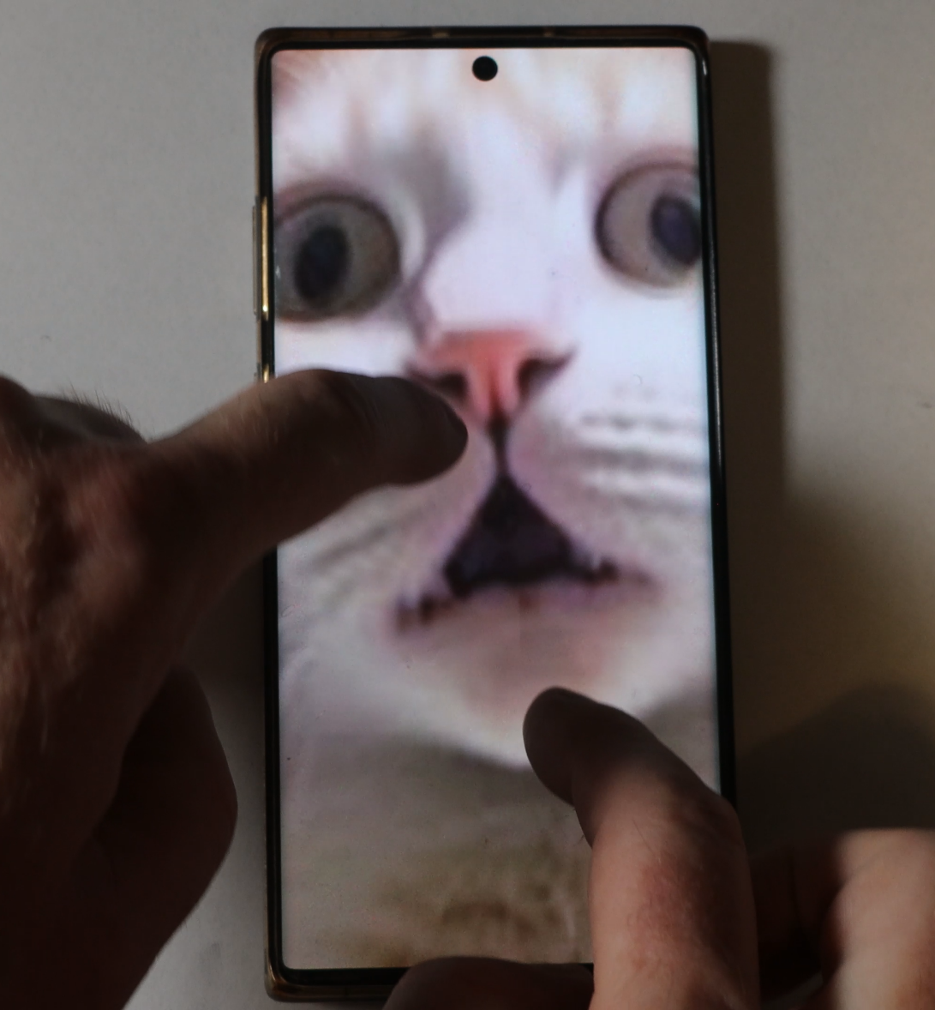
Touchscreen
Touch screens can also be referred to as a digitizers
Sweeping
Pinching
ITFreeTraining.com
Notes:
00:04 Mobile devices have become very popular, it seems everyone has one. Nowadays, mobile devices are quite complex with a lot of different parts in them. There are only a few components that CompTIA would like you to be aware of.
Most mobile devices nowadays have a touchscreen. Touch screens can also be referred to as a digitizer. A touchscreen uses capacitive technology. This technology uses a layer of transparent material placed between the glass and the display. When a finger touches the screen, it disrupts the field which is detected by sensors in the phone.
You can see in this example a larger version of the touchscreen found in a mobile device. Modern Touchscreens support more than just sensing positions. They also support gestures like sweeping, where you can essentially scroll the output on the screen.
More complicated input, like pinching, is also supported. This is often used to zoom in and out. Newer devices may also provide haptic feedback to touch responses. Haptic feedback refers to the tactile sensations produced by devices, such as mobile phones, in response to user interactions, for example the device generates vibrations or movements that simulate the feel of pressing a button or making a selection.

Slide 3
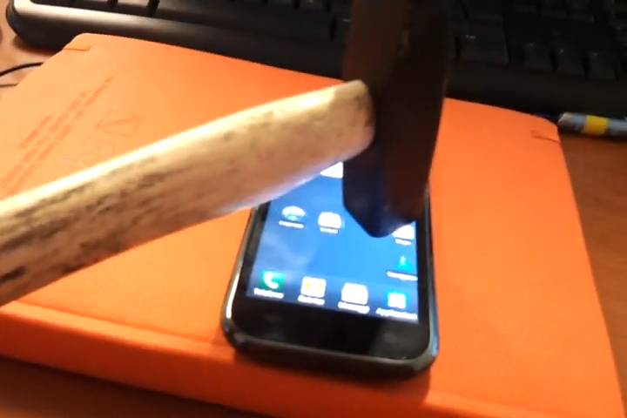
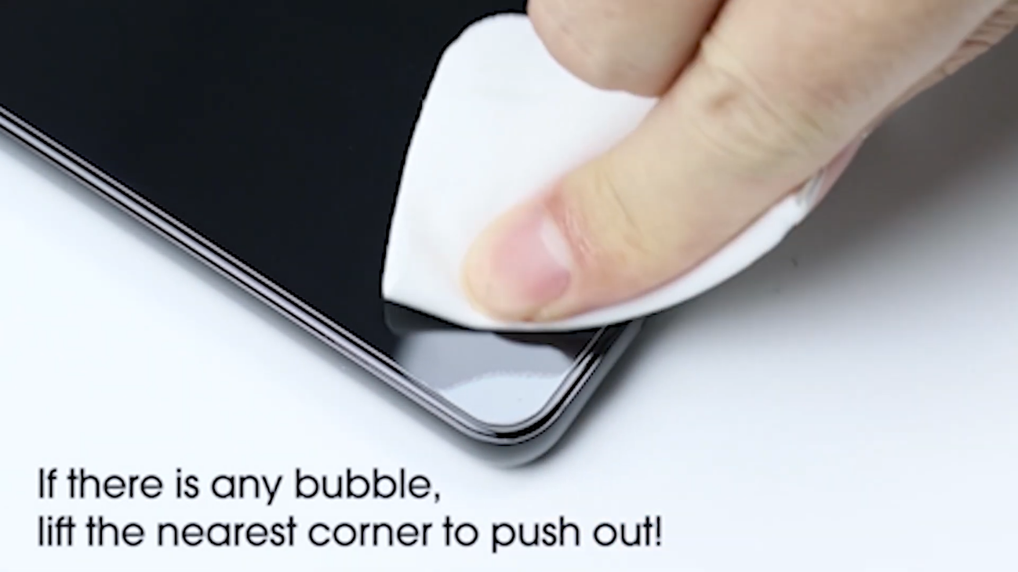
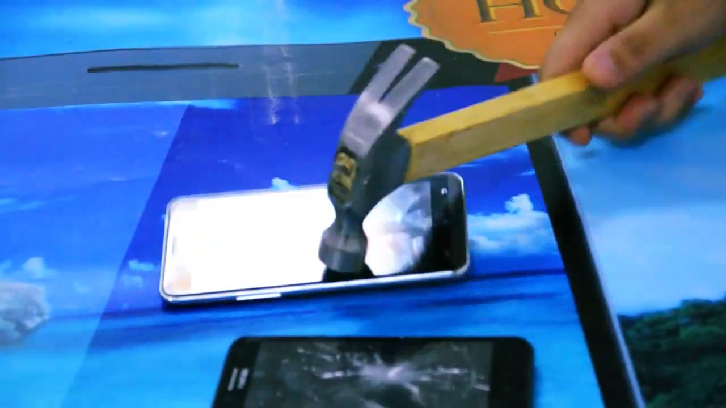

Glass Layers And Screen Protectors
Modern mobile phones are pretty strong
Personally, I still purchase a screen protector and case
Protective screen
Corning’s Gorilla glass
Provides additional protection
Has different generations
E.g., 2, 3, 4, 5, 6, Victus
ITFreeTraining.com
Notes:
01:21 Modern mobile phones are quite strong and can survive being dropped, impact, and scratch damage. In his example being hit with a hammer. Do not do this.
I once saw a commercial featuring a child putting their parent's mobile phone in a fish tank, with the phone miraculously continuing to work. A friend of mine who worked at a mobile phone support center mentioned that they received a large number of calls from parents whose children had tried this at home, resulting in non-functional phones. This serves as a reminder: if you see a video demonstrating stress tests, don’t attempt them at home unless you’re prepared to replace your device if it breaks.
Although mobile devices are quite durable nowadays, I still use a screen protector and case for extra protection. Screen protectors will provide additional protection against damage. Mobile devices are expensive nowadays and often an expensive case is only a small percentage of the cost of the device. I would rather replace a damaged case than the device.
CompTIA specifically mentions Corning's Gorilla Glass for its impressive strength, as illustrated by the contrasting durability of two mobile phones—one shattering easily while the other remained intact. However, there are alternatives to Gorilla Glass, so don't assume that if your device uses a different type of glass it is not strong. Once again, don’t do any home stress testing.
Gorilla glass has a number of different generations. Each generation is stronger than the previous generation. If you are worried about how strong your new device is, have a look at what glass is being used. Regardless of the screen’s specification, I always buy a case and a protective screen, just in case.

Slide 4
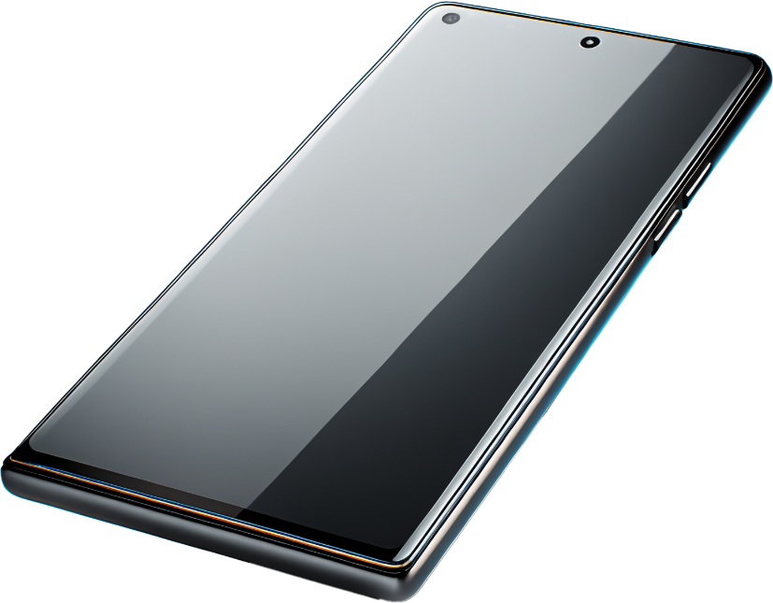
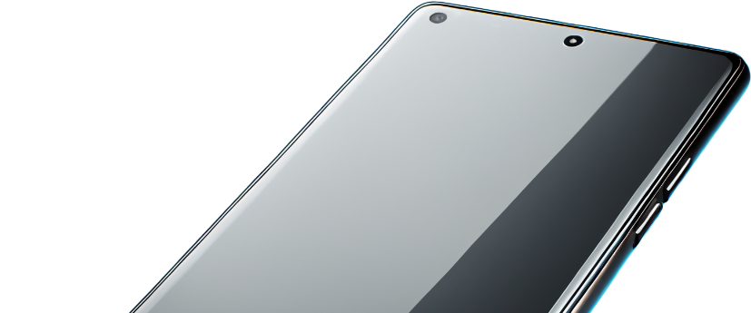
Accelerometers And Gyroscopes
Accelerometer
Gyroscope
Measures distance
Measures rotation speed
Used to determine screen rotation
Only measures rotation speed not position
Measures gravity to determine rotation
ITFreeTraining.com
Notes:
03:07 I will next have a look at accelerometers and gyroscopes. It is unlikely you will encounter a question about this on the exam, but it is included in the study guide. The accelerometer measures distance. It accomplishes this by measuring the device's movement along the X, Y, and Z axes
You might be surprised to learn that the accelerometer also plays a key role in determining screen rotation. It does this by measuring gravitational forces in different directions. Essentially, when the phone is oriented in a specific direction, the force of gravity is measured and can determine the device's orientation.
The Gyroscope is used to measure the speed of rotation, essentially measuring the speed the device rotates in each axis. It, however, only measures rotation speed not position. You can see why the accelerometer is used to determine rotation. The gyroscope can provide information about rotation speed which can be used to assist with screen orientation.

Slide 5

Subscribe
Next video
Video content: https://ITFreeTraining.com/ap11/8a10
Notes:
04:11 Mobile devices have become an essential tool for navigating our daily lives. No matter how strong you think they are, do not perform home stress tests on them or put them in a fish tank. Until the next video, thanks for watching.
References
“The Official CompTIA A+ Core Study Guide (Exam 220-1101)” pages 246 to 247
“License CC BY 4.0” https://creativecommons.org/licenses/by/4.0/
“Video: Foo Fighters at Fenway Park, stadium lit up by fans' cell phones ” https://www.youtube.com/watch?v=ljjBcNBqpkY
“Picture: iPhone breakdown”
“Video :Samsung Galaxy S2 Fishtank Commercial” https://www.youtube.com/watch?v=GOKO6isa08A
https://commons.wikimedia.org/wiki/File:Komponenten_des_iPhone_4.jpg
“Video: Top 5 Best Samsung Galaxy S24 Plus Screen Protector by AllCasesHere licensed under CC BY 3.0” https://www.youtube.com/watch?v=GwBshdQVBig
“Video: Samsung galaxy s VS Hammer referencing by keijar licensed under CC BY 3.0”” https://www.youtube.com/watch?v=HDaKdpfnYzk
Credits
Trainer: Austin Mason https://ITFreeTraining.com
Voice Talent: HP Lewis http://hplewis.com
Quality Assurance: Brett Batson https://www.pbb-proofreading.uk

