Slide 1
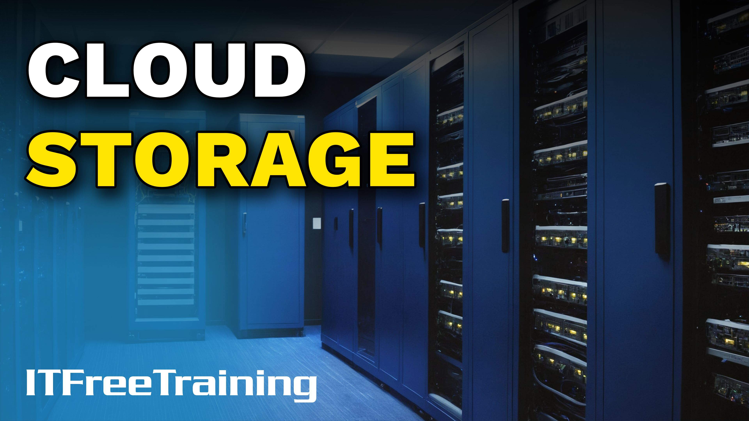
Notes:
Let’s look at Cloud Storage.

Slide 2


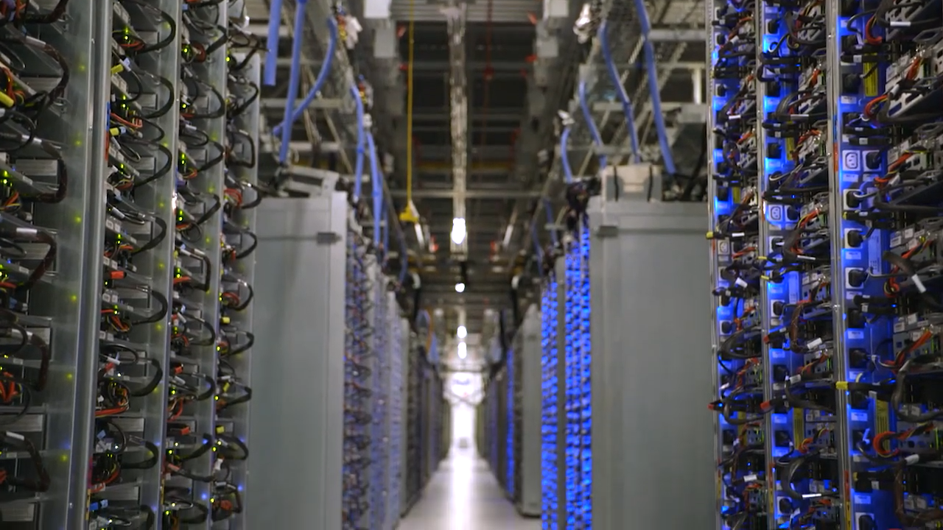
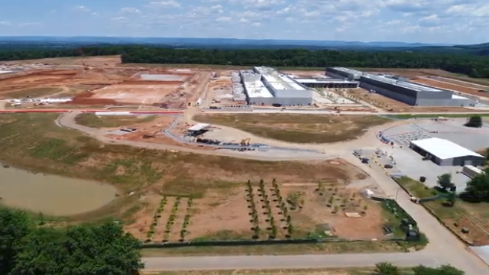
Cloud Storage
Data is easily accessible regardless of how it is stored
All over the world
New data centers under construction
ITFreeTraining.com
Notes:
00:02 Nowadays, cloud storage is available to be used by all our devices. Data is easily accessible by these devices regardless of how it has been stored in the cloud.
Cloud storage has expanded from the early days. Data centres are all around the world. There are new data centres being constructed and existing data centres being expanded. Cloud storage is forecasted to continue to grow so it is an important topic to understand as it will become more and more commonplace.

Slide 3

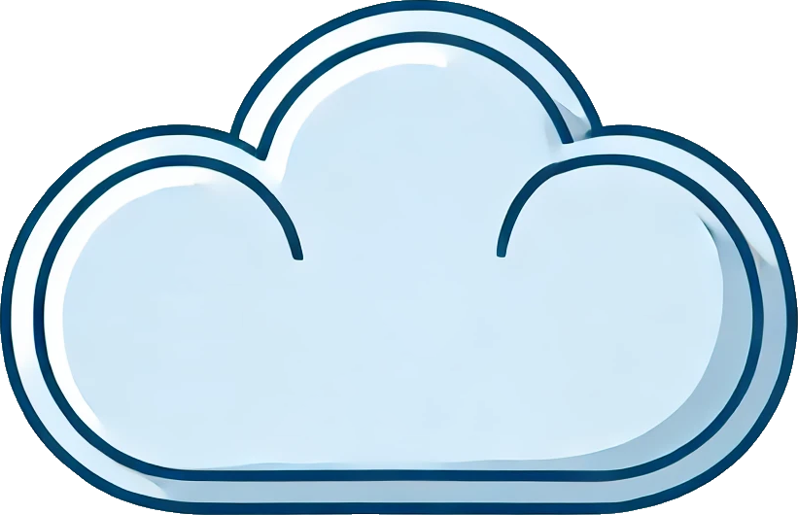
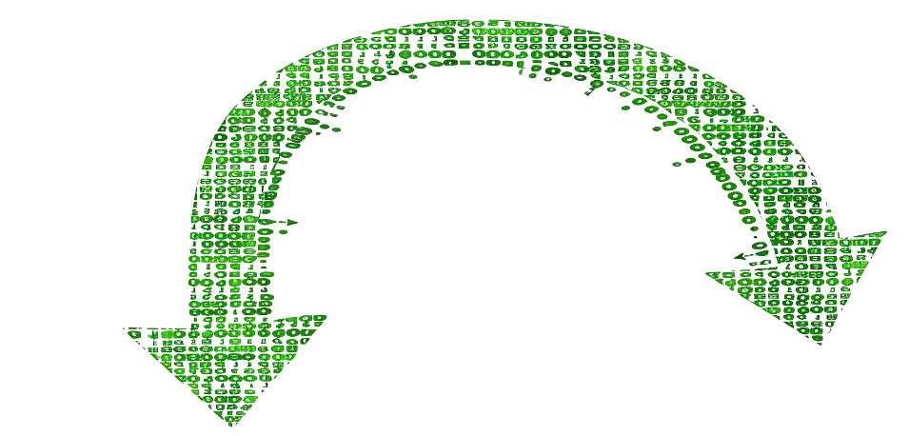
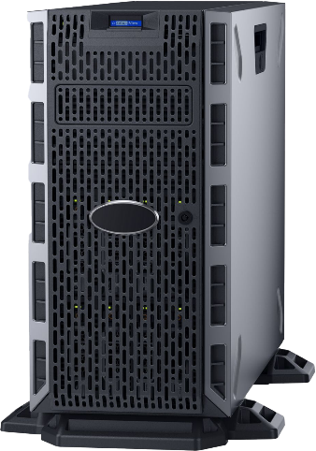


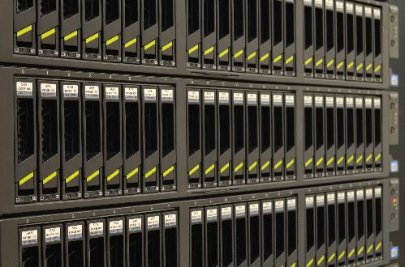
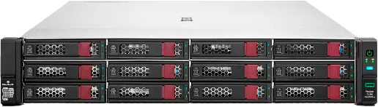

Cloud Storage Fundamentals
Data is no longer stored on local storage (Unless cached)
I wonder
where my data physically is?
Data moved and replicated as required
Managed remotely
ITFreeTraining.com
Notes:
00:33 Cloud storage is a service model in which data is stored online and managed remotely. If you are hired to work on cloud service, you will most likely access it remotely and never physically be near or know what hardware is being used.
The data stored in the cloud could be stored on servers and hardware anywhere in the world. Previously you would have local storage or if it was in the server room, you could walk into the server room and work out which hardware your data is stored on. Nowadays, you don’t really know where your data is stored. What makes things more complex, the cloud can move your data around as required. Even if you could find your data, your data could be moved for many different reasons.
Cloud data can be moved around for load balancing, you keep a backup in another location for redundancy. Content delivery networks will often cache data in different locations around the world to make access faster and reduce network transfer costs.
While the cloud manages data movement in the background, most cloud providers offer some level of transparency and control. You might be able to see logs of data movement or configure certain aspects of data replication and backup. But most of us, we will say our data is in the cloud and never know where it physically is.
Modern data centres are very secure both from cyber attacks and physical security. In modern data centres the hardware will be contained in a secure environment. To get into the heart of the Data Center you would be required to go through many different layers of security. You could go through a whole career in Cloud technician and never see a physical server.

Slide 4
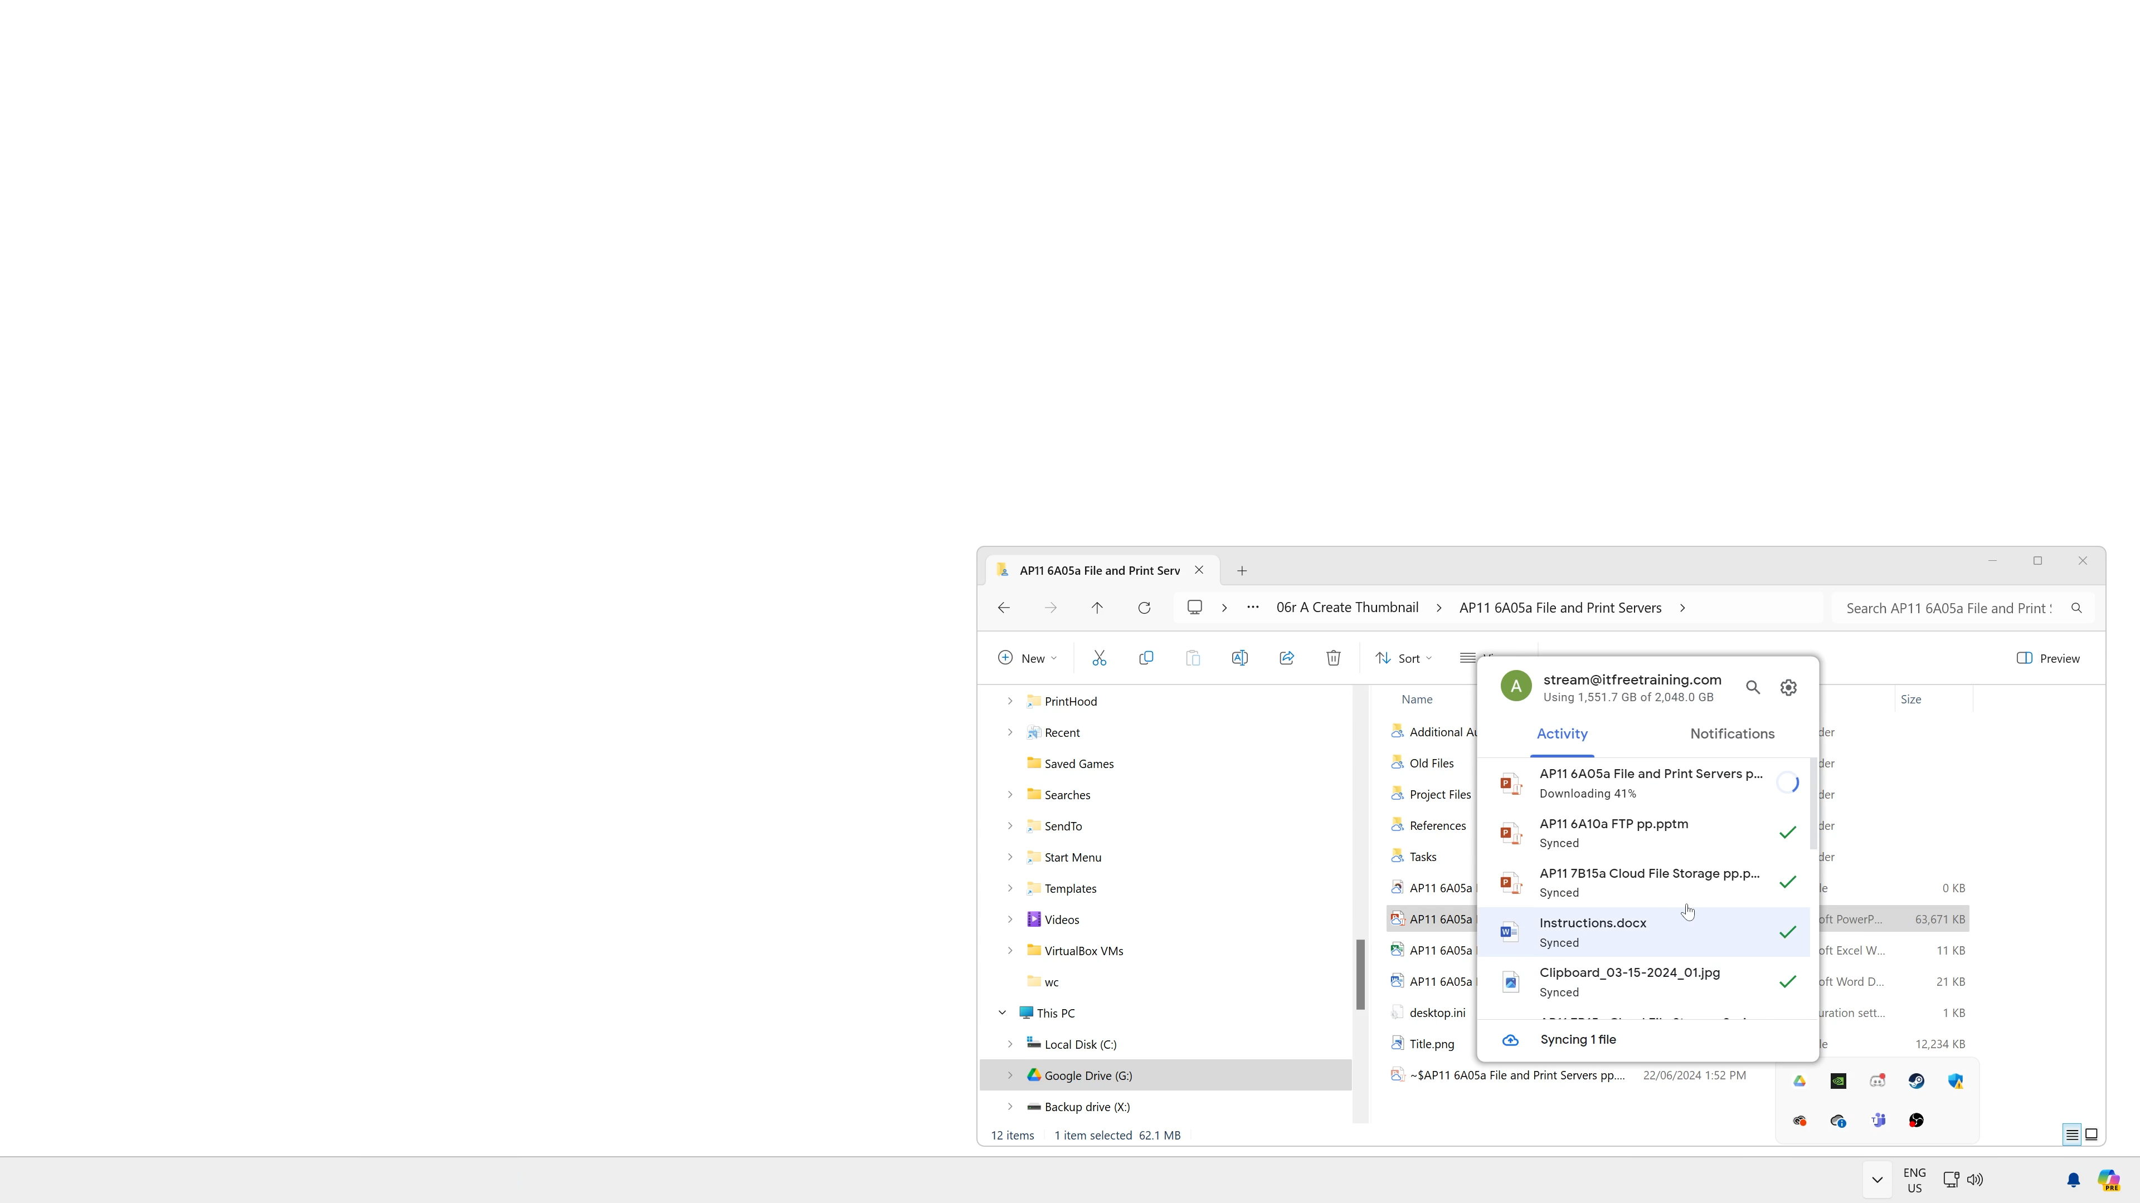
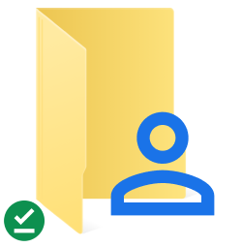
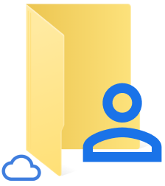
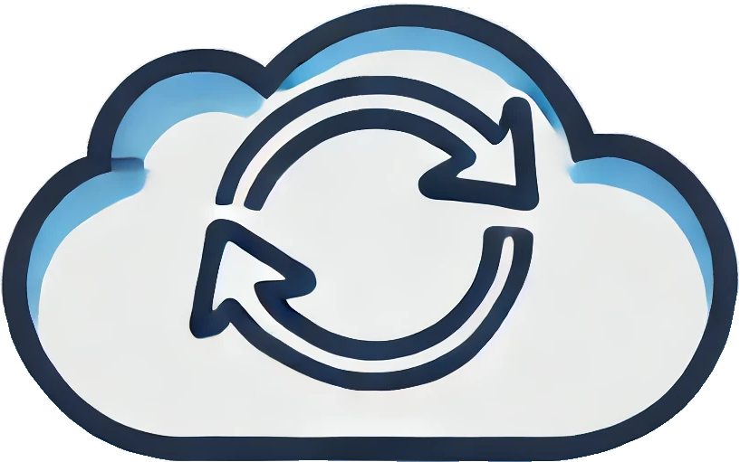
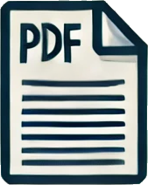


Cloud File Replication
Process of replicating data to and from the cloud
Available offline
Available online
ITFreeTraining.com
Notes:
02:16 Cloud file replication is the process of replicating data to and from the cloud. This is an important concept to understand, as if the process were to fail, your data may be lost. It is easier to understand the concept with an example.
In this example, I have my Google drive which contains our videos that we are working on. The Google drive is shared with our staff all across the world. Notice the folders at the top, notice the folder icons have a green tick next to them. These folders have been replicated to the local cache on the computer and thus available if the internet connection is lost.
At the bottom, notice that the icon is a cloud icon. This indicates that the files are available in the cloud only, or online. If the folder contains a mixture of both offline and online files, the folder will appear as available online. Only if all files in the folder and its sub folders have been downloaded to the local machine will the folder appear as being available offline.
I will now go into one of the sub folders. All these files are available online only. I will select one of the files, right click on it and select the properties.
In the properties, notice that the size of the file and size on disk is reported correctly. Some cloud drives will report the file as being zero bytes if the file is online only and not available in the cache. I will now open the file. You will notice that the file is being downloaded from the cloud. The file will only open once the download is complete.
It is important for users to understand this, particularly when they are working on a slow network connection, for example working from home. In the office the transfers may be very fast in the background and the user may not notice. On a slower connection, the delay will be more noticeable. If you are planning to work on large files on a slow network connection, right click the folder or file and make it available offline when you are working on the fast network connection. That way, when you are on the slow network connection the file is available already in the cache.
When cloud file replication works the way it is supposed to, it will be transparent to the user and they won’t even know that it is working. However, problems can occur.

Slide 5
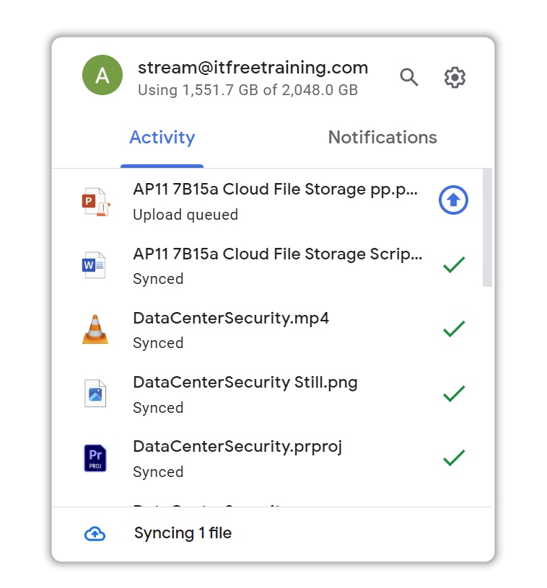
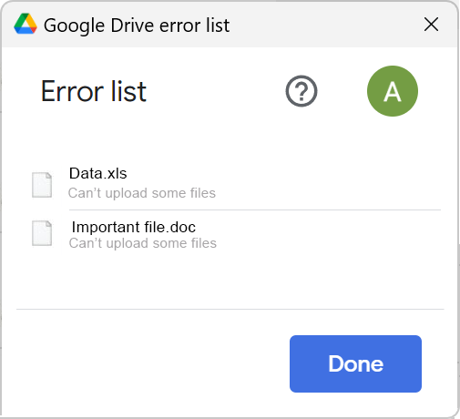
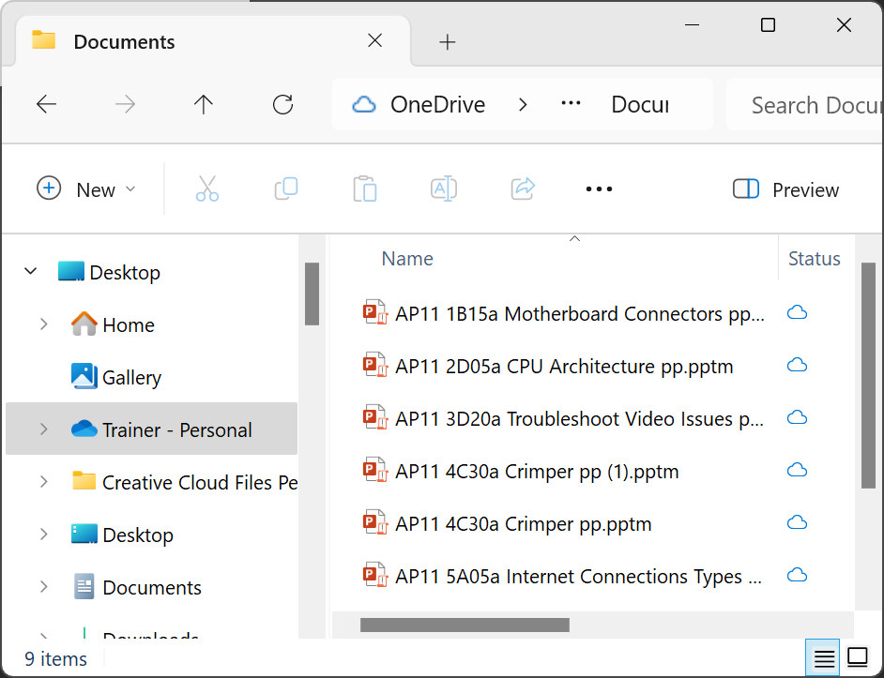


Synchronization (Sync) Problems
Sync not completed yet
Files not available to other devices till sync completed (Lost if local copy lost)
Errors syncing files
Perform sync again or files copied back into drive
Drive is not available
File may get saved elsewhere
Why are my
files here?
ITFreeTraining.com
Notes:
04:40 One of the problems is synchronization has not been completed. In this example, the file is waiting to be synchronized to the cloud. If the file has not been synchronized to the cloud, it will not be available to other devices until the synchronization has completed. If this does not occur and the local copy on the device is lost, the file is lost.
It is important that users check that their files have finished synchronization before they log off their computer. I have had users contact the helpdesk saying they made changes to a file; however, the other staff are seeing an older version of the file. When this occurs, it is most likely the synchronization never completed.
Errors can also occur before the file is synced to the cloud. When this occurs, the synchronization may need to be done again or the file copied back into the drive. Synchronization errors can occur due to network errors, the file becoming corrupted or being moved out of the drive before it can be synced.
Sometimes the drive may not be available. For example, a software crash. In some cases, the file you are working on may get saved elsewhere. I have had this happen where Google Drive crashed and Office, as it comes with some cloud storage, saved the file in OneDrive rather than Google Drive. If you have users saying their files have suddenly gone missing, have a look in the recent folder. If the drive is not available, your software may save the file elsewhere and the user may not realise. With a lot of software coming with some free cloud storage, the software may try to save your file in their cloud storage when other cloud storage fails.

Slide 6
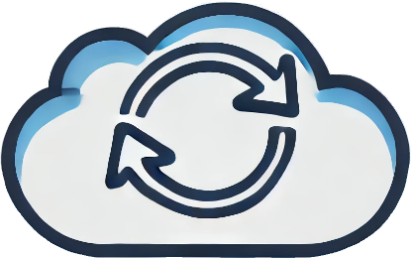

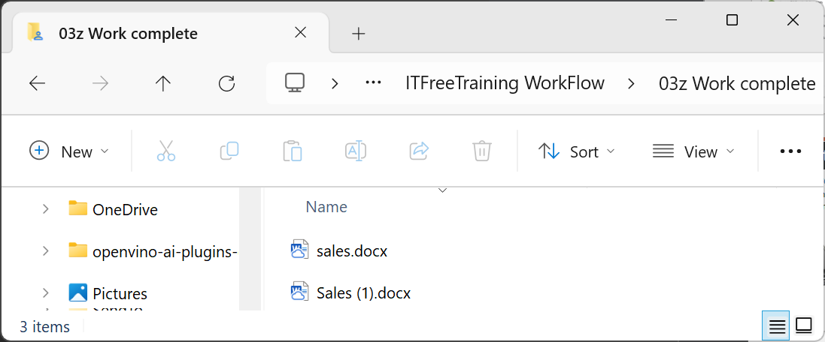


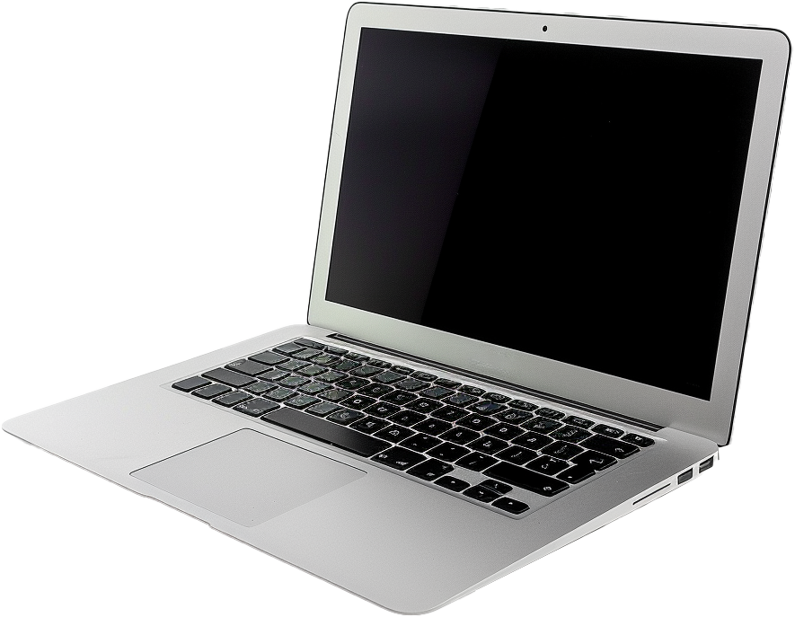
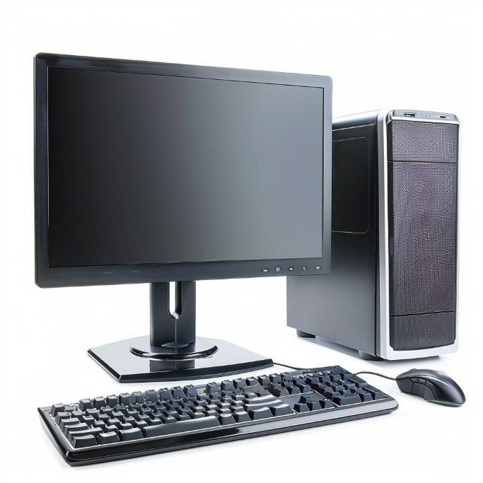
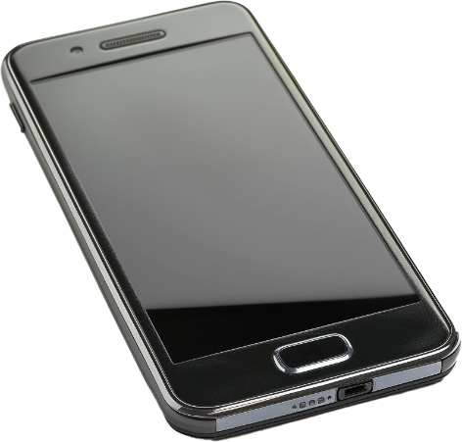
Replication Conflicts
Cloud can replicate the same data to too many devices
If data is modified in two locations at the same time, it will cause a replication conflict
Most cloud implementations will keep both copies and call them different names
Conflicted file renamed
ITFreeTraining.com
Notes:
06:21 Since the data is stored in the cloud, it can be replicated to many different devices. If the same data is modified in two locations at the same time, this will cause a replication conflict. Most cloud implementations will keep both copies and call them different names.
Some cloud implementations may give you a message that a conflict has occurred. If you see replication conflicts, you need to choose the file you want to keep. If you have a user saying they have lost data, have a look for replication conflicts as their data may be in the other file.

Slide 7
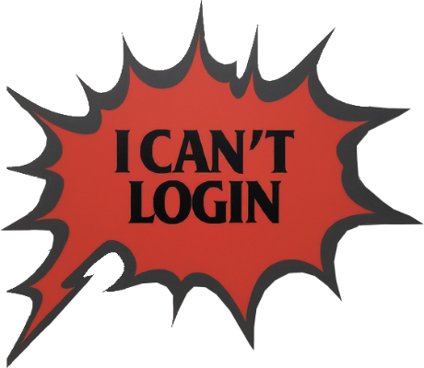
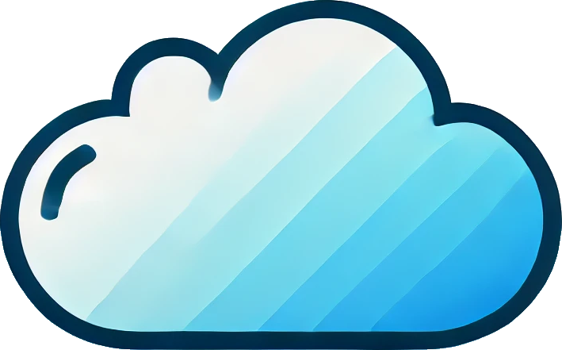

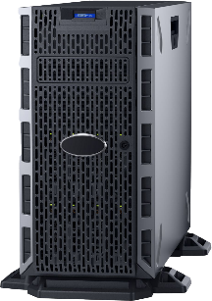
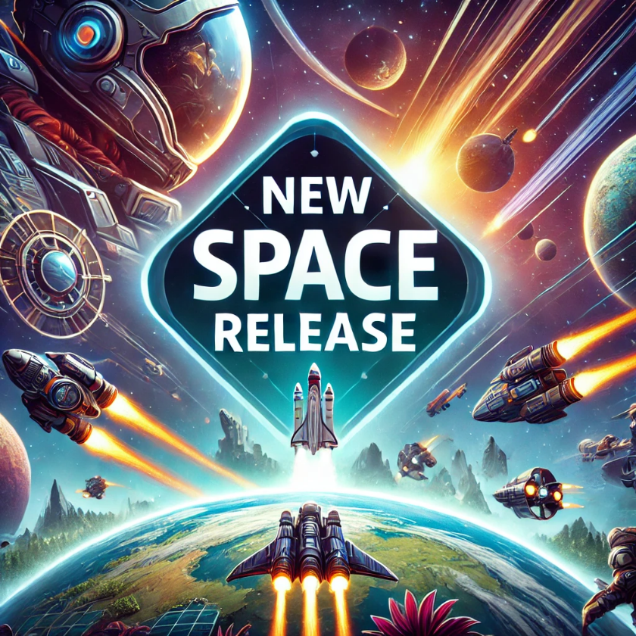
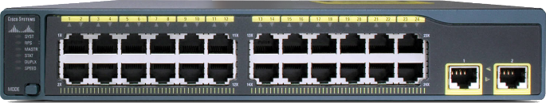
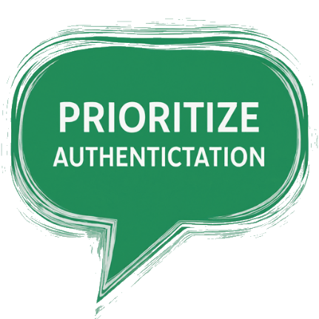

Software-Defined Networking (SDN)
Allows dynamic, software control of cloud networking
Allows network switches and routers to be dynamically configured using methods like scripting
Authentication servers
Game servers
Traffic prioritized to go to game servers
ITFreeTraining.com
Notes:
06:57 For the A+ exam, the main point to remember about Software-Defined Network or SDN is it allows dynamic software control of cloud networking. It allows network switches and routers to be dynamically configured, for example using scripting. If you get a question asking about how to configure cloud networking, the answer is most likely Software-Defined Networking.
Rather than trying to explain SDN, I will first go into an example where it may be used. Let’s consider that a brand-new game is being released. The game has been designed to run inside the cloud. Using the cloud means that additional resources can be added and removed as needed. In this case, the game has a number of game servers and a number of authentication servers.
The cloud has its own network devices. Since it is the cloud, you don’t have direct control over the hardware in the cloud, unless of course it is a private cloud you have ownership of. The game is released and the first thing that happens is the users complain that they can’t log in.
The problem is that the network traffic has been prioritized to go to the game servers. The problem is that the users need to authenticate first before they can access the game servers. With so many people trying to authenticate at the same time, the network traffic can’t get through the authentication servers.
So, using SDN, we can run a script telling the cloud to start prioritizing authentication traffic over game traffic. Once the initial burst of the logins has reduced, we can change the prioritization so the game servers get priority again.
You can see that even though we don’t have control over the hardware in the cloud, we can still control the networking in the cloud. The main take away from this slide is that SDN allows networking in the cloud to be changed without having direct connection to the hardware.

Slide 8
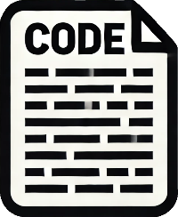

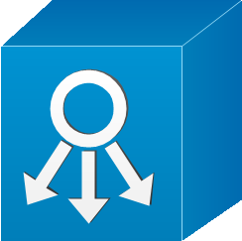
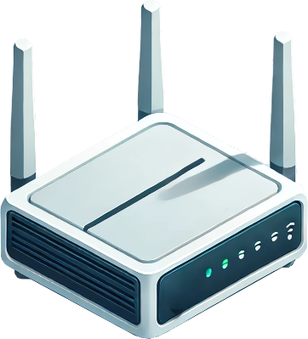
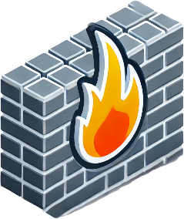
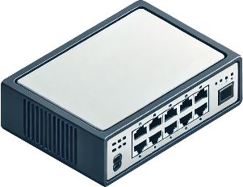
Application Programming Interface (API)
Business logic and desired
configuration
Application Layer
Northbound
API
SDN
Controller
Control Layer
Control Plane
Management Plane
Southbound
API
Network appliances and
virtual network
functions
Infrastructure Layer
ITFreeTraining.com
Notes:
08:52 I will have a brief look at the API that SDN uses. This is included in the official study guide; however, it is unlikely you will get an exam question on it. At the top is the application layer. This is the layer where our scripts run which allows us to make changes to the way networking is handled in the cloud.
At the bottom is the infrastructure layer. This is where all the network hardware for the cloud is found. There is a lot of network hardware out there, so we need a standard way to control it with our scripts. To do this, there is a control layer.
In the control layer, there is the control plane and management plane. The control plane manages the flow of network traffic. The management plane focuses on the broader network management tasks, such as network configuration, monitoring, and overall performance management.
In order to make the required decisions about the network management, an SDN controller is placed in the middle. An SDN controller is a software application that centrally manages and controls network behaviour by interacting with underlying network devices. It acts as the "brain" of the network, making real-time decisions to manage and optimize network resources efficiently.
We have the different layers, but now we need a way to communicate between the layers. To communicate from the application layer to the control layer there is the northbound API. This provides a standard way for our scripts to communicate with the control layer regardless of which software or hardware we use for the SDN controller.
Between the control layer and the interface layer, there is the southbound API. This allows a standard way of controlling the hardware regardless of which SDN controller is used.
The main take away from this is that, due to the layers, you don’t have direct access to the hardware in the cloud. You tell the SDN controller via an API what you want to do and the SDN controller makes changes to the hardware as required using another API.
It is unlikely that you will get a question about this in the exam; just remember that SDN allows scripts to be created to give you high level control over the networking in the cloud.

Slide 9
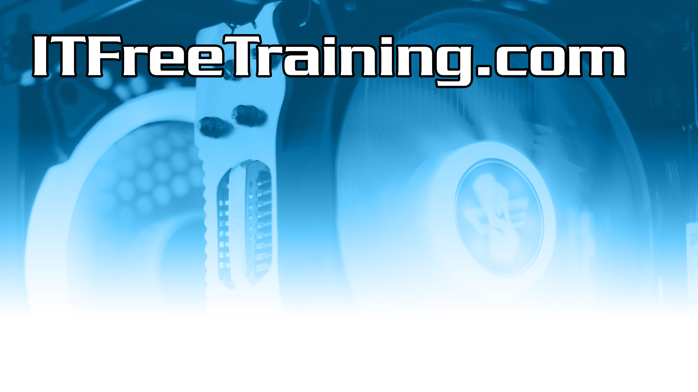
Subscribe
Next video
Video content: https://ITFreeTraining.com/ap11/7b15
Notes:
11:14 If you enjoyed this video, please check out our other videos for more insights and tips. Hopefully you don’t lose any of your data in the cloud like a sock in the laundry. Thanks for watching.
References
“The Official CompTIA A+ Core Study Guide (Exam 220-1101)” pages 238 to 239
“License CC BY 4.0” https://creativecommons.org/licenses/by/4.0/
“Video: Facebook Data Center Huntsville Alabama, Drone Flyby, June 2020 by AirMobileDrone licensed under CC” https://www.youtube.com/watch?v=GKHiYmwCtnA
“Video: Google - Our Secure Data Centers” https://www.youtube.com/watch?v=7pkNt3szF1A
“Picture: Tech Cloud-Markert Spending Forecast” https://www.bloomberg.com/professional/insights/data/infrastructure-services-to-fuel-next-phase-of-cloud-expansion/
“Picture: Data center security” https://commons.wikimedia.org/wiki/File:SecureAreas.jpg
“Picture: System controller by ConceptDraw Team” https://conceptdraw.com/a1777c3/p47/preview/640/pict--system-controller-cisco-products-additional-vector-stencils-library
“What are referencing by person licensed under CC BY 3.0” link
Credits
Trainer: Austin Mason http://ITFreeTraining.com
Voice Talent: HP Lewis http://hplewis.com
Quality Assurance: Brett Batson http://www.pbb-proofreading.uk

