Slide 1
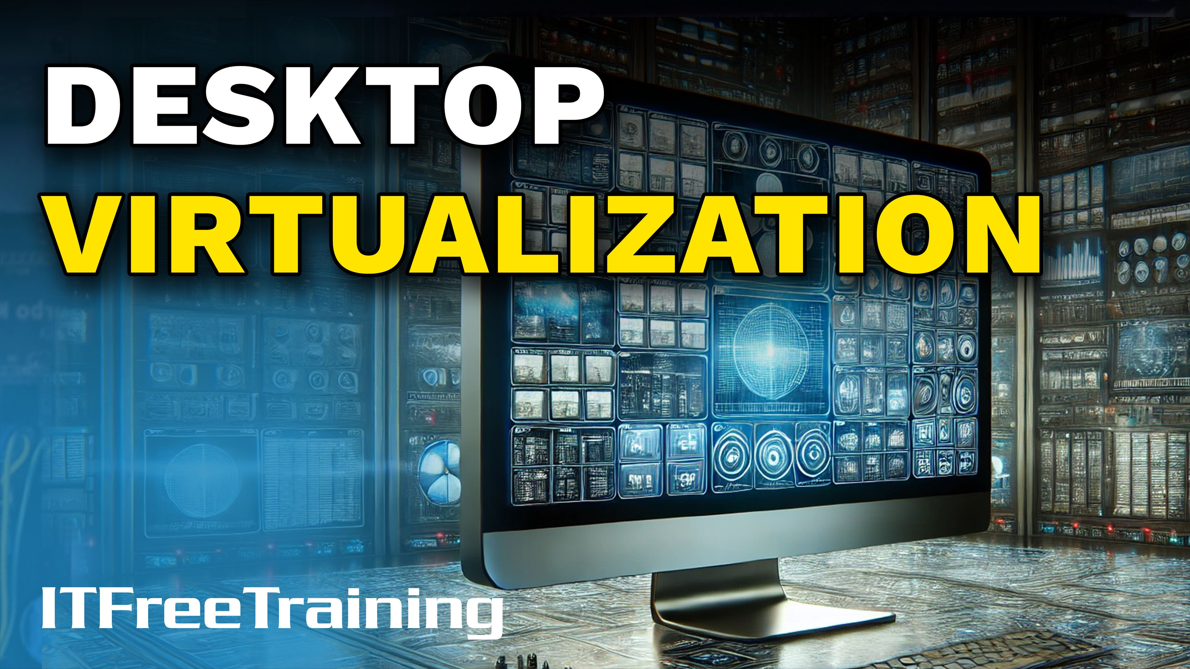
Notes:
Let’s look at desktop virtualization.

Slide 2
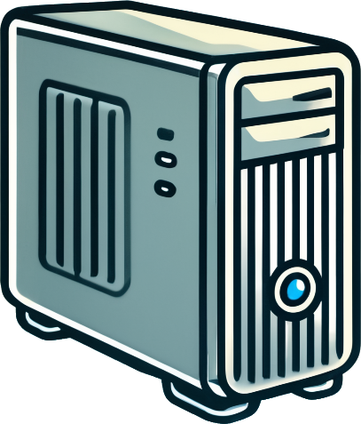
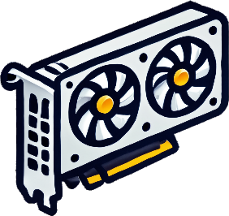
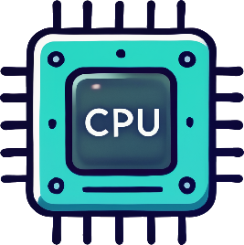
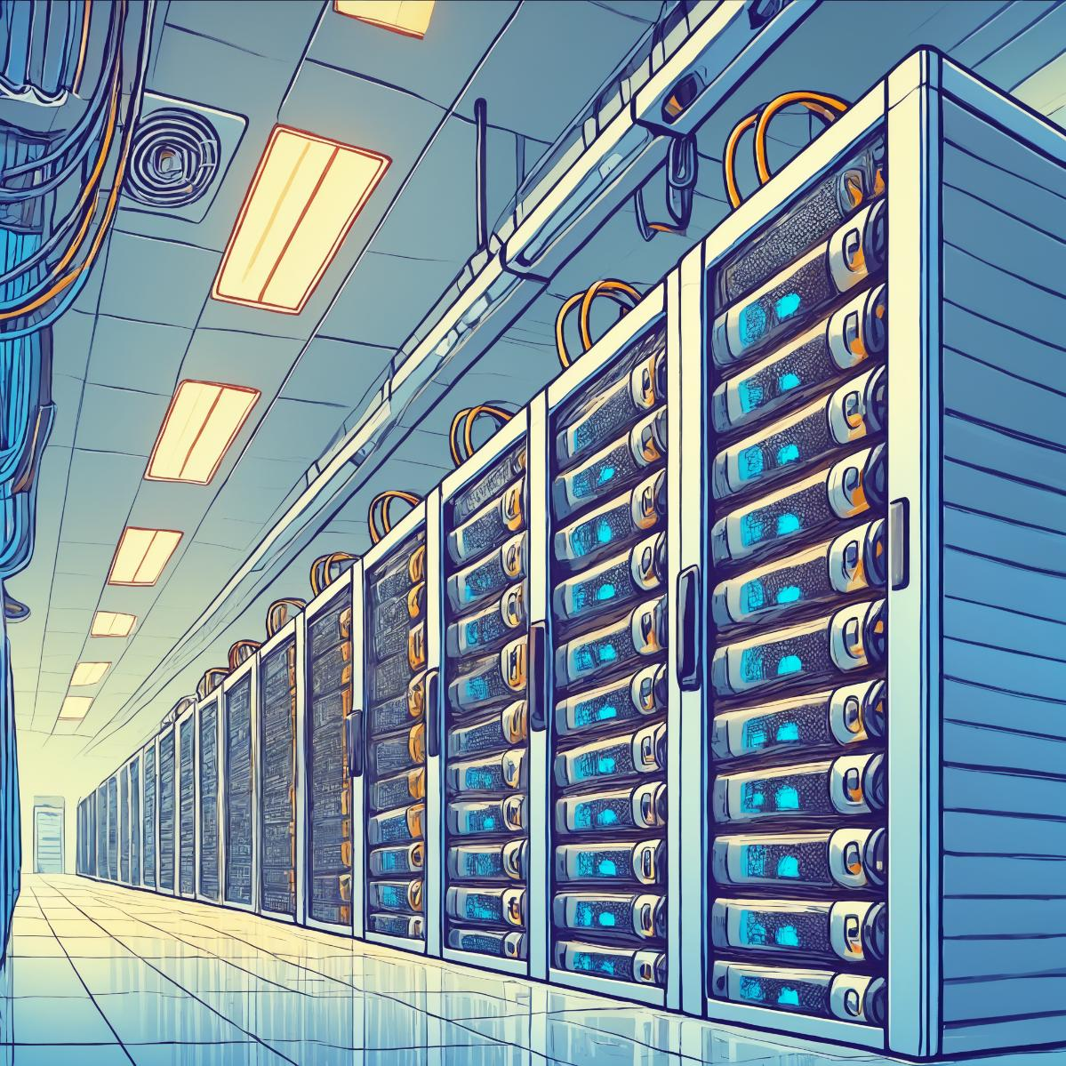

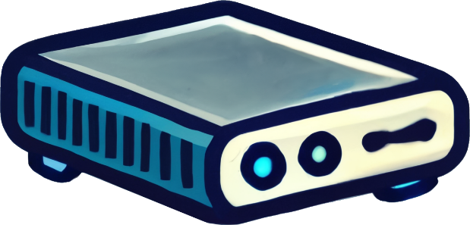
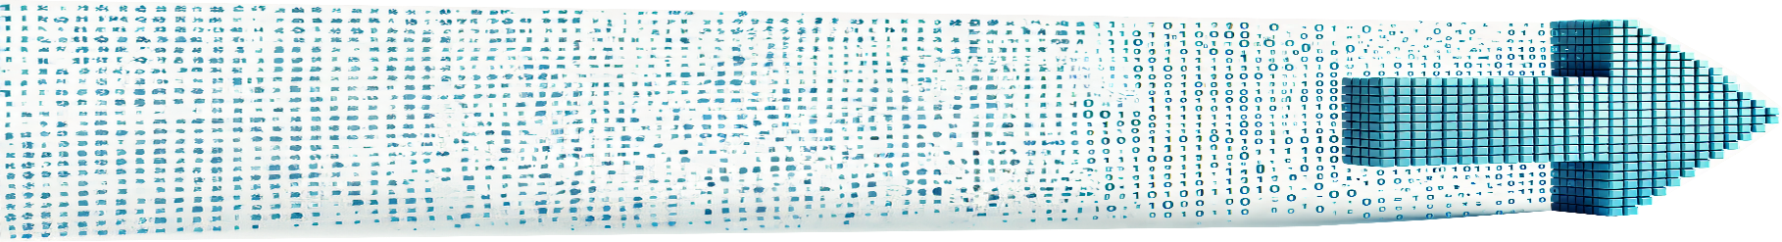
Desktop Virtualization
Separates the desktop environment from the physical client
Thick client (Fat client)
Desktop runs on servers
Most or all processing is done locally
Little to no reliance on server-side processing
Thin client
Primarily relies on server-side processing
Requires network connection
ITFreeTraining.com
© Copyright 2025
Notes:
00:05 Desktop virtualization separates the desktop environment from the physical client. Instead of running locally on the computer, the desktop operates on servers. To understand this, let’s consider how a traditional workstation functions. These workstations are often referred to as thick clients or fat clients.
They get this name because they are heavy is terms of processing power, storage and functionality. So, they generally have good graphics, memory and processing power. For this reason, thick clients can handle most, if not all, processing locally. They have little to no reliance on server-side processing, allowing them to operate independently from the network and continue running even when disconnected.
In contrast, a thin client relies on server processing and requires a network connection. Essentially, the thin client utilizes the server's hardware rather than its own. For this reason, the thin client’s local hardware does not need to be very powerful; it primarily processes user commands and displays the results.

Slide 3

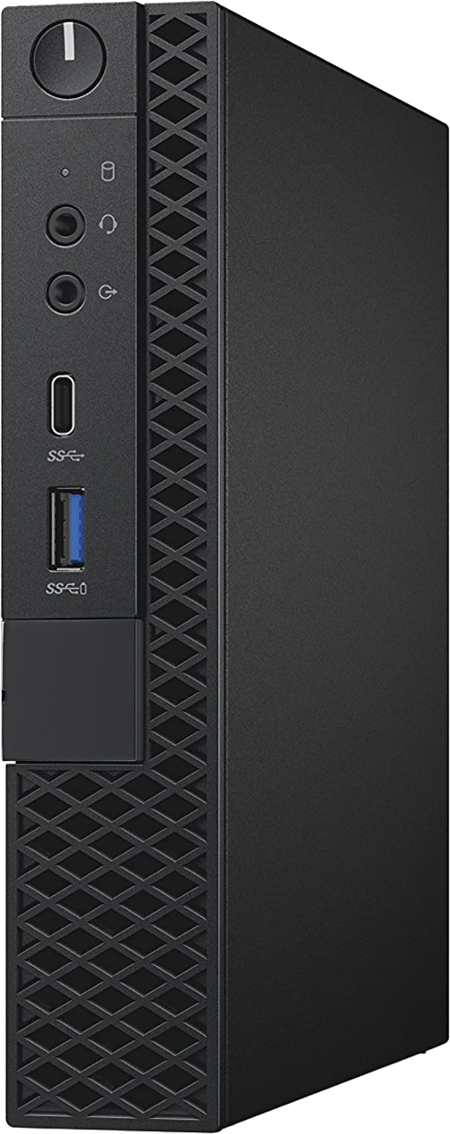
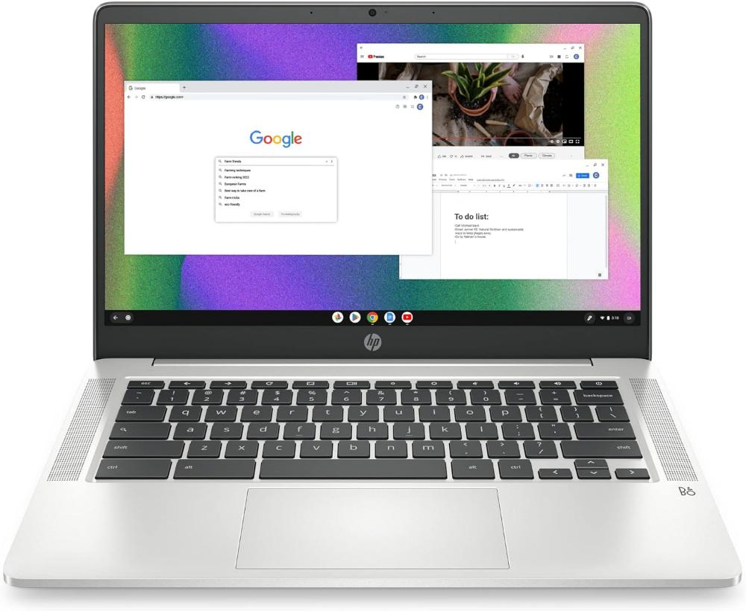
In The Real World
Modern thin clients have reasonable processing power
May meet basic needs, but do not expect high performance
Essentially a PC with limited upgrade options or none at all
Chromebooks are commonly regarded as thin clients
Designed to rely heavily on cloud services
ITFreeTraining.com
© Copyright 2025
Notes:
01:08 In the real world, modern thin clients have a reasonable amount of processing power. Historically, thin clients lacked local storage and would download an operating system from the network. To minimize costs, they were equipped with only the bare minimum hardware.
With advancements in hardware, it is now possible to purchase credit card-sized computers with decent processing power. As a result, basic thin clients on the market often include storage and can essentially function as standalone computers. While they may meet basic needs, their capabilities are limited.
Modern thin clients are essentially PCs with limited or no upgrade options. Chromebooks are often considered thin clients because they rely heavily on cloud services for functionality.
The key takeaway is that, unlike older thin clients, modern thin clients include local storage and offer some processing power but still rely heavily on network services to function effectively. Without these additional services, a thin client is generally limited to basic tasks.

Slide 4

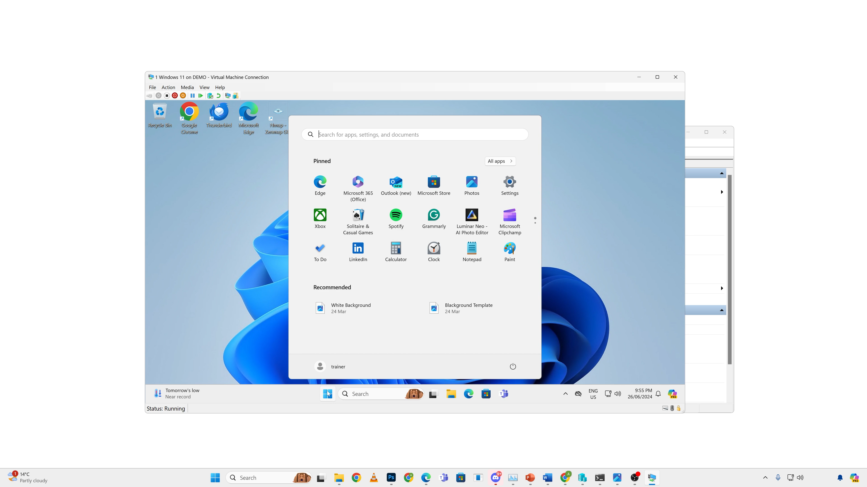
What is Desktop Virtualization?
ITFreeTraining.com
Notes:
02:13 To understand desktop virtualization, it helps to explore an example. In this case, Hyper-V is running on a server, allowing me to select and connect to a virtual machine. With Hyper-V, a remote desktop connection is used to access the virtual machine, prompting you to select the resolution. Once the resolution is selected, the desktop of the virtual machine will be displayed.
Once I log in, I am presented with a desktop. This desktop is a virtual machine running on the server and functions just like a regular physical computer, allowing me to install additional applications and make changes as needed. When the connection is set to full screen, the user experience mirrors that of a physical computer. This demonstrates why significant hardware processing is not required on the client device. The computer only needs to be fast enough to send user input to the server, receive video output from the server, and display it to the user.
Remote Desktop Services is Microsoft’s method for accessing a virtual machine. Other vendors may use different software to access virtual machines. The key takeaway is that a computer with limited hardware can access a virtual machine on another computer. This setup allows the virtual machine to be treated like a physical computer, enabling the installation of additional software. If you have used services like Terminal Services or Remote Desktop Services before, you might wonder what the difference is.

Slide 5
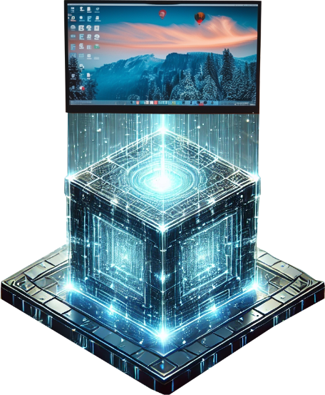


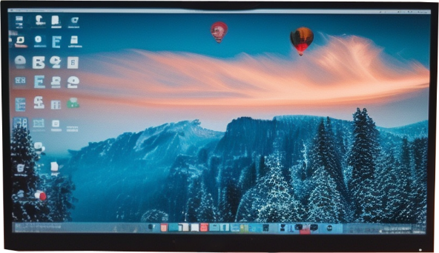

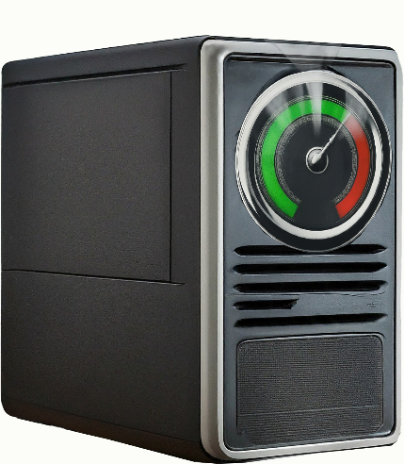

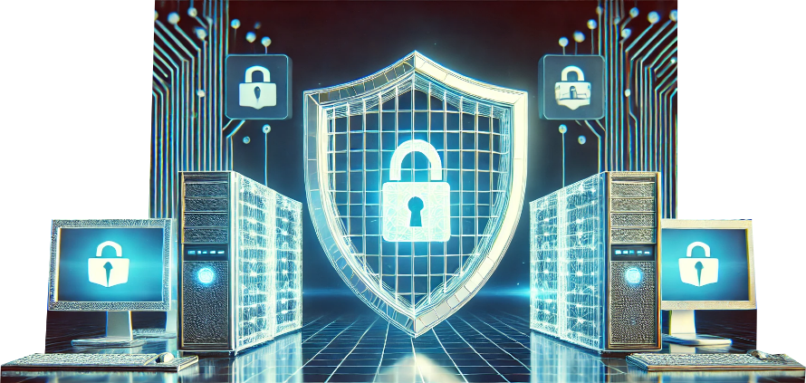
Terminal Services Vs Desktop Virtualization
Terminal Services
Desktop Virtualization
Session-based
Each user has virtual machine
Application based/Can run a desktop
VM
VM
VM
VM
VM
VM
All software executed on host
Software run in VM not on the host
Security risks
VMs Isolated
High system
requirement
Advantages
Disadvantages
Advantages
Disadvantages
ITFreeTraining.com
© Copyright 2025
Notes:
03:45 Terminal Services is session-based, whereas desktop virtualization provides each user with their own virtual machine. Since Terminal Services is session-based, it can be configured to deliver individual applications or an entire desktop environment. The key difference is that, in Terminal Services, all applications are executed on the host computer. In desktop virtualization, the complete operating system, including its applications, all runs within a single virtual machine. Both approaches have their advantages and disadvantages.
Since Terminal Services is session-based and the applications run on the host, it has lower system requirements. When multiple users on the same server run the same application, the server only needs to execute a single instance of the application. Additionally, because Terminal Services is session-based, each session can leverage shared operating system functions, reducing the overall resource consumption on the host.
The primary disadvantage of Terminal Services is the increased security risk. A security breach on the server could potentially impact all users on the server. In contrast, desktop virtualization isolates each virtual machine, providing greater security. However, the drawback of desktop virtualization is that it significantly increases system requirements. Both solutions do, however, reduce the hardware requirements for the client computer by leveraging the server's hardware.

Slide 6


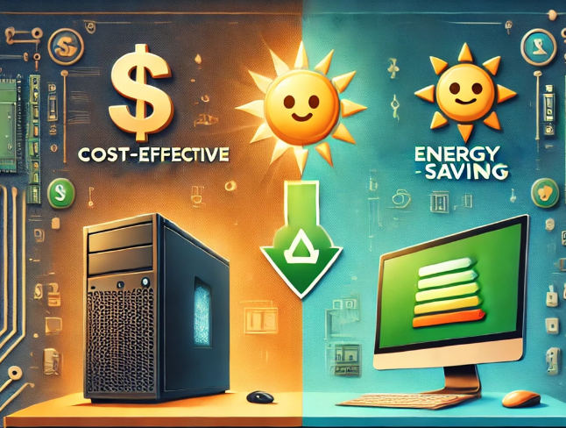
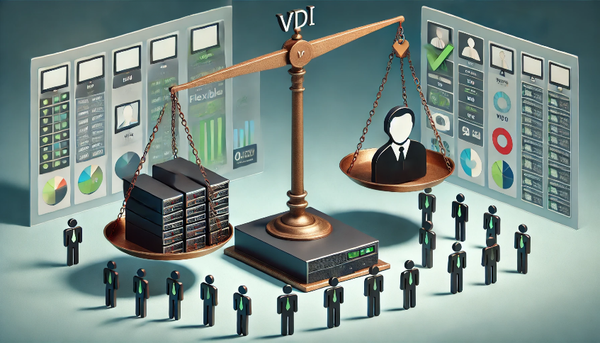
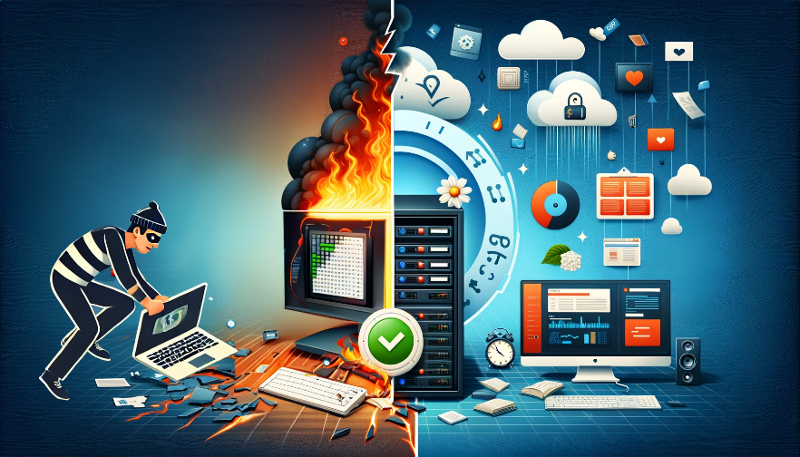
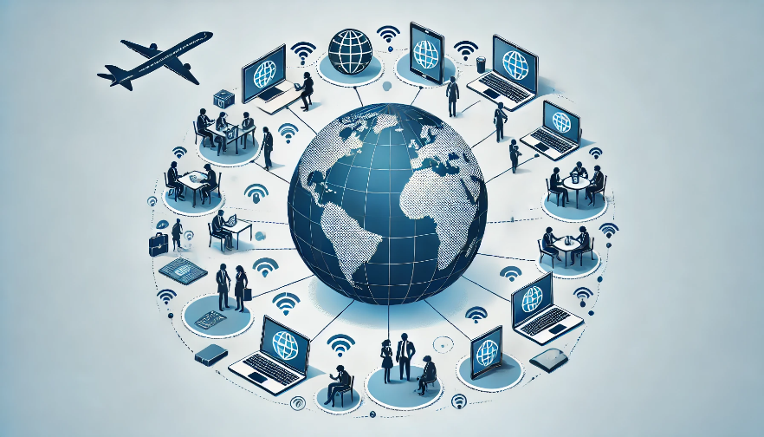

Virtual Desktop Infrastructure (VDI)
The user’s desktop environment runs on a server or in the cloud
VDI enables corporate desktop environments to be provisioned using desktop virtualization
Centrally Managed
Cost Effective
Scalability
Disaster Recovery
Flexibility
Security
ITFreeTraining.com
© Copyright 2025
Notes:
05:21 Virtual Desktop Infrastructure or VDI is a technology used to deliver a desktop environment to users, either hosted on a server or in the cloud. In simpler terms, VDI enables the provisioning of corporate desktops through desktop virtualization.
The user can access the desktop environment from their device, which could be a regular computer or a thin client. It can also be accessed from different operating systems, such as using a Linux machine to access a Windows virtual desktop. When virtual machines are used to deliver a desktop solution to users, this is often referred to as Desktop as a Service.
VDI offers several advantages, one of which is centralized management. Administrators can perform tasks such as updating virtual machine images with software updates and security patches from a single, central location.
VDI can also be cost-effective. Thin clients are typically less expensive and have a longer lifecycle than traditional desktop computers. Additionally, they consume less power, resulting in energy cost savings.
VDI simplifies scaling to accommodate changes in the number of users. Administrators can quickly provision new virtual machines or decommission old ones as needed. When leveraging the cloud, increasing capacity is as simple as purchasing additional resources.
Centralized data storage and virtual machine management enable robust disaster recovery options. VMs can be easily backed up and restored in the event of a failure.
VDI offers additional flexibility, allowing users to access their virtual desktops from any device and location, thereby improving productivity and facilitating remote work.
VDI enhances security by storing data centrally on the server instead of individual client devices, reducing the risk of data breaches from lost or stolen devices. Additionally, VDI environments can enforce strict security policies and access controls for greater protection.
While VDI offers many advantages, it also has its drawbacks. VDI involves high setup costs and complex management. Two of the most significant disadvantages for users are latency and hardware compatibility issues. Since the virtual machine is accessed over the network, it may respond sluggishly to user inputs. Additionally, local devices like USB drives and printers can be challenging or confusing to access through the virtual machine. As with most IT solutions, VDI comes with both benefits and trade-offs.

Slide 7
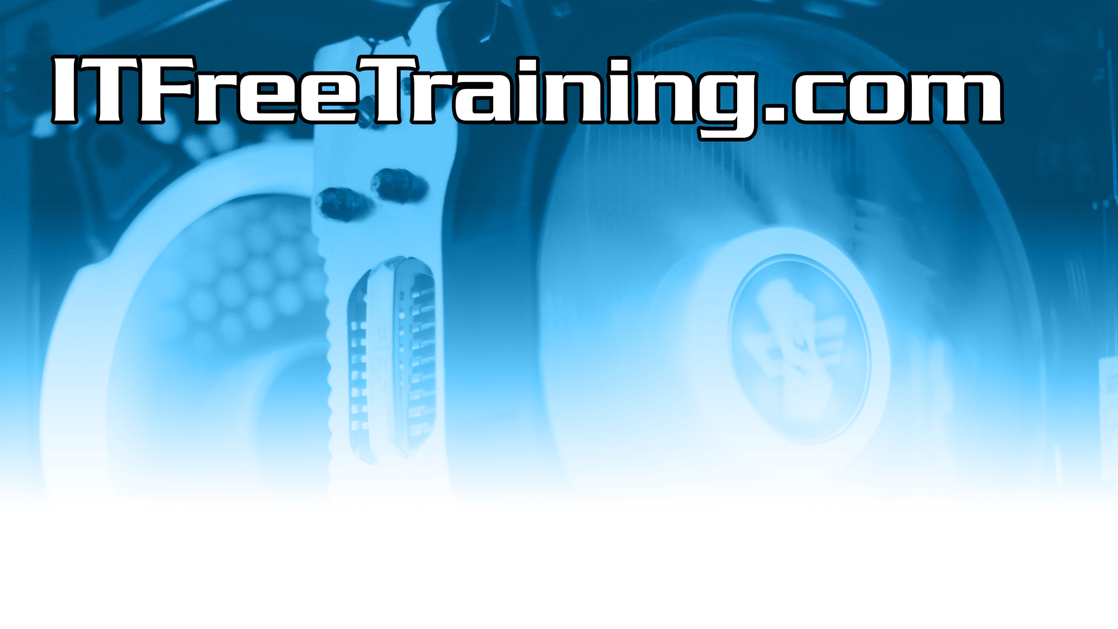
Subscribe
Next video
Video content: https://ITFreeTraining.com/ap11/7b10
© Copyright 2025
Notes:
08:05 If you enjoyed this deep dive into desktop virtualization, don’t forget to check out our other videos. Until next time, thank you for watching.
References
“The Official CompTIA A+ Core Study Guide (Exam 220-1101)” page 238
“License CC BY 4.0” https://creativecommons.org/licenses/by/4.0/
Credits
Trainer: Austin Mason http://ITFreeTraining.com
Voice Talent: HP Lewis http://hplewis.com
Quality Assurance: Brett Batson http://www.pbb-proofreading.uk

