Slide 1
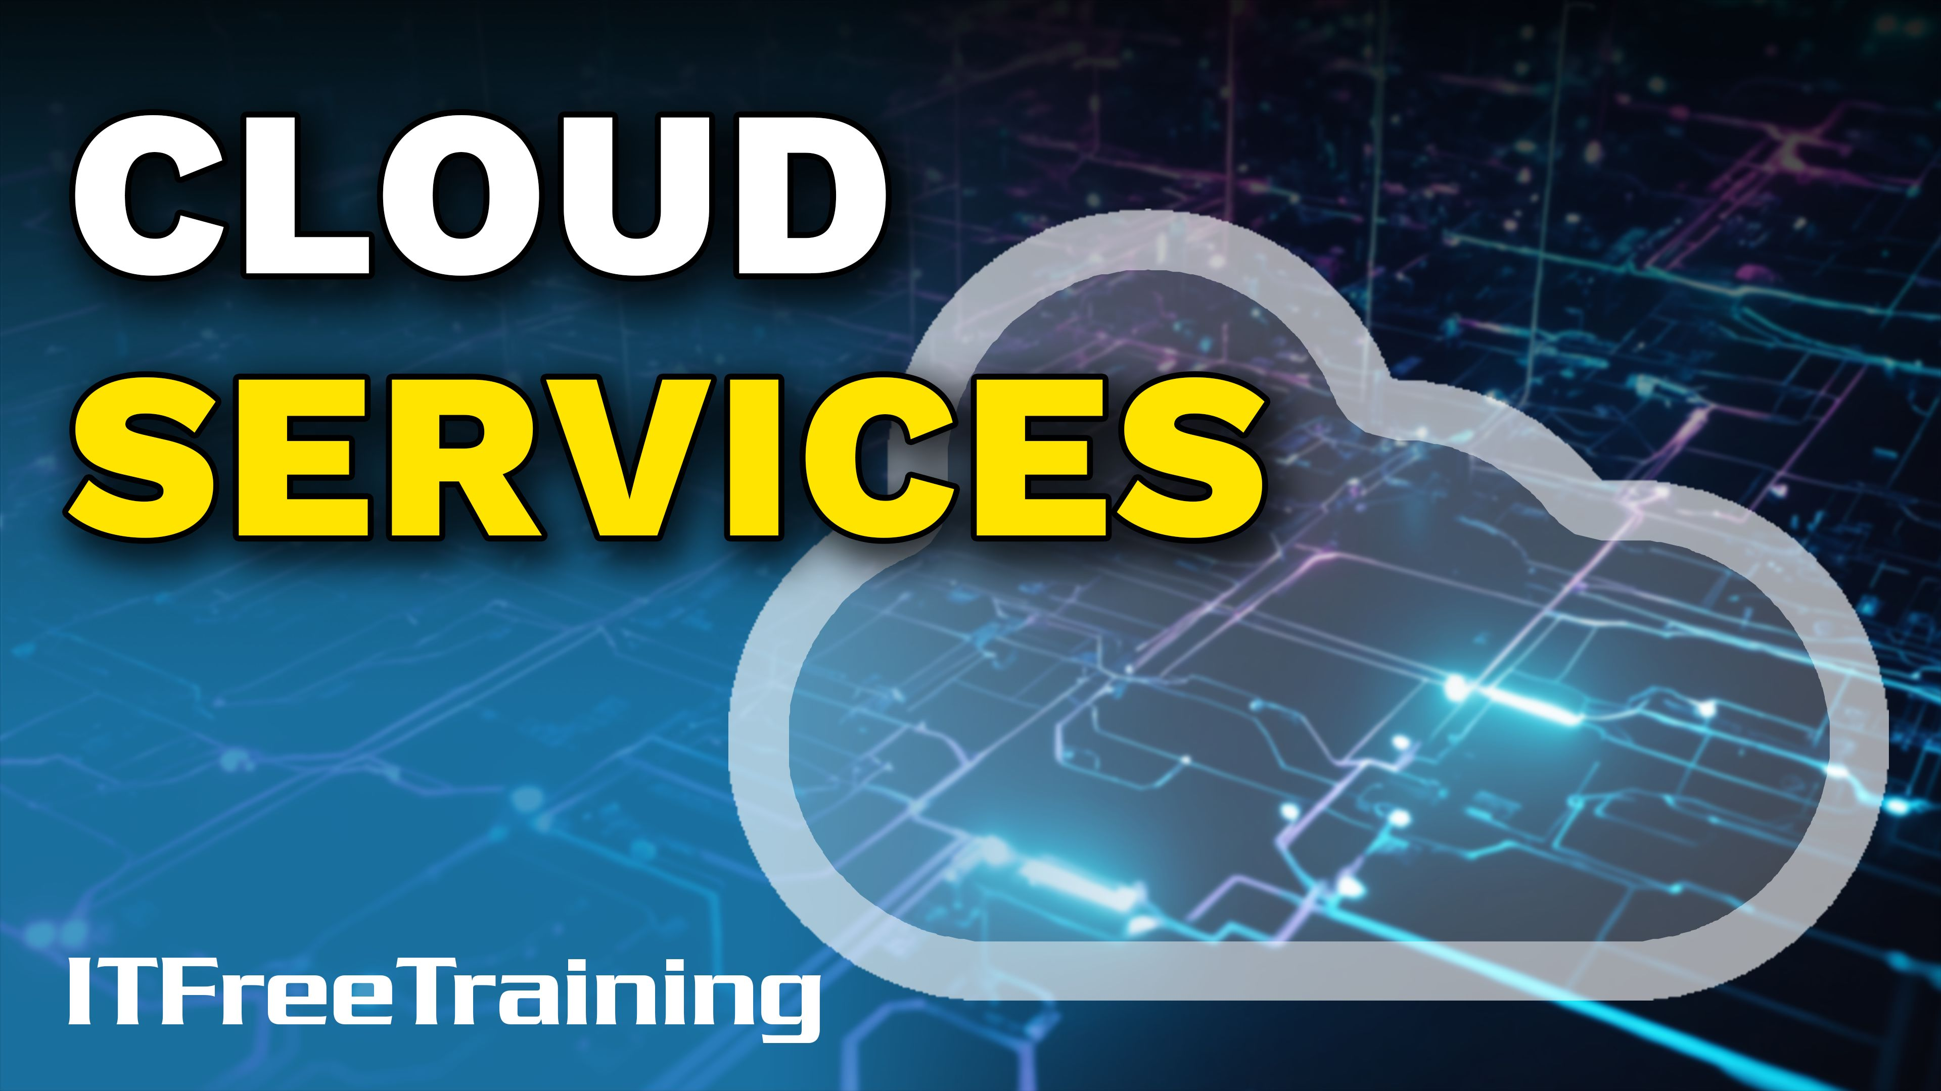
Notes:
Let’s have a look at cloud services.

Slide 2



What is the Cloud?
Network services not individually addressable
You may never know where your data or service is located
Can move data/services around without you even knowing it
Old network monitoring software
Network traffic routed inside the cloud to the other side
ITFreeTraining.com
© Copyright 2025
Notes:
00:03 To start with, what is the cloud? Explaining what the cloud is can be a little tricky, but I will give it a try. Back in the 90s, I remember looking at networking monitoring software and noticing a cloud icon on the screen. I saw a cloud icon on the screen and asked one of the other staff what it was. He told me that the network ran over many sites separated by big distances. To save on costs, some of the links between sites went over a telecommunication provider's switch network. They had no control of the data once it went onto their network, so essentially, the network traffic was routed inside the cloud and appeared out the other side. What route it took, we did not know, and it could change at any time.
If something went wrong, the cloud would start flashing but they had no information about where or what had gone wrong because it was in the telecommunication cloud. Was this where the term "cloud" came from, a simple network monitoring software that chose to use a cloud icon? In my opinion, this is where it came from, but other people may have different opinions.
So what would I say the cloud is? I would say it is network services that are not individually addressable. You connect to the cloud service over the network, but you may never know where your data is or where the service is. Unless, of course, it is a private cloud you created or have control over.
Clouds can also move data and services around without you even knowing it. This can be done for a number of different reasons. For example, for server loading and maintenance. Thus, nowadays I would define the cloud as network/data services that you can use but have no direct control over.
Nowadays, the cloud has advanced from just being an icon on a networking monitoring screen to being housed in large datacentres with hundreds and even thousands of computers inside. These datacentres are located all over the world, so do you really know where your data is or do you just say it is in the cloud?

Slide 3










Cloud Characteristics
Usage
Services on demand
On Demand
Different costs
Meter
Services
Glacier
Intermittently online
ITFreeTraining.com
© Copyright 2025
Notes:
02:10 When you start using cloud services, the model is very different from the traditional way a company may purchase servers and do it in-house. Cloud services are often on-demand. That is, you only pay for what you use. The advantage of this is that if your needs increase, you can purchase more services.
The costing of cloud services can vary a bit depending on who you purchase it from and what you purchase. Many cloud service providers will have metered-based billing. The more you use it, the more you pay. It is important to read what you are required to pay for and what is on demand. Some cloud providers will charge a minimum use and include a certain amount of resources with the base cost, for example, CPU or networking in the charge. Once this runs out, many cloud providers will either charge you more or throttle the resources down a considerable amount. If you are running a website, for example, and you use all your allocated CPU, the speed of your website may decrease significantly until the next billing cycle starts or you purchase more CPU resources.
Costing may also be based on the services you purchase. In some cases, this can be cheaper than using traditional services. For example, cloud services may be streamlined so you only purchase what you need. Traditional web services provided a lot of other services in the cost, for example, email and web statistics tools. If you only require web services, the cloud service provider may be able to sell you a very streamlined virtual machine that only does web services. This also makes the virtual machine more secure since it reduces the attack surface available for an attacker to use to hack into the virtual machine.
Although when you think of the cloud, you probably think of high availability, this is not always the case. For example, Glacier data storage from Amazon, although cloud-based, is only available sometimes. There may also be a delay in getting your data. The storage holding the data is cheaper storage than what is normally used and may be shut down at certain times to save power.
Glacier is designed for archiving data that you don’t need quickly. Glacier data is not always available online and thus, there may be a delay retrieving the data. Since it takes time to retrieve, it comes at a much lower cost than always-online data. Thus, it is worth taking the time to see what is available in the cloud and how much it will cost you.
More and more businesses are starting to put data in the cloud. With more people working from home, it makes sense. It is even possible to have a computer remotely managed by a cloud provider. Some companies, when they hire a new staff member, have them purchase their own computer and add it to the network to be remotely managed rather than providing one. The world is changing, but we can be sure that cloud computing is only going to become more common in the future.
Let’s have a look at some of the common types of clouds.

Slide 4




Public Cloud
Accessible to the general public
May be called multitenant (consumers referred to as tenants)
Usually pay-as-you-go. Some lower tier services may be free
Microsoft Azure
Amazon Web Services
Google Cloud
ITFreeTraining.com
© Copyright 2025
Notes:
05:16 One of the most commonly used types is public clouds. These clouds are as the name suggests accessible to the general public. The top three Cloud services are Microsoft Azure, Amazon Web Services, and Google Cloud.
Public clouds may also be called multitenant, referring to many tenants using the service. Usually, these services are pay-as-you-go; however, some of the lower-tier services may be free. For example, you may be able to access some publicly shared Google Drive files even if you don’t have a Google account.
Let’s now look at the next type of cloud.

Slide 5





Private Cloud
Completely owned by the organization
May be shared with other business units in the same organization
Greater control over security and privacy
Private Cloud
ITFreeTraining.com
© Copyright 2025
Notes:
05:56 Since a public cloud is available to the public, it presents a higher risk of data being stolen. A private cloud, in contrast, is completely owned by the organization. Essentially, the workers in the organization will connect to the private cloud.
Since the private cloud is inside the network, it will generally be behind the company firewall, thus helping keep it safe from attacks from the internet. The private cloud may be shared with other business units in the same organization. This is generally done through the company's internal network, although you could put the private cloud on the internet. The main reason for using a private cloud is greater control over security and privacy.
Private clouds are usually used by banking and government services that require strict access to their operations. Running a private cloud is more expensive than using a public cloud. You would use it when security is more important than cost.
If there are multiple organizations requiring the same services or want to reduce their costs, there is another solution they can use.

Slide 6




Community Cloud
Shared by multiple organizations but not the public
Pools resources together
Shared policies and protocols
Shared data and applications
Low costs
ITFreeTraining.com
© Copyright 2025
Notes:
07:04 When there are multiple organizations that want to share data or access to applications, there is the option of a community cloud. A community cloud is shared by multiple organizations but not the public. Essentially, it pools resources together from multiple organizations.
When a community cloud is created, it shares policies and protocols with all the organizations that use it. Thus, you would expect a community cloud to be created between organizations that have similar objectives and security requirements. For example, different military organizations may use a community cloud to share intel between them, since they have common interests and security requirements.
Having a community cloud allows shared data and applications. It is becoming more common to have applications run online. It makes sense that if you are developing an application, you should share the development costs between different companies if possible.
Having a community cloud often results in reduced costs for all the organizations using it. There are a lot of advantages to a community cloud if you have organizations with similar needs and who can agree on how to implement it.

Slide 7

Hybrid Cloud
Uses both public and private clouds
Private cloud uses public cloud during high utilization (Breakout)
Some functions (e.g., sensitive) kept in private cloud
ITFreeTraining.com
© Copyright 2025
Notes:
08:17 The last type of cloud is the hybrid cloud. These clouds use both private and public clouds together. There are a number of different reasons you may want to do this. For example, using a private cloud that will use public cloud resources during high utilization. This may be referred to as a “breakout.” For example, an organization that is launching a new product and expecting a high initial demand but will quickly slow down after the initial launch. It is more cost-efficient to purchase some public cloud resources temporarily than to purchase new hardware that will only be utilized for a short period of time.
The other way this is generally implemented is for some functions to be kept in the private cloud and others handled by the public cloud. Sensitive functions like customer information and billing information may be kept in the private cloud. The public cloud could be used to process data for customers. This way, if the public cloud data were to be breached, no sensitive information would be able to be stolen.
The services that clouds can provide can be broken up further. Let’s have a look.

Slide 8

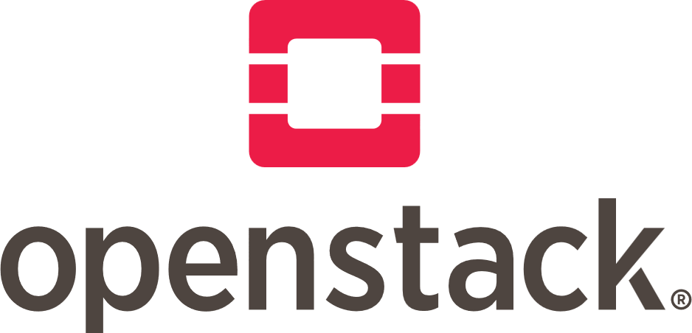

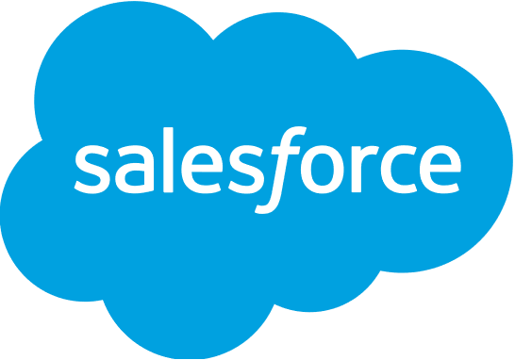

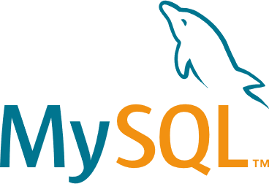


Common Cloud Service Models
Servers/Storage
Bare metal/Customized OS
Infrastructure as a Service
(IaaS)
Microsoft® Azure®
Virtual Machines
Amazon Elastic
Compute Cloud
Openstack
Software applications
Pay-as-you-go
Software as a Service
(SaaS)
Microsoft Office 365®
Salesforce
Google Workspace
Provides services
Database/Application
May be built on an OS
Platform as a Service
(PaaS)
Oracle
MySQL
PHP
ITFreeTraining.com
© Copyright 2025
Notes:
09:23 The services provided by clouds can generally be divided into three categories. For the exam, it is important to know each of these and understand the basics of what they apply to. You may get a question giving you a scenario and asking which model applies best.
The first one is Infrastructure as a Service. Infrastructure as a Service provides a bare metal computer, basically a virtual machine, to install your OS on. In a lot of cases, they will also offer a customized OS for you to use. Just like a regular computer running an operating system, you will need to install and configure the software that you want to use.
Examples of Infrastructure as a Service include Microsoft Azure, Amazon Elastic Compute Cloud, and OpenStack.
Next, there is Software as a Service. This is essentially licensed software. You generally pay as you go for how many licenses you use. Examples of these include Microsoft Office 365, Salesforce, and Google Workspace.
Software as a Service includes your ready-to-go applications. For example, your Office applications. The other cloud models require configuration and additional work in order to get them to work.
Lastly, there is Platform as a Service. Platform as a Service provides services like databases and applications. The application support is not the full ready-to-go applications like before but instead services that you would build large applications on. Examples of Platform as a Service include Oracle, MySQL, and PHP.
For the exam, it is important to understand the differences between each one. Although you don’t really need to have much in-depth knowledge of how they work. I will now have a quick look at some of the services of Amazon to give you a better understanding of how cloud services work.

Slide 9
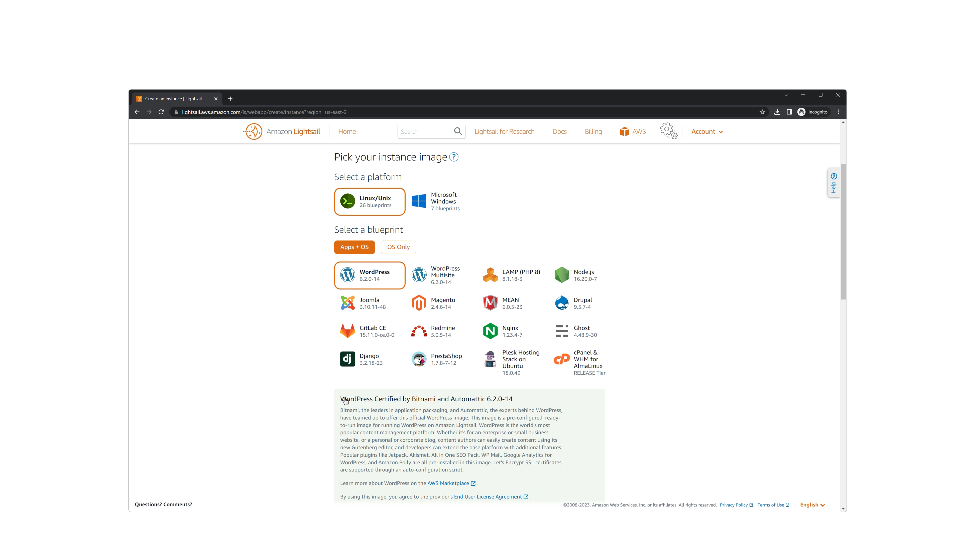
Demonstration
ITFreeTraining.com
© Copyright 2025
Notes:
11:27 I have logged into Amazon Lightsail. Amazon Lightsail allows you to create virtual machine instances using preconfigured configurations. You have the option to install Linux or Microsoft Windows. Notice the option “App + OS” is selected. Below this are all the pre-configured installations available, referred to as blueprints. This is an example of Infrastructure as a Service since we are getting a virtual machine running an OS.
You will notice that the first option is WordPress. WordPress is a popular web content management system. So if this option is selected, the operating system will be installed, and WordPress will automatically be installed for you.
You may think this makes it a Platform as a Service. However, keep in mind that a virtual machine has an OS installed and the application is installed on top. You are free to make changes you want to the OS. If you had access to only WordPress and not the underlying OS, this would be an example of platform as a service.
You will notice a bit further down there is more information about what is actually being installed. The first thing to notice is Bitnami. Bitnami is a company that specializes in creating a library of installers and software packages, essentially automating the WordPress installation.
You will also notice further down that a number of popular plug-ins are automatically installed, saving you the time to install these yourself. However, the installation goes much further still. The operating system is hardened. Hardening is the process of locking down parts of the operating system that are not required, for example, closing ports that are not required or removing or never installing packages that are not required. The main takeaway from this is that by using this blueprint you are getting a specialized installation. The installation and operating system are customized just for running WordPress. No extra features are installed that are not required, and extra security is configured. The end result is a lean, secure virtual machine designed just for running WordPress. Keep in mind that since you have a full OS, you can install additional applications and make additional configuration changes.
When I select “OS only,” I can also install an operating system only. By doing this, I would need to install and configure everything that I wanted to use. This would be an example of Infrastructure as a Service. There is not much hand-holding here; you get a basic virtual machine running the operating system you selected and you work up from there.
You can see Software as a Service is designed to provide a specific software service. If you could somehow separate WordPress from the operating system, you would still be provided WordPress but in a different form. The focus is on providing you the software. Other examples of Software as a Service include where a database is provided online for you to use. Perhaps you have a mobile app that needs to store data somewhere, and thus you need an online database for that purpose.
There is also an option for Microsoft Windows operating systems. Notice that there is an option for “App + OS” and “OS only” like before. Below this, notice “Windows-based instances prices reflect additional licensing fees.” When you purchase an instance, this also includes the licensing fees from Microsoft. Thus, you can see one of the advantages of purchasing an instance. You essentially only pay for the license while you are using it.
The only option for applications is for SQL Server using different versions of Windows Server. Like before, you can install just the operating system if you wish.
When I scroll down, you can see the current prices for the instance. It is important when purchasing an instance to understand what you are purchasing. Notice that you can sort the pricing by memory, processing, storage, and transfer. It is important to understand what you are getting and also understand that values like processing and transfer are limited amounts. Once they run out, often they will run at a significantly reduced rate for a while. If your server is under load, you will most likely notice the instance slowing down. So, it is important to purchase an instance that will meet your needs.

Slide 10




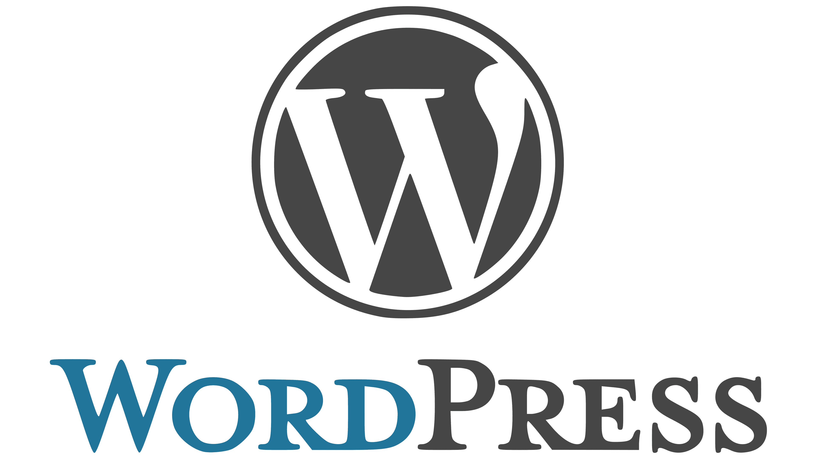


Common Cloud Service Models
Infrastructure as a Service (IaaS)
Virtual Machines
Full OS
Software as a Service (SaaS)
Microsoft Office 365®
Google Workspace
Salesforce
Adobe Creative Cloud
Platform as a Service (PaaS)
Content Management System
SAP Cloud Platform
ITFreeTraining.com
© Copyright 2025
Notes:
16:11 I will now have another quick look at the common Cloud Service Models. It is important to know this. Infrastructure as a Service is when you are looking at, as the name suggests, infrastructure technology. This is generally virtual machines or full operating systems. These devices don’t have a lot of customization; that is left for you to do.
Software as a Service is when the software is hosted in the cloud and you access it from your device. Examples of this include MS Office 365, Google Workspace, Salesforce, and Adobe Creative Cloud. Software may be downloaded and run locally on your computer, but the software itself primarily exists in the cloud.
Platform as a Service offers resources in the cloud but essentially exists between Infrastructure as a Service and Software as a Service. Even if the platform is installed on top of an operating system, the operating system will be customized or locked down for the platform it is running. It is also not designed to run an application for a user but rather to provide resources. Examples include WordPress, Joomla, and SAP Cloud Platform. SAP Enterprise Cloud Platform is a platform used to manage resources in a large organization.

Slide 11
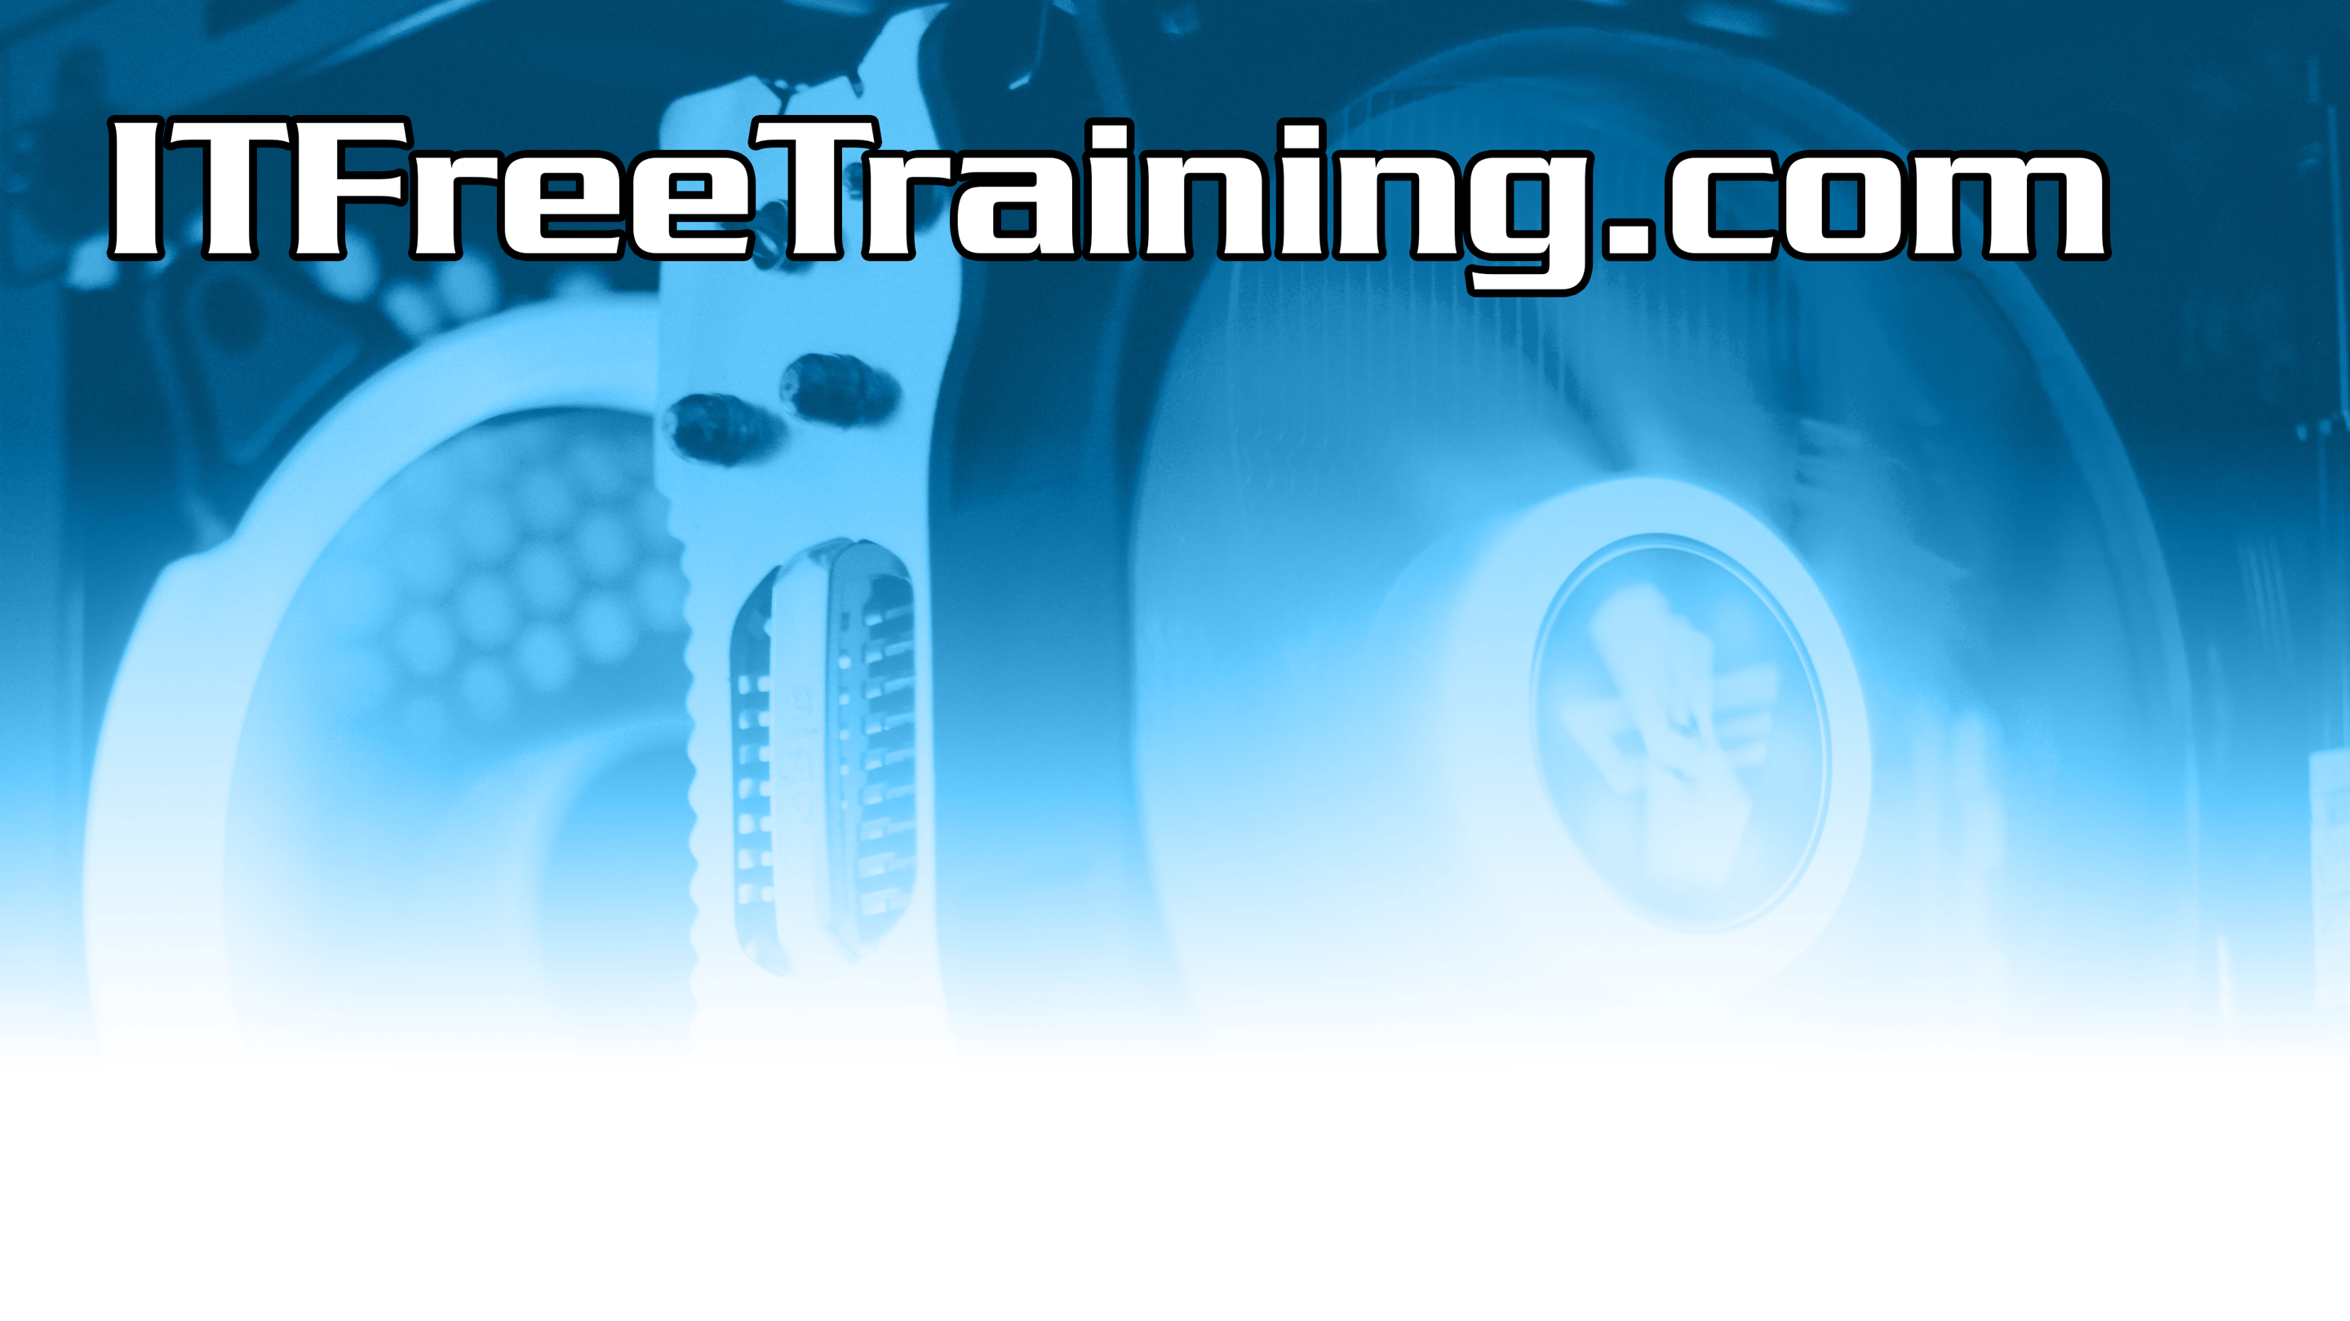
Subscribe
Next video
Video content: https://ITFreeTraining.com/ap11/7b05
© Copyright 2025
Notes:
17:34 That concludes this video on cloud services. I hope you have found this video informative. Until the next video from us, I would like to thank you for watching.
References
“The Official CompTIA A+ Core Study Guide (Exam 220-1101)” pages 235 to 237
“Picture: Microsoft Azure Logo” G:\.shortcut-targets-by-id\10GMruwCoi5942bCdbUMsUiNdws6xEo9g\ITFreeTraining WorkFlow\04d Active Development\AP11 7B05a Cloud Services\Project Files\Resources
“Picture: AWS” https://commons.wikimedia.org/wiki/File:Amazon_Web_Services_Logo.svg
“Picture: Google Cloud” https://commons.wikimedia.org/wiki/File:Google_Cloud_logo.svg
“Picture: Amazon Elastic Compute Cloud logo ” https://commons.wikimedia.org/wiki/File:AWS_Simple_Icons_Compute_Amazon_EC2_Instances.svg
“Picture: Office 365 logo” https://commons.wikimedia.org/wiki/File:Microsoft_365_(2022).svg
“Picture: Saleforce logo” https://en.wikipedia.org/wiki/Salesforce#/media/File:Salesforce.com_logo.svg
“Picture: Google Workspace” https://en.wikipedia.org/wiki/Google_Workspace#/media/File:Google_Workspace_Logo.svg
“Picture: Oracle” https://en.wikipedia.org/wiki/Oracle_Corporation#/media/File:Oracle_logo.svg
“Picture: MySQL” https://en.wikipedia.org/wiki/MySQL#/media/File:MySQL_logo.svg
“Picture: PHP” https://en.wikipedia.org/wiki/PHP#/media/File:PHP-logo.svg
“Picture: Windows logo” https://en.wikipedia.org/wiki/Microsoft_Windows#/media/File:Windows_logo_and_wordmark_-_2021.svg
“Picture: Tux Logo” https://commons.wikimedia.org/wiki/File:Tux.png
“Picture: SAP Logo” https://commons.wikimedia.org/wiki/File:SAP_2011_logo.svg
Credits
Trainer: Austin Mason http://ITFreeTraining.com
Voice Talent: HP Lewis http://hplewis.com
Quality Assurance: Brett Batson http://www.pbb-proofreading.uk

