Slide 1
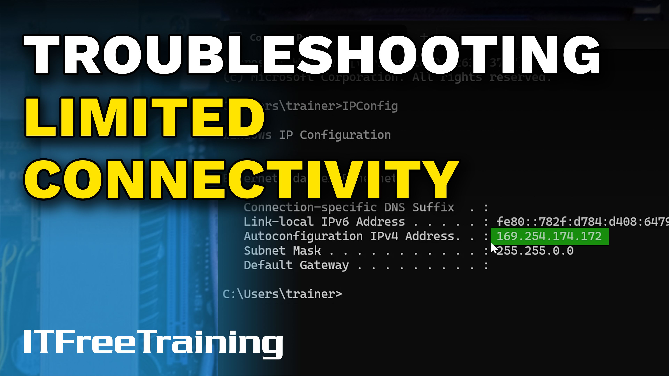


Notes:
Let’s look at solving connectivity problems.

Slide 2


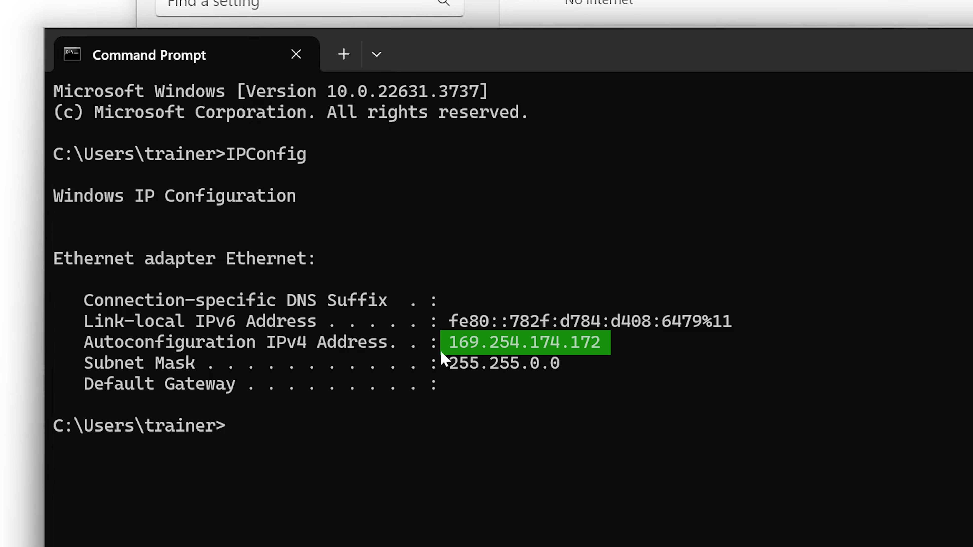
Limited Connectivity
Have some network connectivity (No internet access)
ITFreeTraining.com
Notes:
00:04 In Windows, limited network connectivity is defined as having some network connectivity, but it is limited in some way. If the computer can’t access the internet, it is considered to have limited connectivity. On an isolated network, this is to be expected, for this video it is assumed the computer is required to have access to the internet.
To troubleshoot limited connectivity issues, I will start with no infrastructure and progressively add working components one at a time. You can follow the same systematic steps to diagnose and resolve network problems as demonstrated in this video.
You will notice in the bottom right-hand corner the "Network Connection" icon. Hovering over this icon will show that the network is currently unidentified and there is no internet access.
Right-clicking on this icon will give the option “Network and Internet settings.” Selecting this option will open the “Network & Internet” screen, which provides useful information about the network adapters in the computer.
Notice that the Ethernet adapter is listed as having no internet. Let’s start the troubleshooting process and work out how to fix it. Below this is the option “Ethernet.” Selecting this option will open the configuration settings for the Ethernet adapter.
One of the first things I would check is the IP configuration. In the case of this network adapter, it has been set to automatically obtain the IP address configuration from a DHCP server. The next step is to check if the computer has obtained an IP address. To do this, I will open a command prompt from the start menu.
From the command prompt, I will run the command IPConfig. This tool provides a lot of information about the configuration of your network adapters and allows you to perform various functions. You will notice that the IP address starts with 169.254. You will also notice that there is no gateway listed. Let’s take a closer look at what has happened.

Slide 3


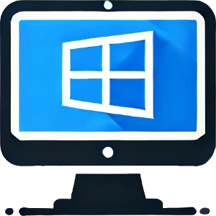



APIPA
Automatic Private IP Addressing
Windows automatically configures an IP address when no DHCP server is available
Randomly configures IP address between 169.254.0.0 and 169.254.255.255
Created APIPA
Depends on distribution configuration
Otherwise sets to 0.0.0.0
Computers can only communicate within same segment
No routing
169.254.123.57
169.254.123.57
169.254.12.68
169.254.16.167
ITFreeTraining.com
Notes:
02:07 APIPA, or Automatic Private IP Addressing, is a feature in Windows operating systems that allows a computer to automatically assign itself an IP address when no DHCP server is available. It was developed by Microsoft for Windows 98 and is still used by Windows today.
When a computer is configured to automatically obtain an IP address but cannot obtain one from a DHCP server, Windows will randomly assign an IP address starting with 169.254.
Some alternative operating systems may also use APIPA. In the case of Linux, it depends on the distribution and how it is configured. Operating systems that do not use APIPA will generally set the IP address to all zeros or leave it blank when they cannot obtain an IP address from a DHCP server.
APIPA was designed so a computer could configure itself with an IP address without any infrastructure on the network and communicate with other computers on the same network. However, APIPA cannot configure a routable address and therefore will not configure a gateway address, just an IP address and subnet mask.
This means that if you have different networks separated by a router, the computer will not be able to communicate across the router.
In the real world, you probably will not use APIPA. However, APIPA is useful because as soon as I see an APIPA address, I know something has gone wrong.

Slide 4
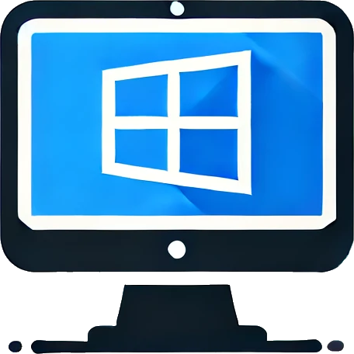

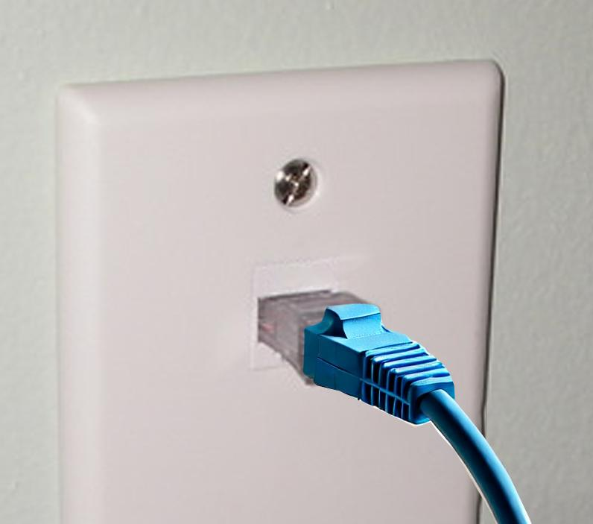
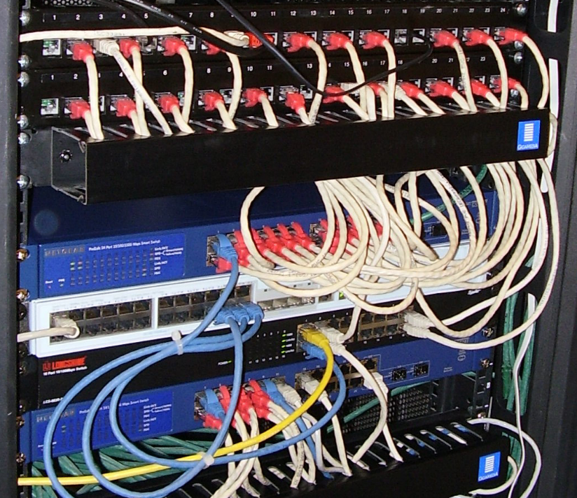
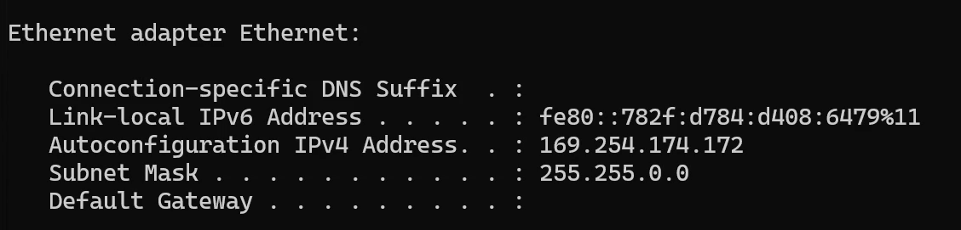
Troubleshooting DHCP Connectivity Issues
Computer not able to contact a DHCP server
Configuration
Cable damage
Cable plugged in
Connected to correct port
Correct VLAN
ITFreeTraining.com
Notes:
03:38 When you get an APIPA address, most of the time it means the computer was not able to communicate with a DHCP server. When fixing the problem, start from the computer and work your way out logically.
The first thing I would check is the configuration of the computer. This involves having the network adapter configured to obtain an IP address and DNS servers automatically.
Next, I would check for cable damage. Most of the time, when network cables get damaged, the plastic clip on the network cable has broken off. This small clip holds the cable in place, and when it breaks, the network cable can easily come out.
Next, check that the cable is plugged in, especially if the clip is broken. If the cable is not fully inserted, your computer won’t be able to communicate on the network. Lastly, check the other side of the connection to ensure the network cable is plugged into the correct port and set up for the correct VLAN.
If the device is connected to the wrong network, it may not be able to obtain an IP address.

Slide 5

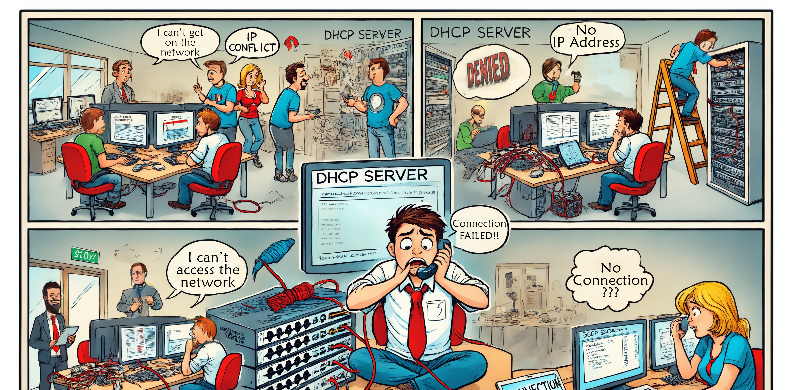

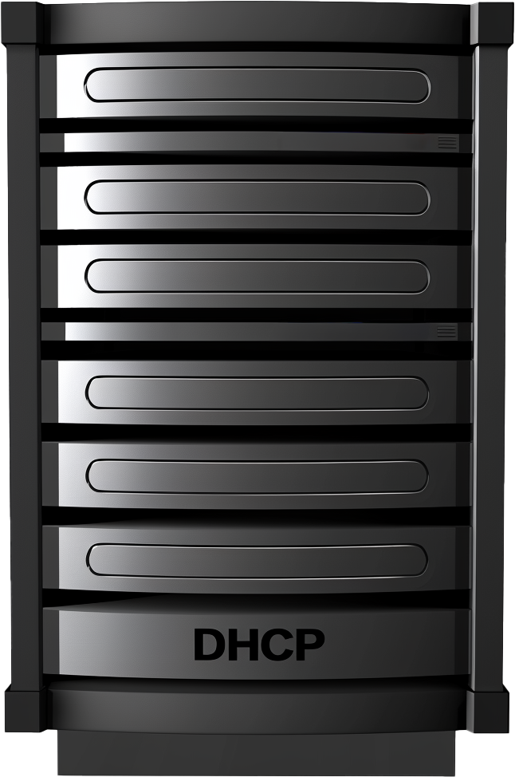

Common DHCP Problems
Server down
Device not authorized
No IP addresses in pool
ITFreeTraining.com
Notes:
04:45 There may be problems with the DHCP server that are preventing you from getting an IP address. If the server is down, you won’t be able to get an IP address. On modern company networks, there may be additional security measures preventing a computer from obtaining an IP address. For example, the MAC address may need to be registered on the network before it will allow access.
If the DHCP server has run out of IP addresses, you won’t be able to obtain an IP address. Company networks are usually designed to prevent running out of IP addresses, but I have worked for one company where this was a problem. To solve it, we had to reduce the amount of time a device could keep an IP address, thus freeing it up sooner and making better use of the IP addresses we had.
In this example, the server running DHCP is currently off, which is why I can’t get an IP address. So, I will start it up and try again.

Slide 6
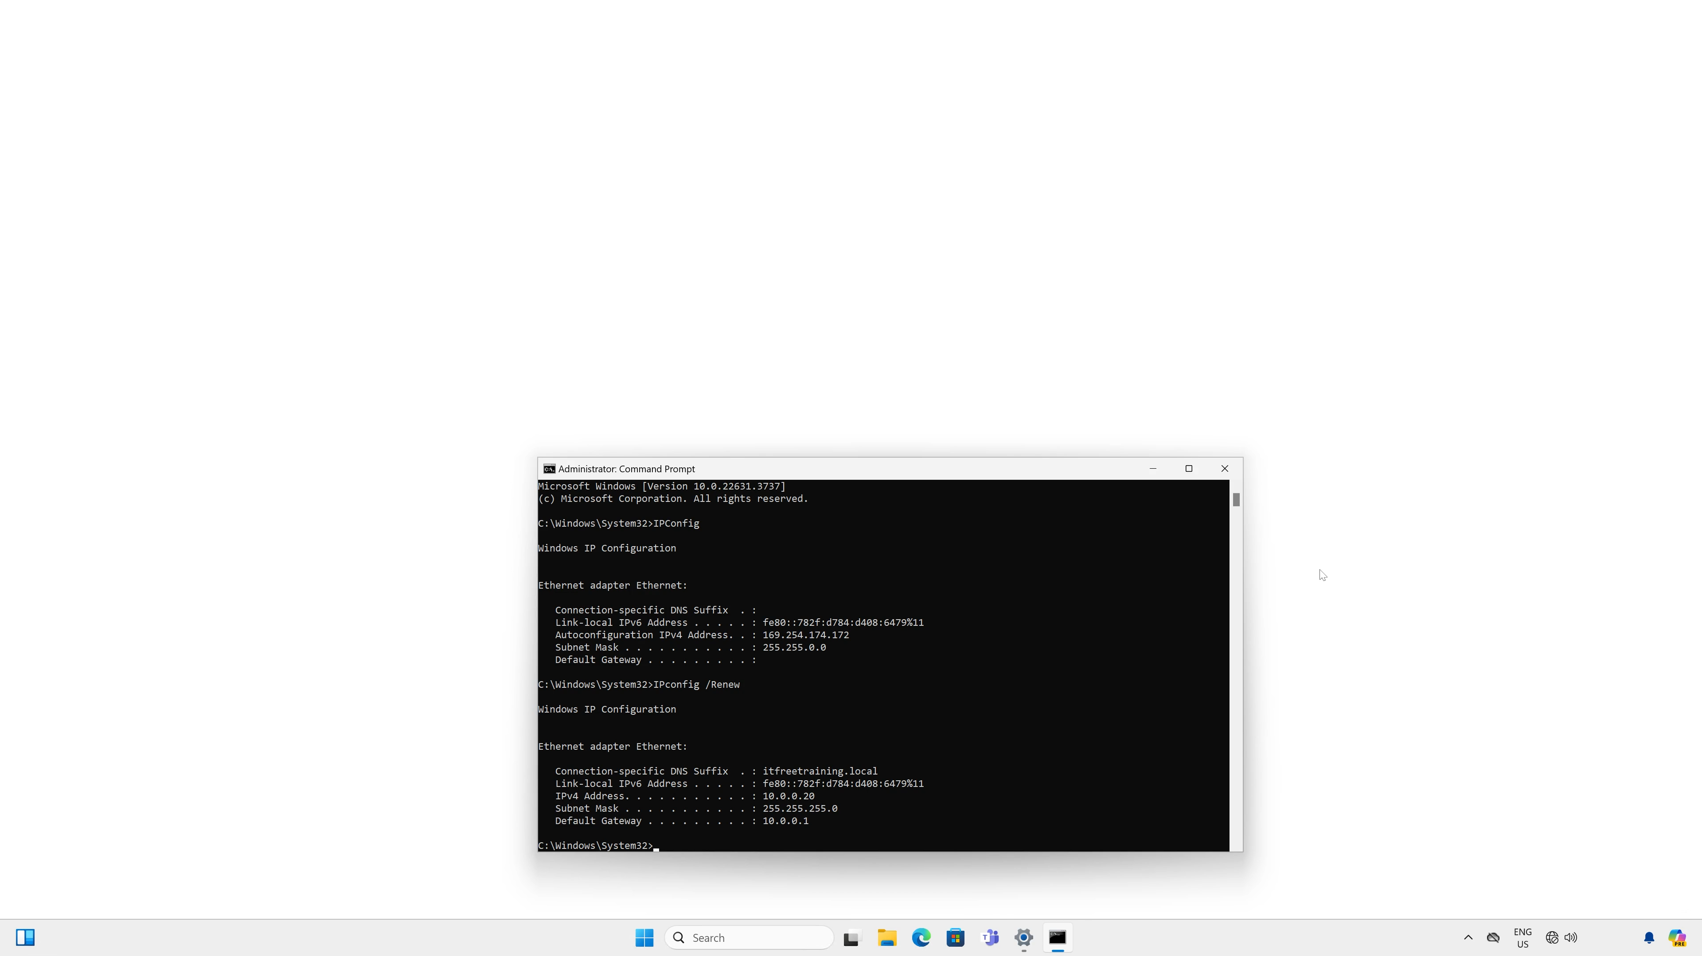
Obtaining an IP Address
Device will attempt automatically or it can be forced
IPConfig /renew
ITFreeTraining.com
Notes:
05:42 Most devices will attempt to obtain an IP address periodically or after events like the network cable being plugged in. One trick to get the device to re-attempt obtaining an IP address is to unplug the network cable and plug it back in. On Windows, you can run the command IPConfig /renew to force Windows to attempt to obtain an IP address.
To run IPConfig, I will open a command prompt from the start menu. To run certain commands, you will need an elevated command prompt. To open an elevated command prompt, I will right-click on “Command Prompt” and select the option “Run as administrator.”
Once I press “Yes,” the command prompt will open with elevated permissions, meaning it will be running with administrator access. I will now run the command IPConfig. With no parameters, IPConfig will show the basic network configuration. You can see I still have the APIPA address.
To force the computer to attempt to obtain an IP address, I will run the command IPConfig /renew. After a short delay, the computer will obtain an IP address and display it. DHCP can also provide other network configurations as well. Since this computer is part of a domain, notice that the DNS suffix for the domain has also been provided.
You will notice that when I hover over the network icon, the network is now shown as the domain name; however, there is still no internet access. Before I troubleshoot this any further, I will first look at how Windows determines if a computer has access to the internet.

Slide 7

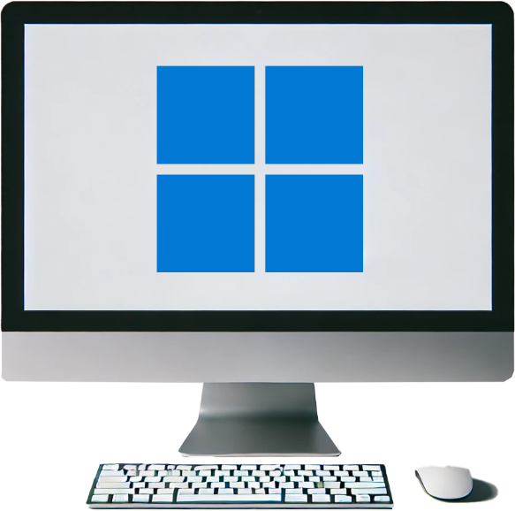



Microsoft Probe Internet Test
Network Connectivity Status Indicator (NCSI)
Connects to http://www.msftncsi.com
If the test file is successfully downloaded, the internet is considered connected
Start test
Resolve DNS name
Route request
Return file
ITFreeTraining.com
Notes:
07:23 To determine if the internet is available, Windows will probe the internet to see if it can access a website. The official name for this is the Network Connectivity Status Indicator. The website is always the same, and the internet is considered working if Windows can download a test file from this website. The test file is a small text file on the website.
When troubleshooting network problems, it helps to break them down into steps. Stepping through the required steps can help you identify where the problem is.
To test if the internet is accessible, Windows will start the test by downloading a file from the website. To do this, Windows first needs to resolve the DNS name for the website. Once resolved, the request will need to be routed across the internet to the website. Once the website is reached, the file needs to be returned to the computer.
At each step, things can go wrong. Services may be down, or security on your network may be blocking the test. In the case of our example, we have an IP address, so the next step would be to resolve the DNS name for the website.

Slide 8
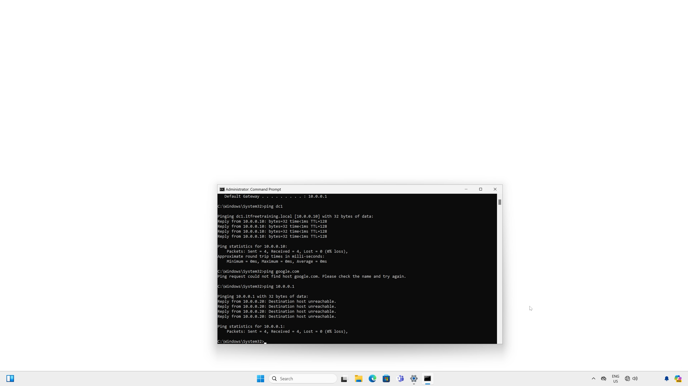
Testing DNS
Pinging a DNS name will cause the name to be resolved
Keep in mind that DNS does cache domain names
Try a DNS name that is unlikely to have been cached
ITFreeTraining.com
Notes:
08:32 The next step I will do is test if DNS is working. Since this computer is in a domain, I will try to ping the local domain controller. You will notice that the IP address is resolved, and I get a response back from the domain controller. So it appears that DNS is working for the local network.
Next, I will try to ping google.com. This will test if the external DNS name can be resolved. You will notice that the domain name will not be resolved. Keep in mind that DNS can cache names. If a name resolves, it may be because it was cached. If the name resolves to an IP address but you don't receive a response to a ping, there might be an issue elsewhere in the network. If you think the DNS may have been cached, try a domain name that is unlikely to be in the cache.
It appears there are some problems with DNS, as the domain was not resolved. Next, I will ping the default gateway. The default gateway was given to us by the IPConfig command. The default gateway is used by this computer and the domain controller to exit this network and reach other networks and the internet.
When I ping the default gateway, notice that I do not get a response back. This is because my default gateway is currently down. This would explain why Windows is reporting no internet access. To fix this problem, all I need to do is start my router.

Slide 9
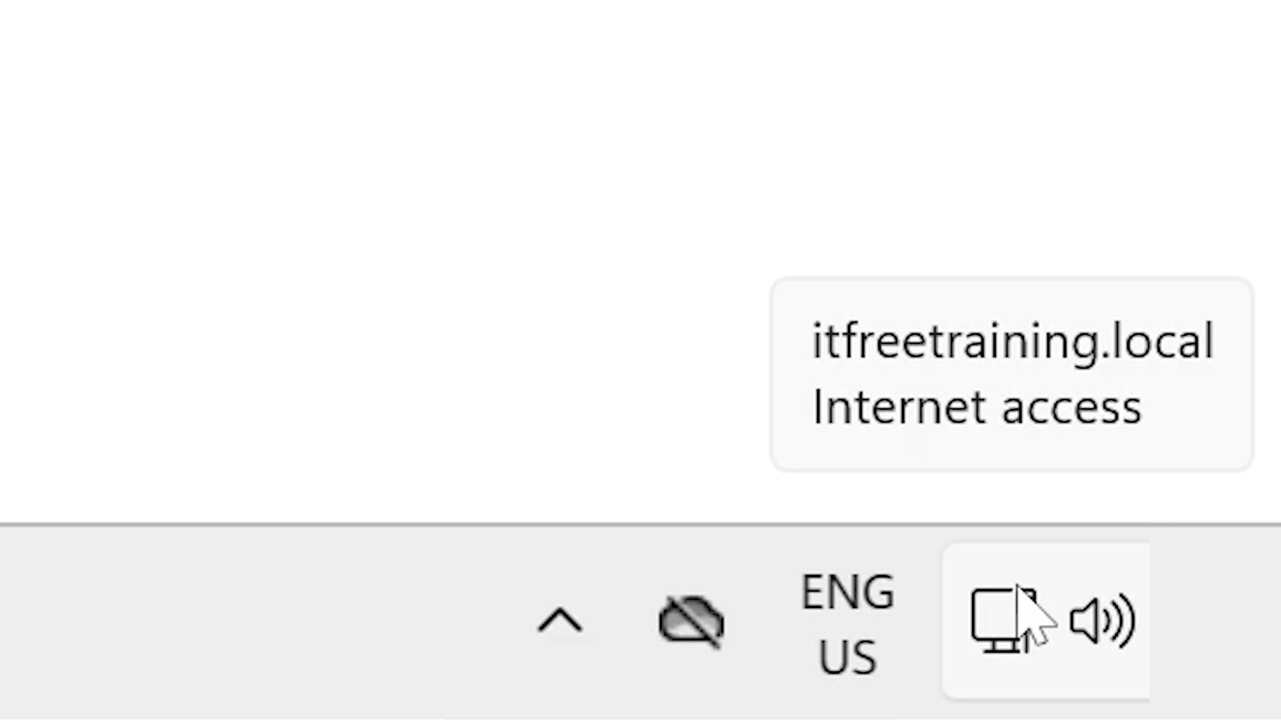
Summary
Check the Network adapter
Physical connection
Network adapter configuration
Check the network port
Plugged in the correct port
On correct VLAN
Network infrastructure
DNS/DHCP
Gateway and internet connection
ITFreeTraining.com
Notes:
10:01 Now that I have started my router, you will notice that the connection is now reported as having internet access. Microsoft will periodically test if the internet is working, so it may take some time for the network connection to update its status as having internet access or not.
When troubleshooting network problems, check the network adapter. You want to check both the physical connection and the configuration.
Next, check the network port. Ensure it is plugged into the correct port and on the correct VLAN. You also want to check the network infrastructure, including DNS and DHCP. Lastly, check that the gateway and internet connections are working.
Different technicians will check for problems in different ways. For example, some may try to ping an internet address and work their way back. It doesn’t matter what order you do it in; you could even do it out of order. The important thing to remember is that it is a process of elimination. Work out what is working, and this will lead you to what is not working.

Slide 10

Subscribe
Next video
Video content: https://ITFreeTraining.com/ap11/6c25
Notes:
11:06 You have reached the end of this video. If your network is still down, remember: a well-placed whack on the side of the router sometimes works (just kidding, please don’t do that). For more tech tips and troubleshooting adventures, check out our other videos. Until the next video, thanks for watching.
References
“The Official CompTIA A+ Core Study Guide (Exam 220-1101)” page 223
“License CC BY 4.0” https://creativecommons.org/licenses/by/4.0/
“Windows logo” https://en.wikipedia.org/wiki/Microsoft_Windows#/media/File:Windows_logo_and_wordmark_-_2021.svg
“Image: Tux logo” https://commons.wikimedia.org/wiki/File:Tux.svg
“Image: Router Logo” https://commons.wikimedia.org/wiki/File:Router_mark.PNG
“Image: Patch panel” https://commons.wikimedia.org/wiki/File:Detalle-armario-telecomunicaciones.jpg
Credits
Trainer: Austin Mason https://ITFreeTraining.com
Voice Talent: HP Lewis http://hplewis.com
Quality Assurance: Brett Batson https://www.pbb-proofreading.uk

