Slide 1
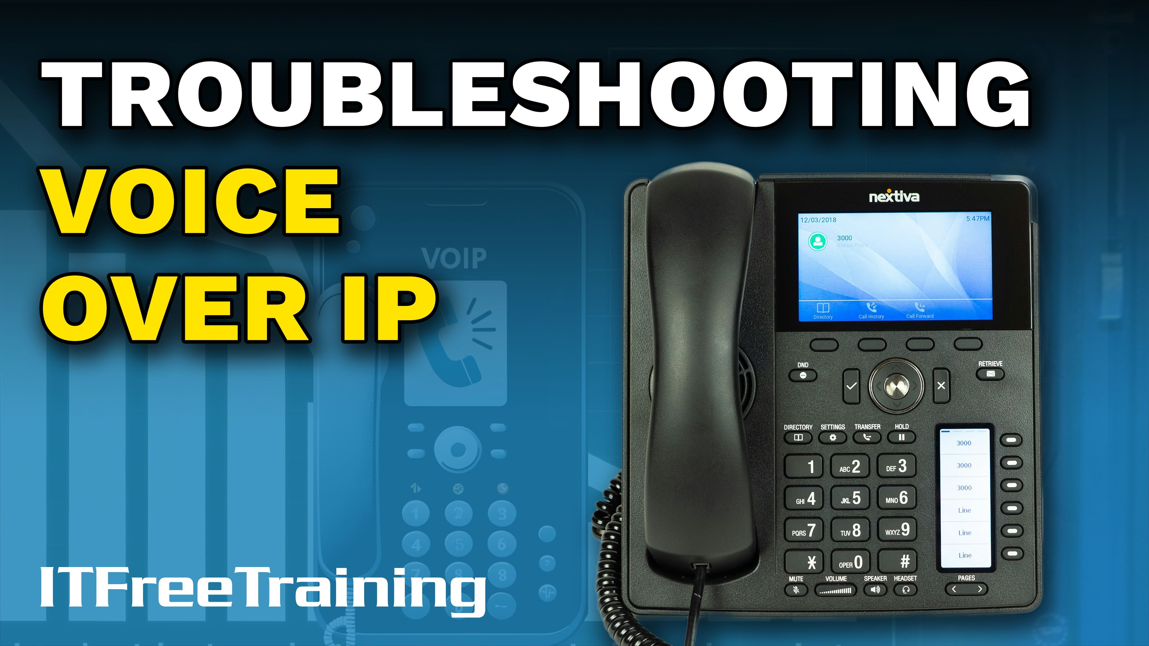


Notes:
Let’s have a look at Voice Over IP.

Slide 2

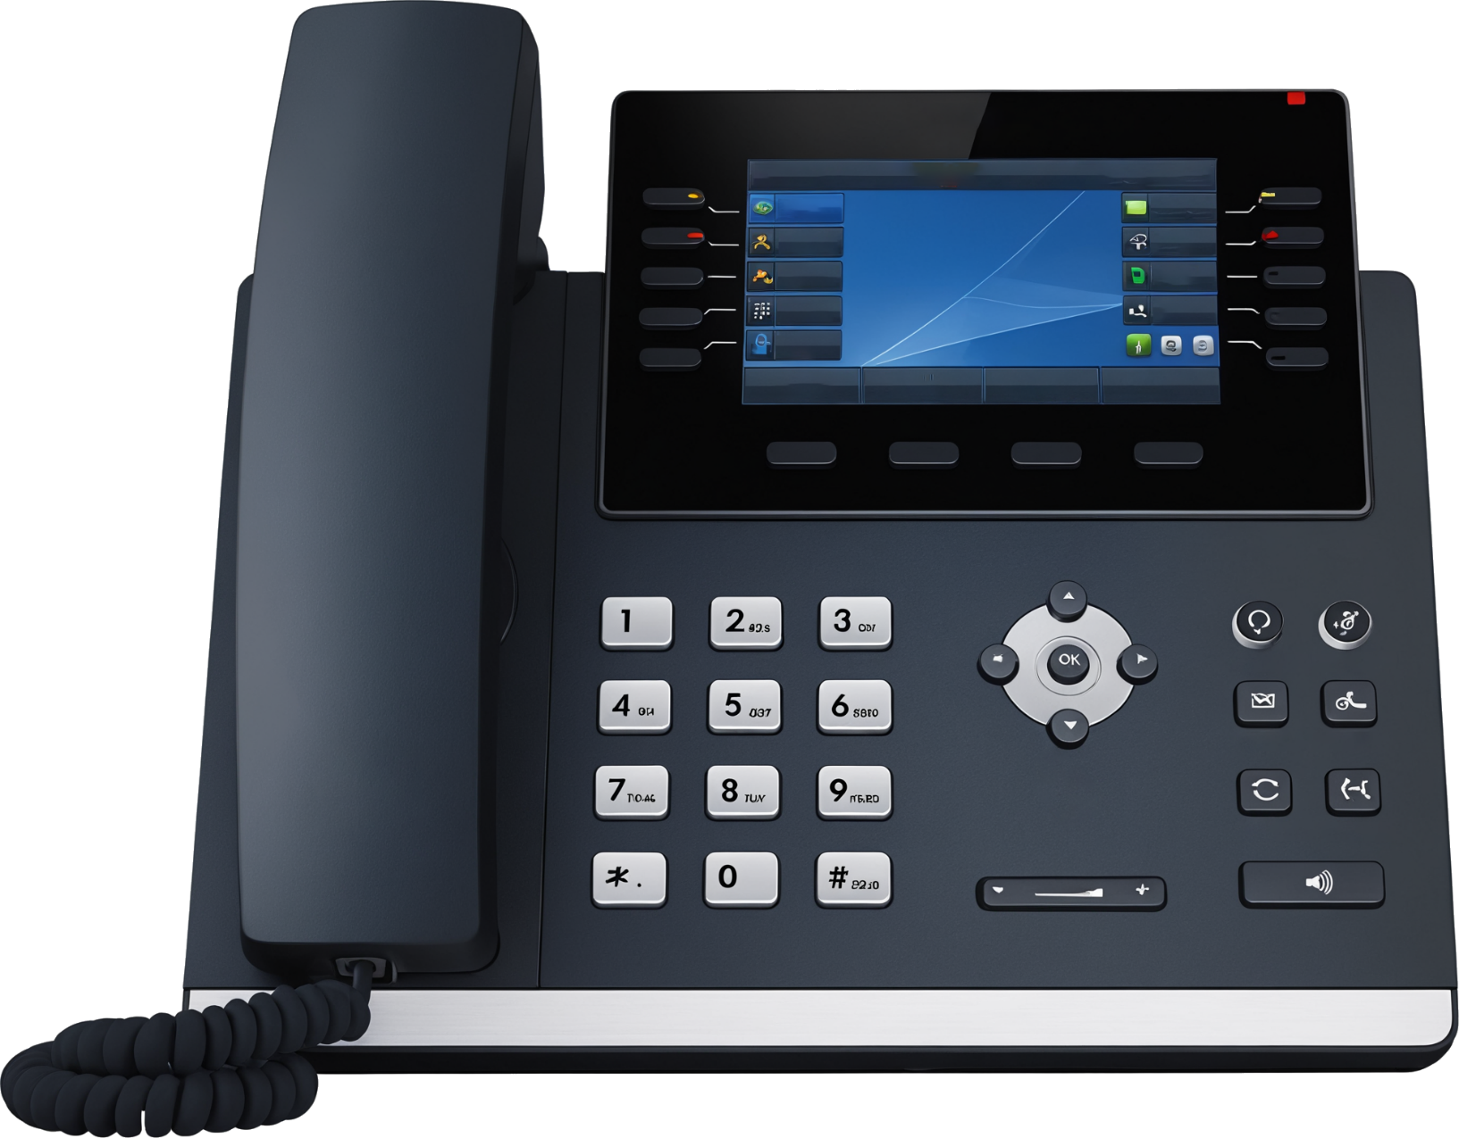

Voice Over IP (VoIP)
Allows voice calls using an internet connection
VoIP telephones look just like a regular phone. Can also be implemented in software
Pass through
to computer
To network
ITFreeTraining.com
Notes:
00:04 Voice over Internet Protocol or VoIP has revolutionized the way we communicate by transmitting voice data over the internet instead of traditional telephone lines. Despite its advantages in cost savings and flexibility, VoIP can encounter several issues that affect call quality and reliability.
As VoIP uses an internet connection, standard network connections around an office can be used. VoIP telephones look just like regular phones. VoIP can also be implemented in software. Many VoIP phones have a pass-through connection, allowing you to plug the phone into the network and then plug your computer into the phone. This means that you only need one connection to each desk, where traditionally you would need one for data and one for a phone line.
Although there are a lot of advantages with VoIP and can save a company money, there can be problems with it.

Slide 3
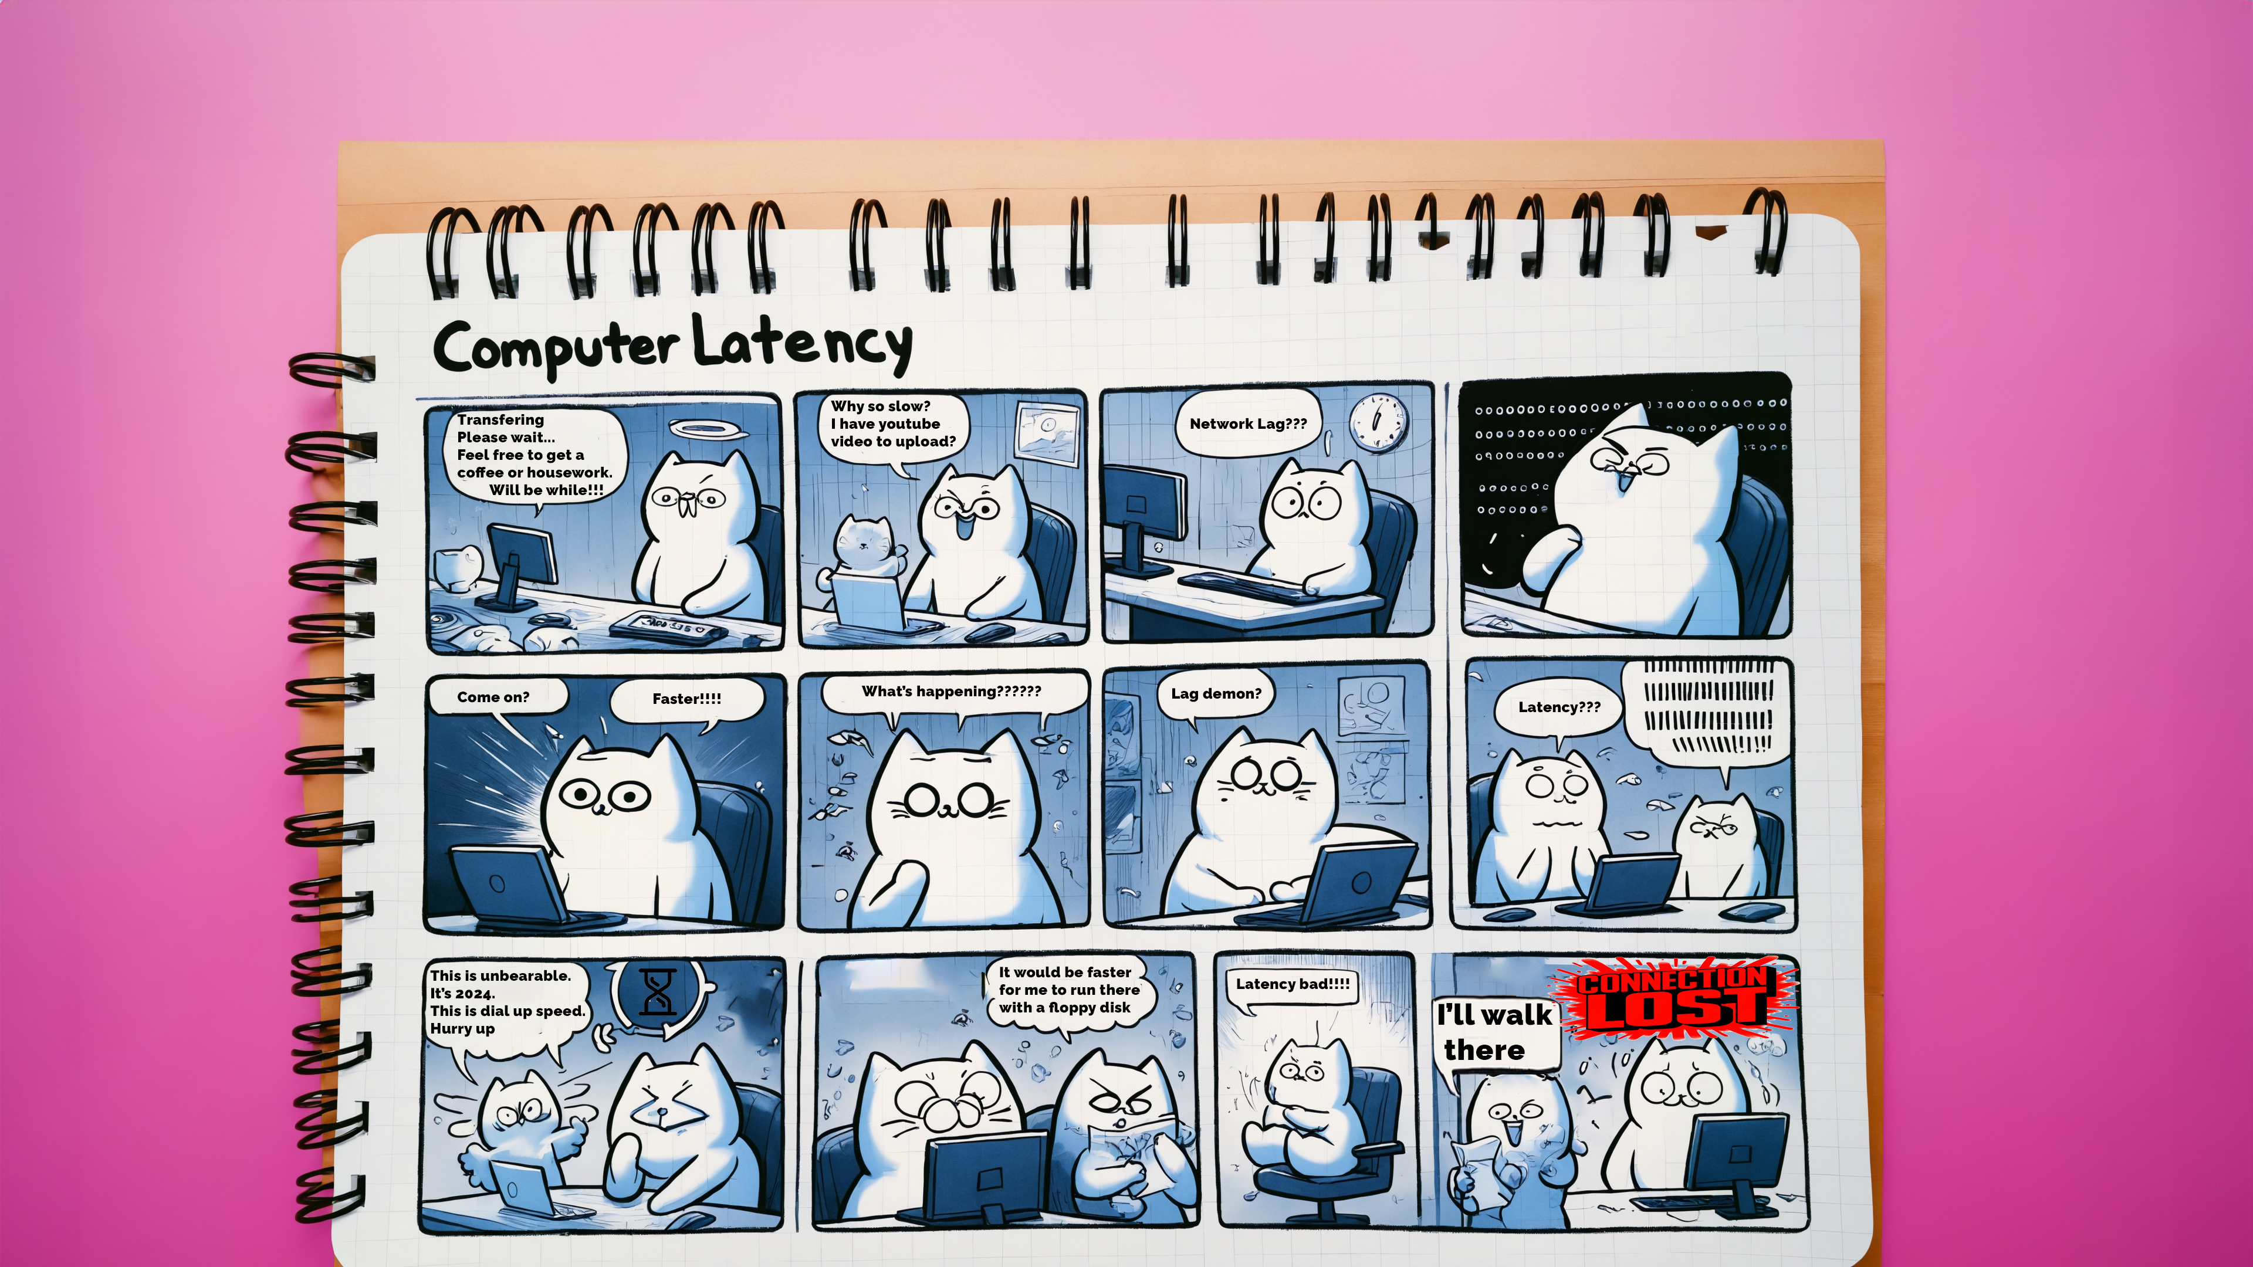





Latency
Time delay for data to travel to its destination
Sender
Receiver
00 ms
100 ms
One-way delay
250 ms
Round trip
One-way measurement requires accurate time synchronization on both sides
Effects of latency on VoIP voice quality
One-way delay (ms):
< 150 ms
150-200
200-300
300-400
400+
Round trip (ms):
< 300 ms
300-400
400-600
600-800
800+
ITFreeTraining.com
Notes:
00:58 VoIP can be affected by latency. Latency is the time delay for data to travel to its destination. Technically, you would want to measure the time from the sender to the receiver, but this is quite difficult. That is why latency is often measured in the time taken to be sent to the destination and return back to the sender called round trip. Let’s take a closer look.
Let’s consider that we have a sender and receiver. The best way to measure latency would be to measure the time it takes for data to be sent from the sender and received by the receiver. This is called one-way delay.
The problem with measuring one-way delay is that it requires accurate time synchronization on both sides. Latency is generally measured in milliseconds, so if the clock is even slightly out, it will give you misleading results. Synchronizing clocks on opposite sides of the planet is achievable, but most companies don't pursue this level of accuracy due to the significant effort and extra costs involved.
For this reason, latency is often measured by round trip. Round trip latency measures the time for data to travel to the receiver and back to the sender. This can be misleading because traffic may not take the same amount of time in both directions. However, if your connection is bad, usually both the sending and receiving directions will be affected, giving you a good idea of overall latency.
Shown here are the latency speeds and the effect they have on VoIP. If your latency is less than 600 milliseconds for a round trip, it should not be problematic. However, anything beyond that, and you will start to notice delays, making it difficult and sometimes impossible to communicate with the other party.
Latency delays the time it takes for data to reach the destination, resulting in a delay before you hear the other party. However, there are other network problems that can affect the quality of VoIP.

Slide 4




Jitter
The variation in packet arrival times
Causes inconsistent audio quality during calls
Network congestion
Improper queuing
Route changes
Non-Critical
Data
Reducing jitter involves ensuring a stable and consistent network connection
ITFreeTraining.com
Notes:
03:02 Jitter can affect VoIP voice quality. Jitter refers to the variation in the time it takes for data packets to travel from the sender to the receiver. This inconsistency can cause packets to arrive out of order, leading to choppy or garbled audio during a VoIP call.
There are three main causes of jitter. Network congestion can cause jitter when the network is overloaded with data traffic, leading to delays and packet loss. This congestion can cause voice data packets to be delayed or dropped, resulting in choppy or garbled audio. When multiple devices and applications compete for limited bandwidth, the quality of VoIP calls deteriorates as packets do not reach their destination in a timely manner. When a packet does not arrive and has to be sent again, VoIP has to decide whether to wait for the packet, delaying the rest of the audio stream, or continue without the packet, causing the audio to become choppy. If VoIP waits, the stream will be behind, and it will need to speed the audio up to catch up.
Improper queuing can also cause jitter. In VoIP, this refers to the mismanagement of data packet prioritization within a network. In a properly configured network, VoIP packets are given high priority to ensure timely delivery and maintain call quality. However, if queuing mechanisms are not correctly set up, VoIP packets may be delayed behind less critical data, causing increased latency and jitter. This can lead to disrupted or poor-quality audio during calls. It’s like being in a store trying to buy one item, and the person in front of you has a full shopping cart. Since VoIP packets are quite small and time-sensitive, the network should be configured to send them before less critical packets, especially if the less critical packets are quite large.
Route changes in VoIP occur when data packets take different paths through the network to reach their destination. It’s like having to take a back road because the highway is closed. These changes can be due to network failures, congestion, or dynamic routing protocols that find alternative paths. While route changes are intended to maintain connectivity, they can result in varying packet delivery times, causing jitter and affecting call quality. Consistent route stability is crucial for VoIP as it ensures packets arrive in the correct order and within the expected time frame.
To have good VoIP service and minimize jitter, you need to maintain a stable and consistent network connection. There is a lot to networking, and I could create a whole course just on designing a network to provide good quality of service for VoIP. However, for the A+ exam, there is only one protocol we need to look at.

Slide 5


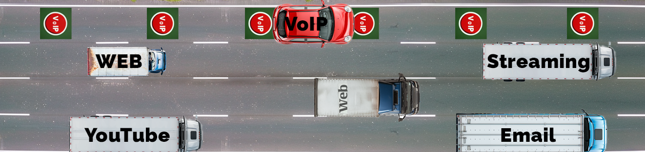
Quality of Service (QoS)
Prioritizes critical network traffic over other traffic
Increases the complexity of the network
Increases the resource usage on network devices (CPU/Memory)
Can reduce overall bandwidth
Potential for misconfiguration can make things worse than before
No control over how the internet or other external networks handles your data
ITFreeTraining.com
Notes:
05:54 To help prevent quality problems with network services like VoIP, you can use Quality of Service or QoS. To understand how QoS can help, consider a queue of people. Each person is like a data packet trying to get to their destination. The VoIP packets have to wait like all the other packets in the queue to reach their destination.
When QoS is used, it can be configured to give VoIP priority over other packets, meaning they get processed before the other packets. It’s like having a VIP line, where those who can use the VIP line get to jump the queue while everyone else has to wait.
Quality of Service prioritizes critical network traffic over other traffic, but it is not without its problems. QoS increases the complexity of the network. If you are going to implement it throughout your network, there may be multiple places you need to configure it.
QoS increases resource use on your network devices. Once you switch QoS on, each packet has to be inspected, and if it matches the requirements, it needs to be prioritized. This additional checking consumes extra CPU and memory on the device.
QoS can reduce your overall bandwidth because it prioritizes certain types of network traffic over others. During high traffic periods, non-prioritized data may experience slower speeds or delays, effectively reducing the available bandwidth for those applications. Imagine you're on a congested freeway. High-Occupancy Vehicle lanes, reserved for cars with multiple passengers, usually have less traffic than regular lanes. While these lanes help reduce overall congestion by promoting carpooling, they also slightly decrease the available space for all vehicles on the freeway. QoS can have a similar effect: your VoIP data will reach its destination faster, but as a result, your usable bandwidth may be reduced.
There is also potential for misconfiguration. If QoS is misconfigured, it can potentially make things worse than if it were not configured at all.
Lastly, keep in mind that you don’t have control over how your data is handled on the internet or by other external networks. Once the data leaves a device you control, it is beyond your control. Many ISPs offer VoIP services, so it may be worth looking into what they have to offer.

Slide 6
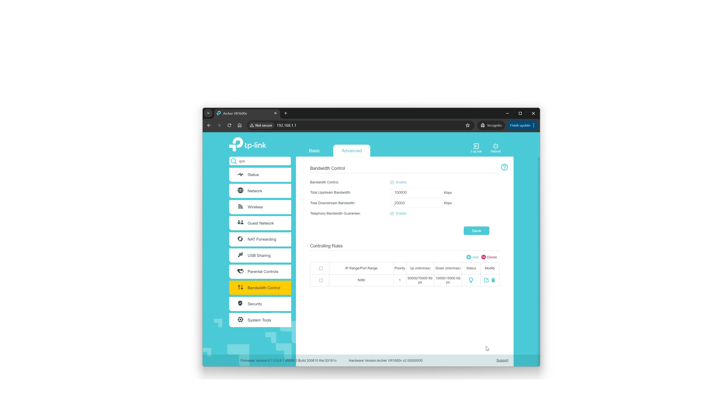
Demonstration
ITFreeTraining.com
Notes:
08:25 I will look at configuring a home router to prioritize VoIP traffic. If you are having problems with your VoIP telephone, this may help you. On this router, there is a bandwidth control area to manage the bandwidth used.
I will tick "Enable" to switch on bandwidth control. At the top, I will enter the speed of the internet connection. This is optional; however, if you don’t enter it, it makes it harder for the router to prioritize traffic since it does not know the speed of the connection.
Below this is the option "Telephony Bandwidth Guarantee." This router allows a telephone to be plugged directly into the router. If you have ticked this, bandwidth will be reserved for the telephone regardless of whether the telephone is in use or not.
In this example, I have connected a VoIP telephone to my computer and not the router, so this option won’t work for my setup. I will now save the settings so my router knows the speed of my internet connection.
Next, I need to set up a rule for my VoIP telephone so the router knows to prioritize the traffic. To do this, I will press "Add" to create a new rule.
I will then enter the port number that my VoIP device uses. For the protocol, I will leave it on "All" since it uses TCP and UDP. Next, I will set the "Priority" value to 1, the highest priority. I will also enter some values for the amount of bandwidth. These values will help the router determine how much bandwidth to allocate to the rule when multiple rules are operating. VoIP does not use a lot of bandwidth, so these figures are higher than what is needed. However, if no VoIP traffic is traveling over the router, it won’t allocate any bandwidth. You may need to adjust the values to meet your needs, particularly if you set up multiple rules.
I will now press "Save" to create the rule. That’s it—QoS is now set up on this router. This means that VoIP traffic from my telephone should get routed before other traffic. If you are having problems with your VoIP telephone, hopefully, this will help.

Slide 7

Subscribe
Next video
Video content: https://ITFreeTraining.com/ap11/6c20
Notes:
10:38 Keep learning and watch more of our videos for more tech tips and tricks! Until the next video, thanks for watching.
References
“The Official CompTIA A+ Core Study Guide (Exam 220-1101)” pages 221 to 222
“License CC BY 4.0” https://creativecommons.org/licenses/by/4.0/
Credits
Trainer: Austin Mason https://ITFreeTraining.com
Voice Talent: HP Lewis http://hplewis.com
Quality Assurance: Brett Batson https://www.pbb-proofreading.uk

