Slide 1
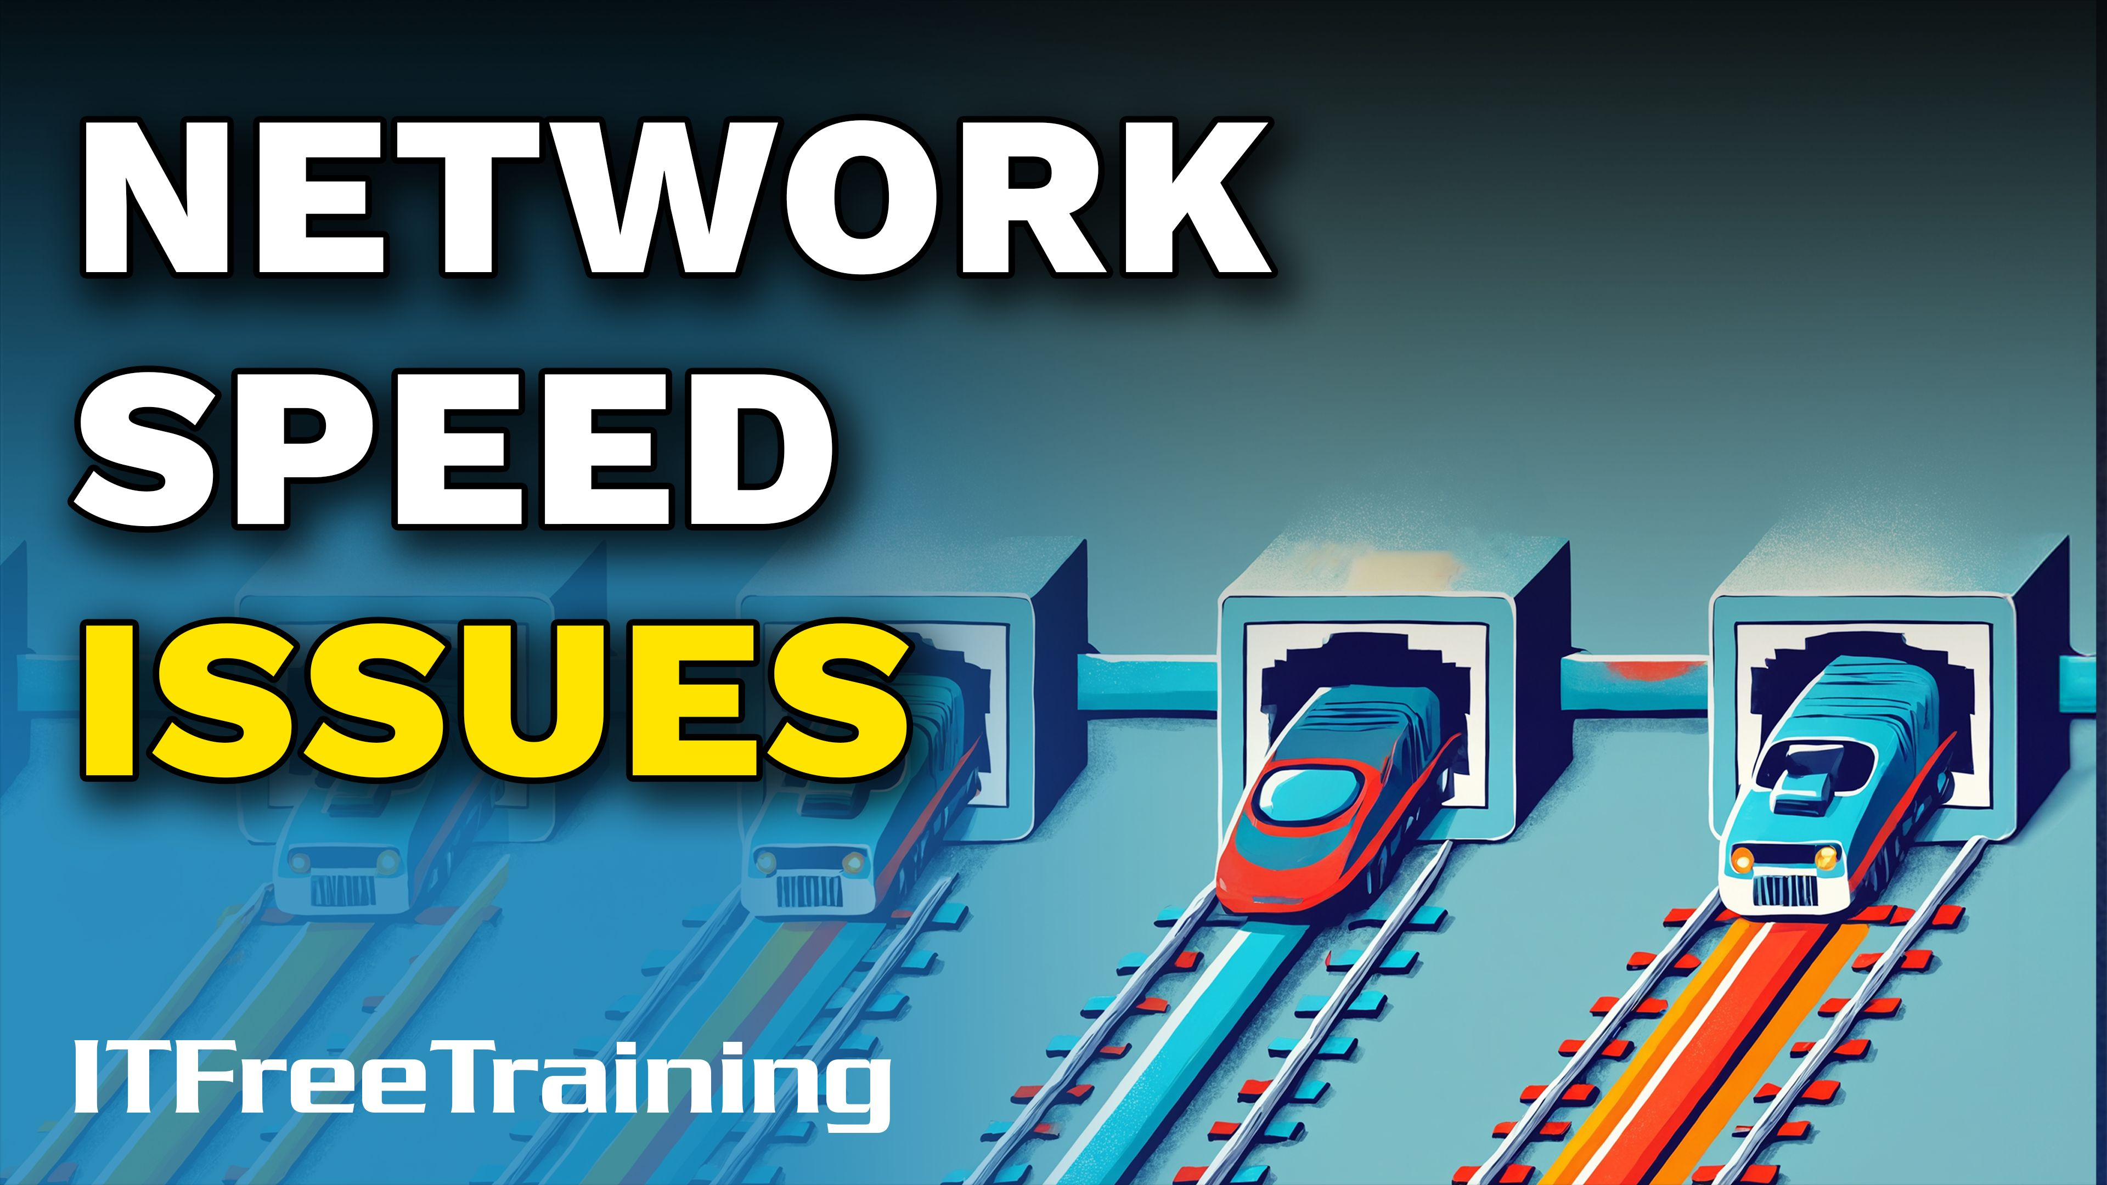


Notes:
Let’s have a look at network speeds issues.

Slide 2

Slow Network Speeds
ITFreeTraining.com
Notes:
00:04 Slow network speeds can disrupt online experiences, degrade overall system performance, and significantly reduce productivity.

Slide 3

What Speed Should You Be Getting?
Real-world, you generally will not achieve the theoretical maximum
10
Gbit/s
5
Gbit/s
2.5
Gbit/s
1
Gbit/s
100 Mbit/s
1.25 GB/S
625 MB/s
312.5 MB/s
125 MB/s
12 MB/s
ITFreeTraining.com
Notes:
00:12 To troubleshoot speed problems, the first question to ask is what speed you should be getting. Shown here are the theoretical maximum speeds for Ethernet. Keep in mind these are ideal speeds, and in real-world scenarios, achieving the theoretical maximum is unlikely. To approach these speeds, everything must be optimal—cable quality, no network congestion, and no interference—conditions typically found only in laboratory environments.
If you are using an internet connection, check with your Internet Service Provider or ISP to determine the expected speeds for your plan. Once you know the expected speed, test your current speed to see if it aligns. Remember, it is highly unlikely to achieve the theoretical maximum.

Slide 4

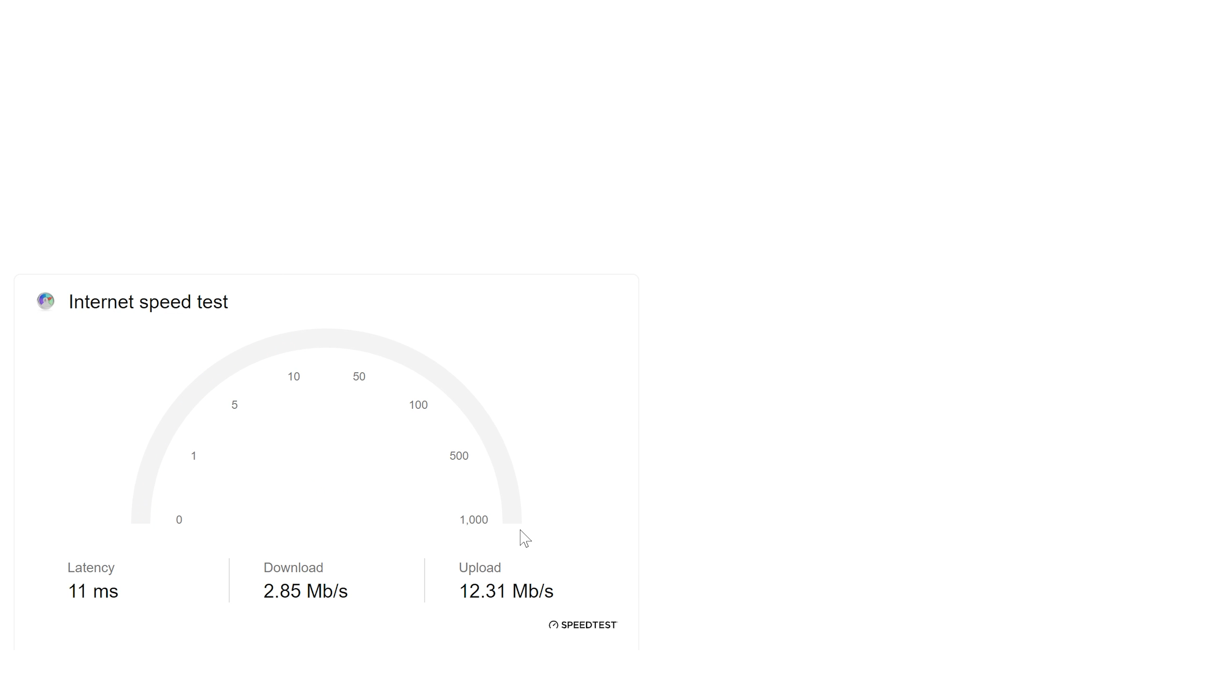


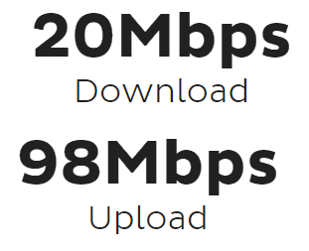
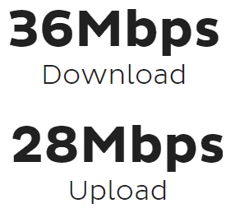
What Speed Are You Getting?
Plenty of speed tests are available online
Can be affected by server location and load
Some ISPs may prioritize speeds tests to get better results
Max Speed
Test 1
Test 2
ITFreeTraining.com
Notes:
00:56 I will now perform a speed test on my internet connection. Many speed tests are available online. Keep in mind that the accuracy of a speed test can be influenced by factors such as server location and load. Additionally, your ISP may prioritize speed tests to produce better results. ISPs often optimize speed test outcomes to make their internet service appear faster and more reliable, enhancing the perceived quality of their connection.
For this internet connection, the maximum speed is 100 Megabits per second for downloads and 40 Mega bits per second for uploads. Your internet connection should not exceed these speeds. However, the results of our test show that the upload speed is almost 100 Megabits per seconds, which is much higher than the download speed. Additionally, the download speed is below the maximum upload speed.
Speed tests can be unreliable, so I will run it again. I had a download running on another computer connected to the network, so I have stopped it to perform the test. It is advisable to stop any downloads or uploads on your network before running a speed test. This download may have been affecting the previous test.
The results of the second speed test are more reasonable. The upload speed is within expected ranges, but the download speed remains slightly low. There may be another device on the network using some of the bandwidth that I am unaware of. If you continue to get unusual results, try switching to a different speed test server and observe the outcomes. If the issue persists, consider using a different speed testing tool.
The quality of your internet connection will determine the speed you receive. Additionally, speeds may vary at different times of the day due to network congestion from other users. Now that we have determined the internet connection is not performing as fast as it should, let’s explore what we can do to address it.

Slide 5
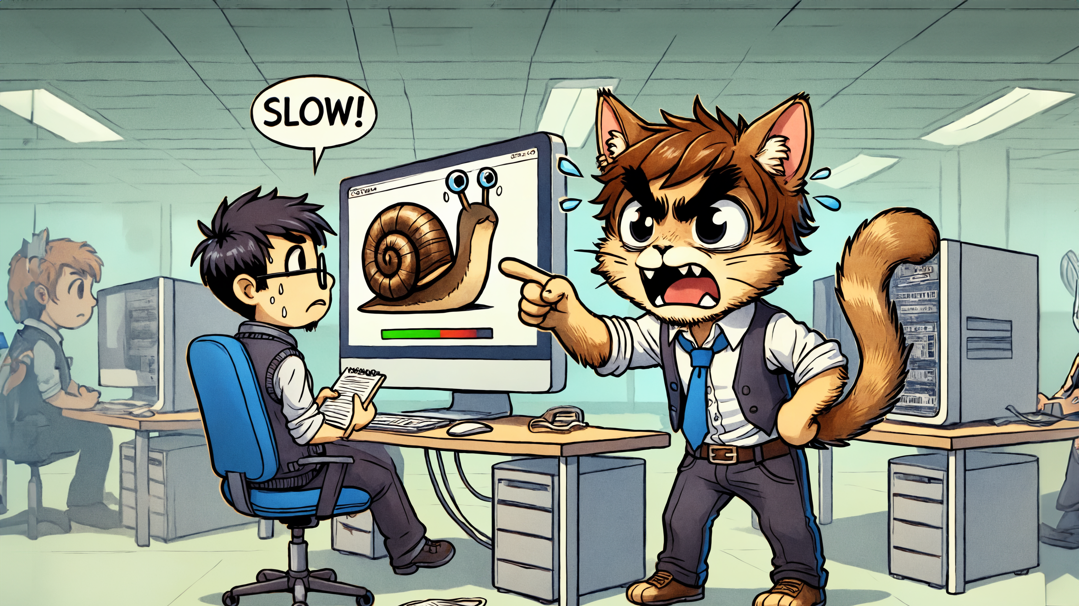






Determine What The User Is Doing
Compare the user's speed to normal speeds
Use network utilities to measure transfer rates
Web browsing
File transfers
Authentication
Application
ITFreeTraining.com
Notes:
02:49 When a user reports slow network speeds, examine the activities they are performing. Start by comparing the user’s current speed with the expected normal speed. If the user is on a slow network, the issue is likely with the network rather than the user’s computer. In such cases, improving performance would involve upgrading the network connection rather than making changes to the user’s device.
If there are network problems, check what the user is doing. Web browsing, especially bandwidth-intensive activities, can slow down a network connection. I once had a user complain that the network was slow. Upon investigation, I found they had multiple live video streams from the Olympics running in the background. They would periodically check the streams throughout the day to see the results and then switch back to other tabs. I advised them to stop the live streams when not actively watching, as they were slowing down other applications.
If a user is transferring files, it can significantly slow down the network. On a network I once supported, large file transfers between certain sites caused issues. Since the site had a single network connection, the file transfer would consume all the available bandwidth, preventing others from using the network. In some cases, a large file transfer can monopolize the network bandwidth, effectively blocking access for other users.
If you are copying a large number of files or transferring large files over external network links, consider using specialized software for the transfer. Such software offers additional options, such as the ability to adjust the transfer speed or suspend the transfer temporarily. If your file transfer is causing issues for other network users, you can briefly suspend the transfer to allow others to use the network without interruptions.
When performing a file transfer, I often let it run at 100% until the speed stabilizes, but I avoid keeping it at 100% for too long. Network file transfers typically start slowly and then accelerate, allowing the speed to adjust dynamically. Once the transfer speed reaches its peak or close to it, I record the value and reduce the speed slightly. This helps prevent network congestion while identifying the connection’s maximum potential. After determining the maximum speed, I lower the transfer speed and monitor performance, making adjustments as necessary. When done correctly, this approach enables large data transfers across the network without significantly affecting other users.
If a user is experiencing trouble with authentication, it could indicate network congestion. While their computer may not necessarily be causing the congestion, it is still a possibility. Authentication involves some back-and-forth communication. Although the traffic volume is not particularly high, significant network congestion can still prevent authentication from occurring. Therefore, you may be addressing a symptom of the problem rather than the root cause.
Consider whether any applications on the computer are causing the issue. A single application can consume a significant portion of the available bandwidth, slowing down other applications on the computer and potentially rendering them difficult or impossible to use.
To troubleshoot problems like these, use network utilities to measure transfer rates. In Windows, Task Manager provides a wealth of information. For example, in this case, a process on the computer is consuming a significant amount of bandwidth. On the Processes tab, you can sort processes by network usage to identify which one is using the most bandwidth.
In this example, the process is a Microsoft background service used for downloading data for services like Windows Update. Here, Windows Update is running in the background and consuming bandwidth. Tools like Task Manager can help you identify which processes are using bandwidth on your computer.

Slide 6
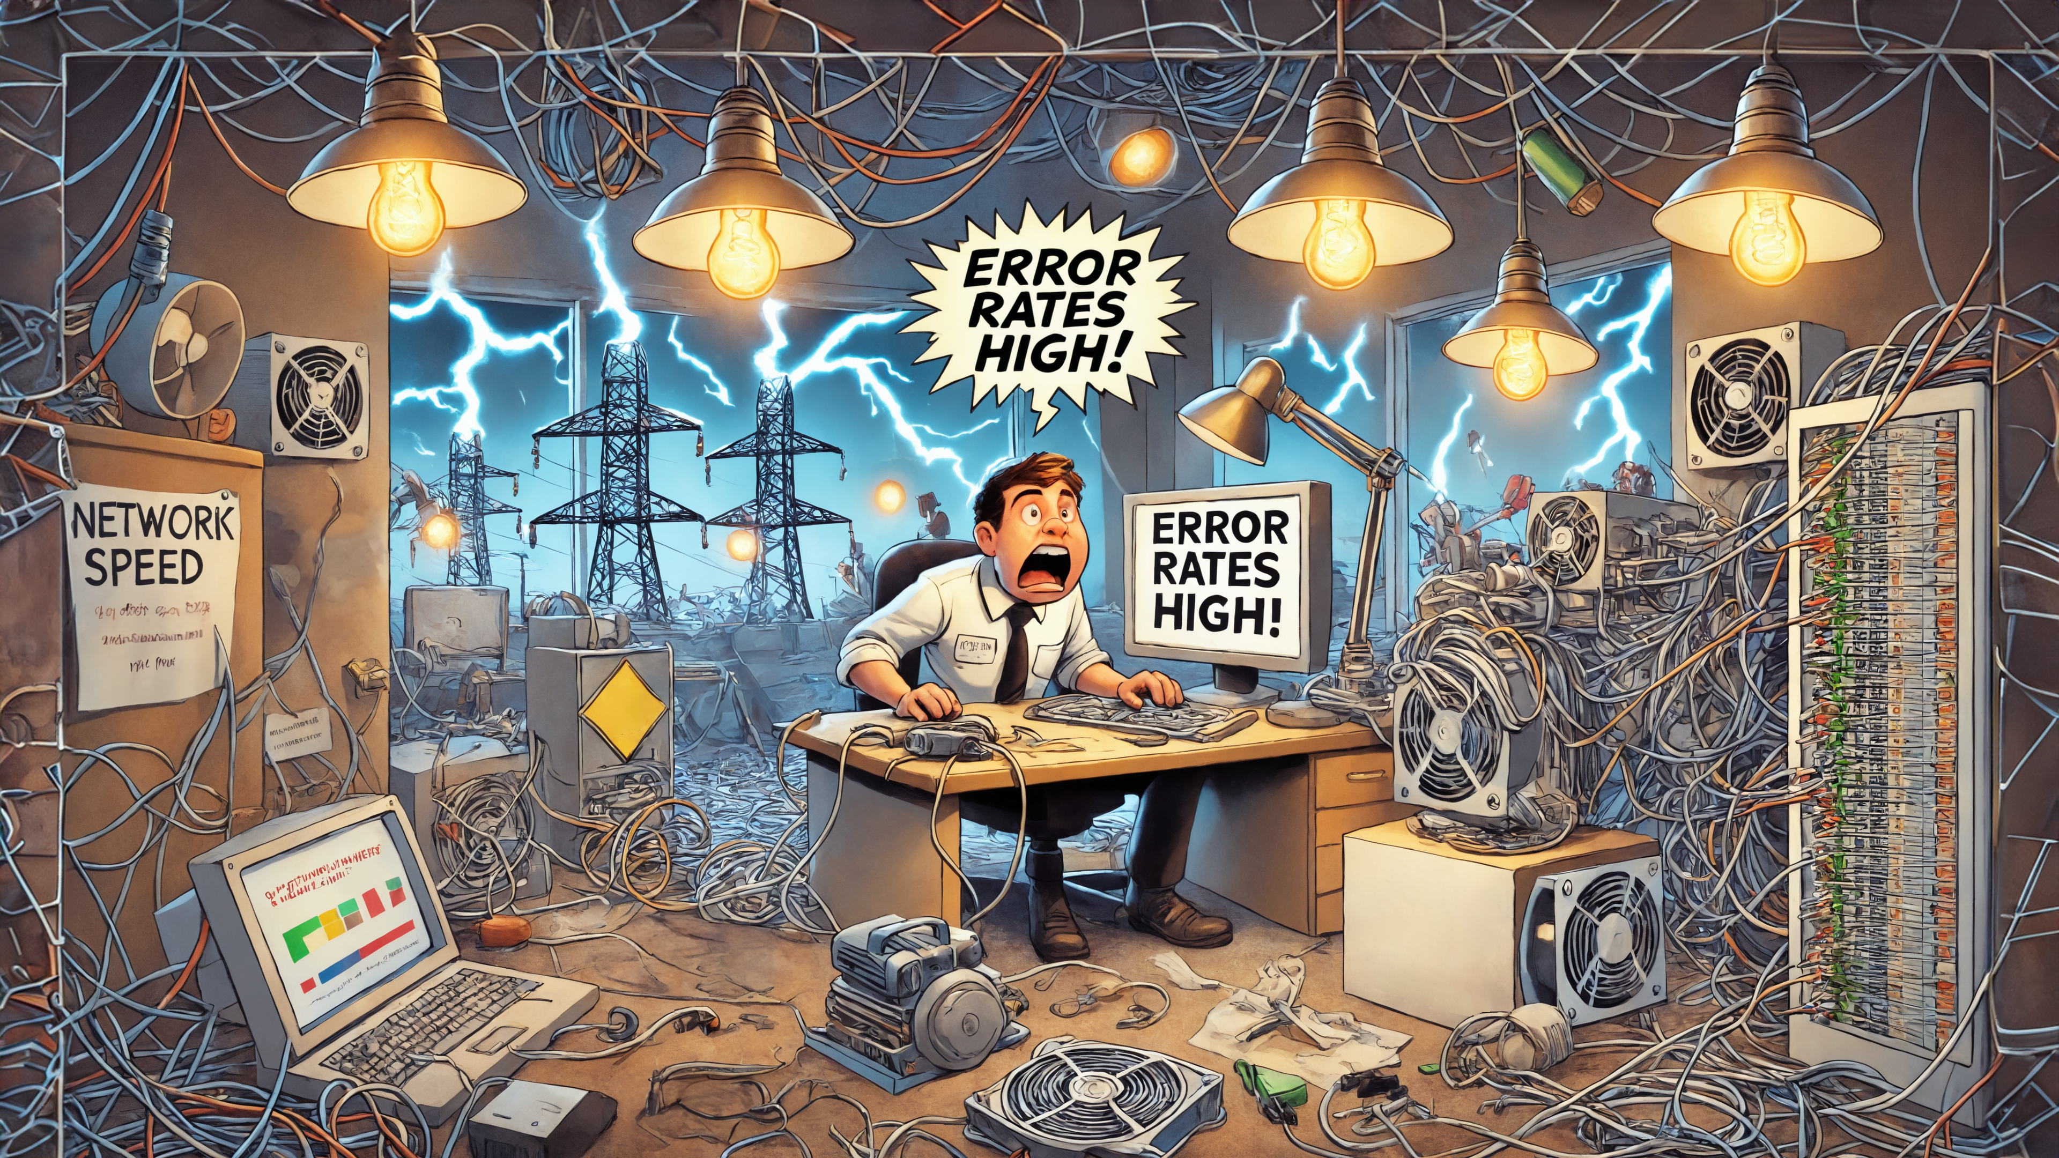
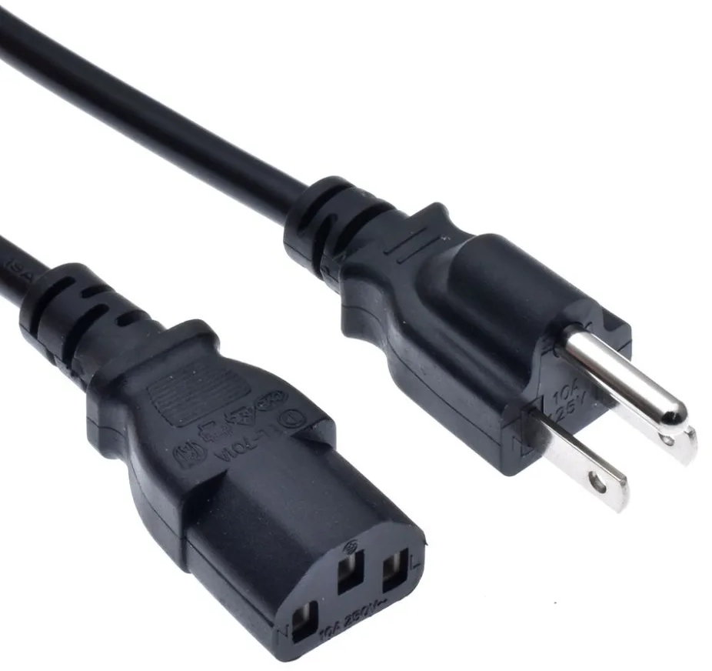
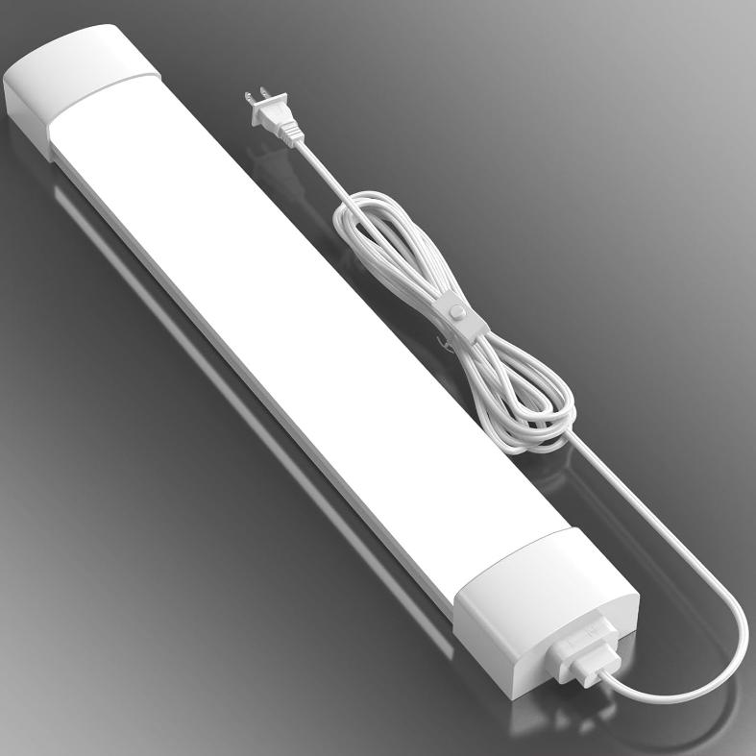

Interference
Slower than normal speeds or high error rates
Keep sources at least 12 inches (30 cms) away from network cables
Running power cables at a 90-degree angle to ethernet cables reduces interference
Keep the following away from network cables
In the real world, modern cables are resilient to interference
ITFreeTraining.com
Notes:
06:50 Interference can cause slower-than-normal speeds or high error rates. If you are experiencing these issues, interference may be the culprit. It is recommended to keep sources of interference at least 12 inches or 30 centimeters away from network cables. However, this distance may vary depending on who you ask.
If power cables need to be near network cabling, they should be run at a 90-degree angle to Ethernet cables to reduce interference.
It is advisable to keep network cables away from power cables, fluorescent lights, motors, and other sources of electromagnetic interference or EMI. Modern Ethernet cables used twisted pair to minimize interference. High category cables like Cat 6 are more resistant to electromagnetic interference, however it does remain best practice to avoid placing cables near high-EMI sources.
In real-world scenarios, modern network cables are highly resistant to interference, thanks to their design features such as shielding and twisted pairs. However, interference can still occur under specific conditions, including poorly installed cables, insufficient shielding, or extreme proximity to strong EMI sources. Nevertheless, interference is rare in typical home or office environments, even with potential interference sources nearby.
When troubleshooting network issues, I often notice technicians attributing problems to interference prematurely, often due to visible objects near cables that appear to be obvious culprits. In my experience, however, interference is rarely the primary cause. As a result, I prioritize investigating more common issues, such as poor connections, faulty hardware, or network congestion, before considering interference as the root cause.
During installation, I ensure cables are routed away from potential interference sources to minimize risks. However, if the cable layout is already fixed, I prioritize investigating other potential issues, as interference is rarely the primary cause of network problems.

Slide 7

Network Adapter
There might be an issue with the network adapter
Update the device drivers and firmware
Test the network adapter
ITFreeTraining.com
Notes:
08:55 The network adapter itself could be the source of the problem. Ensure the device driver and firmware are updated. Depending on the type of device, firmware updates may not be available. Test the network adapter to confirm it is functioning correctly, as this will help determine whether the issue lies with the computer or the network.

Slide 8
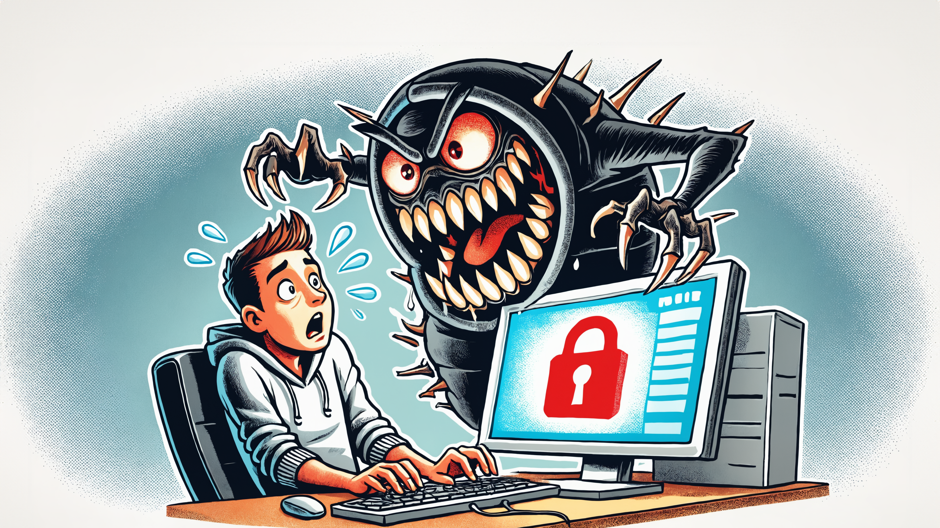

Malware
Malware can consume resources, such as networking
Check network traffic to ensure it comes from a known source and is not suspicious
If traffic looks suspicious, it maybe Malware
Fixing the computer
Remove malware (it may leave damage)
Reinstall OS and software to be sure
Hope you have reliable backups
Isolate computer
ITFreeTraining.com
Notes:
09:15 If the computer is infected with malware, it can consume system resources, including network bandwidth. Malware affecting networking may continuously perform network scans to identify other computers to infect. Monitor network traffic to ensure it originates from known sources and does not appear suspicious.
If you notice suspicious network traffic, it may indicate malware installed on the computer. Isolate the affected computer by either disconnecting its network cable or placing it on a quarantine network.
When fixing a computer, you can attempt to remove the malware. However, malware infections can sometimes damage the software on the computer, leaving residual issues even after the malware is removed. When possible, it is best to reinstall the operating system and software, though this decision often comes down to a judgment call. For some computers, reinstalling everything may be impractical and time-consuming. If the malware is easy to remove, such as a browser hijacker, it typically does not damage the operating system or browser once removed.

Slide 9
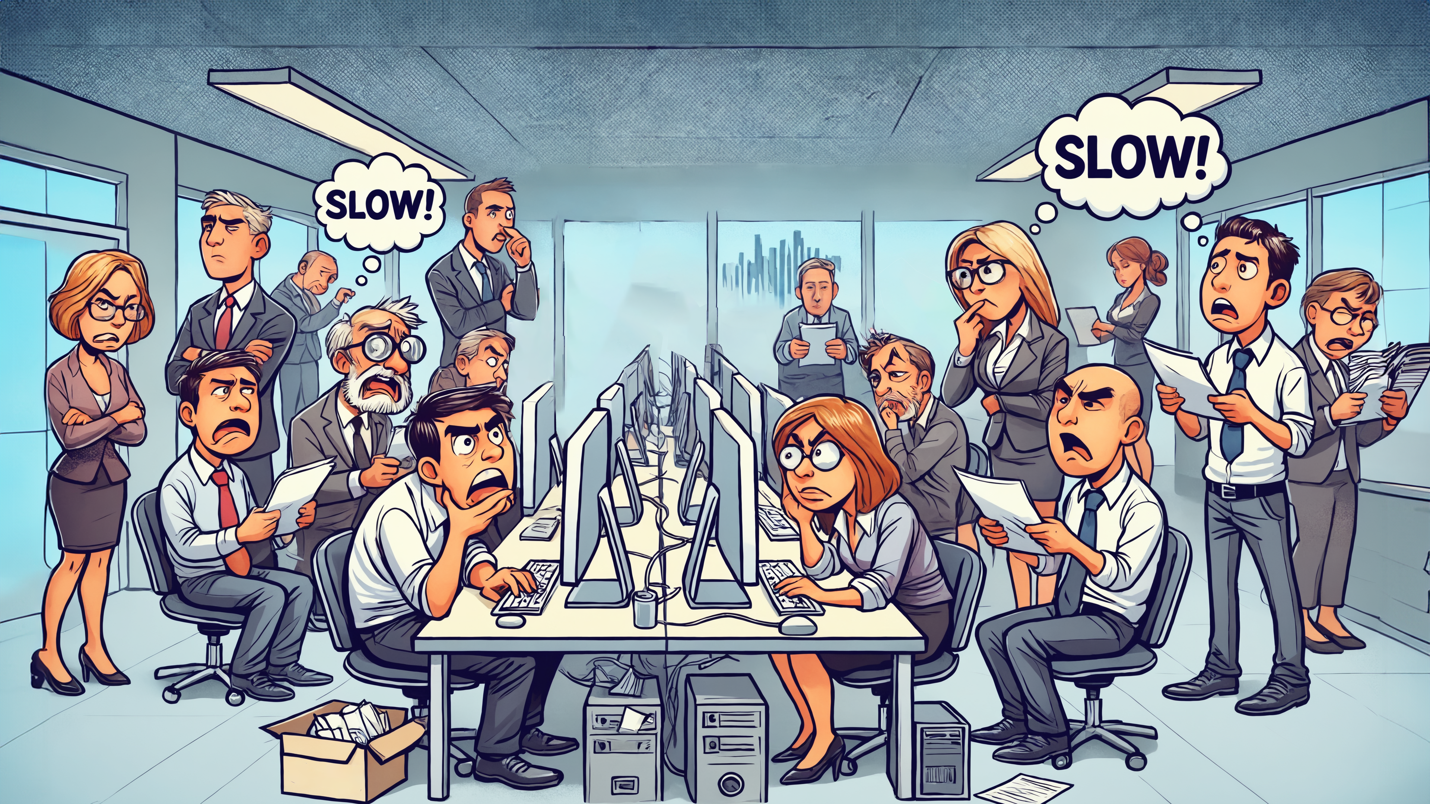




Establish The Scope Of The Problem
Are the issues affecting a single user or a group?
External link is very fast
Misconfigured to operate at a lower speed
ITFreeTraining.com
Notes:
10:19 When encountering network problems, start by determining the scope of the issue. For example, are the problems affecting a single user or a group? I once worked with an IT technician—let’s call him Bob (not his real name). Bob received a phone call from a user claiming their entire team could not work because their computer wasn’t functioning. For context, Bob was later fired, but that’s another story.
Bob went to the floor where the problem was reported and checked computers from a different team, which were functioning normally. All the computers he checked appeared to be working fine. Bob then went back and closed the helpdesk call, putting in the notes there was a problem that was not really a problem.
The team unable to do their jobs was understandably unhappy. While this incident was not the sole reason for Bob’s dismissal, it was one contributing factor.
To understand what occurred, consider that different areas in the office are connected to different switches. While the external link was very fast, it was significantly faster than the links connecting to individual computers.
The switches were interconnected, with the first link operating at a very fast speed. However, the second link was misconfigured to run at a lower speed than it was capable of supporting. Surprisingly, no complaints about the network connection were received until that day.
The issue arose when new timesheet software was deployed company-wide. Although the new software did not consume significantly more bandwidth than the old system, the problem occurred during a training session when the entire team accessed the software simultaneously. While the network should have managed the increased load, the misconfigured link's reduced speed created a bottleneck, leading to insufficient bandwidth to meet the demand.
Bob had disappeared, as he often did when things went wrong, so I stepped in to address the problem. Initially, I did not know the cause of the issue, but I knew that training had been conducted in a nearby meeting room the day before without any problems. I asked everyone to move into the meeting room, and they were happy to comply.
This helped calm everyone down while I worked to identify and resolve the problem. I reconfigured the switch to operate at the correct speed. Once everything was fixed, Bob reappeared, as he often did after someone else had resolved the issue.

Slide 10

Subscribe
Next video
Video content: https://ITFreeTraining.com/ap11/6c10
Notes:
12:36 I hope this video helps you resolve speed-related issues on your network and inspires you to be better than Bob. Don’t be like Bob—take the time to investigate thoroughly, and you will solve problems more effectively! Until the next video, thank you for watching.
References
“The Official CompTIA A+ Core Study Guide (Exam 220-1101)” page 231
“Image: Network Switch” https://www.freeiconspng.com/img/27058
Credits
Trainer: Austin Mason https://ITFreeTraining.com
Voice Talent: HP Lewis http://hplewis.com
Quality Assurance: Brett Batson https://www.pbb-proofreading.uk

