Slide 1
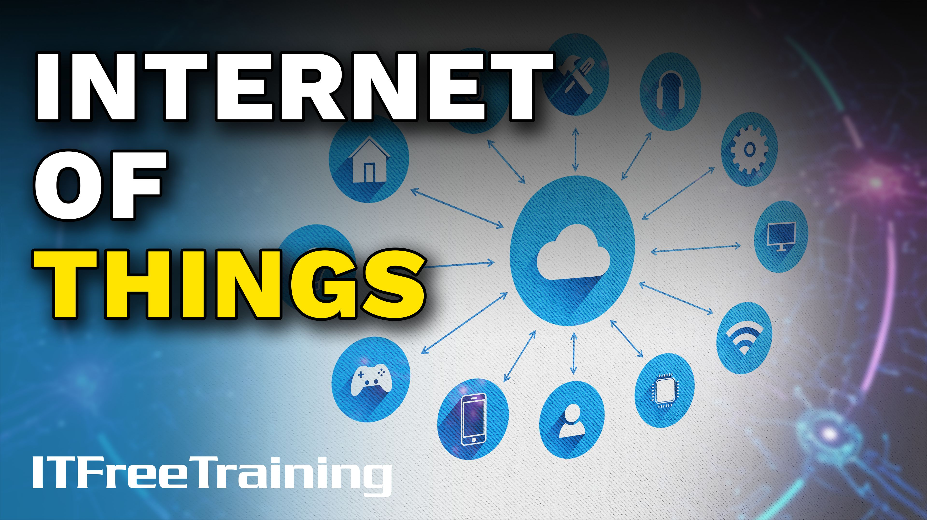
Notes:
Let’s have a look at Internet of Things.

Slide 2
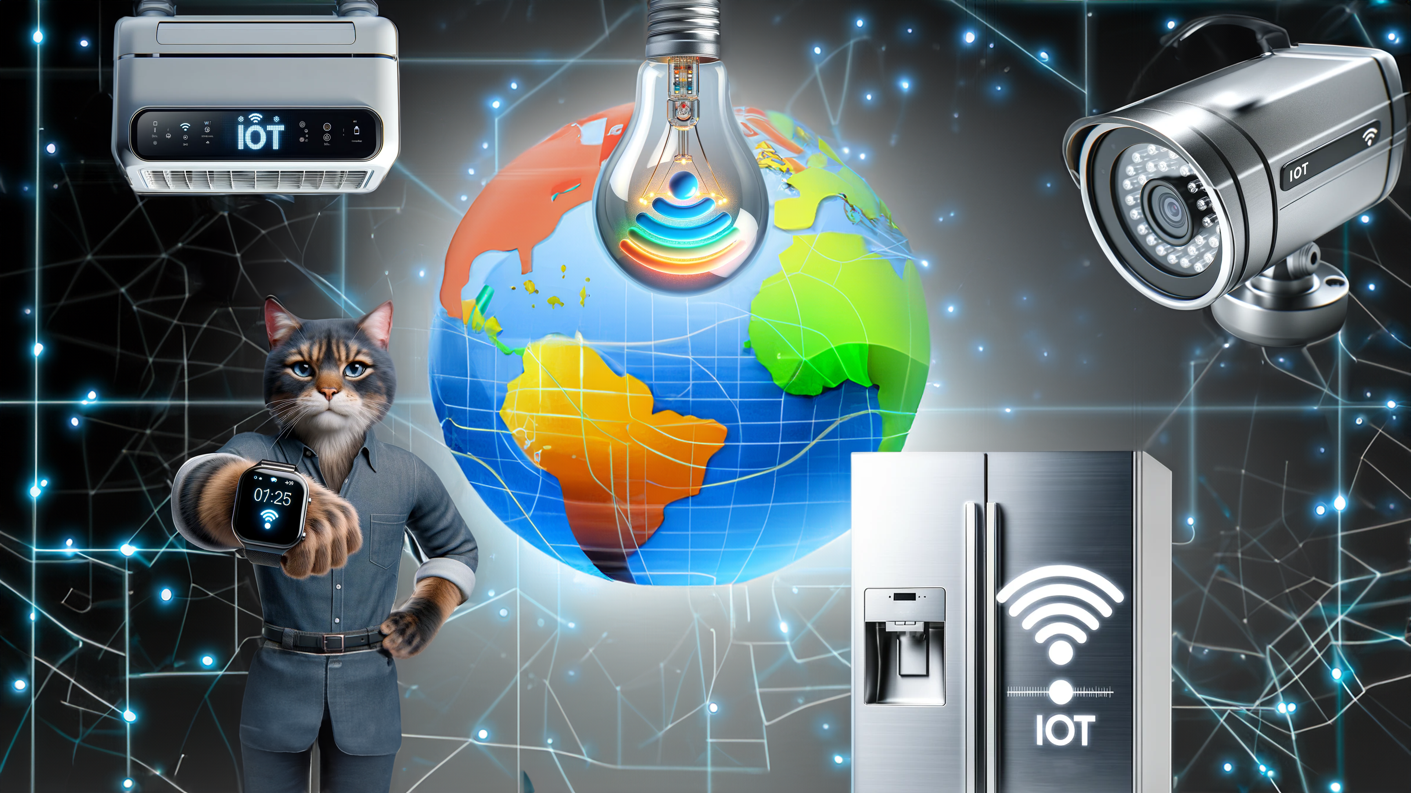
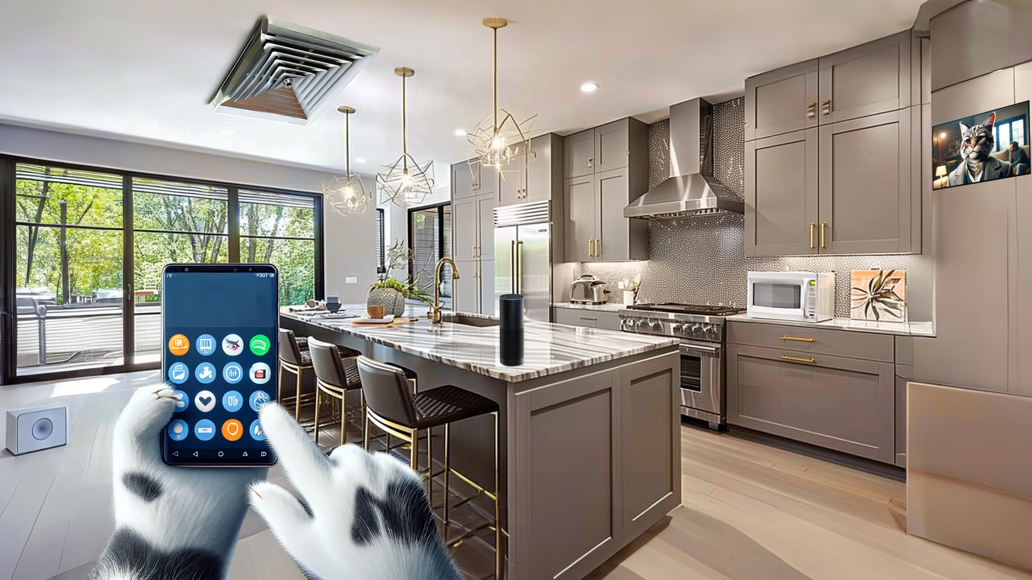


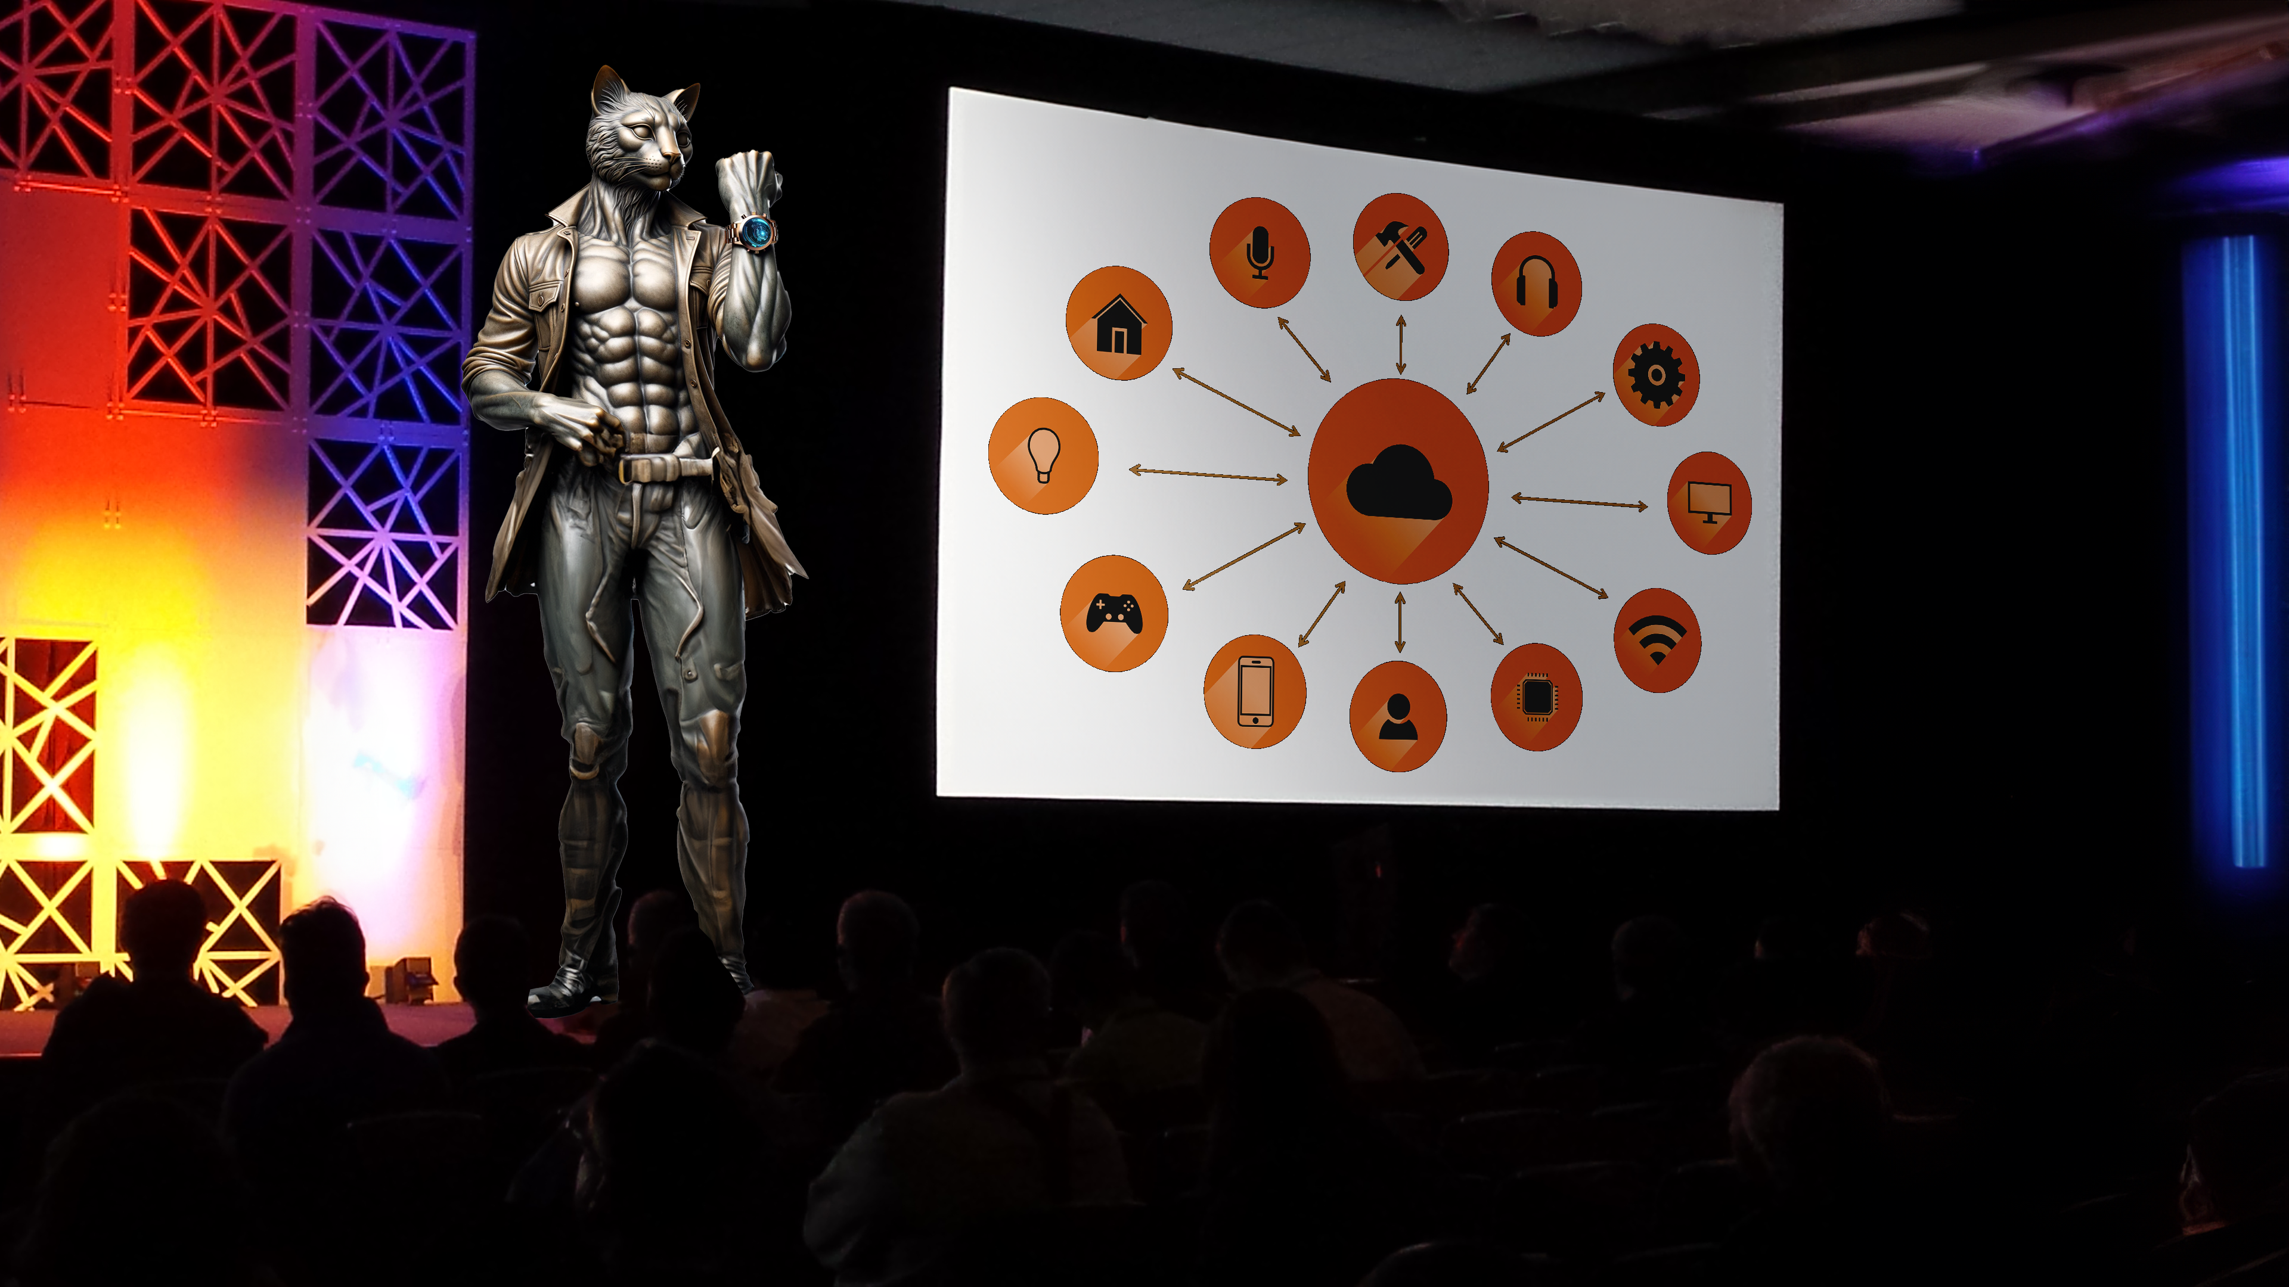
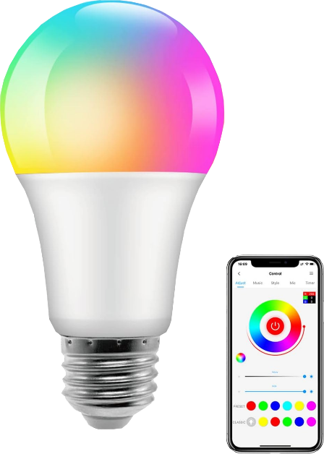
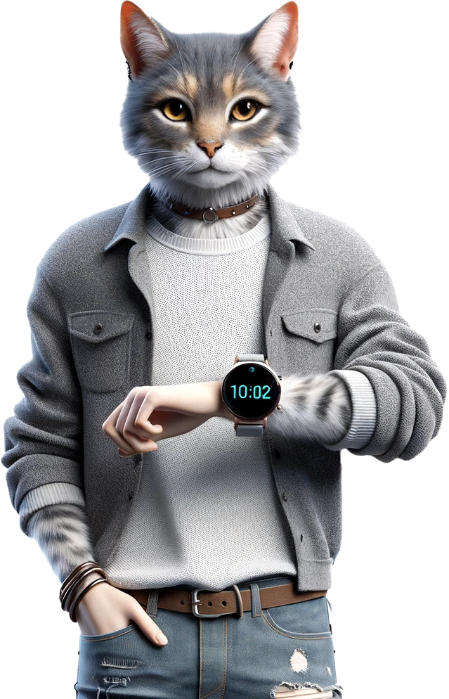

Internet of Things (IoT)
AirConditioner
Hub/Control System
Smart Devices
Lights
Requires a controlling system
Has processing and storage
Have limited processing power
Can take user inputs
LCD TV
Blinds
Fridge
Toaster
Microwave
Alexa
Speaker
Oven
ITFreeTraining.com
© Copyright 2025
Notes:
00:04 The Internet of Things, or IoT, is a term used to describe physical devices embedded with sensors, software, and other technologies that allow them to connect and exchange data with each other and with traditional computer systems. These devices include wearable technology, home appliances, vehicles, and many more.
Imagine a refrigerator that can automatically reorder milk when you're running low or a thermostat that can adjust the temperature based on your preferences. These are just a few examples of the many possibilities that IoT brings.
It can be confusing to understand what the Internet of Things is. To make it easier, it helps to separate IoT devices into two different categories: Hub/Control System and Smart Devices.
Hub-style devices require some sort of controlling system. For example, an IoT light bulb will use a controlling device, often a mobile device, to control the light bulb. Now, I know you must be thinking, "I can switch the light bulb on and off," but you generally won’t be able to control the color of the light bulb without a controlling system.
The light bulb itself does not have a user interface to control the light bulb. The light bulb also has limited processing power and is unlikely to have any storage. Any simple IoT device that requires a control system to function and has limited processing power is part of a hub and control system.
Smart devices, in contrast, have processing and storage. They can also take user input. These devices often have integrated CPUs that run operating systems like Linux. This means these devices can run without a controlling device but also means the device can potentially be vulnerable to malicious code. An attacker could take control of these devices. Devices with cameras and microphones could be compromised and used as surveillance devices. Thus, it is important to buy these devices from reputable manufacturers and to keep them up to date with the latest security patches.

Slide 3

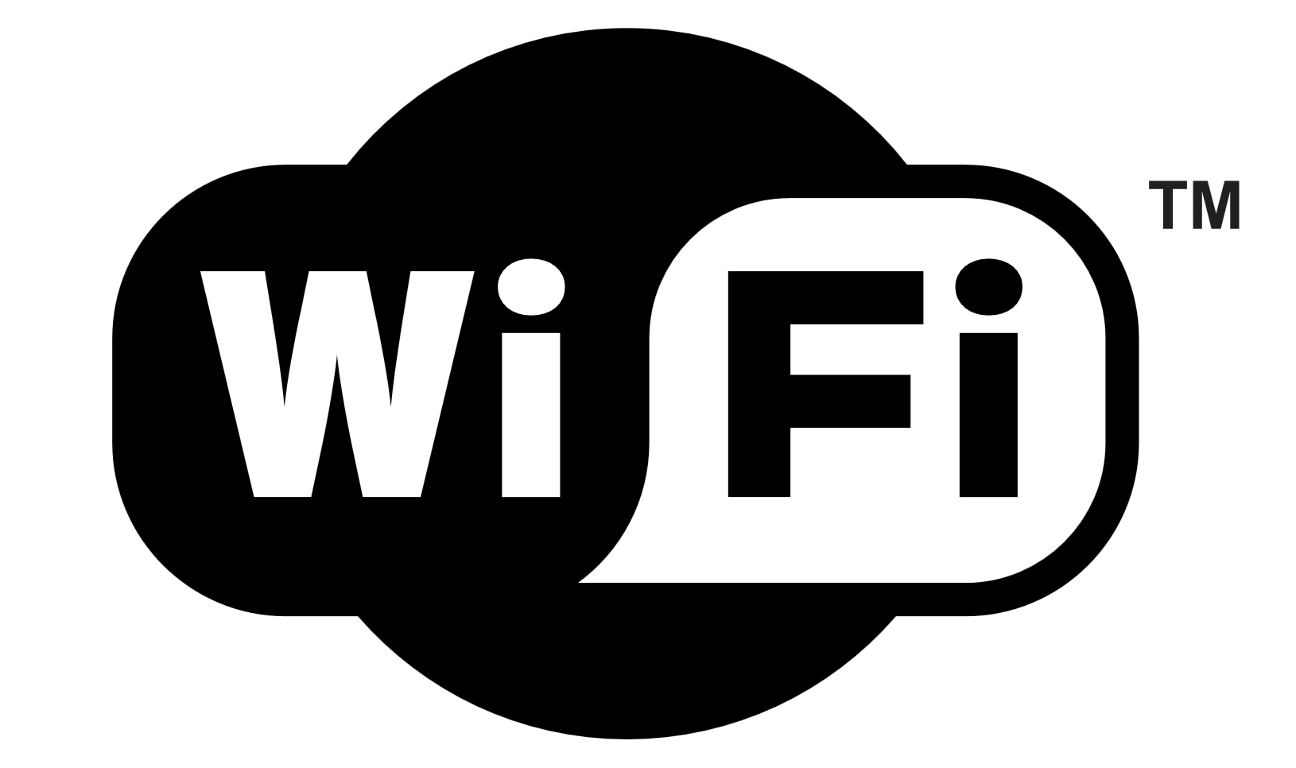


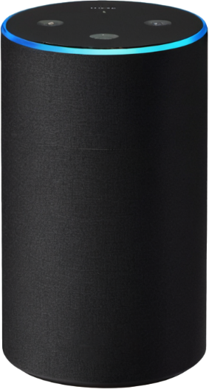
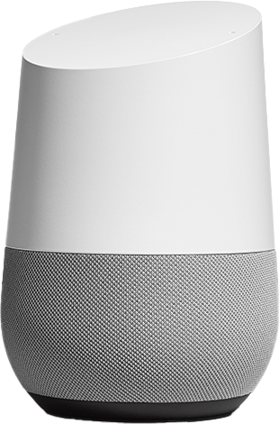
Protocols of IoT
No one protocol to control them all (Unfortunately)
Many IoT devices use Wi-Fi
Low-powered mesh networks
Make sure devices are compatible
ITFreeTraining.com
© Copyright 2025
Notes:
02:06 Now, I know you must be thinking there must be one protocol that the Internet of Things uses, but the fact is there is no one protocol to control them all, unfortunately.
When it comes to the Internet of Things, many devices will use Wi-Fi. However, when it comes to power use, Wi-Fi is not the most efficient. Thus, you may find some Internet of Things devices use Z-Wave or Zigbee. These are different protocols, but both are designed to be low-powered mesh networks.
Since both protocols use less power, they are better for devices that run off battery or don’t get supplied with a lot of power. Since they are mesh networks, this means that other devices in range will pass on messages to each other in the mesh. If you spread these devices out over an area, they act as repeaters, extending your network. There is no need to install additional devices to repeat the signal.
The main point to take away is that if you are going to purchase an Internet of Things device, make sure the devices are compatible with your existing devices. When it comes to the Internet of Things, it is more of a concept than a particular technology. Internet of Things devices are summarized as devices with networking capabilities allowing them to exchange data with other things. What systems they work with and which other devices they will work with depends on the device.

Slide 4

Subscribe
Next video
Video content: https://ITFreeTraining.com/ap11/6b25
© Copyright 2025
Notes:
03:31 Some Internet of Things devices are social butterflies using Wi-Fi, while others use Z-Wave or Zigbee and communicate with secret whispers. But all Internet of Things devices' favorite movie is The Fast and the Connected. Until the next video, thanks for watching.
References
“The Official CompTIA A+ Core Study Guide (Exam 220-1101)” page 216
“Z-Wave” https://en.wikipedia.org/wiki/Z-Wave
“Picture: IoT presentation” https://upload.wikimedia.org/wikipedia/commons/4/48/WilliamRuhAtIEEETechIgnite2017.jpg
“Picture: IoT image” https://pixabay.com/illustrations/iot-internet-of-things-network-3337536/
“Picture: Wi-Fi Logo” https://commons.wikimedia.org/wiki/File:WiFi_Logo.svg
“Picture: Z-Wave logo” https://en.wikipedia.org/wiki/Z-Wave#/media/File:Z-Wave_logo.svg
“Picture: Zigbee Logo” https://commons.wikimedia.org/wiki/File:Zigbee_logo.svg
Credits
Trainer: Austin Mason http://ITFreeTraining.com
Voice Talent: HP Lewis http://hplewis.com
Quality Assurance: Brett Batson http://www.pbb-proofreading.uk

