Slide 1

Notes:
Let’s have a look at proxy servers.

Slide 2






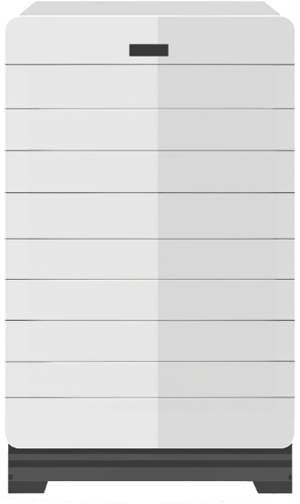


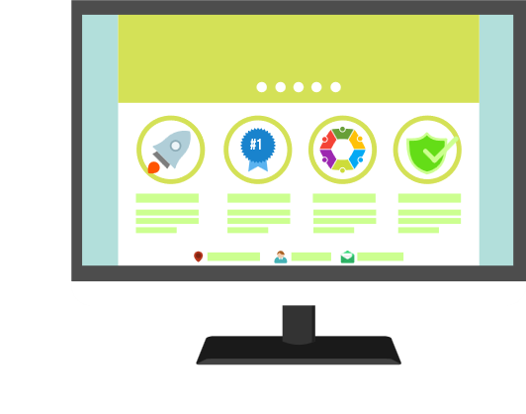
Proxy Servers
Proxy Server
Cached
ITFreeTraining.com
© Copyright 2025
Notes:
00:03 A proxy server acts like a go-between for your device and the internet. Instead of you directly connecting to websites, your requests are sent to the proxy server first. This server then fetches the information from the website and relays it back to you, keeping a copy in its cache. If someone else requests the same information later on, this information can be sent to that user without downloading it again. Proxy servers can significantly reduce the amount of data that is transferred over your internet connection, but there are also other benefits. To understand these benefits, let’s consider the difference between Proxy and NAT.

Slide 3



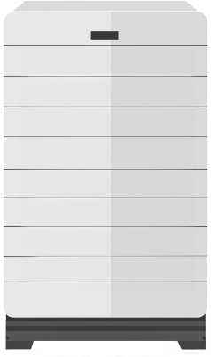

Proxy vs NAT
Proxy accesses website rather than device
Adds an extra layer which can increase response time accessing websites
Shared public
IP address
Shared public
IP address
Proxy
ITFreeTraining.com
© Copyright 2025
Notes:
00:43 NAT is often used on home networks to provide access to the internet. The home network has a router that has access to the internet. The router connects to the local network, which often has many different devices on it. This allows all the devices on the local network to share the same public IP address.
In contrast, a network that uses a router without NAT cannot share the same public IP address. This is because NAT acts as a translator. Without a translator, only one device can use the IP address.
If you add a proxy server to the network, the proxy server can be the one device that can access the internet for the other devices without a translation service. With NAT, the device is accessing the internet directly using NAT as a translation service. With a proxy server, it is the proxy server which accesses the website rather than the device.
Proxy servers offer a layer of security but can also increase the response time when accessing websites. While some proxy servers are very fast, they can introduce a slight delay, which might be noticeable for applications requiring real-time responsiveness.
In a business setting where browsing and basic tasks are common, this delay is usually negligible. However, for home users who game online or rely on services that demand lightning-fast responses, a proxy server could introduce a perceptible lag.
In the business world, proxy servers add some extra features that are very worthwhile to a business.

Slide 4






Proxy Advantages
Caches frequently accessed content, reducing load and bandwidth
Allows more control over website access
Proxy features
Cache
Malware protection
Filtering
ITFreeTraining.com
© Copyright 2025
Notes:
02:15 The main reason proxy servers are used is to cache frequently accessed content reducing the load on your internet connection and the amount of bandwidth being used. Having a proxy server on the network also adds additional features like allowing more control over website access. Let’s consider that you have a network of computers. On a business network, the proxy server essentially filters the web-based traffic to the proxy server.
If a computer attempts to directly access the internet, the company's firewall should be configured to block it. Thus, the only access to the internet should be through the proxy server. You can see how the filtering works; it is like blocking all the roads except for one. Now anyone who wants to leave needs to use that road. Since there is only one way out, we can perform extra processing and auditing on the internet traffic as it passes through.
This is quite a simple network. On a large company network, the features that I am talking about could be on multiple different systems and devices. For example, a business may have a basic server that just does caching and hardware devices designed specifically for the features that I am about to talk about.
Now, as I have previously discussed, the primary purpose of a proxy server is to cache data. Although it is possible to have a web server that does not cache files, this is only used in certain circumstances.
Given that all your web traffic is now traveling through one point, you can add malware detection. There are a lot of malicious websites out there. Hopefully, the next virus will be detected and stopped before it gets to your network.
You can also perform filtering. Filtering is limiting what websites the user can go to, usually based on the type of website. Companies often will block particular websites that are not work-related, for example, gambling websites.
In a company, all these features may be performed by different devices. In other cases, the feature may be an addon that is installed on the proxy server. I will now look at how web proxies are generally implemented.

Slide 5
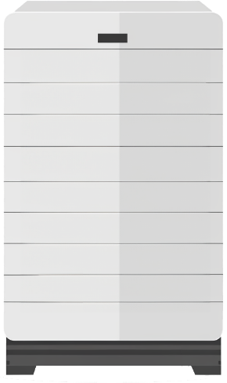


Transparent Proxy (Intercepting Proxy)
Does not require any client configuration
Hardware proxies typically don’t cache files
Proxy
Port 80
ITFreeTraining.com
© Copyright 2025
Notes:
04:23 A transparent proxy does not require any configuration on the device in order for it to be used. The terminology CompTIA uses may refer to it as an intercepting proxy. The way these work is that the device attempts to access the internet on port 80. A router or similar device on the network will receive the request.
Without the device knowing, the request is transferred to a proxy server. The proxy server could be a different device or server or could be part of the routing device. When proxies are implemented in hardware, they generally don’t cache files. Proxies, when part of hardware, often work to filter traffic, load balance, or perform other functions.
The request will be forwarded to the website, and the device won’t be the wiser. These devices are often used to monitor internet traffic. Nowadays, they are also often used for content delivery networks to proxy website data in different geographical locations.

Slide 6
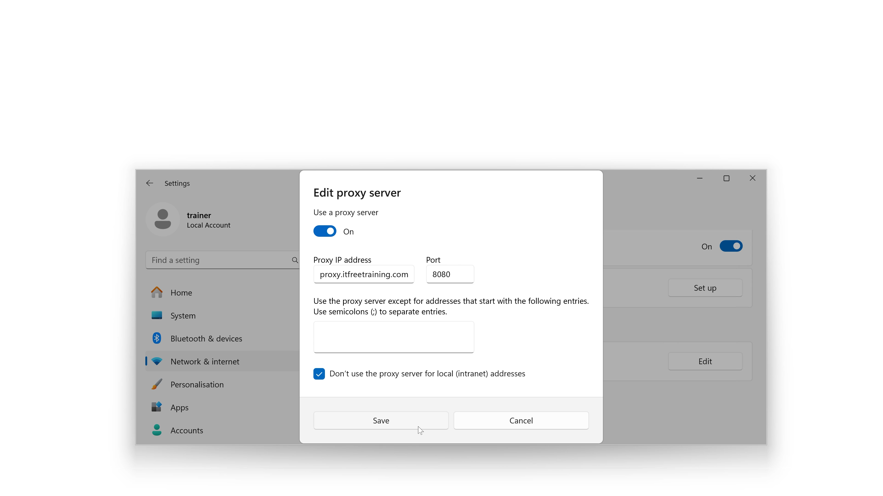
Non-transparent Proxy
Proxy needs to be configured
Businesses will generally configure this automatically (DHCP, group policy)
ITFreeTraining.com
© Copyright 2025
Notes:
05:24 A non-transparent proxy needs to be configured. Businesses will generally configure this automatically using DHCP or group policy. Often, the user will not be able to modify these settings.
On modern Windows computers, the proxy settings need to be configured in the settings rather than the Internet browser. To do this on Windows 11, right-click the start menu and select settings.
Once in the settings, I will type in "Proxy" to find the proxy settings. I will then select the option “Change proxy settings.” This will show the current proxy settings. At the top, notice the option “Automatically detect settings.” When this is enabled, Windows will attempt to set the proxy settings from the network. You generally want to leave this enabled so the computer will automatically get the proxy server settings. This becomes important on laptops when they connect to different networks, as free Wi-Fi access often won’t allow you to access the internet unless you use their proxy server.
The next option down lets you configure a script to configure the proxy settings. Using a script, you could configure different proxy servers for different sites. For testing or for certain applications, this may be useful. In most cases, you would use the same proxy server for accessing all your internet sites.
At the bottom is the option “Use a proxy server.” Once I press “Set up,” I can manually set the proxy settings. Since the proxy server has not been automatically configured, it will be off. Thus, the computer will use a direct connection to access the internet.
Once I switch it on, I will enter in a proxy server. For proxy servers, the default port is 8080. This is the default and can be changed. Under this, I can enter in exceptions. Sites listed here will not use the proxy server. If you have a site that is not working here, you can add it. Nowadays, it is pretty rare to have a website that does not work with a proxy server. If the proxy server is slowing access down too much or maybe for testing, you may want to add the site here.
At the bottom is the option “Don’t use the proxy server for local (intranet) addresses.” Since intranet servers, the internal company’s web server, are usually on the company’s network, you usually want to enable this. In some companies, the proxy server will only be able to access internet websites and will fail when attempting to access websites that are hosted on the company’s network. If you are having problems accessing the company’s intranet web server, you may need to enable this option.
I will press save and the proxy server will be set. A lot of applications nowadays will use the proxy settings configured in Windows, but not all. For some applications, you will need to configure proxy server settings in the application itself.

Slide 7

Subscribe
Next video
Video content: https://ITFreeTraining.com/ap11/6b05
© Copyright 2025
Notes:
08:25 So why did the computer apply for a job as a proxy server? It heard the position was great for those who like to be the middleman! Thanks for watching.
References
“The Official CompTIA A+ Core Study Guide (Exam 220-1101)” pages 212 to 213
“Picture: Website templates” https://pixabay.com/vectors/website-page-template-internet-web-1624028/
“Picture: Router Logo” https://pixabay.com/vectors/router-network-traffic-flow-29825/
Credits
Trainer: Austin Mason http://ITFreeTraining.com
Voice Talent: HP Lewis http://hplewis.com
Quality Assurance: Brett Batson http://www.pbb-proofreading.uk

