Slide 1
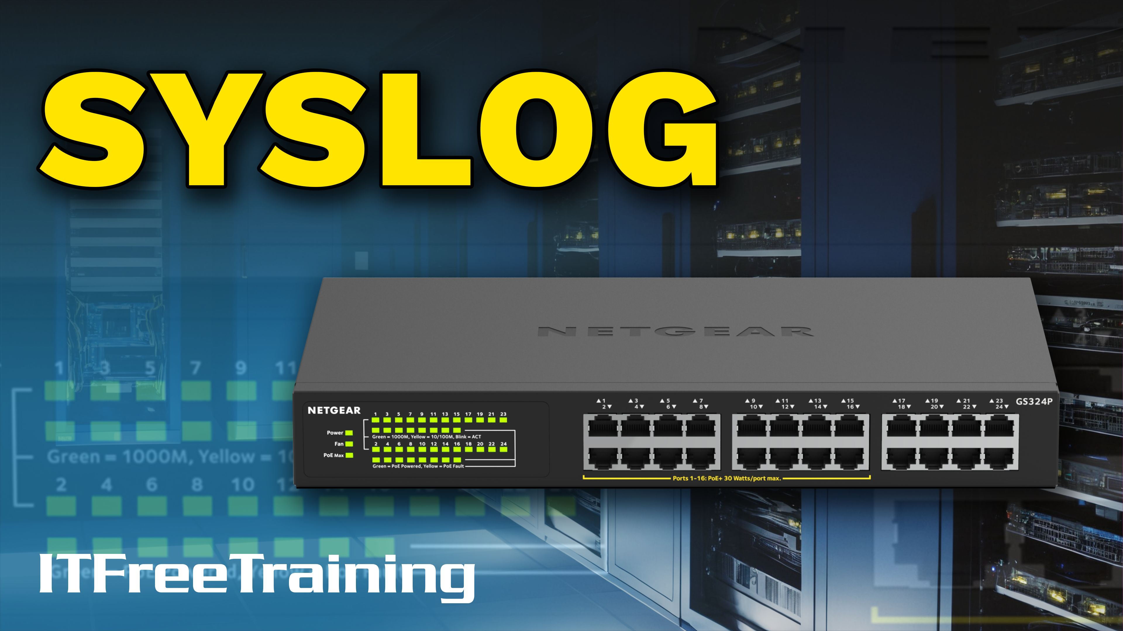
Notes:
Let’s have a look at Syslog.

Slide 2

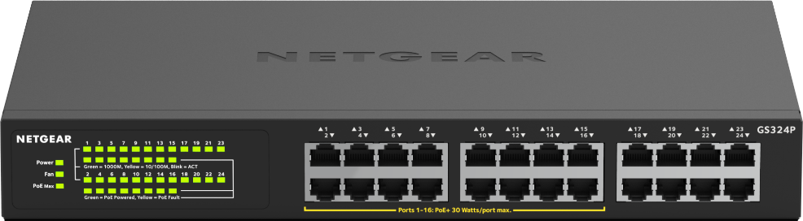
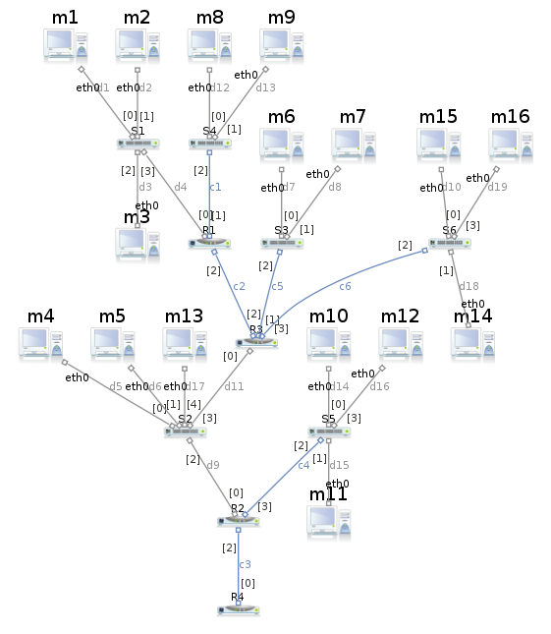
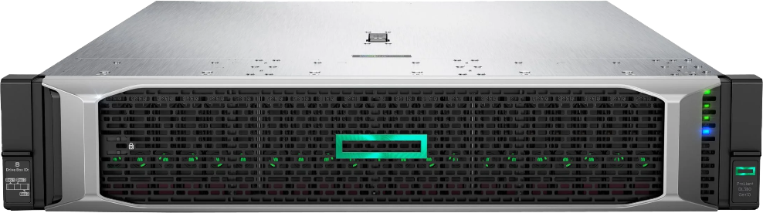
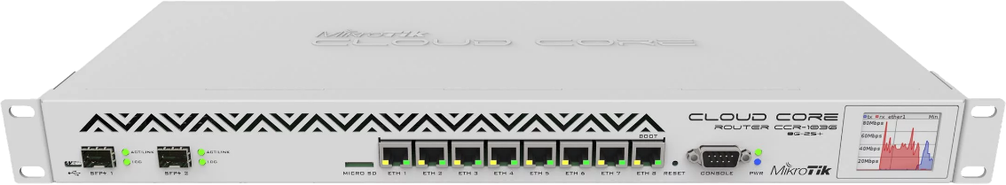

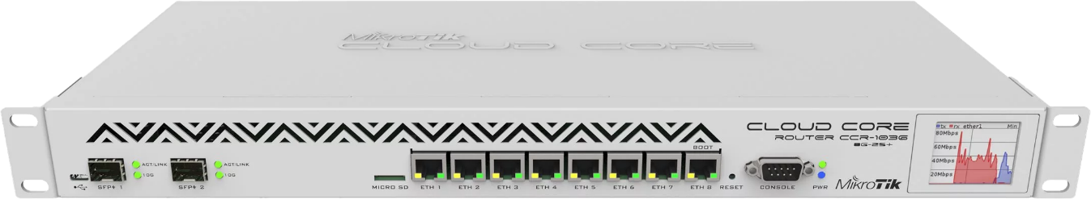
Syslog
Standard protocol for collecting and logging messages
De facto standard for logging events from untrusted systems
Typically uses UDP port 514 (Not encrypted)
SYSLOG MESSAGES
SYSLOG MESSAGES
SYSLOG MESSAGES
SYSLOG MESSAGES
SYSLOG MESSAGES
SYSLOG
SERVER
SYSLOG
SERVER
ITFreeTraining.com
© Copyright 2025
Notes:
00:03 In today's complex IT environments, managing logs from multiple devices can be overwhelming. To streamline this process, log management solutions centralize logs from various sources into a single repository. This consolidated view empowers IT teams to efficiently analyze trends, troubleshoot issues, and respond to security threats.
Syslog is the standard protocol for collecting and logging messages. It has become the de facto standard for logging events in distributed systems. Syslog typically uses UDP port 514, and its traffic is not encrypted by default. However, most devices offer the option to encrypt the traffic using a different port.
To better understand how it works, let’s look at how it is configured.

Slide 3
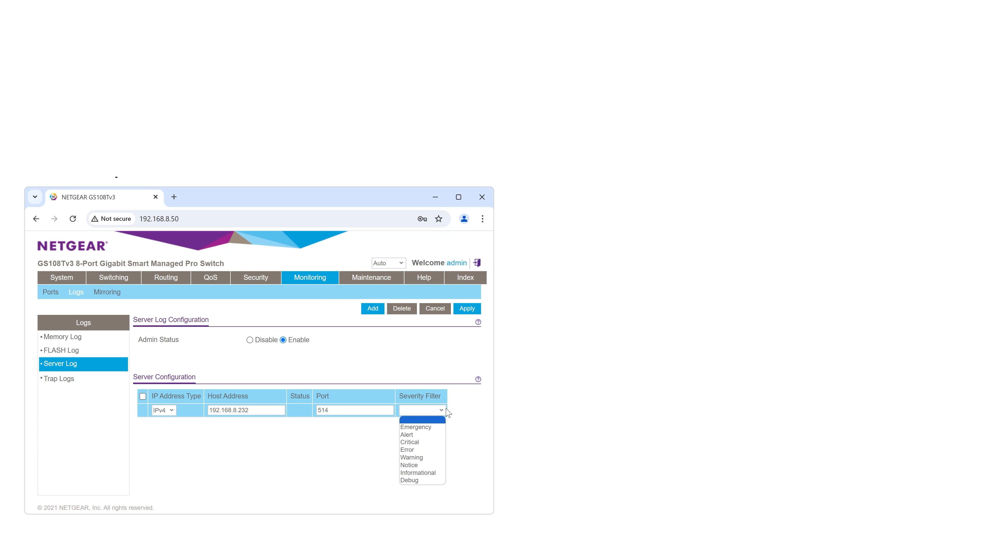
Network Device Setup
Configure device to send logs to Syslog Server
Default UDP port 514
Value | Severity | Description
0 | Emergency | System is unusable
1 | Alert | Action must be taken immediately
2 | Critical | Critical conditions
3 | Error | Error conditions
4 | Warning | Warning conditions
5 | Notice | Normal but significant conditions
6 | Information | Informational messages
7 | Debug | Debug-level messages
ITFreeTraining.com
© Copyright 2025
Notes:
00:49 The first step I need to take is to configure my network device to send logs to the Syslog server. To do this, I will open the network configuration interface for my device. For the A+ exam, you only need a very basic understanding of Syslog. Configuring Syslog in a production environment can be time-consuming because, even though it is a standard, it can be difficult to get devices to send Syslog messages to your server. I am showing the basics of how Syslog works to give you a better understanding, but don’t worry if you forget the details. The A+ exam won’t ask you to configure it.
Next, I will select the log tab. This network switch has several different logs that can be configured. The one that I am interested in is the server log.
Once selected, I will enable it and enter the details of the IP address and port. In this case, I will use the default port of 514, as this is the port used by the Syslog server. The last option is the severity filter.
Severity is measured by a number from zero to seven. Each level corresponds to different types of messages, with the lower levels being more severe. Usually, when a high level is selected, it includes messages from the lower levels as well.
In this case, I will select the filter level as critical. Generally, a higher level means more messages will be sent over the network. Each message adds extra load on your network device and your Syslog server. The appropriate filter level depends on your specific needs.
Lastly, I will apply the settings to the network device. The network device is now configured to send Syslog messages to my Syslog server.

Slide 4
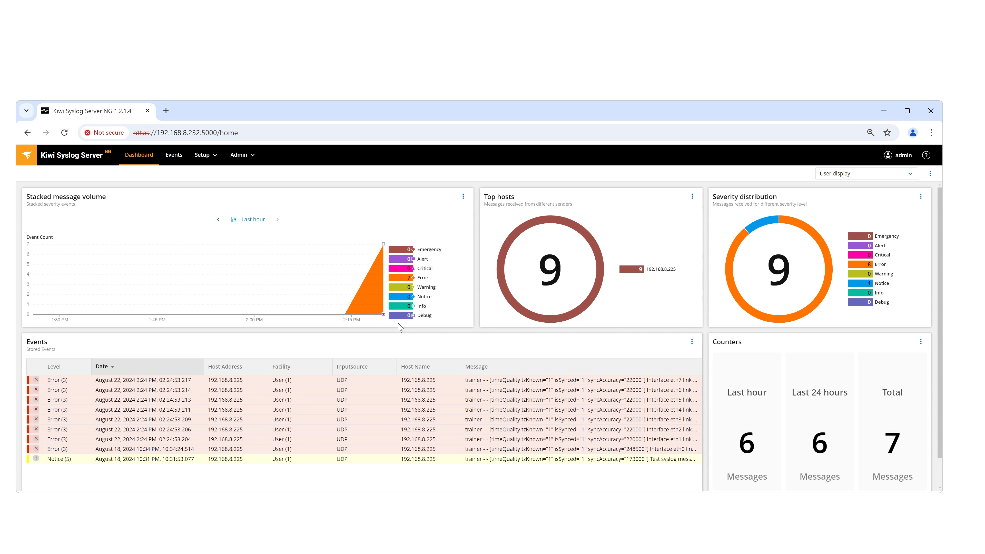
Syslog Server Example
ITFreeTraining.com
© Copyright 2025
Notes:
02:35 I have installed an example Syslog server so we can see how it works. There are many different Syslog servers available, including free ones. Some can be complicated to install.
On the screen, you can see some previous events. To demonstrate how the Syslog server works, I will artificially create some error events to simulate all but the management network connection on my network switch suddenly disconnecting.
You will notice that I receive a number of error events—one event for each network port on the switch, except the port used for network management. This demonstrates one of the limitations of Syslog: if the management port had disconnected, I wouldn’t have received any messages until the network port reconnected. Syslog heavily depends on the connection between your Syslog server and the network device. Therefore, it does not replace other tools that use alternative methods to test if a server is functioning.
In this Syslog server, you can see that the different severity levels are categorized. A lot of information can be sent using Syslog, and messages do not necessarily need to be error-related. On Linux systems, you could have complete log files sent to a Syslog server.
Your Syslog server may have some reporting options. On this Syslog server I can filter out particular events or particular hosts. For example, show all the critical events or other events like notice events.
Different Syslog servers will have different features and reporting abilities.

Slide 5


In The Real World
In The Real World
Syslog is well supported on
Unix based systems
Networking equipment
Windows has no native support
Syslog support can be added using additional software
Worth considering other tools for capturing events
Syslog can be difficult to set up
Configuration can vary in difficulty between different systems
Networking and firewalls need to be configured to allow Syslog traffic
ITFreeTraining.com
© Copyright 2025
Notes:
04:07 In the real world, there are some challenges when using Syslog. Syslog is well-supported on Unix-based systems and network equipment. Not all network equipment supports it, but generally, more expensive devices, particularly those designed specifically for company networking, will support it.
Windows has no native support for Syslog. Syslog support can be added using additional software. It is important to remember that Syslog is just one method for collecting logs from devices and systems on your network. It is worth considering other tools for capturing events. Windows natively supports forwarding events to a centralized server for processing. Depending on your needs, it may be worth not using Syslog for certain systems and using other tools.
Syslog can be difficult to set up. Configuration difficulty can vary between different systems. As we saw, configuring a network switch to send Syslog messages is not too difficult. However, if you want to send more customized Syslog messages—such as when the network switch experiences high traffic—this will be harder to configure, assuming that level of customization is supported by the network device.
Syslog also requires networking and firewalls to be configured to allow Syslog traffic. This includes any firewalls running on the device sending the Syslog messages. Many devices include an option to send test messages to ensure everything is working. It is recommended to send some test messages to your Syslog server to confirm everything is functioning correctly.

Slide 6

Subscribe
Next video
Video content: https://ITFreeTraining.com/ap11/6a40
© Copyright 2025
Notes:
05:42 That concludes the video from ITFreeTraining on Syslog. Keep in mind you just need a basic understanding of it for the exam. If you decide to give it a try setting it up, best of luck. Until the next video, thanks for watching.
References
“The Official CompTIA A+ Core Study Guide (Exam 220-1101)” page 210
“Image: Complex network map” https://upload.wikimedia.org/wikipedia/commons/1/1a/Complex_network_marionnet.png
“SolarWinds Kiwi Syslog Server Overview” https://www.youtube.com/watch?v=wCHgcqguQRc
Credits
Trainer: Austin Mason http://ITFreeTraining.com
Voice Talent: HP Lewis http://hplewis.com
Quality Assurance: Brett Batson http://www.pbb-proofreading.uk

