Slide 1

Notes:
Let’s look at servers and protocols.

Slide 2
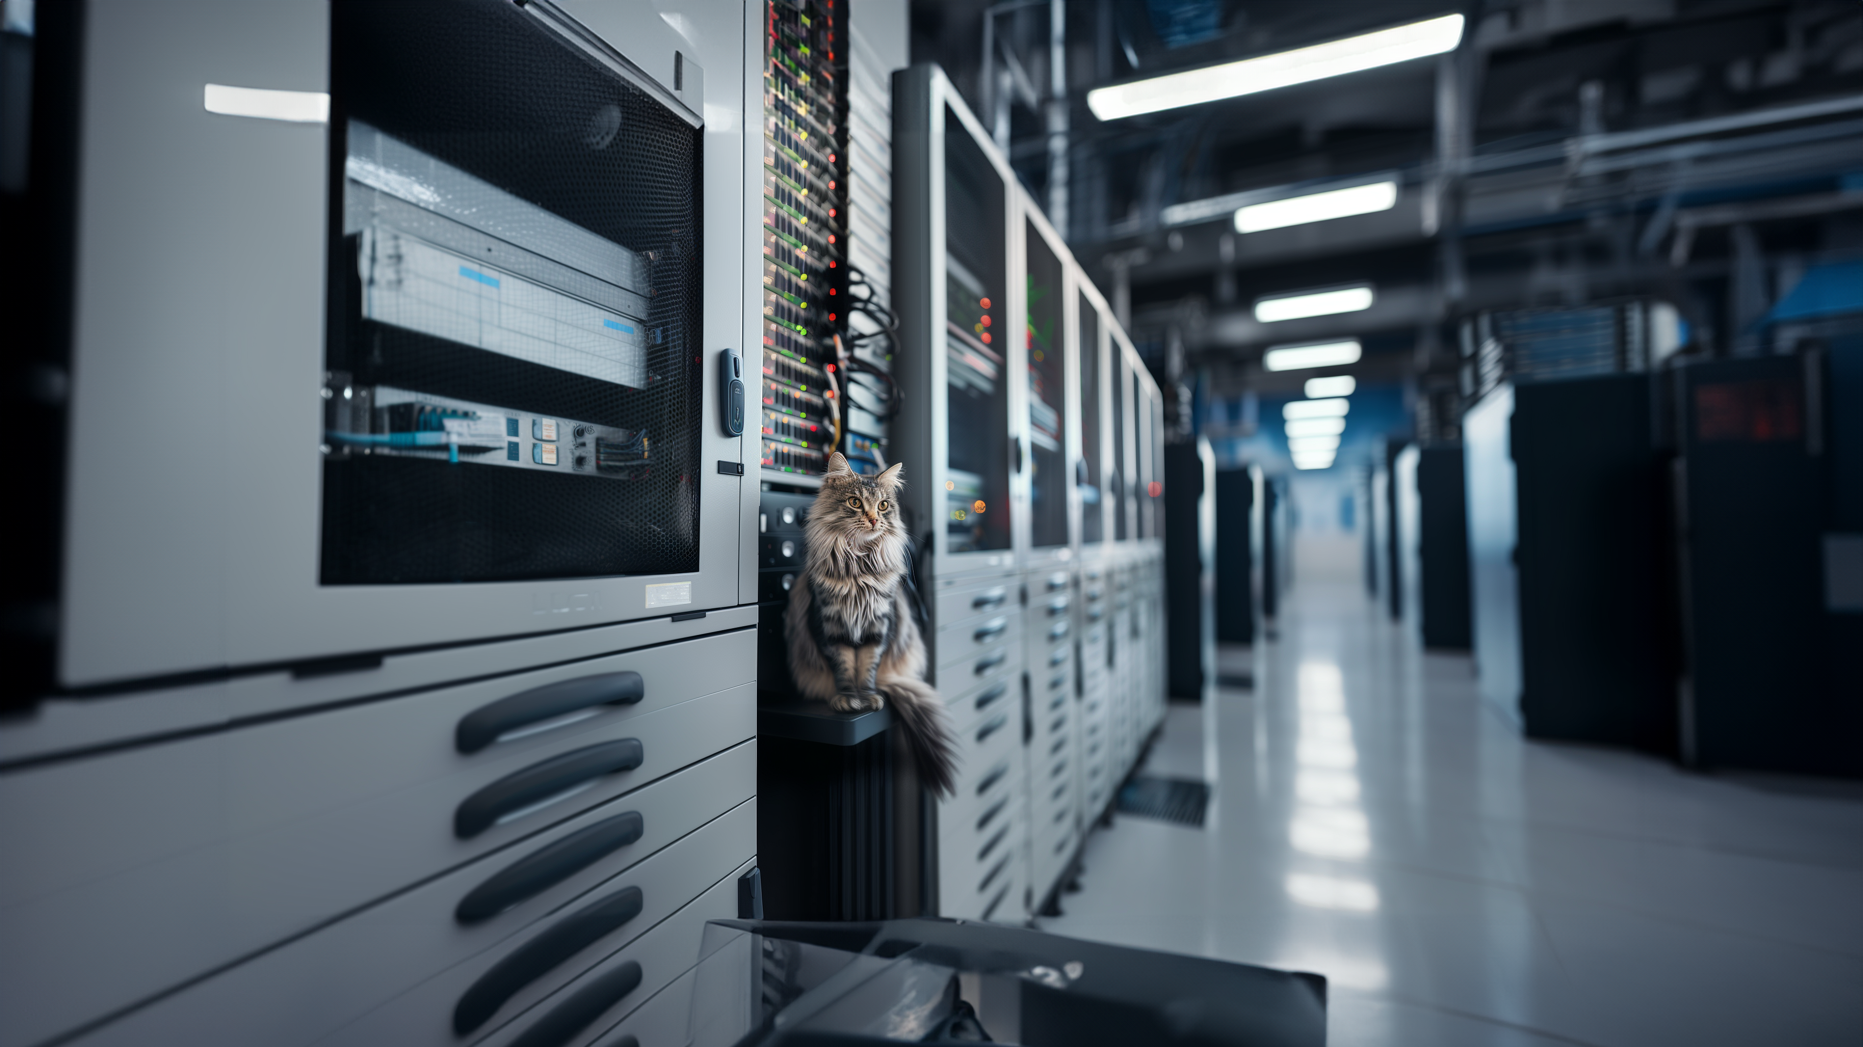
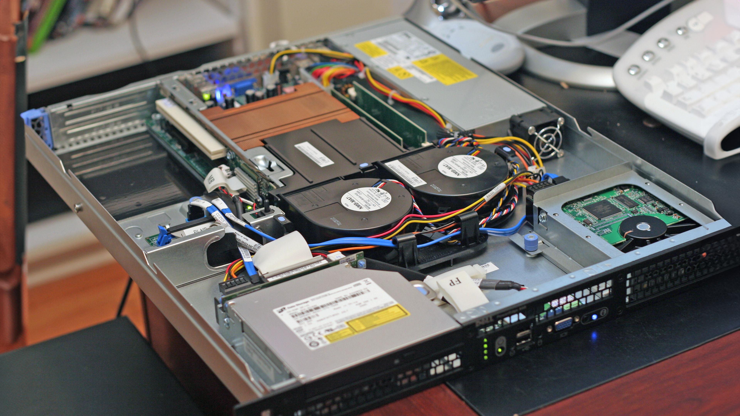
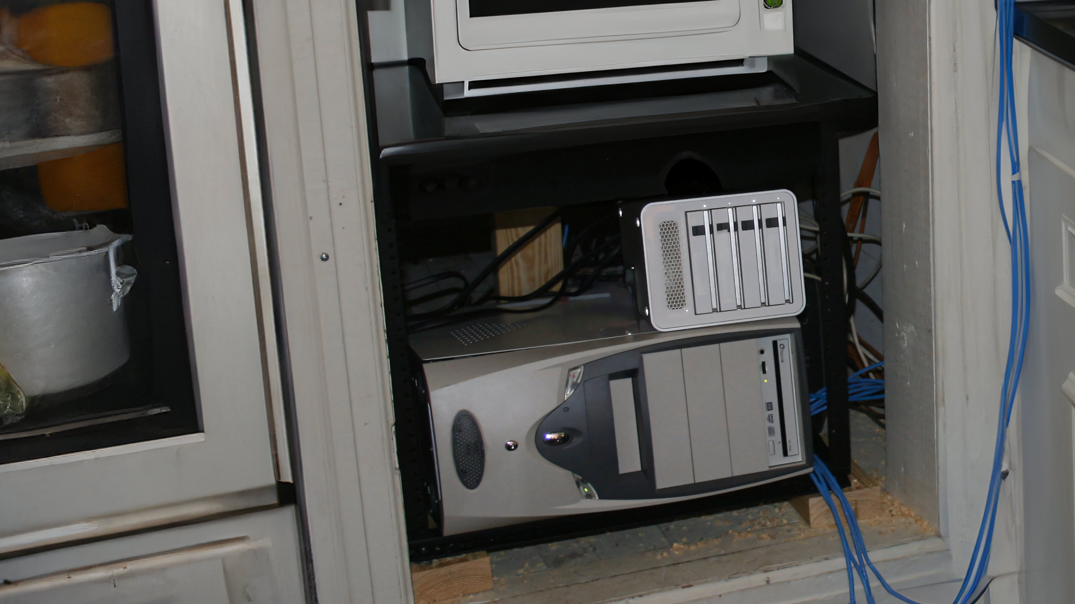
Servers
Provides files/print/application services
Commercial servers use specialized hardware optimized for performance and reliability
Can also run on standard hardware
ITFreeTraining.com
© Copyright 2025
Notes:
00:04 Servers provide services to our users on the network. For example, file, print and application services. Servers can take many different forms. Businesses will often purchase specialized servers as they use specialized hardware optimized for performance and reliability. Commercial servers are manufactured with better components than standard computers as they are designed for 24-hour use. They offer better reliability and uptime in professional environments.
Servers can also run on standard hardware. So, if you have a computer in your attic, you may want to make it a test server or use it as a media server. These servers may see themselves getting perched in places that defy logic – atop refrigerators or wedged between a rock and a hard place (sometimes literally). While it's admirable to give your old machine a sense of purpose, let us not forget that servers need good air circulation and should not be placed in damp areas.

Slide 3


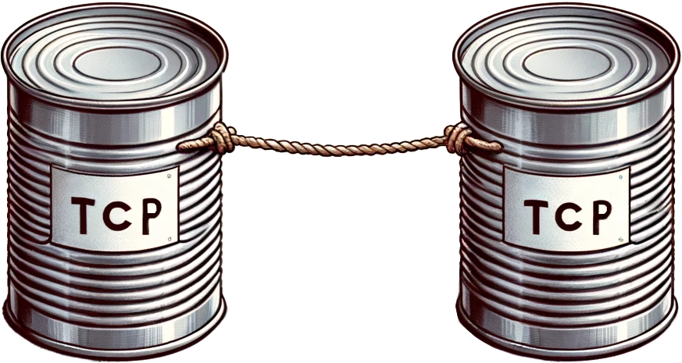



Basic Protocols
DHCP
IPv4
Assigns
IP addresses
Connection based
IPv6
Addressing &
routing internet data
Unreliable. No checks
Names to
IP addresses
ITFreeTraining.com
© Copyright 2025
Notes:
01:02 There have been a lot of protocols developed over the years; however, there are a few fundamental protocols that are found in just about any modern network. The Internet Protocol, or IP, provides unique addresses to devices to allow traffic to be routed between them.
IP is a fundamental protocol that's part of a larger suite of protocols used for internet and network communications. Within this suite, two main protocols that operate at the transport layer are Transmission Control Protocol or TCP and User Datagram Protocol or UDP.
TCP provides a connection-oriented, reliable transmission. It establishes a connection between the sender and receiver before data is sent, ensuring that data packets are delivered in order, and retransmitting any packets that are lost. TCP also performs error checking to ensure the integrity of any data transmission.
On the other hand, UDP provides a connectionless, best-effort service. It sends packets without establishing a connection, which means there is no guarantee that the packets will arrive in order or even arrive at all. There's no error checking or retransmission of lost packets, making UDP faster but less reliable than TCP.
Additionally, Dynamic Host Configuration Protocol, or DHCP, simplifies network management by automatically assigning IP addresses to devices, eliminating the need for manual configuration and thereby reducing manual configuration errors. Finally, Domain Name System, or DNS, acts as a translator, converting user-friendly domain names (like websites) into their corresponding IP addresses, making accessing online resources easier. These protocols work together to ensure efficient and reliable communication within a network environment.
These are the main protocols; I will next look at the main protocols used for file servers.

Slide 4

Server Message Block (SMB)
Used by Windows systems to share files over a network
SMB1
Released 1983. Serious security vulnerabilities. Don’t use
CIFS
Released 1996. Technically a dialect of SMB version 1
(Common Internet File System)
SMB2
Released 2006
SMB3
Released 2012
* CIFS sometimes used for SMB. Treat CIFS as SMB
ITFreeTraining.com
© Copyright 2025
Notes:
03:12 The protocol developed by Microsoft for file sharing is Server Message Block or SMB. SMB is used by Windows systems to share files over a network. Although developed by Microsoft, SMB is also available for non-Microsoft systems.
I will open Windows explorer. There is a network drive connected to a file server. SMB is the protocol that is being used to share files between the server and the client. SMB does all the hard work, so there is not too much you need to know about it.
The first version of SMB was released in 1983. It has serious security vulnerabilities, and it is recommended not to use it. SMB version 1 is deprecated and if it is included in modern versions of Windows, it is disabled. Unless you are accessing a very, very old system, you won’t need to worry about it.
There is one nuance with SMB that you should be aware of. In 1996 Microsoft released the Common Internet File System or CIFS. Technically it is SMB1 with extensions, allowing it to be run over the internet. It is Microsoft’s attempt to have file sharing as an internet standard, rather than a standard just for use on local area networks. This was later abandoned by Microsoft and they returned to SMB development. As newer versions of SMB support the IP protocol, there was no need for network extensions. This was a long time ago in the world of computing, so you probably won’t come across a system that uses the CIFS protocol unless it is very old. Given that it is SMB1 with extensions, just like SMB1, it is recommended that you do not use CIFS.
Although the CIFS protocol is deprecated and recommended not to be used, even today you may come across the terminology although development was abandoned. For example, if you are using a Linux based system and mapping a network drive, you may see the terminology CIFS. In this example, you can see CIFS used in the command line. Although the terminology used is CIFS, modern Linux systems will use a newer version of the SMB protocol.
The next version of SMB is version 2. This was released in 2006. The newest version, SMB3, was released in 2012. Modern operating systems and devices upgraded to this version a long time ago. Thus, it is most likely that you are using this version. Nowadays, you should only be using SMB3 or SMB2.

Slide 5

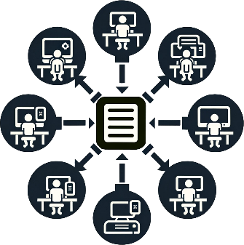


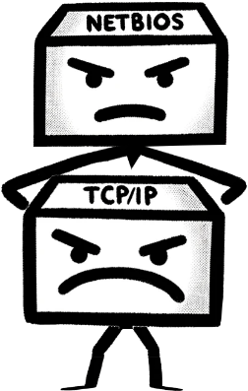
Protocol Ports
Server Message Block (SMB)
TCP/445
HTTP/HTTPS
HTTP port 80. HTTPS port 443
File Transfer Protocol (FTP)
TCP/21 control connection. TCP/20 data transfer connection
NetBIOS over TCP/IP (NetBT)
TCP-UDP/137-139
Legacy protocol before Windows 2000. Just know the port numbers
ITFreeTraining.com
© Copyright 2025
Notes:
06:36 For the A+ exam there are some network ports that you need to remember. For SMB, remember port number 445. For internet traffic, the main two protocols are HTTP and HTTPS. HTTP uses port 80. HTTP transfers traffic unencrypted and thus is not secure. HTTPS is the secure version and uses port 443. Most websites and devices use HTTPS nowadays.
File transfer protocol or FTP uses port 21 for the control channel and port 20 for the data channel. There is an exception when port 20 is not used, but I will cover that in the next video. FTP was around before SMB and allows files to be transferred around the network. It is still used today, although most of the time a secure version of it will be used.
The last protocol is NetBIOS. Before I say anything about this protocol, note that it is a legacy protocol used before Windows 2000. You are unlikely to come across it nowadays, so for the exam, just remember the ports it uses. I won’t go into the details about it since you simply don’t need to know, but essentially it allows the older Microsoft file-sharing protocol to piggyback on the Internet Protocol. If you get a question on it in the exam, it will most likely just be asking what port number it uses or it may be listed as an answer for a port-related question. You should not need to know anything more about it than that.

Slide 6

Subscribe
Next video
Video content: https://ITFreeTraining.com/ap11/6a05
© Copyright 2025
Notes:
08:15 If you have your server hidden away somewhere it should not be, this may be a good time to move it. I won’t tell anyone. Until the next video, thanks for watching.
References
“The Official CompTIA A+ Core Study Guide (Exam 220-1101)” pages 200 to 201
“Picture: server” https://commons.wikimedia.org/wiki/File:Inside_and_Rear_of_Webserver.jpg
Credits
Trainer: Austin Mason http://ITFreeTraining.com
Voice Talent: HP Lewis http://hplewis.com
Additional voice Talent: Stuart Thomas Hall https://www.imdb.com/name/nm12181561/
Quality Assurance: Brett Batson http://www.pbb-proofreading.uk

