Slide 1
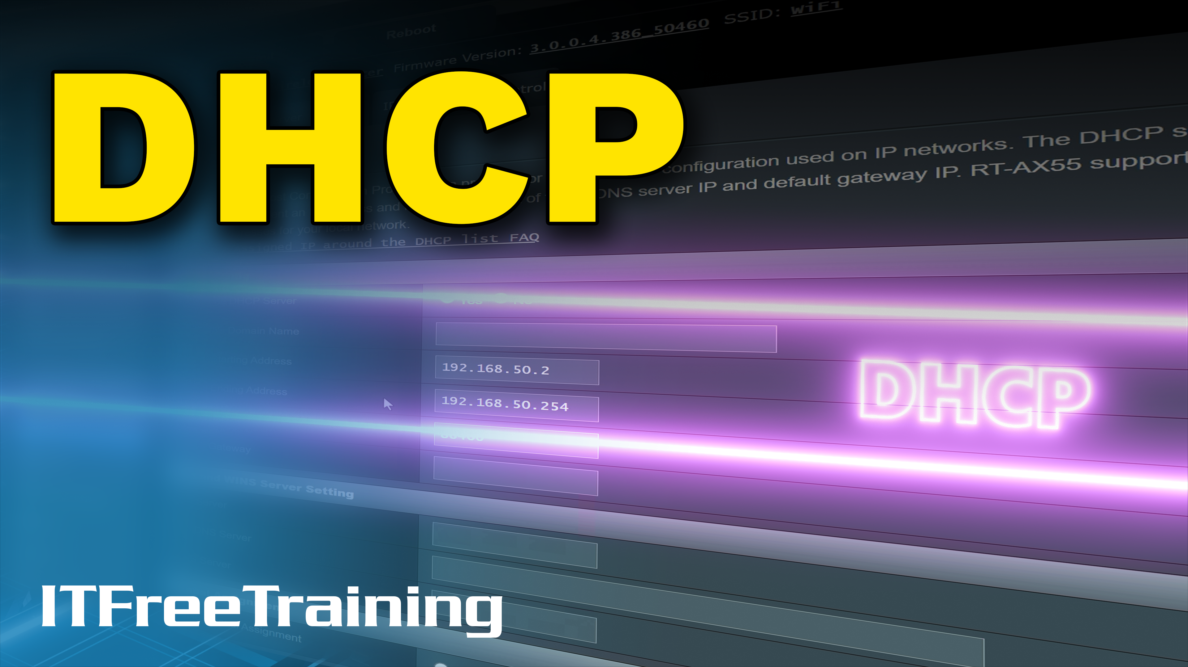
Notes:
Let’s have a look at DHCP.

Slide 2

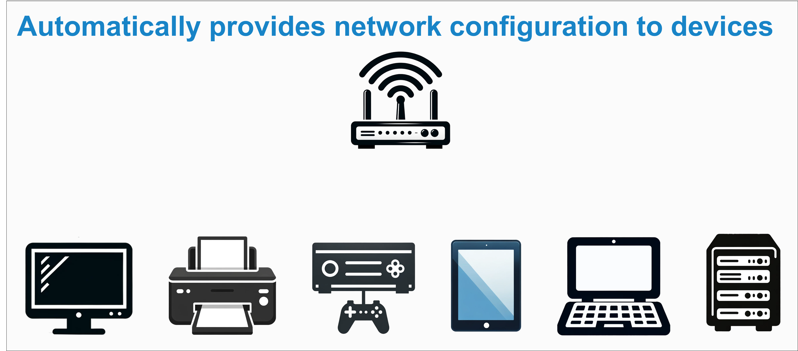
Dynamic Host Configuration Protocol
192.168.0.2
192.168.0.7
192.168.0.3
192.168.0.6
192.168.0.4
192.168.0.5
ITFreeTraining.com
© Copyright 2025
Notes:
00:04 Dynamic Host Configuration Protocol or DHCP is a protocol that assigns network configurations to devices within a network. Basic configurations, such as IP addresses, DNS settings, and other network configurations, are assigned to devices. Numerous settings can be configured, including proxy servers and custom settings. Let's now examine the main concepts behind DHCP.

Slide 3
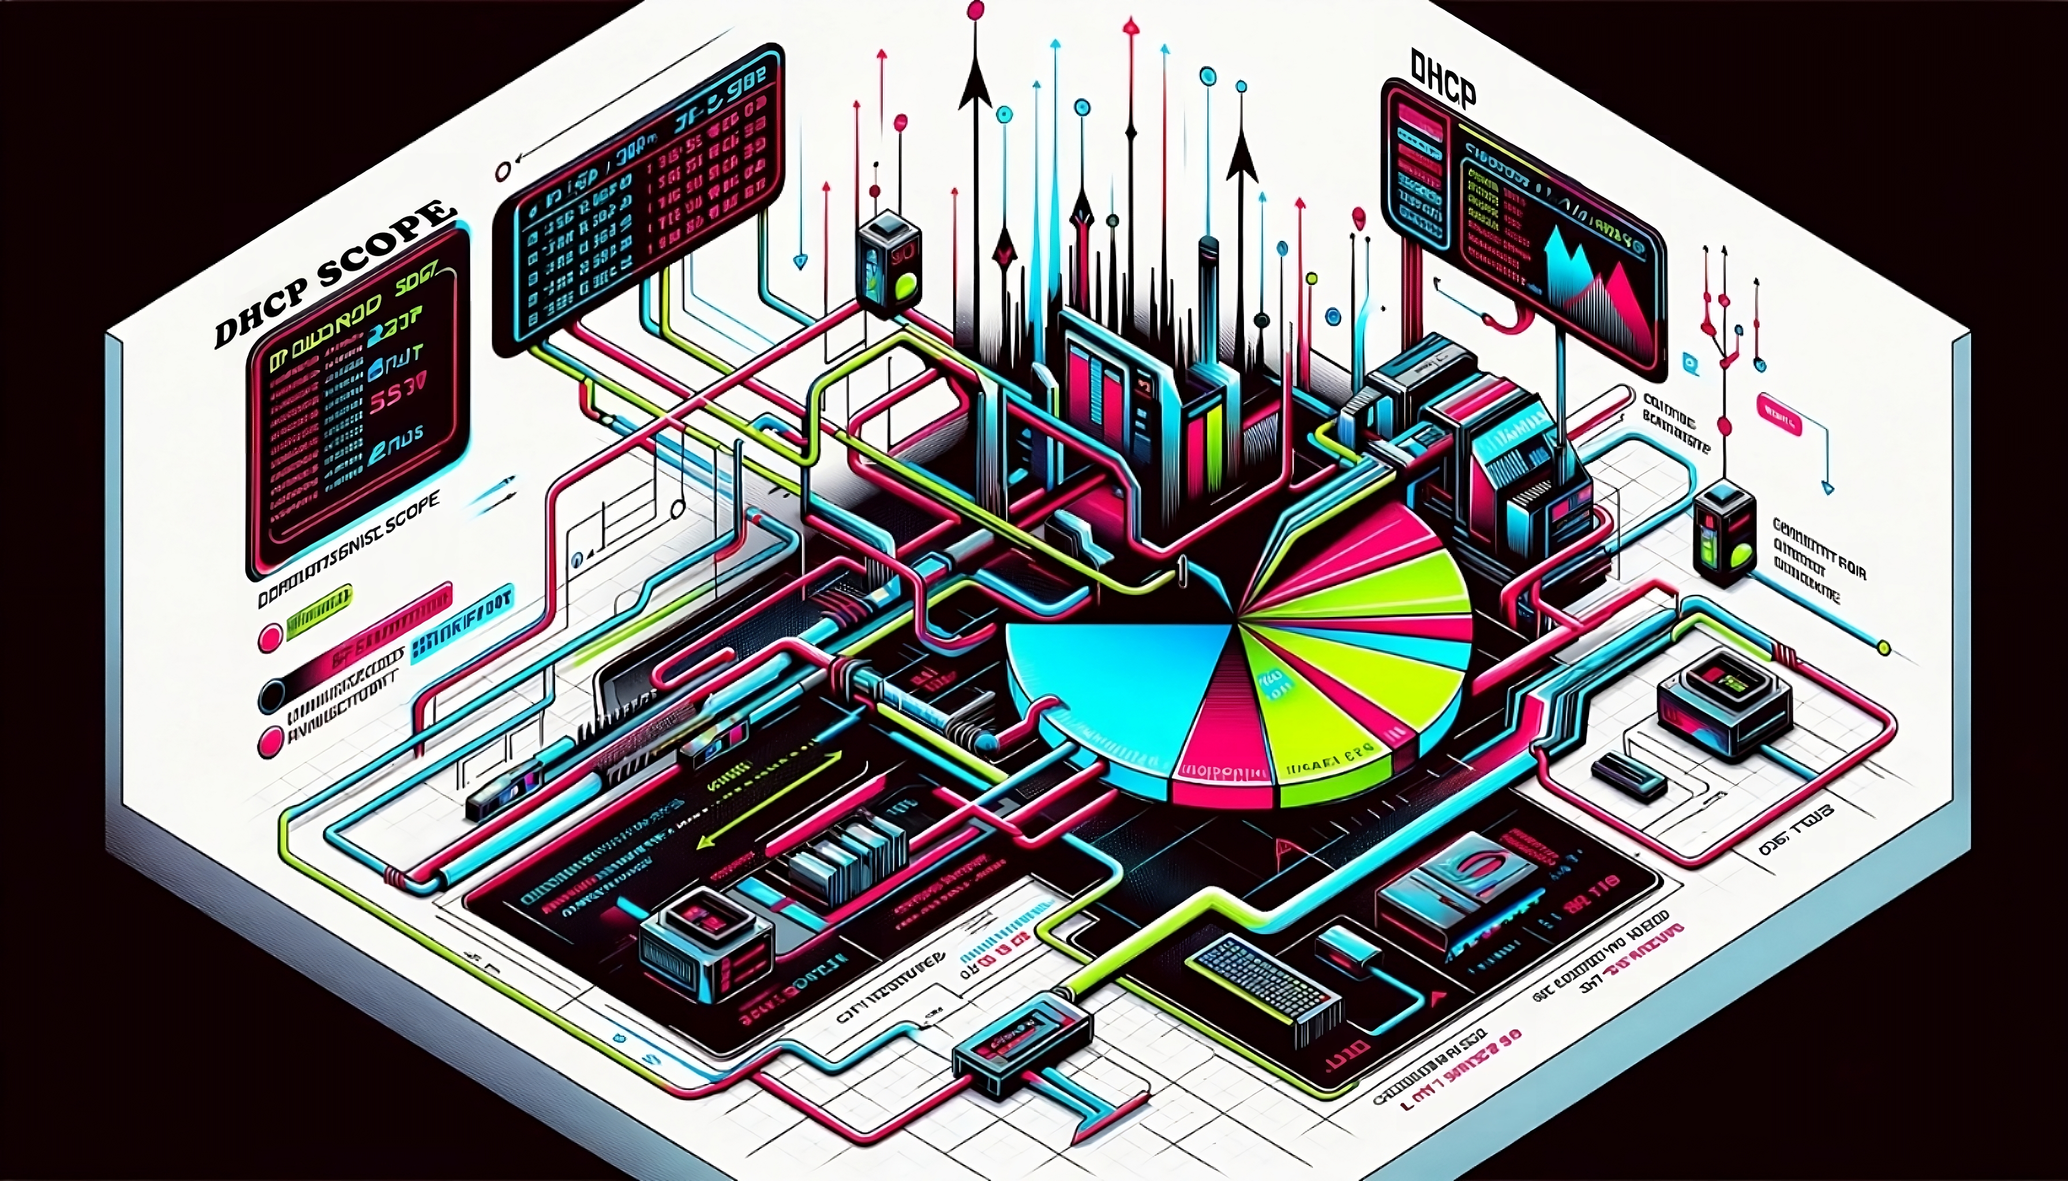
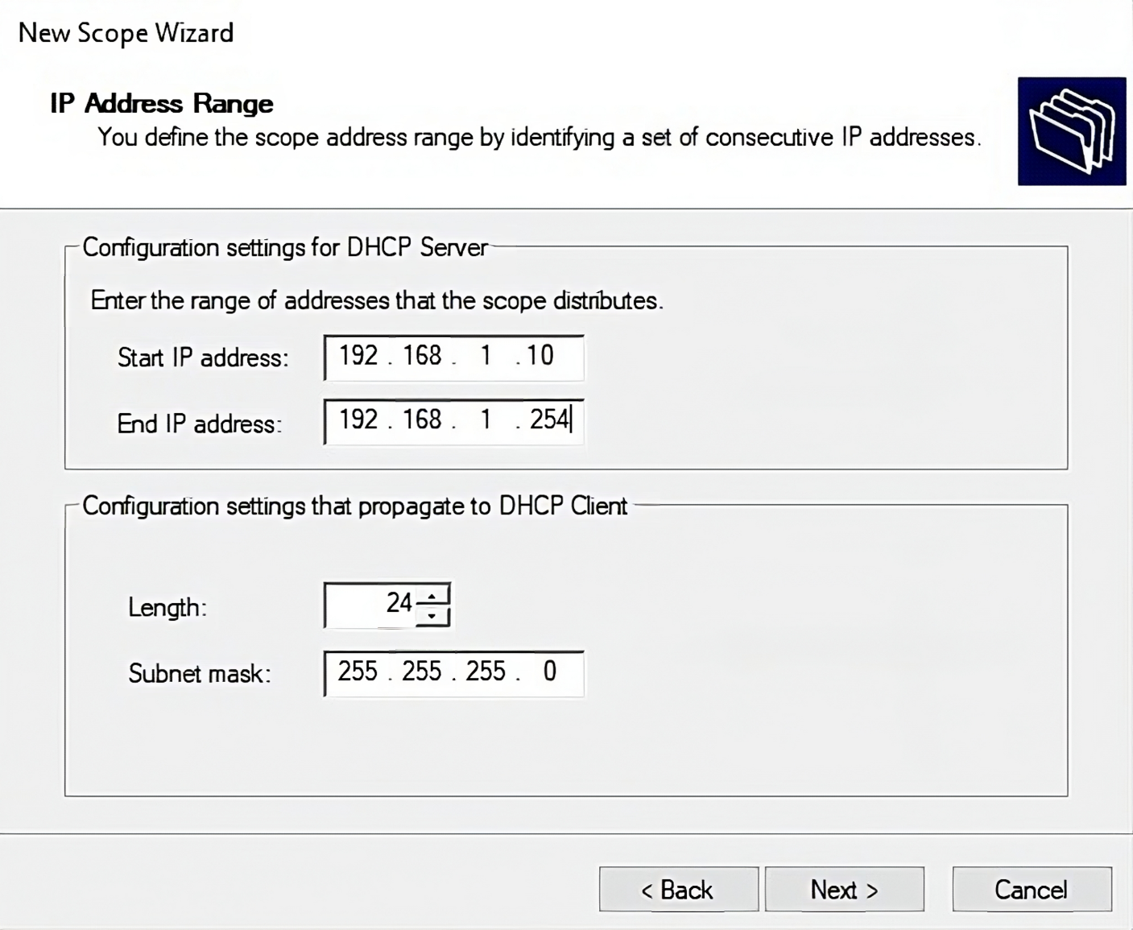
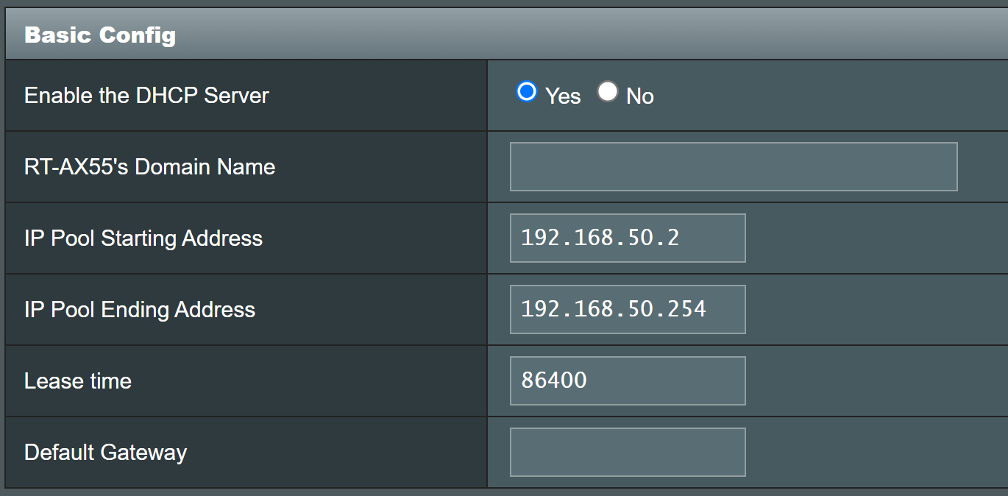
DHCP Scope
A range (pool) of IP addresses
Can be allocated to devices on the network
Start
End
ITFreeTraining.com
© Copyright 2025
Notes:
00:30 DHCP allocates IP addresses from a DHCP scope, which is a range of IP addresses, also known as a pool. Devices on the network can be allocated IP addresses from this pool. Here, we see a screen from Windows Server 2022 to create a new scope. You need to specify the start and end IP addresses for the zone. Devices on the network will receive IP addresses from this scope.
Windows Server supports multiple scopes, allowing you to create multiple scopes on the same network or different scopes on different network cards. For other DHCP implementations, such as a Wi-Fi router, you will typically have one scope to configure. It is essential to make the scope large enough to accommodate the maximum number of devices that will connect to the network.

Slide 4


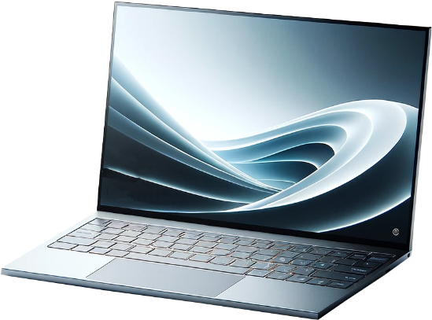
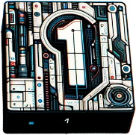
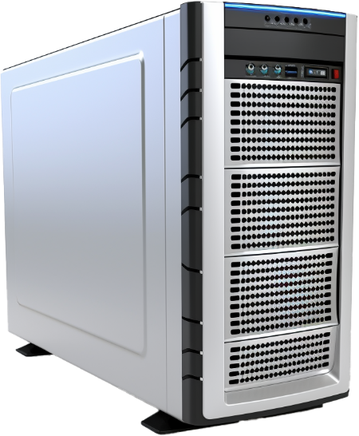



DHCP Leases
DHCP Leases
A temporary assignment of an IP address to a device
Like renting a parking spot for a limited time
DHCPDISCOVER
SrcMAC: AA-BB-CC-DD-EE-FF
DestMAC: FF-FF-FF-FF-FF-FF
SrcIP: 0.0.0.0
DestIP: 255.255.255.255
DHCPOFFER
SrcMAC: 11-22-33-44-55-66
DestMAC: FF-FF-FF-FF-FF-FF
SrcIP: 192.165.1.254
DestIP: 255.255.255.255
Offer IP: 192.168.1.101
Netmask: 255.255.255.255
Server: 192.168.1.254
Lease time: 48 hours
0.0.0.0
DHCPREQUEST
SrcMAC: AA-BB-CC-DD-EE-FF
DestMAC: FF-FF-FF-FF-FF-FF
Src IP: 0.0.0.0
DestIP: 255.255.255.255
Request IP: 192.168.1.101
Netmask: 255.255.255.0
Request parameters
192.16.1.254
DHCPACK
SrcMAC: 11-22-33-44-55-66
DestMAC: AA-BB-CC-DD-EE-FF
Src IP: 192.168.1.254
DestIP: 255.255.255.255
Offer IP: 192.168.1.101
Server: 192.168.1.254
Gateway: 192.168.1.254
Additional parameters
192.168.1.101
ITFreeTraining.com
© Copyright 2025
Notes:
01:20 For a device to use an IP address, it needs a lease, which is a temporary assignment of an IP address to a device. It is like renting a parking spot for a limited time; you'll lose the spot unless you extend the time before it runs out. To understand how a lease works, let's look at an example where a laptop is added to the network. The laptop does not have any network configuration and needs to contact the DHCP server to obtain an IP address and other network configuration settings.
For the A+ exam, you only need a basic understanding of the process clients use to contact a DHCP server to obtain a lease and receive configuration parameters. If you pursue more advanced network certifications, you will need to understand the process in more detail.
The first step a device takes to obtain a DHCP lease is to send a DHCP Discover message on the network. Since the device does not have a valid IP address on the network, it sends a broadcast message. All devices on the network, including the DHCP server, will hear the broadcast. This means that DHCP is limited to the local network. However, using DHCP relay agents, a router can route the DHCP Discover message to a DHCP server on another network.
Once the DHCP server receives the DHCP Discover message, it will send a DHCP Offer message to the device. Since the device does not have an IP address, this message is sent as a broadcast. It is possible for multiple DHCP servers to be on the network, and the device may receive multiple DHCP offers.
The DHCP offer will have an IP address the device can use and a lease time. This is the time the device is allowed to use the IP address before it expires. The device can request the IP address be renewed before the lease time expires.
Since the device can receive multiple offers, it needs to respond with the one it wants to use, which will generally be the first one it receives. It does this using the DHCP Request message, which needs to be sent as a broadcast. This broadcast lets other DHCP servers on the network know that their offer was not accepted and allows them to assign the IP address to a different device.
The device will also request additional network parameters. The DHCP server can send out different network configurations. For example, it is possible to have one set of network configurations for laptops and another for desktops. It is up to the device to request the network configuration it wants; otherwise, it will receive the default configuration. Additional configurations are optional and usually only found on DHCP servers like Windows Servers, not on devices like Wi-Fi routers.
The DHCP server now needs to respond with a DHCP Acknowledgement message, which is sent directly rather than as a broadcast. This message informs the device that it can start using the IP address. The device can use the IP address until the lease expires. Before the lease expires, the device will send a request to the DHCP server to extend the lease.

Slide 5
DORA
Discover
The client sends a message to locate a DHCP server
Offer
The DHCP server responds with an offer message containing a proposed IP address
Request
The devices selects one offer and sends a message to claim the IP address
Acknowledge
The DHCP server confirms that the IP address can be used
ITFreeTraining.com
© Copyright 2025
Notes:
04:49 This whole process is called DORA, which stands for Discover, Offer, Request, and Acknowledge. The client sends a Discover message to locate a DHCP server. The DHCP server will send an Offer message containing a proposed IP address.
The device will select one offer and send a message to claim the IP address. If it received multiple offers, it generally responds to the first one received. Lastly, the DHCP server sends a message to the device confirming that it can use the IP address. Once the device receives this message, it can start using the IP address.

Slide 6
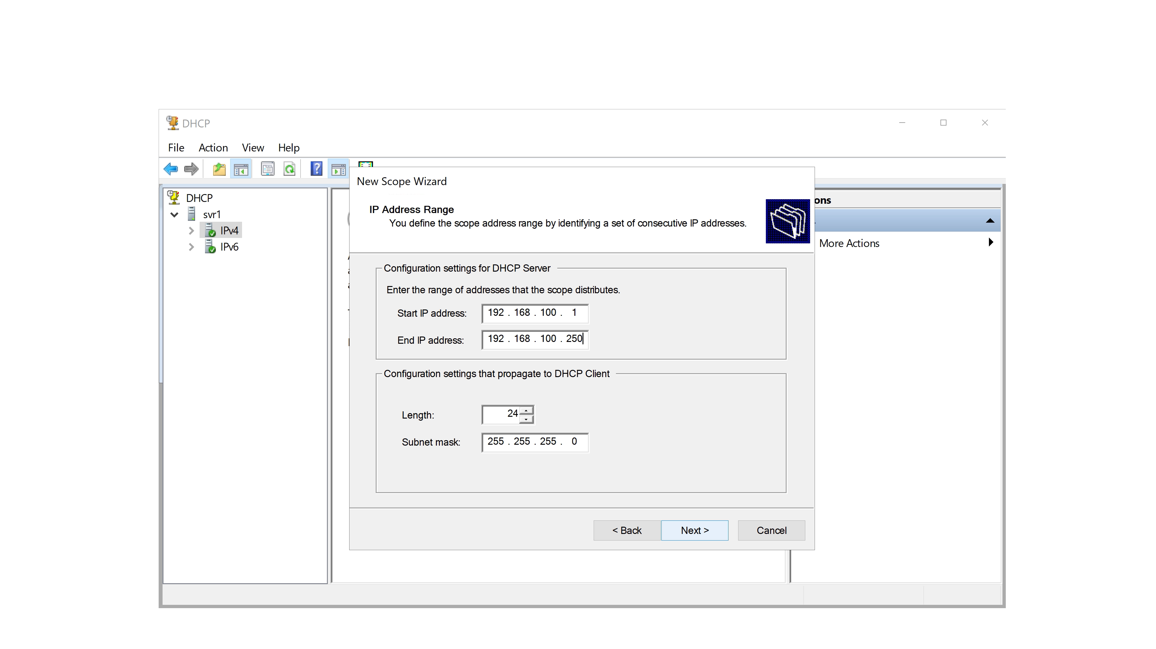
Demonstration
ITFreeTraining.com
© Copyright 2025
Notes:
05:28 To better understand how scopes work, I will open the DHCP admin tools on Windows Server 2022 and use them to create a scope. Although you won’t be required to know how to do this for the exam, I think examining this will help you better understand how DHCP works.
To create a new scope, I will right-click on IPv4 to display the menu. I could also create a scope for IPv6. The process is much the same. To create the scope, I will select “New Scope” to start the wizard.
After passing the welcome screen, I will need to enter a name and description for the scope. On the next screen, I need to enter the range of IP addresses. On your network, you may have IP addresses that you don’t want to allocate. If possible, set the range so these IP addresses are not part of the scope, but we can also exclude IP addresses if they are within the range.
On the next screen, I can enter an exclusion range. I will enter one range. The IP addresses in this range won’t be allocated by the DHCP server.
On the next screen, the lease time can be entered. This is the time the device can use the IP address before the lease expires. I will leave it on the default of eight days and move on.
The next screen will ask if you want to configure additional options. In this case, I will leave it on yes so we can look at the options.
On the next screen, I will enter a default gateway. The wizard will essentially ask you for the standard options that DHCP uses.
On the next screen, I will enter two DNS servers. Configuring DNS servers is common in DHCP. At the top, there is an option to enter a parent domain. This domain name will be appended when a host name is provided rather than a full DNS name.
On the next screen, I can configure WINS servers. WINS was the name system before DNS. In the year 2000 Microsoft added DNS as the primary name resolution to replace WINS. So, it is unlikely your network will use it; so, I will leave it blank and press next.
On the last screen, I can choose to activate the scope or not. If you still need more configuration, you should not activate the scope. In this case, I will activate the scope. On the last screen, I will finish the wizard to complete the creation of the scope.
Additional DHCP options can also be configured. To do this, I will expand to “Server Options,” right-click on it, and select “Configure Options.” This will show the options that can be configured. You can see that there are many options that can be configured. For example, you can configure time servers, proxy servers, and network booting options, just to name a few.
Keep in mind that for the A+ exam, you only need to understand the basic process of devices contacting the DHCP server to obtain a lease and network parameters from the DHCP server.

Slide 7

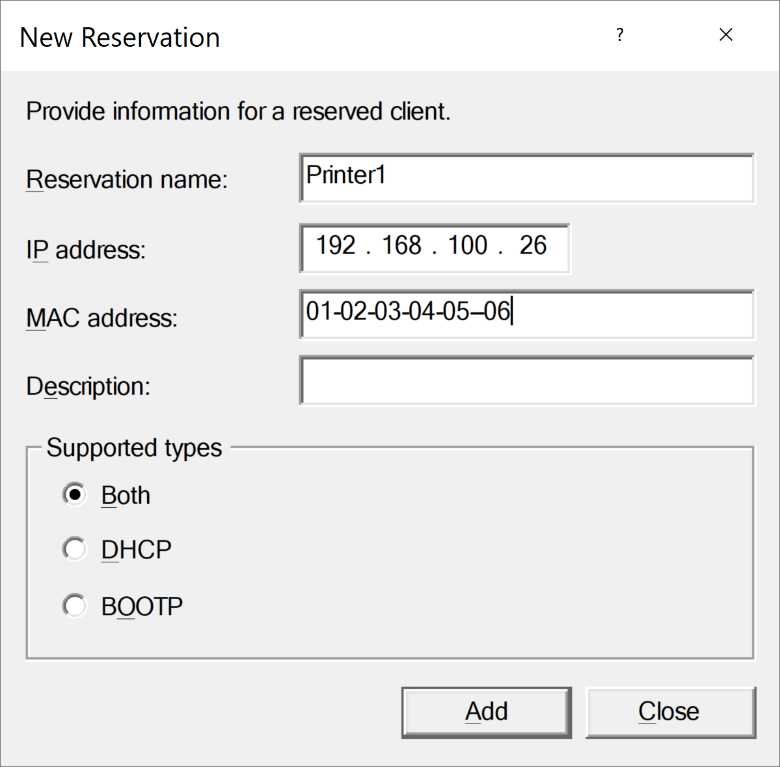
DHCP Reservations
Allocates the same IP address to the device each time
Reservation is created using the MAC address
ITFreeTraining.com
© Copyright 2025
Notes:
08:51 The last topic I will cover is DHCP reservations. Reservations occur when the DHCP server allocates the same IP address to a device each time. To create the reservation on the DHCP server, the IP address and MAC address are entered into the reservation.
When the device attempts to obtain an IP address from the network, the DHCP server will always allocate the same IP address. This is useful for devices like servers, printers, or any other devices where you don’t want the IP address to change. The alternative is to configure a static IP address on the device. The advantage of using a DHCP server is that your IP addresses are centrally managed.

Slide 8

Subscribe
Next video
Video content: https://ITFreeTraining.com/ap11/5d05
© Copyright 2025
Notes:
09:39 That concludes this video from ITFreeTraining on DHCP. I hope you found the video informative and I look forward to seeing you in the next video. Until then, thank you for watching.
References
“The Official CompTIA A+ Core Study Guide (Exam 220-1101)” pages 189 to 191
Credits
Trainer: Austin Mason http://ITFreeTraining.com
Voice Talent: HP Lewis http://hplewis.com
Quality Assurance: Brett Batson http://www.pbb-proofreading.uk

