Slide 1
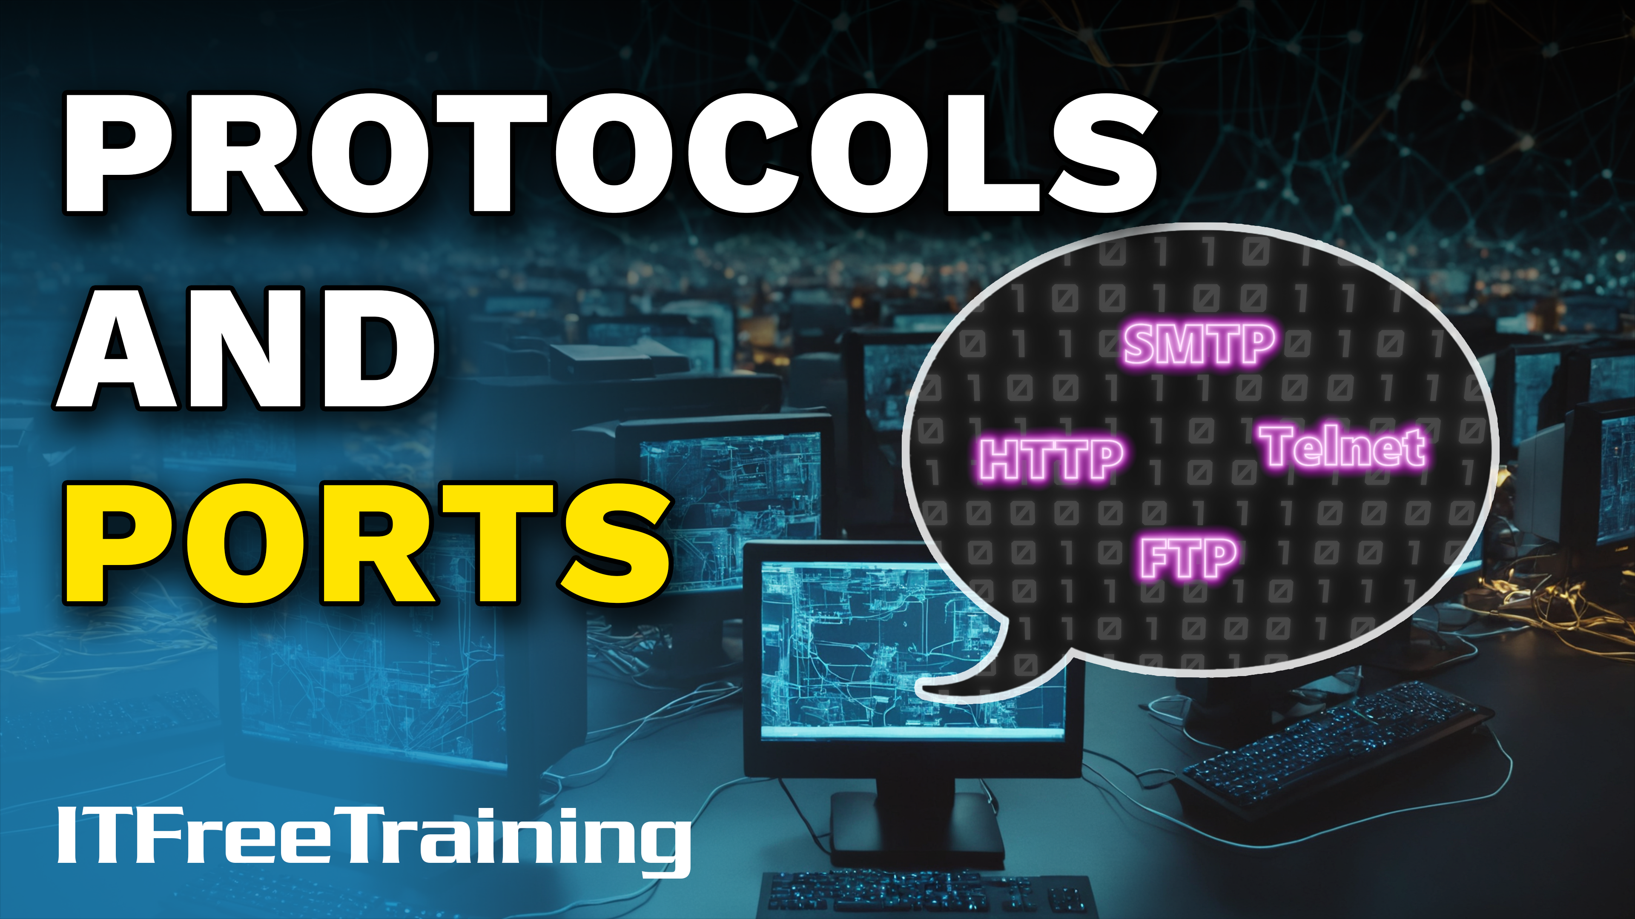
Notes:
Let’s have a look at protocols and ports.

Slide 2


Protocols
Well established rules for communication
Provides common language between devices
ITFreeTraining.com
© Copyright 2025
Notes:
00:03 A protocol is a set of well-established rules for communication. It essentially provides a common language between devices for them to communicate. Without well-defined protocols, devices running different operating systems would not be able to communicate with each other. With networks like the internet, protocols are vital to allow different devices to communicate.
Protocols provide the communication to occur, but this communication needs to be separated so different devices can communicate over the same network.

Slide 3


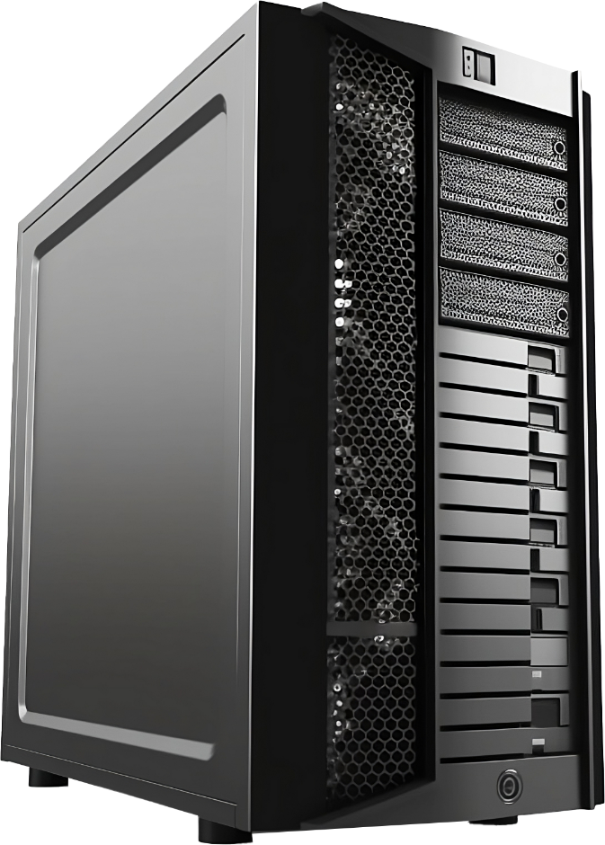

Ports
Uniquely identifies an endpoint for network communication
Data is directed to that port for a specific service
Allows an IP address to be divided up into separate data streams
IP address/Port used to sperate data streams on same destination port
HTTP
Port 80
Dynamic port
Port 80
Dynamic port
SMTP
Network interface
Port 80
Telnet
Dynamic port
FTP
ITFreeTraining.com
© Copyright 2025
Notes:
00:35 Ports are what allow data channels to be created using the same IP address. A port uniquely identifies an endpoint for network communication. Data is directed to a particular port for a specific service.
Let’s consider that we have a server. The server has a network card. The network card is listening on different ports for incoming connections. Having ports allows an IP address to be divided up into separate data streams. When a user connects to the server, the port it connects to will determine which service it is connecting to.
Let’s consider that we have a user on the network. The user is connecting to the web server, which is listening on port 80. Port 80 is a common port for a web server to be listening on but can be changed.
The user, when creating a connection, uses a dynamic port. That is, the port is selected from a pool and, thus, can change every time a connection is made. Having the port dynamic also means the user is free to create a second connection to the same server on the same port. Since the ports for the connections are dynamic, they are different, making it easy to distinguish between them.
Now, let’s consider that we have a second user that makes a connection to the server. Now there are three connections coming into the server using the same port.
Since all the connections are coming over the same port, the server needs a way of telling which connection is which. It does this using the source IP address and port number. When traffic comes into the server on the same destination port, looking at the source IP address and source port allows multiple data streams to go to the server using the same port. This includes data streams from the same device or from different devices.
Now that we understand how ports work, let’s have a look at some of the more commonly used ports.

Slide 4
Well-Known Ports
List provided by CompTIA
Networking | DNS UDP/53 TCP/53 | DHCP UDP/67 UDP/68 | NBT UDP/TCP 137-139 | SNMP UDP/161 UDP/162 | LDAP TCP/389
Remote access | SSH TCP/22 | Telnet TCP/23 | RDP TCP/3389
File transfer | FTP TCP/20 TCP/21 | HTTP TCP/80 | HTTPS TCP/443 | SMB TCP/445
Email | SMTP TCP/25 | POP3 TCP/110 | IMAP TCP/143
ITFreeTraining.com
© Copyright 2025
Notes:
02:38 Shown here are the well-known ports provided by CompTIA. There are quite a few, and it would be difficult to remember them all unless you have a pretty good memory. Although there are quite a few ports, there are some ports that you are more likely to get an exam question on than others.

Slide 5
Exam Tip
High chance of exam question
Port 20 | File Transfer Protocol (FTP)
Port 21 | File Transfer Protocol (FTP)
Port 22 | Secure Shell (SSH)
Port 23 | Telnet
Port 25 | Simple Mail Transfer Protocol (SMTP)
Port 80 | Hypertext Transfer Protocol (HTTP)
Port 110 | Post Office Protocol version 3 (POP3)
Port 143 | Internet Message Access Protocol (IMAP)
Port 443 | Hypertext Transfer Protocol Secure (HTTPS)
ITFreeTraining.com
© Copyright 2025
Notes:
02:53 Shown here are the ports we think you are more likely to get asked an exam question on. Generally, the questions don’t ask if the protocol uses TCP or UDP. Generally speaking, most protocols use TCP.
You may be given a question about setting up e-mail. In order to know this, you need to know which port e-mail uses. Later in the course, I will have a closer look at the applications that use these ports, so don’t worry if you don’t understand them yet.
Other questions may ask, if you are using an insecure web connection, which port do you need to use to make it secure? Web traffic using port 80 is insecure, while using 443 would be secure web traffic.
When you are doing your final study for your exam, it is worth having a look at this screen and refreshing your memory of the port numbers. It is also good to look at this before a job interview. I have had multiple job interviews in the past that ask you to provide the port numbers for particular uses.

Slide 6

Subscribe
Next video
Video content: https://ITFreeTraining.com/ap11/5c10
© Copyright 2025
Notes:
03:55 That concludes this video from ITFreeTraining on protocols and ports. Later in the course, I will have a close look at how these protocols work and how to configure them. I hope to see you in those videos. Until then, I would like to thank you for watching.
References
“The Official CompTIA A+ Core Study Guide (Exam 220-1101)” pages 186 to 187
Credits
Trainer: Austin Mason http://ITFreeTraining.com
Voice Talent: HP Lewis http://hplewis.com
Quality Assurance: Brett Batson http://www.pbb-proofreading.uk

