Slide 1

Notes:
Let’s have a look at TCP/IP.

Slide 2



TCP/IP Suite of Protocols
Suite of protocols
Transmission Control Protocol
Internet Protocol
Reliable communication
Data and routing
ITFreeTraining.com
© Copyright 2025
Notes:
00:03 CompTIA has indicated that for the A+ exam, they want you to have an understanding of TCP/IP. So, don’t worry about memorizing the content in this video. Just have an understanding of what TCP/IP is. I will do a quick review at the end of the video of the major points, so don’t worry.
TCP/IP refers to a suite of protocols; thus, it is not just one protocol that makes it work. It can be subdivided into two groups of protocols. The first is the Internet Protocol or IP. The IP part of the protocol is mainly responsible for sending and receiving data. This includes control messages, error codes using many different protocols and also routing between networks.
The IP protocols were developed first; however, they relied on the network to reliably send the data. This, however, did not always happen. For example, sometimes a packet would be lost and would need to be re-sent. The IP protocols did not have the ability to reliably check if packets were sent and thus needed to be re-sent if lost.
This is where Transmission Control Protocol (TCP) comes into play. TCP builds on top of IP, adding reliable communication. Keep in mind that TCP is also a suite of protocols. TCP also includes connection-oriented communication rather than just sending packets on the network. So even though one of the major features is reliable communication, it also includes the ability to send unreliable communication. TCP essentially works on connection-based communication while IP is based on messages. Let’s have a closer look.

Slide 3

TCP/IP Suite
DHCP DNS
FTP HTTP/HTTPS SMB
SMTP IMAP POP3
SSH RDP Telnet LDAP SNMP Syslog
Application
Transport
TCP
UDP
Internet
IP
ARP
Link/ Network interface
PPP PPTP L2TP
Ethernet Wi-Fi
ITFreeTraining.com
© Copyright 2025
Notes:
01:47 Nowadays, most network protocols have converged to use the TCP/IP protocol suite. Thus, it is important to know. The suite itself is divided into four layers. For the A+ exam, you are unlikely to get a question on this content, so don’t worry about memorizing it. It just helps to have a basic understanding of how TCP/IP works.
I will now look at each layer in more detail so we can have a better understanding of how it works.

Slide 4

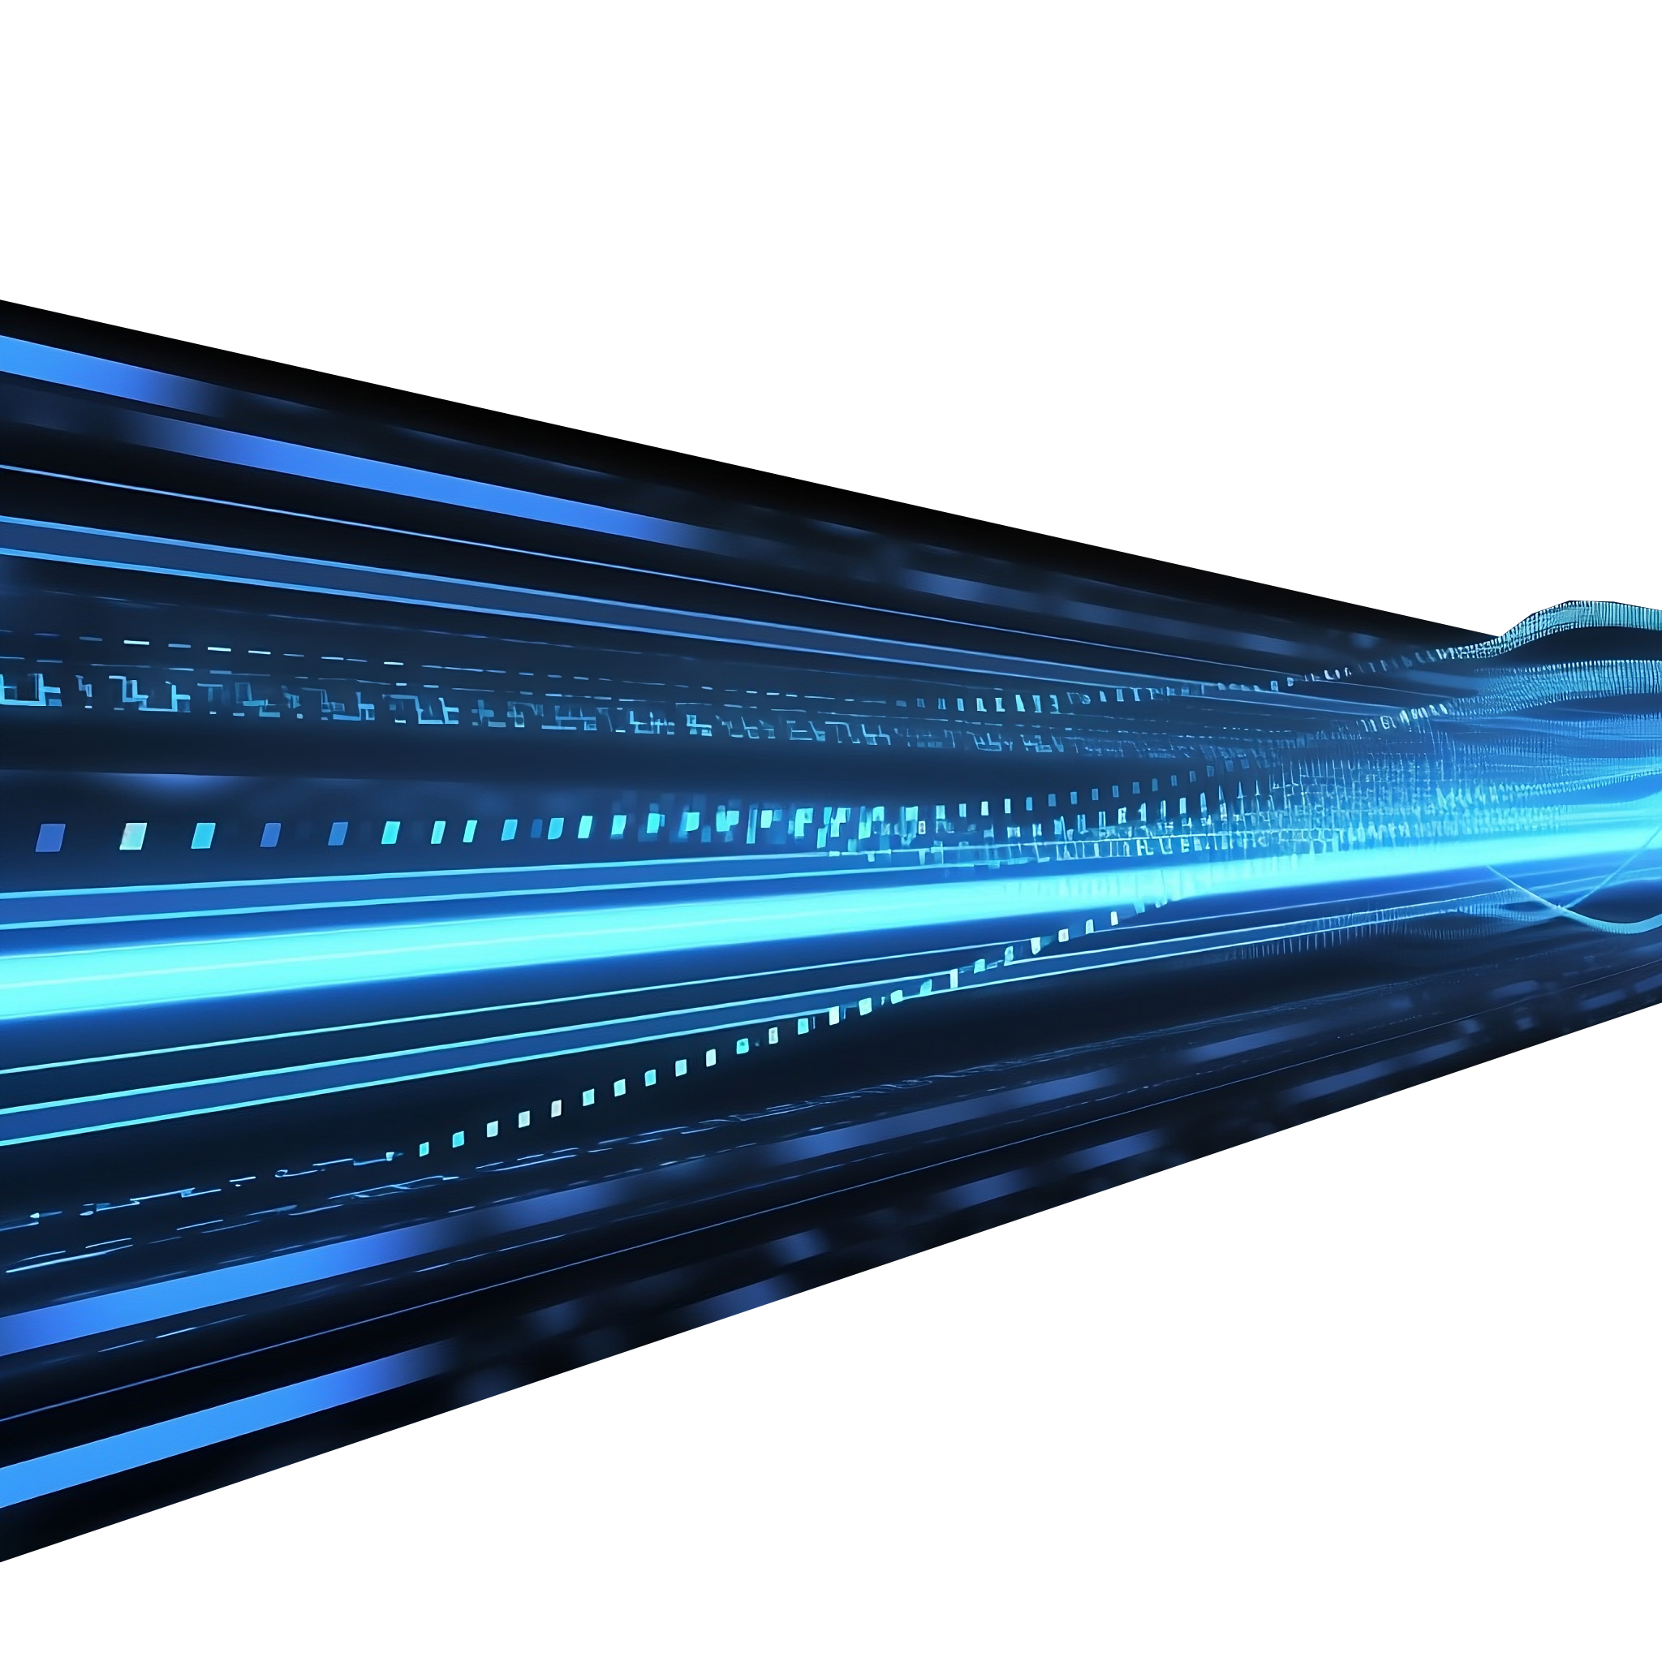
Link or Network Interface Layer
ARP
Link/ Network interface
PPP PPTP L2TP
Ethernet Wi-Fi
Physical addressing and transmitting frames
For example, Ethernet, Wi-Fi, DSL, Cable modem
Limited to local network
Frame
Frame
Frame
Physical cable
ITFreeTraining.com
© Copyright 2025
Notes:
02:15 The first layer I will look at is the link or network interface layer. This layer puts frames on the physical network. There are many different types of network adapters, for example, Ethernet, Wi-Fi, DSL, and cable modem. TCP/IP uses open protocols, making it easy to create device drivers or other software to pass physical frames from the suite onto the physical network. The manufacturer of the hardware just needs to ensure they create the necessary interface to their hardware.
This layer is limited to local network traffic only. Thus, this layer does not perform routing. It simply sends frames from one device to another. It is up to the next device receiving the frame to route it to the next device if required.
You can see that the protocol ARP does not quite sit in this layer. Sometimes certain protocols may work on different layers and thus don’t fit in one layer. In this case, ARP is used to get MAC addresses for devices on the network. Sometimes this is needed by this layer, and sometimes it is needed by the layer above. Let’s look at the next layer.

Slide 5

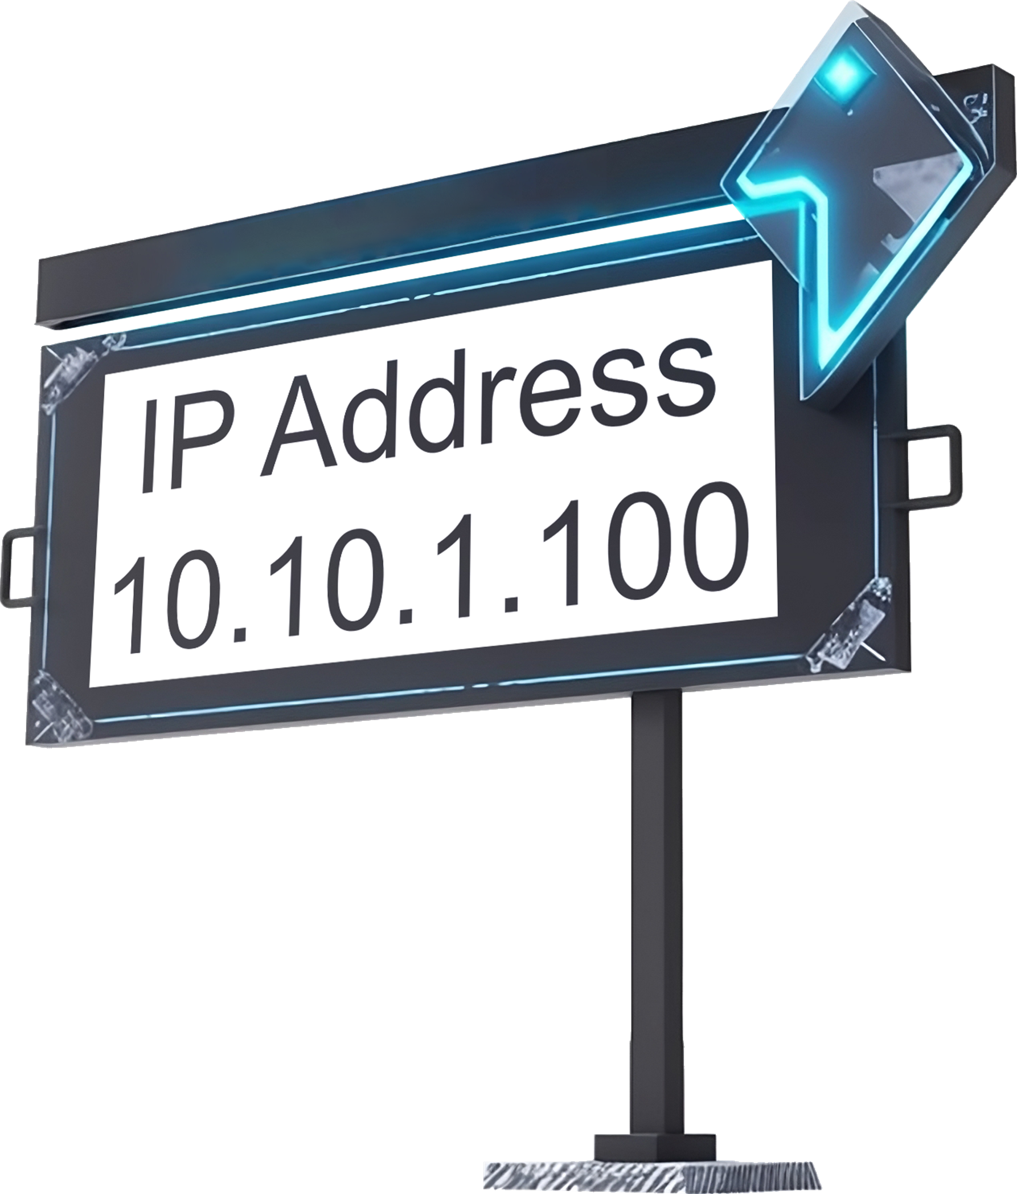

Internet Layer
Internet
IP
ARP
Provides packet addressing and routing
Allows packets to be sent network to network
Routers forward packets between networks
Best effort delivery (Like mailing a letter)
ITFreeTraining.com
© Copyright 2025
Notes:
03:24 The next layer up is the internet layer. This layer provides packet addressing and routing. That is, it adds an IP address. The IP address allows packets to be sent network to network. For a packet to travel between networks, it requires a router to forward the packet to the next network.
The important point to understand is that this layer uses best-effort delivery. Think of it like mailing a letter using the standard postal service. You mail the letter hoping it will get to the destination, but you never know for sure that it will arrive and not get lost on the way.

Slide 6





Transport Layer
1
Transport
TCP
UDP
Implemented using two different protocols
2
Resent
User Datagram Protocol (UDP). Unreliable transmission
Transmission Control Protocol (TCP). Reliable transmission
4
3
8
7
6
5
ITFreeTraining.com
© Copyright 2025
Notes:
04:00 The transport layer manages all the connections being used by the device. This is implemented using two different protocols. Although you can send reliable communication using TCP/IP, the transport layer also includes unreliable communication in the form of the User Datagram Protocol or UDP. This protocol simply sends packets to the destination. There is no guarantee the packets will arrive at the destination, and they could arrive out of order.
UDP is generally used with time-sensitive applications, for example, real-time speech or video. In cases like these, since the communication is in real time, you want to process them as soon as they arrive. If a packet fails to arrive or arrives late, it is no longer useful since the audio or video has passed the point where it could be used. This may translate to a glitch in the video or audio, but this may be more desirable than delaying the communication, waiting for later packets, or for the packet to be re-sent.
The second method of communication is Transmission Control Protocol or TCP. This protocol uses reliable transmission; thus, packets arrive in order, and missed packets are re-sent. To understand how it works, consider the following.
In this example, the packets have been sent to the receiver and are now checked before sending them to the device.
Packet 1 has arrived in the correct order and thus is let through. Packet 2 and packet 3 have arrived out of order. Packet 3 will have to wait until packet 2 is processed.
When packet 2 arrives, it will jump ahead and be processed. Since packet 3 has arrived, it will be processed. Now we have a problem because packet 4 has been lost in transmission. When this occurs, TCP will request the packet be resent. The other packets in queue will need to wait until packet 4 arrives. You can see that TCP handles making sure the order of the packets is correct and requests re-transmission when required.
This layer handles the connections and thus the data flow to and from the computer. But we still need something to send out the data and process it.

Slide 7

Application Layer
DHCP DNS
FTP HTTP/HTTPS SMB
SMTP IMAP POP3
SSH RDP Telnet LDAP SNMP Syslog
Application
Performs high-level functions
Used to configure hosts, manage network hosts and operate services
ITFreeTraining.com
© Copyright 2025
Notes:
06:11 The last layer is the application layer. This layer performs the high-level functions. For example, it is used to configure hosts, manage network hosts, and operate services. The application layer uses TCP or UDP connections. You can see that each layer accesses the layer or layers adjacent to it. Each layer performs a particular function, but all the layers work together to get the end result.

Slide 8



DHCP DNS
FTP HTTP/HTTPS SMB
SMTP IMAP POP3
SSH RDP Telnet LDAP SNMP Syslog
Review
Application
TCP/IP is a suite of protocols
Transport
TCP
UDP
Internet
IP
Specification open to anyone
ARP
Link/ Network interface
PPP PPTP L2TP
Allows devices to communicate with each other
Ethernet Wi-Fi
TCP (Reliable)
UDP (Unreliable)
Sensitive data
Live streaming
Credit cards
Real-time data
ITFreeTraining.com
© Copyright 2025
Notes:
06:40 Let’s do a quick review of the major points. TCP/IP is a suite of protocols. It is an open specification, so everyone can create software or devices that use it. TCP/IP has four layers that work together to allow devices to communicate with each other.
TCP is used for reliable communication. Since it is reliable, the packets will be processed in the same order they were sent. Lost packets will be transmitted again. If you want to send data reliably, you need to use TCP. For example, if sensitive data or credit card information is being sent, it is most likely being sent with TCP.
UDP communication is unreliable communication. There is no guarantee that when you send the data, it will arrive at its destination. It is good for applications like live streaming audio or video. Live stream data is useful when it is first created. If it is delivered later, it essentially becomes out of date.
UDP is also useful for real-time data. For example, if you wanted updates on a stock market price, the information is only useful when it is sent. Any delays in transmission make the data out of date due to new data being available. Traffic like this is a good candidate for UDP communication.
Keep in mind the developer of the application will ultimately decide what they want to use. For example, the developer may use TCP even for real-time information because they are not worried about the data being a bit laggy sometimes. Maybe they want to save all the data coming in so it can be accessed later and thus can’t afford to miss any data, even if it means the data may be laggy sometimes.

Slide 9

Subscribe
Next video
Video content: https://ITFreeTraining.com/ap11/5b05
© Copyright 2025
Notes:
08:20 That concludes this video from ITFreeTraining on the TCP/IP protocol suite. I hope you have found this video informative, and I look forward to seeing you in the next video from us. Until the next video, I would like to thank you for watching.
References
“The Official CompTIA A+ Core Study Guide (Exam 220-1101)” pages 170 to 171
Credits
Trainer: Austin Mason http://ITFreeTraining.com
Voice Talent: HP Lewis http://hplewis.com
Quality Assurance: Brett Batson http://www.pbb-proofreading.uk

