Slide 1
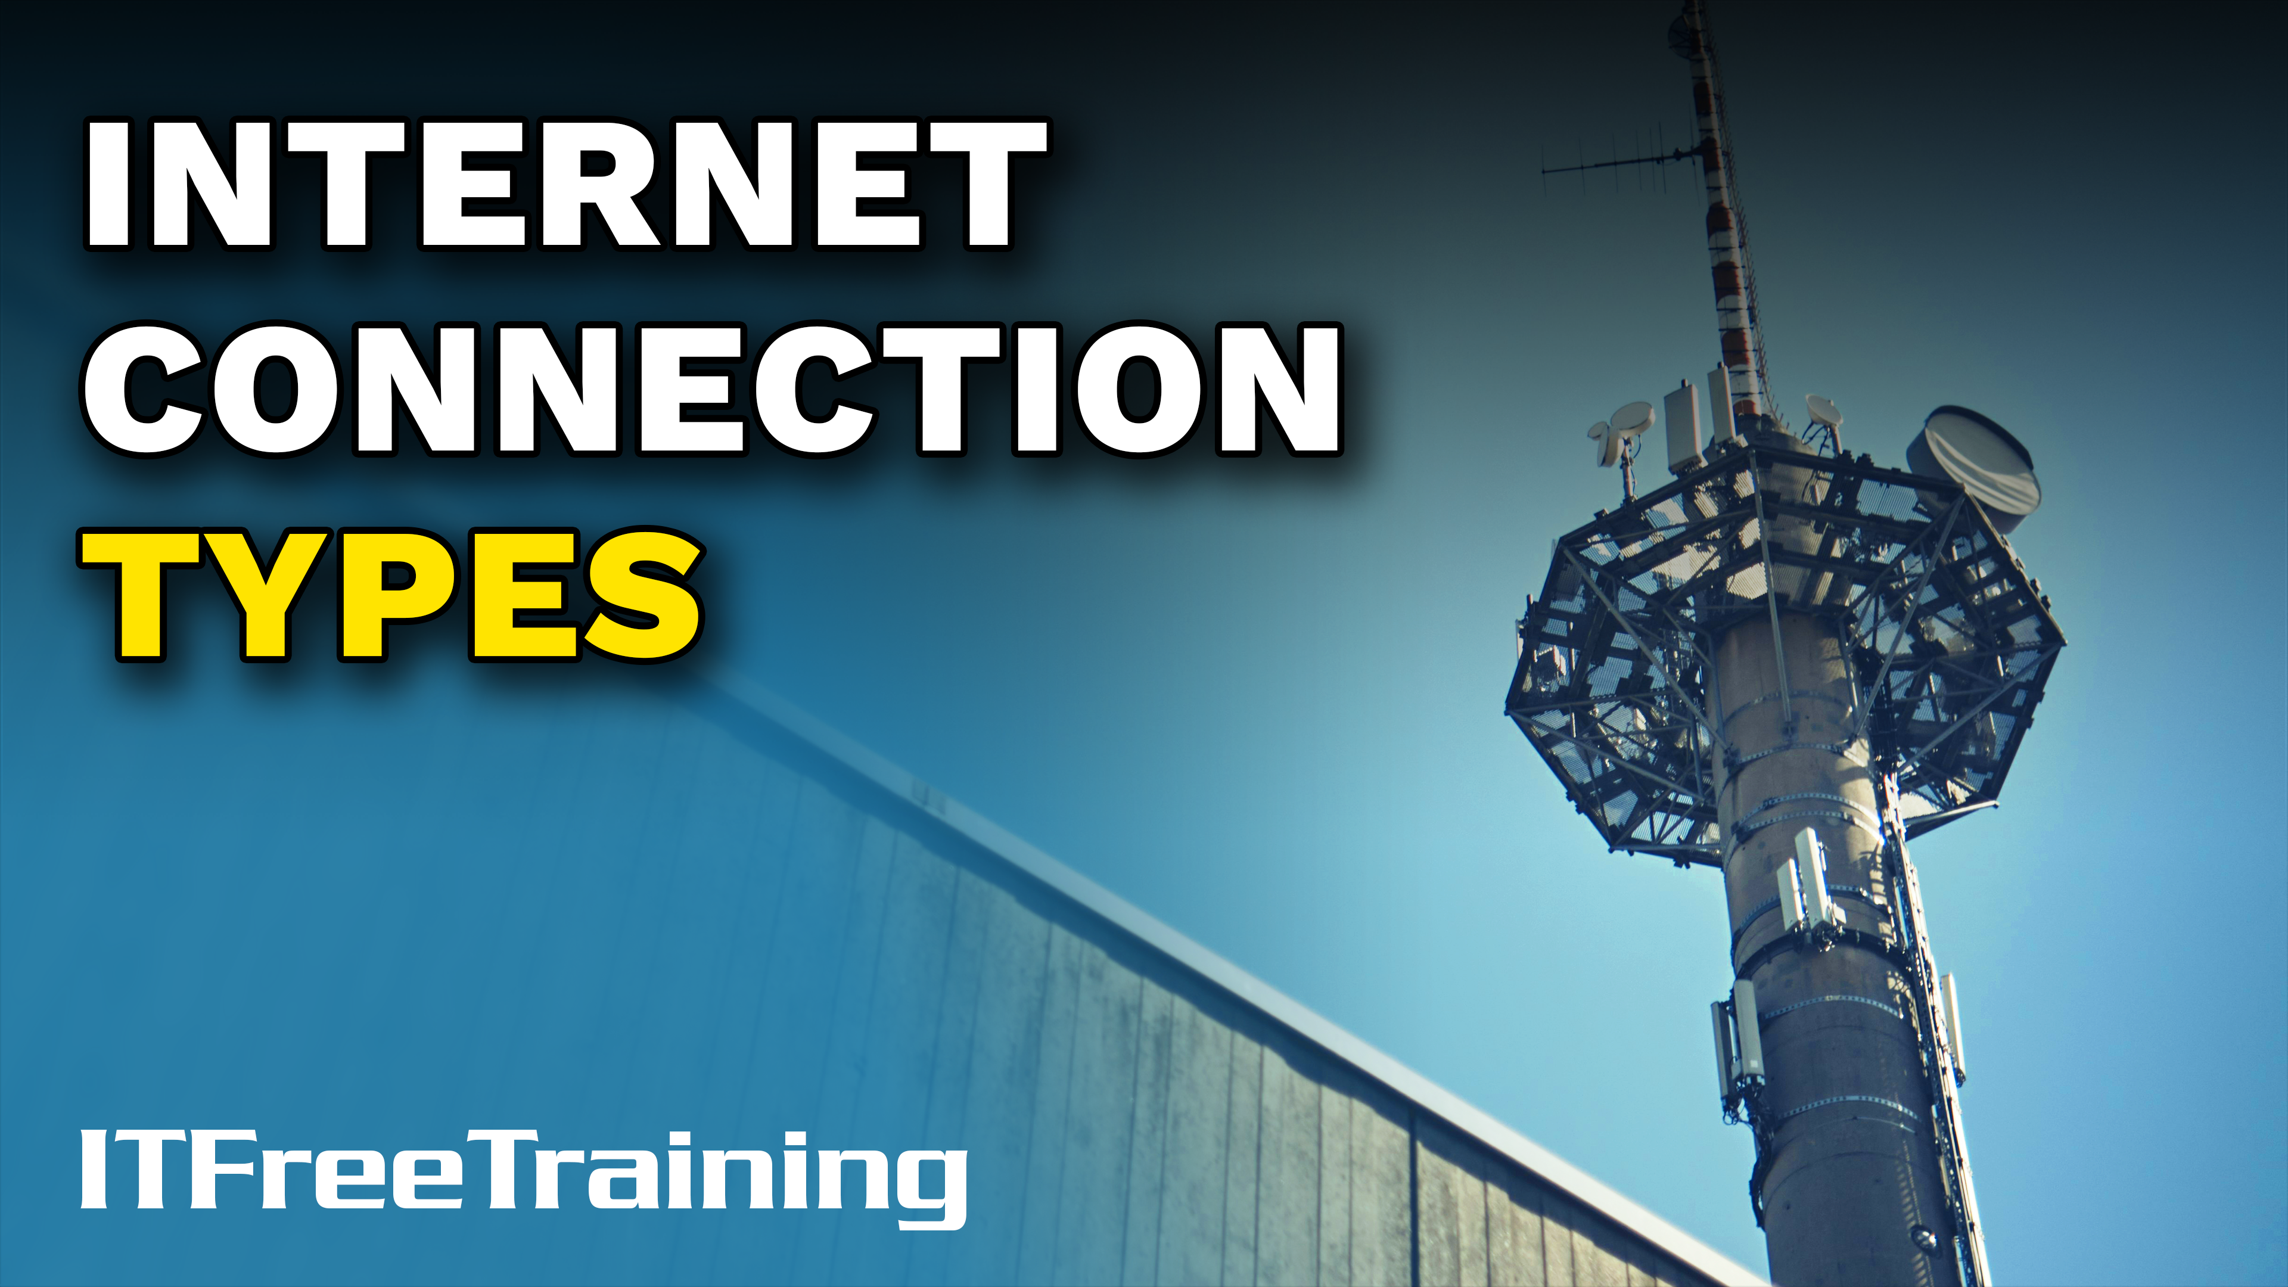
Notes:
Let’s have a look at the different ways you can connect to the internet and the devices required.

Slide 2


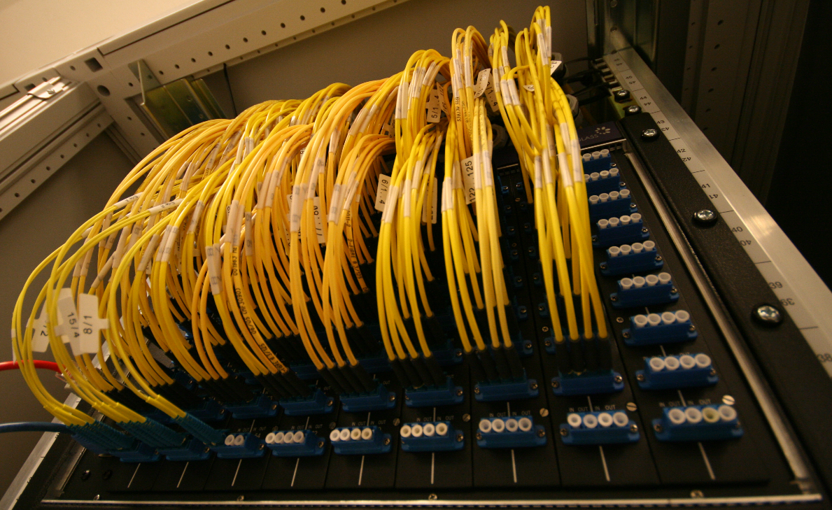


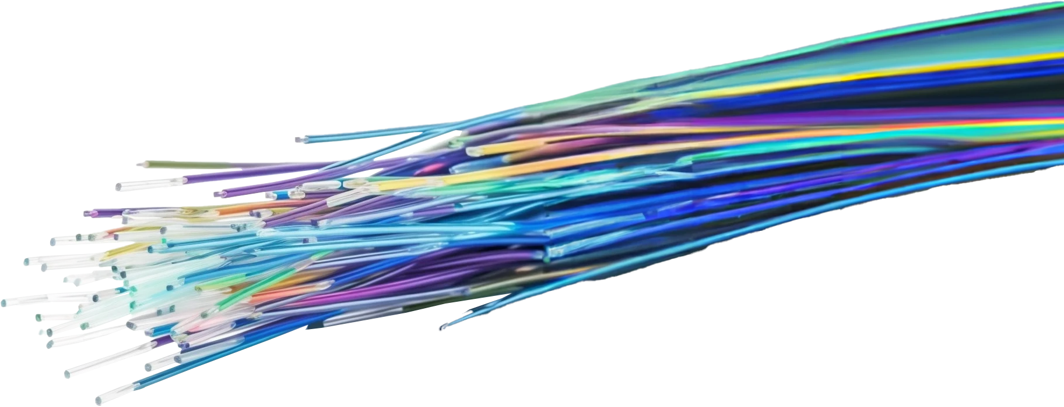




Internet (Network of Networks)
Internet Exchange Point (IXP)
Access backbone of internet
Includes ISP networks
Uses peering to exchange data
Internet Service Provider (ISP)
Provides access to internet
Fiber install for IXP
Customers
ITFreeTraining.com
© Copyright 2025
Notes:
00:06 The internet is essentially a network of networks. Nowadays getting from one place in the world to another is seamless with fiber optic cables connecting every part of the world together. To do this quickly and effectively, large internet backbones carry data long distances.
Internet Exchange Points or IXPs are used to provide access to these backbones of the internet. The modern internet is effectively a tiered network with the backbone being the highest tier. Although in the old days there were separate lines to transfer data, nowadays these may also travel across ISP networks. An ISP, or Internet Service Provider provides access to the internet for their customers.
The ISP generally represents the lower tier providing access via different technologies like wired and wireless. The modern internet backbone is part of many different networks. Part of the ISP’s high speed networks may be included in the backbone network. Internet companies a long time ago worked out that it was often cheaper to share a competitor's backbone rather than build their own. The question is, how is this done fairly?
The backbone of the internet uses peering agreements to exchange data between networks. You will not get asked a question in the exam on peering, so I am just providing it for your information. The idea behind peering is to achieve a balance of data transfer between both parties to minimize the costs. If the peering is one to one, this means that if equal data is sent by both parties no additional data costs are charged. Only the basic costs of running the connection and its maintenance would need to be paid.
The peering may not always be one to one. For example, if it was one to three, then the ratio between sending and receiving would be three. Since IXPs are very efficient at transferring a lot of data, IXPs may be installed directly in data centers. You may be wondering how anyone could make money if they stay within the peering agreement. Depending on the agreement, to install an IXP in a location like a data center, fees may need to be paid. Regardless of what the agreement is, using IXPs and companies sharing networks is a very efficient way to operate the modern internet. Network routing protocols are used to allow connections to be added and removed dynamically, meaning more networks can be added and removed to backbone networks and the network will automatically adjust.
IXPs have a lot of capacity so it is not something that anyone can join. It is, after all, the top tier of the internet. Now that we understand how the internet works, let’s now look at the home/office network and how this connects to the ISP.

Slide 3
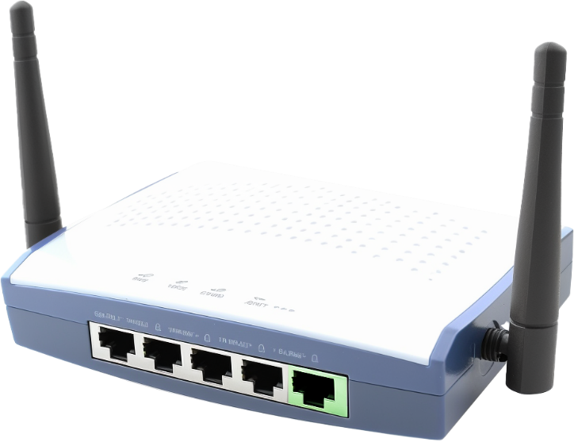



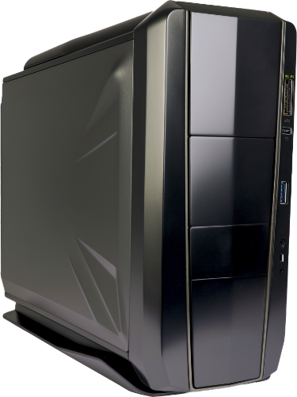
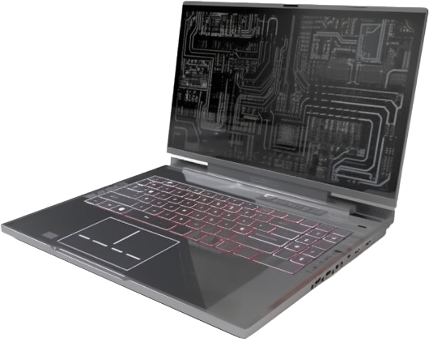




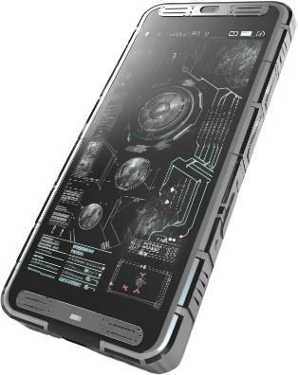
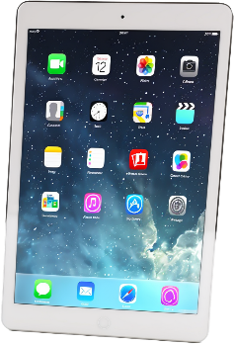
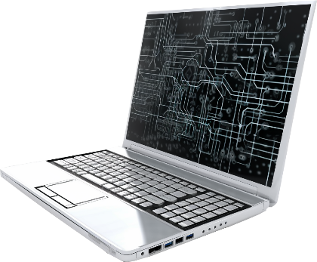
SOHO Network
Small Office/Home Office
Network device/ Cable/Wireless
ISP
Internet
Private network
Public network
ITFreeTraining.com
© Copyright 2025
Notes:
03:02 You may hear a typical home network or small office network referred to as small office home office or SOHO. These networks typically have a router which will divide the traffic into a private network and a public network.
Most of these routers have a number of switch ports for the devices on your network to plug into. The idea behind this is that, for a small network, the router should be able to provide all the networking you require. However, if you require more ports, you can always plug additional switches into the router to provide more ports.
A lot of routers will also include wireless. Essentially the router will treat the wired and wireless devices as being on the same network. Thus, the router will seamlessly route packets between the two networks.
Wireless networks typically run slower than a wired network, thus if two devices are communicating between the wired and wireless parts of the network, the standard IP protocols will automatically slow the transfer of traffic down. Thus, just connect the devices you want, and the router and the protocols will take care of the rest.
To access the internet, the network will need a connection to the ISP. For the rest of this video, I will be looking at this connection to the internet. In some cases, there will be a direct connection to your telecommunication provider. In a lot of other cases, a network device will be used to connect to the telecommunication provider. How you connect to the internet will determine what device you need. The device shown is a fictional device that does not exist. Let's explore the actual devices and technologies used to establish internet connections.

Slide 4
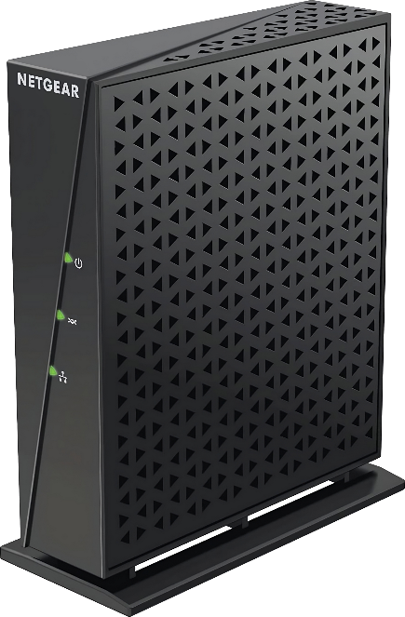
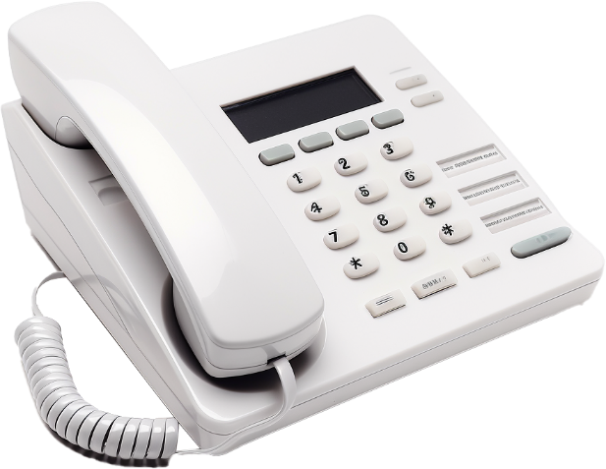
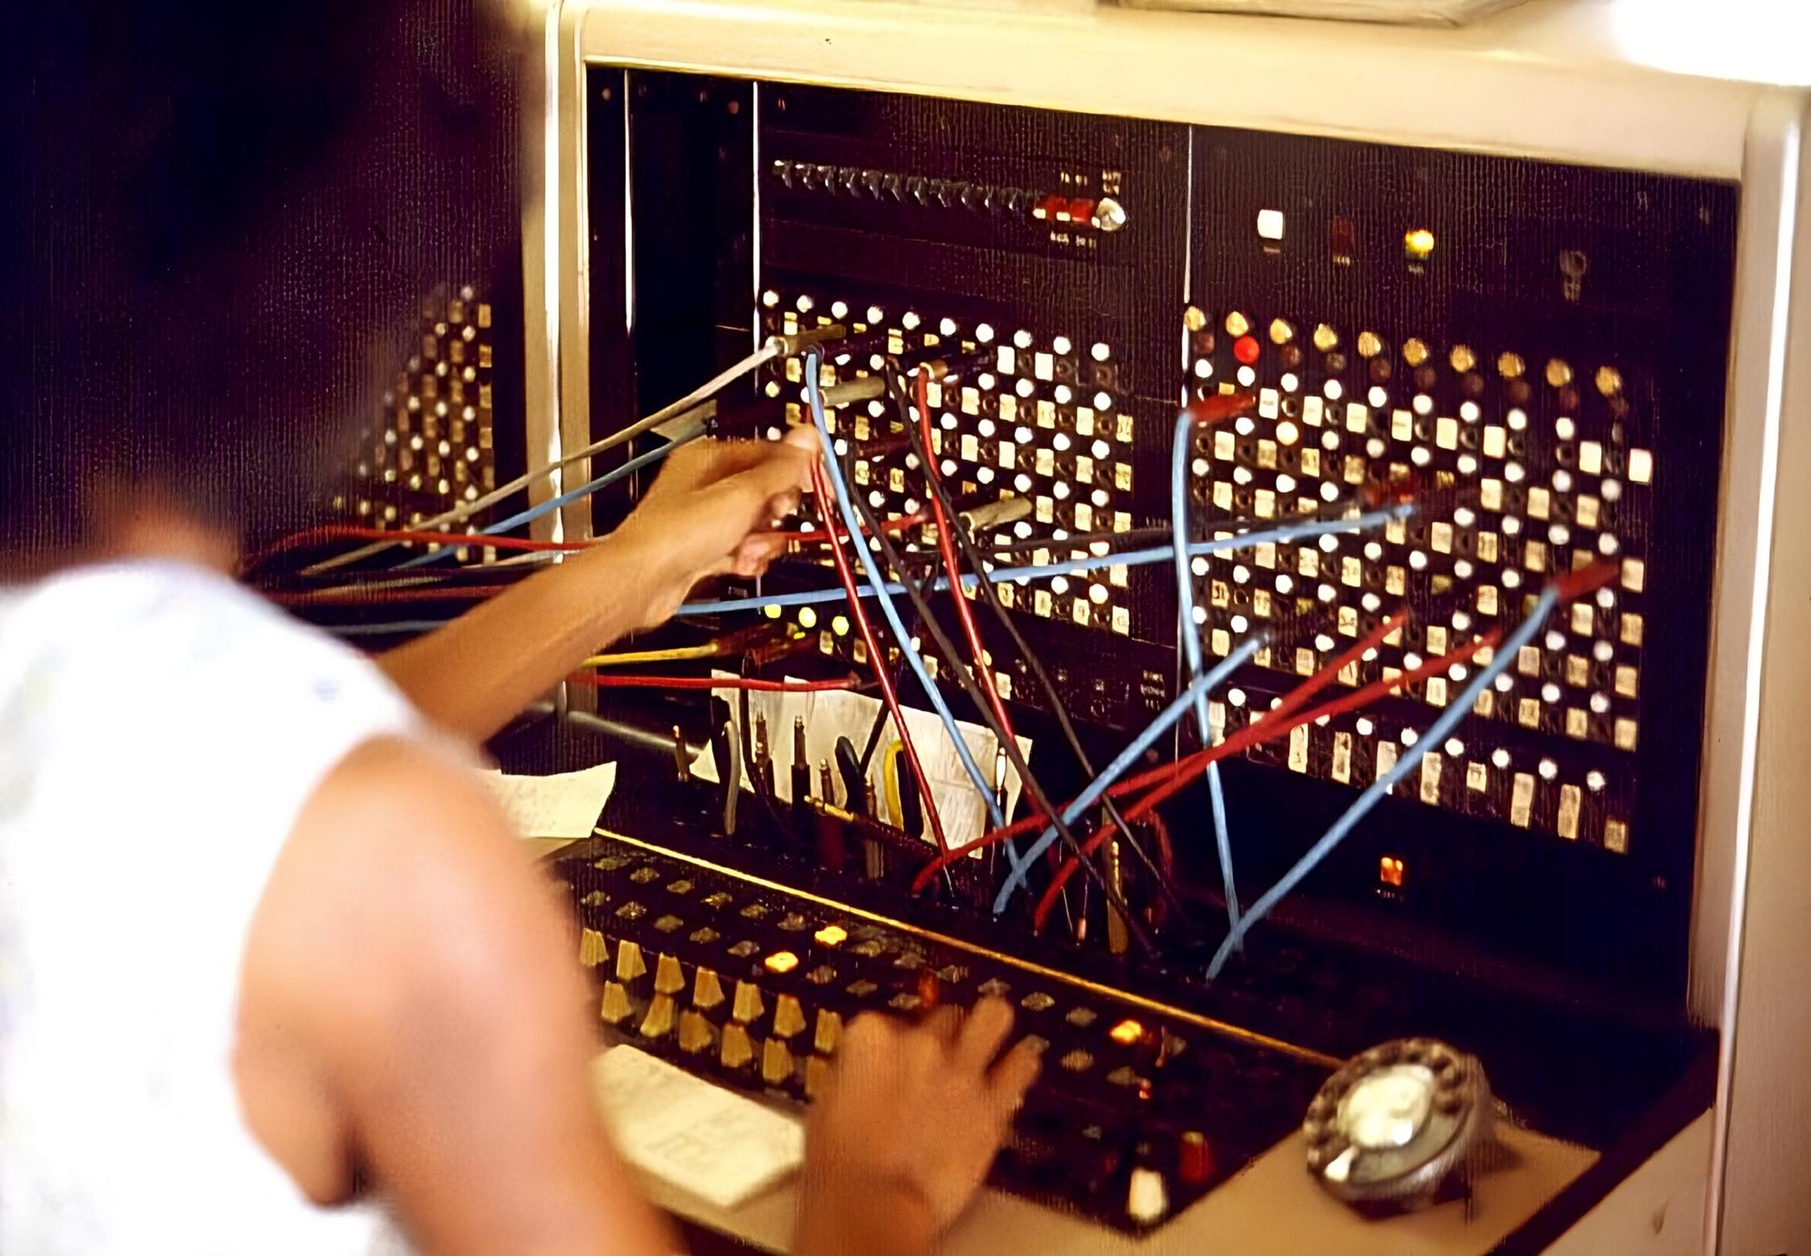
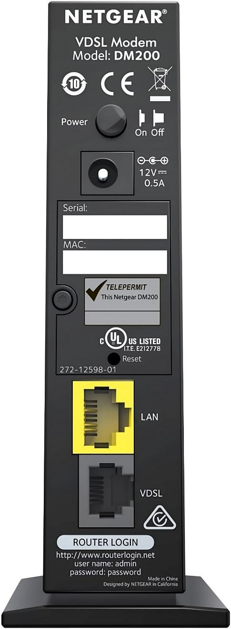
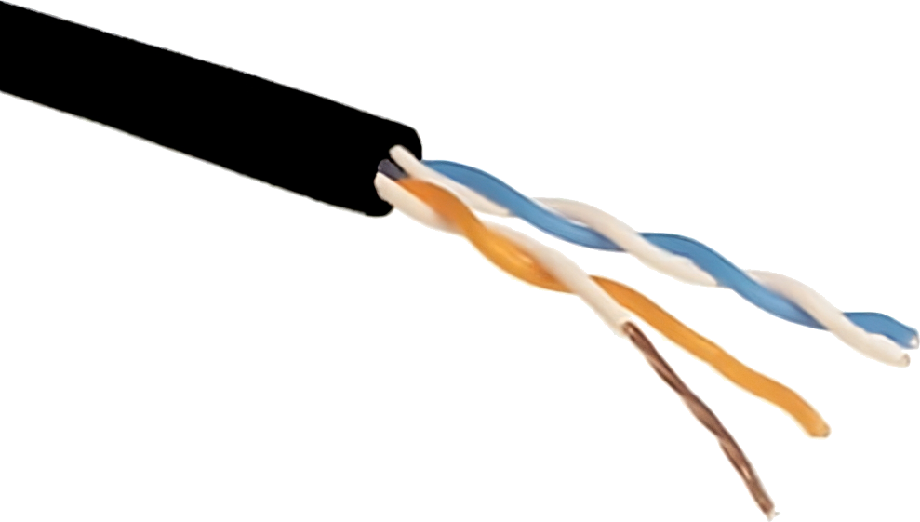
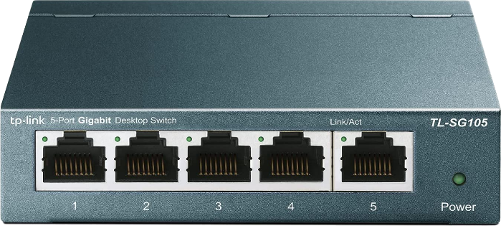
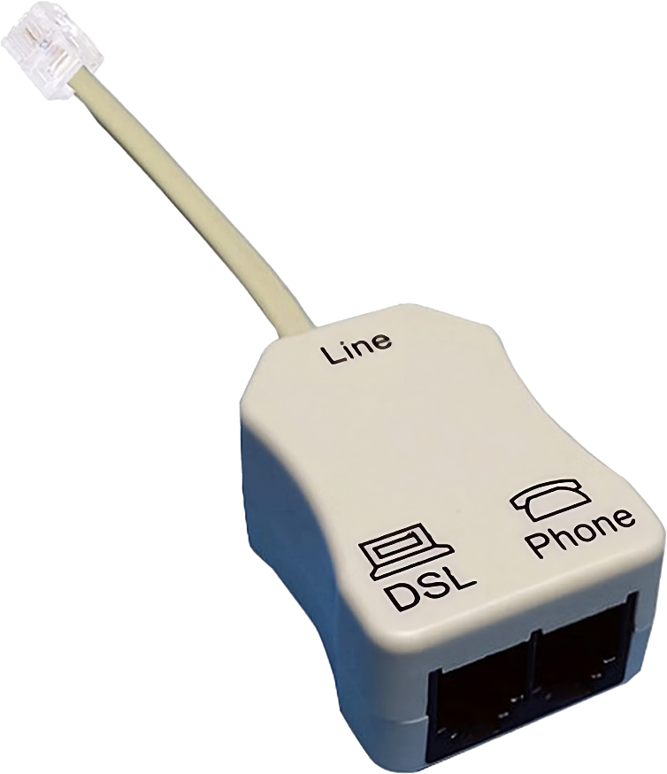
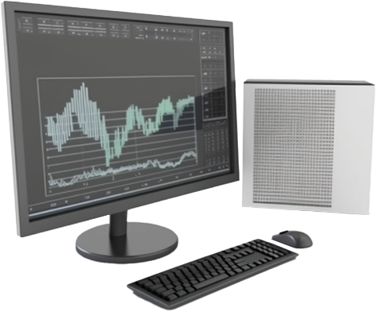
Digital Subscriber Line (DSL) Modems
Public Switched Telephone Network (PSTN)
Transfers voice and data
Uses higher frequencies for data
POTS
Connect to Teleco
Connect to Phone
Connect to Switch
Plain Old Telephone System
Or
Also known as:
Local loop/Last mile
Connect to Modem
Connect to Device
DSL Splitter
Splits voice/data
ITFreeTraining.com
© Copyright 2025
Notes:
04:44 To start with, I will look at Digital Subscriber Line or DSL. This uses the Public Switched Telephone Network or PSTN. This network originated as a phone network using two pairs of copper wires. Although only one pair is required for a phone line, the second pair is there in case the first pair fails or a second phone line is required. In the old days, lines were connected via a telephone operator working on a switchboard using a patch cable. In modern networks, the process is completely automated. Thus, you can see where a switch gets its name, as your telephone line is switched through a public network. You can also see where patch cable and patch panel get their names from.
The PSTN network was originally designed for voice only; however, it has been expanded to transfer voice and data. In order to transfer both, data is transferred at a higher frequency, more on that shortly.
You may also hear this network referred to as the POTS network which stands for Plain Old Telephone System. POTS is a retronym for the old phone network, meaning it is a modern name applied to an existing technology to distinguish the old from the new. Thus, whenever you hear the term POTS, you know they are talking about the old copper network, but in the old textbooks you won’t see it referred to as that, because it was still a modern network when those old text books were written.
Modern PSTN networks utilize fiber for their backbone. Thus, once your data enters the local phone exchange, don’t be surprised if most of the data trip, if not all, will be over fiber. The copper line is also referred to as the local loop or last mile, as it constitutes the final segment of your connection.
In order to use a DSL service, you next need to connect your devices. Keep in mind that voice and data travel over the same line. In order to separate the two, a DSL splitter is used. A DSL splitter essentially divides the signal into two, the data and voice parts. In order to use it, plug your phone into the DSL splitter’s phone plug. If you are not using a splitter, you will still be able to use your telephone, but you will hear a high pitch noise on the telephone.
If you want to see if DSL has been installed or if it is still connected, one trick is to plug the phone directly in the phone connector without the DSL splitter. If you hear a high pitch noise on the line, you know that DSL has been connected to the phone line.
The DSL splitter itself connects to the phone connector the same way a phone would. Essentially, connecting to one of the pairs of copper wires. The DSL connector on the splitter connects to the DSL modem.
Some DSL modems may also include an embedded DSL splitter. When this is the case, you would plug your modem directly into the phone line and then plug your phone into the DSL modem.
In this particular example, the DSL modem has only one network port. You can plug one device into this port. For example, you could plug your computer directly into this port. Your DSL modem should support multiple devices on the same port. Best to check the specifications before purchasing. You should be able to plug a switch in the DSL modem. Then plug your extra devices into the switch.
When purchasing devices like these, it may be worth having a look at what equipment you already have. If you have a DSL splitter and switch already, it may be worth buying a device like this. Afterall, they are pretty cheap. If you don’t have these devices, it is often cheaper to purchase a DSL modem which includes a DSL splitter and a switch. Even if I have the devices already, I will often see how much a DSL device with these extra features cost. Usually, they do not cost that much extra. Buying a DSL modem with a built-in switch is often better than using an external switch, because it reduces devices and potential failures.
DSL has been around for a long time now and there have been some changes, let’s have a look.

Slide 5
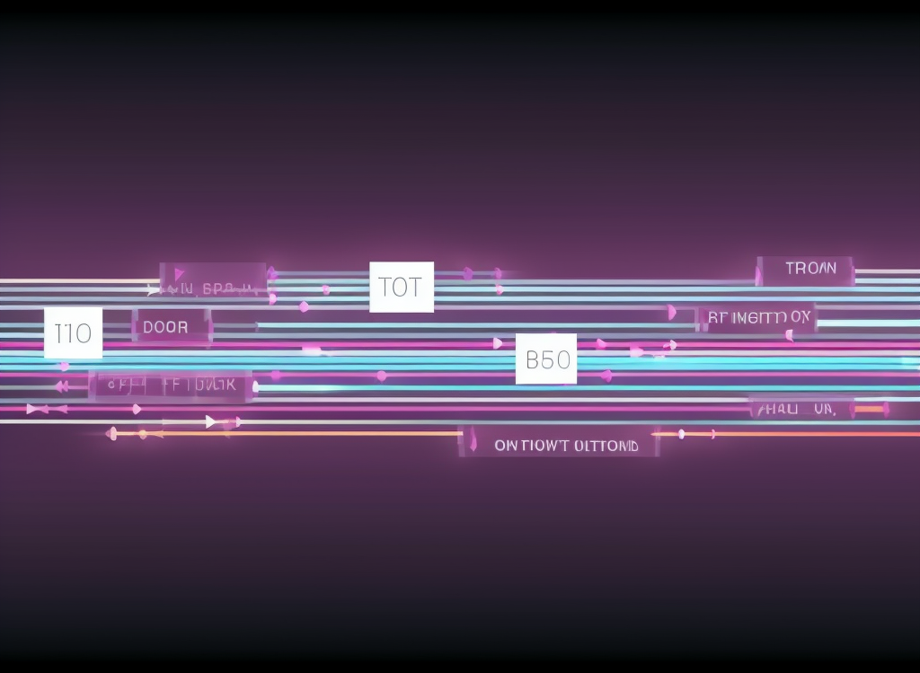
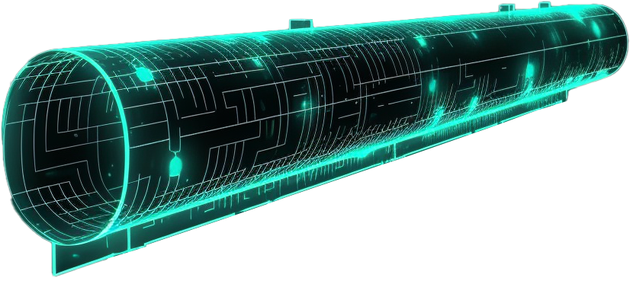
Symmetrical Vs Asymmetrical
Symmetrical
Asymmetrical
Internet
Up
Down
Up
Down
Same bandwidth upstream/downstream
Downstream larger than upstream
Often used by businesses
Known as ADSL
Latest version ADSL2+
ITFreeTraining.com
© Copyright 2025
Notes:
09:06 There are many different types of DSL, but the two main ones you will come across are symmetrical and asymmetrical. Symmetrical has the same amount of bandwidth for upstream and downstream. The speed you can transfer data up and down should be the same. Symmetrical is often used by businesses. This is because businesses often upload more data to the internet than typically used by a home user accessing the internet.
Asymmetrical, in contrast, the downstream is much larger than the upstream. This is often called ADSL. The idea behind this is it is good for basic internet use. In most cases, when using the internet for web surfing, a small amount of data is uploaded to request a web site. The response is the web site, which is much larger. ADSL works well for basic internet access.
ADSL is not good for uploads. If you are working from home and have to upload a lot of files to your office, the performance is going to be slow. The mismatch bandwidth also causes problems when you upload and also perform a high-speed download at the same time. You will generally find that if you are downloading at high speeds and then start uploading, when the upload speed gets too high, the download speed will drop. This is not because the line can not handle it, it is because the packets telling the other side to send more data are being delayed by having to share the upstream. If you have to upload and download a lot of data at the same time, you may find that you will get better performance if you limit the upload speed. Limiting the upload speed will make it easier to put through the packets requesting more data to be sent. It is a bit of trial and error to get it right. Try slowly increasing the upload speed, when you reach the sweet spot, you should see the download speed rapidly start decreasing. It is just a matter of keeping the upstream below the sweet spot to get good upload and downloads.
There have been a number of different versions of ADSL with the latest being ADSL2+. The newer versions have higher speeds. DSL uses the existing phone network to transfer data; however, there is other technology which can use existing networks.

Slide 6

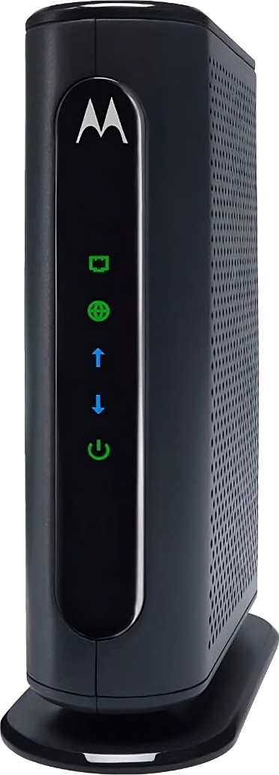
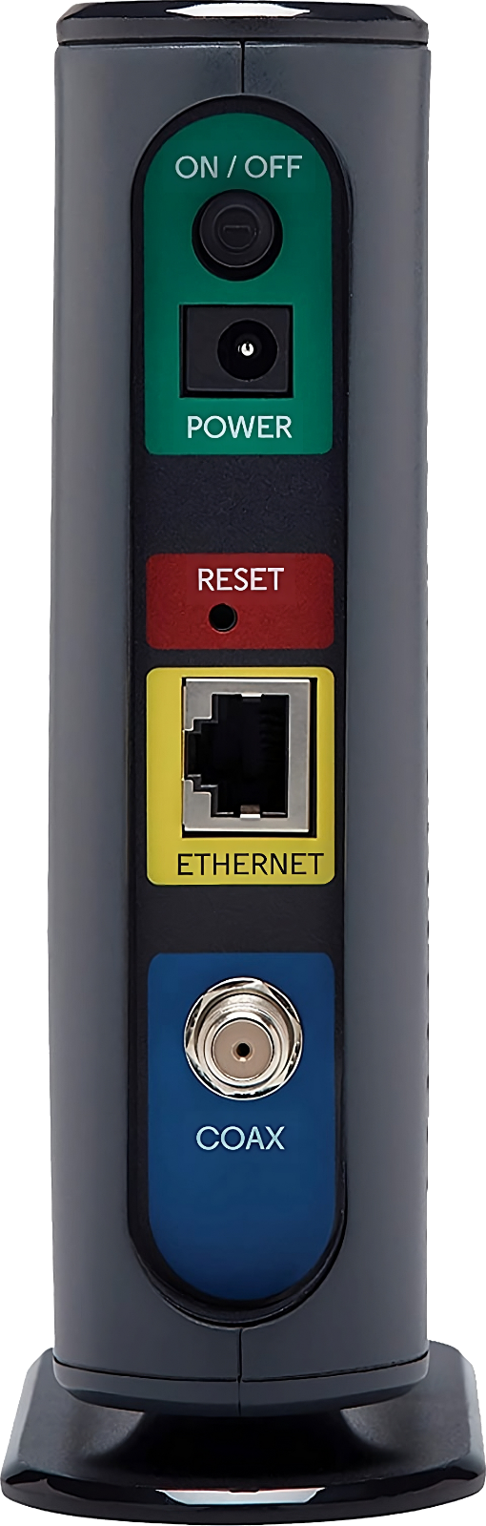
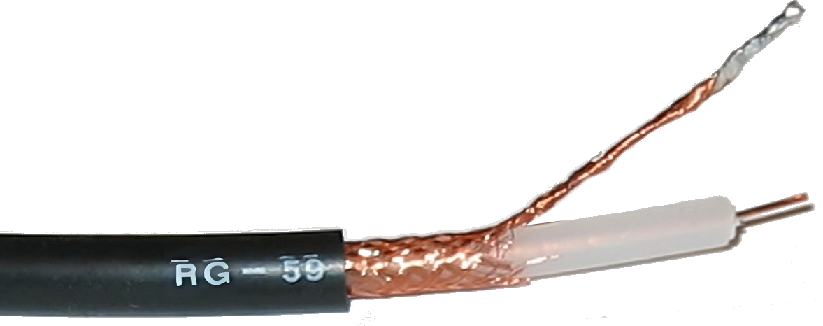
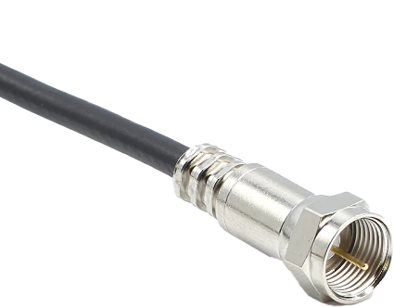
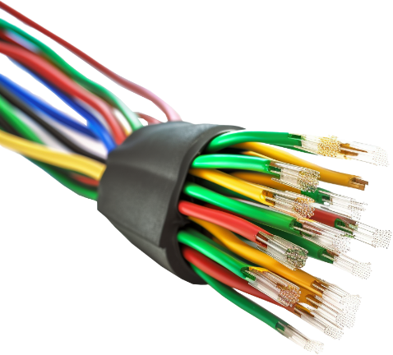
Cable Modems
Usually, part of cable TV network
Bandwidth shared by people on same cable (Loop)
Connect to Device
Hybrid Fiber-Coaxial (HFC)
Connect to Cable
Fiber network
Coaxial cable
ITFreeTraining.com
© Copyright 2025
Notes:
11:30 Another way to get internet into your home is using a cable modem. Cable modems use a coaxial cable. Coaxial cables are able to transmit high frequency electrical signals with low data loss at high speed. They were traditionally installed to provide TV to a home. If you have cable at your home, you may be able to get an internet package that will use it.
The other version of cable is Hybrid Fiber-Coaxial or HFC. This cable uses a fiber network as its backbone. However, to reduce the installation cost, the telecommunication company obtained the rights to use an existing coaxial cable network. Installing fiber to every customer is very expensive. Thus, if you have a coaxial cable that is not being used, this offers an alternative to running fiber to the customer. Modern buildings, during a certain time period, may have had coaxial cable pre-installed; however not fiber. This makes it a good choice for a telecommunication company to take over an existing coaxial network rather than installing fiber to the customer.
Cable offers great speeds, however the point to keep in mind is that the bandwidth is shared by the people on the same cable. This may be referred to as a loop. People on the same cable networks may find that, at peak times, their internet speed will drop considerably. This can happen with any type of internet connection when the Internet Service Provider puts too many customers on the same network, referred to as over subscribing. In the case of coaxial cable, if there are too many customers on the same segment of coaxial cable it will not matter if the ISP does not have a lot of customers, everybody on that segment will be sharing the same cable. Something to keep in mind when using cable networks.
The coaxial cable attaches to the back of the cable modem. Like before, the cable modem attaches to a device on your network. For example, direct to your computer or a switch. You should start to see these devices act much the same. They take some kind of input and convert it to ethernet. Once you cable up one network, it is easy to cable up another type of network. Most of the time it is just knowing which cable to attach to the back of the modem. Configuration after that is much the same.
Now let’s look at arguably the best wired solution you can get.

Slide 7

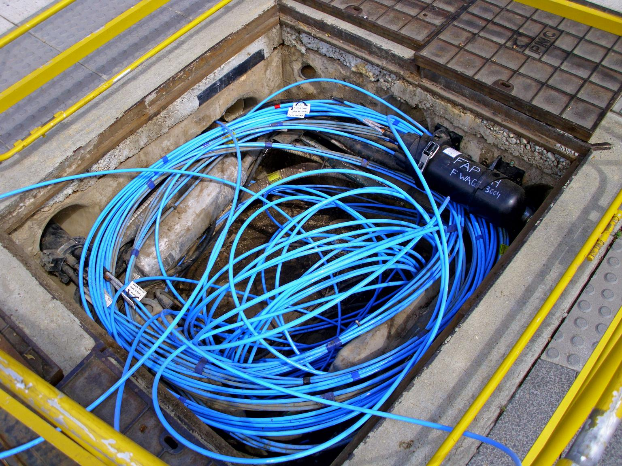
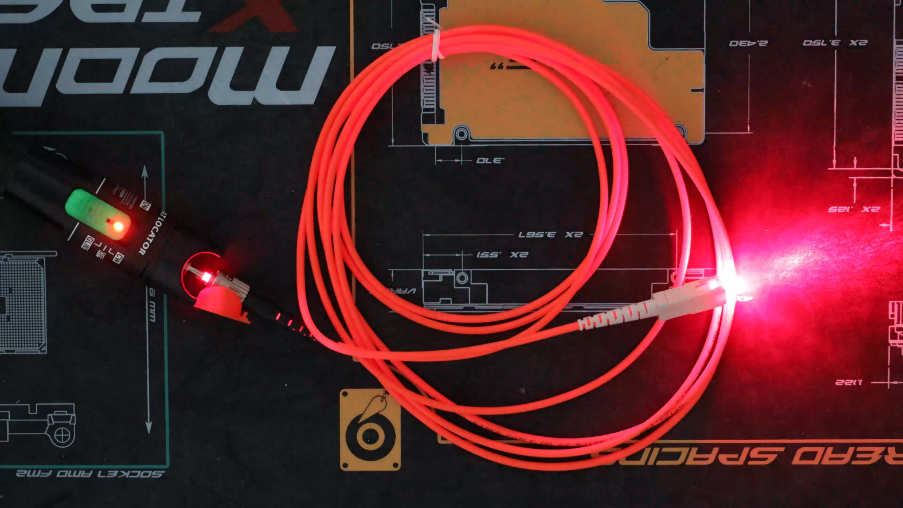
Fiber Optic
Flexible transparent fiber transfers light (Not too flexible)
Uses light to transfer data
Fast/reliable
Fiber pit
ITFreeTraining.com
© Copyright 2025
Notes:
14:02 Fiber optic are flexible transparent fiber designed to transfer light. Although it is flexible, it is not too flexible, so you cannot bend it too much. You can see in this example of a fiber pit, the fiber cable is left coiled to avoid damage. You never see any straight angle bends in fiber optic because the material inside will break. Good quality fiber is made of glass which is easy to break if you mishandle it. There is also plastic optical fiber which handles bending better than glass, but it will still break if you bend it too much. This plastic fiber costs less, but does not transfer data as fast as glass.
Fiber optic uses light to transfer data. It is fast and reliable compared with a lot of other methods used to transfer data. To understand it better, I have a fiber cable. What I will do is use a fiber optic tester which uses a laser to shine light through the fiber cable. You can see the light from the tester is travelling through the fiber cable to the other side. This is essentially how fiber optic works; it switches the light on and off very quickly. The other side of the connection interprets the changes in light as binary data, converting them into zeros and ones.
Let’s now have a look at how fiber optic is implemented.

Slide 8
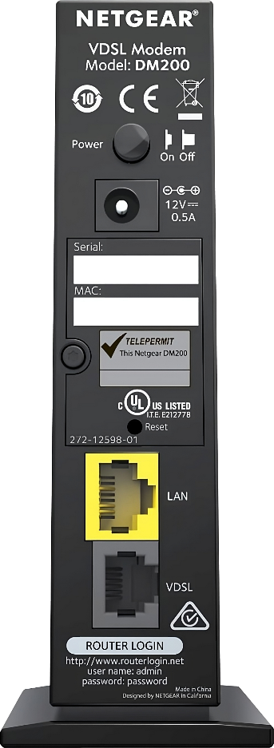
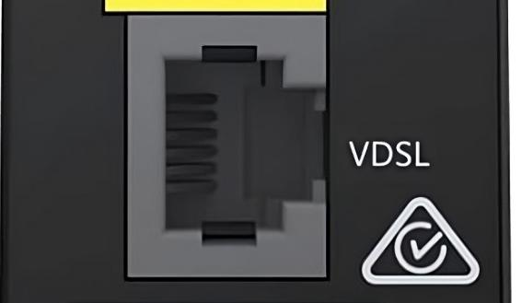

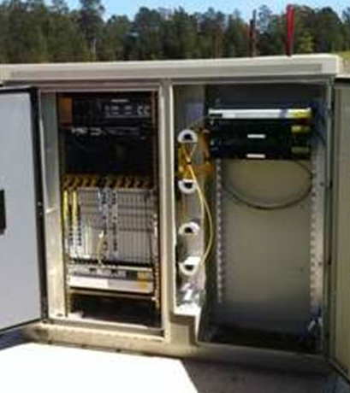
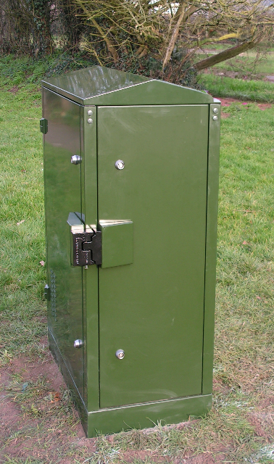
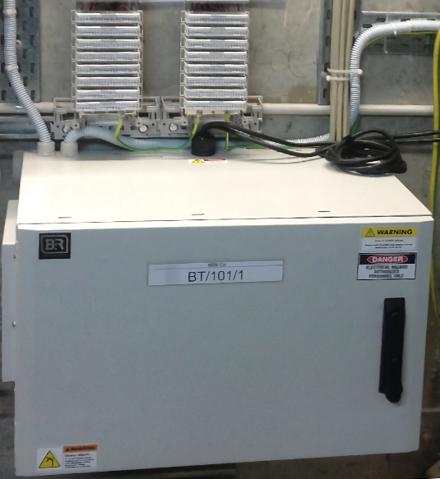
Fiber To The X (FTTX)
Uses copper to connect to fiber (Last mile)
Less distance, faster speed
Uses Very High-Speed Subscriber line (VDSL). Same as DSL
FTTN
FTTC
FTTB
Fiber to the node (FTTN)
Fiber to the curb
Fiber to the basement
ITFreeTraining.com
© Copyright 2025
Notes:
15:28 There are a number of different implementations of fiber that you may come across. Before I look at fiber that runs directly to you, I will first look at fiber that uses copper to connect you to the fiber network, often referred to as the last mile. All these implementations come under the umbrella of “fiber to the X”.
There are a lot of different variants but some you may hear of are “fiber to the node”, “fiber to the curb”, and “fiber to the basement”. Essentially, all these technologies work by providing a connection to the fiber network. You can see in each of the examples there is a box which contains electronics in it. These electronics connect you to the fiber network; however, they also use existing copper cabling to connect the fiber network to you. The idea behind it is that the customer can connect to the fiber network using their existing copper cabling. Sometimes you will find that fiber to the basement may use fiber for the last part of the network, but more on that later in the video.
The most important point to understand with this technology is that the closer the box is to you, the faster the speed you will get. The advantage of this kind of installation is that installing fiber cables is expensive. If you can utilize existing copper cable, the installation cost is reduced but this also reduces the top speed you can receive.
Since copper is being used, it effectively is a DSL connection. Thus, it uses Very High-Speed Subscriber Line or VDSL for communication, the same protocol used by modern DSL. For example, if I have another look at the back of the DSL modem that I looked at previously, notice that the external port is labelled as VDSL. Thus, this DSL modem should still work with any of these fiber connections. Assuming the modem supports the speed of the connection.
However, if your modem is designed specifically for DSL or ADSL, it will not work. The modem needs to support VDSL which is the newer standard. So, do not assume your existing hardware will work; always check for compatibility.
Try not to get confused by any of the terminology. Just think about how far the box is away from you. This will determine how fast your connection will be. It is simply due to using copper. Copper does not work for long distances with high-speed data. The same problem occurs with DSL connections, where your distance from your telephone exchange will affect how fast you will receive your data. So, the obvious solution would be to use fiber for the whole connection.

Slide 9
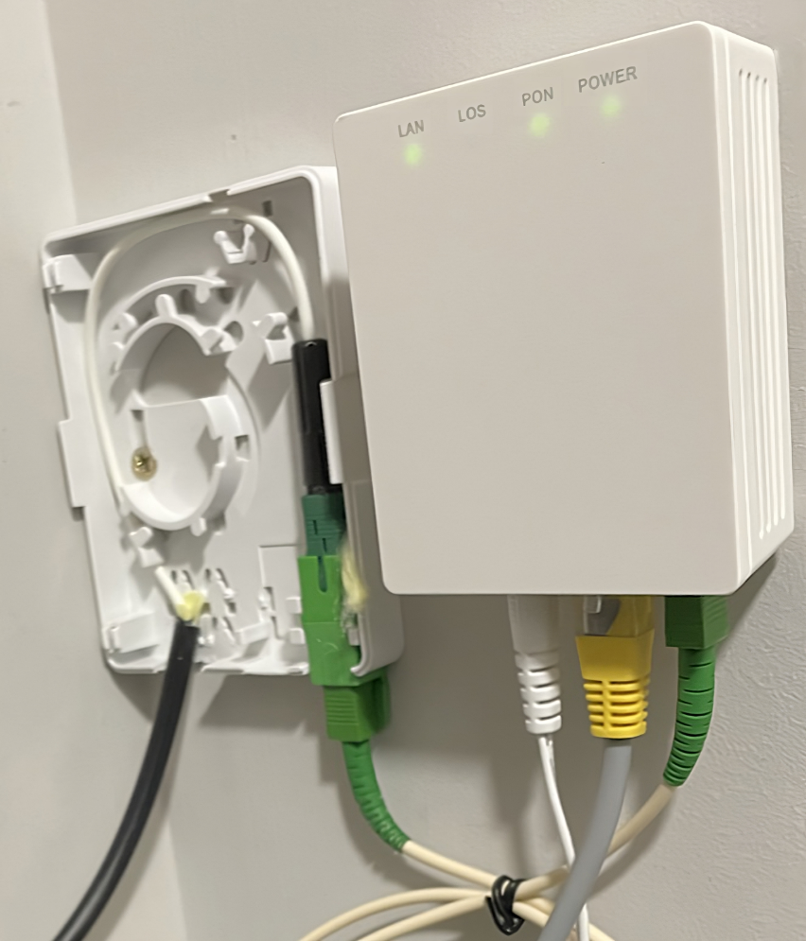
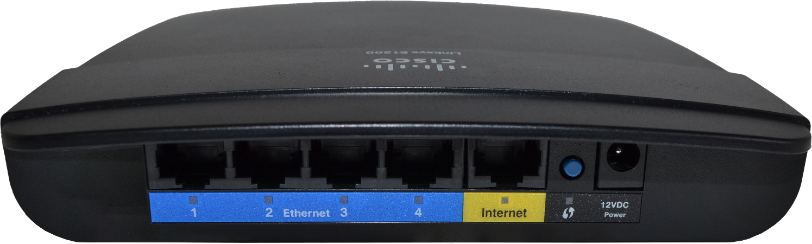
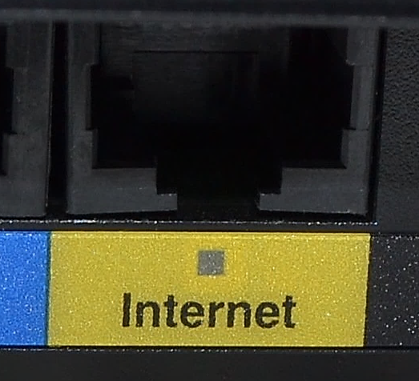
Fiber to the Premises (FTTP)
Connection terminates at customer premises
Generally called a router rather than modem
RJ45 to NTB
Network Termination Device
(NTB)
ITFreeTraining.com
© Copyright 2025
Notes:
18:16 Fiber to the premises uses a Network Termination Device or NTB that will be physically located at the customer’s premises. The customer then connects their router to the NTB. In the case of fiber to the premises, the device you use to connect will generally be called a router rather than a modem.
To understand why, consider that the WAN connection on the back of the device is an RJ45 connection. The connection to the NTB is a straight through network cable. In the old days, a modem connected to a phone line and used the phone line to transmit a signal. Nowadays, you are using the same type of connection (to connect to your computer) that you are using to connect to the external network. Essentially the device is more routing traffic rather than performing signal conversions. Adding to this, any device that has a switch and a WAN port is essentially a router. For this reason, you may see DSL network devices called routers because they perform routing functions. Given that network devices were previously called modems, you can understand how the terminology just stuck with newer devices, but with fiber to the Premises devices they have switched the terminology.
There can be some confusion between “Fiber to the Premises” and “Fiber to the basement”. “Fiber to the basement” means that the fiber line is terminated in the basement of a building. From there a fiber run may be used to connect the apartment to the basement. Other times the connecting cable may be a copper cable. Usually when the whole run is fiber it will be called “fiber to the premises”. If you see “fiber to the basement”, it is best to ask what the cable from the basement to the apartment is. Even a small run of copper will affect the top speed you will be able to get from the line.
Fiber is the gold standard when it comes to networking, but there is nuance to it that is good to be aware of.

Slide 10
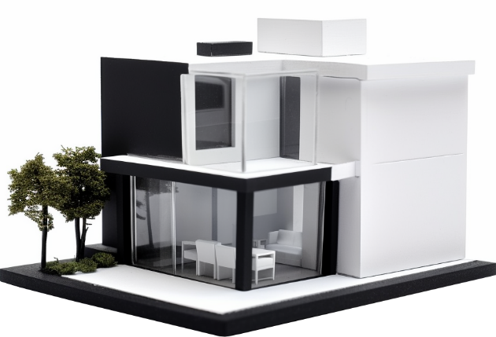




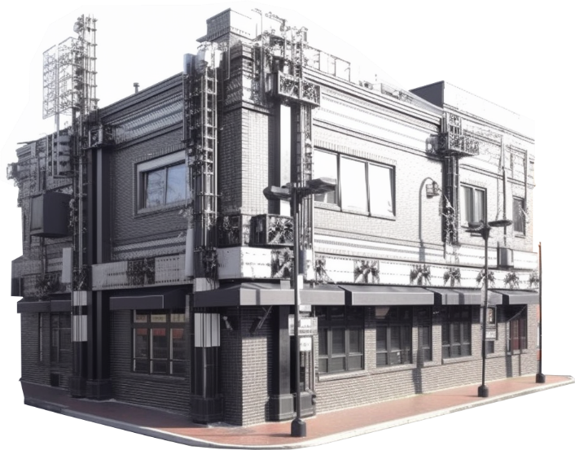

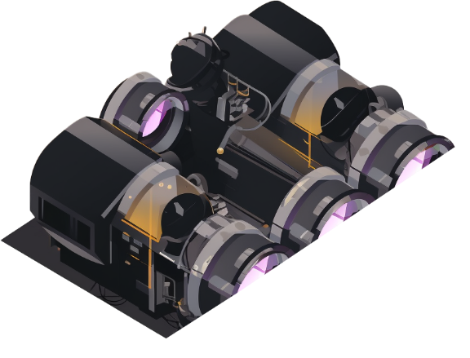
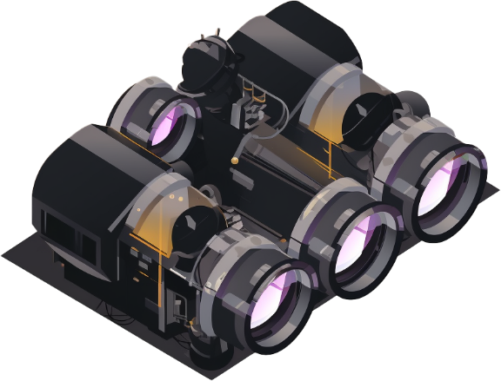

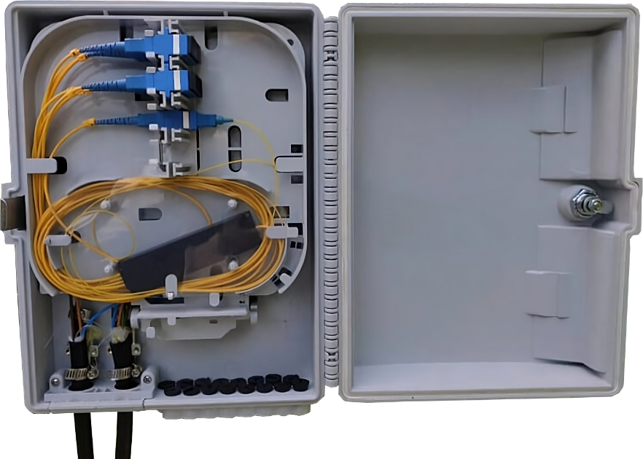
Passive Optical Network (PON)
Splits/combines multiple fibers together
Reduces fiber lines and equipment required
Don’t require power
Down
Data combined/encrypted
Time sliced/changeable
Up
Local exchange
Optical splitter
ITFreeTraining.com
© Copyright 2025
Notes:
20:20 A lot of fiber installations, but not all, use passive optical networks. To understand how it works, let’s consider that we have a local exchange. The exchange holds the equipment that is the first step for the customer to access the internet. In this example, let’s consider there are 3 homes that are connected to the exchange.
In an ideal world, we would have three fiber lines direct from each house to the exchange. Having three lines however is expensive. Thus, to reduce the cost, an optical splitter is used to split the fiber cable into three.
An optical splitter divides the fiber cable in one direction and combines multiple fiber cables in the opposite direction. The reason they are used is it reduces the fiber lines required and also the equipment required. In this example, there are three homes sharing the same fiber cable back to the local exchange. This means that the exchange requires two thirds less equipment.
Optical splitters do not require any power. This makes them easier to install than the other installation we looked at. For example, fiber to the node or fiber to the curb. You simply need a small installation box for the fiber to run into which contains the splitter. Thus, the cost to install is low.
The next question is, if we combine the fiber cables together how do we transfer data? Most installations will use the following. The downstream is quite simple, the data is simply combined together. Thus, the same data is sent to all the different homes. So essentially, all the homes get everyone’s data.
To prevent the homes from eavesdropping on each other’s data, when the data is combined it is also encrypted. The only home that can decrypt the data is the home that data is for. Since the data is combined, it is a simple matter to adjust the speed each home gets by allowing more data through or throttling the data to that home.
The upstream is a little different. Upstream works by using time slicing. Each home will send its data at an agreed time period. When it reaches the optical splitter, since the data arrives at different times, it will be combined together and there should not be any collisions if all the homes send data only when they are supposed to.
The time slice given to each home is changeable. If one home is not using all its time slices, it can be reduced or given fewer time slices. Also, other homes can be given more time slices if they need to transfer more data. Once again, throttling can be implemented easily since the local exchange equipment is what determines what time slices each home gets.
The main take away from this is that your fiber optic installation may be shared between multiple premises. It can have speed problems during peak times. In this example, since three homes are using the same fiber cable to the exchange, the exchange only needs to have one port to connect all three houses. This reduces the cost of equipment in the exchange by a third, so you can see cable costs are not the only consideration. Fiber in my opinion is the best, but if it is shared with too many users on the same connection, this can reduce its performance. This is called over subscribing. In my experience, over subscribing is not such a big problem with fiber optic as it is with other types of technology.
Now that we have had a good look at wired connections, let’s look at wireless connections.

Slide 11
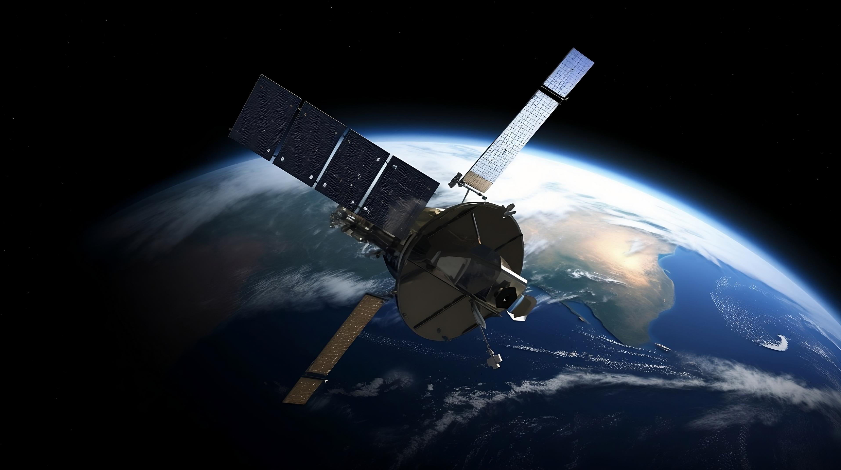
Geostationary Orbital Satellite
Covers large areas of earth’s surface
Can offer reasonable transfer speeds
Latency very high
* Not a real satellite
* Also, not the real earth
ITFreeTraining.com
© Copyright 2025
Notes:
23:57 One option for wireless communication is geostationary orbital satellites. The advantage of these satellites is that one satellite covers a large area of the earth’s surface. For example, one satellite in the right orbit could provide coverage for the United States.
Geostationary satellites can offer reasonable transfer speeds; however the latency is very high. To understand what you expect to receive from a geostationary satellite, let’s have a close look at how they work.

Slide 12
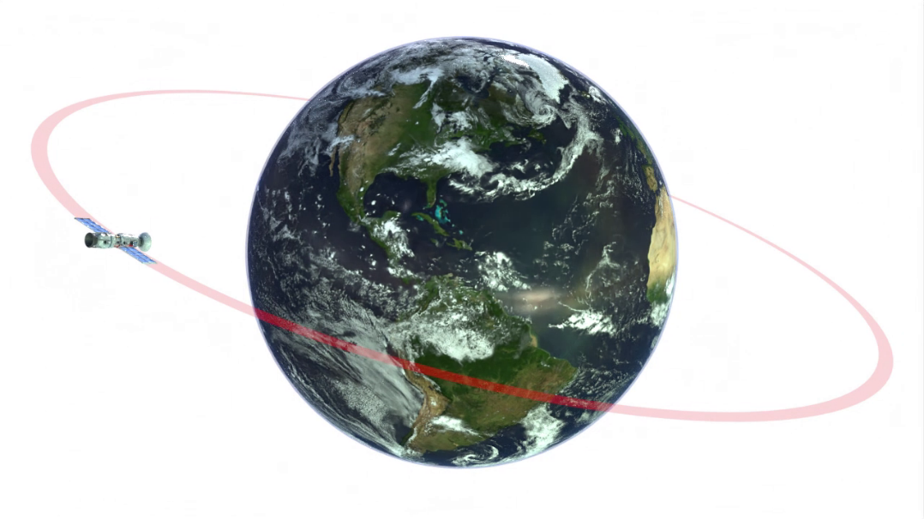

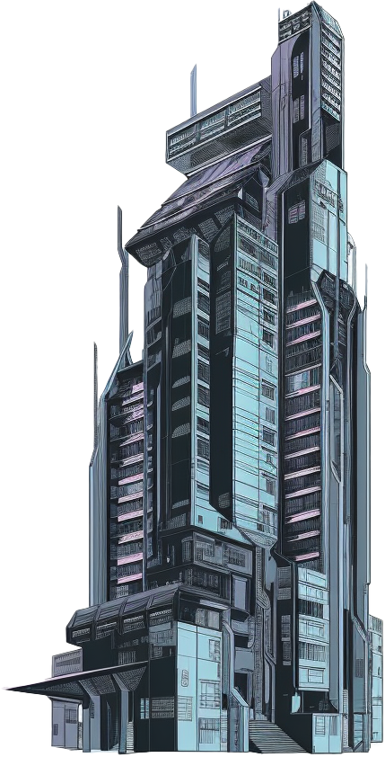

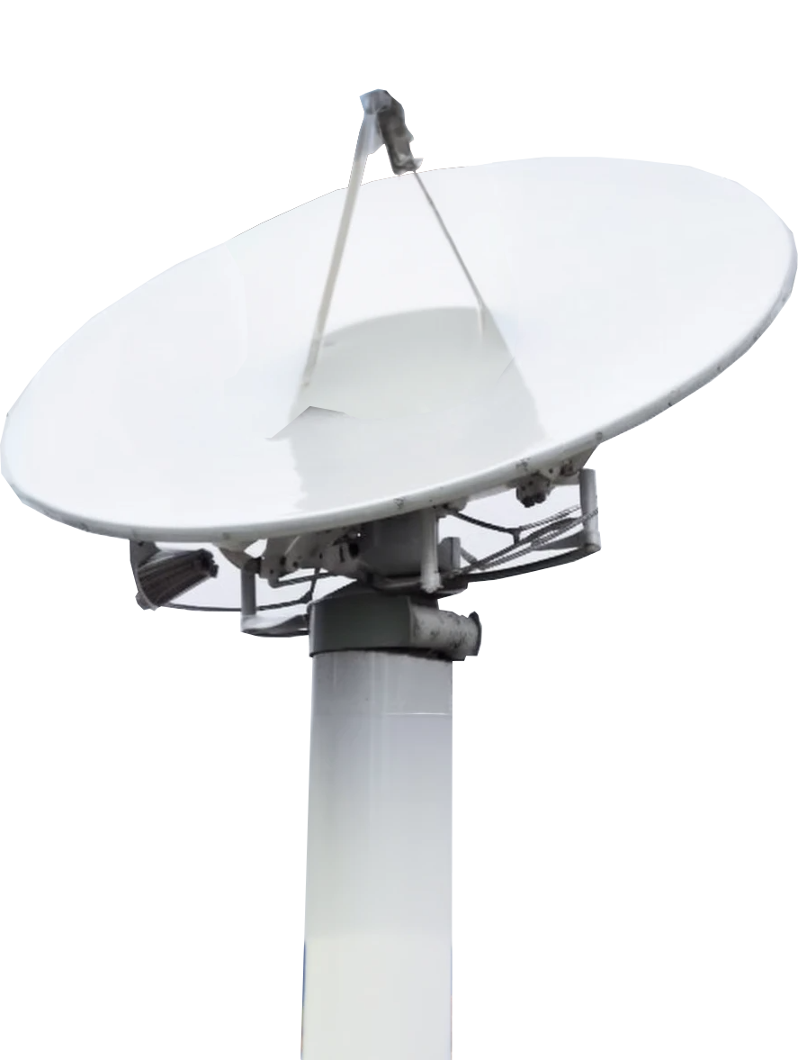
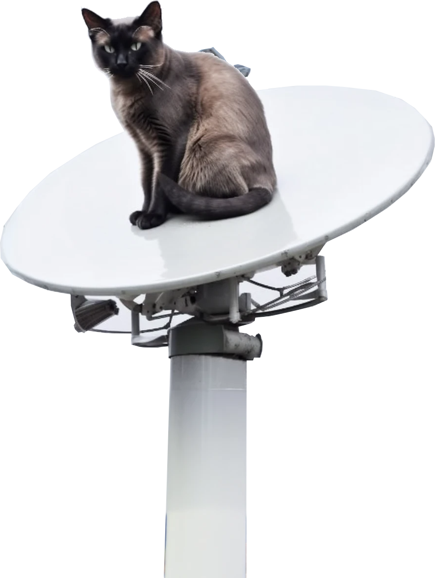
Geostationary Satellite
Remains above same point on earth while orbiting
Signal can suffer interference reducing speed and reliability
Poor weather
Buildings/Trees
Other objects
Dish needs to be aligned
ITFreeTraining.com
© Copyright 2025
Notes:
24:30 A geostationary satellite is a satellite that rotates over the same point as the earth rotates. When a satellite dish is first installed, it needs to be aligned so it is pointing towards the satellite. Once aligned, it should not need to be aligned again because the satellite is in geostationary orbit and remains in the same place in the sky.
The satellite signal can suffer interference which reduces its speed and reliability. Things that can affect it include poor weather. For example, storms, rain, and even clouds can affect it. Buildings and trees in the way of the signal can affect it. When you choose a spot to install the satellite dish, you will need to make sure none of these are in the way. After installation, new buildings being built and tree growth in the way can affect your signal. A tree with a lot of leaves can affect the signal, so you may find you get better performance at different times of the year.
Other objects that get in the way of the signal can also have an effect. During installation these things need to be considered. In some cases, you may not be able to install a satellite dish in a location that can point towards the satellite dish without it getting blocked. If for example you have a balcony that you want to install the satellite dish on, you may only be able to point it in one direction. Different satellites are located in different locations in the sky. You may be able to use one satellite provider but not another because of which satellites you can get line of sight with.
The main point to consider with using geostationary satellites is do you have direct line of sight from your satellite dish to the satellite. If there are objects in the way, this can interfere with your signal and, in the worst case, block it completely. Bad weather can also affect it. Given the high latency, you generally find satellite used when other available options are too slow or not available.
There is also another option for satellite if you decide to use it.

Slide 13

Low-Earth Orbital Satellite
Many satellites in low-earth orbit provide internet services
Latency much lower
Limited time to communicate with satellite. Need to switch before out of range
Low-earth orbit
340 miles
Geostationary
22,300 miles
ITFreeTraining.com
© Copyright 2025
Notes:
26:29 Low Earth orbit is much closer to the earth than geostationary. Unlike geostationary orbit where you only need the one satellite, you need many low earth satellites to provide the customer with internet services.
Since the satellites are much closer, the latency is much lower. Also, since the satellite is moving, the customer has a limited time to communicate with the satellite. To have uninterrupted communication, the customer needs to switch satellites before the satellite is out of range.
Low Earth Orbital Satellites allow for fairly low latency internet and very decent internet speeds. Although not quite as good as fiber, it is a fairly good alternative when you do not have other good options.
Low Earth orbit satellites stay in orbit for a limited time, generally up to about 10 years and require a lot of satellites to run effectively. The loss of satellites require additional replenishment of the satellites in the long term to remain effective.
There are a few things to be aware of if you are going to use low earth orbital satellites.

Slide 14

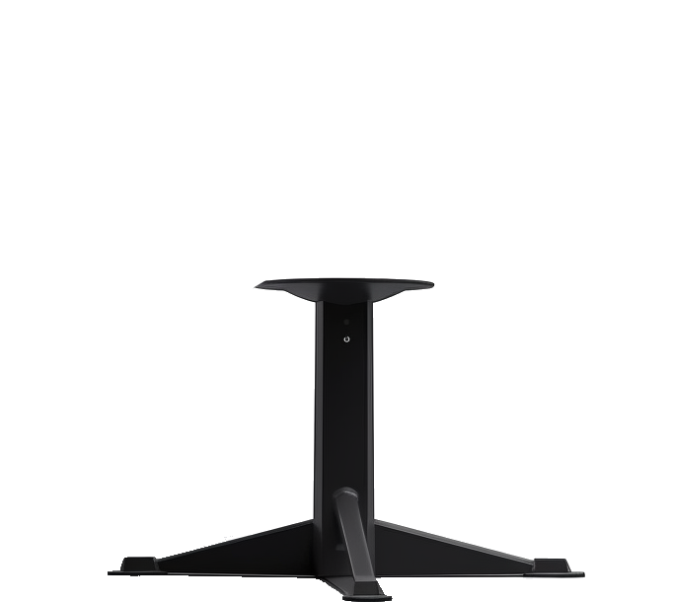
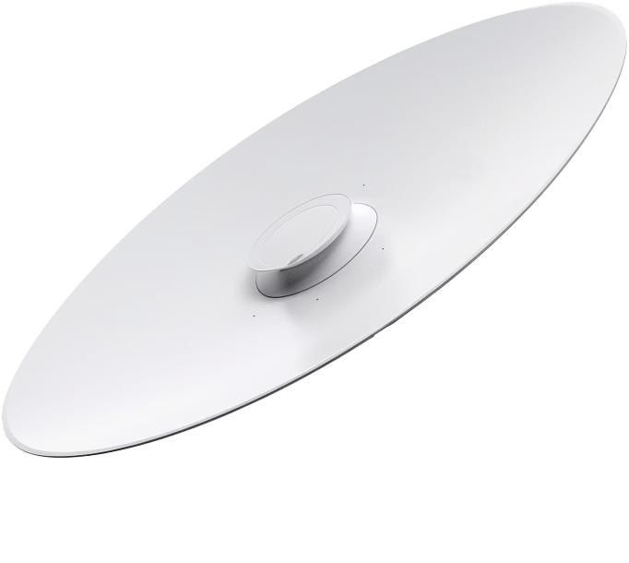
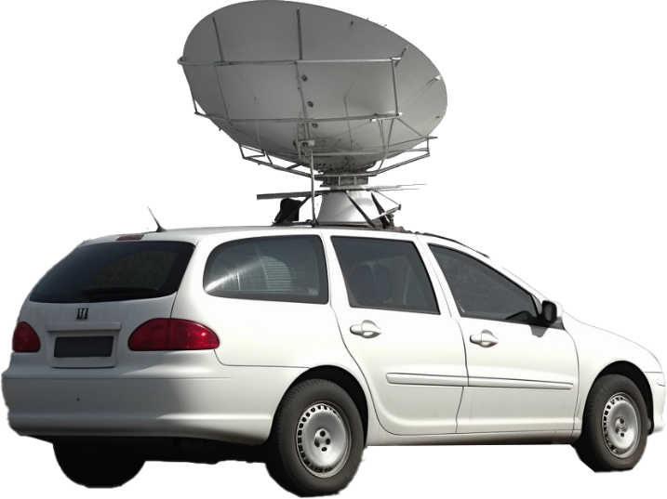
Low-Earth Satellites and Line of Sight
Satellite dish needs to track the satellite
Needs line of sight for full arc of movement
Objects in the arc will interfere with signal
Tree blocking part of arc
ITFreeTraining.com
© Copyright 2025
Notes:
27:37 Since the satellite is moving through the sky relative to the satellite dish, the satellite dish needs to track the satellite. The satellite dish needs line of sight through the full arc of movement. Objects in the arc will interfere with the signal. For example, if you have a tree blocking part of the arc of movement, it may reduce your connection speed or drop it completely when the satellite dish is pointing in that direction.
Older dishes required the whole dish to move towards the satellite. Newer dishes have internal components that move and the dish will remain stationary.
You may need to get creative about where you put the satellite dish. Unlike geostationary satellites, since the satellite dish moves, you do not need a professional satellite dish installer to install the satellite dish. Normally the installer would install the satellite dish making sure it is facing the correct direction and does not move. In the case of low earth satellites, the dish moves - so you just need to find a good place to put it and plug it in. Now let’s look at another option that does not need a satellite.

Slide 15
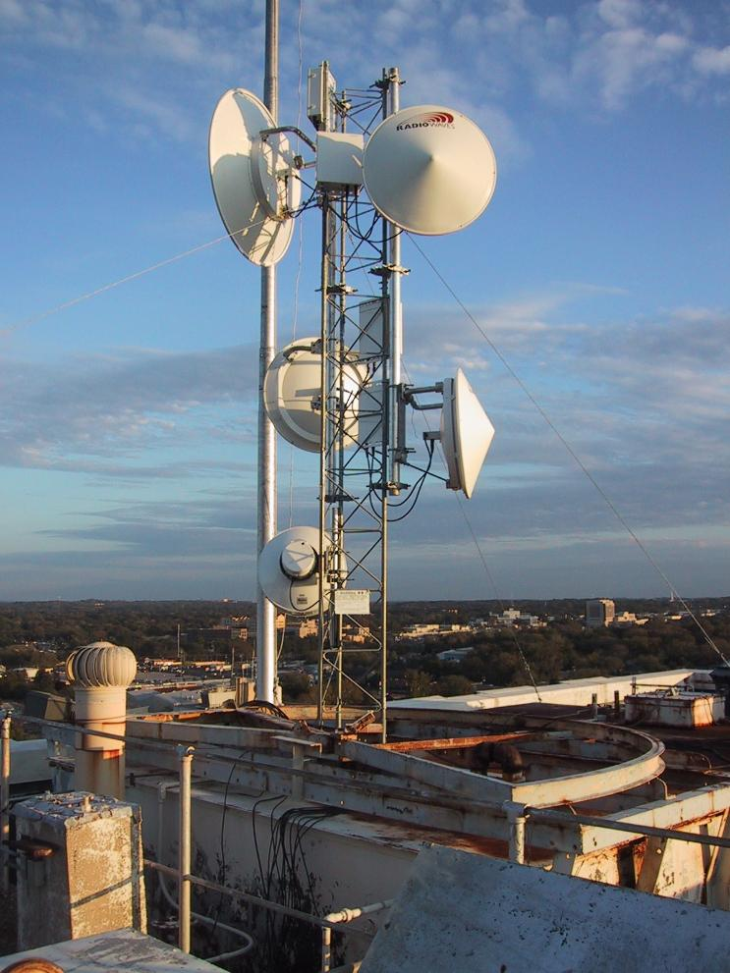
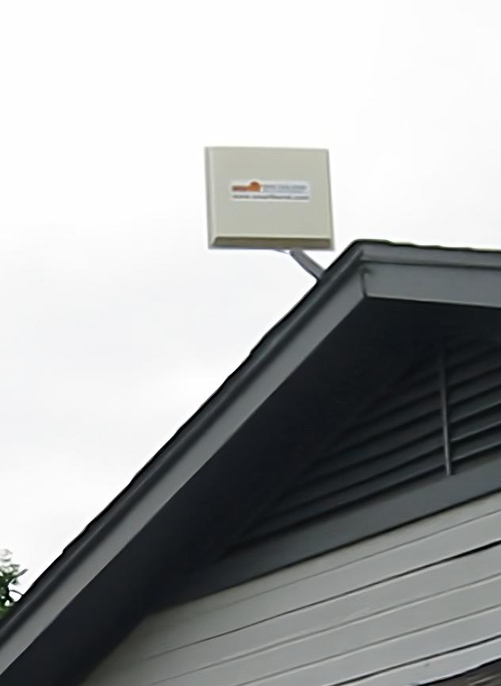
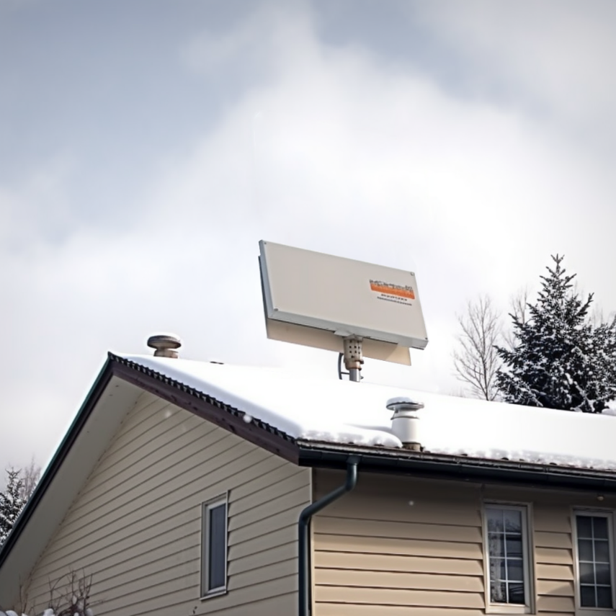

Wireless Internet Service Providers (WISP)
Uses long-range fixed wireless
Needs to be aligned so has unobstructed line of sight
Lower latency then satellite
Effected by whether
Wireless tower
Snow
Rain
Home install
ITFreeTraining.com
© Copyright 2025
Notes:
28:44 Wireless Internet Service Providers or WISP uses long ranged fixed wireless. A typical setup requires two dishes. For example, a wireless tower and a second dish at the consumer site. WISP can also be used to connect two business locations together. For example, connecting two business sites that would be difficult or impossible to connect by a wired connection. In order to use WISP, the dishes need to be aligned so there is an unobstructed line of sight.
WISP works much the same as satellite. Like satellite, it can be affected by weather, for example snow and rain. The big advantage of WISP is it has lower latency than satellite. WISP can go for quite a long distance assuming you still have line of sight. This is to be expected considering the shorter distance. The latency for short distances is similar to what you may expect on a wired network. You will most likely notice latency problems for longer distances or during bad weather where you may have the signal drop out and have to reconnect.
WISP is often used in locations where wired internet has not been installed or is too expensive or difficult to install. For example, if you have a rural town that does not have good telecommunication infrastructure. When used in locations like these, often a signal dish will be used to send and receive data from the town. For that location, it is distributed to other locations in the town.
It is important to understand that options like these are generally used when existing options are poor or non-existent. You generally do not use these in areas where there is a better option. Usually, options like these cost more than other options and thus you would use them when you do not have other cheaper options.
Now let’s have a look at wireless options you are most likely going to use.

Slide 16

Cellular Radio Internet Connections
Provides voice and data services to devices
Allows everyday objects to send and receive data
Currently five generations
ITFreeTraining.com
© Copyright 2025
Notes:
30:38 Cellular Radio Internet Connections provides voice and data services to devices. It allows everyday objects to send and receive data. Currently, there are five generations of these networks. The first generation of these networks was released in the 1980’s. For this video I will look at the last three generations of these networks.

Slide 17



Third Generation (3G)
Started being introduced in 1998
Connect to
Connects based on signal strength but other factors may be considered
Base stations arranged in cells. Thus, the name cell phones
Connect to
ITFreeTraining.com
© Copyright 2025
Notes:
30:59 3rd generation, better known as 3G, was first introduced in 1998. In order to operate, the mobile phone needs to connect to a base station. The mobile phone will connect to the base station based on a number of factors. The primary consideration is signal strength; however, network load and quality of service is also considered. Base stations are spaced out to provide coverage to a certain area. These areas are called cells. Thus, where the name cell phone comes from.
3G networks are being phased out and telecommunications companies are starting to shut these networks down. If you purchase a new mobile device, it will support newer generations of communications and may not support 3G. If you do come across a 3G device, there are some things to know.

Slide 18




GSM and CDMA
GSM
CDMA
Global System for Mobile Communication
Code Division Multiple Access
No SIM Card
Requires SIM Card
Mostly used in
North America
ITFreeTraining.com
© Copyright 2025
Notes:
31:49 3G networks will use GSM or CDMA to transmit voice and data. These networks are not compatible with each other. Thus, when you purchase a mobile phone, it needs to support the network it is being used on. Modern phones will often support both networks. There are a lot of technical differences between how the two networks work, but this is not something that you are going to be tested on. The main thing to understand between the two networks is that GSM requires a SIM card to operate whereas CDMA does not. If your device does not have a SIM card it is CDMA; if it does have a SIM card it supports GSM or both.
CDMA is mostly used in North America. There were a few other places in the world that deployed some CDMA networks; the rest of the world used GSM.
Having two different mobile networks is not ideal in the long term.

Slide 19



Fourth Generation (4G)
Incompatible with previous generations
Can be used
for home internet
Increased speed over 3G. Requires SIM card
Upgraded
Runs on
Upgraded
CDMA
Long-term evolution
ITFreeTraining.com
© Copyright 2025
Notes:
32:50 The 4th generation of mobile networks addresses the issue of having two different networks by introducing long term evolution or LTE. When looking at mobile networks’ generations, certain technology gets grouped together. For example, in the case of 4G, there have been a lot of improvements which are grouped together. This is simply done to make it easier for the consumer to understand what they are purchasing. Thus, you may find that some 4G technology is just an improvement to 3G when you look at all the technical details. In the case of the A+ exam, you do not need to worry about the technical details, but later in the video I will look at what it means in the real world.
4th generation is incompatible with previous generations. Thus, your mobile device will not be able to connect to both networks at the same time if both networks happen to be available. 4G offers increased speed over 3G and requires a SIM card in order to connect to it.
To understand why it requires a SIM card, LTE runs on an upgraded version of the GSM or CDMA network. Thus, the old 3G networks could be used, they just needed to be upgraded. Part of the upgrade they made it so you have to have a SIM card. Thus, if your mobile device does not have a SIM card, it is a CDMA 3G device. If your device has a SIM card, it could be either.
4G has improved to such a level that it can be used for home internet. Although, this will depend on availability in your area and speeds vary from carrier and location. Some internet service providers are selling 4G internet targeted for home use rather than just for mobile devices. Other internet service providers are offering 4G as a backup if the cable running the internet were to fail.
Although 4G does offer great speed improvements, customers are still wanting even faster data transfers.

Slide 20


Fifth Generation (5G)
Latest generation of wireless communication
Offers greater bandwidth than 4G
Broken up into three different frequency ranges
ITFreeTraining.com
© Copyright 2025
Notes:
34:52 5th generation is currently the latest generation of wireless communication. There is 6G in development. However, since it is still in development, there is currently nothing decided on how it will be implemented. We will have to wait and see what they come up with.
5G offers greater bandwidth than 4G. Don't be surprised if your 5G connection isn't always a major improvement. In some situations, you might see speeds similar to, or even worse than, what you get with 4G. This can be disappointing to the customer who is expecting faster speeds than 4G. 5G is broken up into three different frequency ranges. The different frequency ranges support different bandwidth giving different results. Let’s have a closer look.

Slide 21

5G Low Band
Similar frequencies to 4G
Speeds a little higher than 4G. 30 to 250 Mbit/s
Can go 20 miles (32 km) with clear line of sight
Speed reduces over distance
ITFreeTraining.com
© Copyright 2025
Notes:
35:42 The first frequency range is low band. Low band frequencies are a similar range of frequencies to what are used for 4G. There have been some improvements and thus speeds in 5G can be a little higher than 4G ranging from 30 to 250 megabits per second.
Using these frequencies can achieve distances of 20 miles or more with a clear line of sight. However, the speed does reduce over distance. You can see, comparing 4G to 5G, the factors that may affect the result you get. If you connect to a 4G base station that is close by, you will probably get better performance than if you connected to a 5G base station that is further away. You can see why sometimes a customer may get better performance on 4G than 5G. Once the telecommunication providers upgrade more towers to 5G, you should find that you get better performance than 4G, but upgrading takes time and money.

Slide 22

5G Mid Band
Uses frequencies 1.7 to 4.7 GHz
Speeds 100 to 900 Mbit/s
Distance 1 to 12 miles (1.6 km to 20 km)
Requires more base stations than 4G
ITFreeTraining.com
© Copyright 2025
Notes:
36:41 To deliver faster speeds, 5G uses multiple frequency bands. The next range is a mid-range band for optimal performance. Using these frequencies increases the speed to 100 to 900 megabits per second.
Increasing the frequency decreases the length of the wave which essentially means you can fit more data into the wave. There is, however, a downside. Increasing the frequency reduces the distance the wave can travel. The distance is limited to approximately 1 to 12 miles. Signal strength can vary significantly depending on environmental factors such as hills and mountains. This is why you generally see radio towers on a hill or as high up as possible.
Because the distance is less, to deploy 5G mid band requires more base stations than 4G does. It is not a simple matter of upgrading the 4G base stations to 5G. Although upgrading the existing 4G base station to 5G will be fine for low band, mid band will most likely require more base stations to be installed. You will probably find that mid band 5G won’t have as much coverage as low band. Another reason why you may get very different speeds from 5G. If you are close to a mid band tower, you should get good speed; but once you move away, the mobile device will switch to the next tower and if that is a low band tower, your speed will drop.
Let’s next have a look at the fastest speed 5G has to offer.

Slide 23





5G High Band (Millimeter Wave)
Uses 24 GHz to 54 GHz
Speeds 1 to 3 GBps. Increased with MIMO
Distance up to 0.7 miles (1.1 km)
Signal can easily suffer interference or be blocked
Trees
Weather
Buildings
Glass
ITFreeTraining.com
© Copyright 2025
Notes:
38:13 High band uses the highest frequency that 5G offers. This is known as millimetre wave. Having such a small wavelength allows a lot of data to be packed into the wave. This allows for speeds of 1 to 3 gigabits per second. This speed can be increased using MIMO. MIMO is when multiple channels are used on different frequencies at the same time. This is the same technology that has been used in Wi-Fi. MIMO also helps improve capacity and signal strength.
Since the frequency is so high, the distance is only about .7 miles. The signal can easily suffer interference or be blocked. For this reason it is good for places like stadiums where it is a large open area with good line of sight to the base station.
Unfortunately, frequencies this high can easily suffer interference from trees, weather, buildings, and even glass. This makes deploying high band 5G very difficult. You need a lot more base stations and they have to be put in good locations. Even in dense locations like apartment blocks, it can be difficult to get good quality signal into the building using high band.
That covers all the major ways to connect to the internet, let’s have a look at how to apply this knowledge in the real world.

Slide 24



In The Real World
Fiber optic is generally the best
Good speed and reliability
Modern mobile devices work on most networks
May have problems if device is taken overseas. Frequencies not supported
New technology like 5G requires compatible device
Satellite generally last choice or if other choices are bad
Low-orbit latency lower. Can suffer lag
Choice will often be determined by availability/price
ITFreeTraining.com
© Copyright 2025
Notes:
39:41 In the real-world, fiber optic is generally considered to be the best. It offers good speed and reliability. Being made of glass means that it does not suffer from electromagnetic interference or other environmental problems like weather or water getting into the cabling. Due to it being made of materials such as glass, it is difficult to install and easy to damage.
Modern mobile devices work on most networks. When you purchase a modern mobile device, you are unlikely to have problems in the country where you purchased it. You may have problems if the device is taken to another country. Generally, this will be because the mobile device does not support the frequency the telecommunication carrier is using, since that frequency is not used in the country where the device was purchased. These problems should, however, be pretty rare nowadays. If you do experience problems, generally the easiest solution is to purchase a cheap mobile device in that country and swap the SIM cards over while you are in the country. Mobile roaming rates can be quite high. If this is the case, you may want to also purchase a SIM card in that country.
New technology such as 5G requires a compatible device. Although older networks such as 4G are well supported by mobile devices, 5G is not yet supported by all devices.
Satellite generally is the last choice or if the other choices are bad. Although the speed of satellite can be quite good, the latency is generally quite high. Low orbit satellites have better latency, but can still suffer from lag. If your dish for whatever reason has trouble connecting to the satellite, you will get lag. Satellite may work well for large amounts of data being transferred, like video streaming, but online gaming may struggle from time to time.
Ultimately your choice will be determined by availability and price. Do not assume anything will be available in your area; it is best to check. For example, satellite is limited to a certain number of subscribers in the one area. This is in an attempt to prevent over subscribing the service, resulting in too many people using the same satellites, which will reduce the experience for everyone.
Your telecommunication provider may be able to provide your internet via 4G or 5G, but if the area you live in has poor service, your internet will be slow and unreliable. Internet may be advertised as fiber, but is in fact fiber only for a certain distance and the remaining distance is copper. Best to read the fine print before you purchase.

Slide 25

Subscribe
Next video
Video content: https://ITFreeTraining.com/ap11/5a05
© Copyright 2025
Notes:
42:19 That covers it for the different devices and technology that can be used to connect to the internet. I hope this video helps you choose the right connection to meet your needs. Until the next video from us, I would like to thank you for watching.
References
“The Official CompTIA A+ Core Study Guide (Exam 220-1101)” pages 160 to 167
“Picture: Fiber optical panel” https://en.wikipedia.org/wiki/Internet_exchange_point#/media/File:AMS-IX_optical_patch_panel.jpg
“Picture: Switchboard operator” https://commons.wikimedia.org/wiki/File:Jersey_Telecom_switchboard_and_operator.jpg
“Picture: Coax cable” https://commons.wikimedia.org/wiki/File:RG-59.jpg
“Picture: Fiber pit” https://commons.wikimedia.org/wiki/File:Fibre-optic_cable_in_a_Telstra_pit.jpg
“Picture: Wireless tower” https://en.wikipedia.org/wiki/File:Tyler1.JPG
“Picture: WISP home equipment” https://en.wikipedia.org/wiki/Wireless_Internet_service_provider#/media/File:WISP_CPE_installed_on_a_residence.JPG
“Picture: CDMA phone” https://en.wikipedia.org/wiki/Code-division_multiple_access#/media/File:Au_CDMA_1X_WIN_W31SAII_gravelly_silver_expansion.jpg
“Picture: GSM” https://en.wikipedia.org/wiki/GSM#/media/File:GSMLogo.svg
“Picture: LTE logo” https://en.wikipedia.org/wiki/File:3GPP_LTE_logo.png
“Picture: 5G logo” https://en.wikipedia.org/wiki/5G#/media/File:3GPP_5G_logo.png
Credits
Trainer: Austin Mason http://ITFreeTraining.com
Voice Talent: HP Lewis http://hplewis.com
Quality Assurance: Brett Batson http://www.pbb-proofreading.uk

