Slide 1
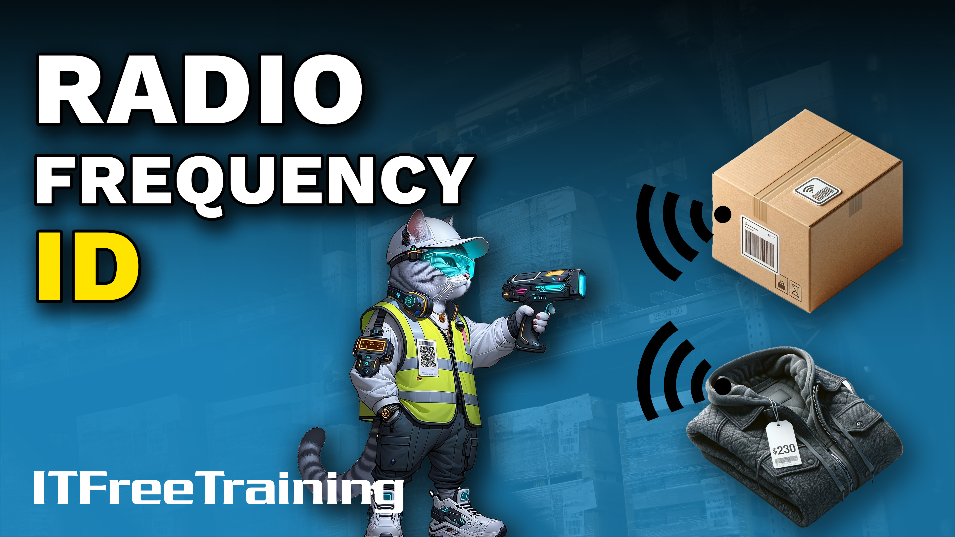
Notes:
Let’s have a look at Radio Frequency ID.

Slide 2
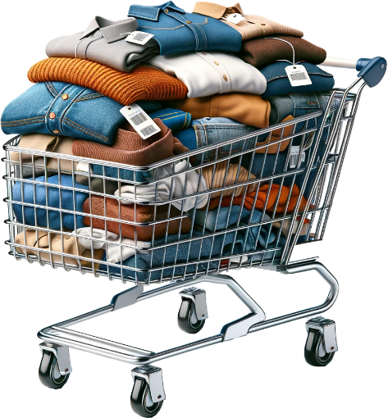
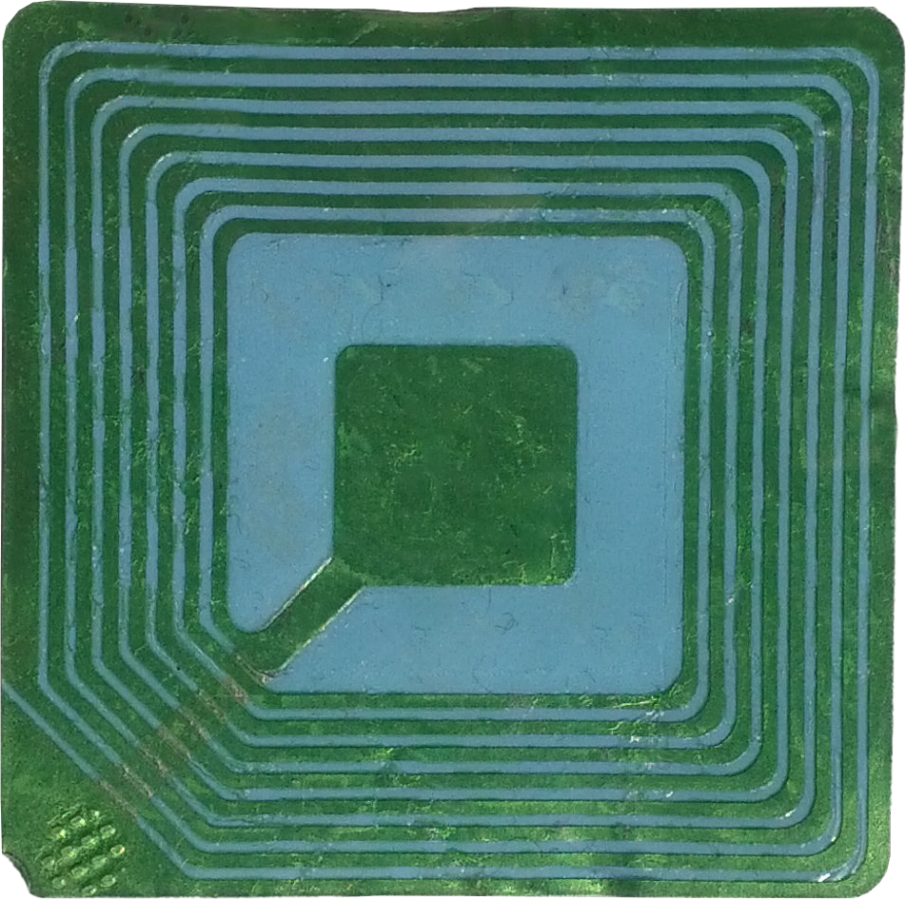
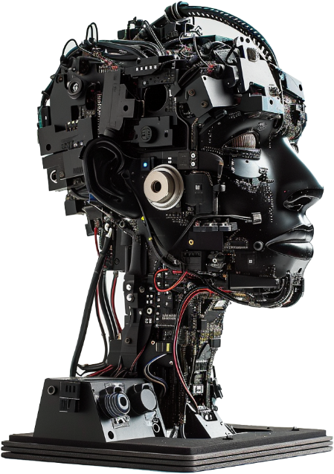
Radio Frequency Identification (RFID)
Generates identification information
Theft reduction
Logistics
Pet identification
Inventory
RFID Tag
Libraries
Prototype tracking
ITFreeTraining.com
© Copyright 2025
Notes:
00:04 Radio Frequency Identification or RFID, uses a small tag that generates identification information. These are commonly used in shopping for theft reduction. If an item is taken out of a store, a security system will pick up that the item was removed. Some stores are now using them as part of their checkout system and they can also be used when stock taking.
Another common use is for microchipping pets. If the pet goes missing, the RFID can be scanned and used to identify the pet and this information can be used to help contact the owner.
Libraries have been using RFID to help prevent theft of their library books. Some libraries are now using them in their checkout and check-in systems.
Other uses include logistics. Although it is not always possible to put an RFID on every item that is shipped, often shipping boxes will have RFIDs on them. The logistics company knows what they put in the box and if they track the box, they know where the items are.
In IT, RFIDs can be used to handle asset tracking, but its use tends to be reserved for large companies. While laptops deserve their price tag, their high visibility often makes dedicated tracking feel redundant as the user quickly notices if they go missing. Smaller firms rarely justify the investment for such easily monitored assets. Instead, RFID finds its niche in managing expensive items that are less easily spotted. For example, people generally notice someone walking out carrying a monitor, so there is no need to put an RFID tag on it.
Companies might use RFID technology to safeguard their prototypes, which are not only costly to produce but may also contain sensitive trade secrets. With the advancements in robotics, RFID provides the microscopic leash for those robotic tech toddlers, so they don’t go wandering off!

Slide 3
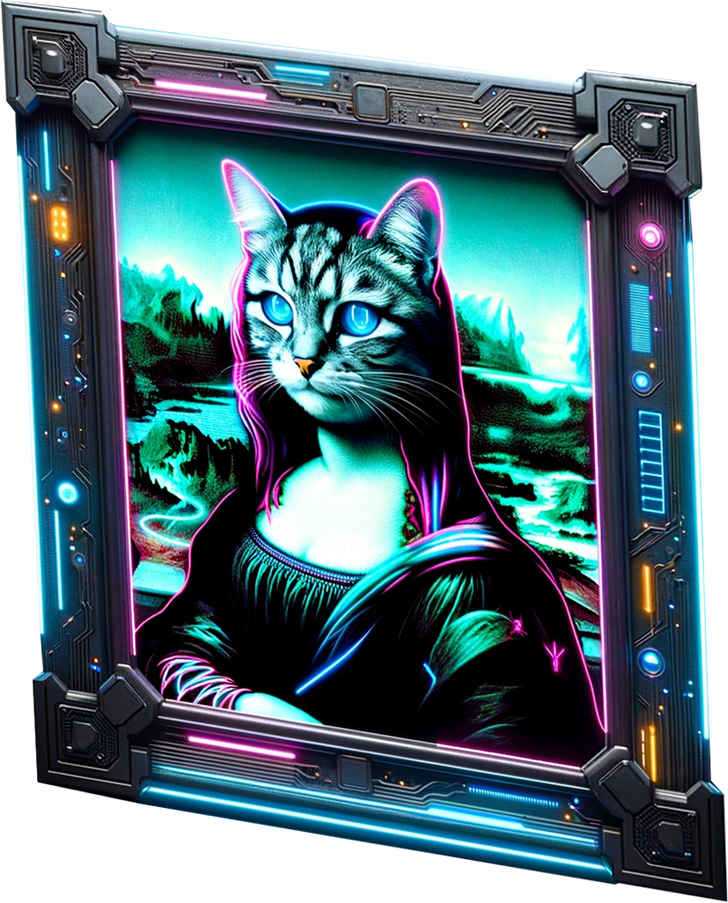
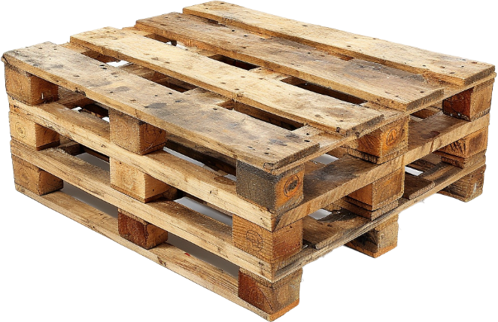
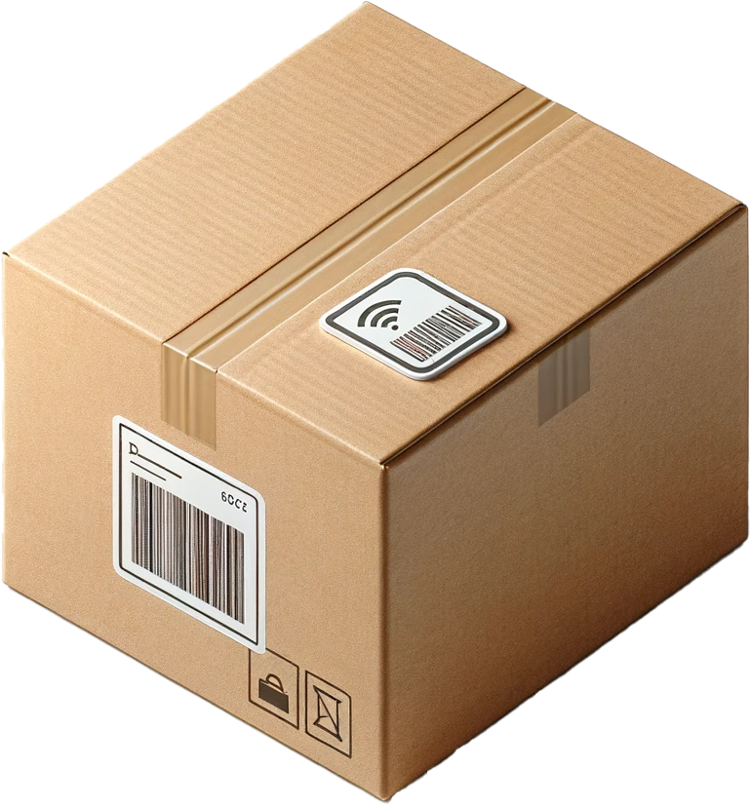
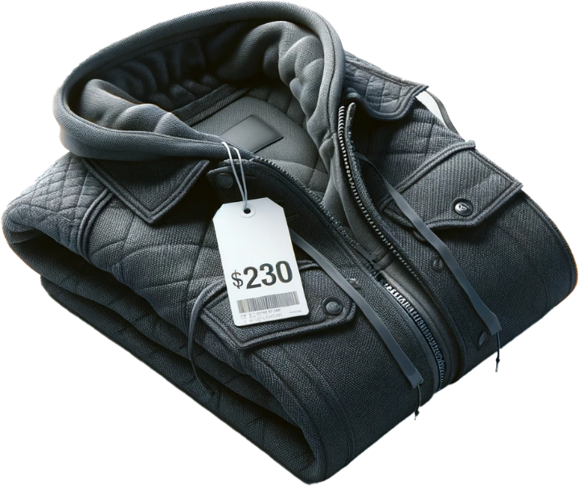
How RFID works
RFID scanner used to detect RFID tags
Low transfer rate/small amount of data/no line of sight
Multiple items can be scanned at once
ITFreeTraining.com
© Copyright 2025
Notes:
01:54 In order to use RFID, a scanner is used to detect the RFID tags. Essentially, the scanner emits radio waves which the RFIDs pick up and respond back to.
RFID has a low transfer rate and small amounts of data are transferred. Considering the RFID tag only needs to send enough information to identify itself, this is enough. It does not require a direct line of sight. If you are using an RFID scanner, they are generally directional, so you need to point it in the general direction of the RFID tag.
Multiple items can be scanned at once. This makes it great for stocktaking, since your stocktaking software can quickly tick off the RFID tags that respond back and tell you which ones it can’t find.
For the A+ exam, a deep dive into RFID technology is not necessary. Just grasp the essentials: RFID has a low data transfer rate and is mainly utilized for identification, auditing, and security purposes. While I will explore RFID in more detail, those focusing solely on exam preparation can conclude the video here if you wish. This foundational understanding of an RFID's basic functions and applications is sufficient for the exam's scope.

Slide 4
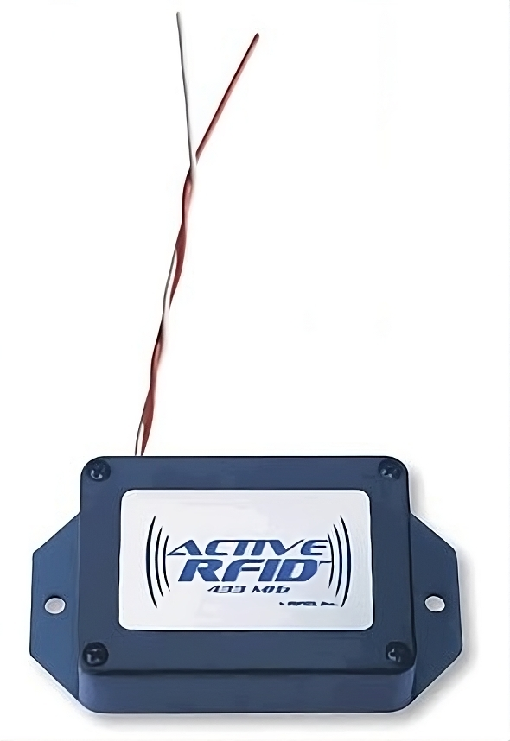
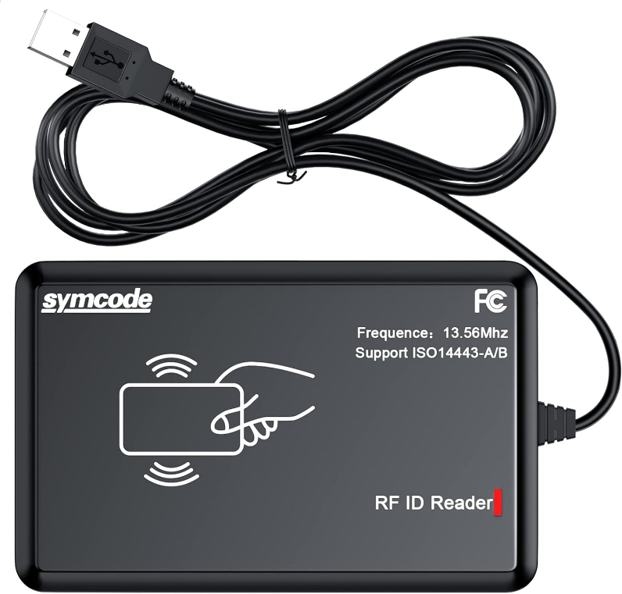
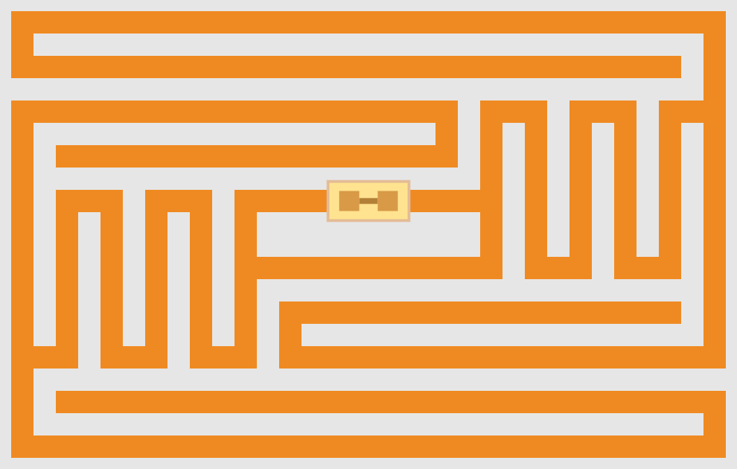
Active/Passive
Uses power
Powered from scanner
Battery or external
Uses inductive coupling
Range 100 meters
Range 25 meters
ITFreeTraining.com
© Copyright 2025
Notes:
03:12 RFID can either be active or passive. Active uses power, either a battery or is externally powered. The advantage of it being powered is it has more range and, depending on the RFID, could reach 100 meters or more. It all depends on the power source and the technology being used, but they can also transmit more data at a faster rate.
There are also other tracking devices on the market, for example GPS trackers, that don’t require additional hardware like scanners to be installed.
The more common RFID that you will come across is passive. These receive power through the scanner using inductive coupling. Inductive coupling is the transfer of energy between two coils through a magnetic field without direct physical contact. To understand how it works, let’s consider an example.
In this example, the USB scanner radiates a magnetic field. I will place an RFID tag near the scanner, in this case a security card. This is the inside of the card; you will notice that there is a coil of wire around it. This is the antenna and it serves two purposes. The first is, the magnetic field from the scanner is picked up by the antenna. This then causes an electrical current to be inducted into the card using the antenna.
The card itself has some capacitors that, once charged, will run a small processor on the card that will transmit a signal back. The scanner will pick up this signal. Since electricity has to be induced into passive RFIDs, they have a limited range. Generally, this would be a maximum range of 25 meters, although it all depends on how much magnetic field the scanner can generate and how strong a signal the RFID can send back. A lot of RFIDs are used for security doors; these RFIDs will need to be held pretty close to the sensor in order to get them to work.

Slide 5
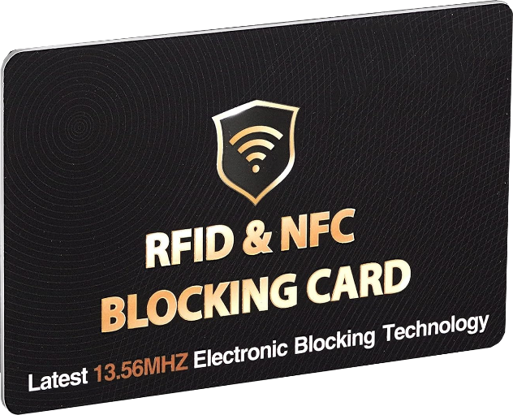
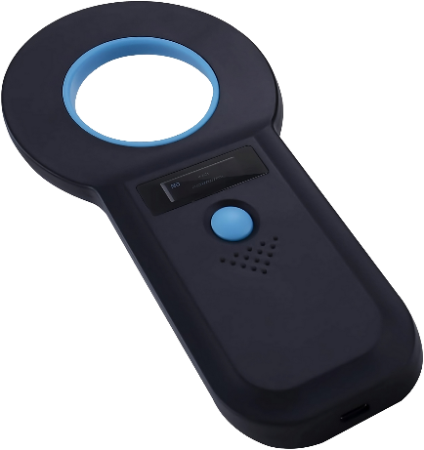
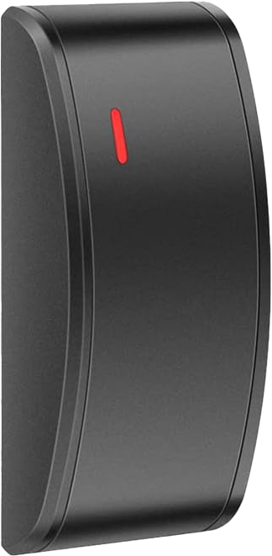
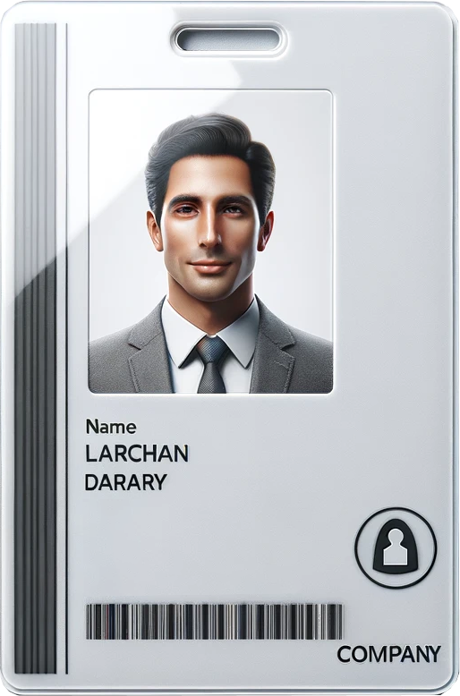
Security
Generally, contains no personal information
Simple devices contain a unique code only
More complex RFIDs use security like challenge response
RFID blocking cards are available which block induction coupling
UID: 6160875000362897
Challenge
Response using secret
ITFreeTraining.com
© Copyright 2025
Notes:
05:10 The last topic I will look at is security. RFIDs generally do not contain any personal information, although it is possible. For basic RFIDs, when they are scanned, they will provide a unique number. For example, with pet chips a unique number is provided. A person with appropriate security clearance can look up this number on a database and get personal details that have been associated with that ID. In some countries, microchipping pets is required by law.
These basic RFIDs can be copied. In most cases, where these types of RFIDs are being used, this is generally not a problem. For example, you could copy the unique ID from a pet chip, but why someone would want to do this and what would it achieve, I don’t know.
The more complex RFIDs use security (like challenge and response) to prevent them being copied. For example, if you have a door sensor and a security card. The system works by having a shared secret that the door and security card both know.
When the security card is near the door, the door scanner sends a challenge to the security card. This usually contains a random number or unique identifier. The security card has a small microprocessor which is used to generate a response based on the challenge.
The response is then sent back to the door scanner. If the response is correct, the door will open. Modern door systems should be using a challenge response system that will protect you from people copying the security card. If you have an older security system, it may not use challenge response and thus is not very secure. If this is the case, if someone were to get close to the security card, they could potentially copy it.
To prevent unauthorized copying, blocking cards are available which prevent induction coupling. Essentially, you place the blocking card on top of the security card, preventing it from receiving any power. The card is passive, so no power means that it will not work.

Slide 6
Subscribe
Next video
Video content: https://ITFreeTraining.com/ap11/4d35
© Copyright 2025
Notes:
07:07 That concludes this video on RFIDs. I hope you have found this video informative. Until the next video from us, I would like to thank you for watching.
References
“The Official CompTIA A+ Core Study Guide (Exam 220-1101)” page 155
“Mike Myers All in One A+ Certification Exam Guide 220-1101 & 220-1102” pages 1219 to 1220
“Picture: RFID” https://en.wikipedia.org/wiki/Radio-frequency_identification#/media/File:EPC-RFID-TAG.svg
“Picture: RFID” https://commons.wikimedia.org/wiki/File:Smart-Label-RFID-Tag.jpg
“Video: Water ripple” https://pixabay.com/videos/ripple-waves-water-liquid-clean-635/
Credits
Trainer: Austin Mason http://ITFreeTraining.com
Voice Talent: HP Lewis http://hplewis.com
Quality Assurance: Brett Batson http://www.pbb-proofreading.uk

