Slide 1
Notes:
Let’s have a look at Bluetooth.

Slide 2
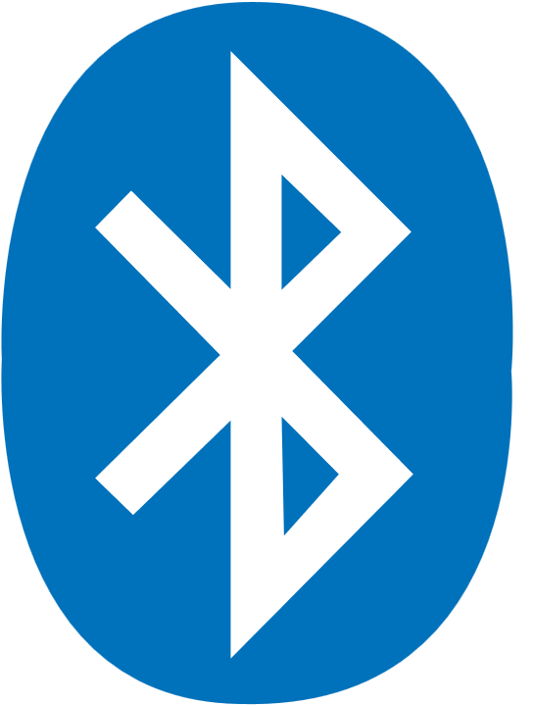
Bluetooth
Named after Harald Bluetooth
They gave up trying to find another name
ITFreeTraining.com
© Copyright 2025
Notes:
00:02 The name Bluetooth was originally intended as a temporary placeholder until a better name could be devised by the marketing department. It was derived from the Danish king Harald Bluetooth, who united Denmark and Norway during the 10th century. Harald Bluetooth had a blueish, blackish tooth and this is where he got the name from. They tried to find another name, but other names proved to be unusable for various different reasons. The Bluetooth name started getting used, so they gave up trying to find a new name. They say Harald Bluetooth united Denmark and Norway, but who would have thought his legacy would be uniting smartphones and headphones centuries later!

Slide 3
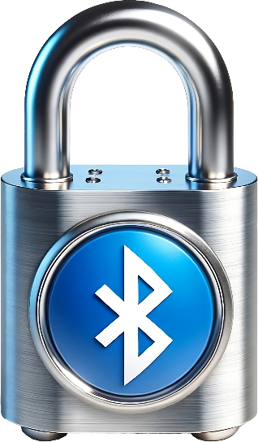
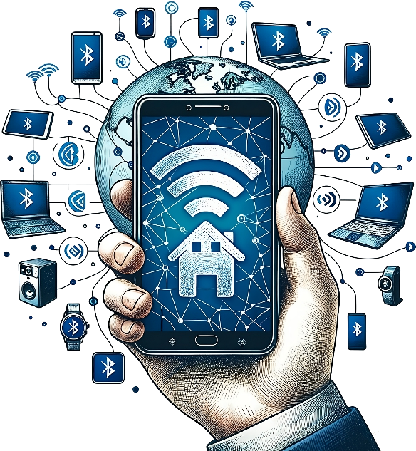
Personal Area Networks (PAN)
Small wireless network with limited range
Low Power Consumption
Secure
Resilient
Mobility
ITFreeTraining.com
© Copyright 2025
Notes:
00:44 Bluetooth is considered a Personal Area Network or PAN. These are small wireless networks with a limited range. They are essentially devices that are worn by a person or are in close proximity. PAN networks are designed to have low power consumption. Bluetooth devices are designed to run for a long time. To do this, they use a few tricks to reduce power usage when transmitting and receiving data.
They are designed to be secure, thereby preventing eavesdropping and your devices being hijacked.
In the case of Bluetooth, it is designed to be resilient. This means it is resistant to interference and congestion on the network.
Lastly, they are designed to be mobile. If you are running, traveling in a car or on a plane, the device should remain connected.

Slide 4
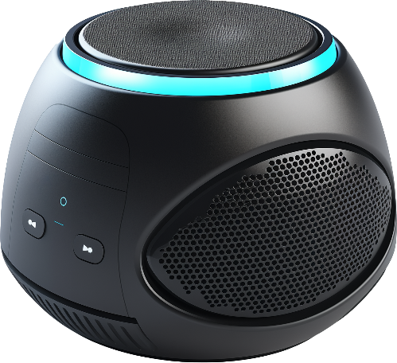
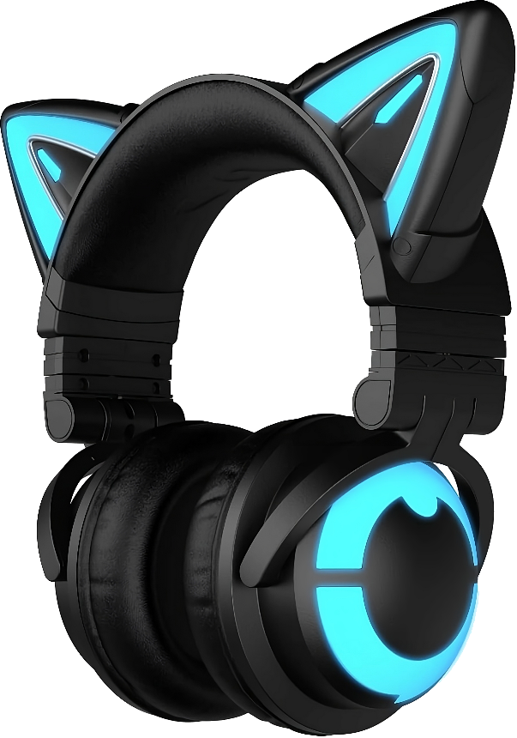
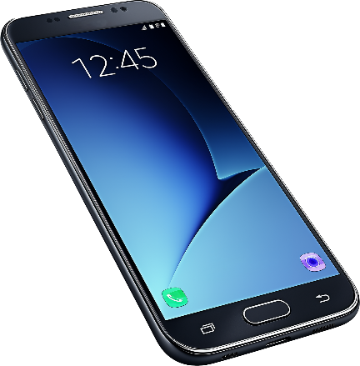
How Bluetooth Works
Uses master slave communication system
Could also be described as controller and device
Device is paired with the controller
Device
Controller
Device
Device
ITFreeTraining.com
© Copyright 2025
Notes:
01:34 Bluetooth uses a master slave communication system. Master slave terminology was often used in the old days to describe the relationship between devices. It is when one device controls the other just like a conductor would control an orchestra. The terminology does not get used that much nowadays as other terminology is now more commonly used.
Bluetooth was initially created in 1998 when this terminology was commonly used, but nowadays there is a shift toward a different terminology. In the case of Bluetooth, it could also be described as controller and device. So, for this video I will use these terms. When looking at technical documentation, keep in mind the terminology used will most likely be master and slave.
In order to use Bluetooth and keep it secure, a pairing system is used, where the device pairs itself with the controller. This pairing establishes a secure connection which allows the device to communicate but also prevents eavesdropping on the communication. Bluetooth was also designed to operate in secure environments with a lot of other devices. Let’s have a look at how it achieves this.

Slide 5
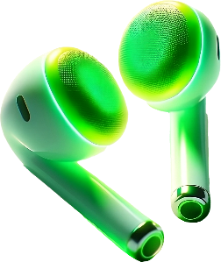
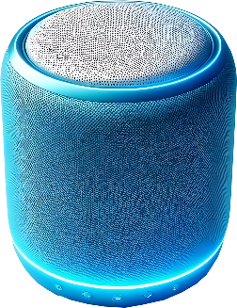
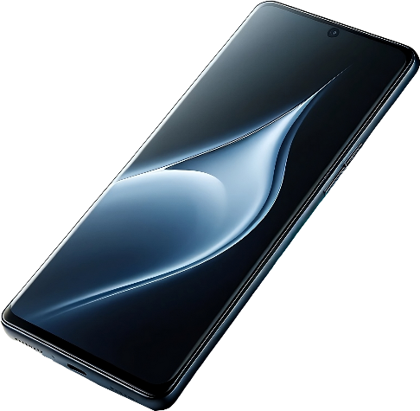
Frequency-Hopping
Bluetooth divides 2.4 GHz into smaller channels
Reduces interference and increases security
Increases power consumption and reduces maximum data rate
Frequency
Time
ITFreeTraining.com
© Copyright 2025
Notes:
02:44 Bluetooth uses frequency hopping to increase security and reduce interference in crowded environments. It is very unlikely you will get a question on this in the exam, but it will help you understand why we get the results we do when using Bluetooth.
Let’s consider that we have three different Bluetooth devices. The keyboard and earplugs are paired to a laptop and phone respectively. The speaker is connected to a different device which is not displayed in this scenario.
The Bluetooth signal traveling between the two devices will change frequency. This is what you call frequency hopping. Frequency hopping reduces interference by rapidly switching the communication signal among many frequency channels, minimizing the chance of long-term interference with other signals. It also enhances security by making it difficult for unauthorized entities to intercept or disrupt the signal, as they cannot predict the changing frequencies.
The controlling device decides the frequency and timing for communication with the paired device. Essentially, it instructs the paired device when to transmit by specifying that it will be listening at this time, and you should also be listening during these times as I may send you data. This allows the paired device to work better in environments with a lot of interference as the controlling device can select channels with less interference and can dynamically change channels if needed.
The downside of frequency hopping is that constantly changing frequencies leads to higher power usage. Moreover, each frequency change introduces a delay, reducing the amount of time the device can send data and thereby decreasing the overall data throughput.
This increased power consumption is not such a problem with devices like keyboards and other similar devices since they have a decent size battery. However, for small battery-powered devices like watches and other wearable technology, such as monitoring devices, this became more of a problem as these devices send data regularly and have small batteries to keep the size of the device small, so reductions in power consumption had to be made.

Slide 6
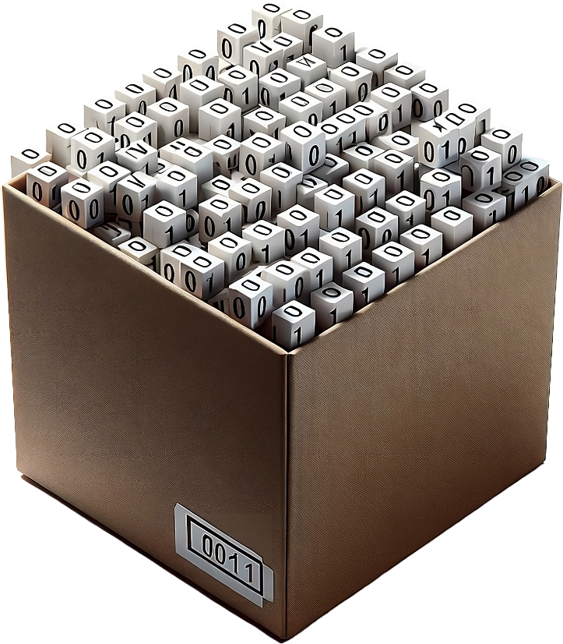
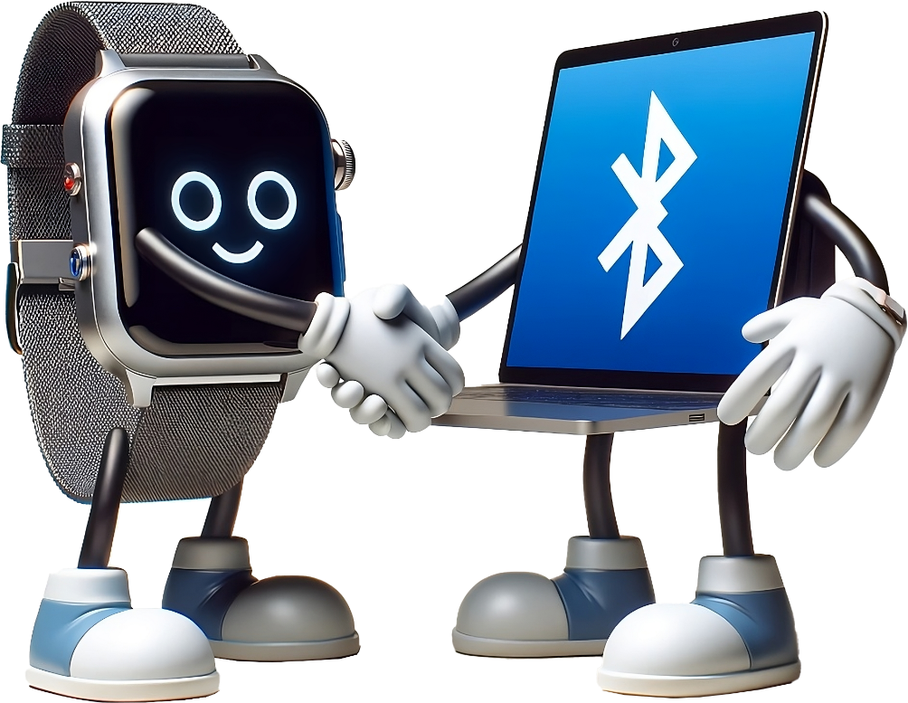
Bluetooth Low Energy (BLE)
Designed to reduce power consumption in 2009
Also known as Bluetooth Smart
Requires Bluetooth version 4
BLE is not backward compatible, but devices can use BLE or classic Bluetooth
Smaller data packets
Sleeps when not transmitting
Negotiates transmission times
ITFreeTraining.com
© Copyright 2025
Notes:
04:52 In 2009, Bluetooth Low Energy or BLE was introduced which is designed to reduce the amount of power consumption in Bluetooth devices. It does this by using smaller data packets. Sending smaller packets means there is less wastage when all the data does not fit in the packet. Often, wearable devices only need to send small amounts of data, so this mechanism reduces how much wasted data will be sent.
The device will also go into a sleep mode when not transmitting. Keeping the antenna powered up takes power, so keeping it powered down when it is not needed can have a significant reduction in power usage.
In order to do this, the device negotiates with the controller on transmission times and other configuration information. This allows the device to have a connection that is more customizable to its needs. For example, a device that tracks sleep patterns does not need to send data that often albeit the data is time critical. Devices like earplugs need to send data more often, otherwise there may be delays in the audio received by the device.
Bluetooth Low Energy may also be called Bluetooth Smart. Since it was introduced in 2009, if your device requires it, most likely it is supported. BLE also requires Bluetooth version 4. BLE is not backward compatible with previous versions of Bluetooth, however, devices can use BLE or classic Bluetooth. You can see that Bluetooth, nowadays, pretty much manages itself. You don’t need to worry about version numbers or features.
There is another feature of Bluetooth that helps reduce power consumption.

Slide 7
Classes
Defines the maximum power use
More power means more range but increased battery/power consumption
Class | Max. Power Usage | Max. Range
Class 1 | 100 mW | 100 meters
Class 2 | 2.5 mW | 10 meters
Class 3 | 1 mW | 1 meter
ITFreeTraining.com
© Copyright 2025
Notes:
06:35 To reduce power even more, Bluetooth defines different classes. The class the Bluetooth device is designed for determines the maximum power used. More power means more range but also increased battery or power consumption. Class 3 devices work up to o ne meter whereas Class 2 devices have a distance of ten meters. Most of the Bluetooth devices on the market will be Class 1 or Class 2, although there are not many that are Class 1. When you start getting to ranges over ten meters, generally most devices will use other technology such as Wi-Fi.
So far, I have looked at power usage, so I will now have a look at the speeds you can get with Bluetooth.

Slide 8
Speeds
Speed quite low compared to other networking options
Bluetooth’s main focus is not high speed
Version | Speed | Released
1.1/1.2 | 1 Mbps | 2001/2003
2.0/2.1 | Adds enhanced data rate 3 Mbps | 2004/2007
3.0 | Adds 24 Mbps using 802.11 connection | 2009
4.0/4.1/4.2 | Same | 2010/2013/2014
5.0 | Increases speed to 2 Mbps at expense of range | 2016
ITFreeTraining.com
© Copyright 2025
Notes:
07:19 Shown here are the speeds Bluetooth can achieve. The main takeaway from this is, the speed is quite slow compared to other networking solutions. Bluetooth’s main focus is not high speeds. It is designed to provide short range communication in a secure way while trying to reduce power consumption.
The original Bluetooth specification had a maximum speed of 1 Megabit per second. In version 2, enhanced data rate was added which increased the speed to 3 Megabits per second.
Version 3 increased the speed to 24 Megabits per second, however, there is a caveat. To achieve this speed an 802.11 connection is used, essentially, a Wi-Fi connection.
Version 5 increased the speed to 2 Megabits per second, however, it does this at the expense of range. It is important to note that these speeds are the theoretical maximum and can be reduced due to overheads.
The main takeaway is that Bluetooth is not that fast compared with other networking options. It is fast enough, however, for devices like speakers, keyboards, mice, and headphones. For this reason, you often see Bluetooth used with these devices.

Slide 9
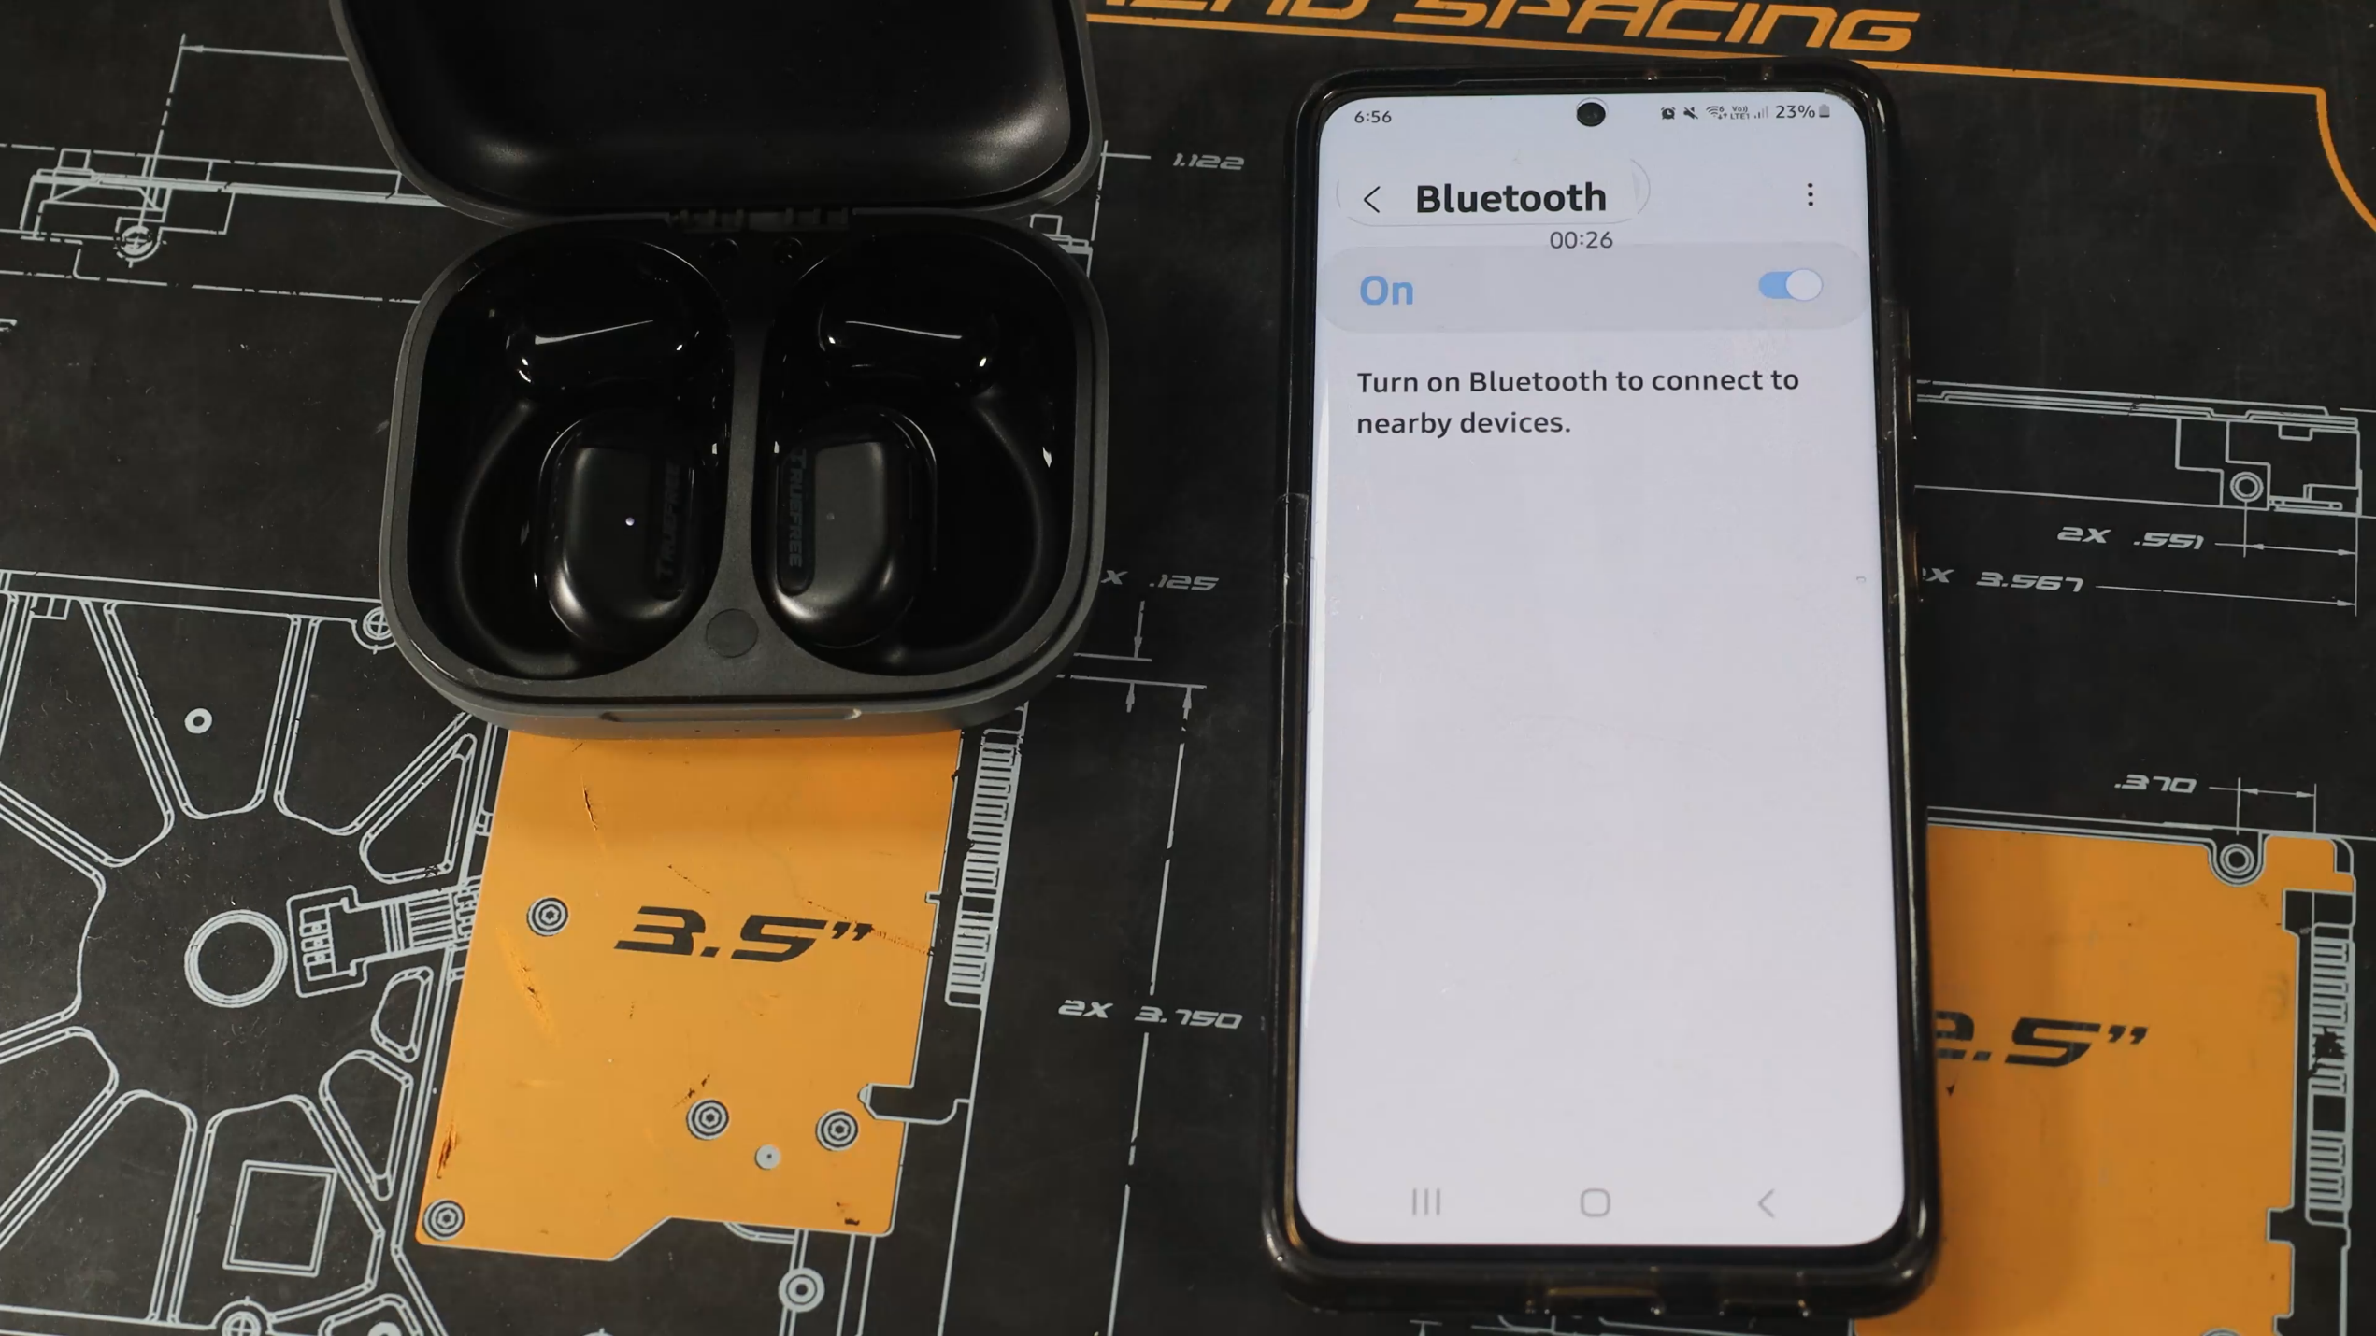
Pairing
Put device in pairing mode and connect
ITFreeTraining.com
© Copyright 2025
Notes:
08:31 To use Bluetooth, you need to put the device in pairing mode. Depending on the device, the process can be different. With modern devices, there is often a button that you need to hold down.
I will now pair these earplugs with this mobile device. I am currently in the phone’s settings. So, I need to first switch Bluetooth on. In many devices, it can be enabled by swiping down from the top of the screen and selecting the Bluetooth logo. If you switch off Bluetooth using this method, keep in mind that some devices, mostly Apple devices, will disable Bluetooth for a set period of time and then enable it again. If your device does this, you need to switch off Bluetooth in settings to make sure it stays disabled.
For this device, to put it into pairing mode, I need to press this button. I also need to hold the button down to clear any previous pairing. The device may have some LEDs to let you know which mode the device is in. You will need to refer to the documentation on how to set up pairing and how to reset your device.
Hopefully your device will be detected, but if not, you may need to press the scan button to scan for new Bluetooth devices. At the top is shown the devices that are already paired; once paired, you don’t need to pair them again unless the pairing is deleted. At the bottom is a list of the Bluetooth devices found.
I will now select Bluetooth to start the pairing process. This will establish a secure connection with the Bluetooth device in a way that prevents eavesdropping. I will get a prompt to confirm the pairing and once I press ‘Pair’, the connection will be made. The paired device will be added to the others already shown. Even if Bluetooth is taken out of range or the battery goes flat, the pairing will be remembered. In older Bluetooth devices, you may need to enter in a pin number to confirm the pairing. This may be displayed on the Bluetooth device or you will need to read the instructions to find out what the pin is. If you do not know the pin, try the two most common pin numbers 0000 and 1234.

Slide 10
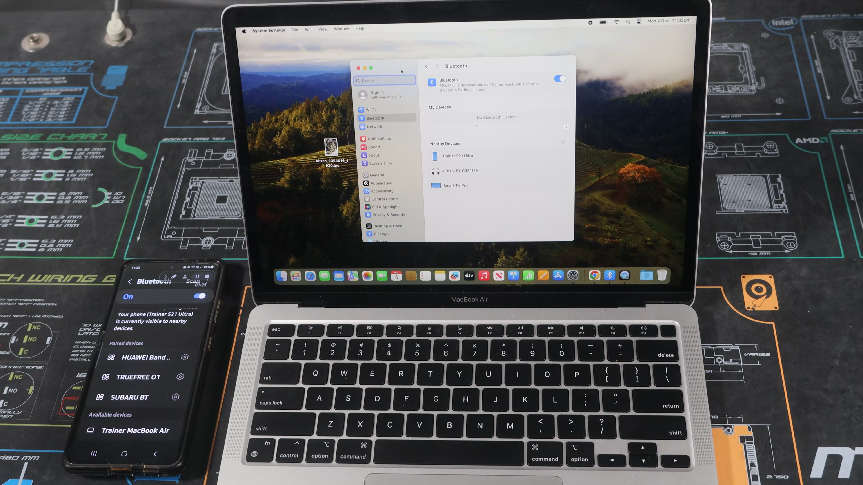
Exchanging Files
ITFreeTraining.com
© Copyright 2025
Notes:
10:34 Bluetooth can also be used to exchange files between devices. Although in a lot of cases it is easier using other methods like the cloud or e-mailing files, sometimes it can be very convenient to use this feature.
For this demonstration, I have a mobile phone and a MacBook. I will send a file from the MacBook to the mobile phone. To do this, I will first need to pair the two. To do this, Bluetooth needs to be enabled on both devices and be broadcasting their Bluetooth Device Names. On some devices, Bluetooth may be enabled but additional settings need to be configured in order for them to broadcast their Device Name.
To connect the devices, on the MacBook I will select the mobile phone and press ‘Connect’. This will send the pairing request to the mobile phone. Both the MacBook and the mobile phone will display a message asking you to confirm the pairing. You will notice that there is a code displayed. This code should be the same on both devices. If it is not, don’t press the pair button as it is possible someone is trying to hack into your connection.
I will press ‘Pair’ on the MacBook and then I will press ‘Pair’ on the mobile phone. The connection will be established just like it was in the previous example. I will next need to send the file from the MacBook to the mobile phone. To do this, I will open Spotlight and perform a search for Bluetooth File Exchange – this software is used to start the file transfer.
To start the file transfer, open the software and select the file that you want to transfer. Next, I need to press the send button. I will be prompted for the device that I want to send the file to. Once selected, press the ‘Send’ button. For the file transfer to start, I need to press ‘Accept’ on the mobile phone. Once this is done, the file will be transferred.
Bluetooth is not the fastest at transferring files, but it can be useful for one-off transfers between different devices.

Slide 11
Subscribe
Next video
Video content: https://ITFreeTraining.com/ap11/4d30
© Copyright 2025
Notes:
12:37 Why don't Bluetooth devices ever change light bulbs? Because they're too busy trying to connect! Thank you for watching, and stay tuned for more videos soon.
References
“The Official CompTIA A+ Core Study Guide (Exam 220-1101)” page 154
“Mike Myers All in One A+ Certification Exam Guide 220-1101 & 220-1102” pages 846 to 847
“Picture: Bluetooth logo” https://simple.wikipedia.org/wiki/Bluetooth#/media/File:Bluetooth-Logo.svg
Credits
Trainer: Austin Mason http://ITFreeTraining.com
Voice Talent: HP Lewis http://hplewis.com
Quality Assurance: Brett Batson http://www.pbb-proofreading.uk

