Slide 1
Notes:
Let’s look at long-distance wireless.

Slide 2
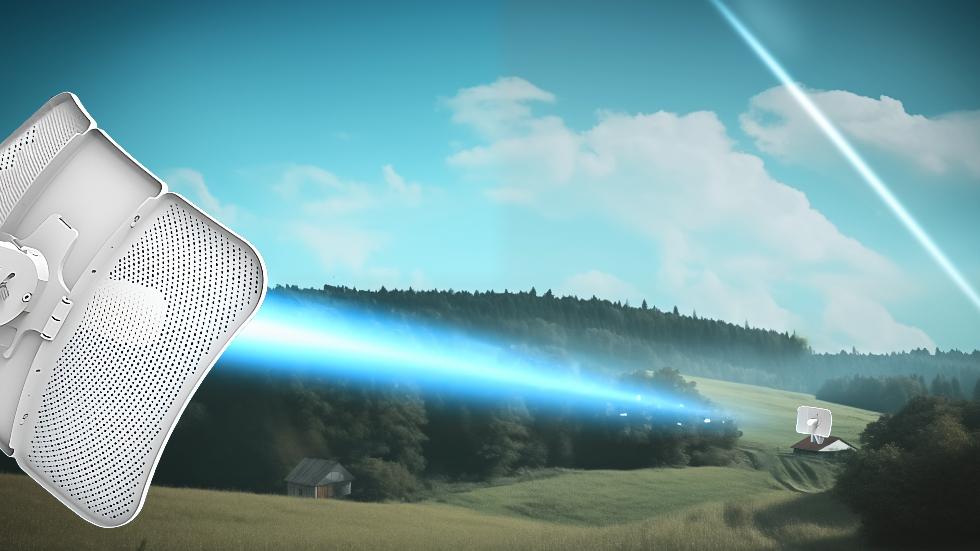
Long-Distance Wireless
Point-to-point
Unobstructed view between antennas (Line of sight)
Uses microwave antennas to transmit signals
ITFreeTraining.com
© Copyright 2025
Notes:
00:03 Long-distance wireless works by having two antennas facing each other creating a point-to-point connection. Point-to-point means data travels between the two antennas and not to any other devices. Thus, the antennas provide a bridge connection combining two different networks together. In this example I am looking at long distance, but point-to-point can still range from a few meters to several kilometers.
Effective long-range wireless communication hinges on having an unobstructed view, also known as line of sight, between the antennas. This means you need to have a clear visual path from one antenna to the other, free from any intervening obstacles. The initial placement of the antennas is critical, and potential future obstructions, such as tree growth, must be taken into account. This is why antennas are typically mounted at higher elevations, minimizing the risk of such obstructions and ensuring a clear, direct path for signal transmission.
Wireless uses microwave antennas to transmit signals. Let’s have a closer look at what that means.

Slide 3
Microwave Frequencies
Range of frequencies from electromagnetic spectrum
Microwave ovens generally use 2.45 GHz
Unlicensed
Name | Frequency (HZ)
Gamma ray | > 30 EHz
X-ray | 30 EHz – 30 PHz
Ultraviolet | 30 PHz – 750 THz
Visible light | 750 THz – 400 THz
Infrared | 400 THz – 300 GHz
Microwave | 300 GHz – 300 MHz
Radio | ≤ 300 MHz
No authorization required/Free to use
Subject to interference from other devices
Lower equipment cost
Licensed
Authorization required
Protected from interference
Higher cost
ITFreeTraining.com
© Copyright 2025
Notes:
01:12 When referring to microwave transmissions, this is a specific range of frequencies in the electromagnetic spectrum. People often confuse the microwave spectrum with microwave ovens, however, microwave ovens only use a frequency of 2.45 Gigahertz. Devices like Wi-Fi and Bluetooth use the same frequency as microwave ovens, however, the power levels are so low they will not cause you any harm.
The frequencies are essentially divided into two parts, these being unlicensed and licensed. Unlicensed is where no authorization is required and is generally free to use. However, it is subject to interference from other devices using the same frequency. Since it is free to use, often many devices will use it. Unlicensed has the advantage that the equipment is generally cheaper since there is a bigger market which drives the price down.
Licensed frequencies, on the other hand, require authorization. Usually, a government authority will determine who can use these frequencies, as they are a limited resource and thus regulation is required.
Generally, you will be the only one using a licensed frequency, and therefore there won’t be interference from other users. Licensed frequencies generally have a higher cost. Often a fee will be required to use such a frequency, which is an additional cost over unlicensed. Also, the equipment generally costs more than unlicensed since the market is not as big. The advantage of paying a fee is that you have the right to use that frequency and other people don’t. So, if you find that someone else is causing interference on that frequency, there should be a legal avenue you can follow to have them stop using it.

Slide 4
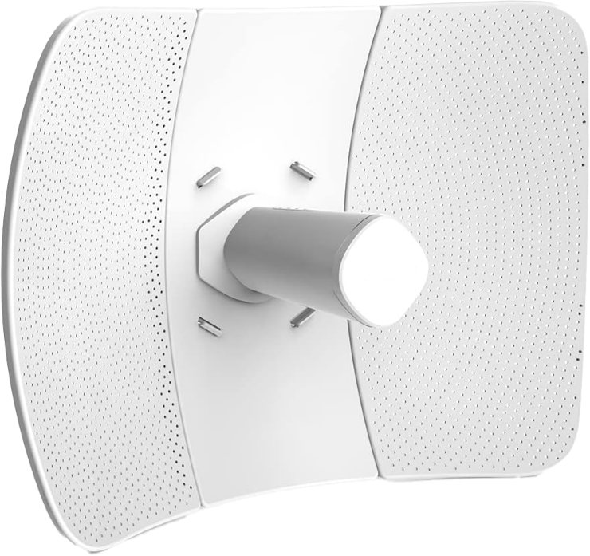
Transmission
11010100011101011010110101000110101011010100001101110
Antenna gain (dBi)
Amount boosted directionally
Focused rather than spread out
Transmit power (dBM)
Effective isotropic radiated power (EIRP)
Limited by regulatory requirements
Sum of transmit power and gain
ITFreeTraining.com
© Copyright 2025
Notes:
02:57 This information is in the official study guide, but I doubt very much that you will get asked a question about it. The transmission power of the antennas is measured in decibels per milliwatt or dBM. To get a better signal over longer distances you want this to be as high as possible, but it will be limited by regulatory requirements. Boosting the transmission power beyond certain limits isn't just risky, it is illegal. Doing so increases the chance of interfering with other devices and violating regulations, which can lead to hefty fines from authorities. So, I would check your local regulations to make sure that you are compliant.
Antenna gain is measured in decibels per isotropic or dBi. This is a measure of how much the signal is boosted in a particular direction. Essentially, this is how focused the signal is rather than it being spread out. The measurement is calculated by comparing the output with a hypothetical antenna that radiates equally in all directions. Thus, a higher value means the signal is more focused which is what you want if you are transmitting over long distances.
Effective isotropic radiated power or EIRP is the sum of the transmitted power and gain. This is, essentially, the other two specifications combined. EIRP provides a measure of the overall efficiency of the transmission system, a combination of how far and how well the signal can travel.
If you are planning to install long-distance wireless, check your local regulations to ensure that you are compliant. Depending on the country you live in, there are large fines if you use a frequency that you are not supposed to be using.

Slide 5
Subscribe
Next video
Video content: https://ITFreeTraining.com/ap11/4d25
© Copyright 2025
Notes:
04:43 Remember, setting up a long-distance wireless connection is a bit like playing darts blindfolded – you need to know exactly where you are aiming. So, make sure you have a clear line of sight
Until the next video from us, I would like to thank you for watching.
References
“The Official CompTIA A+ Core Study Guide (Exam 220-1101)” pages 153 to 154
Credits
Trainer: Austin Mason http://ITFreeTraining.com
Voice Talent: HP Lewis http://hplewis.com
Quality Assurance: Brett Batson http://www.pbb-proofreading.uk

