Slide 1
Notes:
Let’s look at how to install a wireless Mesh.

Slide 2
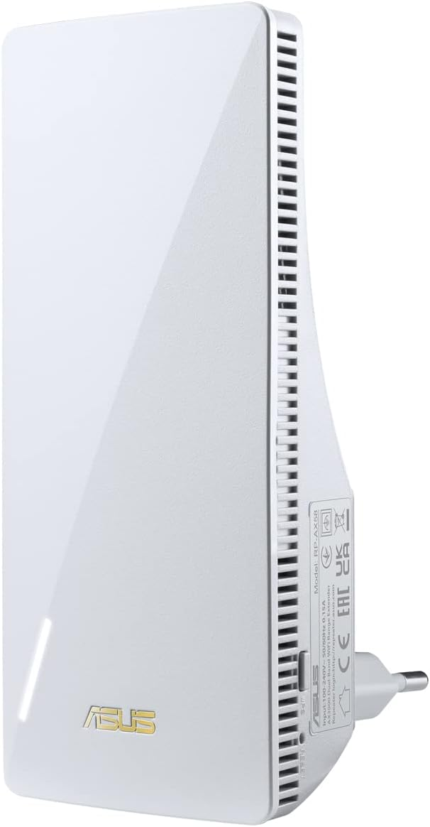
Demonstration of Mesh
ASUS WLAN Repeater AX3000 RP-AX58
Wi-Fi Extender
ITFreeTraining.com
© Copyright 2025
Notes:
00:03 For this demonstration, I will be setting up the following Wi-Fi extender. A Wi-Fi extender increases the range of your existing Wi-Fi network. If you have dead spots or areas of low signal, putting Wi-Fi extenders in those areas can fix these types of problems.
For this demonstration, I will be adding a Wi-Fi extender to an existing network. This network already has a router that provides internet and Wi-Fi. However, in some areas the Wi-Fi is not very strong, so I will be adding a second Wi-Fi. This will work to extend the Wi-Fi network, so I will get good coverage anywhere in the house.

Slide 3
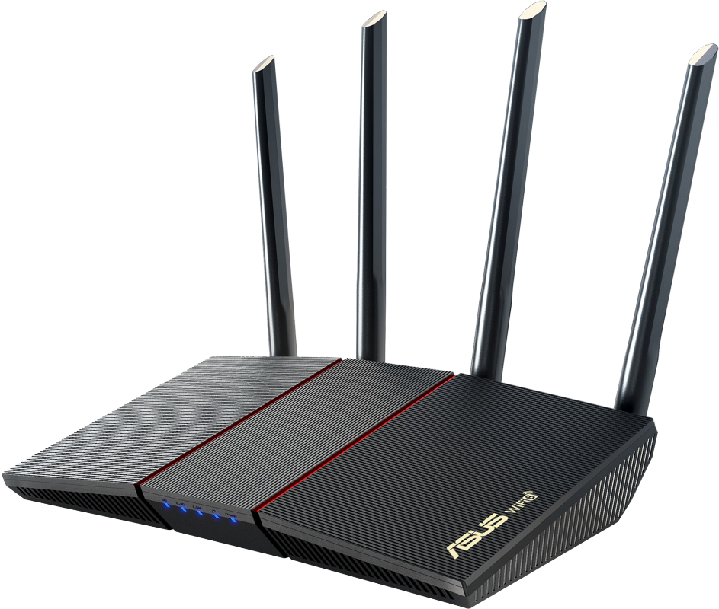
Wi-Fi Mesh
Combines multiple Wi-Fi routers together
Devices seamlessly change between Wi-Fi points as required
Internet
Different vendors have implemented different solutions
Physical network cable
ITFreeTraining.com
© Copyright 2025
Notes:
00:43 In order to do this, I will use Wi-Fi Mesh. This combines multiple access points together. A wireless access point is a device that connects wireless devices to a wired network, essentially acting as a connection point. Using Mesh, Wi-Fi devices will seamlessly change Wi-Fi points as required. For example, if a device moves closer to an access point that has a better signal, it will seamlessly change between the Wi-Fi points as required.
Different vendors have implemented different solutions for Mesh. Thus, to use it, you will need to use the same vendor’s equipment and make sure it supports Mesh.
A dedicated Wi-Fi extender tends to be cheaper than buying a router. However, if you have an old router lying around, you may as well use it. If you do use an old router, it is not recommended to use Mesh with different generations of Wi-Fi, for example, Wi-Fi 5 and Wi-Fi 6.
In this example, the router will be connected to the internet. It will also provide Wi-Fi to devices on the network. The extender will be connected to the Wi-Fi router using a physical network cable. Access points can use wireless to communicate between themselves, but if available, plugging a physical network cable into the extender offers the flexibility to choose between wired and wireless connections for communication between access points.
Hopefully the Wi-Fi extender will use a different band to transmit, so it does not affect your other devices; however, it can reduce the throughput because at least one antenna is being used to transmit data. Thus, having the physical network cable as an option can help if the extender gets a lot of wireless traffic.
If your device does not support Mesh, you can use the same SSID for multiple access points, but your devices might cling to the initial Wi-Fi even when a stronger signal is available. Alternatively, using different SSIDs allows for manual switching to stronger signals, but this can be inconvenient and requires user intervention. Mesh Wi-Fi solves these issues by intelligently managing your devices, automatically steering them to the optimal access point for seamless, consistent coverage.

Slide 4
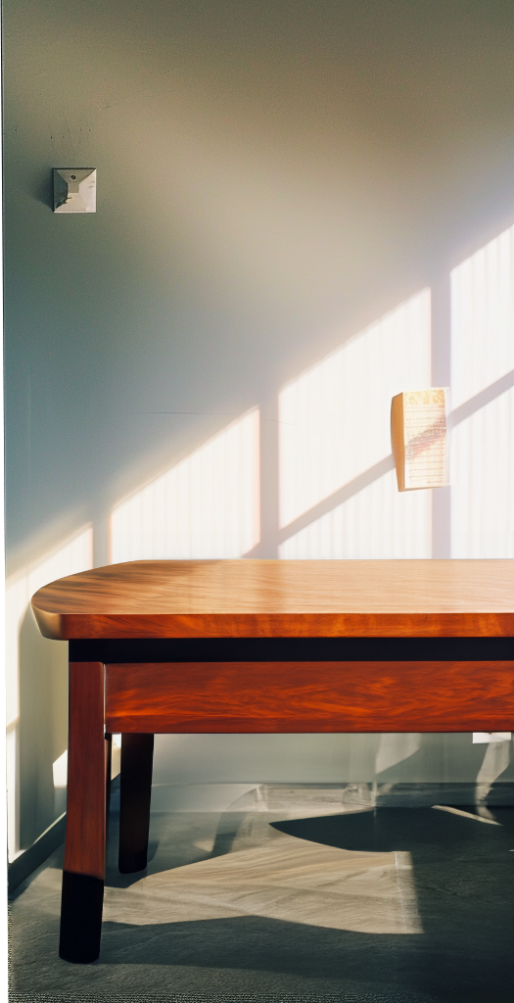
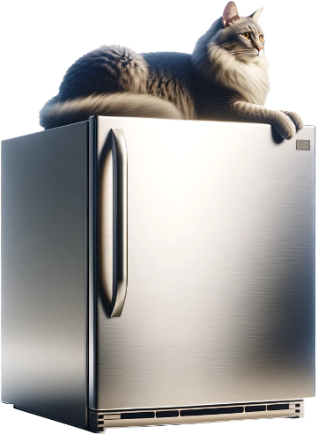
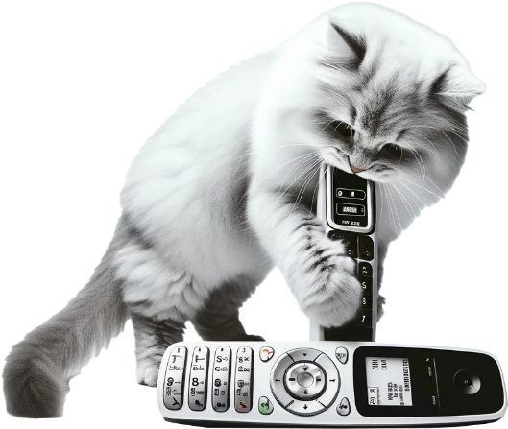
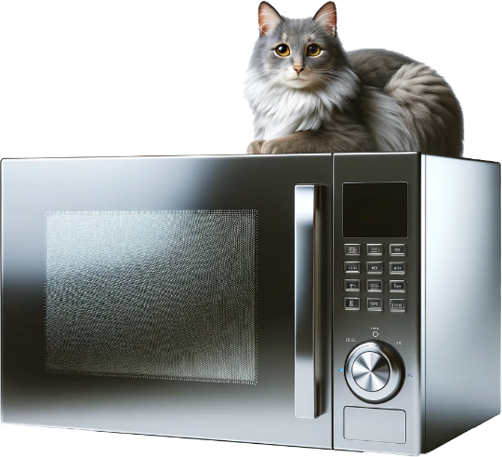
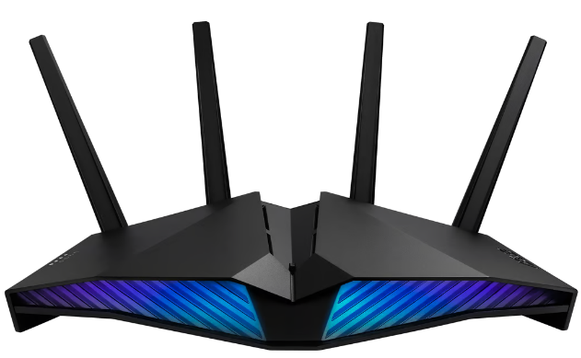
Positioning the Access Point
Central to where it is needed if possible
Keep out of direct sunlight
Keep away from devices that may cause interference
Refrigerators
Bluetooth devices
Fluorescent lights
Industrial equipment
Cordless phones
Microwave ovens
ITFreeTraining.com
© Copyright 2025
Notes:
03:03 When positioning the Wi-Fi access point, it is recommended to keep it central where possible. Sometimes in the real world this is not always possible. In the case of this example, the networking for the house enters from the side. There is no networking in the center of the house. I could run a cable, but this would not be an aesthetically pleasing solution. For this reason, it was decided to install an extender on the other side of the house where there is a network point. Sometimes, you just have to work around what you have.
The next thing to consider is keeping the Wi-Fi access point out of direct sunlight. Sunlight can cause increased heating, material degradation, and reduce the Wi-Fi’s lifespan. Also, keep the Wi-Fi access point away from sources that can cause interference. There is no official distance on how far you should keep a Wi-Fi router away from a device causing interference, because it changes depending on how strong the signal is coming from the device. As a rule of thumb, 3 to 6 feet or 1 to 2 meters is generally a good distance.
Devices that can cause interference include refrigerators, Bluetooth devices, fluorescent lights, industrial equipment, cordless phones and microwave ovens. It can be a challenge to work out where to put the access point; there may not be a perfect spot, so just find the best spot you can.

Slide 5
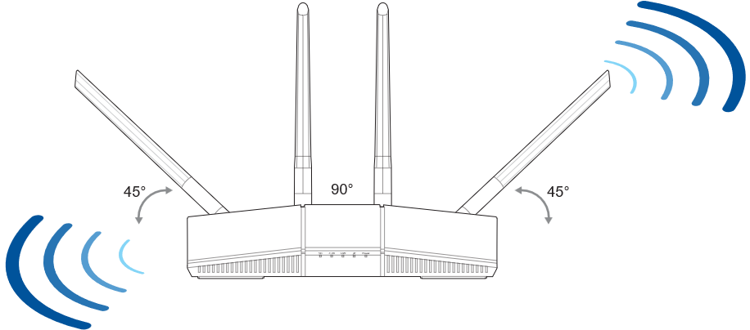
Antenna Orientation
May need to do some trial and error
Manufacturer’s recommendation
ITFreeTraining.com
© Copyright 2025
Notes:
04:30 For my existing Wi-Fi router, I am going to change the antenna orientation to use the manufacturer’s recommendation from the manual. Once installed, if I am not getting the result that I want, I may need to do some trial and error to work out the right orientation for the antennas. Since I did set my antennas positions when there was no Wi-Fi extender on the network, I am going back to the defaults and make changes as required.
If you have a small area you want to provide Wi-Fi to, this setup will probably work well. If you have multiple levels, you may want to face one of the antennas more toward the horizontal to provide signal to the level above or below. In a very wide, single level building, you would want to configure the antennas so they are facing more vertically. In a later video, I will look at how to do a Wi-Fi Site Survey which will help you work out how well your Wi-Fi network is working and if any changes need to be made.
If you don’t know the IP address of your existing Wi-Fi router, you can connect a computer to the network to get an IP address on that network and you can run the command IPConfig. This will give the network configuration of the network card. In particular, I want the default gateway. The default gateway will be the IP address of my Wi-Fi router.
I will now enter in the IP address for my router in my browser. This will load the login screen, and once there, I will log in to the router.
The only thing that I need to do is make sure that the firmware is updated, which it is. I have already configured the SSID on this router to TrainingWiFi. You should always change the default SSID for your Wi-Fi router. If the SSID remains on the default setting, it may identify what type of Wi-Fi router you are using. An attacker will then know what hardware you are using and thus can do a targeted attack on your router.
Since everything is done here, I will now have a look at what needs to be done on the extender I am adding to the network.
The extender is brand new and still in the box. To use it, I will first remove it from the box. The next thing to do is configure it.
To configure it, it needs my Wi-Fi router to provide the configuration. This process can be done using the physical network cable or Wi-Fi. If you are planning to use Wi-Fi for the initial configuration, it is recommended to plug it in close to the Wi-Fi router, but not that close. As we will see, having it this close will cause interference, thereby reducing the signal strength. Try keeping the devices at least 3 to 5 feet or approximately 1 to 1.5 meters away from each other. Once the Wi-Fi extender is configured, you can move it to where it needs to be.
Configuring the extender needs to be done in the admin interface of my Wi-Fi router. To configure, I will select the option ”AiMesh”. From here, I need to select the option “Add AiMesh Node”. This will start the process of adding the extender to my network – it may take a bit of time to find the extender.
Once the Wi-Fi extender appears, I next need to select it. Once selected, I will press “Connect” and the initial setup process will start. This process takes a few minutes to complete, so I will pause the video and return shortly.
Now that the initial configuration has completed, I will press the “Finished” button. Depending on the Mesh solution that you are using, you can add additional Wi-Fi extenders if you have them.
The extender has been added, so I can now select it and manage it from this interface. You will notice that the signal quality is weak. Thus, you can see why it is not a good idea to put them this close together as it affects the signal quality.
Now that the extender has been set up, I will plug it in where I need to use it. First, I will plug in the network cable, which can be used by the extender to transfer data. More on that in a moment. I will next plug the extender into power. That is all you need to do. If you need to move it, unplug it and plug it in where you need to use it.
I will now go back to the interface of my Wi-Fi router. I will select “AiMesh”. You will notice my Wi-Fi extender has been detected.
The Wi-Fi extender is now paired with the Wi-Fi router and needs to be managed here. To manage it, all I need to do is click on it. If I attempt to access the web interface for the extender, I would be automatically redirected to the Wi-Fi interface page.
You will also notice that the signal quality now is great. So, if you are having problems with your Wi-Fi signal, in some cases it may be a matter of moving your extender to a different location, as there are a lot of factors that can affect a Wi-Fi signal.
I will now select the “Network” tab, as I want to have a look at the network configuration for the extender. At the top, is the uplink type. This is the management link between this device and the Wi-Fi router and also the interface IP address. However, if you go to this IP address, you will be redirected to the Wi-Fi router interface.
Below this is the Backhaul information. Backhaul is the data connection from the extender to the Wi-Fi router. This is currently using Wi-Fi which may be confusing because the first question you may ask is, why is the physical network cable being used? More on that in a moment.
Below this is the Fronthaul configuration. At the top is Ethernet which may seem strange at first. Essentially, Fronthaul are devices which are communicating directly with the extender. So, you may have the extender plugged into a switch or directly into a device, but these devices are isolated from the main router. Think of it like a bridge – it allows your devices to connect to the internet wirelessly without needing a cable running all the way back to the main router. So, the extender acts as a middleman, bringing the internet connection to your devices using a wireless connection to the main router rather than using a physical cable.
Below this are the two wireless bands. Devices can connect directly to these and, if required, data is sent through the Backhaul to the Wi-Fi router. I will now scroll up and select “Management”.
You will notice that option for “Backhaul Connection Priority”. This option allows you to configure the extender to use wireless first or WAN first. If you are running a network monitor, you may want to define where the traffic goes to, or if you have other reasons to manually set it. If you leave it on auto, the extender will automatically monitor the traffic and change as required. When it comes to wireless, I recommend leaving the options on automatic when you can. That way, if wireless networks change, which they often do, the device will automatically change as required.
At the top, notice that there is an update for the firmware. It is recommended when using Mesh to update your firmware as it helps to ensure the devices in the Mesh are communicating effectively. If the firmware is not up to date, there is more risk of communication problems and errors between devices.
I will select the firmware option to go to the firmware screen and press the “Check” button to check online for new firmware. You will notice that there are two different firmware’s listed. One is for the extender and one for the Wi-Fi router. Since both are linked together using AiMesh, both can be managed through the one interface.
The first is for the Wi-Fi router. The second firmware is used with the extender. I will now select the option “Firmware Upgrade” which will download and update both firmware’s. It is recommended to update both, as mismatched firmware can cause problems.
While the firmware is updating, let’s have a closer look at what has been set up.

Slide 6
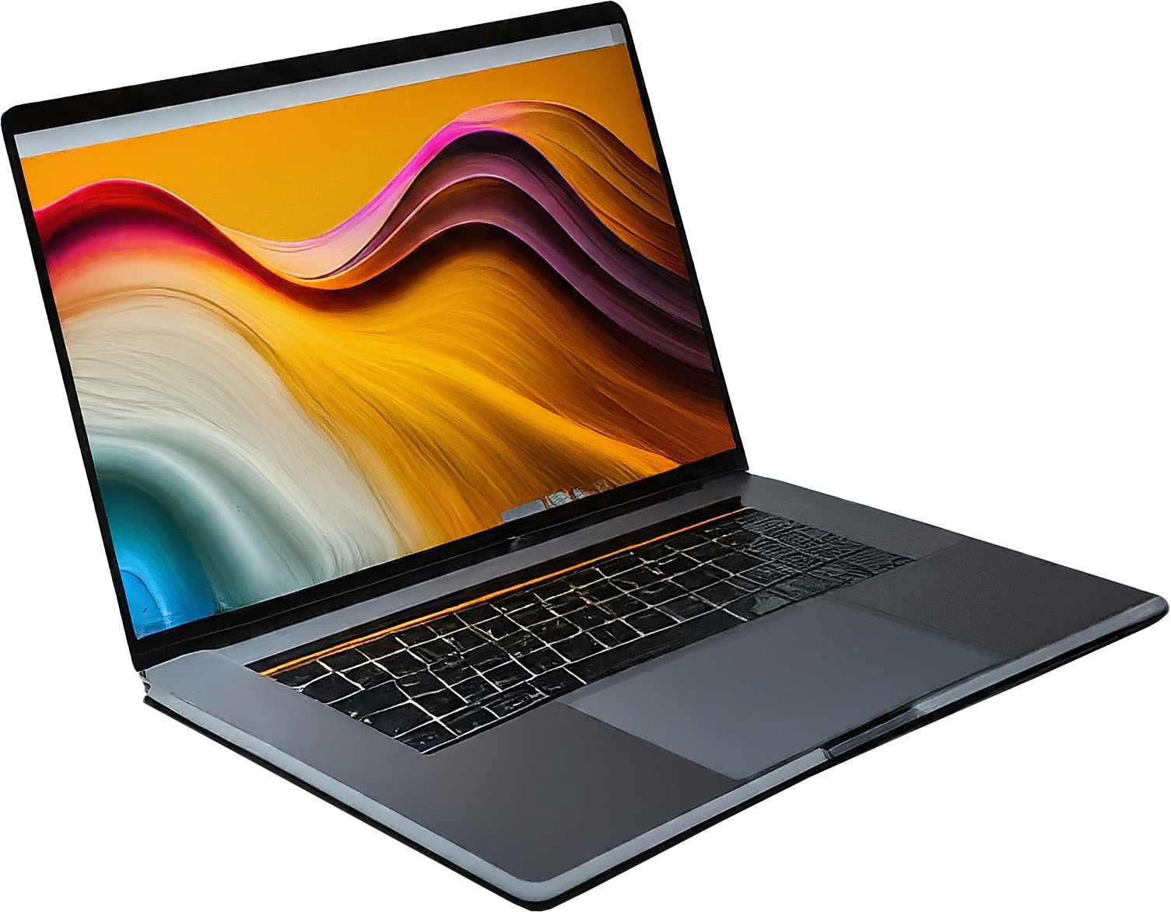
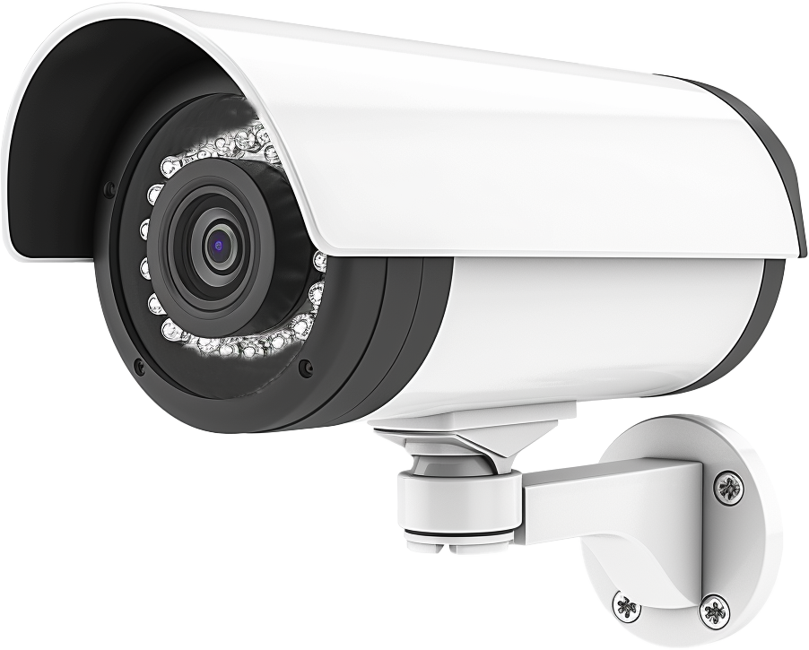
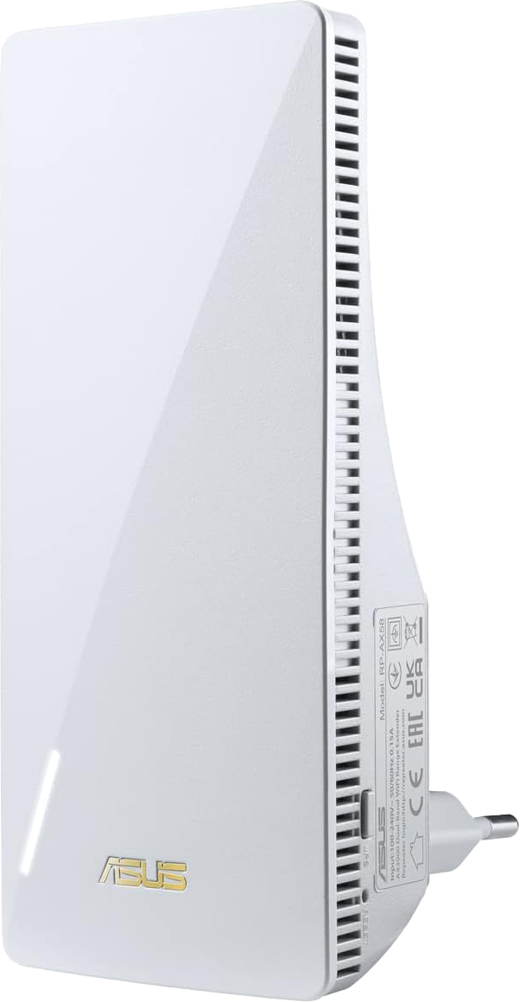
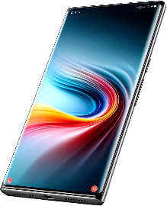
Demonstration Wi-Fi Setup
Internet
Fronthaul
Wi-Fi
Backhaul connection
Fronthaul
Wi-Fi or cable
cable
ITFreeTraining.com
© Copyright 2025
Notes:
13:02 On this network is the existing Wi-Fi router. A Wi-Fi extender has been added. This will provide Wi-Fi to other areas that may have no Wi-Fi or poor Wi-Fi. In order to connect the two, a Backhaul connection is used. This can use a physical network connection or a Wi-Fi connection. If the connection is set to auto, the Backhaul can change depending on changing network conditions.
The connections that connect to Wi-Fi devices are called Fronthaul. Fronthaul uses Wi-Fi, since the main reason to purchase an extender is for Wi-Fi support. Fronthaul can also support a physical cable. Devices can use this to send traffic to the extender rather than via the Wi-Fi router. For example, if a device needs to connect to a wireless device, it may be more direct to go via the extender rather than the Wi-Fi router.
The other use for the Fronthaul cable is to connect to devices that do not have Wi-Fi. For example, if you have a TV set that does not have Wi-Fi, you could plug it into the extender.
The benefit of having a Mesh system is that if a device starts moving and gets to a point where a different device in the Mesh can provide a better Wi-Fi signal, it will automatically switch to that device.
I will now go back to my Wi-Fi router. The firmware update has been completed, so I will login. Once I have logged in, I will select “AiMesh”. The extender has only just started up. You will notice the link between the two Wi-Fi devices is yellow indicating the link is weak. When Wi-Fi devices are configured to automatic settings, they will attempt to make changes to improve the connection. This may mean using different channels or changing bands. Notice that there are four devices (or clients) currently connected to the extender. There are currently zero devices connected to the Wi-Fi router.
I will now go up and select “Network Map” and then select “AiMesh” to refresh it. You will notice that the link between the two devices is now green indicating a strong connection. Also, notice that each device has two clients connected to it. In this short period of time, the devices have changed access points in order to get a stronger connection. Since the area is quite small, if you watch long enough, it may change again. Mesh works a lot better than using the same SSID on multiple access points. When a device connects to an access point without Mesh, it can be very stubborn to change it.

Slide 7
Subscribe
Next video
Video content: https://ITFreeTraining.com/ap11/4d17
© Copyright 2025
Notes:
15:51 That concludes this video. Check out our other videos for the A+ exam. The videos will help you prepare for the exam. Until the next video, I would like to thank you for watching.
References
“The Official CompTIA A+ Core Study Guide (Exam 220-1101)” pages 150 to 151
“Mike Myers All in One A+ Certification Exam Guide 220-1101 & 220-1102” pages 854 to 853
“Picture: Wi-Fi logo” https://commons.wikimedia.org/wiki/File:WiFi_Logo.svg
“Picture: Wi-Fi symbol” https://commons.wikimedia.org/wiki/File:WIFI_icon.svg
Credits
Trainer: Austin Mason http://ITFreeTraining.com
Voice Talent: HP Lewis http://hplewis.com
Quality Assurance: Brett Batson http://www.pbb-proofreading.uk

