Slide 1
Notes:
Let’s look at how to install a router and configure wireless.

Slide 2
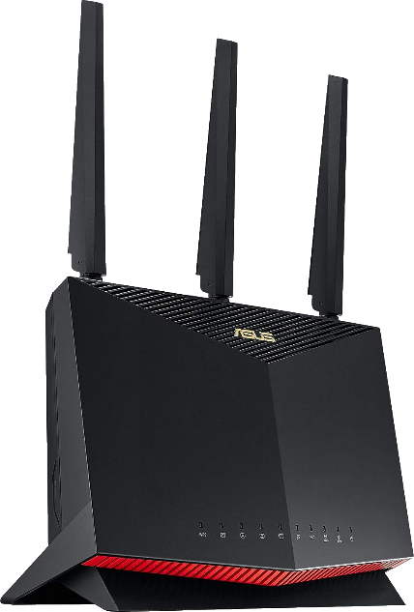
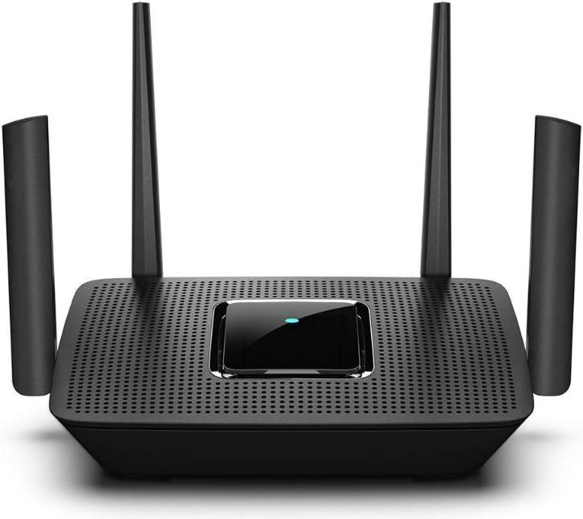
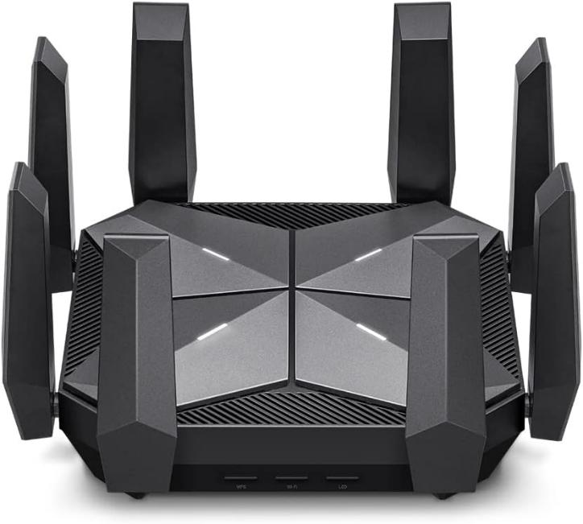
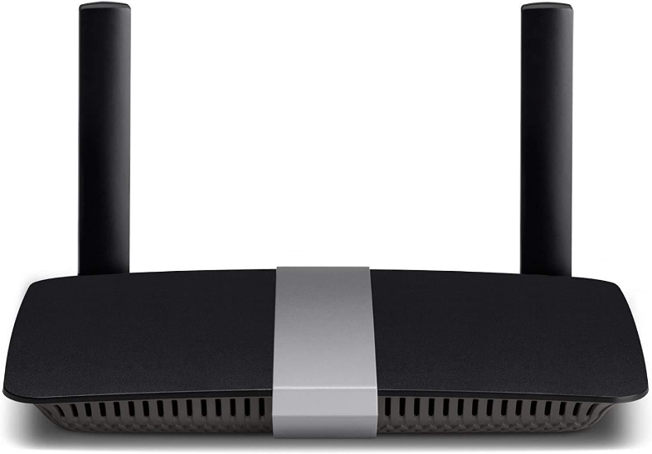
Frequency Band Class
Frequency Band Class
How many different bands can be used at the same time?
Extra antennas does not mean extra bands can be transmitted at the same time
Wi-Fi 6e adds 6 GHz frequency band
Single
Dual
Tri
Quad
2.4 GHz
2.4 GHz
2.4 GHz
2.4 GHz
5 GHz
5 GHz (x2)
5 GHz (x2)
6 GHz
ITFreeTraining.com
© Copyright 2025
Notes:
00:05 Before you install wireless, you first need to purchase a wireless device. Nowadays, most home routers include wireless. When you purchase a Wi-Fi router, the Wi-Fi router will support a number of different bands. This is how many different frequency bands can be used at the same time. In the case of a single-band Wi-Fi router, it will support the 2.4 GHz band only.
In this example, we are looking at a single-band Wi-Fi router equipped with two antennas. It is important to clarify that having additional antennas does not equate to the capability to transmit on multiple bands. This particular router operates on a single frequency band; however, the dual antennas serve specific and distinct purposes to enhance performance. One antenna may be dedicated to transmitting data to your devices, while the other focuses on receiving data from them. Alternatively, both antennas can be employed for a technique known as beamforming. Beamforming is a smart signal processing feature that directs the Wi-Fi signal directly toward your devices by using tricks like constructive interference, instead of dispersing it indiscriminately in all directions. This targeted approach helps in strengthening the signal reception of your devices, improving the overall network efficiency and performance. Usually, the more onexpensive routers will support beamforming.
A dual-band Wi-Fi router will transmit on frequencies 2.4 GHz and 5 GHz at the same time. Being able to operate on two different frequency bands at the same time improves the performance of the router.
A tri-band Wi-Fi router, if you have not guessed it already, allows transmission of three different frequencies at the same time, these generally being one 2.4 GHz channel and two 5 GHz channels. The frequency bands are broken into smaller channels. A tri-band Wi-Fi router is able to transmit on two 5 GHz channels at the same time.
It is important to point out here that Wi-Fi 6e adds a 6 GHz frequency band. This is an extension to the original Wi-Fi 6 standard. Thus, it is possible to have a tri-band Wi-Fi router that supports each frequency. For these routers, essentially, one of the 5 GHz signals is changed to 6 GHz. Thus, three frequency bandwidths are being used at once.
Quad-band Wi-Fi routers transmit on four frequencies at the same time, these being one 2.4 GHz, two 5 GHz and one 6 GHz. Nowadays, you can get a dual-band Wi-Fi router pretty cheaply. So, whenever possible, I would start with this. If your budget allows, you may want to consider a tri- or quad-band Wi-Fi router. However, these Wi-Fi routers can get pretty expensive, especially the quad-band ones.

Slide 3
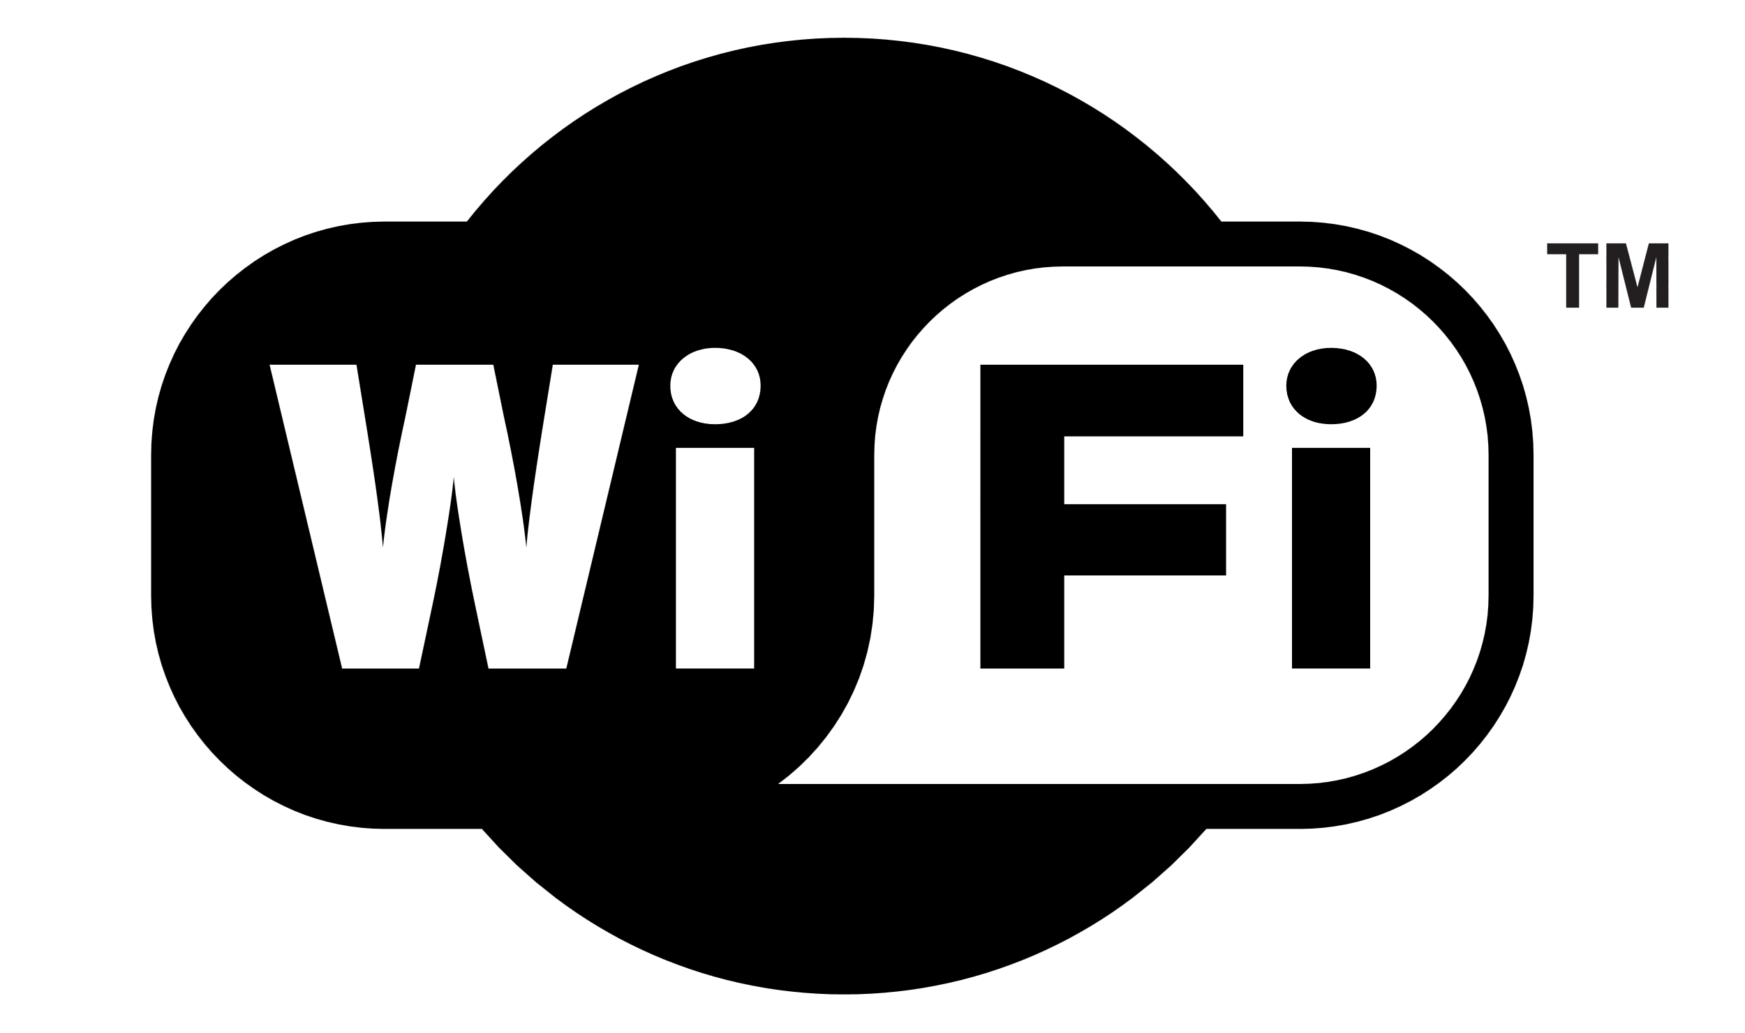
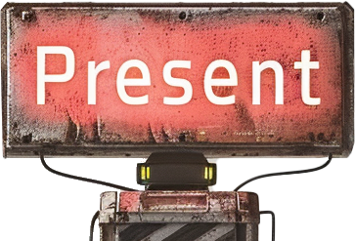
Wi-Fi Generations
Device will support a particular Wi-Fi generation
Device are generally backward compatible
ITFreeTraining.com
© Copyright 2025
Notes:
03:04 The Wi-Fi router that you purchase will support a particular Wi-Fi generation. There are currently seven different standards; however, three are commonly found in the market.
Wi-Fi 5 was released in 2019. The present market is mostly Wi-Fi 6. Whenever possible, I would go for at least Wi-Fi 6. Wi-Fi 7 is the future but has only started being used in devices in 2024. So, you won’t find too many devices that use it and most likely they will be expensive.
Devices will generally be backward compatible. It should be rare to find a device that does not support older generations. The wireless router and the device should communicate with each other and agree on a generation of Wi-Fi to use.

Slide 4
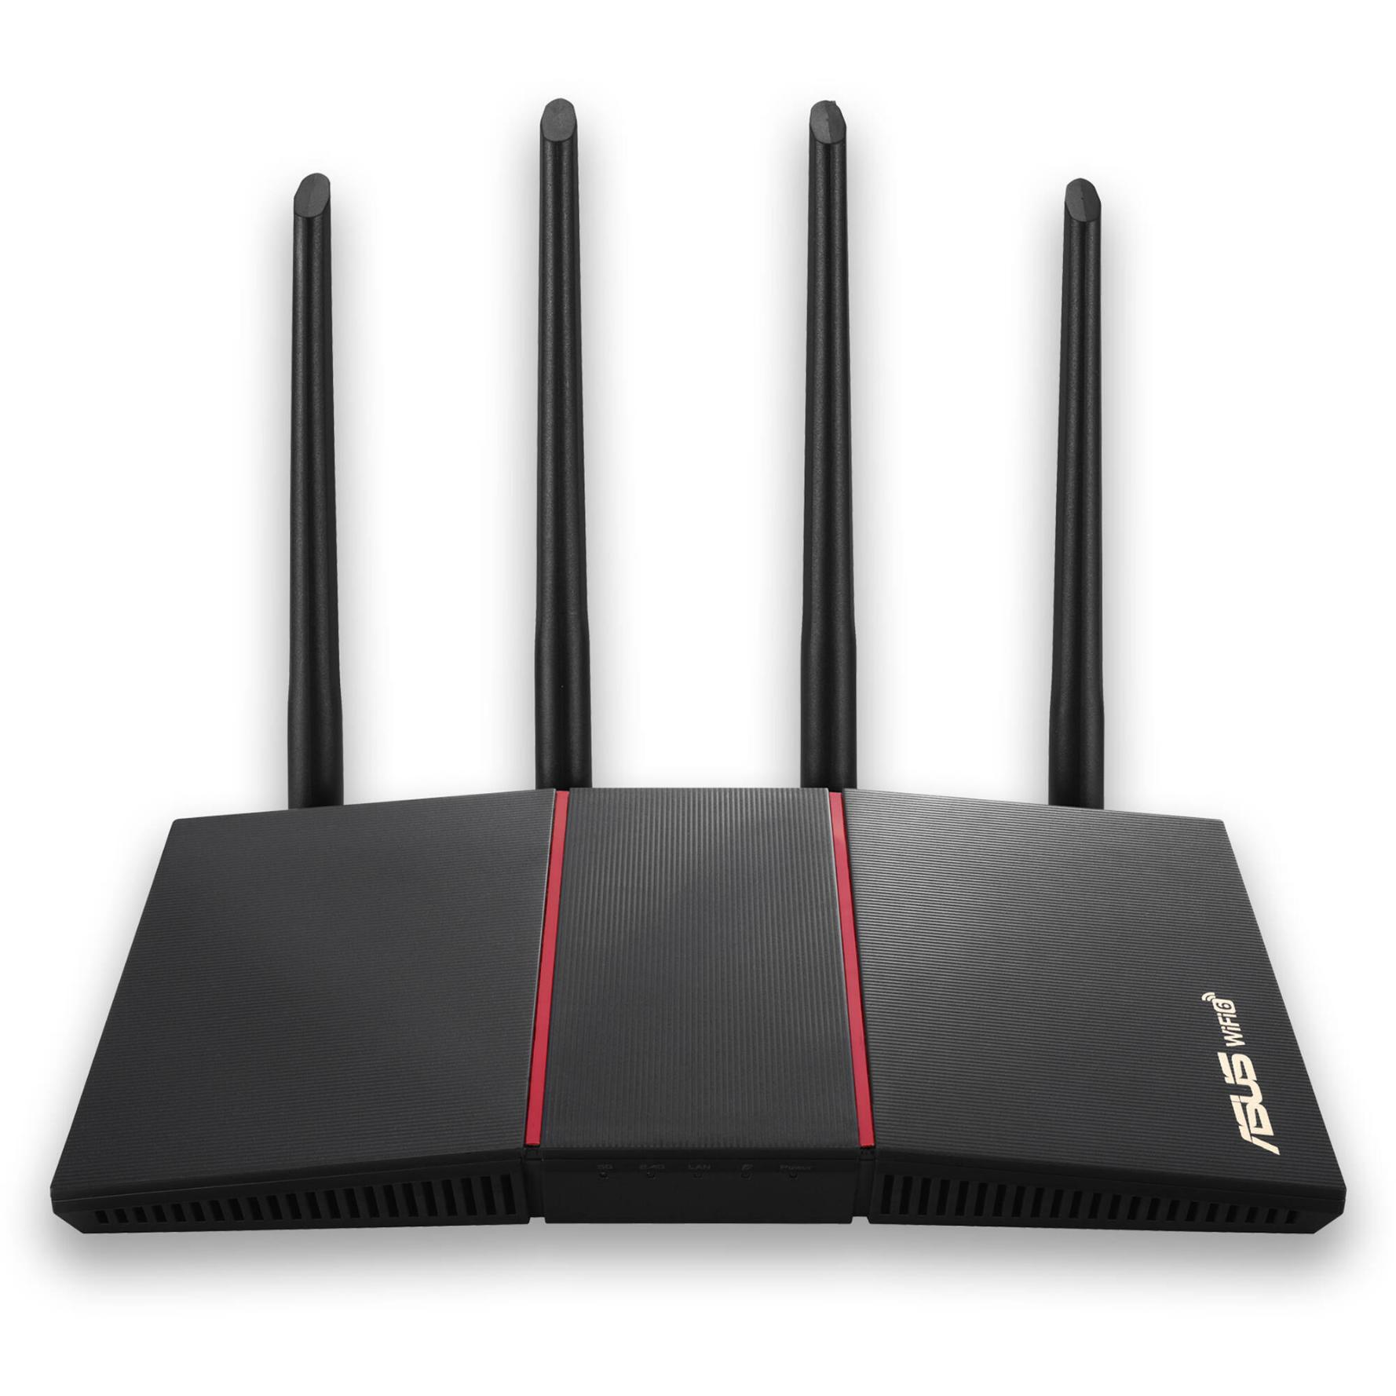
Demonstration of Wi-Fi Router Install
ASUS RT-AX55
ITFreeTraining.com
© Copyright 2025
Notes:
03:51 For this demonstration, I will set up a Wi-Fi router to access the internet and configure the Wi-Fi on the router.
To start setting up the Wi-Fi router, I will first plug in the WAN cable. This cable goes to the termination box for my telecommunication company. In this case it is fiber optic and thus uses a standard ethernet cable. The type of network service you are using will determine which cables you need to use, and you will need a router that supports that connection type.
I will next plug in the network cable. This cable runs to another room containing a switch to which I connect my devices. Most home routers, nowadays, have multiple ports so you can connect multiple devices to the router if you need to. The next step is to start configuring it.
To do this, I will need to go to the web admin tool for the Wi-Fi router. To work out how to access the Wi-Fi router, you can have a look for the Wi-Fi admin IP address in the manual. In the case of this Wi-Fi router, you need to go to a URL address. Essentially, the router will resolve this DNS name to the IP address for the router. Some routers will have an IP address that you need to access, others will have a DNS name as this one does.
Another way to work out the IP address of the Wi-Fi router is to run the command “IP Config”. When you have a computer set to automatically obtain an IP address, the gateway address will be the IP address of the web admin interface.
When performing the initial setup of a Wi-Fi router or any network device, it is recommended to connect the device directly to a computer using an ethernet cable for the initial configuration. Although you could connect it directly to your network, using a direct connection to a computer like this can help avoid potential issues such as IP address conflicts.
The computer should be configured to automatically obtain an IP address unless the documentation says to configure a static one. Once the initial configuration is completed, you can add the Wi-Fi router to your network. If the Wi-Fi router is being added to a home network and there are no other devices that may cause conflicts, you can now add it directly to your network to configure it.
In the case of this Wi-Fi router, it can be accessed using the DNS name. Thus, the router is performing DNS services and resolving the DNS address back to the router. If you have other devices on the network that perform DNS services, this can prevent the process from working correctly, thus it is recommended to isolate the Wi-Fi router from the network during initial configuration.
I will now go to the DNS name in the documentation. If this does not work or is not available, use the gateway IP address. You will notice, this will take me to the initial default configuration screen, since this Wi-Fi router has not been configured yet.
I will select the link to start configuring it. I will get an error message that the connection is not private. Since the connection uses certificates, they need to be verified. However, since I do not currently have access to the internet to perform this verification, an error will be displayed that the connection is not private. So, in this case, this error is expected and can be ignored. Thus, to ignore the error, I will press “Yes”, then press the option “Advanced” and then select the option to proceed.
Once done, I will be taken to the initial configuration screen for the Wi-Fi router. Different devices will have different initial configuration screens. In some cases, there will not be an initial configuration screen and you will be taken to the web interface. When this is the case, you will need to look in the documentation for the default username and password for the device in order to access it.
From the web interface, I will select the option “Create A New Network”. In the case of this Wi-Fi router, it will attempt to detect the connection, however, it won’t be able to detect what type of connection that it is using.
My Wi-Fi router is connected to the internet using PPPoE so I will select it. This stands for Point-to-Point Protocol over Ethernet. This protocol allows ethernet data to be encapsulated over an internet connection like DSL or fiber optic. This is the most commonly used option, but some ISPs use different settings so you should check with your ISP to determine which setting you should use.
I will next enter in the username and password. This will be provided by your ISP. Once entered, I will press “Next”. I will now be asked to enter in an SSID name and password for Wi-Fi. SSID stands for Service Set Identifier. Essentially, this is up to 32 characters in length, it identifies the device and allows devices to connect to it. The SSID by default is broadcasted, so your devices can find the Wi-Fi router.
On some Wi-Fi routers, a default SSID will be provided which you can change. In this example there are two SSIDs displayed. One identifies the manufacturer and the other identifies the manufacturer and model of the Wi-Fi router. It is not recommended to use SSIDs like these. If your Wi-Fi router defaults to names like these, I would change it to something else that does not identify details about the device. If an attacker is able to identify what network equipment you are using, it makes it easier for them to exploit vulnerabilities for that network device.
Also, avoid SSIDs that include identification information such as a physical address. This will help an attacker locate the Wi-Fi device. If, however, it is a public Wi-Fi point for a business, you will most likely use an SSID which includes the name of the business, to make it easier for your users to connect to the Wi-Fi point.
This router has the option “Separate 2.4 GHz and 5 GHz”. This creates separate Wi-Fi networks for 2.4 GHz and 5 GHz bands, thereby allowing devices to choose which frequency they connect to rather than the router deciding. Separating the networks creates two SSIDs and potentially different passwords to manage, which can be confusing. If you need to configure specific devices to connect to particular frequencies, separation can be helpful. Otherwise, leave it unticked and your router will automatically connect devices to the best band for optimal performance.
I will leave the option unticked and press “Apply”. On the next screen, I will enter in a username to manage the router. In this example, I will enter Router1. When possible, you should not use default or common usernames like Admin, as they are easy for an attacker to guess. On large corporate networks, you may want to use the same username on all your network devices to make it easier. For example, just adding letters like ITAdmin makes it harder for an attacker. An attacker will, most likely, try the default or commonly used usernames.
While changing the default username can offer an additional layer of security, it's not as crucial as having a strong password for your network device. A robust password is the primary defense against unauthorized access, regardless of the username.
However, if you are concerned about forgetting the username, keeping the default one is understandable. Just remember to prioritize creating a strong, complex password that you can remember. This combination will significantly improve the security of your network device.
Once I press “Next”, the initial configuration is completed. You will notice that the internet status is listed as disconnected. There is some additional configuration required by my ISP in order to get the connection working. I will next have a look at how to troubleshoot problems like these when they occur.
To get an idea of what is happening, I will go down to the section “System Log”. The system log will provide some information about what the Wi-Fi router is doing and where the problem may be. I will have a good look through the log file, but for the A+ exam you do not need to know too much about log files. You may get a simple log file, for example an access log, but nothing as complicated as this one. I will look through the system log to help you understand what you should look for in order to troubleshoot a problem like this one.
The system log is reporting an issue obtaining a public IP address. These technical logs can be challenging to interpret, even for those familiar with networking. Typically, the router will automatically attempt to reconnect at regular intervals. Thus, notice the same error appears later down in the log.
When trying to troubleshoot this type of problem, look for the repeating messages so you can narrow down what the problem may be. Here, it appears these messages are logged each time the router attempts to reconnect.
It can be hard to understand what these messages mean. But there are certain ones that can give you an idea of what is occurring. In this case, notice there are no messages relating to usernames or passwords. There, however, is a message in relation to PPPoE discovery. Thus, it tends to suggest the problem is a very low-level hardware error. If there was a problem with the username and password, you would see messages in the log that at least it was trying the username and password.
To get a better understanding of what to look for, here is a working log file. Notice, there are a lot more log entries that were not in the other log file. It can be hard to understand what is going on, but look for key words like connections established, authentication succeeded, and IP address being allocated. When troubleshooting a problem like this, break it down to its core components.
In this example, the connection can be broken down into three steps. Your device will most likely log different information and the amount of information it logs can be very different between devices. First, a hardware connection is made between my router and the ISP’s equipment. The next step is that a protocol connection is made. In this example, this allows data to be transferred over the connection. The final step is authentication. Once the ISP has authenticated the router, it will allow configuration to be performed, such as an IP address, DNS servers, and for the connection to transfer data.
In this example, it appears the initial hardware connection is failing. I have checked all my cables and they all appear to be on. I have also checked my connection box. It has power and the optical cable is working. There are no activity lights and no alarms, so it appears the fiber connection is working, but no data is being transferred over it.
I will now go to the WAN section, as I want to check the settings there to make sure everything is working correctly. The settings appear to be set correctly. Even though we did not get a username and password error, I would check that the username and password are correct. Some routers report more information in the system logs than others. The system log may not explicitly indicate an invalid username or password, or the log entry might be cryptic and thus difficult to understand what it is referring to.
Most of the settings should be left on the defaults. You should check with your ISP to see if there are any special settings for your connection. Sometimes they will require additional settings. If the ISP provides the router, they will most likely have a guide to explain how to configure it. For other routers, there may or may not be a guide, since there are a lot of routers out there and it is not possible to create a guide for all of them. Thus, if you are going to use your own router or purchase a router, make sure your ISP supports it; otherwise, you run the risk it will not work.
My ISP has informed me that additional configuration is required. In this case, the VLAN ID needs to be set to two, as the traffic is separated using VLAN IDs because the ISP uses the same lines to run internet, phones, and internet TV. The VLANs separate the different services from each other. In this case, if the VLAN ID is not configured, the service will not work at the low-level hardware level. This explains why the log file does not have connection related messages like incorrect username and password.
To configure the VLAN ID on this router, it is in a difficult place to find and not well documented in the manual. Hopefully if you have a setting like this, it will be easier for you to find. To configure the setting, I need to select “LAN”.
In the LAN section, I need to select “IPTV”. Sometimes to find settings like these, you really need to hunt around. From selecting ISP profile, I need to select “Manual Setting”. Once selected, I need to enter “2” for VID. VID stands for VLAN ID. So now that the VLAN ID has been configured, I will press “Apply”, the settings will be updated, and the router will reboot.
Once the router has rebooted and I have logged back in. You will notice that the internet is now connected. Hopefully when you set up your router, it will go smoothly.
When I first set up a router, I check the firmware is up to date. In this case, if I click the firmware version at the top of the screen, I will be taken into the firmware update screen. To check the firmware, I will press the button “Check”.
The router will attempt to see if there is a newer version available. If the router is not connected to the internet, you can manually download the update from the manufacturer’s website. In this case, a newer firmware has been found, so I will press the button “Firmware Upgrade” to update it. It takes a few minutes for the firmware to be updated, so I will return once it is done.
The firmware update has completed, and I have logged back into the router. I will now select “Wireless” on the left-hand side to configure the wireless settings. At the top, there is a drop down for “Smart Connect”. Smart connect will automatically connect devices to 2.4 GHz or to 5 GHz as required. This also means the settings for both are combined in the one screen. When I switch off Smart Connect, notice that I can now select which frequency I want to configure.
I will now select 5 GHz and the router will display the settings for this. There are two different settings, one for 2.4 GHz and the other for 5 GHz. I will re-enable Smart Connect so there is only one set of settings. I prefer to do it this way and let the router manage everything for me. However, on your network, you may want more control by dividing the networks into two.
Below this is the option “Hide SSID”. If this is enabled, the SSID for the Wi-Fi will not be broadcast. In order for a device to connect to the Wi-Fi, it will now need to know the SSID name which will have to be manually entered. Hiding the SSID is not considered to provide great security as, using the right tools, a hidden SSID can still be detected.
Below this, you have the option to disable Wi-Fi 6. If you have old devices on your network, they may have problems with this version. If this is the case, you can disable it, but this does mean your newer devices will not be able to use it.
Further down you have the option for authentication method. Nowadays, it is recommended to use WPA and at least version 2. WPA version 1, otherwise known as WPA1, has good security but has known vulnerabilities and is not recommended. WPA2 has better security and thus is the recommended version to use.
WPA3 offers even better security, and was released in 2018, but was a little slow to take off. Thus, not all the devices on the market support it.
There are two different versions. The personal version requires a password to be configured that the device will need to know in order to connect. Enterprise means that another service performs the authentication. Thus, a device needs to send a username and password to access the Wi-Fi point. When Enterprise is used, the username and password is sent to another system for authentication.
In this case, I will select “WPA2/WPA3 Personal”. This will use either WPA2 for legacy devices and WPA3 for newer devices. Since it is using personal, the device will only need to know the password. If you are experiencing problems, I would switch to WPA2.
Even though the two bands have been combined, some settings are specific to one band. For the 2.4 GHz band, there is a channel bandwidth. This is the width of the radio spectrum that is used to transmit and receive: 20 MHz is the equivalent of one channel. Being smaller in bandwidth means less potential for interference from other networks, but less data can be transmitted. 40 MHz is effectively two channels, allowing more data to be transmitted, but there is more chance of interference. The default options allow the router to choose either option as required. Thus, I will leave it on this option and allow the router to manage it.
Below this is the channel that is being used. Wireless has multiple channels, which allows nearby Wi-Fi access points to use different channels to avoid interference. Currently this is set to auto, and to the right, you can see the current channel being used is 9.
If you wish, you can manually configure the channel to get the best results. However, if the Wi-Fi network changes around you, for example someone adds a Wi-Fi network near yours, this network may interfere with your network, causing it to run slower. I usually leave this setting on auto, so if this happens, the router will automatically change channels as required.
Below 2.4 GHz are the same kind of options for 5 GHz. As before, you can change the bandwidth and there are three different options to choose from. Multiple channels can be combined into a large channel. The same principles apply, large bandwidth means more chance of interference, while small bandwidth means less data can be transferred. As before, I will leave this on the default option where the router will choose the bandwidth setting.
Below this are the channel numbers. The numbers are different, but they act the same way. To the right you can see the current channel is 40. I will leave this on auto, so the channel can be changed by the router as required.
I will now go up and switch Smart Connect off again which will divide the 2.4 GHz and 5 GHz up into two separate networks rather than managing them together.
Once the settings have been applied, I will go back to the main screen. Notice, on the right-hand side the networks have been divided into two. Each network can be configured with different SSIDs and different security settings.
You can see there are a lot of different settings, but in my opinion, start with the automatic ones. Unless you are having problems or have special network needs, I would not change any of them.

Slide 5
Subscribe
Next video
Video content: https://ITFreeTraining.com/ap11/4d15
© Copyright 2025
Notes:
24:11 That concludes this video. In the next video I will look at using Mesh to extend your Wi-Fi network. I hope to see you in that video. Until then, thanks for watching.
References
“The Official CompTIA A+ Core Study Guide (Exam 220-1101)” pages 150 to 151
“Mike Myers All in One A+ Certification Exam Guide 220-1101 & 220-1102” pages 854 to 853
“Picture: Wi-Fi logo” https://commons.wikimedia.org/wiki/File:WiFi_Logo.svg
“Picture: Wi-Fi symbol” https://commons.wikimedia.org/wiki/File:WIFI_icon.svg
Credits
Trainer: Austin Mason http://ITFreeTraining.com
Voice Talent: HP Lewis http://hplewis.com
Quality Assurance: Brett Batson http://www.pbb-proofreading.uk

