Slide 1
Notes:
Let’s look at coaxial cable.

Slide 2
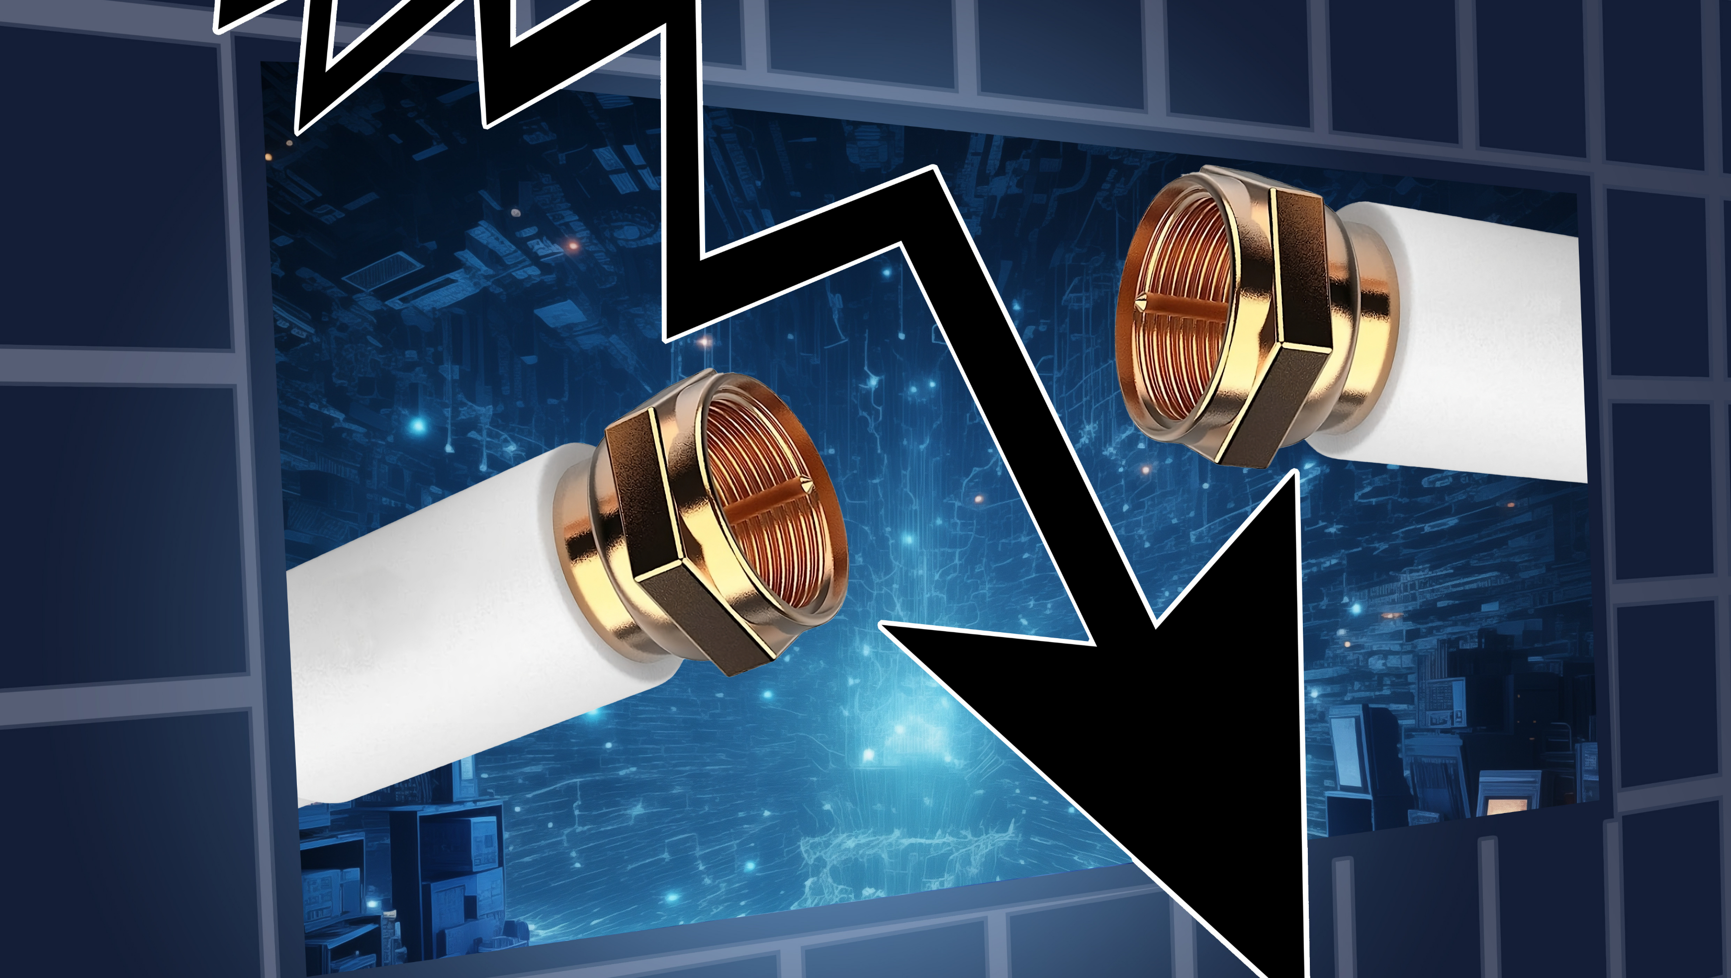
Current State of Coaxial Cable
In 2020 coaxial cable was used by 30% of broadband households in US
Expect to decline to 20% by 2025
ITFreeTraining.com
© Copyright 2024
Notes:
00:04 Coaxial cable in the old days was used for Ethernet but has largely been superseded by twisted pair cable; however, coaxial cable remains in use for cable modem and satellite connections. In 2020 coaxial cable was estimated to be used in 30% of broadband installations in the US. It is expected to decline to 20% by 2025 as other technology is slowly replacing it. While its use is declining, you may still encounter coaxial cable in some installations.

Slide 3
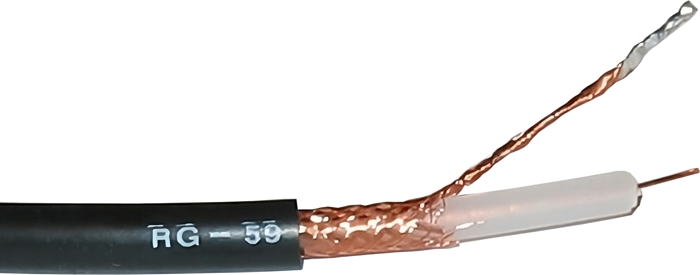
What is Coaxial Cable?
Cable with central conductor/insulating layer/metal shield
Outer plastic sheath
Copper core
Woven copper shield
Inner dielectric insulator
ITFreeTraining.com
© Copyright 2024
Notes:
00:36 Coaxial cables transmit high-frequency electrical signals with minimal signal loss. However, their ability to carry large amounts of data diminishes with increasing distance, due to various factors.
The coaxial cable itself is made of an outer plastic sheath to protect the cable, making it quite strong and resistant to damage. Under the plastic sheath is a woven copper shield. This copper shield helps protect the cable from electromagnetic interference and is also used as a ground.
Under the shield is an inner dielectric insulator. This is a non-conductive material that separates the inside and outside of the cable. The inside of the cable consists of a copper core. This copper core is what transmits the data through the cable.

Slide 4
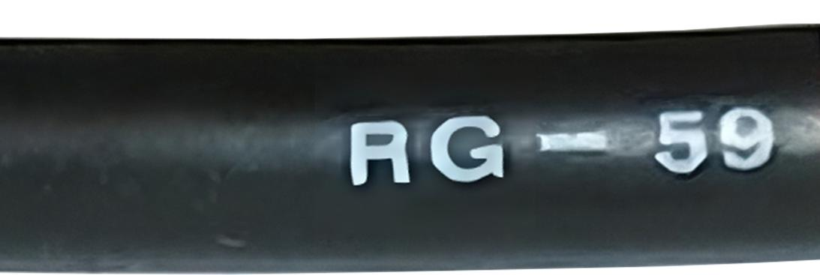
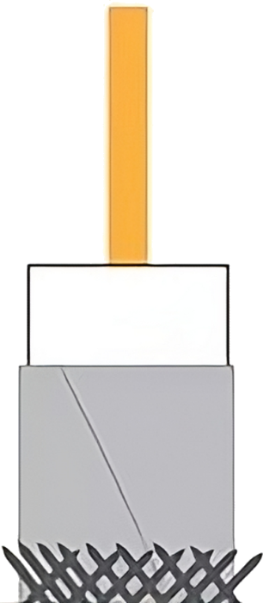
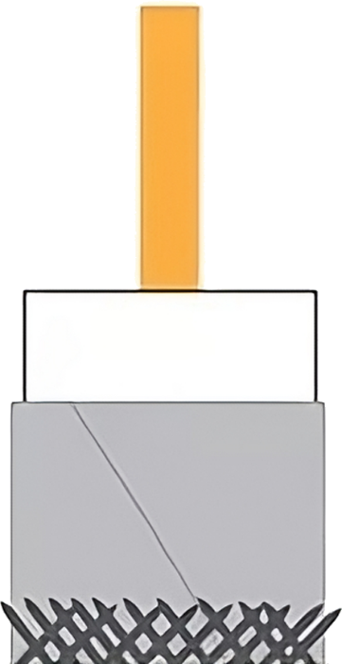
Cable Types
RG-59
RG-6
Thinner and more flexible
Thicker and less flexible
Lower bandwidth/distance
Higher bandwidth/distance
VCRs, DVD players, TVs
Cable television, satellite connections
ITFreeTraining.com
© Copyright 2024
Notes:
01:22 There are many different coaxial cables on the market, but for the A+ exam you only need to know two. These are the RG-59 and RG-6. On the cable it should be printed which type of cable it is. The RG-59 is a thinner and more flexible cable, while the RG-6 cable is thicker and less flexible.
Since the RG-59 is thinner, it has lower bandwidth and can travel shorter distances than the RG-6. RG-59 is generally used with VCRs, DVD players, and TVs. The RG-6 is used with cable television and satellite connections. While RG-6 cables are designed for higher bandwidth applications, they can still be used for connecting VCRs, DVD players, and TVs – they may be less flexible and slightly more expensive than RG-59 cables for these applications, but they will still function effectively.

Slide 5
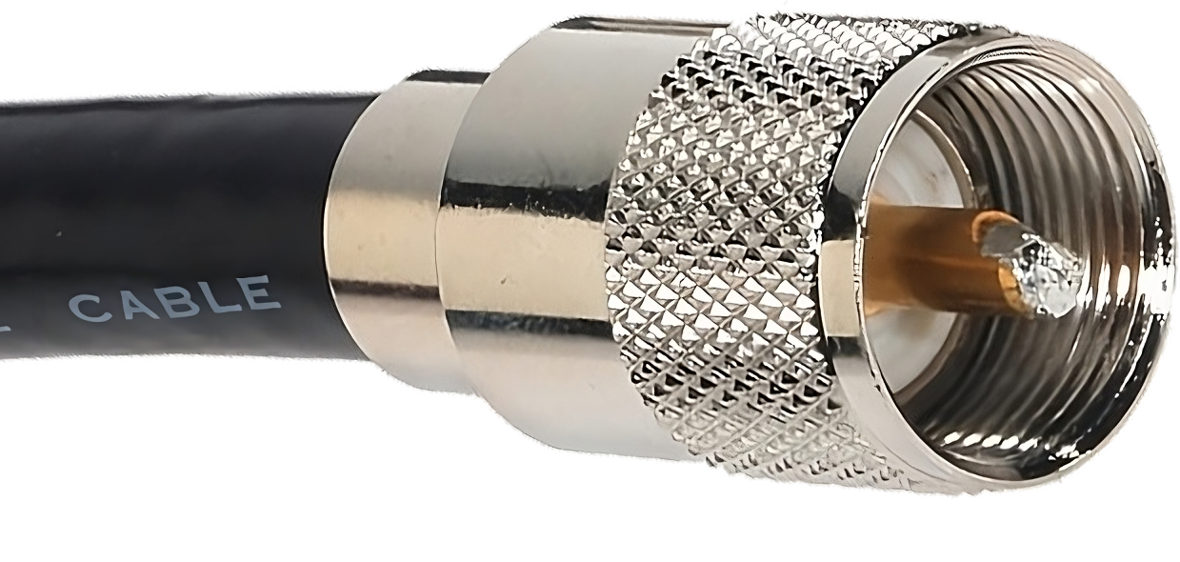
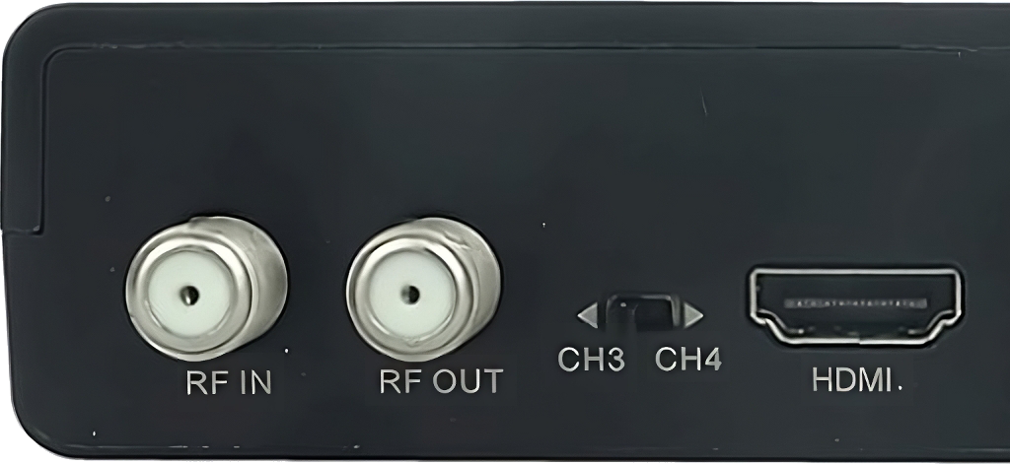
F-Type Connector
Commonly used to connect devices
ITFreeTraining.com
© Copyright 2024
Notes:
02:17 There are a number of different connectors, but the one you will most likely come across nowadays is the F-Type. The F-Type connector is a coaxial cable connector commonly used for connecting televisions, cable modems, and other devices to coaxial cables. It is a threaded connector.
To use it, you simply need to connect it to the device and screw the connector in until it is finger tight. If the connector is not working, check to make sure that it is screwed all the way in. Don’t screw it in too much, as this can damage the connector in the device.

Slide 6
Subscribe
Next video
Video content: https://ITFreeTraining.com/ap11/4c55
© Copyright 2024
Notes:
02:52 So why did the IT technician cross the road? To get to the other coax-ide! Thanks for watching; please check out our other videos.
References
“The Official CompTIA A+ Core Study Guide (Exam 220-1101)” page 143
“Mike Myers All in One A+ Certification Exam Guide 220-1101 & 220-1102” pages 749 to 750
“Global cable assembly market size from 2012 to 2021, by industry” https://www.statista.com/statistics/827499/global-cable-assembly-market-size/
“Picture: Downward arrow” https://pixabay.com/illustrations/financial-crisis-stock-exchange-544944/
“Picture: Coaxial cable” https://en.wikipedia.org/wiki/Coaxial_cable#/media/File:RG-59.jpg
Credits
Trainer: Austin Mason http://ITFreeTraining.com
Voice Talent: HP Lewis http://hplewis.com
Quality Assurance: Brett Batson http://www.pbb-proofreading.uk

