Slide 1
Notes:
Let’s have a look at installing copper cabling.

Slide 2
Copper Cabling Types
Reading the jacket will tell you type/spec of cable
https://www.cablewholesale.com/support/technical_articles/jowling_for_jackets.php (Retrieved Nov 2023)
ITFreeTraining.com
© Copyright 2024
Notes:
00:03 When it comes to cables, there are a lot of them on the market. To understand what type of cable you have, take a look at its jacket, the jacket being the outer plastic cover of the cable, with printed text on it. This will give you a lot of information about the cable, including the type, specifications and shielding – there is quite a lot of information.
CompTIA has provided this cable website as a reference. There is a lot of information on here. If you are not sure what the text means on a cable, have a look at this website and it will give you a description. I would use this website as a reference, you don’t need to remember it all for the exam.
The site also provides information about what temperatures and conditions the cable should be used with. Cables used outside are more exposed to the elements and thus need to be made of a more robust material. Cables that are used inside roofs and walls need to be made of a different material in case there is a fire; this is done to limit chemicals being released into the air conditioner ducts during a fire. Let’s have a closer look.

Slide 3
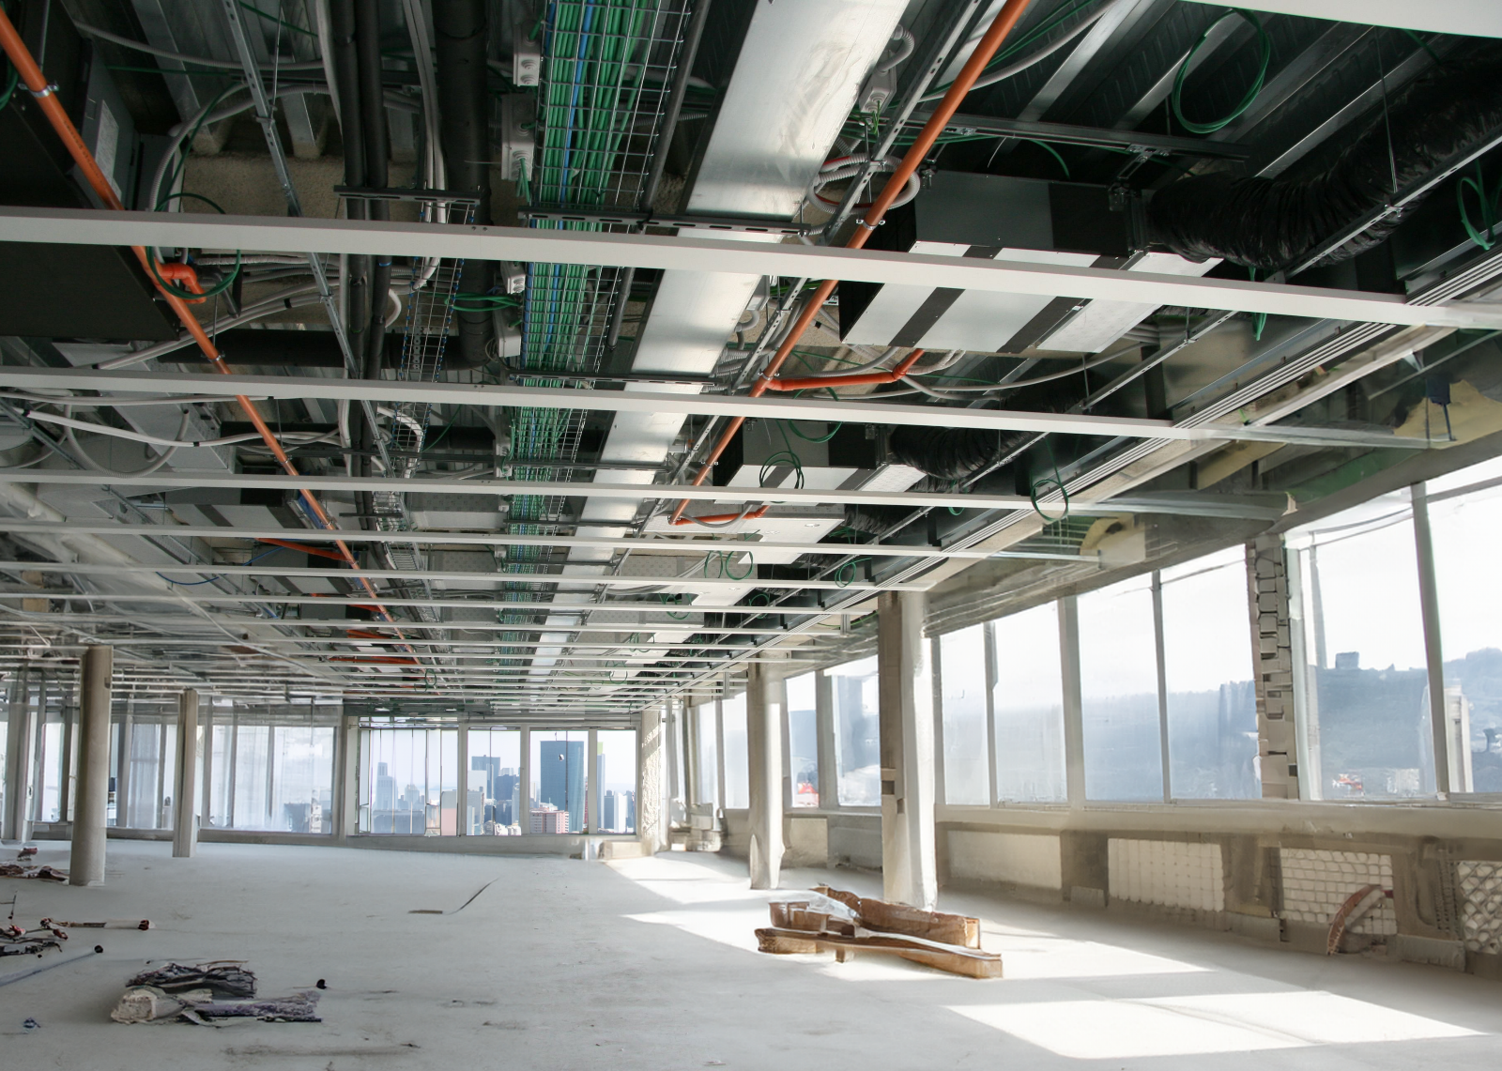
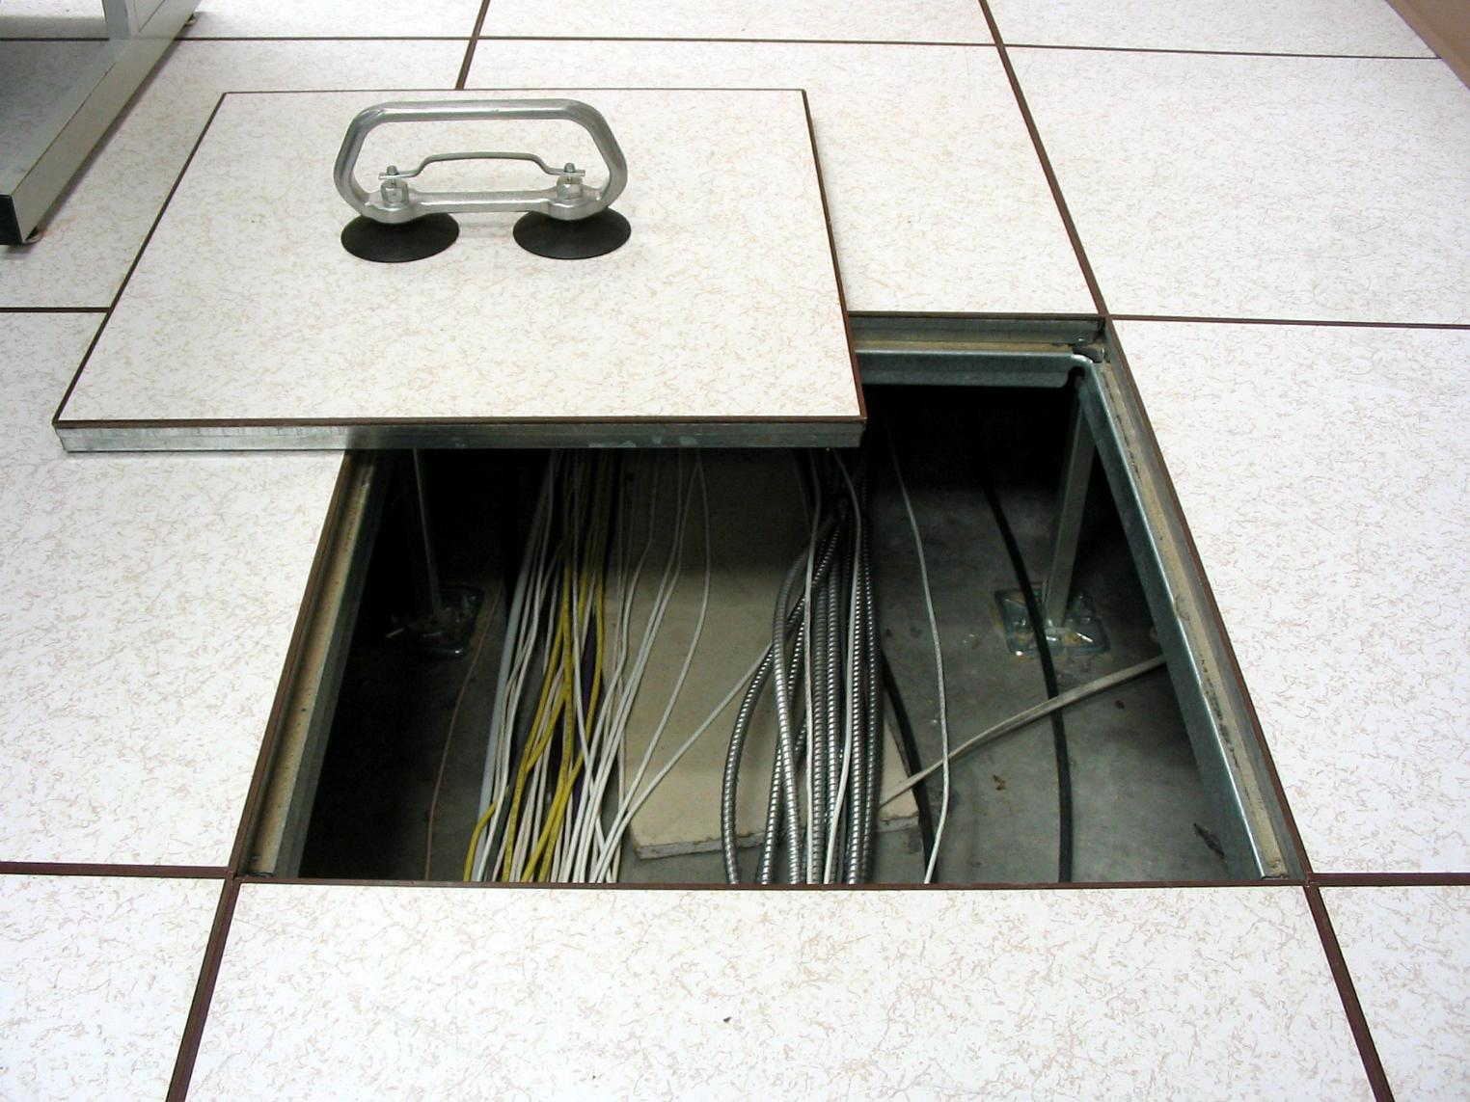
Plenum Space
Void space in a building to carry building services’ systems
E.g., heating, ventilation, air conditioning
Ceiling space
Raised floors
ITFreeTraining.com
© Copyright 2024
Notes:
01:09 Before I look at Plenum cable, I will first look at what Plenum space is, as this will help you understand when they may be used. Plenum space is a void in a building used to carry building services’ systems. These voids carry services such as, for example, heating, ventilation and air conditioning.
In a lot of cases, the Plenum space is the ceiling space. In office buildings there will usually be a false roof, so the workers don’t see all the pipes and cables. Plenum space can also include raised floors. What is considered to be Plenum space is determined by the regulations in a specific country.
Plenum spaces are required to adhere to higher standards compared to cabling in other areas of the building. This ensures enhanced safety and compliance with specific building regulations. The standards vary in different parts of the world. Let’s have a closer look at the cables themselves.

Slide 4
Plenum Cables
Burn at a slower rate/release less toxic smoke
Cost more than regular cables
Less flexible than regular network cables
Local fire regulations will determine when they are required to be used
ITFreeTraining.com
© Copyright 2024
Notes:
02:09 Plenum Cables are made of different materials compared to regular network cables. These materials are designed to burn at a slower rate and release less toxic smoke than regular network cables. They do, however, cost more than regular cables.
The other downside of Plenum cables is they are less flexible than regular ones. Depending on where you are in the world, local fire regulations will determine when Plenum cables are required to be used. Another reason why you should not run cables in your office unless you know exactly what you are doing is, if you use the wrong cables and there is a fire, the fire may be investigated and you may face legal consequences for running the wrong cables.
Here I have two cables. The top one is a Plenum cable and the bottom one is a standard network cable. Since Plenum cables are generally used in roofs and inside walls, they are generally sold in boxes of 1000 ft or a few hundred meters. Because of this, you can see the top cable does not have a network plug on it. Plenum cables are often run from a patch panel to an outlet and thus don’t require a network plug.
It is difficult to see in the video, but the network cable is more flexible than the Plenum cable. The Plenum cables are harder to work with and thus you generally don’t want to use them for your general networking cables. From a data transfer point of view, both cables will transfer data at the same speed. Thus, there is no benefit from a performance point of view which you use. The decision will generally be dictated by fire regulations. Now let’s have a look at external cables.

Slide 5
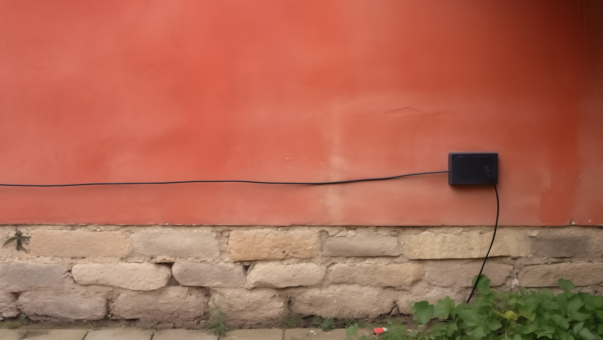
External Cables
Runs outside the building, exposed to weather
Cables will get degraded by ultraviolet/temperatures/damp
Use cables designed for outside use
ITFreeTraining.com
© Copyright 2024
Notes:
03:58 External cables run outside the building and are thus subject to weather and other environmental factors. The cables will become degraded by ultraviolet light from the sun, temperature changes and dampness. It is important to use cables that are designed for outside use.
When selecting cabling, it's important to make sure it is designed to be used outside. While external cables often do not have specific fire regulation requirements, the scenario changes if these cables enter a building, such as by penetrating a wall or by being routed indoors. In these circumstances, the cables must adhere to internal fire regulation codes. Thus, when purchasing an external cable, if it is going into a building, you need to make sure it also meets the fire requirements.

Slide 6
Conduit Cable
Provides more protection to cables
Cables still subject to extreme temperatures and damp
ITFreeTraining.com
© Copyright 2024
Notes:
04:47 When running cables between buildings, there is also the option of putting the cables in a conduit. Conduits provide more protection, although the cables are still subject to extreme temperatures and dampness. For this reason, you still need to use cables that can withstand environmental effects.

Slide 7
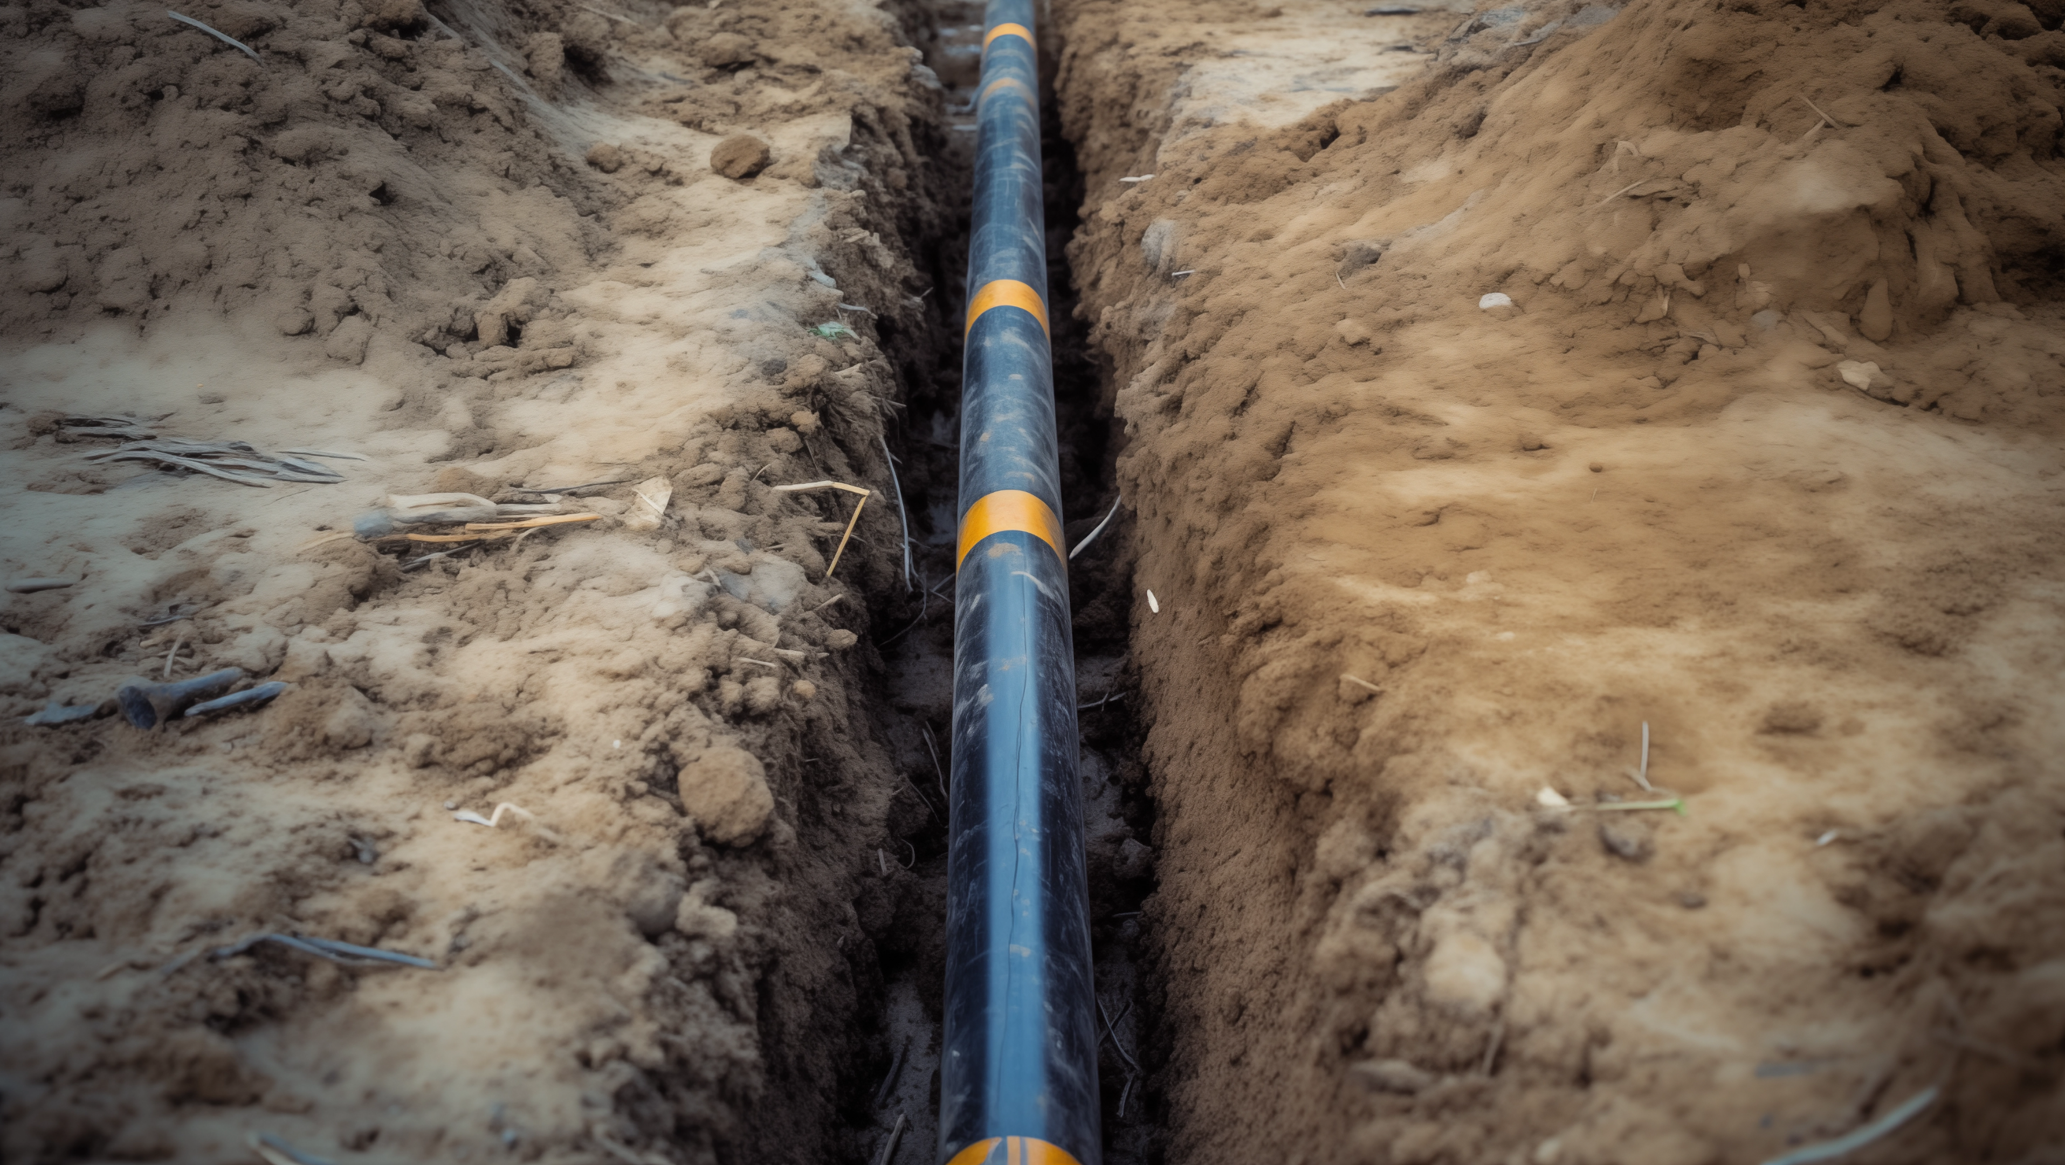
Burial
Cable is buried and covered with earth or cement
Good protection against damage
Higher initial costs and difficult to repair/upgrade
Nice aesthetics. Out of sight
ITFreeTraining.com
© Copyright 2024
Notes:
05:03 The next choice you have is to physically bury the cable. The cable is placed in a trench and then buried with earth or cement. This offers good protection against damage. The disadvantage is the higher initial costs and difficulty to repair and upgrade.
Lastly, this option offers better aesthetics. Essentially, the cabling is out of sight. This should give you an idea of what you need to consider when installing cabling. However, there is one thing that we have not looked at.

Slide 8
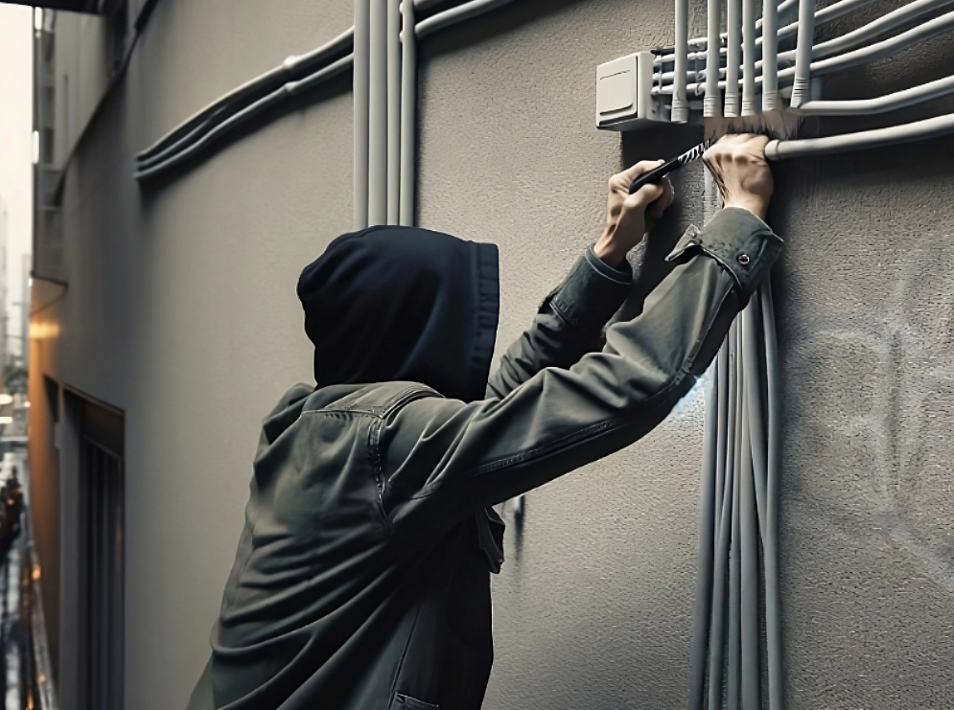
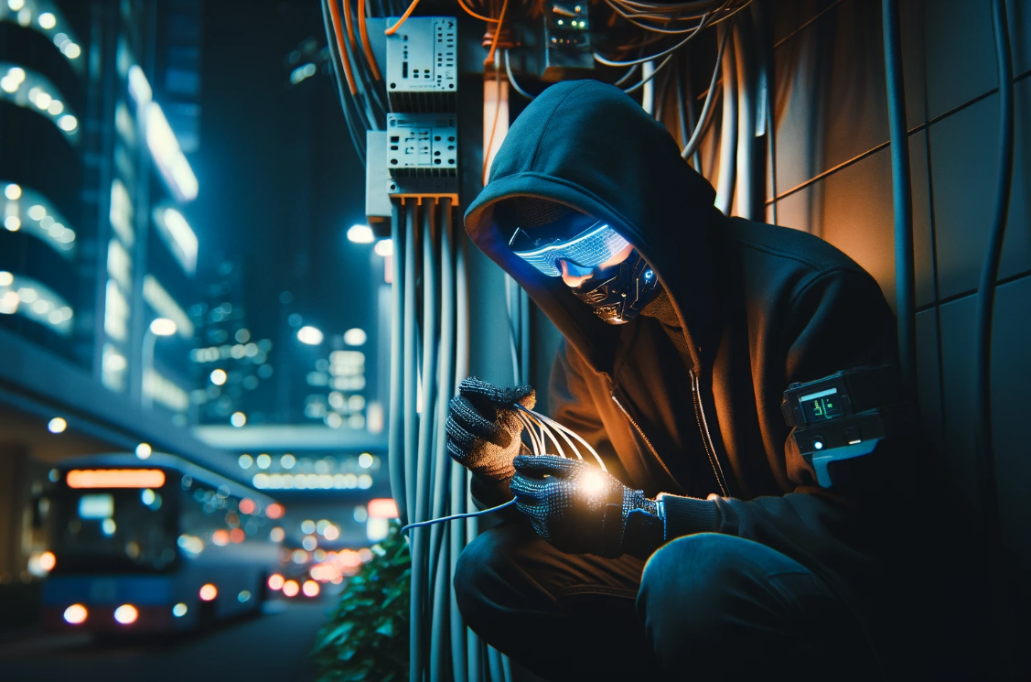
Cable Security
Unauthorized Access
Damage
Eavesdropping
Secure cabinet rooms
Buried cables
Physical security
Secure cabling
Tamper-proof hardware
Encryption
Disconnect unused ports
Physical security
ITFreeTraining.com
© Copyright 2024
Notes:
05:38 When installing any cabling you want to consider security. The first security concern is unauthorized access. This includes securing cabinet rooms and securing the cables, not just from members of the public, but also from staff!
Staff members have been known to bring in their own devices to work and plug them into the network, for example, their personal laptops so they can use the company’s internet to do their downloads. If you have good network security, they should not be able to access the internet with their own equipment, but some staff can be more resourceful than others to get around systems like these, particularly if you have staff on night shift with not much work to do and time on their hands.
To help stop this from occurring, disconnect any unused ports. If a network port is disconnected in the network cabinet, they won’t be able to plug their own devices in unless they unplug something else.
I once worked on a site where they had a small workshop right at the back of the site. It had one computer and printer in it and was right next to an external fence. One day we found a Wi-Fi router had been plugged into the network. We disconnected it but were never able to work out if a staff member had put it there or if someone had jumped the fence. Since the workshop was right at the back of the site, it would have been easy for someone to scale the fence unseen and install the device.
To fix the problem, we told the workshop staff to lock the workshop up after they left, which they never used to do, and let us know if they saw any new network devices appearing in the workshop.
When installing cables, you should also consider potential damage to the cables. This can be accidentally or through vandalism. To prevent damage, burying cables is the best option. If the cable is out of sight, it is harder to damage it. There have been incidents where a cable has accidentally been dug up. You want to take measures to protect yourself from damage like this.
If you can’t bury the cable, consider tamper-proof hardware. Just using tamper-proof screws and fasteners for cable boxes and enclosures makes it difficult for vandals to open them without specialized tools.
You may also want to use physical security, such as putting fences in place or other security measures to prevent people getting access to the cabling. In a previous role, I encountered a unique challenge at a workplace where employees frequently used large exercise balls indoors. They were physiotherapists so this made sense; however, this posed a risk to our fiber optic line, which terminated in a small metal box located in a corner of the room.
We spoke with the staff and explained the significant consequences of any damage to the fiber line, including the extensive time required for repairs and the operational disruptions for the company. Once the employees were made aware of the potential repercussions, they agreed to refrain from using the exercise ball near the fiber box, thus mitigating the risk of accidental damage. Damage can happen in many different ways.
The last point to consider is eavesdropping. This is when someone connects to the network, but is not attempting to gain access, they are just listening to the traffic going over the network. If you have external networking that is easy to get to, an attacker could splice their listening equipment into the line and listen to everything that goes over that part of the network.
To prevent this, you want to physically secure the line. This prevents an attacker getting access to the network line in the first place. Next, you want to put encryption on your network. Encrypting the traffic means that even if an attacker were to access the line, they would not be able to make sense of any of the data.
Modern home routers encrypt traffic to prevent eavesdropping, as this is easier to do than to guarantee physical security of the lines. When installing new cabling, don’t forget about cable security.

Slide 9
Subscribe
Next video
Video content: https://ITFreeTraining.com/ap11/4c45
© Copyright 2024
Notes:
09:44 That concludes this video. I hope this video has helped you understand what is involved in installing new network cables. Until the next video from us, I would like to thank you for watching.
References
“The Official CompTIA A+ Core Study Guide (Exam 220-1101)” page 141
“Picture: raised floor” https://en.wikipedia.org/wiki/Raised_floor#/media/File:Tile-lifter-in-use-raised-floor.jpg
Credits
Trainer: Austin Mason http://ITFreeTraining.com
Voice Talent: Stuart Thomas Hall https://www.imdb.com/name/nm12181561/
Quality Assurance: Brett Batson http://www.pbb-proofreading.uk

