Slide 1
Notes:
Let’s have a look at copper cable testing.

Slide 2
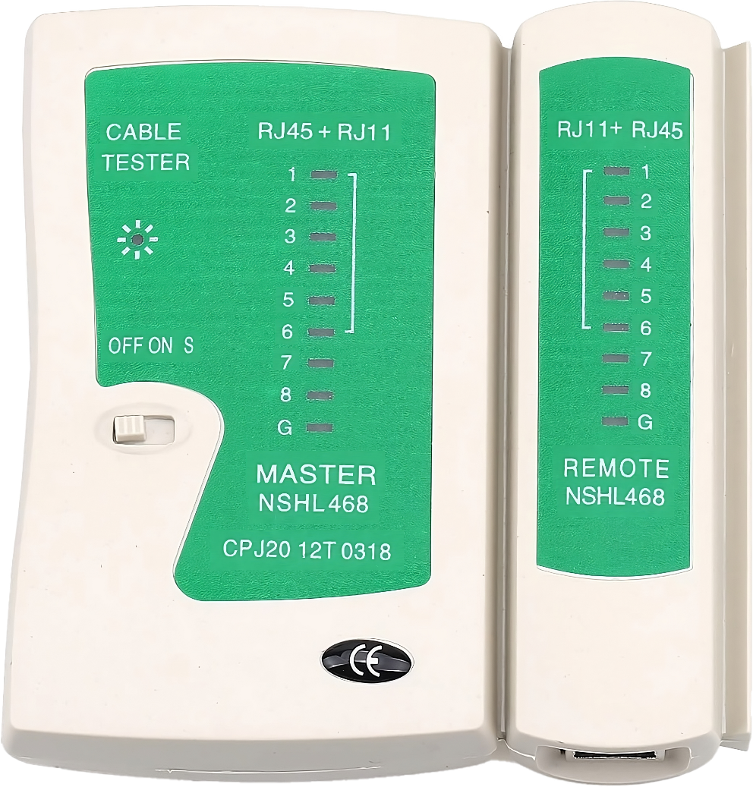
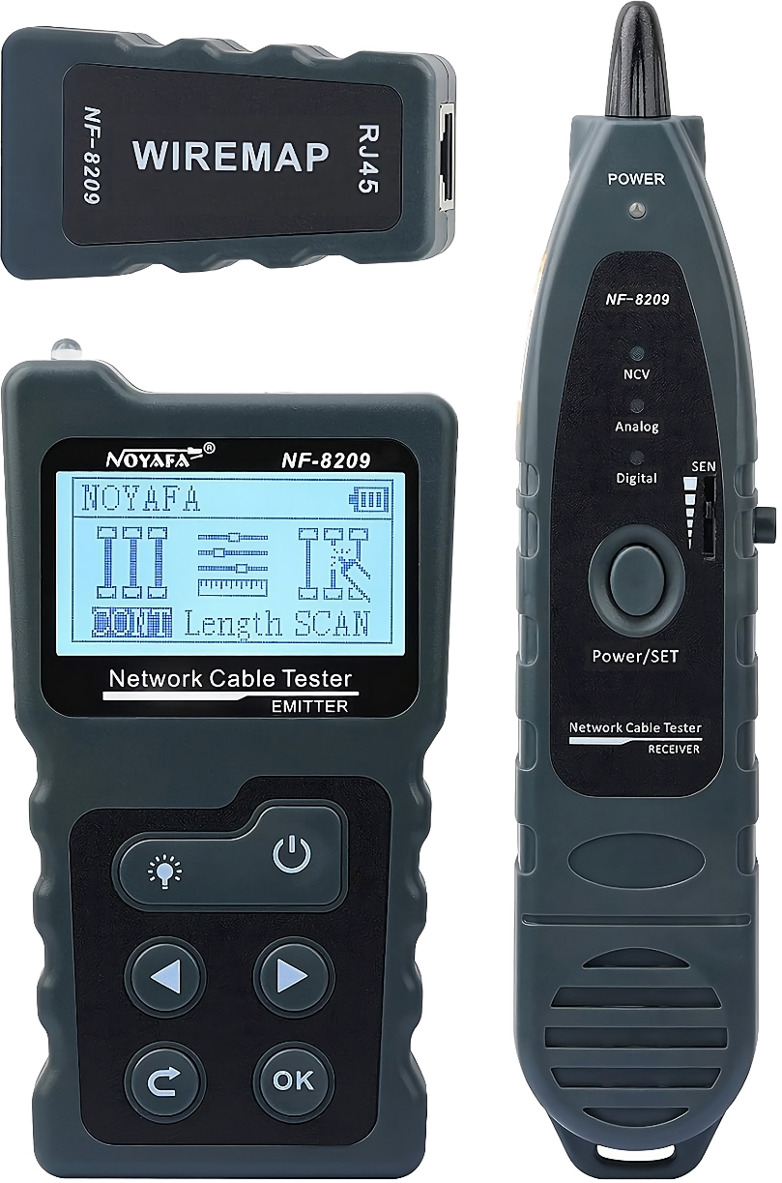
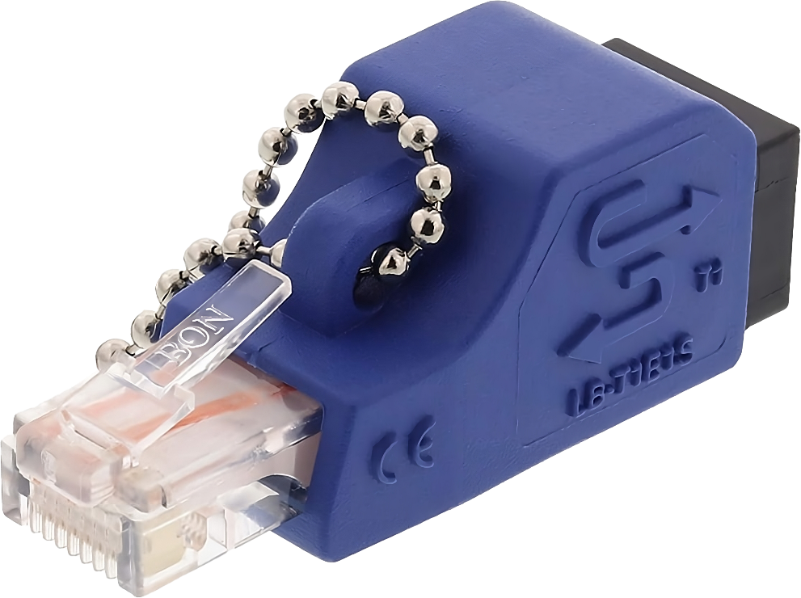
In This Video
Loopback Plug
Cable Tester
Toner Probe
ITFreeTraining.com
© Copyright 2024
Notes:
00:03 In this video I will look at the loopback plug, a simple plug that reflects back the network signal like a mirror. Next, I will look at a cable tester. This device will test for incorrectly connected wires or broken wires. Lastly, I will look at a toner probe. This device emits a signal through the cable, enabling you to track wires amidst complex cable configurations or through barriers such as walls. With each device, the cost increases, but so do the available features. Let's explore what each one offers.

Slide 3
Loopback Plug
Tests a network adapter or switch port
Unlikely to work with gigabit ports
Standard
All pairs crossed
ITFreeTraining.com
© Copyright 2024
Notes:
00:37 The loopback plug is the cheapest option. It is a simple device that tests a network adapter or switch port. The biggest disadvantage of the loopback plug is that it is unlikely to work with gigabit ports. Since most modern networks are at least one gigabit, I would personally go for a different option, but it is in the exam objectives, so I will cover it.
You can purchase a loopback plug like the one shown; however, you can also make one if needed by connecting wires together as shown. You may also come across loopback plugs where all the pairs are connected together.
For 100-megabit networking, only two wire pairs are utilized, making two pairs sufficient for loopback testing. One gigabit networking employs all four wire pairs. However, the presence of additional looped pairs typically doesn't influence the functionality of a loopback connection. Therefore, looping more than two pairs is not essential for effective loopback testing in most scenarios. Thus, don’t get fooled into thinking the extra looped pairs will allow the loopback plug to work on one-gigabit ports.
I will demonstrate how to use the loopback plug using a 100-megabit switch with two one-gigabit ports. The switch is plugged in a patch panel with the red network cable. The patch panel is plugged into a network point. The network point is connected with a green network cable.
I will now plug the loopback plug into the green cable. You will notice that the connection light on the switch has come on. This light may not come on straight away, and on some switches it may take approximately 20 seconds to light up if it does light up at all.
The loopback plug can also be plugged directly into the network point. I will unplug the network cable from the network point, unplug the loopback plug and plug it into the network point. You can see I will get the same result as before, that is, the light on the network switch will light up.
I will now move the network connection from the 100-megabit port to the one-gigabit port. You will notice that the light does not light up. Even if I wait 20 or more seconds, it won’t light up because the loopback plug is not compatible with the one-gigabit port on this switch. For this reason, I would not recommend the loopback plug, so I will next look at what else you can use that will give you better results.

Slide 4
Cable Tester
Basic testing of connectivity of wires in a cable
Wire continuity (Wires are connected)
Wiring order
Main tester
Remote tester
ITFreeTraining.com
© Copyright 2024
Notes:
03:08 A cable tester is a device used to test the functionality of network cables. It has two parts: a main tester and a remote tester. The main tester is typically connected to one end of the cable, and the remote tester is connected to the other end. The main tester then sends a signal through the cable, and the remote tester receives it.
The cable tester essentially tests for two things: Wire continuity, to make sure that all of the wires in the cable are properly connected and wiring order, to make sure that the wires in the cable are connected in the correct order.
Cable testers offer a convenient and affordable way to check basic cable functionality and wiring connections. It does not provide any insight into cable quality or damage to the cable.
I will use this cable tester to test some cables. You can see that the main tester on the left has an RJ11 plug and an RJ45 plug. On the right side is the remote tester with a single RJ45 connector. The RJ11 connector is on the other side.
I will now plug in the cable and switch the cable tester on. This cable is in good condition and functioning properly, which means you should observe each LED illuminating sequentially. If any of the LEDs fail to light up, it suggests that one of the wires may be damaged or disconnected. The cable tester features a slow mode; when activated, the LED lights will illuminate at a slower pace. For a cable in proper working order, the LEDs should light up in sequence, with all LEDs from one to eight lighting up accordingly.
If you are having trouble working out if all the LEDs are lighting up or are in sequence, put the cable tester in slow mode. Some cable testers will have a button that you can cycle through each LED.
I will now swap the cable with another. This cable has the T56A standard on one side and T56B on the other side, otherwise known as a crossover cable. The LEDs light in order on the main side, but on the remote tester, only half the LEDs light in the correct order while the other half do not.
In the old days, a cross-over cable was used to connect two devices together without using a network switch or hub. Nowadays, the vast majority of devices are auto sensing and automatically swap to a crossover cable if needed.
The last cable I will look at is a roll cable otherwise known as a rollover cable. Here, the wires in the cable are wired opposite to each other. These cables are used for console access to some devices and some legacy systems, but you don’t tend to see them used much nowadays. There has been a shift to other technologies like ethernet and USB.
I will have a look at how you would test a connection from the patch panel to the wall outlet. In this example I have a network cable going from my wall outlet to the remote tester. I also have a cable running from my patch panel to the main tester. If you had a user saying there was a problem with their network connection, this is how you would test for basic connectivity from their computer to the patch panel.
I will now switch on the cable tester. You will notice that there is a problem with the remote tester for wires four and five. The sequence is not correct, wires four and five appear to be reversed. I next need to work out where the problem is. To do this, I will treat it as a logic problem and divide it up into smaller parts.
I will unplug the cable from the wall outlet and plug it into the main part of the tester. You will notice that the wires are out of sequence. So, I have found the problem and the cable going from the wall socket to the computer will need to be replaced.
If you see a fault on the remote unit, there is a problem with the cable. If everything looks good on the remote unit, you should also check the main unit. These basic network testers don’t offer a lot of features and only check that the basic wiring is correct and there is continuity. I will next have a look at a toner probe which also includes a more advanced network cable tester.

Slide 5
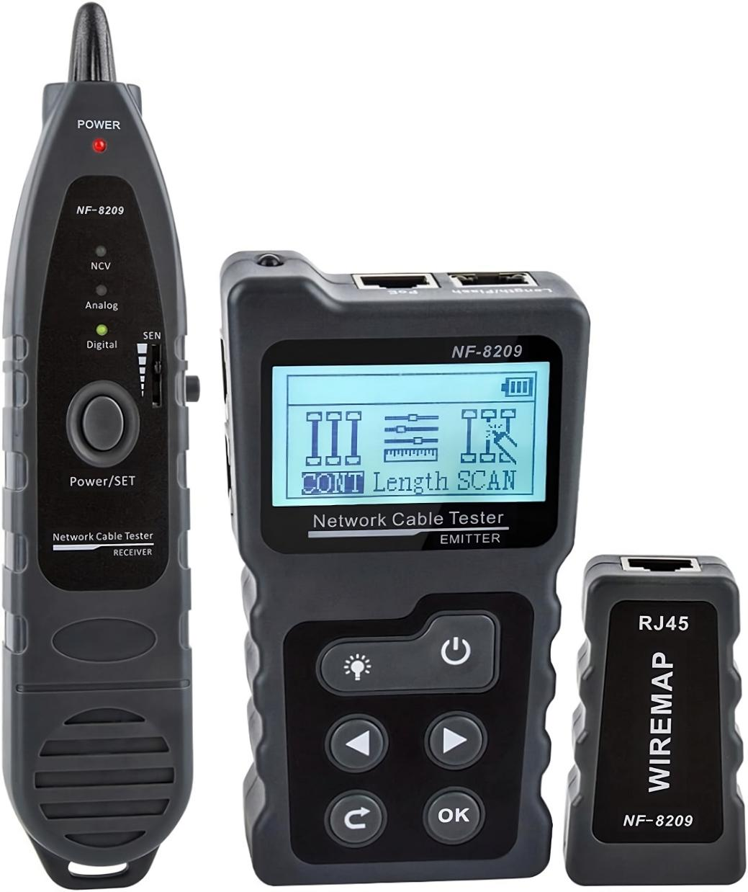
Toner Probe
Tone sent down a cable allowing it to be traced
Often included with cable tester
Disconnect the other end from network equipment before use
Receiver (Probe)
Transmitter
Remote
ITFreeTraining.com
© Copyright 2024
Notes:
07:24 A toner probe is used to send a tone down a cable allowing it to be traced. It is often included with a cable tester. This network cable tester has a number of different features, including a loopback tester, cable tester, toner probe, among other features that I will look at later. Essentially, it includes the loopback plug and network cable tester I looked at earlier in the video.
If you are considering buying a cable tester, it may be worth paying a little more to get a device like this one with additional features. While it's more affordable compared to professional-grade network cable testers, this device delivers satisfactory results. Although it may not match the performance of high-end products, its cost-effectiveness — at roughly one-tenth the price of professional models — makes it a practical option. Keep in mind you get what you pay for, thus you won’t get the same results as a professional cable tester.
The device works like this; as before there is a transmitter. This is the main part of the unit that sends the signal or tone down the wire. The next part is the receiver, generally called the probe. This is what picks up the signal going through the cable. I will demonstrate how that works in a moment.
The last part is the remote. This performs the same purpose as the remote tester in the previous cable tester that I looked at. Not all functions in the network cable tester require the remote. CompTIA recommends disconnecting the other end from network equipment before use. However, if you are using a toner probe, it is most likely because you are trying to find the other end of the cable because you don’t know where it is, so you won’t be able to unplug it. I would say, if you can’t disconnect the cable, refer to the operating instructions for the device and consider the risks before use.
In this demonstration, I'll be using the toner probe to trace the red cable back to the patch panel surrounded by blue cables. I have used different colors to make it easy to understand, however, it is important to note that in real-world scenarios, cables are typically uniform in color, making it more challenging to distinguish one from another.
The network cable tester is on the right. It has four different plugs for performing different tests. For the tone probe, I need to plug it into the one that is marked “Scan”. I will look at the others later in the video.
I will now switch the tester on. I will next need to select which test I want to run, and in this case, I will select scan. The device will emit a digital tone down the cable. This device also supports analog mode. The digital tone works better with noise and maintains signal integrity over a longer distance. Analog is cheaper to implement. In some cases, analog will work better, so if one does not work, I would try the other.
To detect the signal going over the cable, I will need the probe. To use the probe, I first need to switch it on making sure it is on the digital setting since the network tester is set to digital. The same principle applies if the network tester was set to analog, the probe won’t pick up anything if it is configured for digital.
To detect the signal, I need to wave the end of the probe over the cable. You will hear the signal in the form of audible tones when the end of the probe is near the red cable.
Whenever the probe is near the cable connected to the network tester you will hear the probe. We can now apply that to the patch panel. All I need to do is run the probe down the patch panel until I hear the tones and I will be able to identify which cable it is.
This is a fairly simple example, but you can also use network probe devices to detect cables in walls. This is one of those times you get what you pay for. An inexpensive network probe will have a harder time detecting cables in walls and may not detect them at all. More expensive network probes have higher sensitivity, precision, enhanced frequency range and more advanced technology allowing them to detect and trace signals through denser materials like walls.
For the A+ exam, you only need to have a basic understanding of the devices that I have looked at, so feel free to end the video here if you are only interested in studying for the exam, as - in the rest of the video- I will have a look at some of the other features this device has that may be useful to you when troubleshooting.

Slide 6
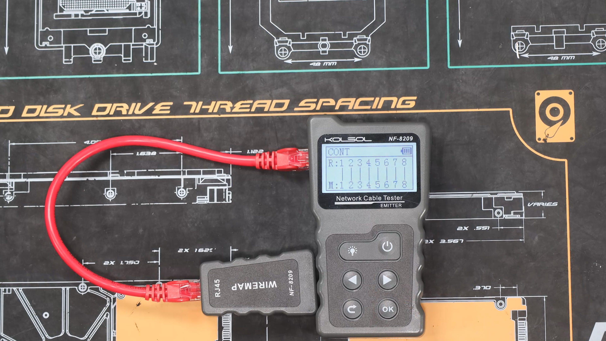
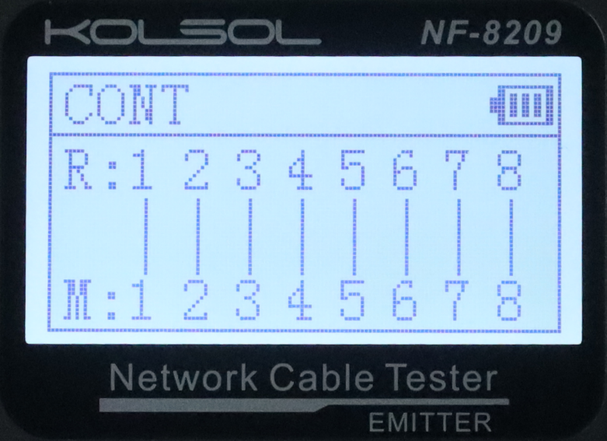
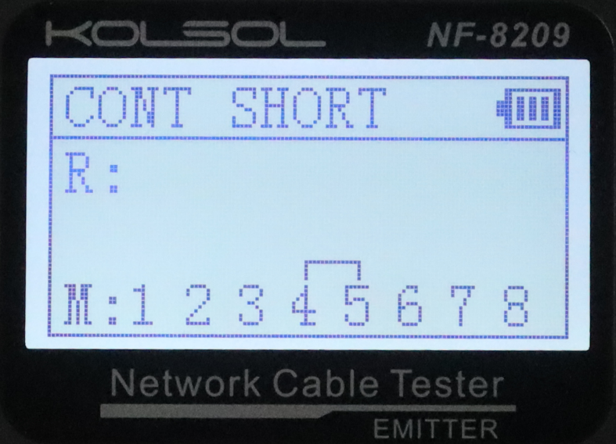
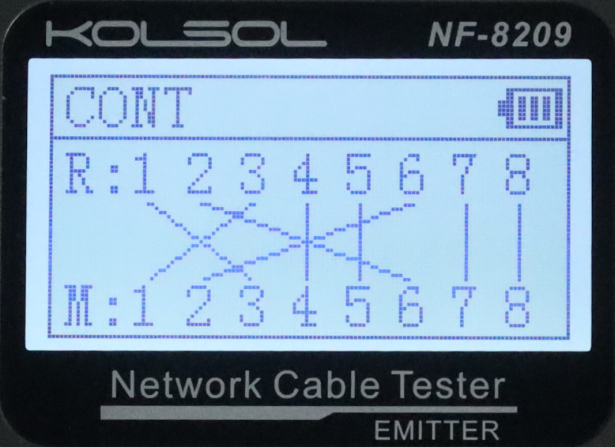
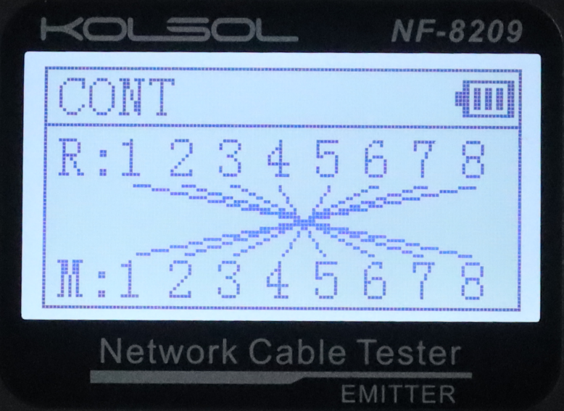
Continuity Testing
Test wires connected, shorts and order
Straight
Short
Crossover
Rollover
ITFreeTraining.com
© Copyright 2024
Notes:
11:57 I will next look at the continuity testing part of the device. This tests that the wires are connected, detects shorts and the order of the wires. To use this, plug the cable you want to test to the “Continuity” port and plug the remote tester to the other end of the cable. It is just a matter of switching it on and selecting “continuity test” from the menu and pressing o.k. to run the test.
For a straight through cable, you will get a graphic showing all the wires directly connected. The vast majority of cables that you come across should be of this type. If you have a short in the cable, that is two or more wires connected together, this will show as a short. This cable should be thrown away, although, depending on where the short is, you may be able to fix the cable by re-crimping it.
It is possible that you may come across a crossover cable, where two of the pairs will be swapped. The need for crossover cables has largely diminished in modern networking thanks to automatic detection.
In the old days, rollover cables were required to access the console on some network devices. If you come across one of these cables, all the wires in the cable will be opposite to each other.

Slide 7
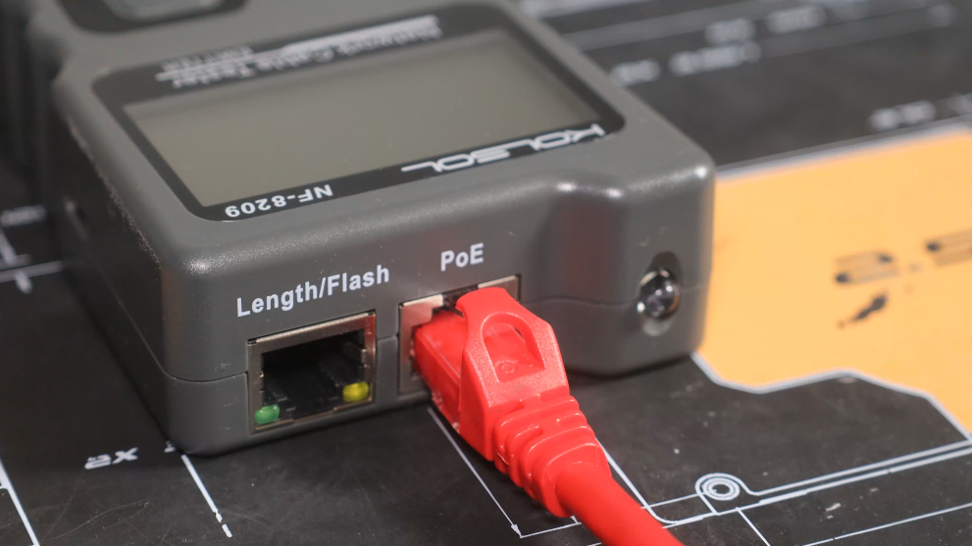
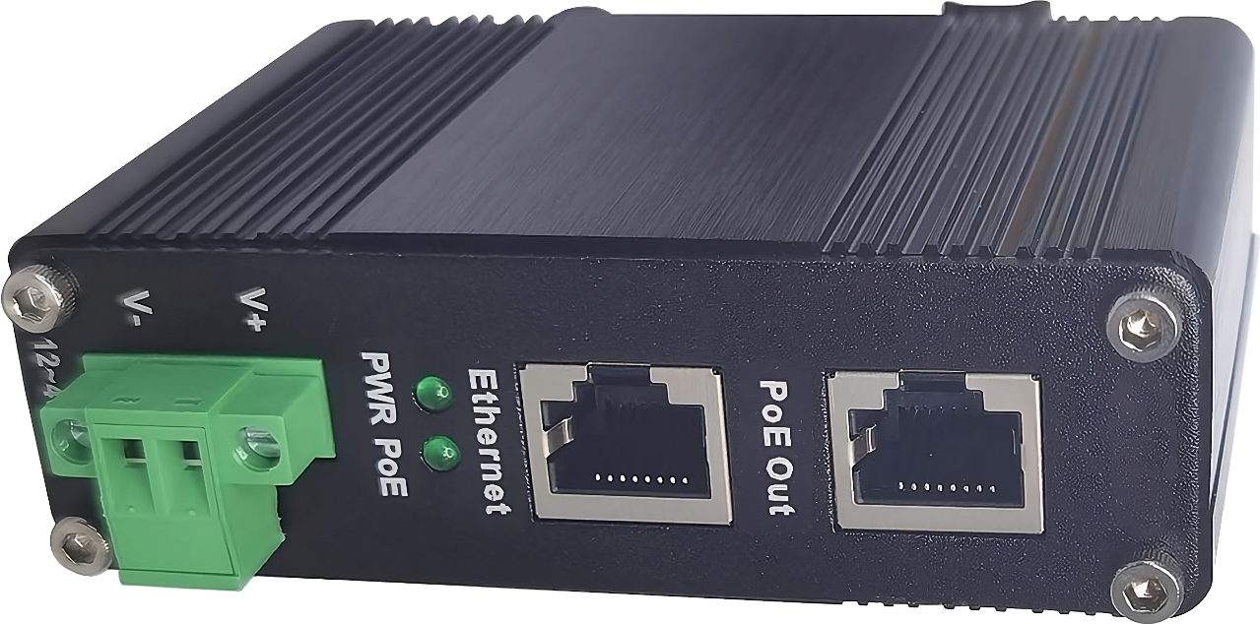
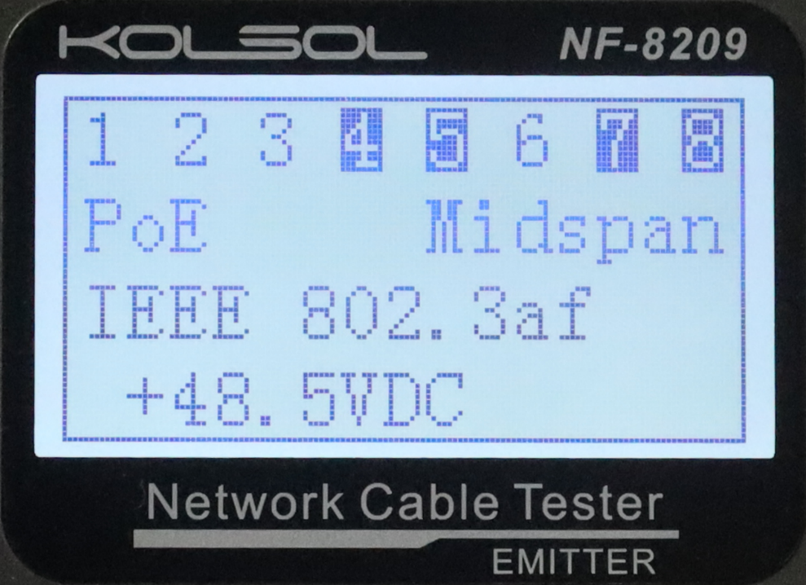
Power over Ethernet (PoE) Testing
Tests if voltage is present on the cable
Incorrect voltage to PoE device can cause damage
Voltage to non-PoE device can cause damage
Power injected
From network
ITFreeTraining.com
© Copyright 2024
Notes:
13:10 The next test the device can perform is “Power Over Ethernet” testing. Voltage can be injected into an ethernet cable, often done by using the two unused pairs of wires in 100-megabit networking.
Certain network devices have Power over Ethernet built in, but at other times you may need to use an injector like the one shown. Injectors like this have a connection to the network and a connection that adds power which goes to the device. Power over Ethernet is often used for Wi-Fi points which are often in locations that are difficult to get power to and, thus, running the power over the network cable is a good alternative.
The network tester can test if voltage is present on the cable. To use it, plug the cable that you want to test into the network tester. Select the “PoE” option and this will tell you the voltage on the cable and which wires have voltage going through them.
Checking the voltage achieves two things. There are a number of different PoE standards that use different voltages. Using an incorrect voltage with a PoE device can cause damage to the device. Voltage supplied to a non-PoE device can also cause damage. Thus, you want to make sure the voltage provided by the cable is compatible with the device and that you are not using a cable with voltage on it and then plugging it into a non-PoE device.

Slide 8
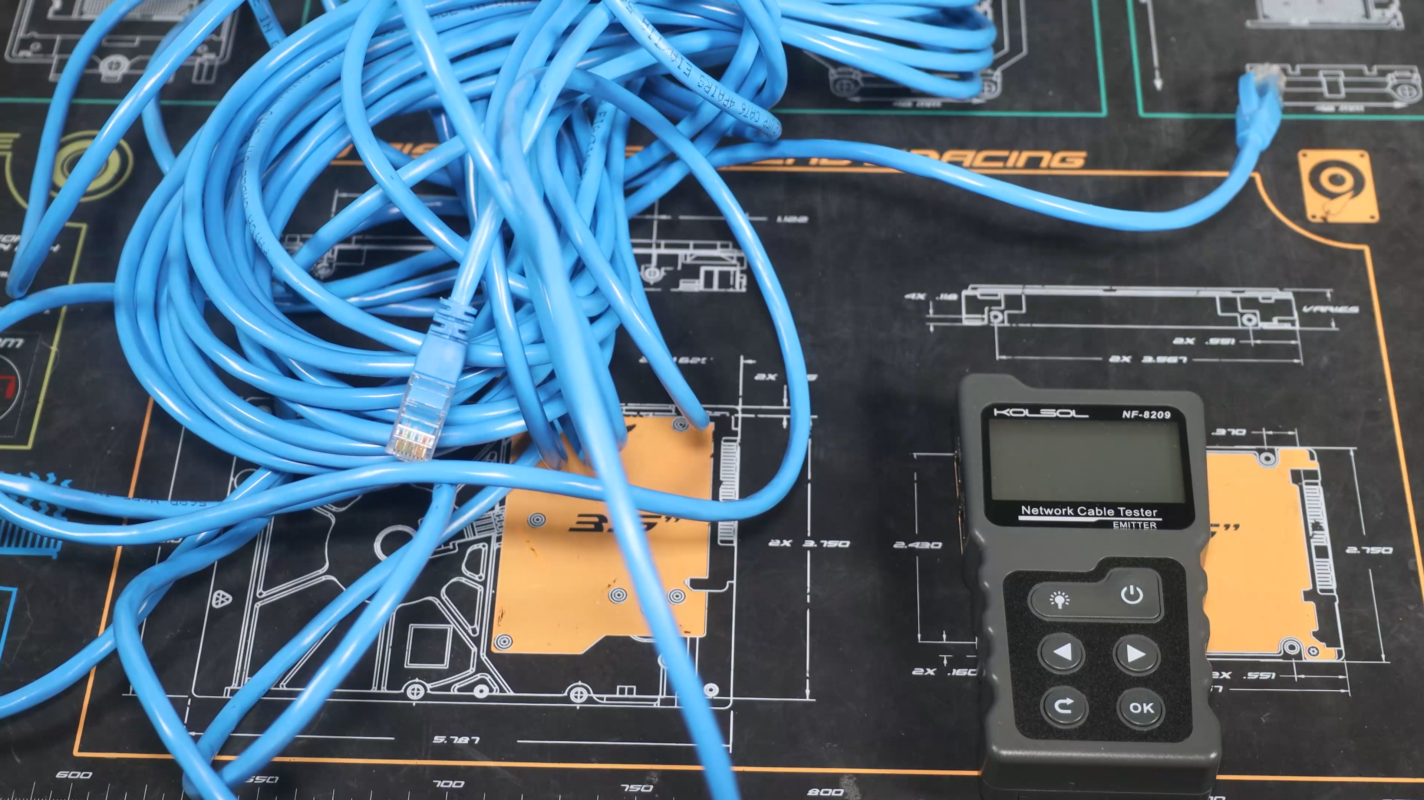
Length Testing
ITFreeTraining.com
© Copyright 2024
Notes:
14:38 The network cable tester also has the ability to measure the length of a cable. Keep in mind that devices like these only give an approximate length of the cable. For this demonstration, I will test this 20-meter network cable. Check your device to see what lengths it can test. This device can only test cables over two and half meters and less than 200 meters in length.
To perform the test, make sure the cable is not plugged into anything as this can affect the testing. To test the cable, I will first need to plug it into the Length port in the network tester.
I will next switch on the network tester and select the length option. The category of the cable needs to be selected. This device supports CAT5 and CAT6. This cable is CAT5e, so I will need to select CAT5.
I will next select “Start Test” to begin testing. The testing does not take too long to complete. The results are displayed as divided up into the four pairs of wires. The first line is the pair that uses wires 1 and 2. It has returned a result of 21.3 meters. You will notice that all the results are 21.3 meters, that is, for the pairs using wires 3 and 6, 4 and 5 and 7 and 8.
If one of the pairs is broken, the signal will stop at the break. Thus, if you ever see the length reported differently, there is something wrong with the cable and it probably needs to be replaced.

Slide 9
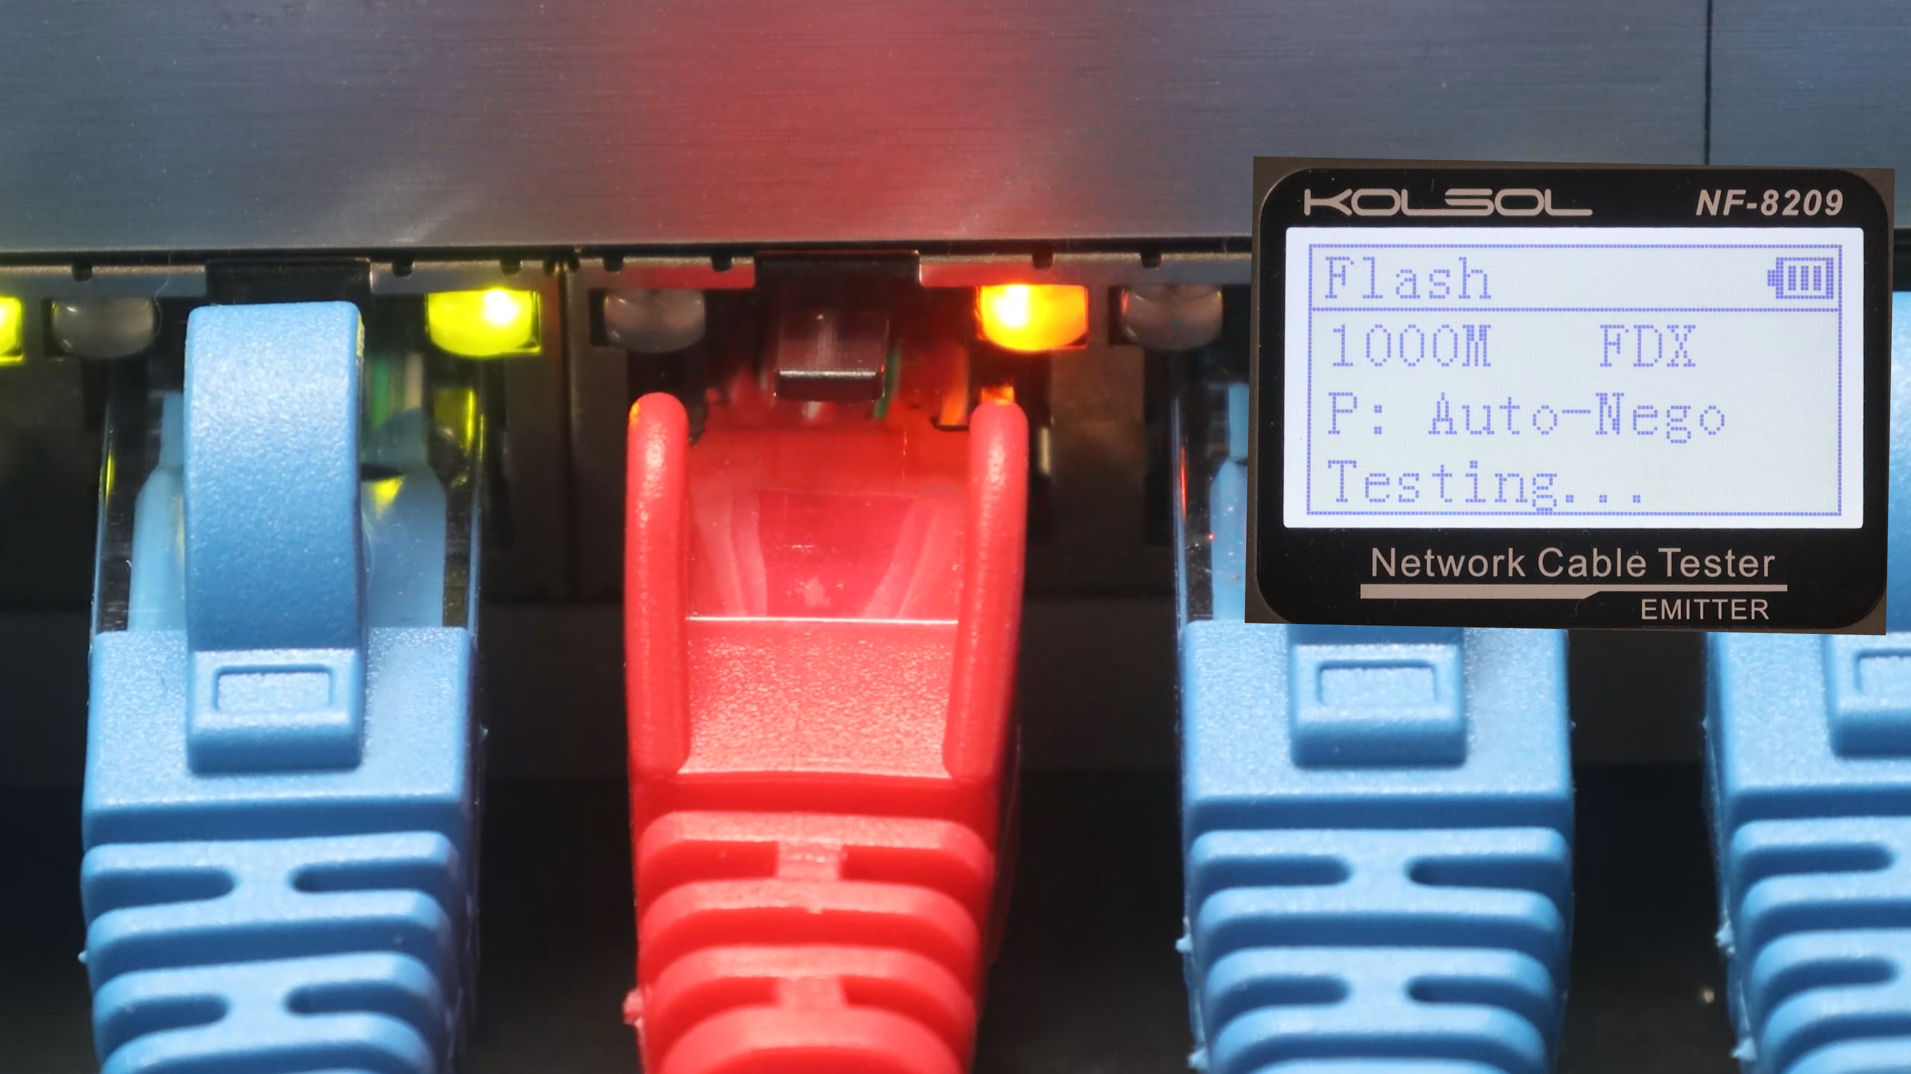
Port Flash
ITFreeTraining.com
© Copyright 2024
Notes:
16:10 The last feature that I will look at is “Port Flash”. This feature allows you to locate a connected cable to a device like a switch by flashing the LED light on the switch. In this example, I will use it to locate which port the red network cable is plugged into.
I first need to connect the cable to the Flash port of the network tester. I will next switch on the network tester. From the menu, I will need to select “Flash”.
Once selected, a link test will be performed. It can take a little bit of time before you see a result, so don’t be surprised if you don’t get a result straight away. You can see the network cable tester has reported the cable is connected to a one-gigabit connection and the port is configured to auto negotiate. That is, the port will change its configuration based on what device is plugged into it.
You will notice that the light on the network switch will slowly blink. This will help you identify which port the cable is connected to. They can be very useful in environments with a lot of cables where you are having trouble tracing the cable back to the switch.

Slide 10
Subscribe
Next video
Video content: https://ITFreeTraining.com/ap11/4c35
© Copyright 2024
Notes:
17:19 That concludes this video from ITFreeTraining on the basic devices you can use to test and trace network cables on your network. I hope this video has helped you. Until the next video from us, I would like to thank you for watching.
References
“The Official CompTIA A+ Core Study Guide (Exam 220-1101)” pages 138 to 140
“Mike Myers All in One A+ Certification Exam Guide 220-1101 & 220-1102” pages 138 to 140
Credits
Trainer: Austin Mason http://ITFreeTraining.com
Voice Talent: HP Lewis http://hplewis.com
Quality Assurance: Brett Batson http://www.pbb-proofreading.uk

