Slide 1
Notes:
Let’s have a look at how to crimp a network cable.

Slide 2
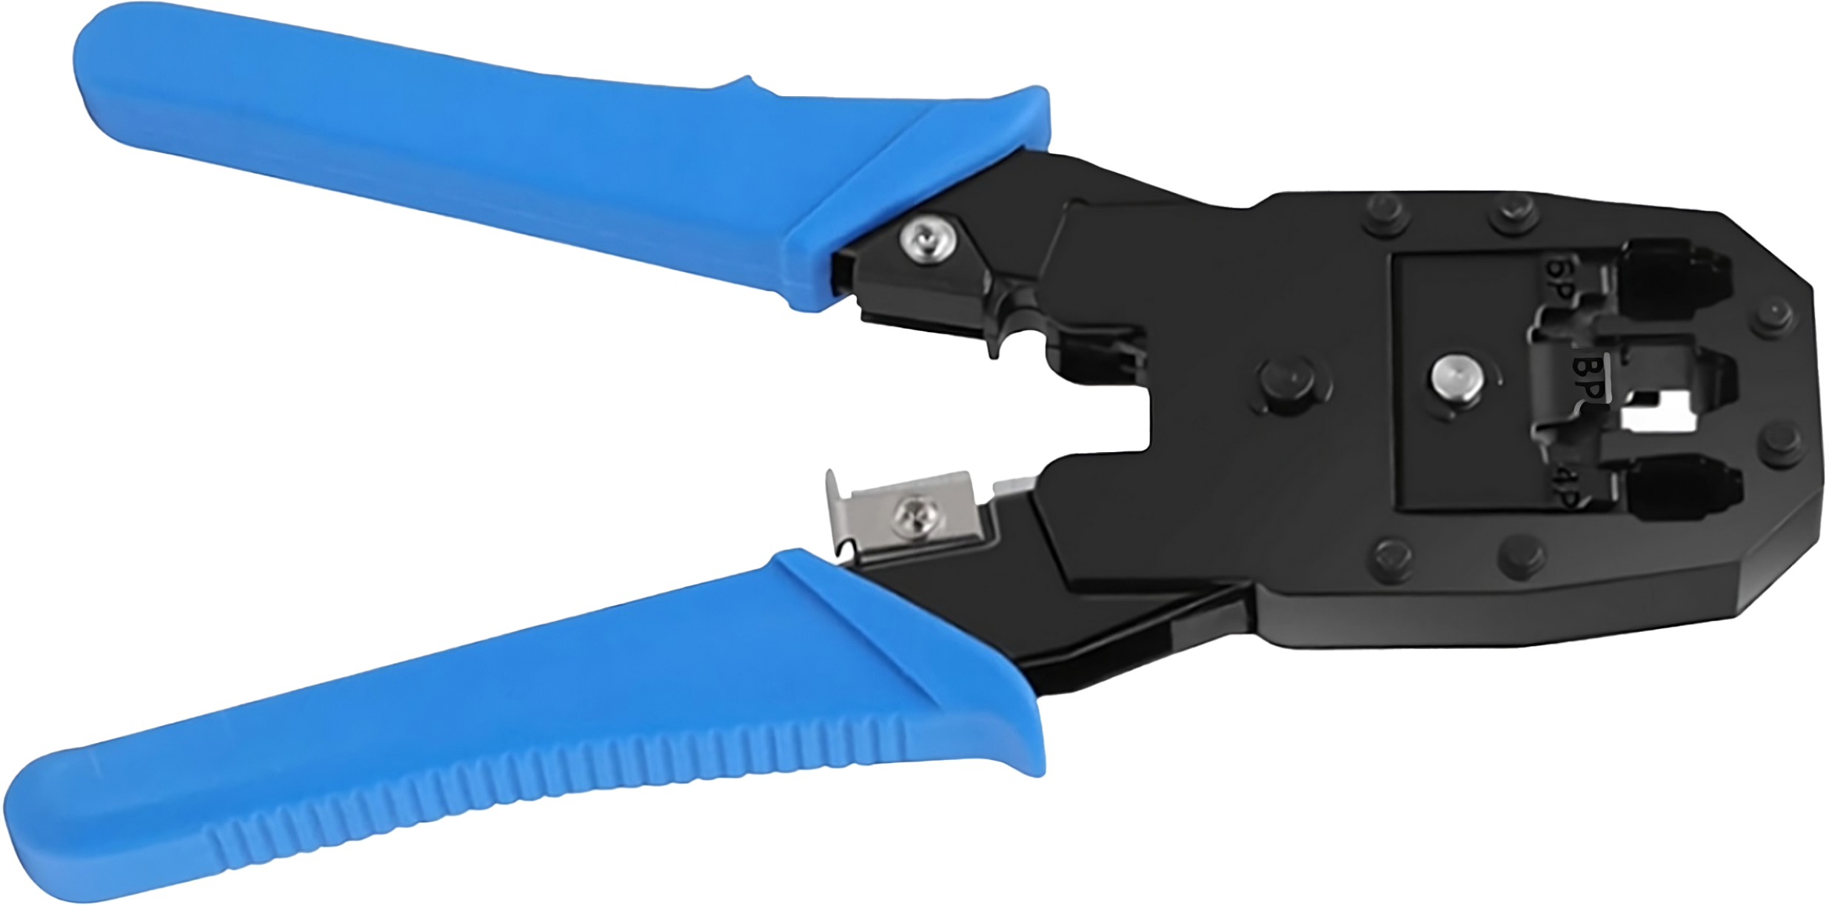
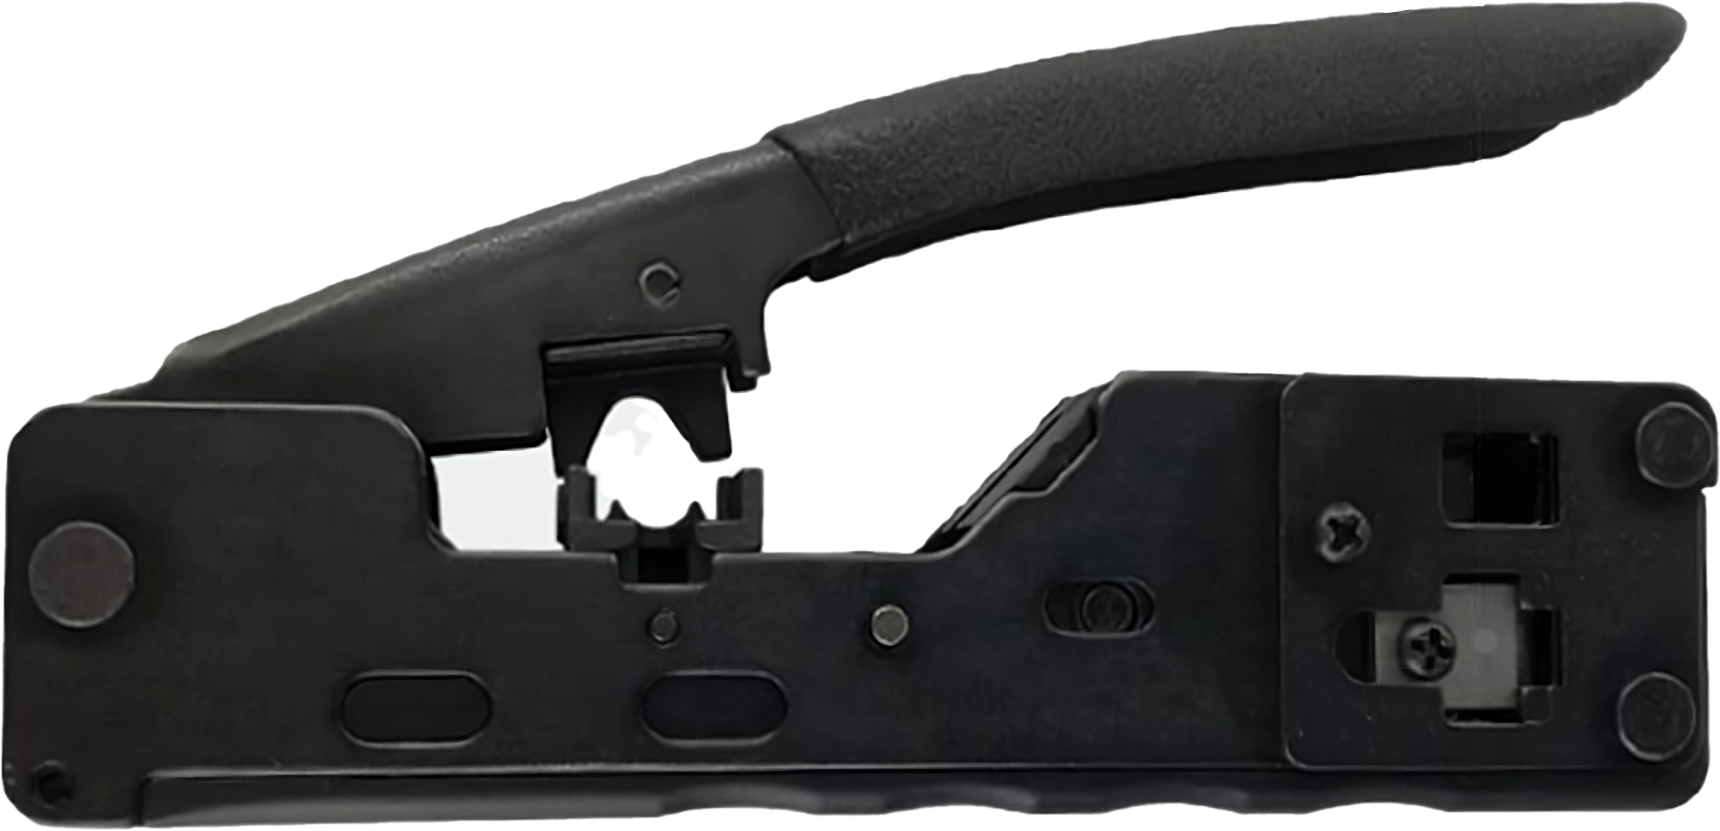
Crimping
Process of connecting RJ45 connector to cable
Locks wires to the connectors inside the plug and locks the cable into place
Can only be done once
Standard plug
Pass-through plug
ITFreeTraining.com
© Copyright 2024
Notes:
00:04 Crimping a network cable is the process of connecting an RJ45 connector to it. Crimping locks the wire to the connectors inside the plug and also locks the cable into place. This process can only be done once. Crimping the cable pushes a small plastic latch onto the cable, which is a one-way process and can’t be undone. If you want to start again, you need to cut the cable and use a new plug.
In this video I will be using a standard RJ45 plug and a pass-through plug. When using a standard plug, any network crimper can be used; however, with a pass-through plug, a crimper with a cutter needs to be used. The cutter trims the wires sticking out from the end of the plug.
The advantage of the pass-through plug is it makes it easier to see that the wires are in the correct order. If you were to crimp the wires in the incorrect order, the cable may not work as expected.

Slide 3
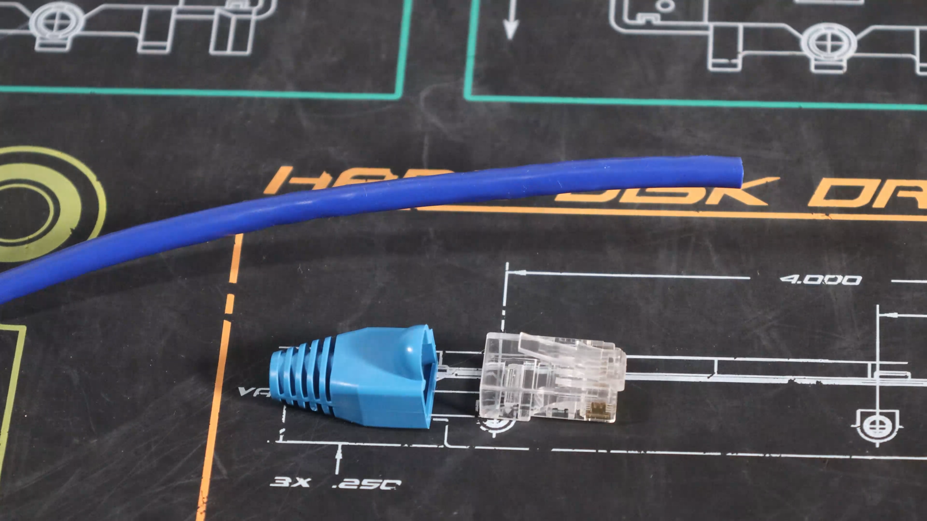
Demonstration Standard Plug
ITFreeTraining.com
© Copyright 2024
Notes:
01:01 I have my network cable which I am going to crimp. I will use a strain relief boot to protect the latch on the plug which helps to prevent it from accidentally breaking. Before you start, place the strain relief boot on the cable.
The next step is to remove the outer jacket of the cable exposing the wires inside. To do this, I will use a network wire cutting tool. This tool is pretty cheap and designed for a number of different purposes, but in this case I will be using it to remove the outer jacket.
To remove the outer jacket, push the network cutter onto the cable and spin it 360 degrees. You want to remove the wire cutter and pull the outer jacket away. If you slide the network wire cutter along the cable, you may damage the wires inside.
Inside are four twisted pairs of cables. You can also see, at the top, there is a single strand called the ripcord cable. The ripcord cable can be used to remove the outer jacket; later in the video I will have a look at how to use it to remove the outer jacket.
Some cables will have a cross separator in the middle of the cable. This cable has one, but the cable I am working on does not. If your cable has one of these, you just need to remove it using the wire cutters, making sure you do not damage the wires inside.
For my cable, I only have a ripcord cable that needs to be removed. Use your wire cutters to remove it. Once it is removed, I can start working on the wires.
The wires forming the pairs need to be split apart. You can use your fingers or the leftover outer jacket from the cable. Once the pairs are split, the wires need to be straightened out the best you can. You may find it easier to use the table to help straighten them out. It does not need to be perfect.
Next up, I need to arrange the eight wires in the correct order. There are two different standards that can be used, T-568A and T-568B. In this case, I will use the T-568B standard because it is the most commonly used. It does not matter which one you use, but you need to use the same standard on both sides. If your site already uses a particular standard, it is recommended to keep consistent with that standard to avoid confusing other technicians.
After aligning the wires in the correct order, securely hold them with wire cutters without cutting them. Cutting the wires ensures a straight edge, and you'll notice that wires near the jacket are more compact and easier to align. Toward the end, they tend to be less orderly and more challenging to manage. Straightening them as much as possible makes the next step easier.
You next need to trim the wires. To work out where to trim the wires, hold the RJ45 plug against the cable end. Line up the outer jacket with where it will sit inside the plug. We want all eight wires to reach the very end inside the plug without any poking out. The outer jacket should be secure inside the RJ45 plug when it is crimped. If the wires are hanging out of the plug, this increases the risk of damage. Also, keep in mind that the wires are twisted pairs, thus the further away the wires are from the plug, the longer it takes for them to become twisted again. This becomes very important with high-speed data transfers.
When you cut the wires, move your finger to the end of the wires to keep them from moving when you remove the wire cutters. It is best to do this before you cut the wires.
Now, carefully slide the wires into the plug. Push the wires in all the way until they touch the pins at the end of the plug. Essentially, push the cable in as far as it will go. Have a look to make sure the wires are in the correct position.
The last step is to use the crimping tool. This splices the wires to the copper pins and secures the cable inside the plug. To use it, simply put the plug into the tool, making sure it is all the way in. Once the plug is in place, hold the cable in place to make sure it does not fall out, and squeeze the handles of the tool together. This will connect the wires and secure the plug. The plugs are one-time use, so if you get it wrong or it does not work, you will need to cut the plug off and start again.
I will remove the plug from the crimper and slide the strain relief boot onto the cable; once this is done, this end of the cable is now complete. I will now crimp the other end of the cable, but I am going to use the ripcord and a different type of plug which you may find makes the process easier.

Slide 4
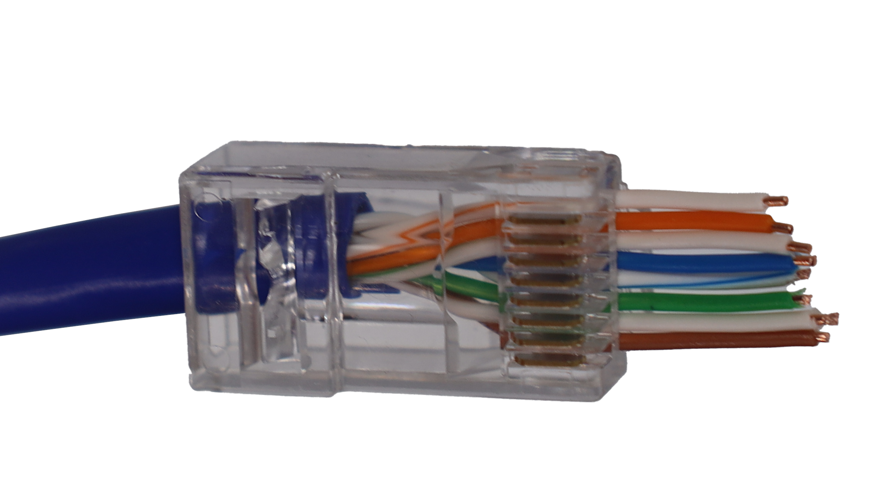
Demonstration Pass-Through Plug
ITFreeTraining.com
© Copyright 2024
Notes:
05:34 RJ-45 pass-through plugs are a variation of the standard RJ-45 plugs. The pass-through design means that the wires are fed through the connector for easier alignment and trimming. To use these connectors, you'll need to crimp them onto the wires using a pass-through plug and a pass-through crimper, which is different to the standard type.
As before, I will remove the outer jacket using the network cutting tool. This time, however, I will use the ripcord to remove more of the jacket. To do this, I will use my wire cutters to create a small split in the jacket. The next step is to pull the ripcord downwards to increase the size of the split. In order to do this, you need a decent amount of ripcord otherwise it is difficult to keep a good grip.
I will now peel back the jacket and remove it with my wire cutters. I will also remove the ripcord. This method wastes a little more cable but eliminates the risk of using the network cutter to remove the jacket which may damage the wires inside.
As before, I will divide the pairs up using some of the cable jacket; This is a bit easier on the fingers. I will next straighten out the wires and try to get the kinks out the best I can.
I will next lay out the wires, so they are in the correct order. Since I used T-568B on the other side, I will need to use it on this side. Remember to always use the same standard on the different ends.
Once the wires have been straightened out in the correct order, place the wire cutters on the wires and move your thumb up to hold them in place. We don’t need to measure the distance, as the extra wire will be cut off when the cable is crimped. Then cut the wires keeping your thumb in place so the wires don’t get separated. You don’t want them getting out of order.
I will now push the wires through the plug. Since it is a pass-through plug, the wires will go straight through the plug. This also allows you to check to make sure the wires are in the correct order.
The last step is to crimp the cable. To do this, you will need to use a crimper that is designed for pass-through plugs. The crimper I used previously won’t work because it does not cut the wires. To use it, I just need to put my pass-through plug into the crimper.
On one side of the crimper is a metal blade that pushes into the plug causing the plug to lock the cable into place. On the other side, the wires are cut. In order to crimp the cable, it is just a matter of pushing down on the lever. Both ends of the cable have now been crimped.
I would recommend that once you finish crimping, test the cable with a cable tester. With this cable tester, if the cable is working, you will get eight lights on either side of the cable tester lighting in sequential order. You can see in this case, I am getting eight lights on both sides in sequential order and, thus, this cable is working correctly. It is very easy to get a wire in the wrong position, so I could not recommend testing the cable enough.

Slide 5
Subscribe
Next video
Video content: https://ITFreeTraining.com/ap11/4c30
© Copyright 2024
Notes:
08:39 That concludes this video. I hope this video has helped you, so until the next video from us, I would like to thank you for watching.
References
“The Official CompTIA A+ Core Study Guide (Exam 220-1101)” page 138
Credits
Trainer: Austin Mason http://ITFreeTraining.com
Voice Talent: HP Lewis http://hplewis.com
Quality Assurance: Brett Batson http://www.pbb-proofreading.uk

