Slide 1
Notes:
Let’s have a look at the Punch Down Tool.

Slide 2
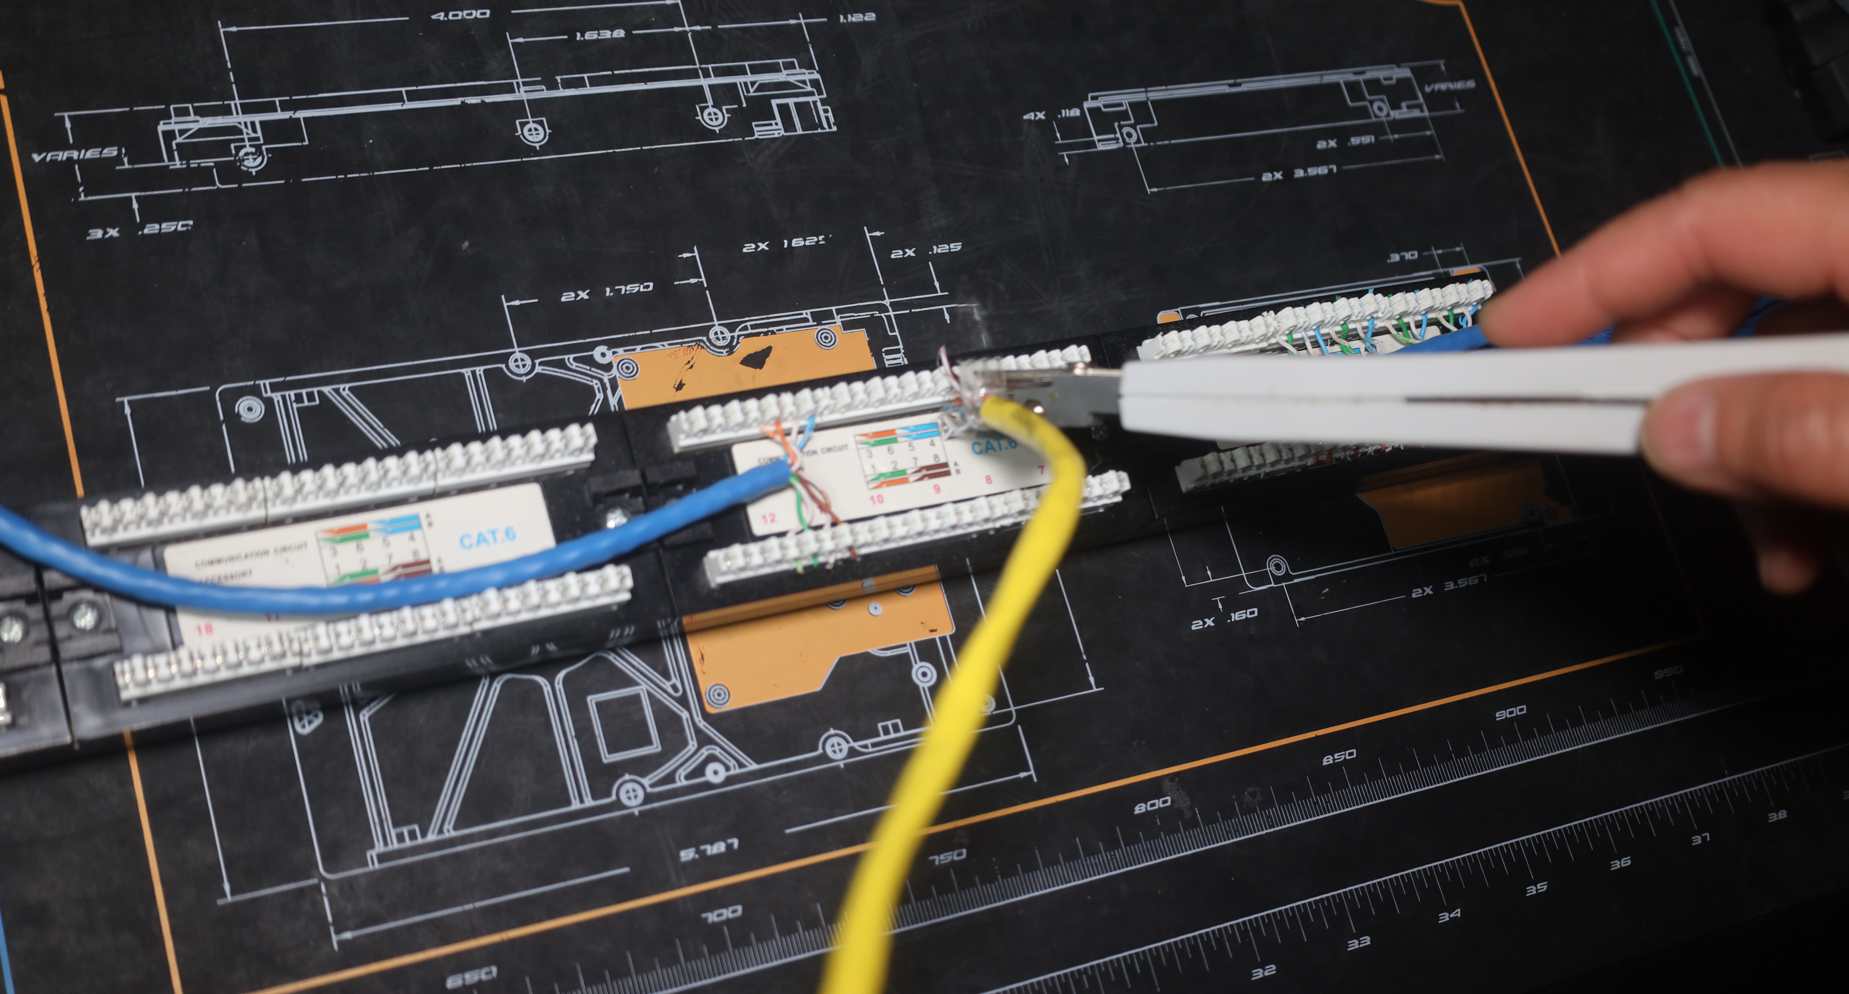
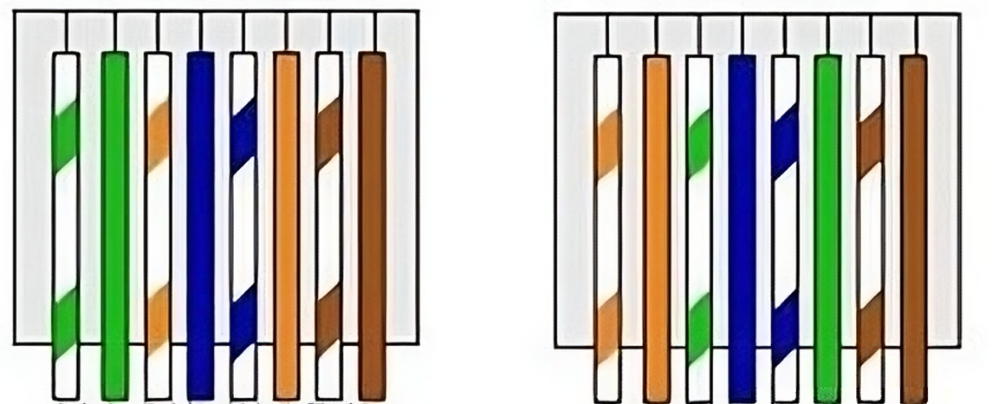
Punch Down Tool
Inserts wires into a punch down panel
Terminates the network cable securely to the panel
Two standards used to terminate cables. Use same standard on both ends
T-568A
T-568B
ITFreeTraining.com
© Copyright 2025
Notes:
00:03 The punch down tool is used to insert wires into a punch down panel. A punch down panel, also known as a punch down block or patch panel, is commonly used for Ethernet and phone lines. The punch down tool effectively terminates the network cable on the panel. The cables terminate on one side, while a network cable, often referred to as a patch cable, is plugged in on the other side.
When terminating cables, it is essential to adhere to one of the two established standards. While the specific standard chosen is not critical, consistency is crucial; ensure the same standard is applied to both ends of the cable for proper connectivity. The demonstration of the punch down tool will clarify this further.

Slide 3
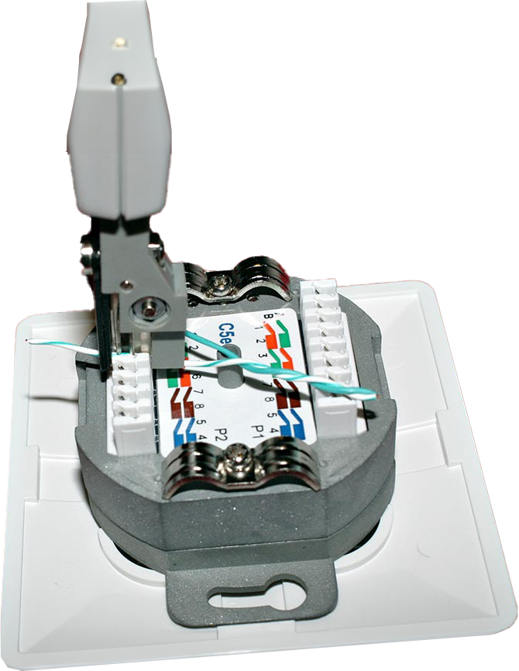
In The Real World
Most IT technicians will never use a Punch Down tool
Most organizations hire cabling specialists to install or modify cabling
Punch down tools are primarily used by networking specialists
ITFreeTraining.com
© Copyright 2025
Notes:
00:47 In the real world, most IT technicians will never use a punch down tool. Most organizations hire cabling specialists to install or modify cabling. Occasionally, you may work for an organization with a small IT budget where the IT technician handles cabling as well, but this is uncommon. In most cases, IT staff are responsible for maintaining the equipment, while cabling is typically pre-installed. If additional cabling is required, cabling specialists will be called in to perform the installation.
If you specialize in networking, you may use a punch down tool. However, even network specialists will likely rely on cablers to handle cable terminations.
For the A+ exam, it is important to understand what a punch down tool is, but there is no need to buy one or practice with it. If you get a job that requires its use, then you can purchase one. Otherwise, invest your money in equipment that you are more likely to use.
Let’s have a look at how to use a punch down tool.

Slide 4
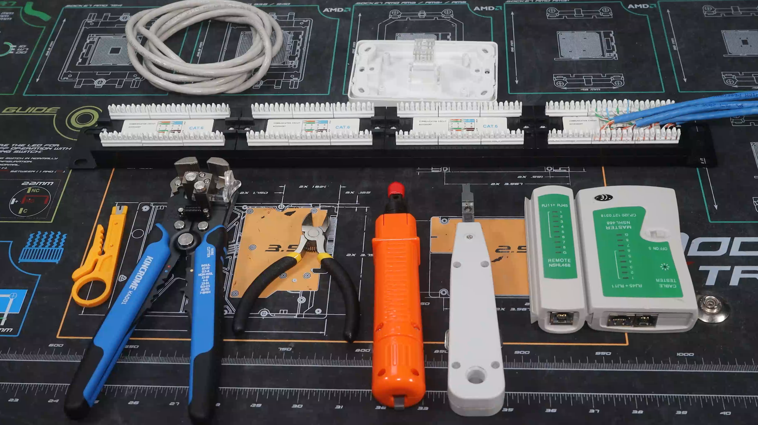
Demonstration
ITFreeTraining.com
© Copyright 2025
Notes:
01:51 I will demonstrate how to connect a network outlet to a 110 block, a common type of punch down block. For the A+ exam, you do not need extensive knowledge of the punch down tool. If a question arises on the exam, it may state that a network port is not functioning, with one possible answer being that it is not properly punched down in the panel.
Here are the tools I will be using. The first two tools are for stripping the outer sheath and trimming the cable. I have two different punch down tools and a cable tester to ensure everything is functioning correctly.
Punching down the cable essentially means terminating the cable, such as at a patch panel. In a patch panel, the cables are terminated at the back, while the front of the panel is used to connect network cables to the ports.
This video demonstrates connecting a cable to the back of a network point. This is the standard Ethernet network point typically found in offices. I will use a length of plenum cable, as it is commonly used for running through plenum spaces to connect the network point to the patch panel.
I will plug the other end of the cable into a 110 block. One side of the block contains the termination points, also known as IDCs or Insulation-Displacement Contacts. IDCs are electrical connectors designed to directly connect to the conductors of an insulated cable. They use sharpened blades to cut into the insulation during the connection process, eliminating the need to strip the insulation from the conductors. When correctly punched down into an IDC, the connection is very secure and highly reliable.
The other side will have the ports where your patch cables will plug in. These ports will be numbered, but typically, you will assign your own numbering at the top of the patch panel to match the numbers assigned to the corresponding wall outlets. It is up to the organization to determine the numbering system. Some may simply number the ports, while others may include additional information, such as a specific number for the patch panel.
To begin, I will remove some of the outer insulation from the cable using this tool. This is an affordable tool that serves two purposes: removing outer insulation and functioning as a punch down tool. It is ideal for occasional use, suitable for punching down a few cables. However, for extensive cable installations, investing in a higher-quality tool is advisable. While this basic tool can handle one or two installations, it can be tough on the hands during prolonged use. For projects involving hundreds of installations, choosing a more advanced and ergonomic tool is a wiser option.
I will now remove the outer insulation. To do this, I will press the cutting part of the tool onto the cable and rotate it around. After that, I will remove the tool and pull the insulation away. Do not remove the insulation by pulling the cutting tool down the cable, as this can damage the internal wires.
At the top of the cable, you can see a thin, string-like cord known as the rip cord. It is used to help strip the outer jacket without damaging the wires inside.
I will attempt to pull the rip cord back, but the jacket of this cable is quite tough, so I will not be able to. To neatly open the cable jacket, I will first make an incision using wire cutters. Then, I will pull the rip cord downward to split the jacket cleanly along its length. After this, I will carefully peel back the insulation to expose the wires inside. It is important to not be too forceful when doing this, as that could damage the wires inside.
You can see, the wires are intact, indicating that the cut is good. In my opinion, if you trust your wire stripping tool, this additional step is unnecessary. However, when working with a new cutting tool, I often perform this check to ensure everything is functioning correctly, at least until I am confident in the tool's reliability.
Next, I will pull the four wire pairs away from the center divider. Note that not all cables have a divider. The divider helps keep the wires separated from each other. I will now remove the divider. The cable is nearly ready.
I will next pull the four wire pairs away from the center divider. Not all cables will have a divider. The divider helps keep the wires separate from each other. I will now remove the divider. The cable is almost ready.
I will next need to split the four twisted pair wires. If you are having difficulty separating them, you can use the insulation previously removed from the cable. This can be used to pry the wires apart, making the process easier. Once complete, we can now punch the cables down into the 110 block.
The block usually has a diagram indicating the placement of each wire. There are two different wiring standards: T-568A and T-568B. The primary difference between the two is that the orange and green pairs are swapped. The important point to remember is to use the same standard on both ends of the cable. The most commonly used standard is T-568B, which I will use for this demonstration. Therefore, I only need to refer to the B line and can ignore the A line.
In this example, the wires are punched down on both the top and bottom. I will demonstrate how to connect a block where all the termination points are on the top. I will initially place the wires in the top row only, ignoring the bottom row, to show the correct placement of the wires, as it is easier to see. The wires are not in their final positions, as they need to be placed in both the top and bottom rows.
To meet the BICSI cabling standard, established by the Building Industry Consulting Service International, an organization that sets best practices for network installation, it is recommended that the twisted pairs are not untwisted more than half an inch or 13 millimeters from the termination point. Therefore, ensure you do not untwist too much of the wires before termination.
I will now place the wires into the termination points, making sure that I follow the wiring diagram for T-568B. When you do this, you want to have the cable in the center of the block. You also want to make sure the untwisted wires are no more than half an inch or 13 millimeters away from the termination point. If you have trouble getting all the wires in at once, with the wires coming loose, you can always put in one pair of wires at a time, just make sure the cable is positioned correctly.
To punch the wires down in the block, I will use the tool I used to cut the outer jacket earlier in the video. Punching a wire into the block is simply a matter of pushing down on the wire with the tool.
Notice the excess wire protruding from the block. The tool does not remove this extra wire, so I will need to use wire cutters to trim it. Excess wire can cause signal crosstalk and interference, which may degrade network performance. Therefore, always trim the wires properly.
Next, I will use a Punch Down tool. This tool features an impact mechanism that automatically applies the correct amount of force when inserting a wire into the connector, ensuring a secure and reliable connection without damaging the wire or the connector. The tool also has a blade that cuts the excess wire. This tool makes punching down wires faster and easier, especially during large-scale network installations.
It is used similarly to the previous tool. Push down on the tool, and it will insert the wire into the block and ideally cut the wire. This is a relatively inexpensive tool, which may be why the wire was not fully cut.
Since the wire was only partially cut, twisting it a few times will break it, allowing me to remove it. This is a basic tool, so I will try a more expensive one to see if it yields better results. Unlike the previous model, this tool is adjustable.
This tool can be adjusted to vary the amount of force applied. It has settings labeled L and H for low impact and high impact, respectively. When punching down cables into blocks, you should always set the tool to maximum impact. In this case, turn the top to the high impact setting. Now we are ready to punch down the last two twisted pairs.
I will punch down the wire as before. Push the tool down until you hear it click. Unfortunately, as with the previous tool, the wire was not automatically cut. So, I will twist the wire until it breaks. It appears the first wire was not cut cleanly, so perhaps the cheaper tool provided better results. The cable is now terminated to the block, and the next step is to repeat the process with the network point.
Next, I will strip off the outer jacket as before, but this time I will use an automatic wire stripper. To use this tool, thread the cable into it and squeeze the handles together. The jacket will be automatically removed from the cable. This method carries some risk of damaging the wires. If the tool is in good condition and configured correctly, the chances of this happening are low. If you are concerned about damaging the wires, use the rip cord to remove more of the jacket.
Next, I will remove the rip cord, the internal divider, and untwist all the twisted pairs. The network point will need to be punched down just as before, so the process remains the same. Some network points use an ARJ-45 plug; however, in this example, the same type of termination is being used as for the block.
Before terminating the wire, I need to remove the plastic cap from the network point. This cap protects the wires once they have been terminated, so be sure to place it somewhere safe for replacement later.
You can see that this network point has a diagram indicating where to terminate the wires. In this case, T-568B is displayed in the center of the diagram. Since I used T-568B on the other end, I need to use the same standard here.
Next, I will terminate the cable to the network point using the T-568A standard to demonstrate what happens when this mistake is made. I will also terminate each pair individually rather than all at once. If terminating one pair at a time, ensure the cable is positioned correctly. The cable should be just outside the socket; otherwise, the punch down tool may hit it while attempting to punch the cable down.
Next, I will punch down the first twisted pair. Ensure it is fully inserted before punching the wire down. Make sure the cable does not have too much slack, as this can impact the data transmission over the cable.
I will punch down the opposite twisted pair. Ensure the cable is positioned correctly, with minimal slack, and punch down the wires as before. With two pairs securely punched down, I can now move to the outer twisted pair. Always punch down the inner twisted pair first, as it makes it easier to position the cable correctly.
Now, I will punch down the last two twisted pairs. These pairs will be swapped to terminate using the T-568A standard instead of T-568B. The rest of the process remains the same as before. When punching down, ensure the wire is correctly inserted, use sufficient force, and push the tool straight down. If you do not, the wire may not terminate properly. In this example, the brown wire is not terminated correctly. If this happens, data will not transfer correctly, so it is crucial to get this step right.
If the wire is damaged, you may need to pull all the wires out, trim the cable, and punch them down again. In this case, the wire is not damaged, so I can simply adjust it and punch it down again. As you gain experience using the punch down tool, you will become more proficient with it.
I will now trim the excess wires using my wire cutters. If you plan to use a punch down tool frequently, I recommend investing in a high-quality one to minimize the need for additional wire cutting.
I will now place the plastic cap back on. You will notice that it does not fit properly because I did not trim two of the wires sufficiently. If you are using wire cutters, make sure to trim the wires as far back as possible. This helps ensure a more reliable connection.
I will remove the plastic cap and trim the wires again. Once done, I will put the cap back on. It should fit better this time. This is the final step of the punch down process; now we need to test to ensure everything is working.
I will verify the functionality of the cable using a basic cable tester. This device ensures that all the wires are correctly connected and operational. While basic testers are quite affordable, professional-grade cable testers are significantly more expensive but offer much more comprehensive and advanced testing capabilities. This demonstrates the value of hiring a professional cabler for cable installations, as they typically use advanced testers that can assess more parameters than a basic model.
To use the cable tester, I will plug a network cable into the port I want to test. Then, I will connect the cable to the main part of the cable tester, known as the transmitter, which sends the signal through the wires. Next, I will connect another cable to the network point and plug it into the remote unit.
I will now switch on the transmission unit. Each wire will be tested, and a light will illuminate when the wire is correctly connected. You will notice that wire 4 is not working, so it will not light up. If the cable is functioning properly, all the lights on the tester should illuminate sequentially, one after another, in order. In this case, wire 4 is either damaged or not properly punched down.
When I add the receiver unit, notice that the lights are not flashing in the correct order. This is because I used different wiring standards on the two ends. If the lights illuminate in the wrong order, it indicates that the wiring is incorrect.
To fix these issues, I would re-cut the cable, punch down the wires again, and this time use the same standard on both ends. Although it may be tempting to pull out just wire 4 and punch it down again, something has gone wrong, so it is best to start over. To remove the wires, simply pull the cable upwards.
Punching down the wire, even once, cuts it to establish a good contact. Multiple cuts on the wire reduce its efficiency. Therefore, always trim the cable back and start again.

Slide 5
Subscribe
Next video
Video content: https://ITFreeTraining.com/ap11/4c25
© Copyright 2025
Notes:
16:58 That concludes this video from ITFreeTraining on the punch down tool. I hope you have found this video informative, and until the next video from us, I would like to thank you for watching.
References
“The Official CompTIA A+ Core Study Guide (Exam 220-1101)” page 137
“Picture: Patch Panel” https://i.pinimg.com/originals/3c/54/67/3c5467002ccceaff77c9329da9adb268.jpg
“Picture: Punch down tool” https://commons.wikimedia.org/wiki/File:Schneidklemme-Angelegte_Ader.jpg
Credits
Trainer: Austin Mason http://ITFreeTraining.com
Voice Talent: HP Lewis http://hplewis.com
Quality Assurance: Brett Batson http://www.pbb-proofreading.uk

