Slide 1
Notes:
Let’s have a look at cable strippers.

Slide 2
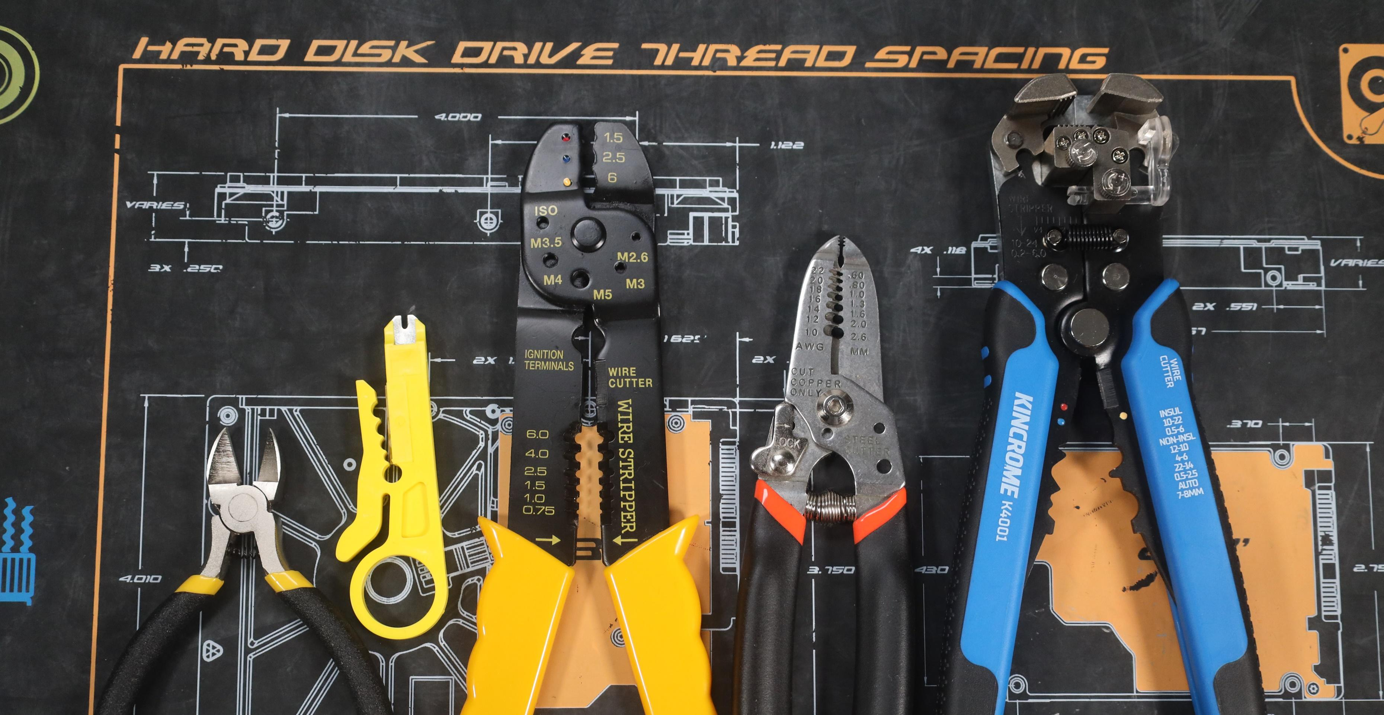
Cable Strippers
Removes protective insulation around wires
Without damaging the conductive material beneath
ITFreeTraining.com
© Copyright 2025
Notes:
00:02 In the IT field, you may use wire strippers; then again, you may never need to use them, not even once. The most common reason for using them is when creating custom-length network patch cables. Stripping the cable removes the protective insulation around the wires without damaging the conductive material beneath it.
There are several different tools that perform the same function as cable strippers. I will now look at a few of them.
To start, I will use wire cutters to trim a network cable. This network cable has been used before, so I want to trim it to start afresh. When trimming a cable like this, the flat side of the cutters should face the part of the cable that you want to keep to ensure a flush cut. The beveled edge should face the end that you want to discard.
I will now cut the cable. When done correctly, you should have a nice, straight cut across the cable. Now I can look at removing the outer insulation of the wire.
To remove the outer insulation, I will use the following tool. This is a rotary wire stripper that also includes a punch-down tool. For this video, I am only looking at the rotary wire stripper part. This tool is quite cheap and simple to use.
To use it, the cable needs to be in the recess cutting area of the tool. To get the cable into the recess, press the lever down. Next, spin the tool 360 degrees. Remove the tool from the cable and remove the insulation. Don’t pull the tool down the cable as this risks damaging the wires.
Next, I will look at a wire stripping tool. This tool is designed specifically for wire stripping. The wire stripping part is in the middle of the tool. To use it, the tool is labeled according to the gauge of wire it can accommodate for stripping. Find the hole that matches the width of your wire.
Use your thumb to push the tool away to strip the wire. One common mistake people make is to pull the tool away. Doing this increases the risk of damaging the wire. In this example, the cable is comprised of stranded wire, meaning it has a number of flexible strands of wire inside. Unfortunately, in this case, some of the strands broke when I removed the outer insulation. It may take you a few tries to get it right, particularly when the wire is very thin. The fewer strands there are, the worse the connection is going to be.
The other type of wire is solid core, which contains only a single wire. These wires are a little easier to strip than the stranded ones. The advantage of solid core is that it has less resistance than stranded wires. The disadvantage is that it is less flexible.
There are many different types of wire strippers on the market. This one has more gauge sizes than the previous tool, so maybe I will have better luck stripping the wire this time around. I will unlock the tool and try a few of the stripping notches to find the one that matches my wire. Use your thumb to push the tool away, and the wire is stripped.
You will notice that I got much better results than I did with the other tool. With this tool, I was able to use a slightly larger gauge than the other tool would allow, which may have helped. You may find that with different tools, you may get better results.
The last tool that I will look at is an automatic wire stripper. These tools automatically adjust to the width of the wire and remove the insulation by squeezing the handles. It is the most expensive out of the tools but is easy to use and gives good results.
To use the tool, put the wire you want to strip in place and simply squeeze the handles together. The tool will automatically adjust to the required width and remove the outer insulation. Although the tool costs more, it makes the process easier and removes all the guesswork.
The tool can also be used on thinner wire. The tool will automatically adjust to the width of the wire and give you good results. If you are planning on doing a lot of wire stripping, it is worth getting this tool; otherwise, you may just want to save some money and get one of the other tools.

Slide 3
Subscribe
Next video
Video content: https://ITFreeTraining.com/ap11/4c20
© Copyright 2025
Notes:
04:15 That concludes this video from ITFreeTraining. I hope this video has been informative. Until the next video, I would like to thank you for watching.
References
“The Official CompTIA A+ Core Study Guide (Exam 220-1101)” pages 136 to 137
Credits
Trainer: Austin Mason http://ITFreeTraining.com
Voice Talent: HP Lewis http://hplewis.com
Quality Assurance: Brett Batson http://www.pbb-proofreading.uk

