Slide 1
Notes:
Let’s have a look at structured cabling.

Slide 2
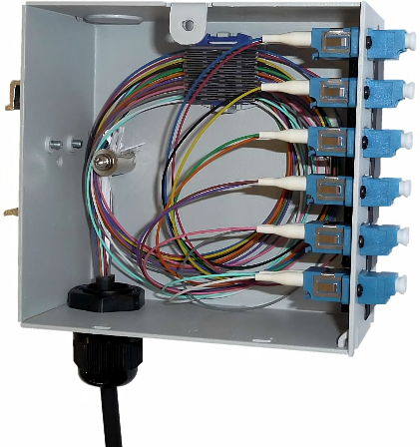
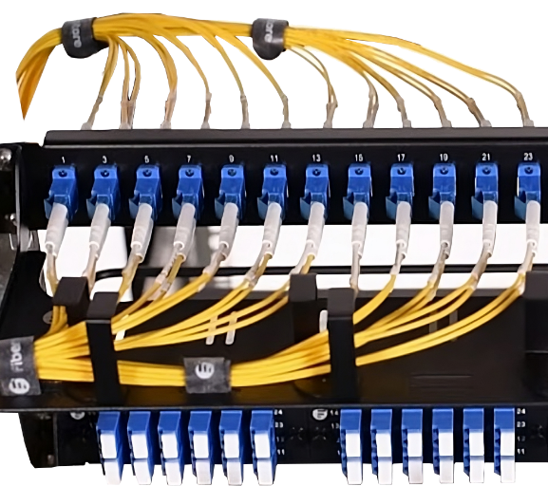
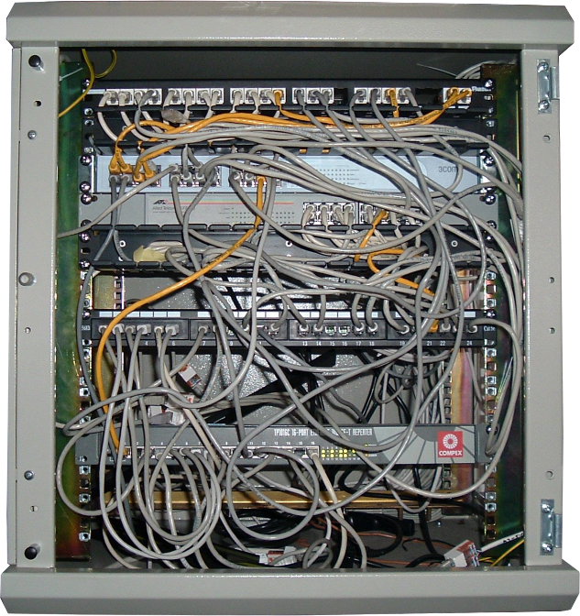
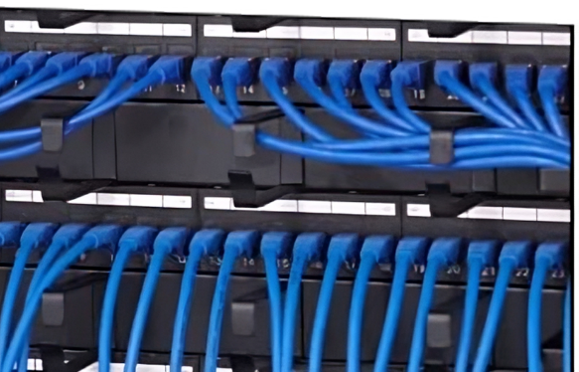
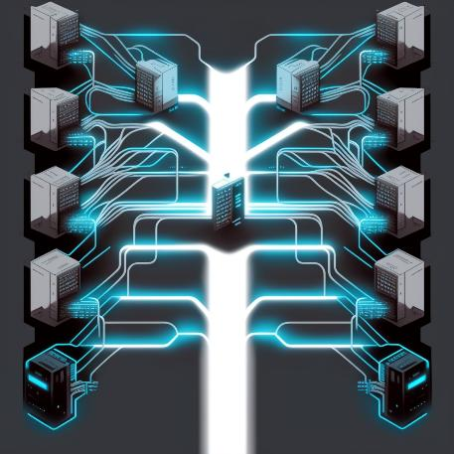
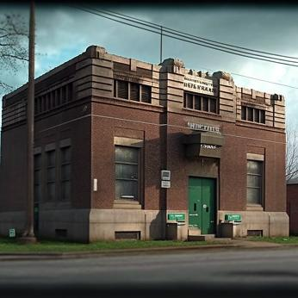
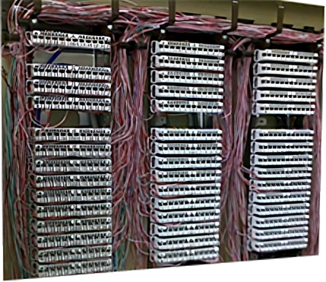
Structured Cabling
Collection of standardized components for networking
Defined under the ANSI/TIA standards
External
Demarc
Main Distribution Frame (MDF)
Intermediate Distribution Frame (IDF)
Work area
Internet
Fiber
Exchange
Punch blocks
Patch panel
Backbone
ITFreeTraining.com
© Copyright 2024
Notes:
00:03 Structured cabling is a collection of standardized components for networking. They are defined under the ANSI/TIA standards. For the A+ exam, you only really need to have a basic understanding of how networking components are connected together. It is unlikely that you will get a difficult question on this topic.
To understand how a site may be cabled up, let’s have a look at some of the components and how they are connected together. Let’s first consider that your business has an external connection to the internet. In this example, it has a fiber optic connection to the internet.
The fiber cable will need to terminate somewhere on the business site. This location is called a demarcation point or demarc. These demarcation points can look very different from site to site. Often, they are located in a room on the ground floor or basement.
Let’s now consider how the business connects to the telephone network. In this example, the business connects to a telephone exchange. To do this, there are a number of phone lines running from the business to the exchange. In this example, these phone lines are terminated at punch blocks.
Punch blocks are often used for telephone installations as they allow quick changes to the wiring by punching the wires down into the block and position required. A special punch down tool is used to punch the wiring into place.
The point where phone wires from outside the building connect to the internal wiring is called the demarcation point. This is where the public network ends and the customer’s network starts. However, to make it easier to make changes, these may be connected to a Main Distribution Frame or MDF.
It is important to point out that every site is different. It is not uncommon for the MDF and demarc point to be in the same set of punch down blocks. Usually, the first group of punch down blocks will be the incoming lines. The upper block numbers are going to the cabling running to the customer’s patch panels or their internal wiring. As businesses grow, there may not be enough punch blocks, and more are then added. As existing punch blocks become full, newer external lines may need to be installed at the end of the punch panel rather than at the start. Don’t assume that external lines will always be the first punch blocks. Most MDFs will have documentation to explain what wires go where, but often this documentation is not kept up to date. So, don’t assume anything.
Hopefully, your MDF will just be a patch panel making it easy to make changes. The MDF will generally be in close proximity to where the external cables come into the building. I have seen cases where fiber lines terminated at a patch panel. Thus, the demarc and MDF are in the same rack. I have also seen one site where there was a room large enough to park two cars in. In the center of the room was a small box where the external fiber line terminated. The room contained only a single fiber optic box. Another fiber optic line ran from this box to a nearby room housing the MDF.
It may seem strange to have a setup like this, but keep in mind that networking is often added to overtime. In the case of this site, the fiber could not be run directly to the MDF as it was too expensive for the telecommunication company to run the cable the extra distance. The cable was run from a service termination nearby while the MDF was on the other side of the site. Thus, a fiber line was run to the closest room they had available which happened to be very large. Fiber cables then had to be run from this room to the MDF room. Modern buildings don’t have these problems as they are designed with networking in mind, but with old buildings, the network can be in strange places and for that reason don’t make a lot of sense. If it does not make sense, it was probably built up slowly over time and made sense using the technology available at the time.
From the MDF, lines will go out and the next stop will probably be an intermediate distribution frame or IDF. Particularly on large sites, IDFs will be all over the site. These IDFs are connected by backbone connections. These backbone connections also run all over the site and allow different areas to be connected together. This is generally done due to distance limitations, but sometimes may also be because of environmental factors.
From each of the IDFs, there will be cables that will go to the work areas. Thus, you can see how each component makes up part of the network. Offices will follow these standards when it comes to installing networking. It is not important for you to understand every part of how these standards work, unless you go into a career in network cabling, but the technician needs to have a bit of an understanding, so at least they will know what they need to do or who they need to call when working with networks.
Let’s now have a look at how these components work together.

Slide 3
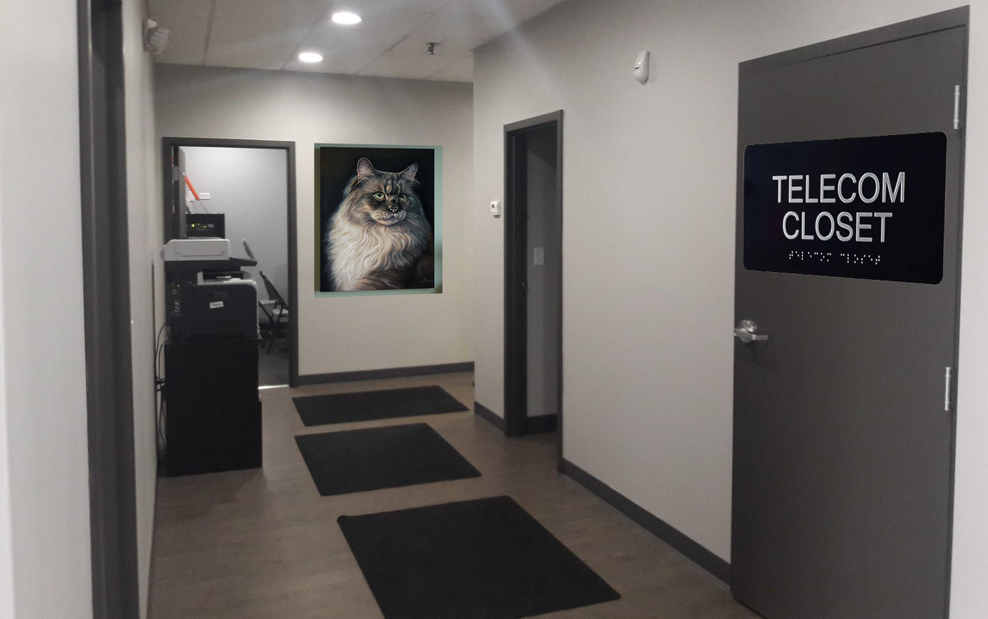
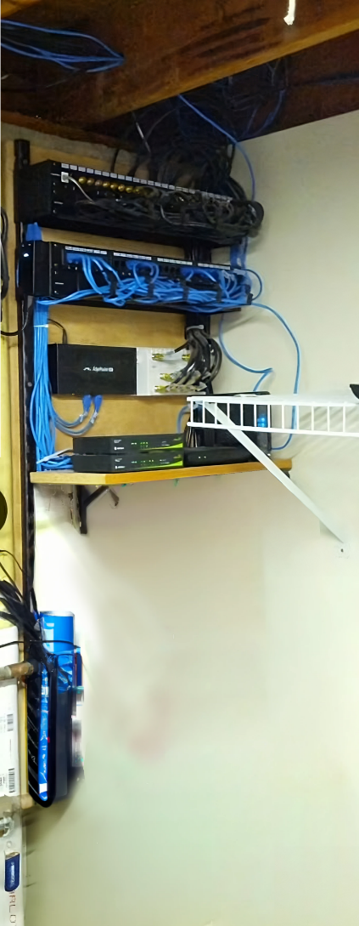
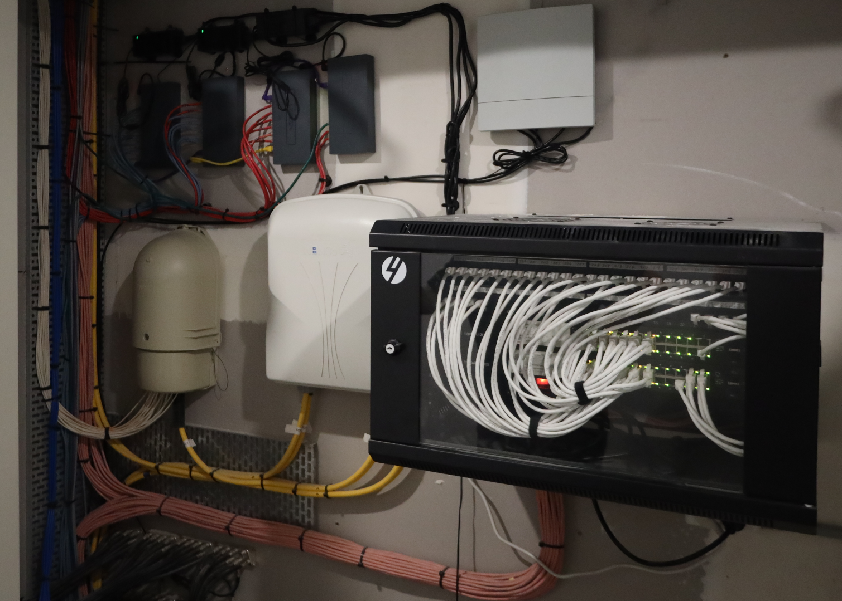
Telecommunication Room
Houses network devices and cables. Plus, others
Also known as network closet, comms room, network room
ITFreeTraining.com
© Copyright 2024
Notes:
05:13 One of the first locations you are going to want to find is the telecommunication room. This is where the network devices and others are stored. I say others, because often CCTV, electrical, alarm systems and other devices are put in these cabinets. They are also known as network closets, communication rooms, or network rooms.
Hopefully the room is clearly labeled. However, sometimes they may not be. In the case of small buildings or small installations, usually they are crammed into small places. When you don’t have a lot of space to start with, you don’t want to waste space on a network closet if you don’t have to. I have seen them under stairs, on roofs, and in storage rooms surrounded by junk. So, if you don’t know where it is, have a really good look around. The staff may be able to assist you. If, however, they are unfamiliar with the term "telecommunication room," rephrase your question with simpler terms. For example, you could ask them: "Do you know where all the internet equipment is?" or "Do you know where the technicians go to work on the building's network equipment?”
Now let’s have a look at where the cables from the network closet go.

Slide 4
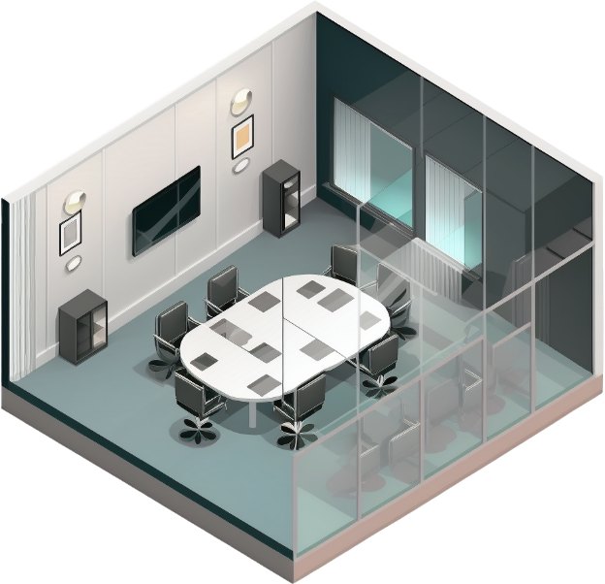
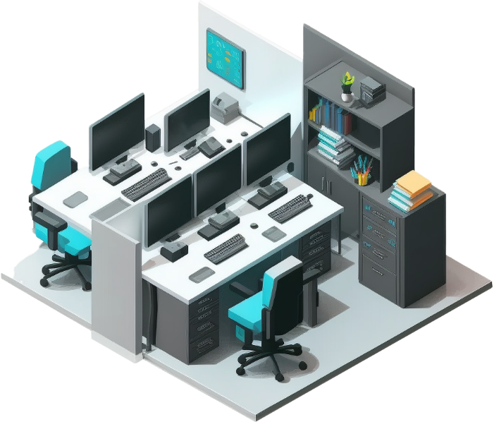
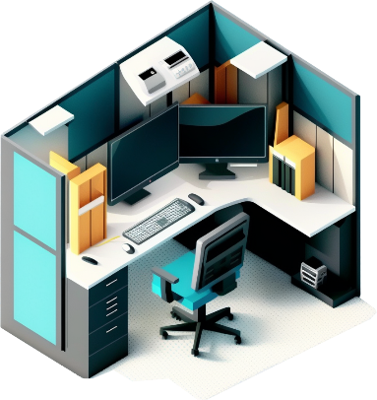
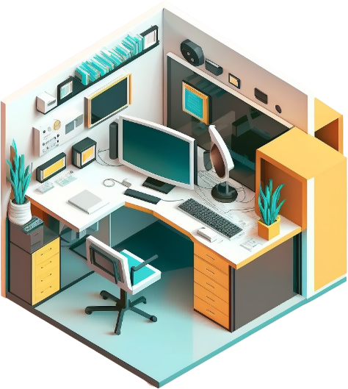
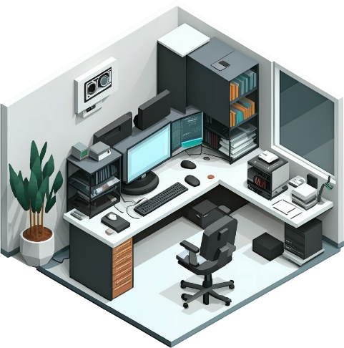
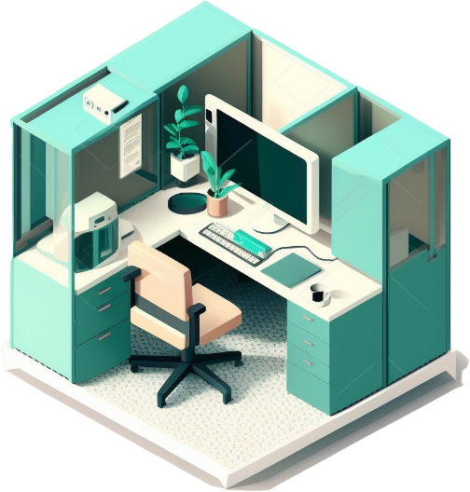
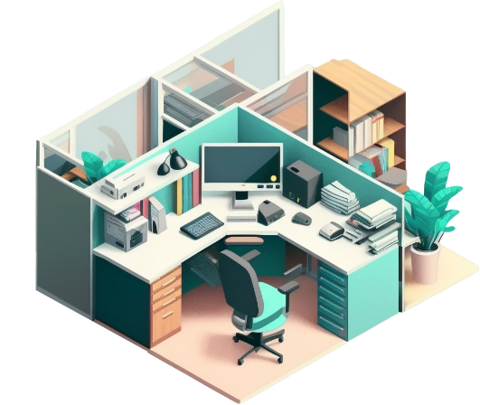
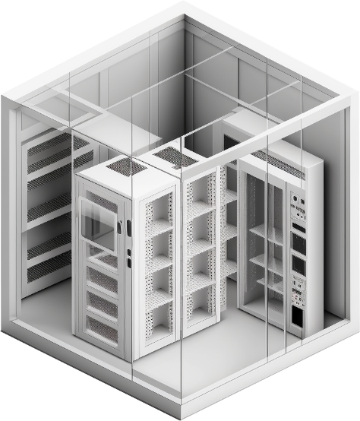
Horizontal Cabling
Generally, run horizontally from patch panel to wall socket
Makes a star network with patch panel at the center
ITFreeTraining.com
© Copyright 2024
Notes:
06:25 The cables from the telecommunication room generally run horizontally from the patch panel to the wall socket and are thus known as horizontal cabling. If the same patch panel connects two or more floors, you will generally find the cabling will go directly up or down to the next floor before running horizontally.
Let’s consider that you have a number of workspaces you want to connect to the network. In order to connect them, a cable is run from the telecommunication room to each wall socket. If a wall socket has multiple connections, multiple cables need to be run.
Ideally, you would want the telecommunication room near the center of the building, but this is not always possible. If more work areas are added, the cables need to be run from the telecommunication closet to these locations. Since one cable goes to each network location from a central point, a network like this is considered to be a star network.
Star networks have the advantage that each device has its own cable back to the network equipment in the telecommunication room. This does incur the added cost of cabling, but given the advantages, nowadays, you will find this setup has become very popular. Let’s now have a look at what kind of distances we can expect.

Slide 5
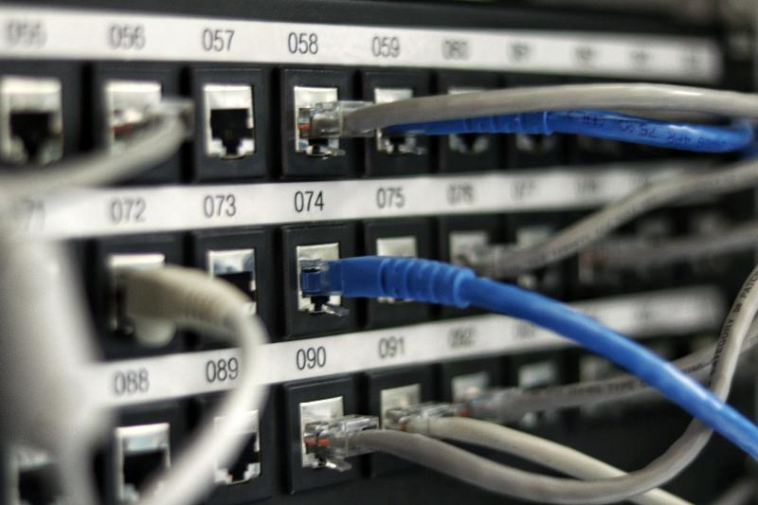
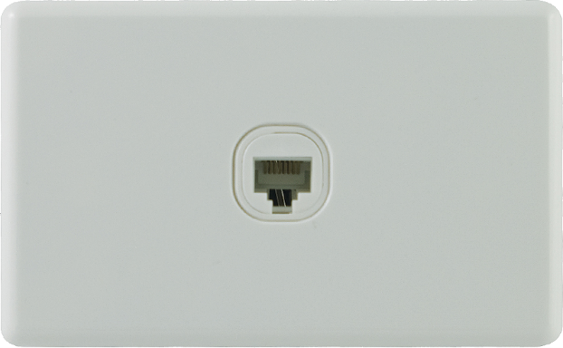
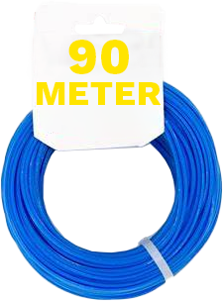
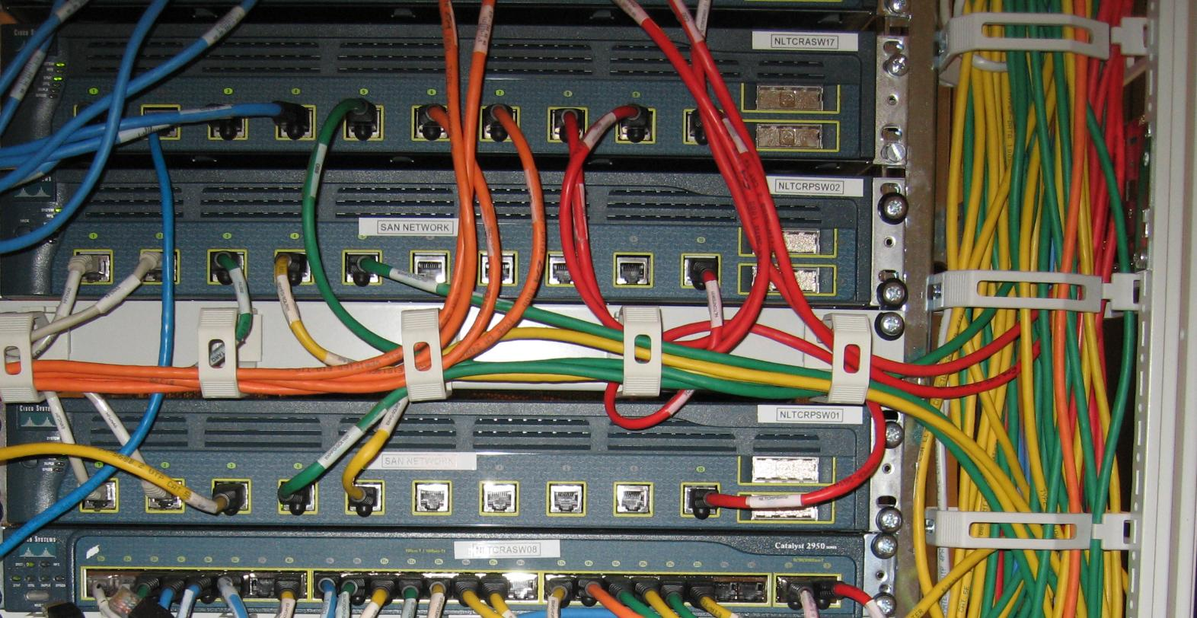
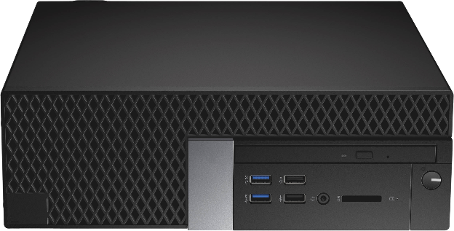
Cabling Distance (Channel Link)
Most ethernet standards allow up to 100 meters
ITFreeTraining.com
© Copyright 2024
Notes:
07:43 Most wired ethernet standards have a maximum distance of 100 meters. This is the maximum distance of the whole link, which may be referred to as the channel link. Generally, this distance will be broken down as follows: From your network devices to your patch panel, allow for five meters of cabling.
From your patch panel to your wall socket, allow for a maximum of 90 meters. Lastly, to make up the 100 meters, allow another five meters to the device you are plugging into the wall socket.
So, the question is, what happens when you need to go over 100 meters?

Slide 6
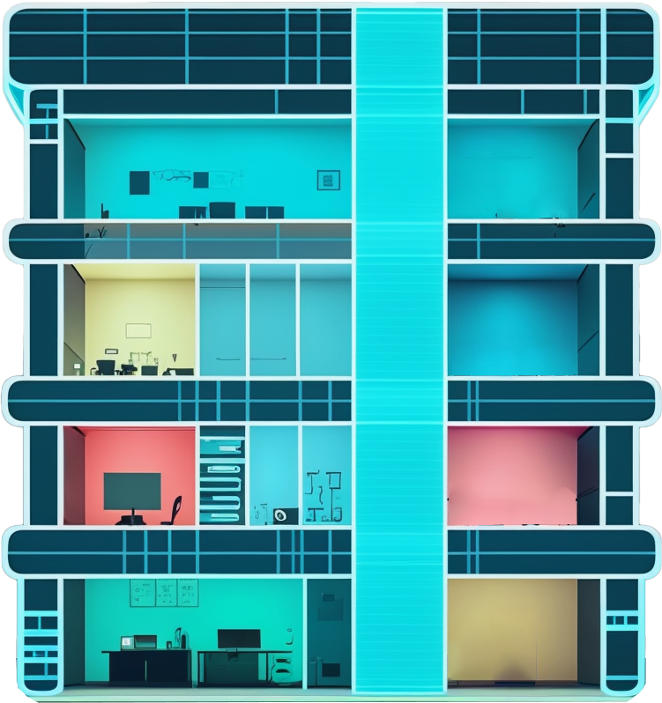
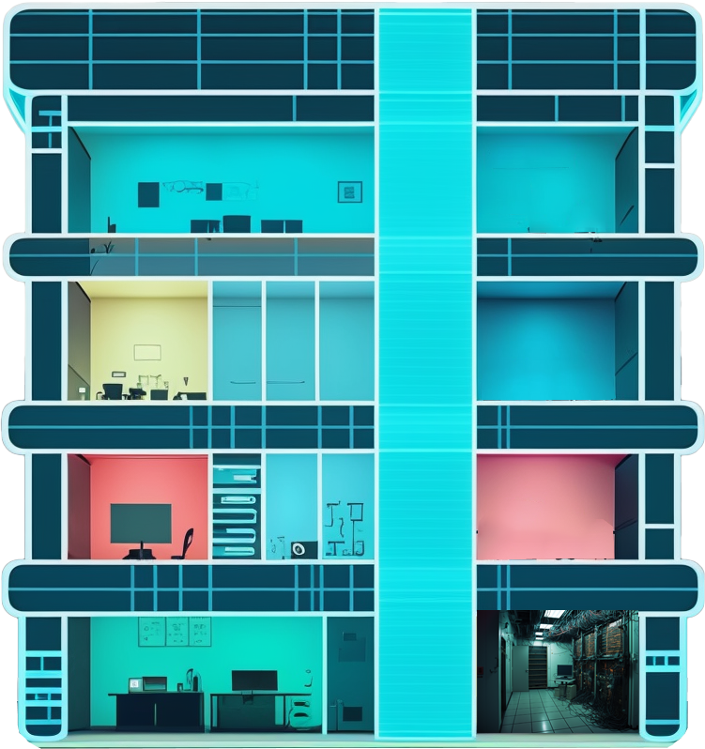
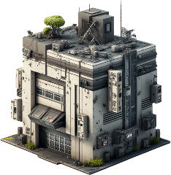
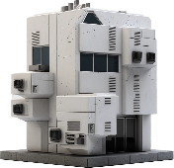
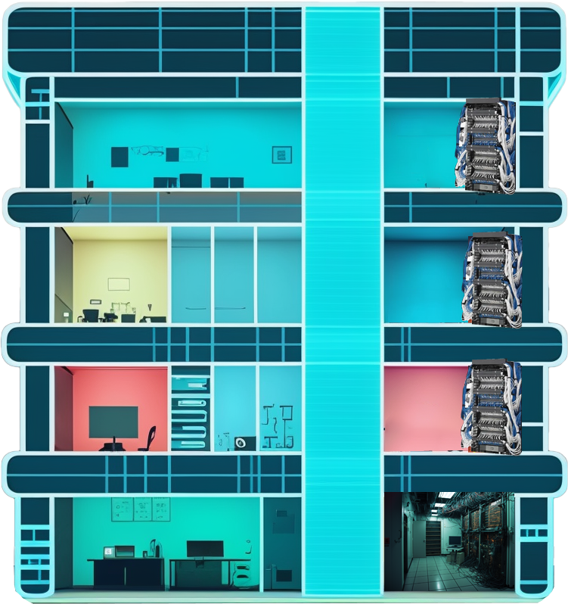
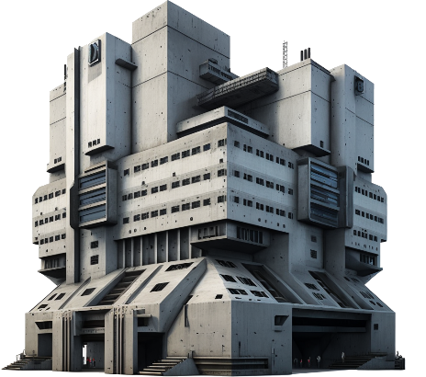
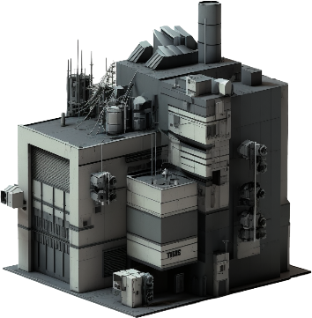
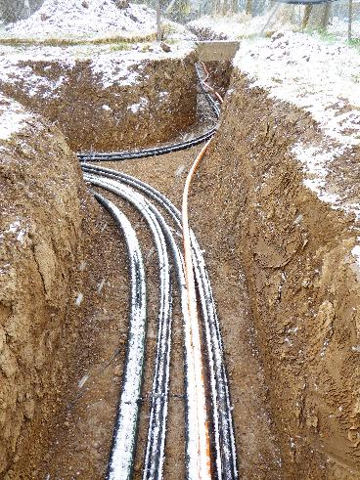
IDF and Backbone Networks
Often uses fiber optic for increased distance/reliability
Pit with fiber lines
IDF on each floor
ITFreeTraining.com
© Copyright 2024
Notes:
08:21 To connect different parts of the network together, an IDF and backbone networks are used. Often, they are connected together using fiber optic. Fiber optic allows for greater than 100-meter distances and tends to be more reliable than copper cabling.
Consider that you have a network that is split over multiple buildings in one large site. To connect these buildings together, fiber is used. The fiber is run through pits which need to be dug between each of the buildings. Often extra services may be included since it costs money to dig such pits, for example, including electrical and phone lines.
In each of the buildings there will be an IDF. Each time the network packets reach an IDF, the packet data gets recreated and forwarded to its next destination. These connections may be referred to as a backbone. A backbone generally consists of high-speed links that can transfer a lot of data and connect various smaller networks together.
Not all links are considered to be backbones. To understand this better, let’s consider one of the buildings. This building has an MDF room on the ground level. This room has a fiber optic line that connects to the other building. It also has additional services like telephone lines. On each level of the building is an IDF.
Each floor houses an IDF that connects devices to the network on that level. In modern buildings, these IDFs are often stacked directly above and below each other, making it easier to connect floors together. Cables connect each floor together, but generally all floors will connect to one location, often the ground floor or basement.
If the building is an old building, these buildings were probably not designed with networking in mind. The IDFs might not be located directly above each other, unlike the example shown. The point to take away is that, IDFs are generally network closets containing a network rack that has your network equipment and a patch panel. The IDF distributes the networking to a local area network under the 100 meter limit. The IDFs may be connected using copper or fiber optic cabling.
If your network is large enough, it may have backbones to connect different networks together. Backbones are like superhighways for networks and the IDFs are the local roads that lead you to your destination.

Slide 7
Subscribe
Next video
Video content: https://ITFreeTraining.com/ap11/4c15
© Copyright 2024
Notes:
10:48 That concludes this video on structured cabling. I hope this video has given you a better understanding of how different parts of the network are connected together. Until the next video from us, I would like to thank you for watching.
References
“The Official CompTIA A+ Core Study Guide (Exam 220-1101)” page 136
“Mike Myers All in One A+ Certification Exam Guide 220-1101 & 220-1102” pages 781 to 759
“Picture: 110 phone block” https://commons.wikimedia.org/wiki/File:110-network-hardware.jpg
“Picture: Network rack” https://commons.wikimedia.org/wiki/File:Ethernet_12U_box.jpg
“Picture: Patch Panel” https://unsplash.com/photos/40XgDxBfYXM
“Picture: Network switches” https://commons.wikimedia.org/wiki/File:Cisco_Catalyst_2950_network_switches_in_situ_-_IMG_1076.jpg
“Picture: Roof cabling” https://wallpapercave.com/w/BFvNq20
“Picture: Cable pit” https://commons.wikimedia.org/wiki/File:2021-04-08_M%C3%BCrztal_Kabeltrasse_Strom_LWL3.jpg
Credits
Trainer: Austin Mason http://ITFreeTraining.com
Voice Talent: HP Lewis http://hplewis.com
Quality Assurance: Brett Batson http://www.pbb-proofreading.uk

