Slide 1
Notes:
Let’s look at the connectors and standards used for network cables.

Slide 2
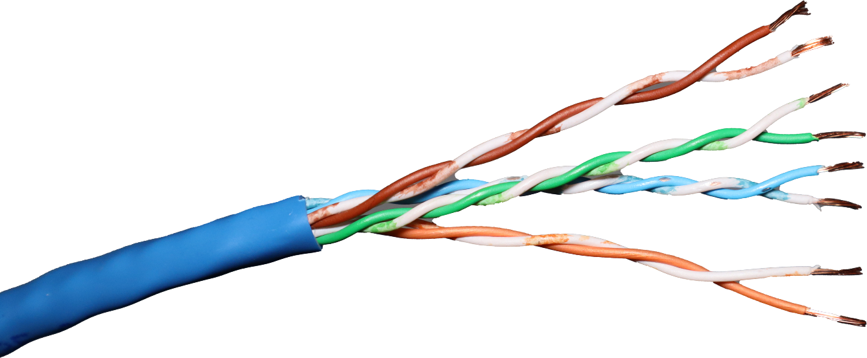
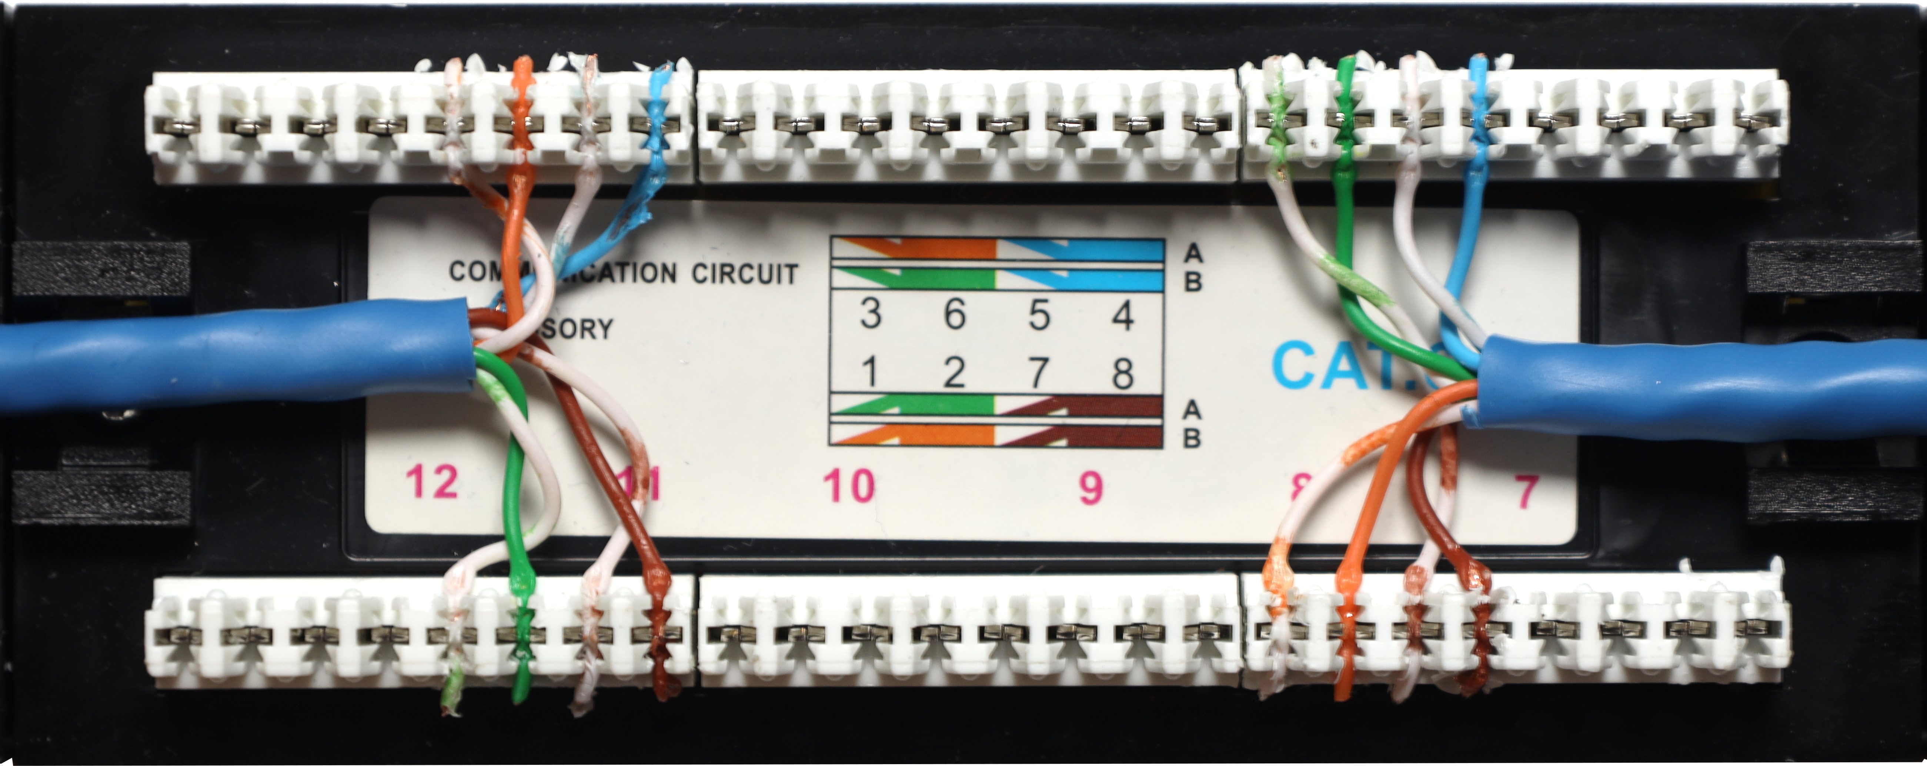
Termination Standards
568A
568B
Defined under the ANSI/TIA-568-D standard
ITFreeTraining.com
© Copyright 2024
Notes:
00:05 Nowadays, standard network cables will contain eight wires grouped into four pairs of wires. For a connector to be used with these wires, they need to be terminated. There are two standards for terminating these wires, the 568A standard and the 568B standard. These standards are defined under the ANSI and TIA 568-D standard.
On the left, I have used the 568A wiring standard, while on the right, I have used the 568B standard. In practice, when terminating patch panels, it's crucial to stick to a single standard throughout, to ensure consistency and reliability in your network infrastructure. However, for the sake of illustrating the distinctions between these two standards, I have uniquely terminated each side with a different standard to show the difference.
The standards specify how wires are terminated. Regardless of the standard chosen, two of the wire pairs always terminate at the same location. However, the termination points for the remaining two pairs differ between the standards. Let's examine this more closely.

Slide 3
568A and 568B
568A
568B
Compatible with USOC standards
Most widely used
Pair 3(Different)
Pair 2(Different)
Pair 1(Same)
Pair 2(Different)
Pair 3(Different)
Pair 1(Same)
Pair 4(Same)
Pair 4(Same)
* ANSI/TIA-568A recommended for horizontal cables
* 568A required for U.S. government contracts
ITFreeTraining.com
© Copyright 2024
Notes:
01:13 Shown here is the wiring for the two standards. To understand the difference, let’s first look at what is the same. Pair 1 for both standards and pair 4 are the same.
What is different is, pair 2 on the 568A standard is the second set of wires from the middle. In the 568B standard, pair 2 has been moved to the top. Pair 3 in the 568A is at the top, and in the 568B standard, pair 3 has been moved to the middle. So, you can see there is not much difference, as only the orange and green pairs have been swapped.
The 568A standard is backward compatible with older phone networks. However, the 568B standard is used worldwide more than the 568A standard. The 568B standard saw a lot of popularity with early ethernet networks.
Some things to consider are that the 568A standard is recommended for horizontal cabling. Horizontal cabling is used to connect wall outlets and different networking cabinets together. Also, the 568A standard is a requirement for U.S. government contracts.
There is a bit to consider here, but let’s have a think about what it means in the real world.

Slide 4
In The Real World
Use the standard the site is using
If different, make both sides the same
ITFreeTraining.com
© Copyright 2024
Notes:
02:32 In the real world, don’t over complicate it. Essentially, just use the same standard the site is already using. Once a standard is being used, the site should continue to use that standard. If for whatever reason both standards are being used, make sure when you are connecting cables together, that they are using the same standard on both ends. If both ends of a cable are using the same standard, you are fine. Let’s have a look at what happens when you have a cable using one standard for one end and the other standard for the other end.

Slide 5
Crossover Cable
Connects two devices of the same type together
Modern network cards have automatic crossover support
568A
568B
ITFreeTraining.com
© Copyright 2024
Notes:
03:06 Utilizing different wiring standards on each end of a cable creates what is known as a crossover cable. This type of cable is specifically designed for a direct connection between two similar devices. For instance, when attempting to link two computers using a standard (straight-through) cable rather than through a network device like a switch, both will try to transmit and receive data on the same wires, leading to a communication mismatch. A crossover cable addresses this issue by swapping the transmit and receive wire pairs.
The good news is, in the later 90’s, network adapters and network devices added technology allowing them to automatically detect and swap the necessary wires, eliminating the need for manual crossover cables. Thus, it is pretty likely that, if you connect two devices together, one of them will support automatic crossover. It only takes one device to support it to cause a swap when required. This is the reason you don’t really see crossover cables used nowadays, as you can simply use a straight-through cable.
Therefore, if you inadvertently mix up the termination standards while setting up network cables, modern networking devices are often forgiving, automatically adjusting their transmit and receive pairs to maintain communication. Mixing termination standards is a clear sign of inexperience—a rookie mistake, so to speak. In upcoming videos, we will delve into methods for testing your network setup to ensure that everything is correctly configured, helping you avoid common pitfalls.
Now that we understand the wiring in cables, I will next have a look at the different types of cables that are available.

Slide 6
Cat Standards
Specification that defines network cables
Standards are backward compatible
Cat | Year | Max. Transfer Rate | Max. Distance | Network Application
5 | 1991 | 100 Mbps | 100 m (328 ft) | 100BASE-TX (Fast Ethernet)
5e | 2001 | 1 Gbps | 100 m (328 ft) | 1000BASE-T (Gigabit Ethernet)
6 | 2002 | 1 Gbps | 100 m (328 ft) | 1000BASE-T (Gigabit Ethernet)
 |  | 10 Gbps | 55 m (180 ft) | 10GBASE-T (10 Gigabit Ethernet)
6a | 2008 | 10 Gbps | 100 m (328 ft) | 10GBASE-T (10 Gigabit Ethernet)
ITFreeTraining.com
© Copyright 2024
Notes:
04:51 Network cables are rated to a particular standard. The standard defines the specifications the cable needs to meet, for example, the number of twists the cable will need to have per meter. Higher category cables have more twists per meter and have to meet other standards to be considered compliant. The standards are backward compatible. Thus, if you purchase a cable of a higher category number, it will work with lower-speed network devices.
Cat 5e quickly rose to prominence as an enhanced version of the earlier Cat 5 standard, supporting gigabit networking speeds that are widely utilized by most modern computers. Although Cat 6 was introduced after Cat 5e, it initially saw slower adoption rates. Nowadays, Cat 6 and Cat 6a cables have become increasingly popular, especially among businesses aiming to future-proof their network infrastructure. Given that the majority of cabling expenses are attributed to labor costs, investing a little extra in high-quality cables represents a minor increase in overall expenditure, a worthwhile investment for ensuring long-term network reliability and performance.
Cat 6a is an enhanced iteration of Cat 6, featuring improvements that enable data transmission over longer distances. While there are newer categories of ethernet cabling available, they fall beyond the scope of the A+ exam and will not be discussed in detail here. These advanced cable categories offer further enhancements, often finding their application in specialized environments such as data centers, where their superior performance supports the demanding requirements of high-speed, high-volume data transmission.
The important point to remember when looking at cables is, the speed you want to run at and the distance you want to run the cable. Feel free to purchase cables that are of a higher category than you need, but keep in mind these cables cost more. If you are never planning to fully utilize the cables to their full specification, it may be worth saving some money and using cheaper cables.

Slide 7
Subscribe
Next video
Video content: https://ITFreeTraining.com/ap11/4c10
© Copyright 2024
Notes:
07:02 That concludes this video. I hope it has helped you understand the termination standards and cable standards better. We have more networking videos in this series, and I hope to see you in those videos. Until the next video, I would like to thank you for watching.
References
“The Official CompTIA A+ Core Study Guide (Exam 220-1101)” pages 135 to 136
“Mike Myers All in One A+ Certification Exam Guide 220-1101 & 220-1102” page 745
Credits
Trainer: Austin Mason http://ITFreeTraining.com
Voice Talent: HP Lewis http://hplewis.com
Quality Assurance: Brett Batson http://www.pbb-proofreading.uk

