Slide 1
Notes:
Let’s have a look at copper network cables.

Slide 2
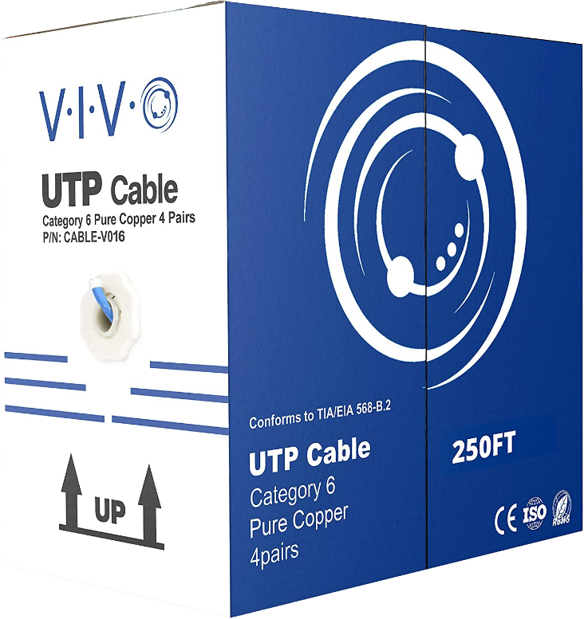
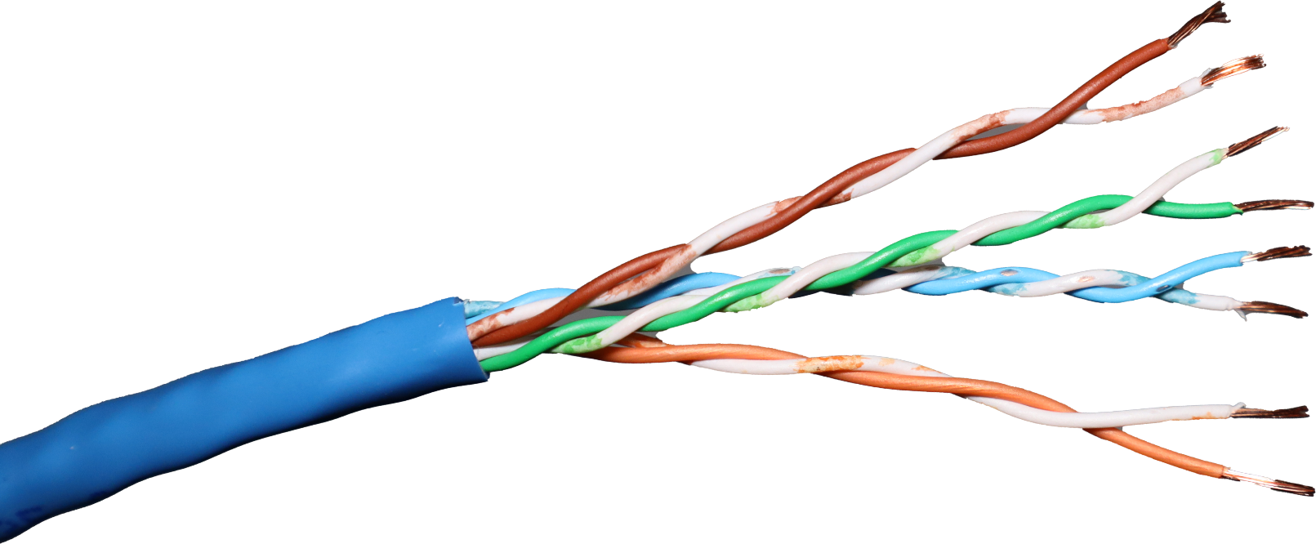
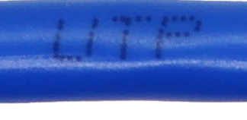
Unshielded Twisted Pair (UTP)
Four balanced wire pairs
Twisted to reduce interference
More twists less interference
Four pairs
Insulated jacket
Wires twisted together
* No shielding in cable
ITFreeTraining.com
© Copyright 2024
Notes:
00:03 The most used cable in networking is unshielded twisted pair, otherwise known as UTP. The cable has eight wires which are organized into four pairs. Each pair operates on the principle of balanced transmission, where each wire carries a signal that is the inverse of its counterpart. This design effectively cancels out electromagnetic emissions from the wires, enhancing signal integrity and reducing interference. This design allows data transmission to be more reliable, which has contributed to the widespread preference for UTP in various networking applications.
To further mitigate interference, the wire pairs in a UTP cable are twisted together. The twisting means that electromagnetic radiation coming from the direction of the wires is continuously altered, diminishing potential interference with adjacent wires or nearby electronic devices. The effectiveness of this method is proportional to the number of twists: more twists equates to less interference. This characteristic is particularly crucial when deploying cables over extended distances or for high-speed data transmission, as it helps with signal integrity and performance.
The four pairs within a UTP cable are encased in an insulating jacket. This jacket does not offer electromagnetic shielding. However, this is typically not an issue if the cable is not placed near sources of significant electromagnetic radiation, such as fluorescent lights, motors or heavy machinery.
To determine the type of cable you have, simply refer to the markings printed along its length. In this example, the cable is UTP so you will find "UTP" on the cable itself. If your installation requires running cable through areas with devices that generate significant electromagnetic interference, be aware that there are alternative cable types specifically designed for such environments.

Slide 3
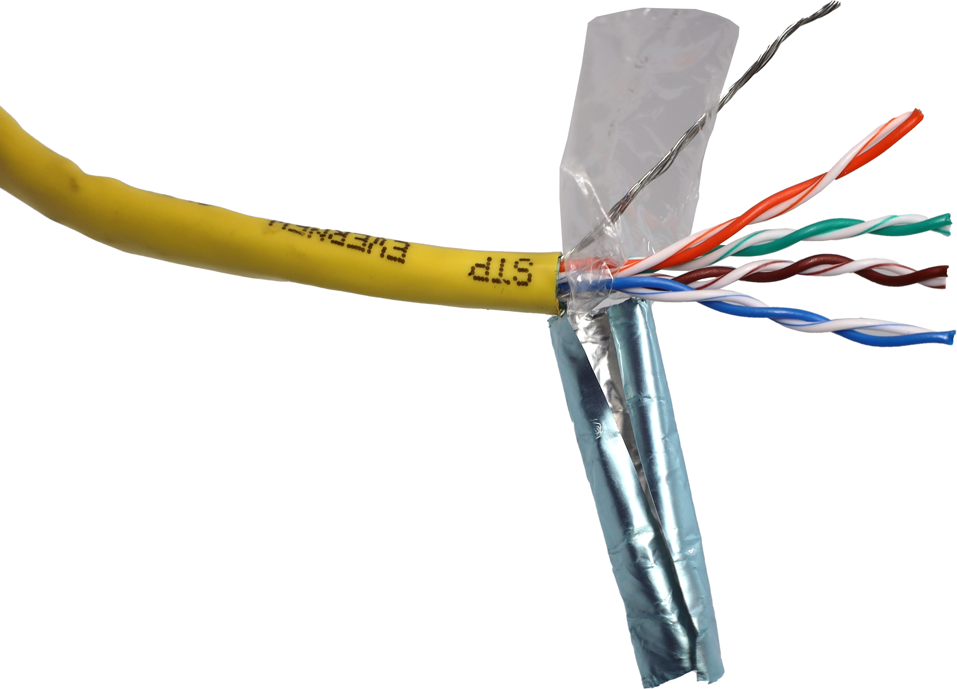
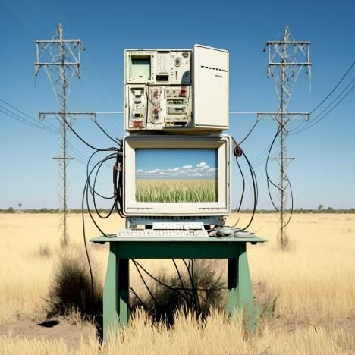
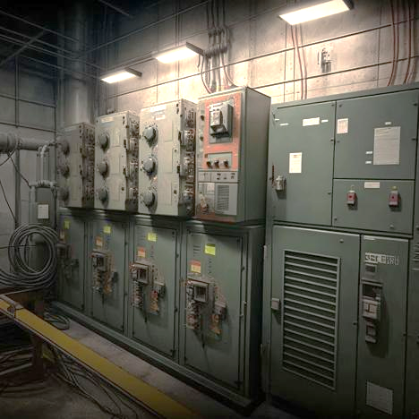
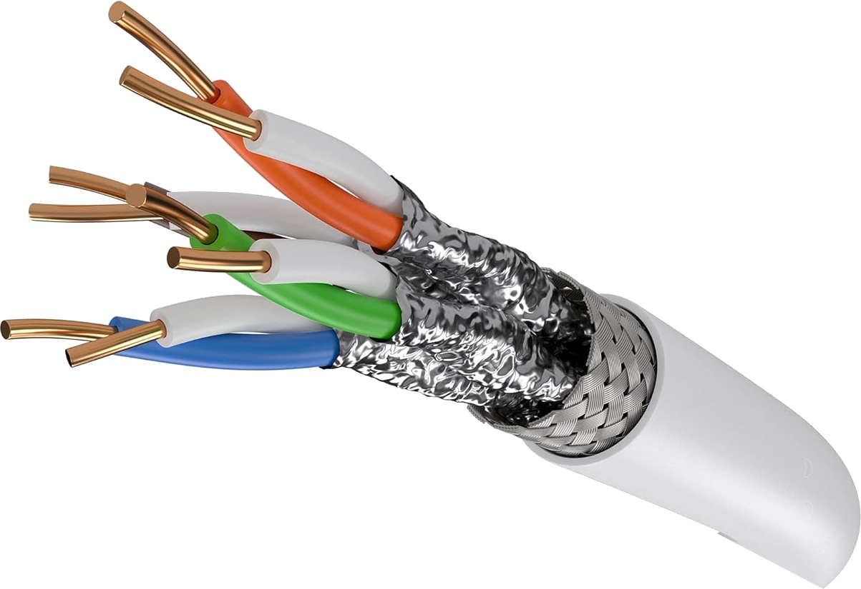
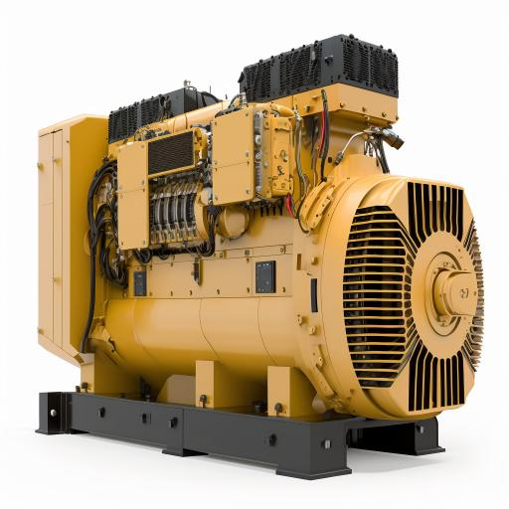
Shielded Twisted Pair (STP)
Has shielding to protect against interference
Use in areas with interference and/or high speed data transmission
Shielding
Power lines
Electrical room
Shielding
Shielding
of wire pairs
Screen cable
Fully shielded
One shielding layer
Generators
> 10GB speeds
All pairs shielded
ITFreeTraining.com
© Copyright 2024
Notes:
01:56 To protect against electromagnetic interference there is a shielded twisted pair or STP. This cable type has electromagnetic shielding inside the cable to protect it against interference. The basic type is screen cable which has one layer of shielding around all four pairs of wire.
Since STP cables offer enhanced protection against interference, they are often used in areas where there is a lot of electromagnetic interference or areas requiring high-speed data transmission. For example, areas with power lines, electrical rooms, near generators or for data transmission over 10 Gigabits per second.
Since the cables are shielded, they have higher reliability than unshielded twisted pair cables. This is why they are more reliable at higher speeds. The basic STP cable will only have one layer of shielding. You can also get full-shielded STP where the outer shielding is present, but there is also shielding around each pair of wires.
STP cables cost more than UTP cables, are also not as flexible and thus are harder to work with. There are also other factors to consider before purchasing a cable.

Slide 4
Cat Standards
Defines the standard the cable is made to
Higher standards, higher data rates
Standard printed on cable
Cat | Max. Transfer Rate | Max. Distance | Ethernet Standard Support
5 | 100 Mbps | 100 m (328 ft) | 100BASE-TX (Fast Ethernet)
5e | 1 Gbps | 100 m (328 ft) | 1000BASE-T (GB Ethernet)
6 | 1 Gbps | 100 m (328 ft) | 1000BASE-T (GB Ethernet)
 | 10 Gbps | 55 m (180 ft) | 10GBASE-T (10 GB Ethernet)
6A | 10 Gbps | 100 m (328 ft) | 10GBASE-T (10 GB Ethernet)
ITFreeTraining.com
© Copyright 2024
Notes:
03:00 The cable will be made to a particular standard referred to as Cat followed by a number. The higher the number or standard, the higher the data rates the cable can support. The cable will have printed on it which standard it is made to.
For the A+ exam, CompTIA only has the four standards listed as exam objectives. There are other standards above this as well. If you purchase a cable of a high standard, it will be of better quality, and thus will support faster speeds.
The oldest standard is Cat 5. This only supports up to 100 Megabits per second. It is pretty common for devices to support at least 1 Gigabit per second nowadays. So, I personally would not purchase Cat 5 cables anymore.
At a minimum I would purchase Cat 5e cables. This standard has historically been the most popular cable used in networking. It supports up to 1 Gigabit networking.
To attempt to future proof myself, I generally only purchase Cat 6 cables or above, since they are created to a higher quality than Cat 5e, and data transfer over the cable may be better than Cat 5e in some cases.
Cat 6A cables have the advantage over Cat 6 cables that 10 Gigabit speeds can be transferred over 100 meters rather than only 55 meters. Unless you are running cables over 55 meters in length this is not a concern. So, for my network cables, I just buy a minimum of Cat 6. If a cable with a higher Cat rating is available for a good price, it is still worth buying if you don’t mind spending the extra money.
Understanding copper cables is straightforward for most practical purposes. In real-world scenarios, you are likely to choose UTP cables for standard office computer setups. In environments with higher levels of interference, STP cables are preferable, and they are also often used in data centers for enhanced reliability. The primary decision you'll need to make concerns the Category of the cable, which determines the data transmission speed and bandwidth capabilities. This choice is crucial to ensuring your network meets both current and future connectivity needs.

Slide 5
Subscribe
Next video
Video content: https://ITFreeTraining.com/ap11/4c05
© Copyright 2024
Notes:
04:59 That concludes this video on copper cables. I hope you have found the video informative. Until the next video from us, I would like to thank you for watching.
References
“The Official CompTIA A+ Core Study Guide (Exam 220-1101)” pages 133 to 135
“Mike Myers All in One A+ Certification Exam Guide 220-1101 & 220-1102” pages 54 to 59
Credits
Trainer: Austin Mason http://ITFreeTraining.com
Quality Assurance: Brett Batson http://www.pbb-proofreading.uk

