Slide 1
Notes:
Let’s have a look at different network types.

Slide 2
Networks
Networks
Groups of computers or other devices connected together
Warning Data Theft
ITFreeTraining.com
© Copyright 2025
Notes:
00:03 Networks are groups of computers or devices that are connected together. These networks can be small local networks, global networks, or anywhere in-between. Networks allow resources to be shared - such as printers, files and applications. This allows for a lot of benefits but also creates other risks, such as data theft and denial of service attacks.

Slide 3
In This Video
Personal Area Networks (PAN)
Wireless LAN (WLAN)
PAN
Local Area Network (LAN)
Small Office Home Office (SOHO)
WLAN
Enterprise LAN
LAN
Metropolitan Area Network (MAN)
Wide Area Network (WAN)
MAN
Datacenter
WAN
Storage Area Network (SAN)
ITFreeTraining.com
© Copyright 2025
Notes:
00:25 In this video I will look at the different types of networks that are available, their benefits and limitations. I will also look at some other topics and concepts that you may come across when working with networks and data.
When trying to remember the different types of networks, it often helps to work out the geographic area the network operates in. This often helps to identify which networks you are working with. To start with, I will look at the smallest network.

Slide 4
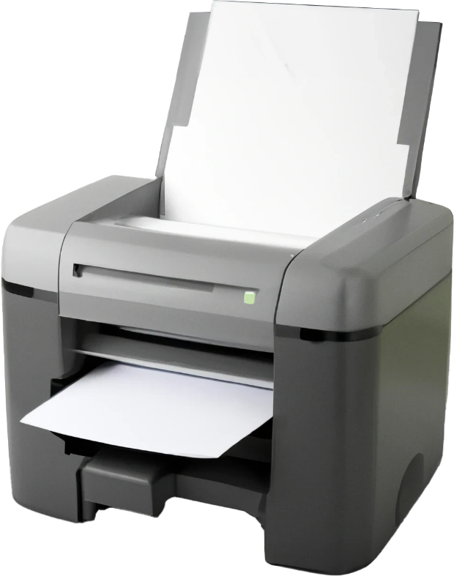
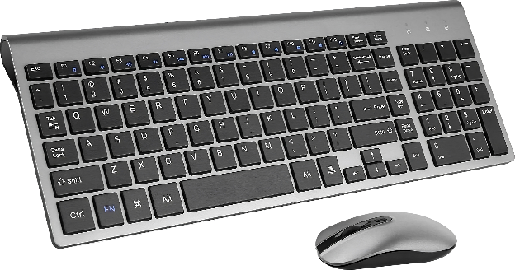
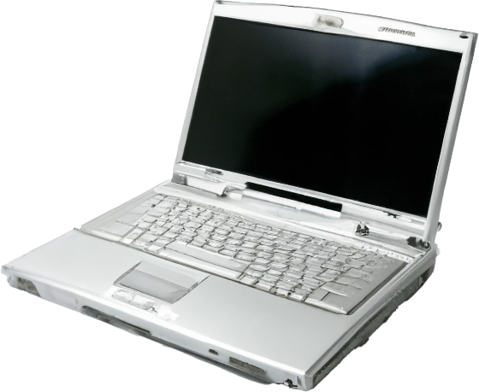
Personal Area Network (PAN)
Short range wireless network to connect devices
Bluetooth range 10 meters (33 feet)
Infrared
* CompTIA does not include wired device like USB in their definition
ITFreeTraining.com
© Copyright 2025
Notes:
00:54 Personal Area Networks or PANs are networks specifically designed for short-range device connectivity. This category encompasses any device operating within a limited range. The technology used will determine the range but will always be short. For instance, Bluetooth typically covers a distance of up to 10 meters or 33 feet. However, under specific conditions and with appropriate equipment, it's possible to extend this range further.
You will find that some definitions for PAN will also include wired devices connected via connections such as USB. CompTIA, however, does not include wired devices in their definition of PAN.
The most common wireless connections are Bluetooth and Infrared. Infrared is an older technology and can easily be blocked by objects and even people. Bluetooth signals can be affected by objects, reducing the signal strength and quality, but not as much as Infrared.
Before Bluetooth, Infrared was used for devices like printers, but Bluetooth is now much more prevalent. You will still find Infrared used for devices like keyboards and mice. Keyboards and mice are generally close to the computer and thus don’t get affected so much by signal degradation. Thus, you still find Infrared used in some cases although Bluetooth has now become very popular.
Let’s look at the next network type.

Slide 5
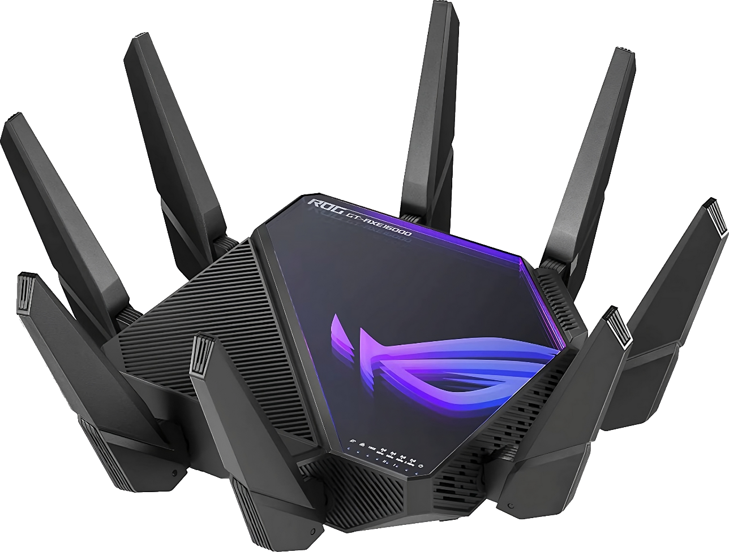
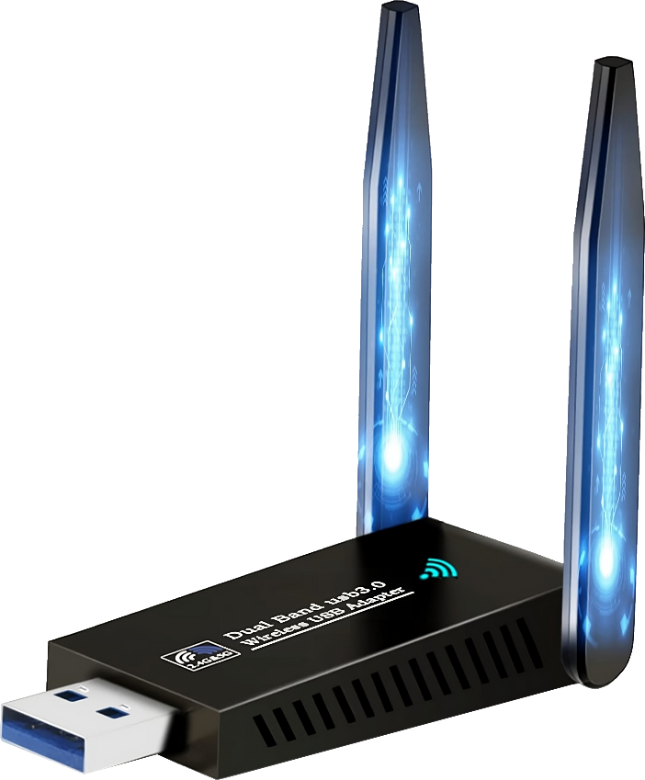
Wireless LAN (WLAN)
802.11 dominates wireless standards
Better known as Wi-Fi
Others generally not IP networks
Wireless Access Point (WAP)
Signal decreases with distance and obstacles
Often uses wired network between WAPs
Many different wireless standards
Number and type of antennas can make a difference
Different devices support different standards
ITFreeTraining.com
© Copyright 2025
Notes:
02:22 Although PAN networks are generally wireless, when referring to wireless we are often referring to wireless LANs. The dominant wireless standard being 802.11, better known as Wi-Fi. Later in the course, I will look at wireless networking in more detail.
Other wireless networks are generally not IP networks, that is, accessible using the internet. For example, smart light bulbs generally don’t use Wi-Fi since they are not required to be directly accessible on the internet. If they were IP compatible, the device would require a lot of electricity just in order to operate.
Nowadays, most wireless LANs tend to be implemented using Wireless Access Points or WAPs. Although it is possible to connect Wi-Fi devices directly to each other, most people use WAPs to access them.
The signal decreases with distance and if obstacles get in the way. Thus, you generally want to get nearer to a WAP in order to get the best performance. Wi-Fi also has problems where the Wi-Fi signal extends past the area in which it is intended to be used. For example, an attacker sitting in the car park accessing the Wi-Fi of a business.
In order to extend the Wi-Fi signal, often multiple WAPs are connected together using a wired network. It is possible to extend the network without them, however, this often comes at the cost of bandwidth.
There are many different wireless standards, which I will go through later in the course. Also, the number and type of antennas used can make a difference. Different devices will support different standards. Sometimes you may find that newer standards may have compatibility problems with some devices.
Wireless is generally good for short distances. If outside, the signal tends to go further since it is not being blocked. If you want longer distances, you will usually go for a wired solution.

Slide 6
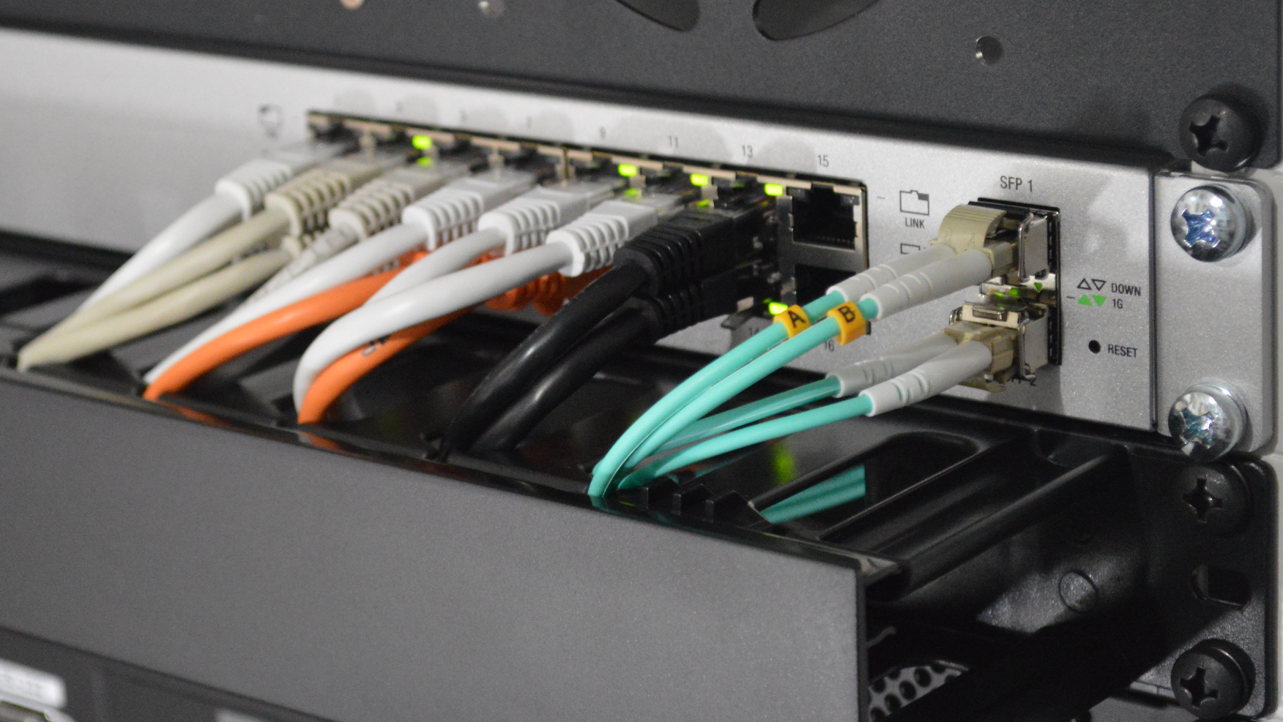
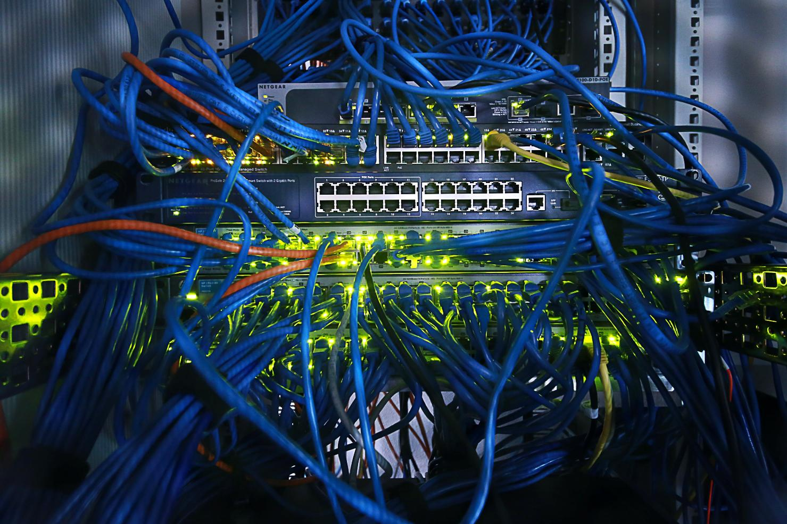
Local Area Network (LAN)
Interconnected devices within a limited area
Home office/office building/school (Geographically in same location)
LANs are generally connected by fast reliable links
Main factor is the geographic size and single location of the network
ITFreeTraining.com
© Copyright 2025
Notes:
04:20 Local Area Networks or LANs can initially seem complex due to their versatile nature. Essentially, a LAN can encompass anything from a modest network with just a few devices to an extensive setup with numerous devices. The key characteristic of a LAN is that it connects devices within a single confined geographical area. The primary emphasis here is on the 'limited area' aspect, which distinguishes LANs from other broader network types.
A home office, office building, and even a school may be considered a LAN, assuming they are in the same geographical location. In a lot of cases, the traffic will be on the same network segment, but a LAN could still utilize a router to connect different networks together, as long as all the networks are in the same geographical location.
LANs are generally connected by fast reliable links. If the LAN covers different network segments, for example, different floors of the same building, generally good quality cabling is used to connect them.
Of course, it is possible to use poor equipment and low-quality cabling in a LAN, so don’t consider that to be the main factor, but generally LANs have good cabling. LANs are what users connect directly to, so if the network is poor, there are going to be complaints. The main factor is the geographical size and single location of the network that makes it a LAN.
Try not to overthink it. If you can walk between devices on the same network easily and it is in a single location including the same building, it is probably a LAN. If you have to exit the building you are probably dealing with something else.
Let’s have a look at how we can combine wireless and wired together.

Slide 7
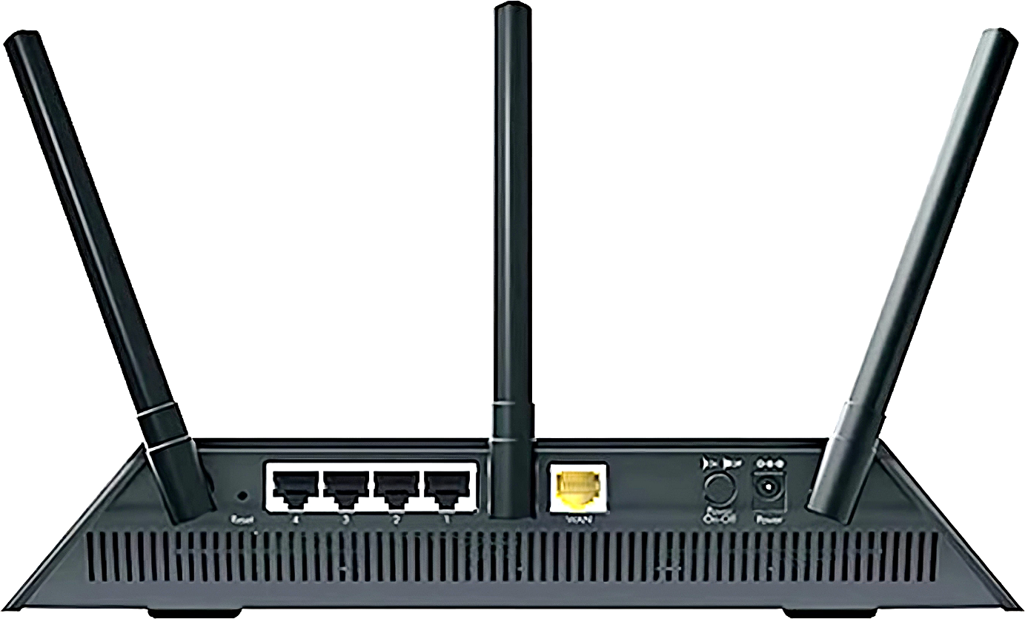
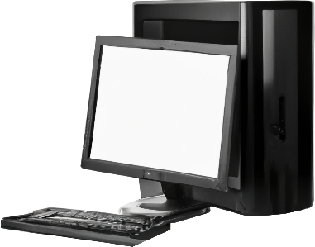
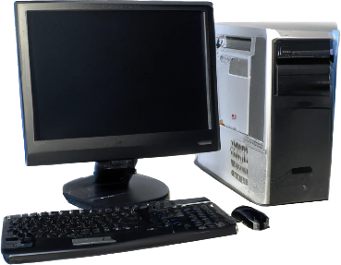
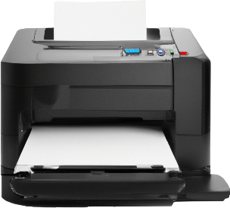
Small Office Home Office (SOHO)
Used in a home or a small office
Small network. Only a few users in small building
Often have only small amounts of network equipment
Wireless
ISP
Wired
Internet
ITFreeTraining.com
© Copyright 2025
Notes:
06:06 You may hear the term Small Office Home Office or SOHO. This refers to a home network or a small office – SOHOs are small networks with at most a few users in a small building, often having only a small amount of network equipment. They may only have one network device that connects all the devices to the internet. The point to remember is, SOHOs are small networks in a small space.
In this example there is one network device that connects to the internet. Nowadays, the network device will generally connect to an Internet Service Provider or ISP. The ISP is what connects to the internet. In the old days, companies would lease lines and have their own private networks to connect their sites together. This still happens, but not as much as it used to. A lot of companies with small networks will simply connect to the internet and use a virtual private network or VPN to connect different sites together. With the availability of cloud-based services, a VPN is not required as much as it used to be.
To understand why SOHO networks have become more popular, consider this network device is also a firewall. Thus, the internal network has some security from the internet, provided by the firewall. These devices will often have VPN capabilities. In the old days, a site may have needed a number of devices to provide all these features. Technology has improved so much that it can now be provided by one device. The important point to remember is, a SOHO network is a small home network or a small business network. Even if you have a few network devices, if the network is a small home or office network, then it is a SOHO network.
These networks may provide wired and wireless networking. Often a network device will provide a bridge between the wireless and wired network. From a technical point of view, both networks are connected to the same LAN just using different technology. Thus, devices on the wireless network can be connected directly to devices on the wired network.
SOHO are only small networks, so let’s look at what happens when the network gets a bit bigger.

Slide 8
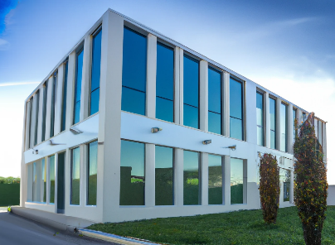
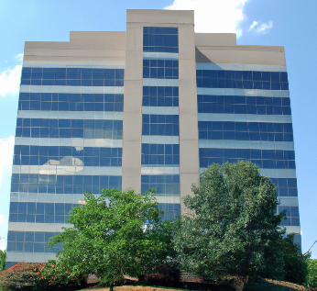
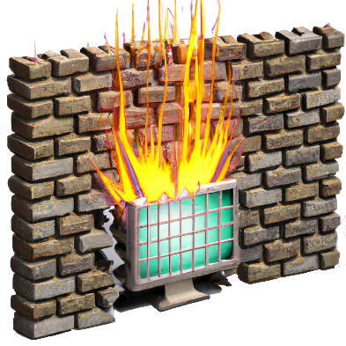
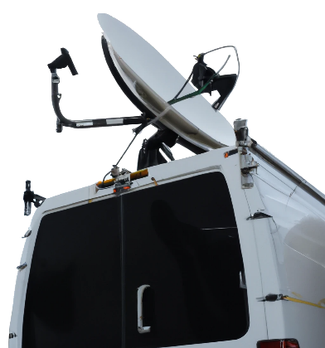
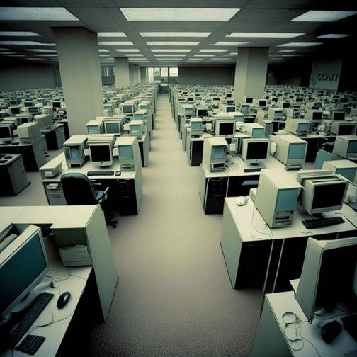
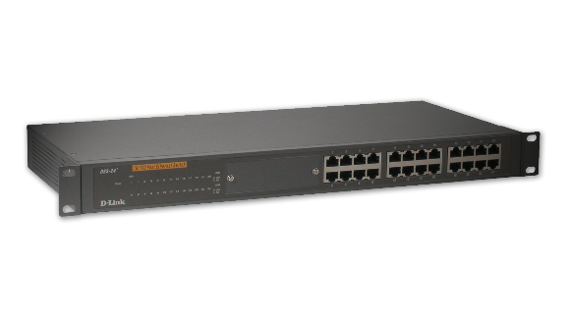
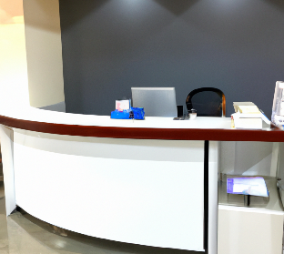
Enterprise LAN
Enterprise LANs cover one large geographic location
Head office is most likely one
Usually uses dedicated devices due to larger load
Enterprise network
Mid-large company network
Refers to internal network only
DMZ
ITFreeTraining.com
© Copyright 2025
Notes:
08:21 Although not one of the topics for this video, as we progress through our exploration of networks from the smallest to the largest, it is important to understand what constitutes an Enterprise network. An Enterprise network typically refers to the network infrastructure of a mid-sized to large company. Key characteristics of Enterprise networks include their expansive size, coverage over large geographical areas, and the presence of multiple sites. Essentially, when we talk about mid to large company networks, we are referring to Enterprise networks. A crucial distinction of Enterprise networks is that they specifically denote the internal network only.
So, what is an Enterprise LAN? An Enterprise LAN is essentially one large geographic location of an Enterprise network. Thus, an Enterprise network may have locations all over the world. A large single location of that Enterprise network is an Enterprise LAN. If it is only a small office location, it would be a SOHO. Most likely, the head office will have an Enterprise LAN as they tend to be the largest network.
Enterprise LANs usually use dedicated devices rather than all-in-one devices (like a SOHO network does) due to the larger load of having more users on the one network. Let’s consider an example.
An Enterprise LAN will generally have a dedicated firewall device. These devices have one job and that is to perform firewall services for the network. You generally find these firewalls are large rack-mounted devices costing much more than consumer versions. As soon as you start working with Enterprise devices the price goes up, but they give better performance.
Some companies may purchase devices that perform more than just firewall functions, but these are still Enterprise devices and have an Enterprise price tag.
The firewall will generally be connected to the internet. If the site does not require internet access, a firewall may be used to segregate the network or access to other sites, but is not required.
Depending on the requirements of the network, it may have a demilitarized zone or DMZ. A DMZ essentially allows your public facing servers to be on a separate network. The idea being that if the server were to be compromised, the attacker would not have access to the main network.
An Enterprise LAN typically supports a large number of users, who are usually interconnected through network switches. These switches are often more substantial in scale compared to those used in a home network and may offer remote management capabilities. With Enterprise LANs, the key concepts are scale and enhanced performance, which in turn increases the price. In environments where numerous devices share the same network, businesses often invest more in high-quality equipment. This investment is crucial to ensure network security and to minimize the risk of outages. Given that network disruptions in a setting with hundreds of users can result in significant productivity losses, the cost of robust Enterprise network equipment is generally justified and viewed as a necessary expense.
Now let’s leave the company network and look at the next large network.

Slide 9
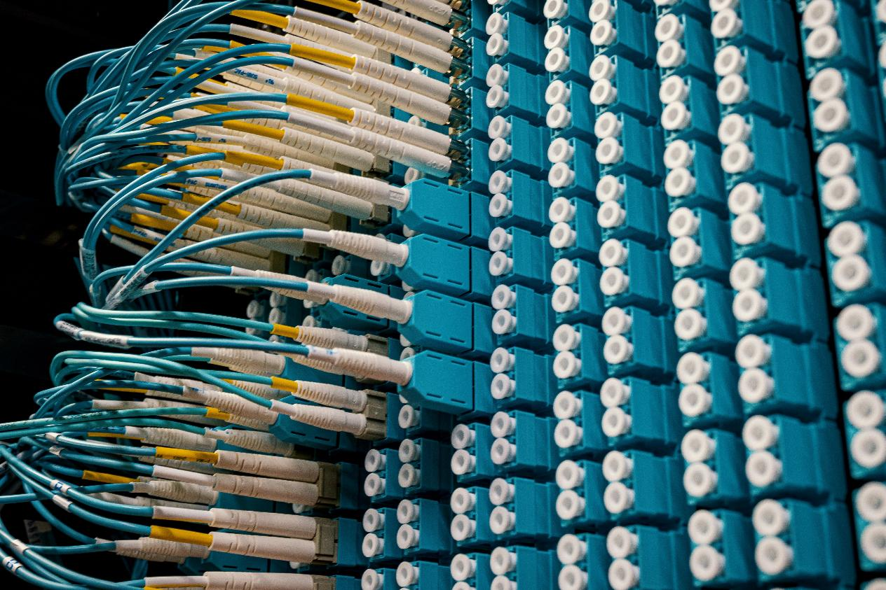
Metropolitan Area Network (MAN)
Number of LANs connected together
Network the size of a city (Metropolis)
Nowadays
Uses many technologies
Darth Fiber
Dark Fiber
Extra fiber installed that was never used
However, MANs may run over any network
ITFreeTraining.com
© Copyright 2025
Notes:
11:41 The next network that I will consider is the Metropolitan Area Network or MAN. A MAN is essentially a number of LANs connected together. The catch with this one is, the network is the size of a city or, another word for a city, Metropolis.
To understand MANs a little better, it is probably easiest to go through a brief history of how they developed. When fiber optic is installed, a major part of the cost is the labor, not the cable itself. Thus, more fiber optic cable is usually installed than is needed. This extra is used for replacing broken cable and for future capacity. This extra fiber is often called dark fiber.
Dark fiber is so named because, when unused, it remains 'dark' or inactive. In an effort to maximize profits, telecommunications companies devised an innovative strategy to utilize this dormant resource. As a result, businesses with multiple city-wide offices began leasing or purchasing dark fiber to expand their networks. One of the big factors in MANs becoming more common was the use of dark fiber.
Having a MAN network like this means you essentially have a private network but can run it over existing fiber cables without the added cost of having to install any yourself. However, MAN networks may run over any network.
Nowadays, dark fiber is not used so much for MAN networks as it once was, and instead, may use other technology like 5G to cover larger areas. Some companies even pay for dedicated fiber lines rather than leasing dark fiber.
Now, let’s look at a network that is even bigger.

Slide 10
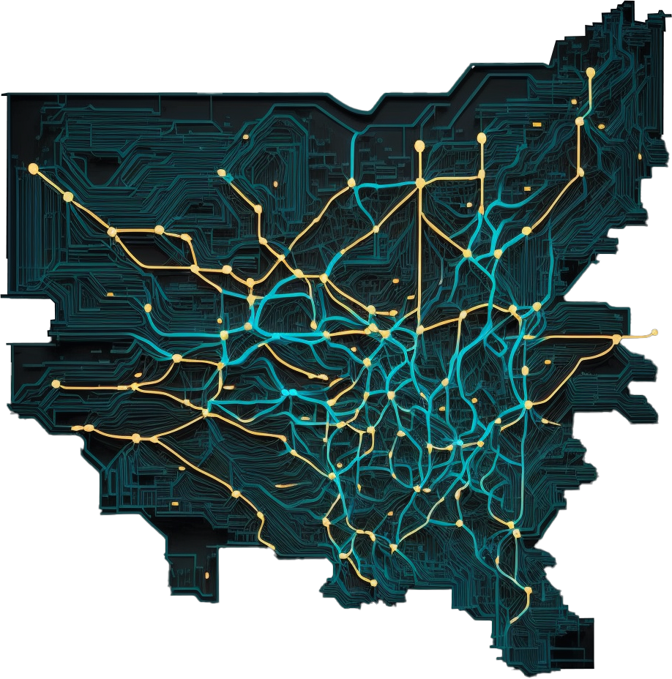
Wide Area Network (WAN)
Multiple geographic locations
State/Country/World
May use private or public networks
Statewide
Worldwide
ITFreeTraining.com
© Copyright 2025
Notes:
13:27 A Wide Area Network or WAN, is a network that spans multiple geographic locations. For example, it could be statewide, countrywide or even worldwide. The main point to remember is that a WAN covers multiple geographic locations. Before MAN networks, a MAN would have been known as a WAN.
In the real world, you may have a network that is inside a city; however, people will refer to it as a WAN. I would not be concerned about what it is called in the real world, but for the exam, know the difference. If you are not sure, always consider the geographic size of the network. Now let’s have a look at specialized networks.

Slide 11
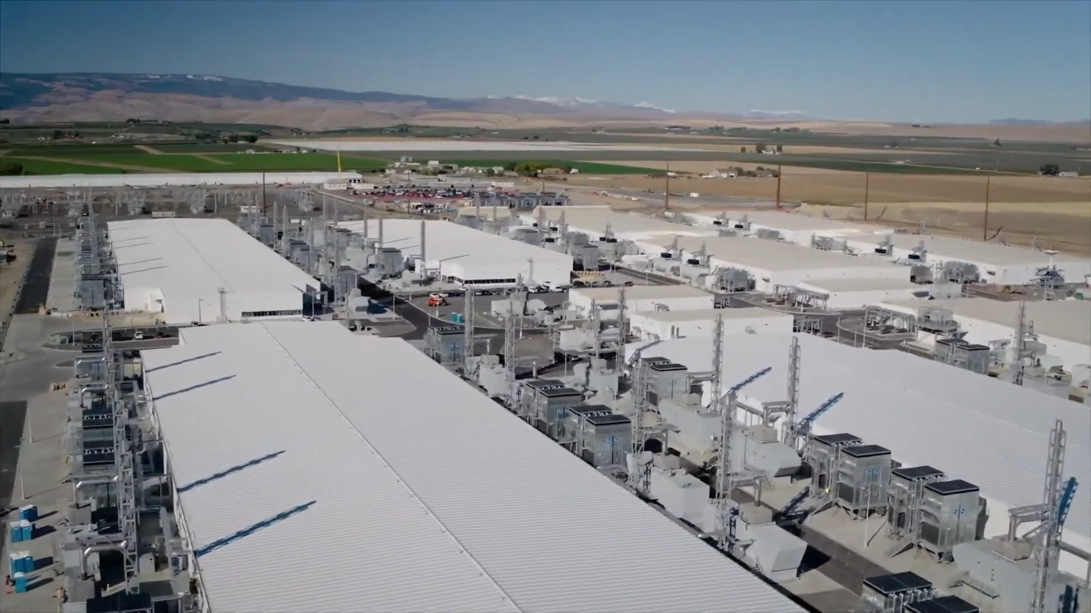
Datacenter
Whole site dedicated to server resources
Purpose-built facilities/High availability
Dedicated networking/climate control/power features
ITFreeTraining.com
© Copyright 2025
Notes:
14:11 Datacenters are whole sites dedicated to server resources. These sites are purpose-built facilities designed with high availability in mind. The sites are equipped with specialized networking, advanced climate control, and dedicated power systems.
With so much data being on the cloud nowadays, some companies may decide to hold some of their data or applications in a datacenter rather than hosting them on their own site. Now let’s have a close look at how this data may be stored.

Slide 12
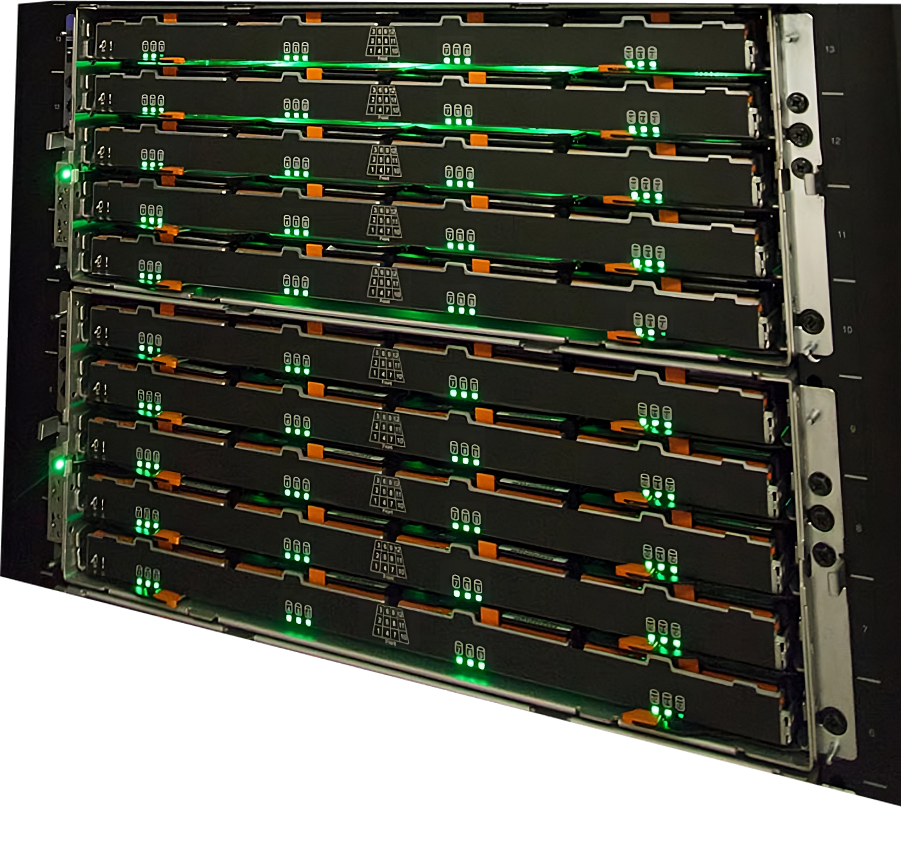
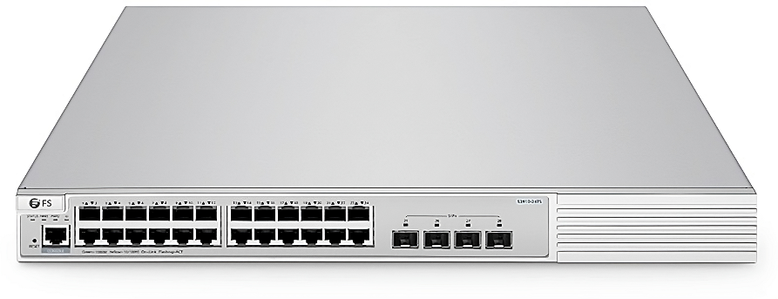
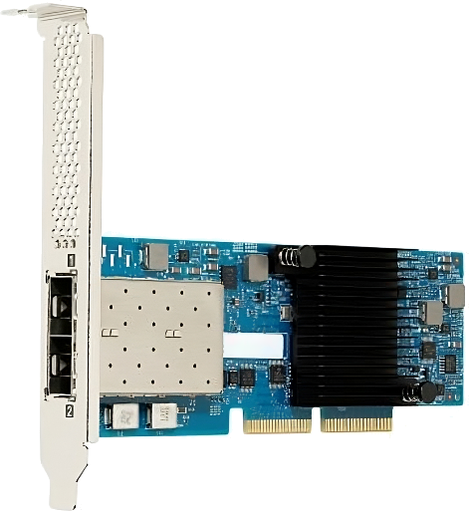
Storage Area Network (SAN)
Network for storage
Provides pool of storage
Fiber switch
Generally used by servers
Fiber card
SAN
Server
ITFreeTraining.com
© Copyright 2025
Notes:
14:43 In Enterprise networks, you will often find a Storage Area Network or SAN is used to store data. SANs provide a pool of storage. Essentially, SANs are a collection of storage. SANs can be set up with redundancy. Also, stand-by storage can be added so, if a storage device fails, stand-by storage will replace it automatically.
SANs are generally used in a server room and are connected to a fiber switch. The fiber switch provides network functions for the data from the SAN to and from the servers. The fiber switch plugs into a fiber card which is installed in the server.
SANs are essentially a pool of storage that is networked and shared. This pool of storage can be divided up in whatever way the administrator sees fit.
SANs are generally connected using fiber optic cabling for speed. Although fiber optic cabling supports long distances, you generally find that SANs are only used for short distances around the server room to connect the servers to the SAN.
Now that I have had a look at the different types of storage, before finishing this video, I will do a quick summary of the network types.

Slide 13
Summary
Geographic size best indicates which network it is
PAN
WLAN
LAN
MAN
WAN
Close range
Wi-Fi
One geographic location
One city
Large. Many geographic
locations
Mobile device
802.11
(Metropolitan)
Headphones
ITFreeTraining.com
© Copyright 2025
Notes:
15:52 For the exam, one of the simplest ways to identify which network is which is by looking at its geographic size. PAN networks are close range networks. If your device needs to be near the receiver, it is most likely a PAN network. Nowadays, most of these devices are Bluetooth or Infrared. Typical PAN devices include mobile devices, headphones, keyboards, and mice.
Next, we have wireless networks which often use Wi-Fi. While these networks vary in size, it is important to note that an increase in area typically leads to a decrease in signal strength and, consequently, speed. Personal Area Networks or PANs typically extend only a few meters if you are lucky. If a network spans beyond this range, it is most likely a wireless LAN. Consider this scenario: a wireless device placed right next to the receiver will function, but if you move it more than a few meters away and it still works, it's likely utilizing wireless LAN technology.
LAN networks are wired networks limited to one geographic location. This generally means a single building, but in some cases may be multiple buildings if they are close together and well connected. For example, an office building with a smaller annex office connected at the back.
A MAN network is a network that is limited to a city or a metropolitan area. The next type is a Wide Area Network or WAN. These networks are the largest of the networks. They include many different networks in many different geographic locations. For example, the internet is an example of a WAN.
MANs are technically WAN networks; however, for the exam, if you see a question referring to a single city, it is most likely talking about a MAN network.

Slide 14
Subscribe
Next video
Video content: https://ITFreeTraining.com/ap11/4a10
© Copyright 2025
Notes:
17:44 I hope you have found this video on the different network types informative. For more videos from us, see our YouTube channel or website. Until the next video from us, I would like to thank you for watching.
References
“The Official CompTIA A+ Core Study Guide (Exam 220-1101)” pages 120 to 123
“Picture: Network types”
“Picture: Bluetooth” https://commons.wikimedia.org/wiki/File:BluetoothLogo.svg
https://upload.wikimedia.org/wikipedia/commons/6/6e/Data_Networks_classification_by_spatial_scope.svg
“Picture: Network equipment” https://unsplash.com/photos/ISG-rUel0Uw
“Picture: Network cabinet” https://unsplash.com/photos/Re6__yidc48
“Picture: Fiber cabinet” https://www.pexels.com/photo/fiber-optic-device-with-many-connected-cables-4373998/
“Picture: SAN” https://cac.queensu.ca/wiki/images/1/1a/Ess-gl6.jpg
“Video: Microsoft reveals its MASSIVE data center (Full Tour)” https://www.youtube.com/watch?v=80aK2_iwMOs
“Video: Inside a Google data center” https://www.youtube.com/watch?v=XZmGGAbHqa0
Credits
Trainer: Austin Mason TFreeTraining.comVoice Talent: HP Lewis http://hplewis.com http://I
Quality Assurance: Brett Batson http://www.pbb-proofreading.uk

