Slide 1
Notes:
Let’s have a look at network standards.

Slide 2
What Is A Network Standard
Set of rules for data communication exchange
Defines technical specifications including cables and protocols
ITFreeTraining.com
© Copyright 2025
Notes:
00:03 A network standard defines the rules for data communication. For example, it defines technical details of the standard including specifications, cables, and protocols.
For devices to communicate effectively, they must adhere to a specific standard. This requirement applies regardless of the type of device. If a device fails to conform to this standard or implements it poorly, compatibility with other devices cannot be guaranteed. In large networks, such as the internet, adherence to these standards is crucial. Non-compliance could lead to communication issues or unforeseen problems with other devices.
Let’s have a look at the network standards we need to know for the A+ exam.

Slide 3
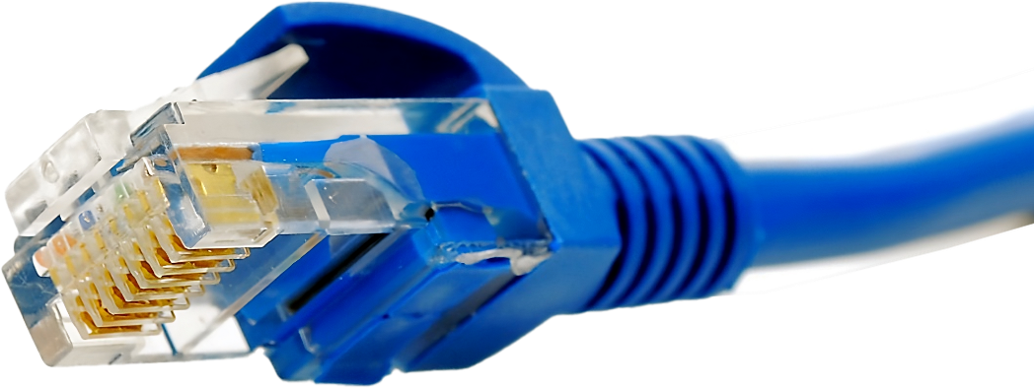
IEEE 802 Network Standards
Institute of Electrical and Electronics Engineers (IEEE)
Created and updates the network standards
802
.3
Ethernet
802
.11
* 802 is the project number. Coincidentally the first meeting was 1980 in February
ITFreeTraining.com
© Copyright 2025
Notes:
00:45 When working with networks, you will come across IEEE followed by 802. IEEE is the Institute of Electrical and Electronics Engineers. It is the largest association of technical professionals in the world and is responsible for developing and maintaining the network standards we will be examining.
802 is the project number. When they first started, this was the next project number.
By a stroke of coincidence, the first meeting took place in February 1980. Thus, some people have come to the conclusion that 802 was named after the year and month of the first meeting; however, this is not true; it is just a coincidence.
Under 802 there are a number of different standards. For the A+ exam, we are only concerned with two of them. The first one being the third standard. This is for Ethernet which is concerned with physical cabled networking.
If you have not guessed it already, the second standard is wireless and is standard number 11. These standards keep being updated and added to. Let’s have a closer look.

Slide 4
Ethernet Standards
Defines speed and cabling
For A+
100
T
BASE
100BASE-T
100 Mb/s
1000BASE-T
1000
10GBASE-T
1000 Mb/s or 1 Gb/s
10G
10 Gb/s
Prefix
Mid
Suffix
Speed in Mb/s
Base for baseband
Cable and distance
G in Gb/s
T- Twisted pair
ITFreeTraining.com
© Copyright 2025
Notes:
01:54 When using Ethernet, the standards are written using a designated easy-to-understand format. This is divided into a prefix, middle part and suffix. The prefix defines the speed which is written in megabytes or gigabytes.
The middle part for the A+ exam is always “base”. Different standards will use a different convention, but unless you go on to do more study on networking, for example Network+, you won’t need to worry about it.
In the case of Ethernet, base stands for baseband. Ethernet is essentially baseband, unless it is run over a digital subscriber service like ADSL or DSL.
The last part is the suffix. For the A+ exam, know that T stands for Twisted pair. There are other suffixes used, for example, with optical fiber. There are also other suffixes used to indicate the cable length is longer than normal. For twisted pair Ethernet, if you are using the right cabling, the distance is 100 meters. As you get beyond 10 Gigabit speeds, the distance decreases and you need to use other media like fiber optic if you want to get longer distances.
The standards listed for A+ for Ethernet are 100, 1000 and 10 Gigabit, so make sure you know these. As long as you know the start is in reference to the speed and recognize T as twisted pair, you should be okay.
Now let’s have a look at wireless.

Slide 5
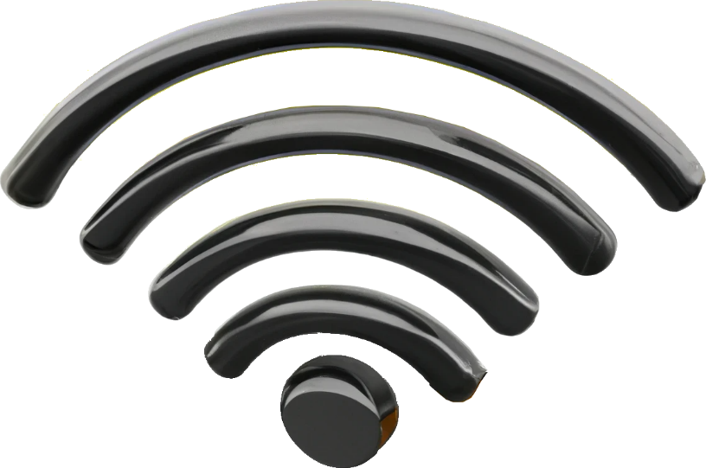
Wireless 802.11 Standards
Suffix denotes standard
Defines speed, radio frequency, distance, etc.
IEEE Standard | 802.11a | 802.11b | 802.11g | 802.11n | 802.11ac
Year released | 1999 | 1999 | 2003 | 2009 | 2014
Max data rate | 54 Mbps | 11 Mbps | 54 Mbps | 600 Mbps | 7 Gpbs
ITFreeTraining.com
© Copyright 2025
Notes:
03:28 Later in the course I will look at wireless in a lot more detail. The wireless standards all start with 802.11 followed by a suffix. The standard defines the speed, radio frequency and distance supported, etc.
Since the last standard was released in 2014, you will find that a lot of modern devices will support all the standards shown. However, some devices may not support the latest standard. Your circumstances will determine which standard you will choose. For a lot of different reasons, you may need to choose a particular standard, but to understand which standard you should be using, I will leave that to another video.

Slide 6
Subscribe
Next video
Video content: https://ITFreeTraining.com/ap11/4a05
© Copyright 2025
Notes:
04:10 This concludes this video on network standards. We have a lot more videos on networking coming up from the A+ course. I hope to see you in those videos. Until the next video, I would like to thank you for watching.
References
“The Official CompTIA A+ Core Study Guide (Exam 220-1101)” page 120
“Mike Myers All in One A+ Certification Exam Guide 220-1101 & 220-1102” pages 746 to 479
“OVERVIEW AND GUIDE TO THE IEEE 802 LMSC” https://grouper.ieee.org/groups/802/802%20overview.pdf
“Picture: IEEE logo” https://upload.wikimedia.org/wikipedia/commons/2/21/IEEE_logo.svg
“Picture: WiFi” https://commons.wikimedia.org/wiki/File:Wi-fi_alliance_logo.png
Credits
Trainer: Austin Mason http://ITFreeTraining.com
Voice Talent: HP Lewis http://hplewis.com
Quality Assurance: Brett Batson http://www.pbb-proofreading.uk

