Slide 1
Notes:
Let’s look at how to troubleshoot date and time problems on your computer.

Slide 2
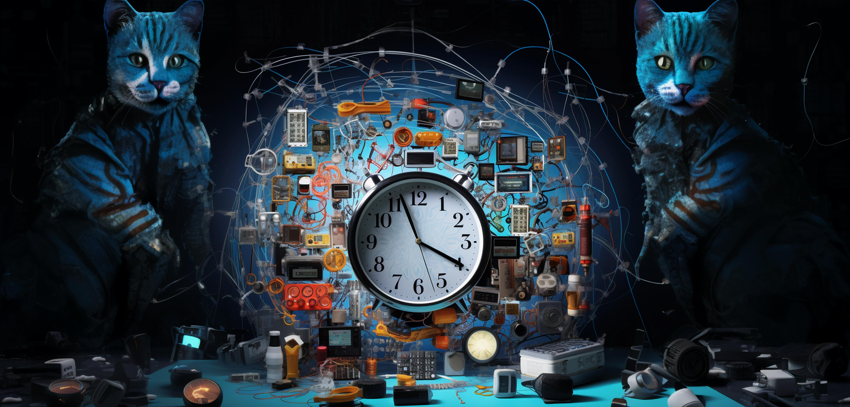
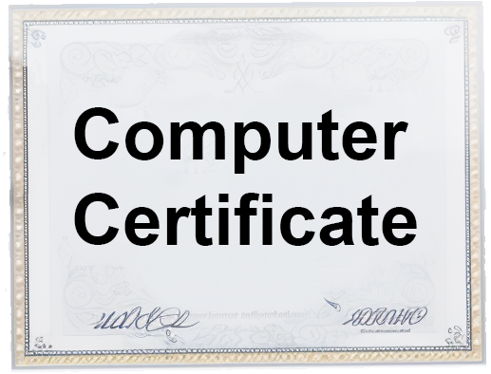
Functions of the Clock
Timestamps
Validation
Time zones
Log files
Legal Compliance
ITFreeTraining.com
© Copyright 2024
Notes:
00:05 The clock inside your computer is used in a lot of different ways; thus, it is important to make sure it is set correctly. For example, the clock is used for timestamps. Timestamps are used when creating a file. The modification timestamp is generally updated when the data in the file is changed. However, different operating systems may also change it at other times, for example, when permissions are changed. When the accessed timestamp is updated, it is very operating system specific. By default, in older versions of Windows this was always updated, then by default it was disabled. In newer versions, Windows will only update it under certain circumstances. So don’t rely on accessed time as always being correct.
If the clock is set incorrectly, you can’t rely on the information in the timestamps being right. This will also affect backups as it will make it harder for the computer to determine what files have changed since the last backup.
The clock is also used for validation, for example, when accessing secure websites, and logins to services like Windows domain. If you find that you can’t authenticate, it may be that the time is set incorrectly. In Windows, if the time is out by more than five minutes, you won’t be able to login.
The time and date that you are shown is also adjusted by a time zone. Before changing the time, I would first check that the time zone is correct.
The clock is also used when creating log files. If the clock changes, since the log files are written sequentially, the timestamps won’t appear in order. This makes it much harder to troubleshoot problems.
Adherence to legal compliance requirements is a critical aspect of business operations, particularly concerning the accurate recording of employee timesheets. This mandates the necessity for precise timekeeping. Ensuring that all clocks and time-tracking systems are correctly synchronized and set is not only a matter of regulatory compliance but also a cornerstone of maintaining trust and integrity in the workplace. Accurate time recording is essential for upholding labor laws, calculating wages, and meeting audit standards. It is therefore vital for organizations to regularly verify and calibrate their timekeeping devices to align with legal mandates.

Slide 3
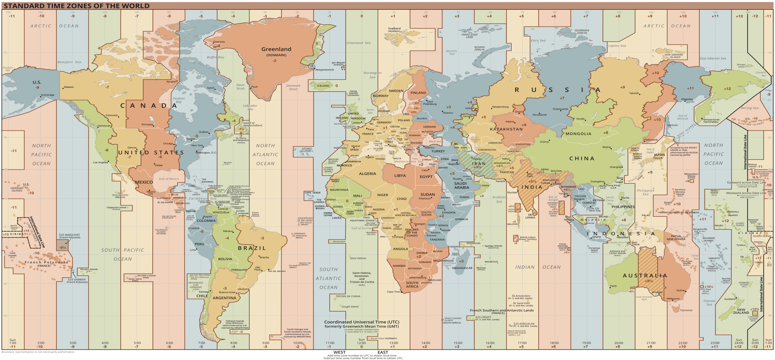
Coordinated Universal Time (UTC)
Primary standard used to regulate time
User sees local time (UTC + Time zone + Daylight savings)
User sees local time
Modern PCs/OS
use this time
User sees local time
ITFreeTraining.com
© Copyright 2024
Notes:
02:32 Before I start looking at time, I first need to look at Coordinated Universal Time or UTC. This is the primary standard used to regulate time in the world. There is not too much to know about it other than it is the central reference point. UTC does not belong to a specific time zone or geographical location, but is the reference point that the time zone offset is applied to, to get local time.
Modern PCs and operating systems are designed to maintain time using UTC. To present the correct local time to users, the system applies the appropriate time zone offset and accounts for daylight saving time when applicable. While users interact with and view their local time, the operating system consistently operates using UTC in the background. This ensures accurate timekeeping regardless of any changes in a user's time zone. For user convenience, the displayed time is seamlessly converted from UTC to local time.

Slide 4
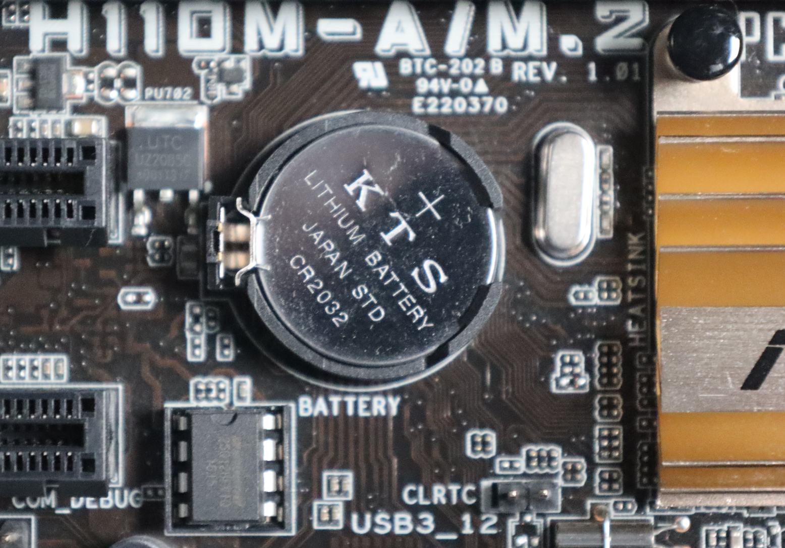
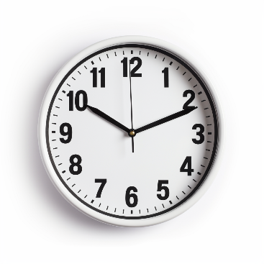
Real Time Clock (RTC)
Uses local time
Modern OS uses UTC
BIOS/UEFI UTC or local
Modern PCs use UTC
OS may set as UTC regardless
UTC+0
Different OS/VM can cause problems
Apply time zone
Battery keeps clock powered
User sees local time
Older computers - also keeps configuration
ITFreeTraining.com
© Copyright 2024
Notes:
03:38 The computer has a real time clock otherwise known as RTC. If the power is disconnected, a battery on the motherboard will keep providing power to the clock. On older computers, the battery also kept the computer’s configuration powered. In modern computer systems, configuration settings are stored in non-volatile flash memory, which preserves the configuration without the need for a power supply. This ensures that the computer retains its configuration even when it's powered off.
Modern operating systems use Coordinated Universal Time or UTC. Very old operating systems use local time. Your BIOS may support UTC time. Modern computers should support UTC, while older computers may not.
The operating system operates on UTC, independent of the computer's hardware clock settings. While this approach is typically seamless, it can occasionally lead to complications. For instance, Windows can be configured to either align with local time or to set the computer's hardware clock to UTC, irrespective of the computer's native support for UTC. This distinction usually doesn't cause issues within a single OS environment. However, when multiple operating systems or virtual machines are in use on the same hardware, it's crucial for all systems to have a consistent approach to handling time. They must all agree on whether to interpret the hardware clock time as UTC or as local time to maintain synchronization across different platforms.
Ideally, you should not encounter issues with varying time displays when switching between different operating systems. Each system should apply the correct time zone adjustments so that, as a user, you consistently see the correct local time. However, if you notice that the local time fluctuates each time you switch between operating systems, it is likely due to those systems interpreting the computer's base time differently – one might be using UTC and the other local time. This discrepancy can lead to any observed inconsistencies in time display across various operating systems. To fix, change one of the operating systems to interrupt the time using the other method.

Slide 5
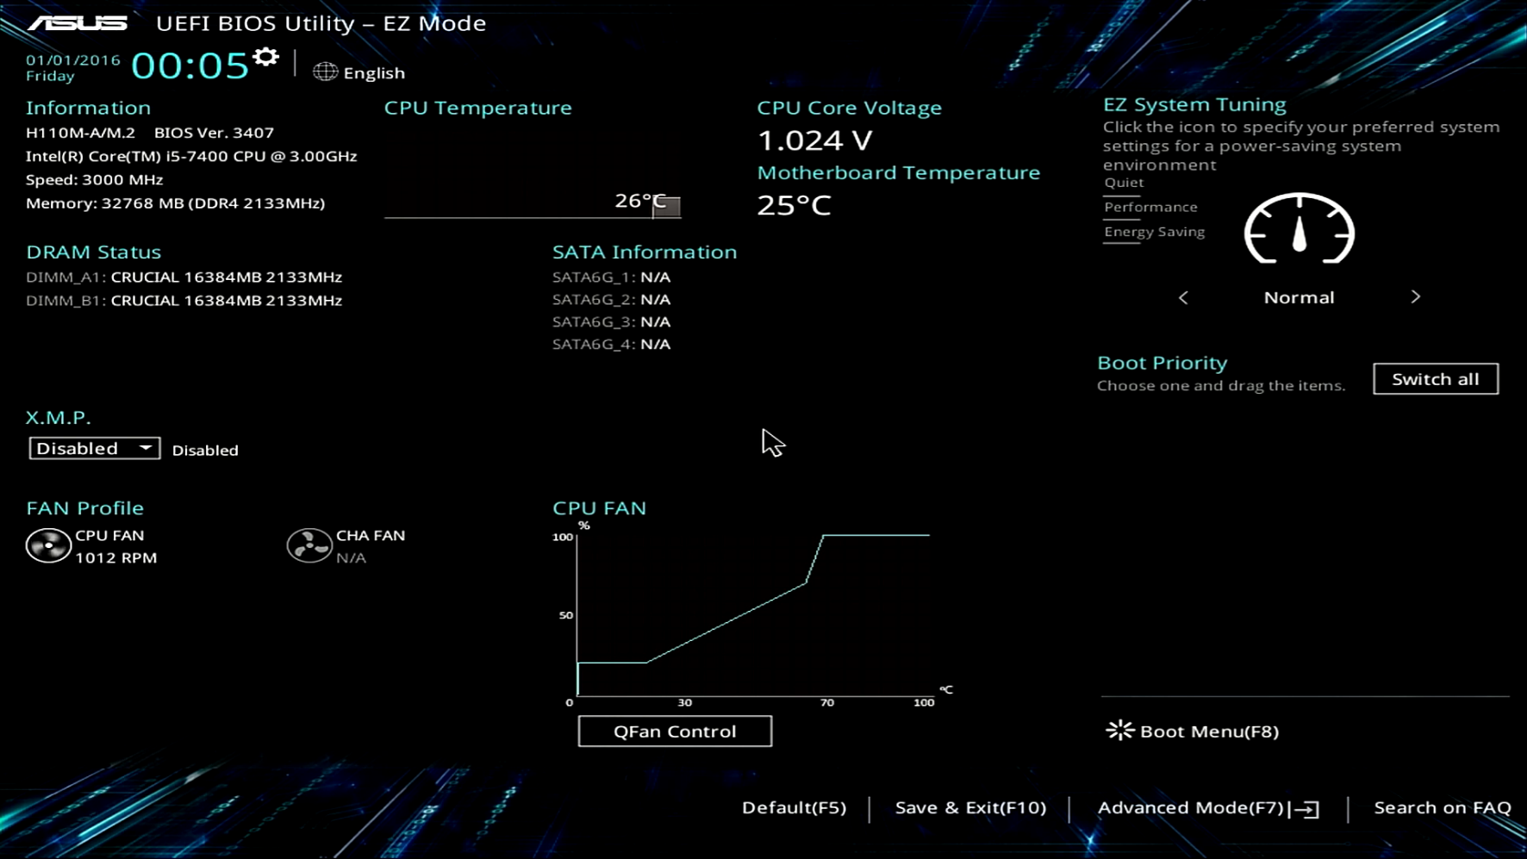
Signs Battery is Flat
Error message on start up
Date very inaccurate
ITFreeTraining.com
© Copyright 2024
Notes:
05:58 If the battery in your computer goes flat or dead, the internal time clock will lose its time and reset back to a specific start time. When this occurs, you will generally get a message on startup. In some cases, the message will say the date and time has been lost. In this example, the message just indicates that BIOS settings have been lost. Since modern computers keep configuration settings in flash, on a modern PC you should only lose the date and time.
When the date and time has been lost, it will revert to its start time. In this example the first date is the first of the year, 2016. Some computers may go back as far as the 1980’s. If you see a date and time that is years or tens of years old, this generally indicates it has reset back to its start time. If you start seeing symptoms like this, it is most likely time to change the battery.
Changing the battery is a simple matter. Use a flat head screwdriver to release the battery cover and remove the battery from the computer. Buy a replacement battery of the same type. Button batteries like these are fairly common, so should be easy to obtain. Once you have purchased a replacement battery, push it in until it clicks into place. Once the battery has been replaced, you will most likely have to set the date and time. Let’s have a look at how you would do that.

Slide 6
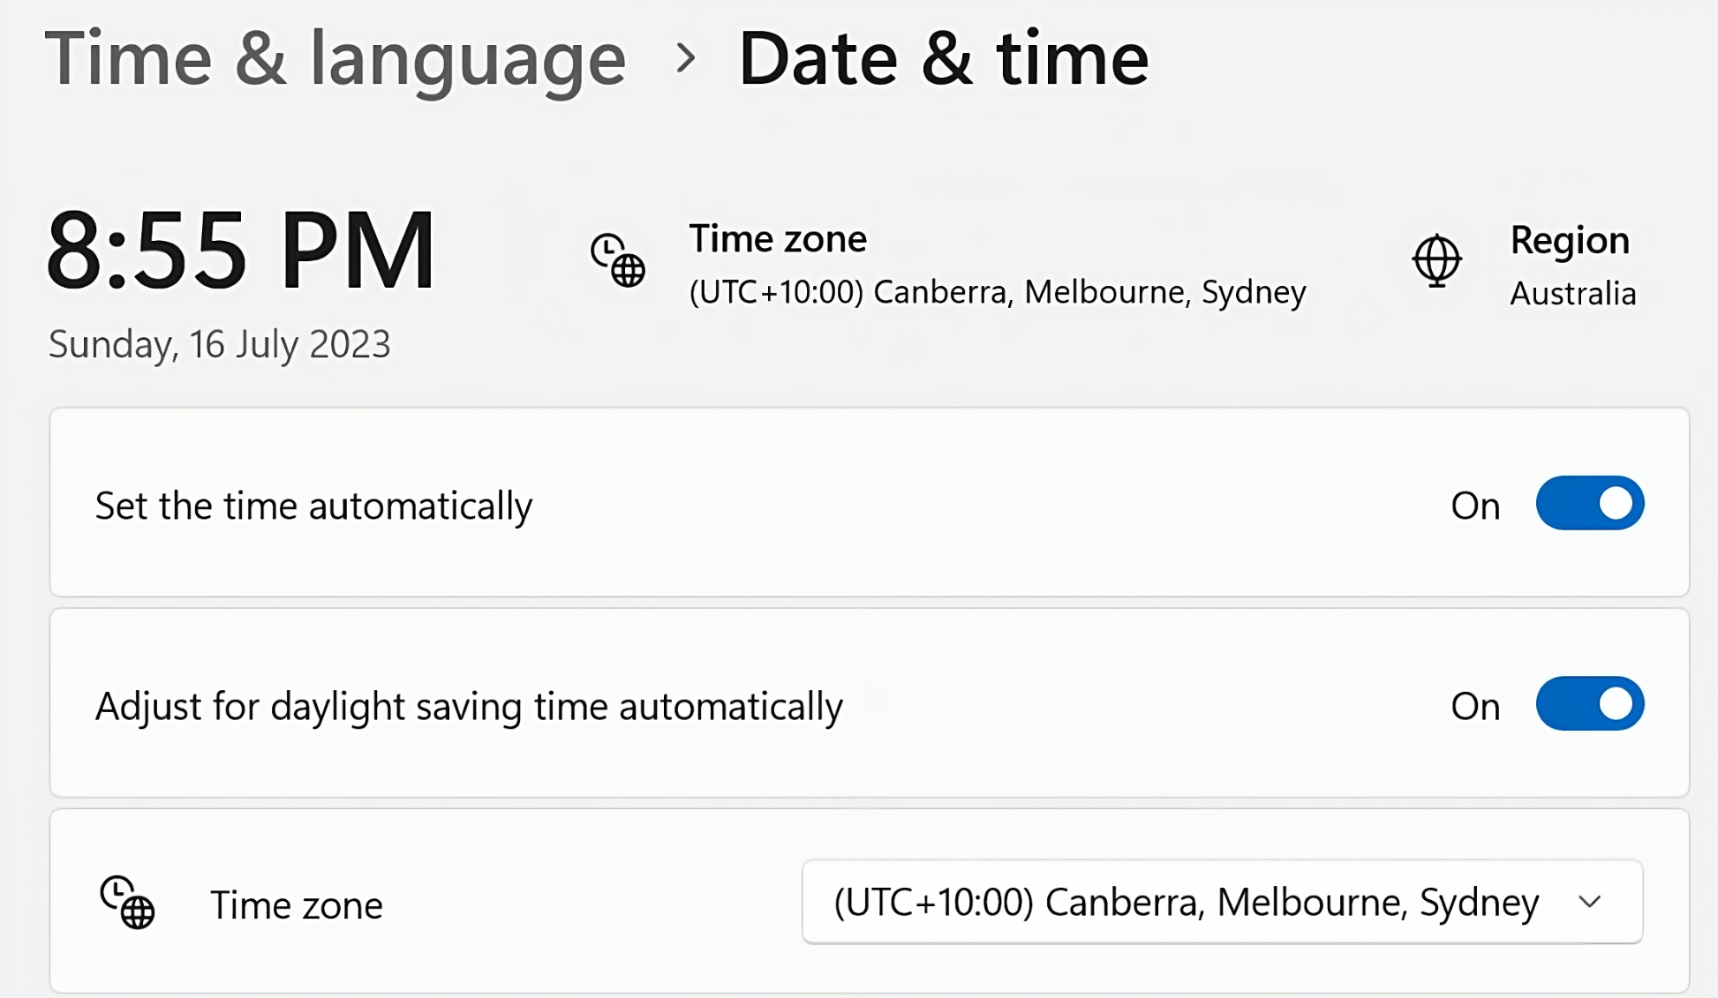
In The Real World
Modern OS will automatically sync with a time source
Requires an internal company time source or an internet connection
OS automatically changes internal clock
Troubleshooting
1. Start computer and allow time to sync
2. Login and manually sync or edit
3. Login as local administrator and set
4. Change date and time in computer setup
ITFreeTraining.com
© Copyright 2024
Notes:
07:23 In the real world, modern operating systems will automatically sync the date and time from a time source. This requires an external time source or an internal company time source. When you change the time in the operating system, it automatically changes the internal clock accordingly.
In a lot of cases, the process happens automatically, and you won’t know it is happening. You could have a computer with a dead internal battery, but since the computer automatically re-syncs on startup, you may not even notice.
In some cases, you may have a problem where the time does not sync automatically. When this occurs, I would recommend the following steps to fix the problem. Firstly, I would start the computer and allow time for it to sync by itself. Certain devices require an external time source to be present on boot. For example, credit-card sized computers like the older Raspberry Pi didn’t have a battery to keep the time clock running and therefore, on every boot, required the device to re-sync its date and time.
If the computer does not sync the date and time, log in and try to manually force the time to sync or edit the time to the correct time. In some cases, you may not be able to log in. For example, on Windows domains, you may not be able to log in if the date and time is too skewed from the correct time. When this occurs, log in to the computer as a local administrator and set the date and time manually.
If this fails or perhaps you don’t have a local administrator account, restart the computer and change the date and time in the computer’s setup. Some technicians may do this first, but since you can achieve the same result in the OS, I would try the OS first.
As long as the operating system shows the correct time, it typically doesn't lead to any functional issues. However, if the time is incorrect, even with the correct time zone and other settings, you may need to modify certain other settings within the operating system to rectify the issue. In some instances, this might involve altering registry settings to prevent the operating system from incorrectly resetting its internal clock to UTC. While this type of problem is uncommon, it's important to address it to ensure that time-dependent applications and processes function as intended.

Slide 7
Subscribe
Next video
Video content: https://ITFreeTraining.com/ap11/3d15
© Copyright 2024
Notes:
09:43 Thanks for watching this video on troubleshooting time and date problems. I hope you have found this video informative. Until the next video from us, I would like to thank you for watching.
References
“The Official CompTIA A+ Core Study Guide (Exam 220-1101)” pages 112 to 113
“Picture: Time zones” https://commons.wikimedia.org/wiki/File:World_Time_Zones_Map.png
“License CC BY 4.0” https://creativecommons.org/licenses/by/4.0/
Credits
Trainer: Austin Mason https://ITFreeTraining.com
Voice Talent: HP Lewis http://hplewis.com
Quality Assurance: Brett Batson https://www.pbb-proofreading.uk

