Slide 1
Notes:
Let’s have a look at how you would troubleshoot your storage devices.

Slide 2
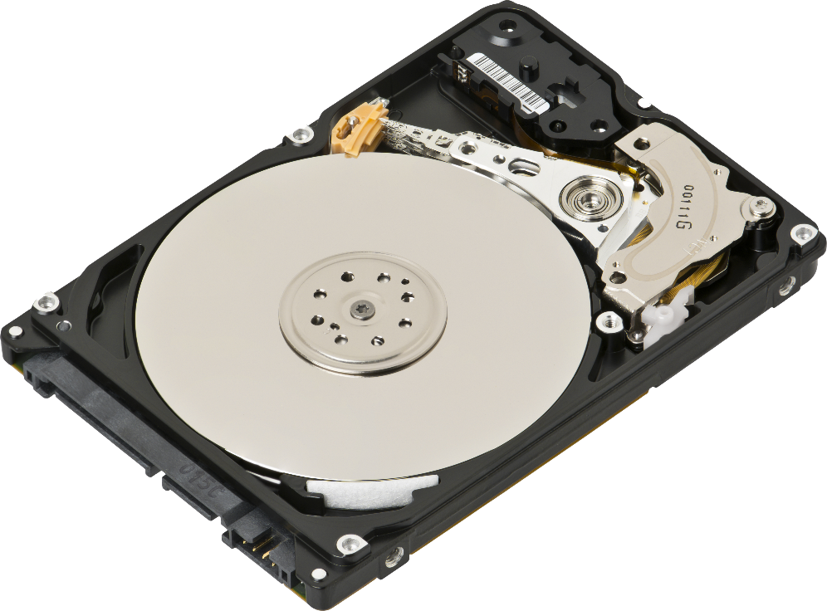
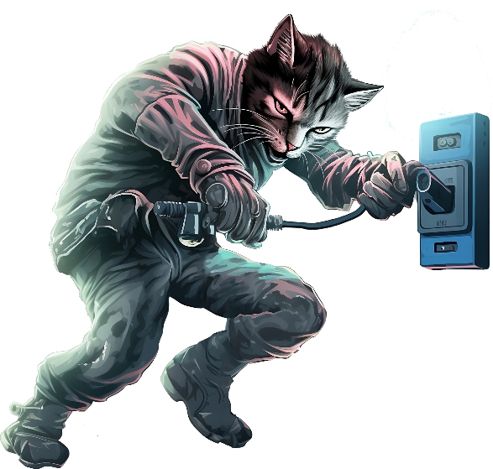
Drive Availability
Hard Disk
Solid-State-Drive
Generally, more reliable and last longer
Generally, fail due to mechanical problems
Ware increases if more writes performed
Power lost
Can cause damage or file corruption
Particularly if in the middle of write operations
ITFreeTraining.com
© Copyright 2024
Notes:
00:04 Storage devices contain our valuable data. Hard disks, when they fail, do so generally because of mechanical problems. Factors like running time and heat reduce a hard disk’s lifespan. However, performing functions like reading and writing doesn’t tend to reduce the lifespan of a hard disk.
In contrast, Solid-State-Drives generally last longer and are more reliable than hard disks. However, wear increases if more writes are performed on a Solid-State-Drive. The other point to consider is that, if power is lost, this can cause damage or file corruption. This is a particular concern if the storage device is in the middle of write operations.
Let’s have a look at some of the things to look for to help you determine if there is a problem.

Slide 3
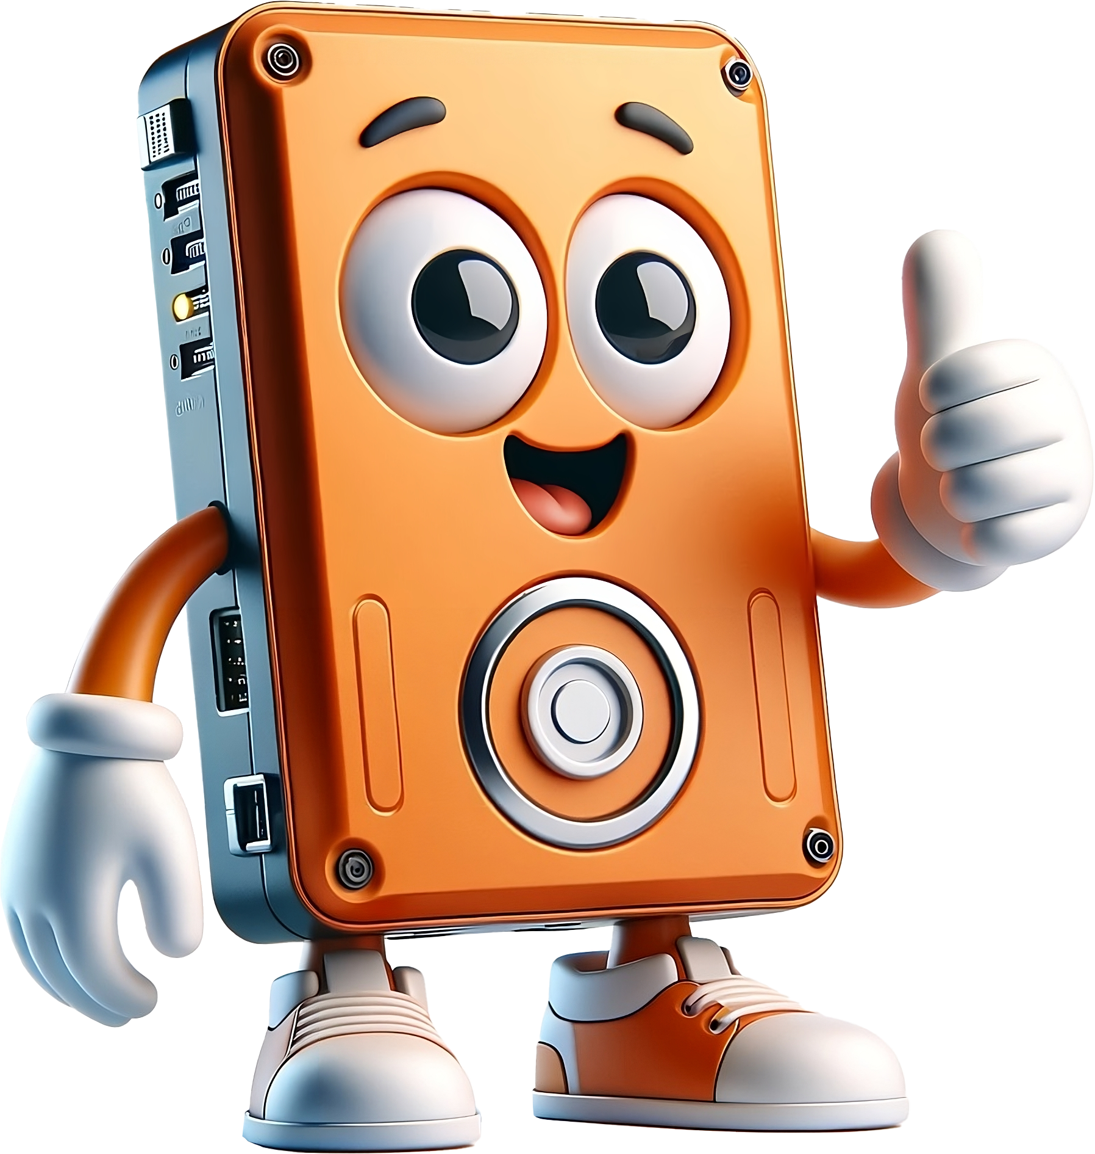
Hard Disk Normal Startup Sounds
Does basic checks
Motor spins up
Checks hard disk head
Reads configuration information
ITFreeTraining.com
© Copyright 2024
Notes:
00:52 To start diagnosing a hard disk, it is first a good idea to understand what it sounds like under normal conditions. When a hard disk first powers up, it will do some basic checks. You should hear the motor spin up. A check is done of the hard disk head and some configuration information is read. It should sound like this.
If you don't hear the typical sounds from a hard disk, it might indicate a problem. These sounds are often quiet and hard to detect. You can try feeling the hard disk for vibrations, especially when it first spins up. USB hard disks might be harder to hear due to them often being inside a plastic enclosure. Normally, you should hear the motor spin up followed by the read/write head moving, then returning to its parked position. If the motor spins but the head remains still, the drive might be failing, but remember, some drives are quieter than others.

Slide 4
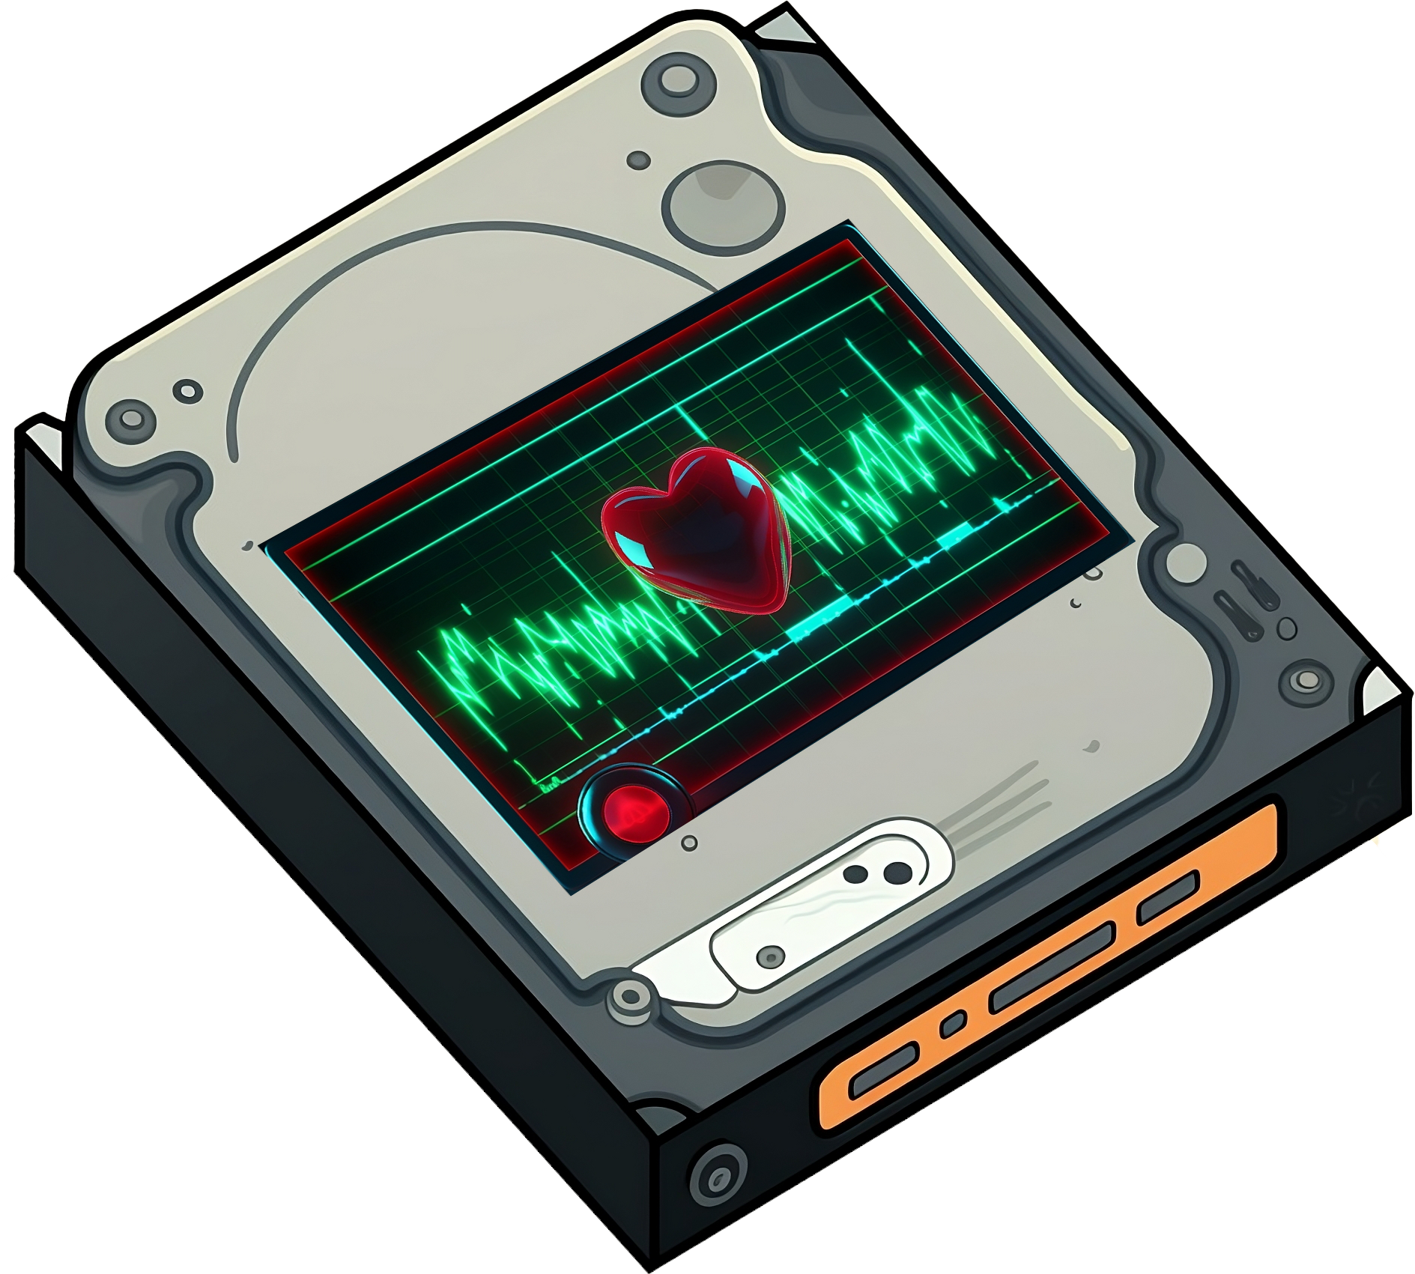
Normal Operation
Mild buzzing noise
When reading and writing
ITFreeTraining.com
© Copyright 2024
Notes:
01:53 During normal operation, a functioning hard disk typically emits a soft buzzing sound, which is the read/write head moving across the disk's platter. This sound is a normal indicator of the disk's reading and writing activities. It sounds something like this.
During normal operations, you should hear a random soft clicking noise of the head moving – it should be pretty random and quiet in nature. If it is a loud clicking and not random, there may be a problem with the hard disk. Let’s have a look.

Slide 5
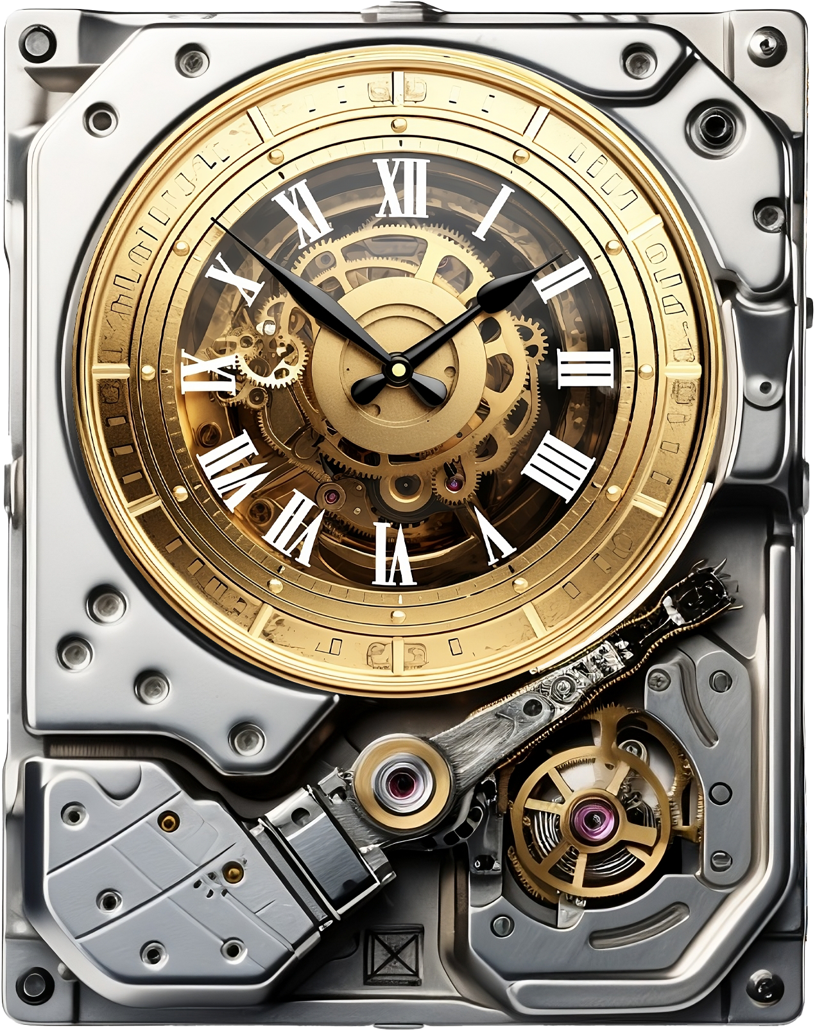
Click-Click
Periodic clicking noise
Head is resetting itself and trying again
May need to be replaced
ITFreeTraining.com
© Copyright 2024
Notes:
02:29 If you ever hear a clicking noise from the hard disk, this is the sound of the hard disk head resetting itself and trying again. It may mean the hard disk needs to be replaced and could sound something like this.
A repetitive clicking noise from a hard drive often signifies that the drive is repeatedly resetting and attempting an operation again. This behaviour is commonly observed when encountering a bad sector or when there's damage to a disk platter. In the case of a bad sector, the drive struggles to read from that sector, fails and retries. If the platter is damaged, the drive head may become stuck at the damaged area, unable to move past it. As a result, the drive resets itself in an attempt to try again.
Once you know what a healthy hard disk sounds like, any other noises like grinding noises or clicking noises are a sign of mechanical problems. Consider replacing the hard disk. Let’s have a look at what other signs you can look for.

Slide 6
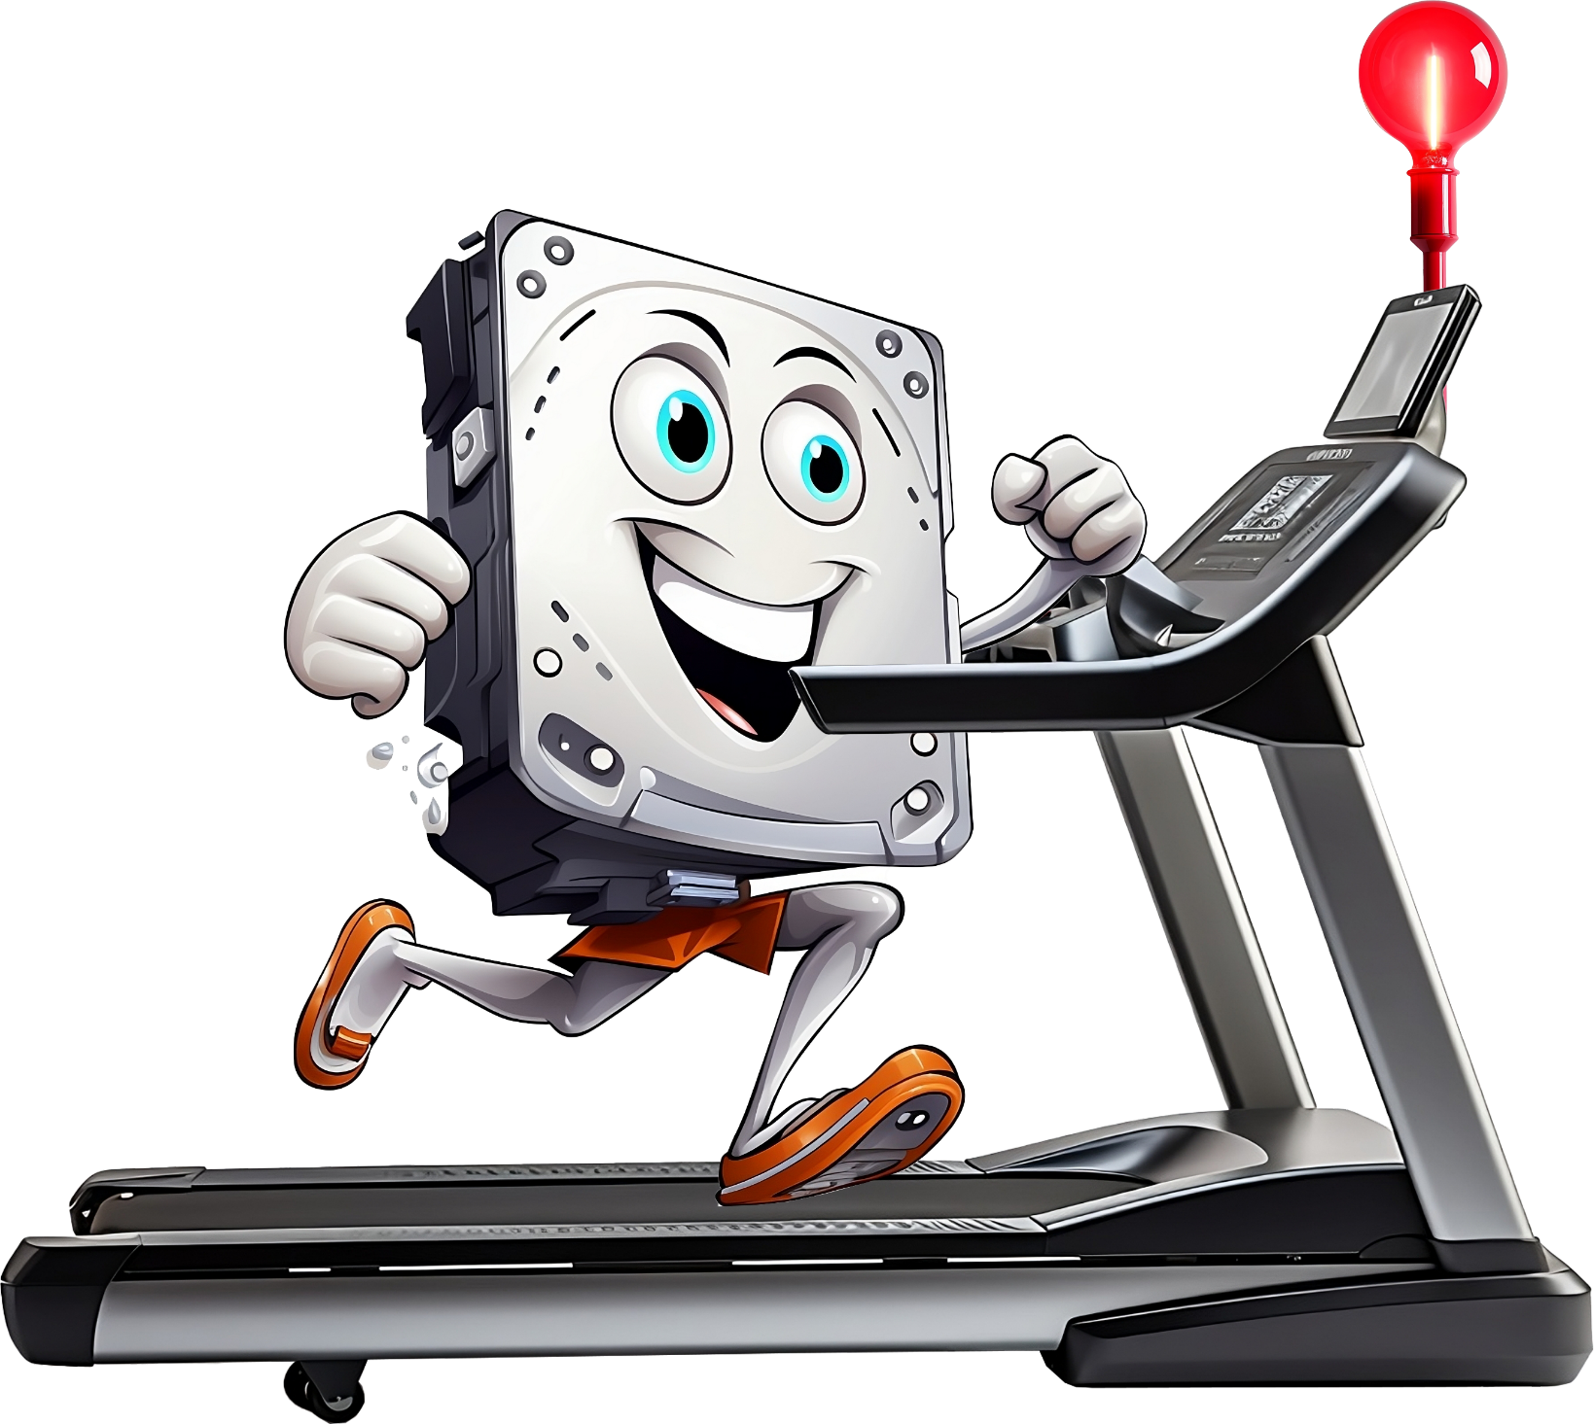
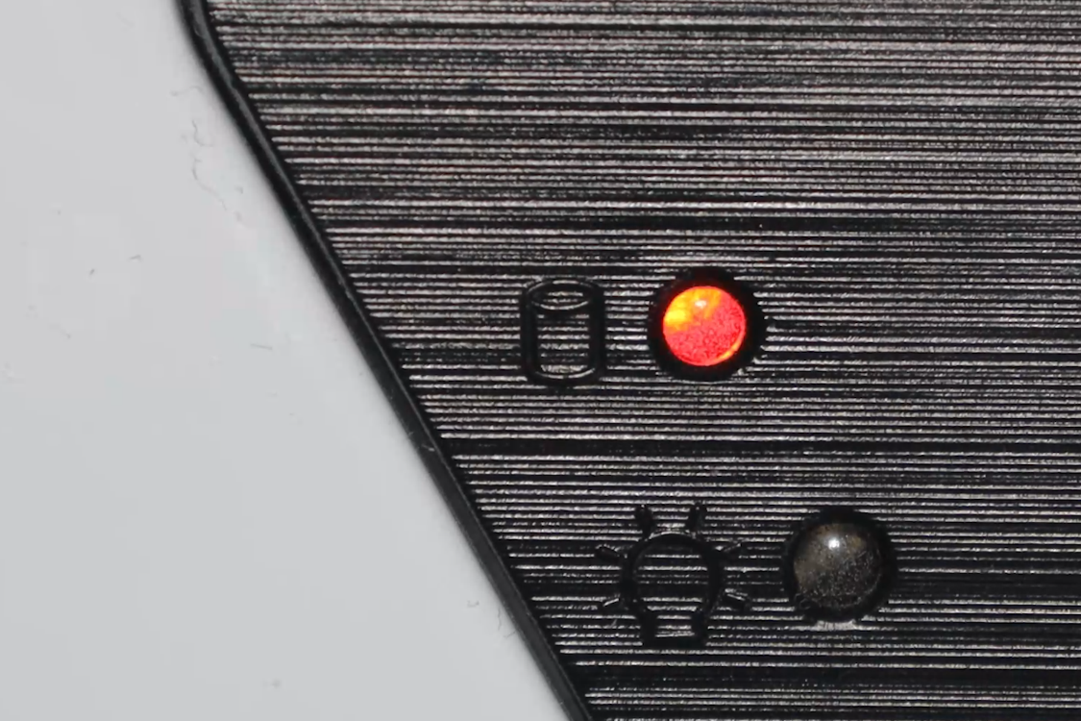
Hard Disk Activity Light
Indicates storage access
Both read and write
All storage connected directly to motherboard
No activity - May not be getting power
Constant - Indicating not enough RAM
ITFreeTraining.com
© Copyright 2024
Notes:
03:36 On your computer, there should be a hard disk activity light. This flashes when accessing storage, both for read and write access. Although it was traditionally designed for hard disk activity, hence the name, it works for any storage that is directly connected to the motherboard. Thus, SATA Solid-State-Drives and M.2 drives will cause the light to flash when they are accessed. However, USB storage devices will not, since they are not considered to be internally connected storage.
On your computer case you should have a hard disk activity light, often red in color. Assuming it is connected, it will flash when the internal storage is accessed.
If there is no activity at all, it may mean the storage device is not getting power. It can be hard to tell when you have multiple storage devices because you won’t know which one is being accessed. If you find that the activity light is constantly flashing or on all the time, it may indicate that you do not have enough RAM in the computer. When a computer runs low on RAM, it begins using its storage drive as virtual memory, which can significantly slow down performance. If the activity light is constantly flashing without heavy storage use, it may be a sign that your computer needs more RAM.

Slide 7
Fail To Boot/Missing Drives
Check cabling/make sure storage device plugged in
Also check it is enabled and detected in computer setup
Fail to boot
Either storage device not available or data corrupted
Missing storage device in OS
Make sure storage device is enabled in OS
ITFreeTraining.com
© Copyright 2024
Notes:
04:55 If you are finding that your computer is not booting or there are missing storage devices, check the cabling and make sure the storage devices are plugged in. Check both the data and power cables. Also check the storage devices are enabled and detected in the computer’s setup. Keep in mind that if you plug a storage device back in, you may need to fully shut down the computer in order for it to be detected.
If the computer is failing to boot because the storage device is not being detected, you will usually get a message saying there was an error loading the operating system. When this occurs, it is either the storage device is not available or the data is corrupted.
If your storage device isn't showing up in the operating system but appears in the computer's BIOS or setup, the issue might lie with its configuration in the OS. Ensure the device is enabled in your computer's storage management settings. Additionally, the operating system may require specific device drivers, especially for specialized devices like RAID arrays. While most common devices are usually supported natively, more complex storage solutions often need these extra drivers for the OS to utilize them.

Slide 8
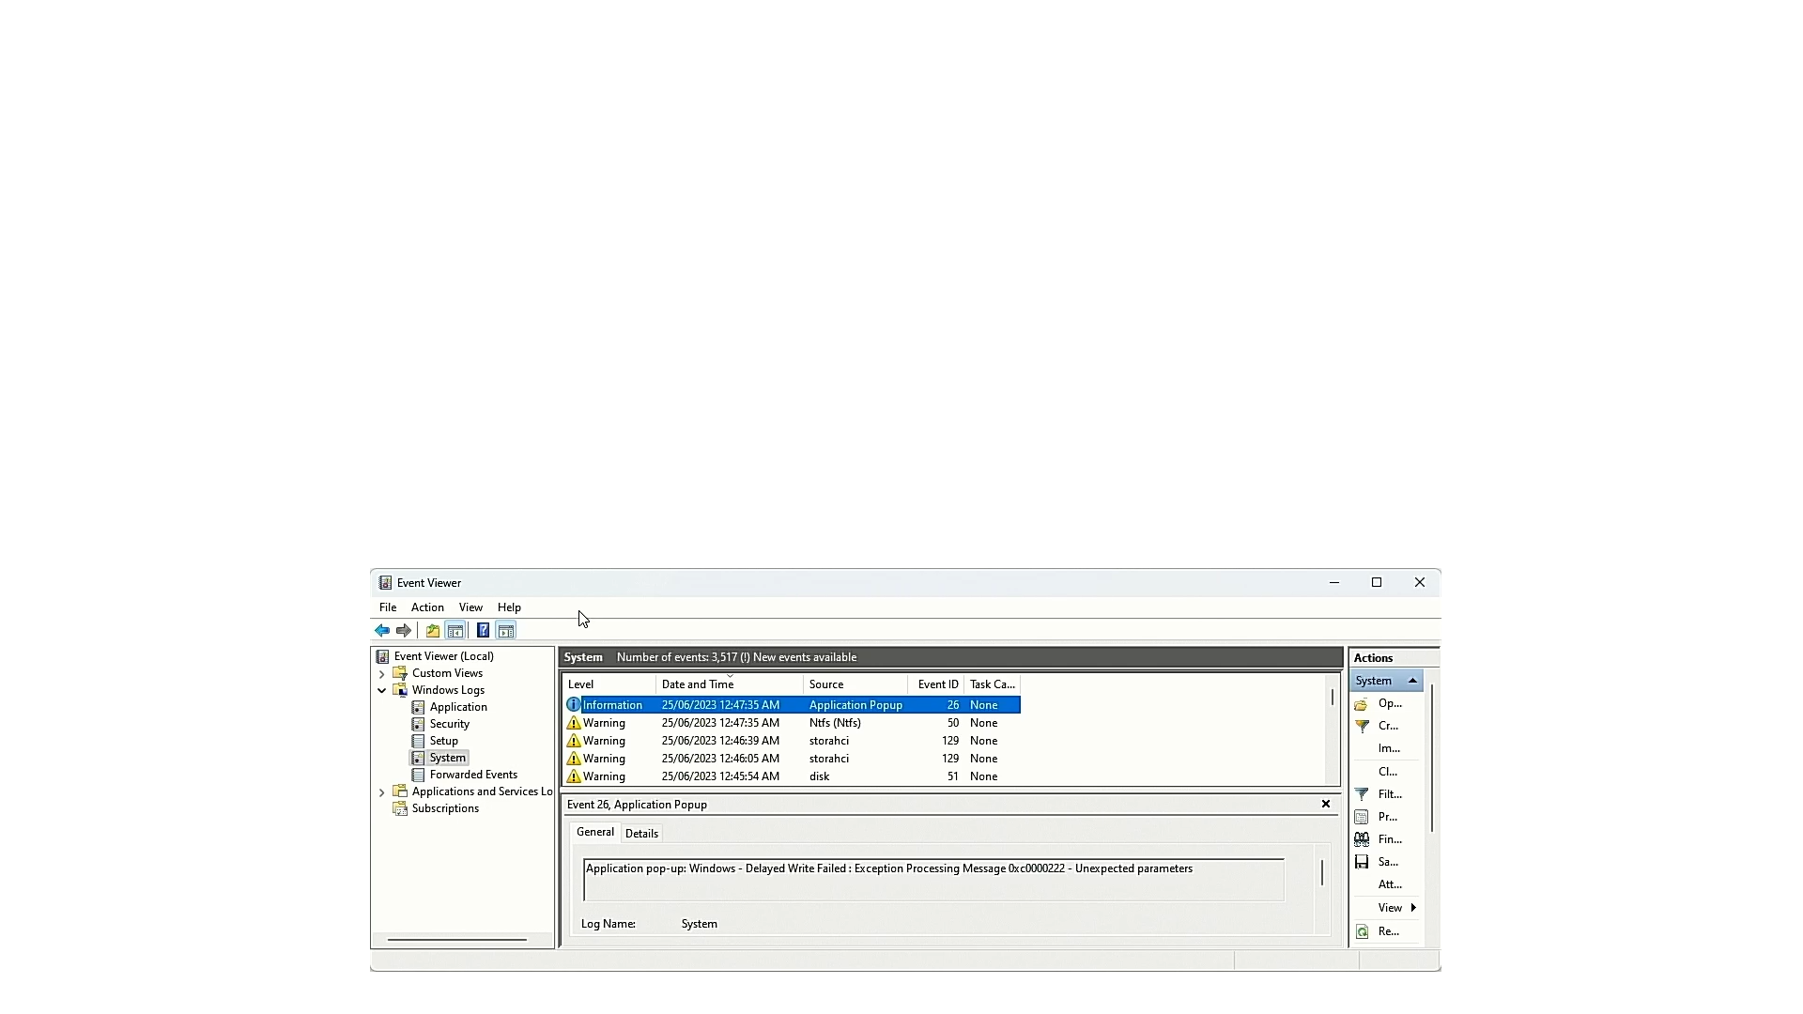
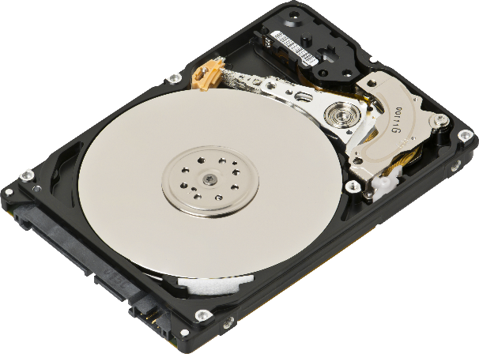
Read/Write Failure
Receive errors - data could not be read or written
Bad sectors or mechanical faults
Writes degrade storage
Modern SSDs last a long time
ITFreeTraining.com
© Copyright 2024
Notes:
06:08 When using storage, generally when there is a problem reading or writing, there will be some kind of message to indicate a problem has occurred. In the case of hard disks, a lot of errors are caused by bad sectors or mechanical faults.
In the case of Solid-State-Drives, writing to the storage device degrades the storage faster. Modern Solid-State-Drives do last a long time. I have one in a computer that is on every day and gets used every day. After four years its useful life span has gone down by 7%. Depending on who you ask, modern Solid-State-Drives with average use will last five to ten years. Keep in mind, the more you write to a Solid-State-Drive, the quicker it will wear out. The technology has improved significantly since it first came out.
If you are using Windows, and you are having storage problems, you should get some errors in the Event Viewer. Other operating systems should have logs indicating there is a problem.
The hard disk in this computer is failing and thus a number of events have been created. You will notice the first error indicates that a message pop-up was displayed that a delayed write failed. Windows will often not write data straight away to storage. It does this so it can cache writes making it more efficient. A delay write error means the write was delayed and took longer than it should have. These are a concern because sometimes when they occur, data is lost.
The next event is related to the file system NTFS. This error also mentions a delay write. Essentially, it is saying that it was trying to write to the NTFS file system and an error occurred.
The next error is saying a reset was performed on the RAID port containing the hard disk. The hard disk is connected by a SATA port which supports RAID. It is not running with RAID enabled, but since it is supported, it is reported as being a RAID port. Don’t let the description confuse you.
It is normal to occasionally get a reset error for a device. These can happen for a number of different reasons and may not be because of a problem with the device itself. If the device is getting reset all the time, this indicates something is seriously going wrong.
The last error is in relation to the disk. This error simply means that there was an I/O error accessing the hard disk, meaning, it either could not read or write to it. This is a problem because it indicates a hardware problem with the hard disk.
When you observe numerous disk-related errors clustered together in the event log, it often signifies a serious issue with your storage device. If the hard disk is attempting to access bad sectors, this may trigger these errors, while at any other time the errors are not being generated. Even a small number of such errors should be a cause for concern. I recommend considering a replacement of the hard disk in these cases, as these errors can be early signs of impending disk failure. It's better to be proactive in addressing these issues to prevent potential data loss.

Slide 9
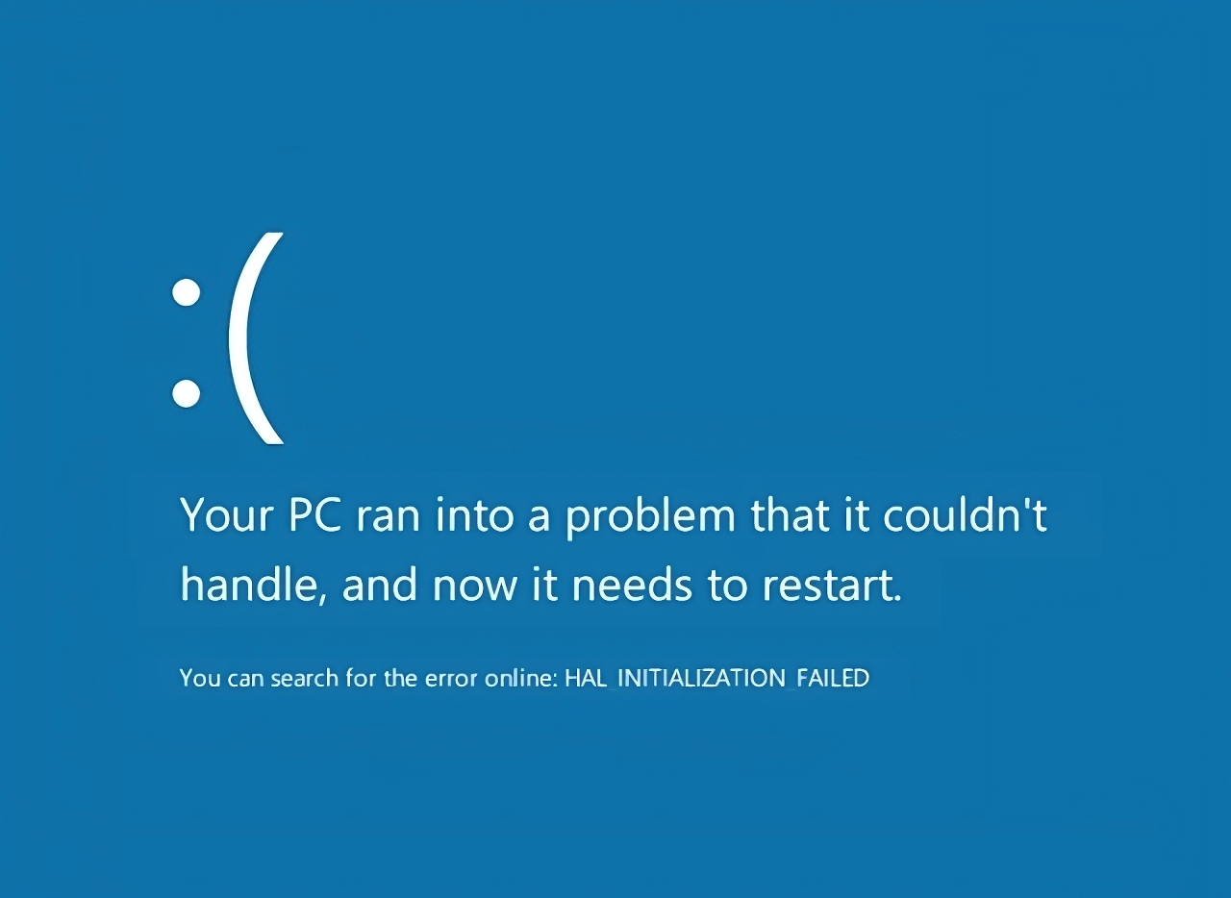
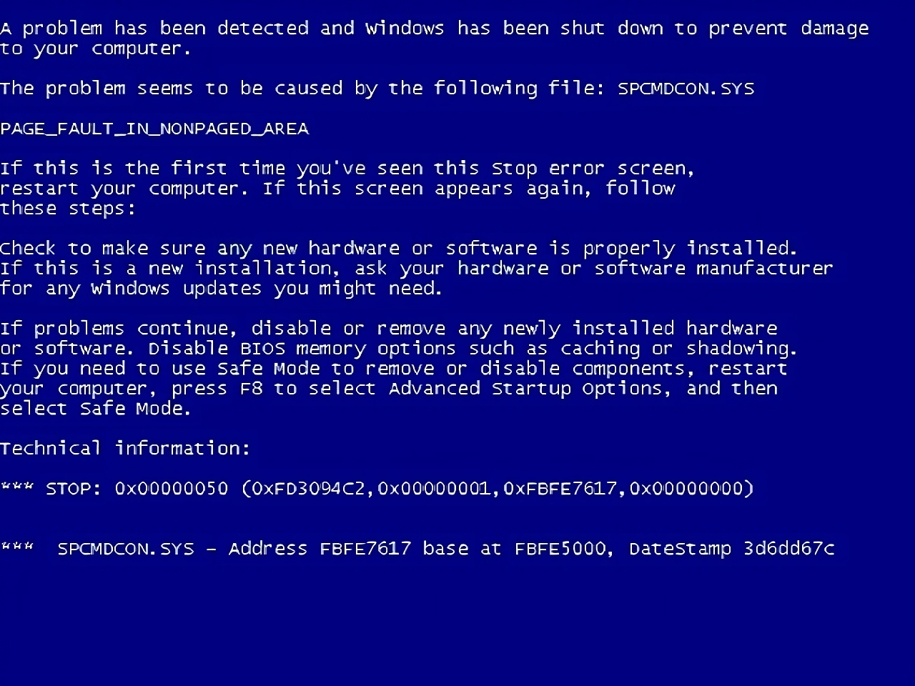
Blue Screen (Stop Errors)
Blue screen of death (BSOD)
Random unrelated blue screens indicate storage or memory problems
Less information given on blue screen. Use Event Viewer or other tools as well
ITFreeTraining.com
© Copyright 2024
Notes:
09:22 Storage problems can also cause the computer to generate a stop error which will be displayed on a blue screen. Its unofficial name is ‘blue screen of death’. Stop errors can be caused by many different sources. A faulty storage device driver can cause them; however, these kinds of errors are rare. Usually, storage device drivers are quite stable and don’t cause the computer to crash. If you do get a blue screen that indicates the device driver was at fault, update your device driver.
In most cases, random unrelated blue screen errors indicate storage or memory problems. Microsoft seems to be providing less and less information on blue screen errors as time goes by. You may need to check the Event Viewer or use other tools to analyze the blue screen to get more information. The main thing you want to look for is what generated the stop error? On the blue screen, hopefully Microsoft will give you some information to help you identify the cause.
If you look at where these errors are originating from and it seems quite random, check your storage and memory to make sure it is working properly. The reason these errors appear to be random is that, as you can imagine, if memory or storage is corrupting code or data, this can cause the system to crash when the corrupt code or data is used. This corrupted code or data could be used by any hardware device or system. Thus, the stop errors may seem to be random in nature.

Slide 10
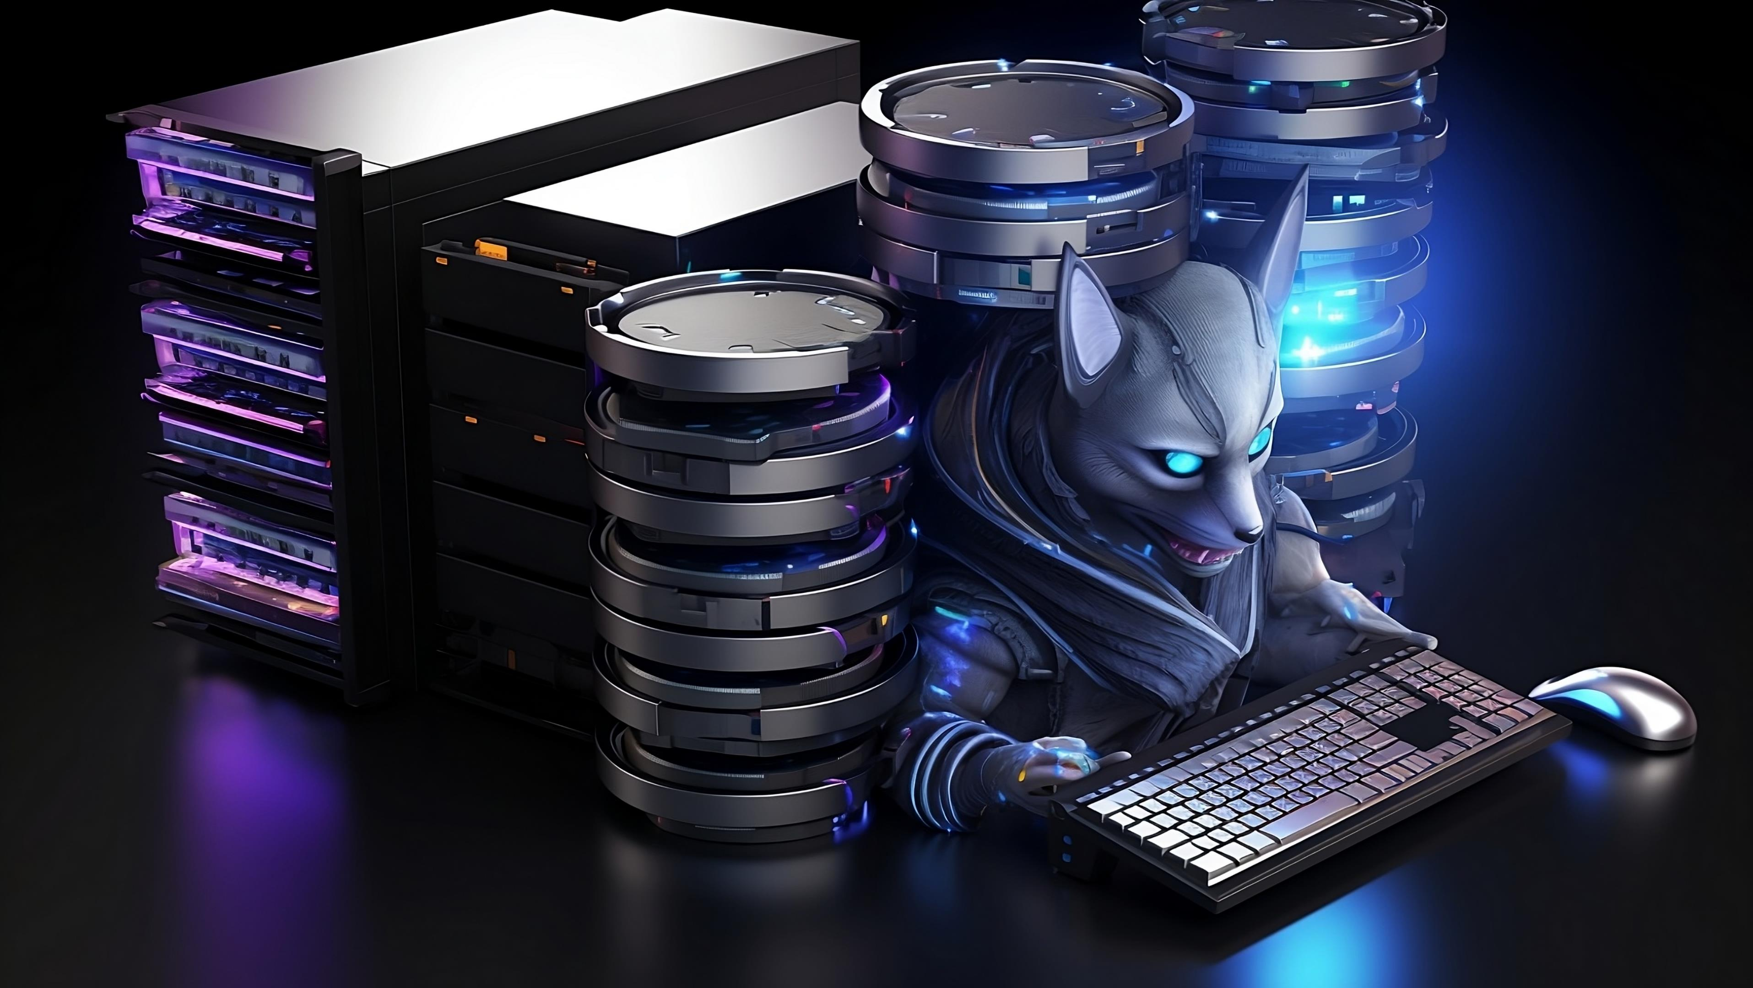
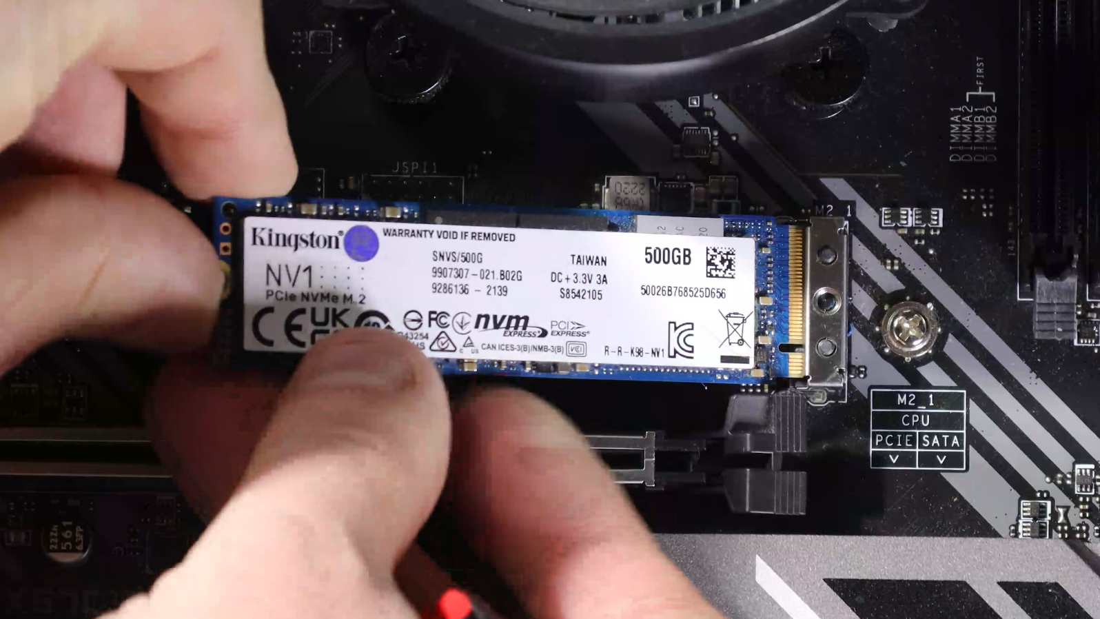
Backup Data and Replace Storage
Copy data off storage device as soon as possible
Replace failed hardware as
soon as possible
ITFreeTraining.com
© Copyright 2024
Notes:
10:50 If you find that you have a storage device that is failing, copy the data off the storage device as soon as possible. Once done, replace the failed hardware as soon as possible. The longer the hardware is being used, the more chance there is of data loss. Although storage devices have some reserve sectors that are automatically used to replace failing ones, once your storage starts going bad, there is a high probability it is going to fail. You want to copy your data off before it fails because, once it does fail, you won’t be able to do so.

Slide 11
Subscribe
Next video
Video content: https://ITFreeTraining.com/ap11/3c20
© Copyright 2024
Notes:
11:24 That concludes this video on drive availability. I hope this video helps you get your storage devices back if something goes wrong. If you do have a failing storage device, make sure you replace it. Until the next video from us, I would like to thank you for watching.
References
“The Official CompTIA A+ Core Study Guide (Exam 220-1101)” pages 102 to 103
“Mike Myers All in One A+ Certification Exam Guide 220-1101 & 220-1102” pages 361 to 364
“Picture: Inside Hard disk” https://commons.wikimedia.org/wiki/File:Laptop-hard-drive-exposed.jpg
“Picture: Blue screen stop error” https://commons.wikimedia.org/wiki/File:BSOD_Windows_8.png
“Picture: Blue screen stop error2” https://commons.wikimedia.org/wiki/File:Windows_XP_BSOD.png
References
“The Official CompTIA A+ Core Study Guide (Exam 220-1101)” pages 102 to 103
“Mike Myers All in One A+ Certification Exam Guide 220-1101 & 220-1102” pages 361 to 364
“Picture: Inside Hard disk” https://commons.wikimedia.org/wiki/File:Laptop-hard-drive-exposed.jpg
“Picture: Blue screen stop error” https://commons.wikimedia.org/wiki/File:BSOD_Windows_8.png
“Picture: Blue screen stop error2” https://commons.wikimedia.org/wiki/File:Windows_XP_BSOD.png
“License CC BY 4.0” https://creativecommons.org/licenses/by/4.0/
Credits
Trainer: Austin Mason https://ITFreeTraining.com
Voice Talent: HP Lewis http://hplewis.com
Quality Assurance: Brett Batson https://www.pbb-proofreading.uk

