Slide 1
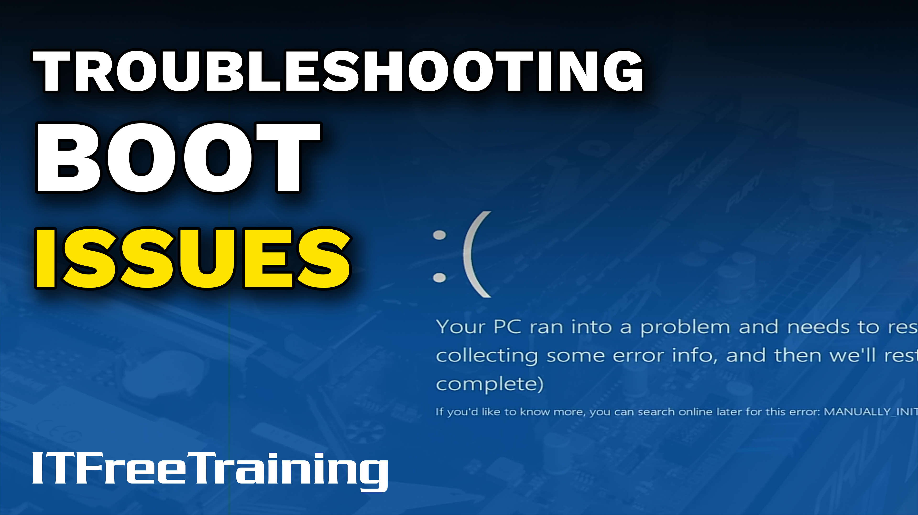
Notes:
Let’s have a look at troubleshooting boot issues.

Slide 2
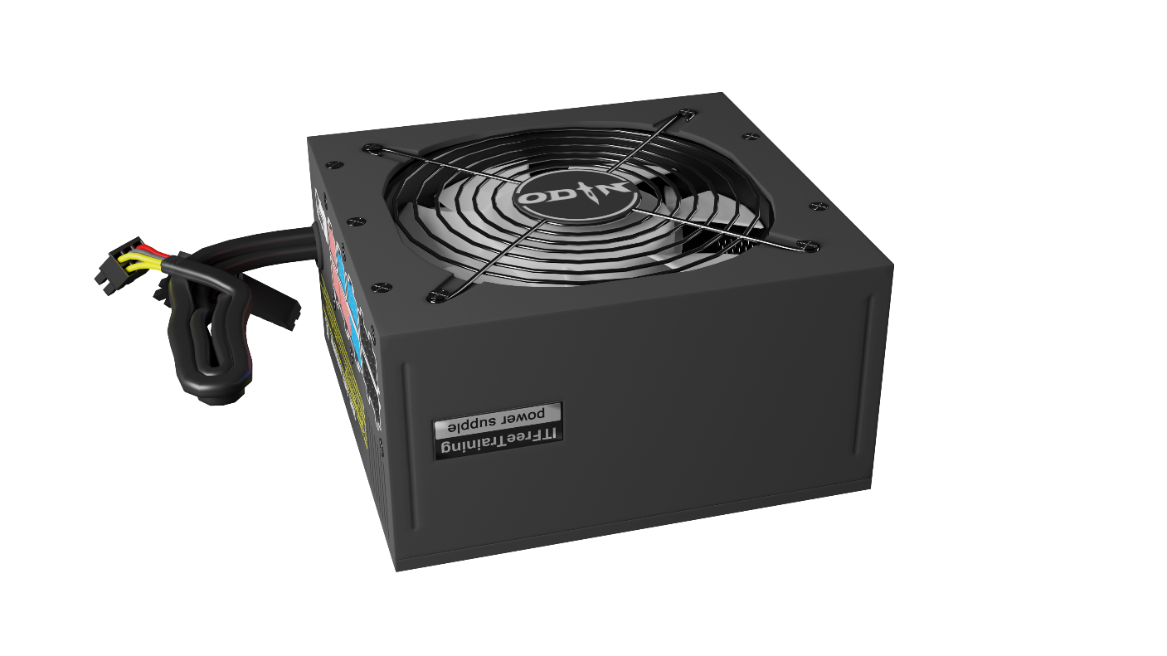


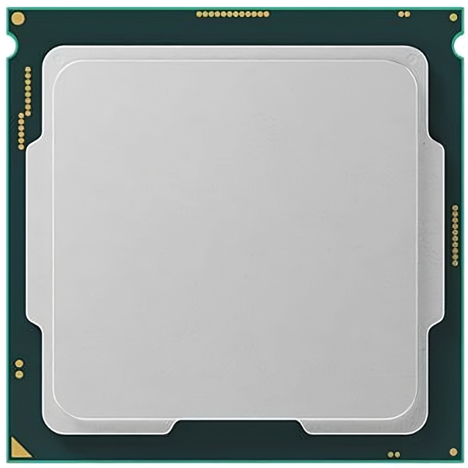
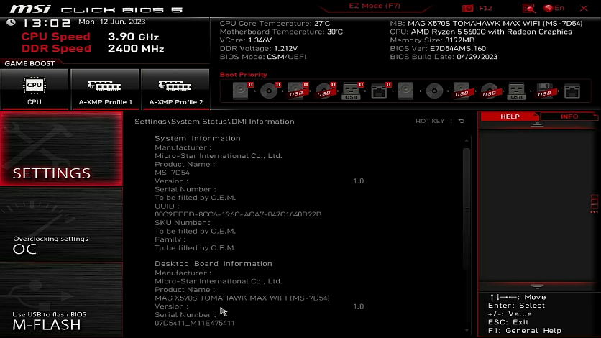
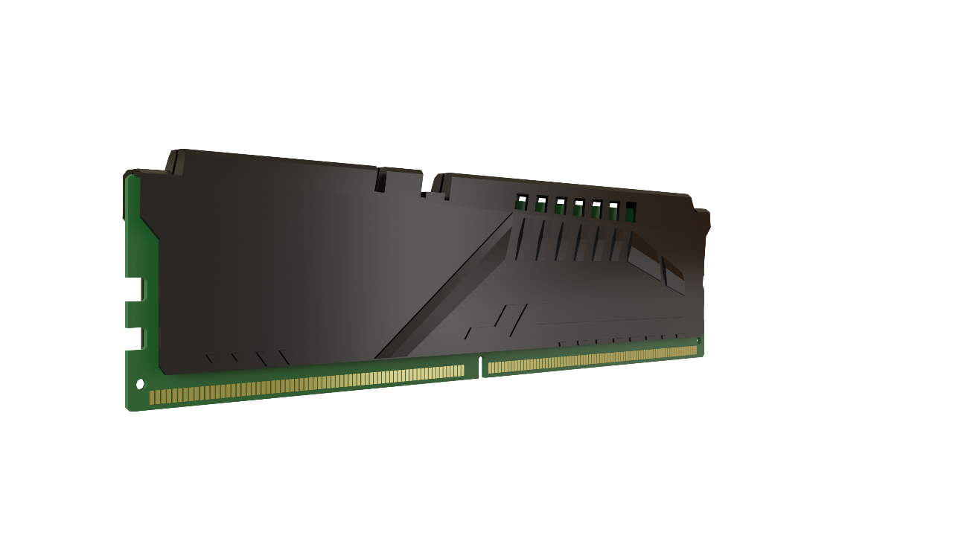
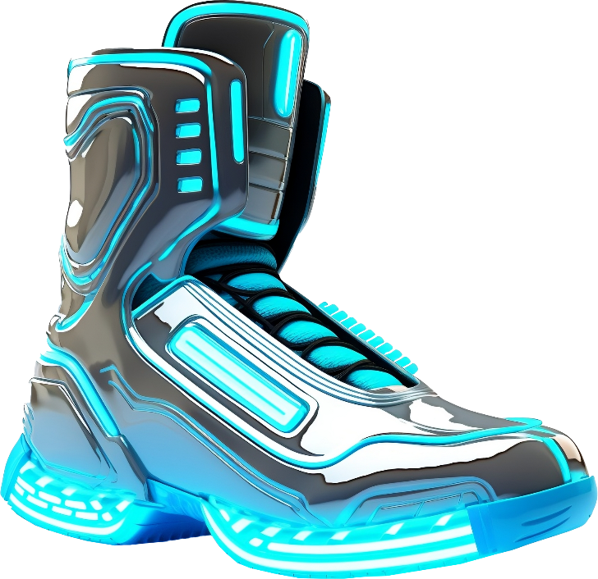
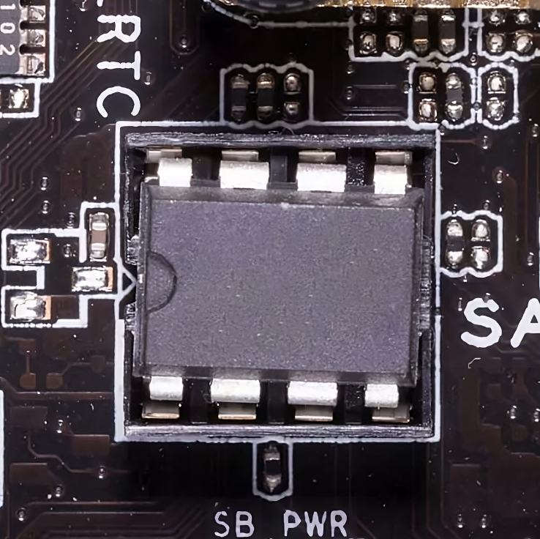
Boot Process
Power good
Settings
Boot
Firmware
ITFreeTraining.com
© Copyright 2024
Notes:
00:04 Before I look at troubleshooting boot issues, I will first have a quick look at the boot process. Understanding how this works helps when troubleshooting boot problems.
Initially, the power supply sends a 'power good' signal to the CPU, effectively resetting the CPU and other hardware, preparing them for operation. For the computer to start functioning, the CPU needs some code to run.
On the motherboard there is a BIOS or UEFI chip. This contains basic firmware to run the computer. This firmware is transferred to the memory to be run by the CPU.
The CPU now has some code to run. It can be used to access the computer setup to change settings on the computer. The computer can also start the boot process. Essentially the firmware provides a very basic code to run other software. This is enough to start the boot process. So, let’s have a look at what happens next.

Slide 3

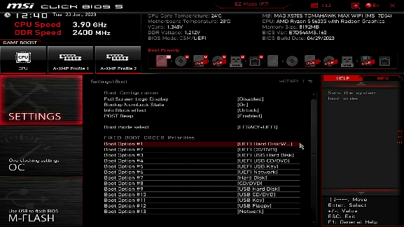
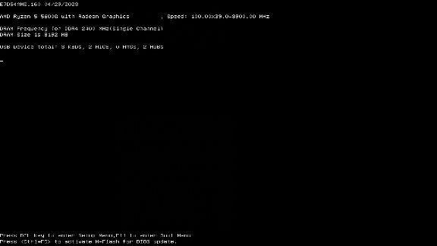
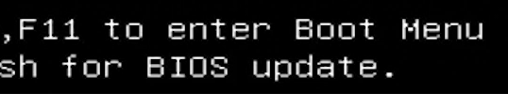
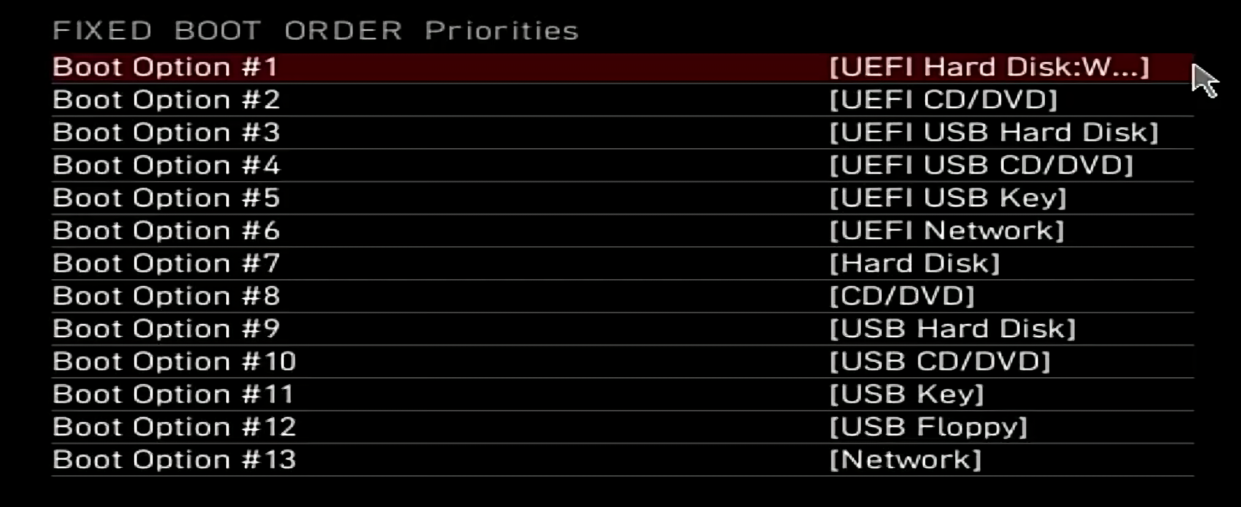
Boot Order
Configured in the computer's setup
Most computers have a hot key to choose the boot device
ITFreeTraining.com
© Copyright 2024
Notes:
01:00 The boot sequence of a computer is configured in its system setup, allowing you to specify the order in which different devices are checked for a bootable system. Additionally, most computers offer a hotkey option at startup to specify which device you want to boot from. Pressing this key during the boot process opens a menu where you can choose a specific device to boot from on a one-time basis. This feature adds flexibility to the boot process, allowing for temporary changes without altering the permanent settings in system setup.
When your computer fails to boot, one of the primary checks should be to ensure it is attempting to boot from the correct device. If a storage device malfunctions, the computer's setup may automatically switch to other available storage options, like a second hard disk. It's crucial during troubleshooting to verify that you're focusing on the right device. For instance, if your primary hard disk fails, your computer might try booting from a second hard disk. In such cases, troubleshooting symptoms related to the wrong storage device can lead you astray.
When a computer bypasses its normal boot device and starts booting from or trying to boot from an alternative source lower in the boot order, it often indicates an issue with the primary boot device. Thus, when you see this occur, it is best to start troubleshooting from the storage device the computer is supposed to boot from.

Slide 4


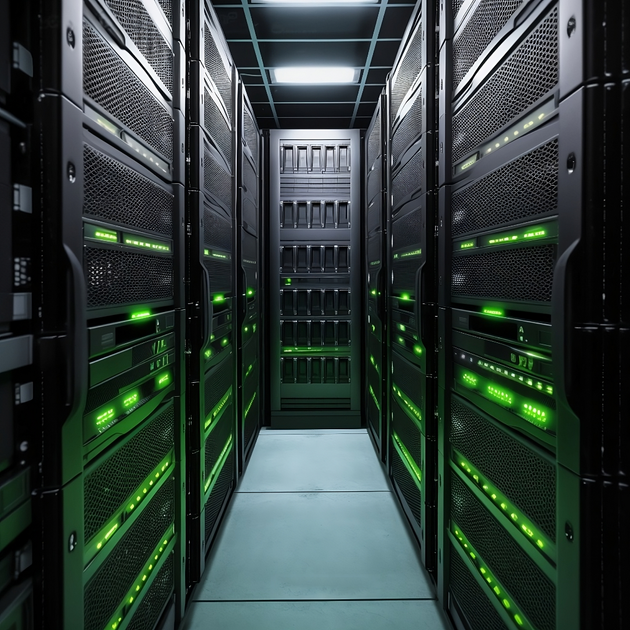
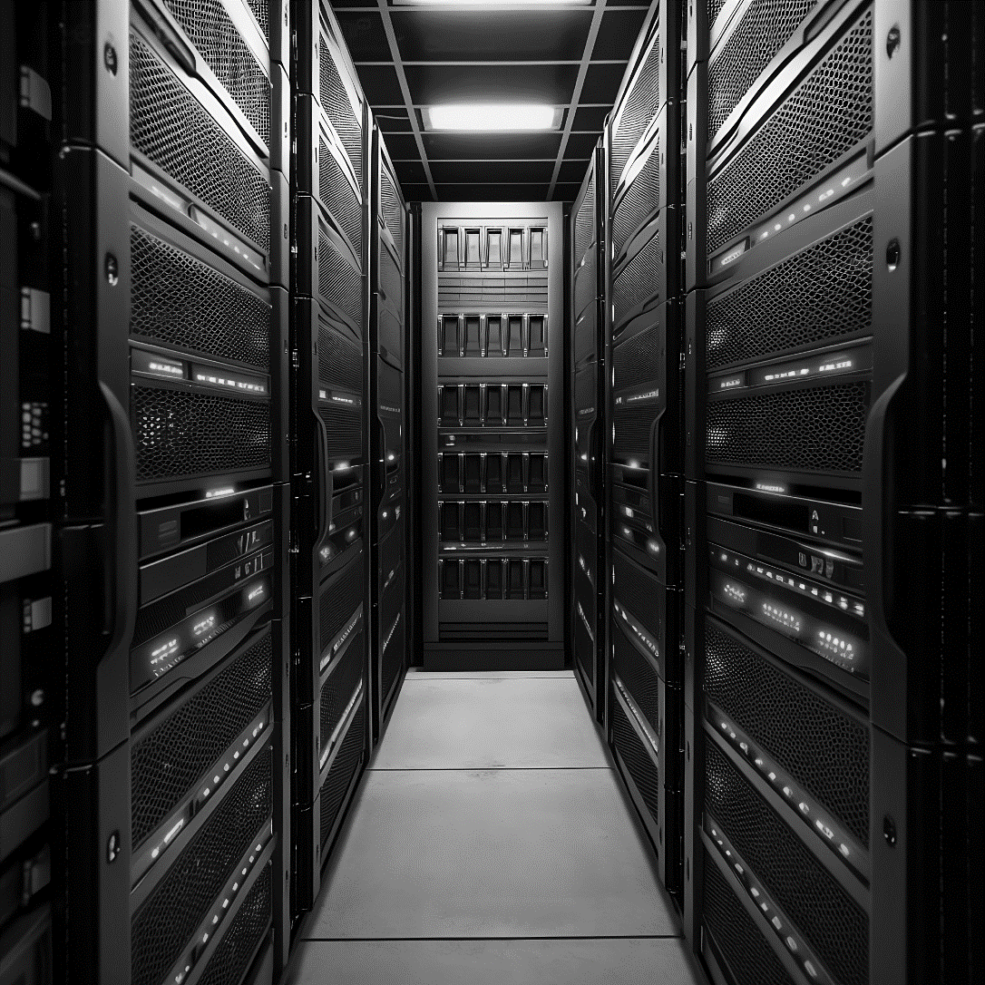
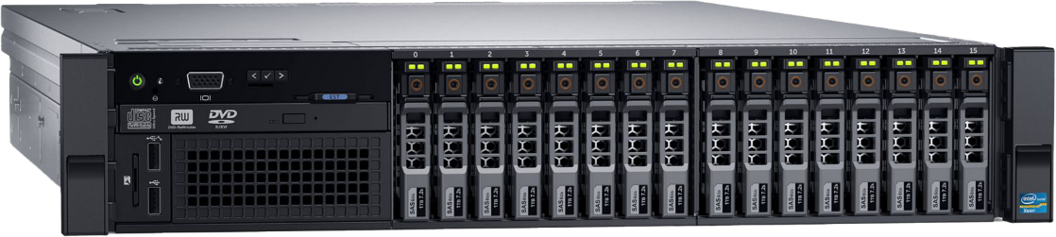
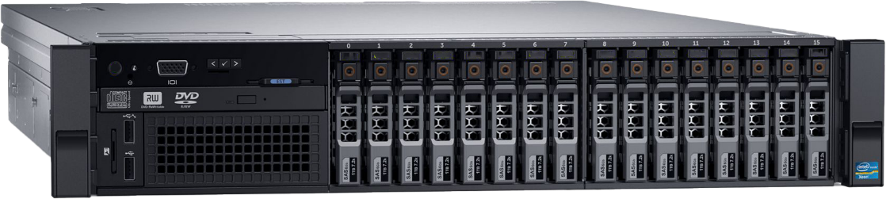
Real-World Example
Server storage
Located on SAN
SAN not available
ITFreeTraining.com
© Copyright 2024
Notes:
02:28 Here is a practical example to illustrate how boot issues can arise. I was once involved in migrating company data from internal RAID storage to a Storage Area Network or SAN. The migration was successful. The server was configured to boot from the SAN rather than the internal RAID. This transition went smoothly, and the server operated well after the change.
After a few days of the server working well, we had a power blackout. The UPS did its job correctly and shut down the equipment and we just had to wait for the power to come back on.
The power came back up and the server started up. However, the server started faster than the SAN did. Thus, the server failed to boot from the SAN and went to the next boot device which was the internal RAID. The server was thus running off the internal RAID which contained data from before the migration.
Unfortunately, we never noticed what had occurred until we got a phone call from a user saying there was something wrong with the data on the server. We quickly shut the server down, disabled it from booting from any other device other than the SAN and started the server up again.
The lesson to be learned here is that, when supporting computers, if you have multiple boot devices, consider disabling ones that you don’t need. Most modern computers will support pressing a key on startup for the rare occasion you want to boot off another device.
Let’s consider what happens when the computer tries to boot from a storage device.

Slide 5
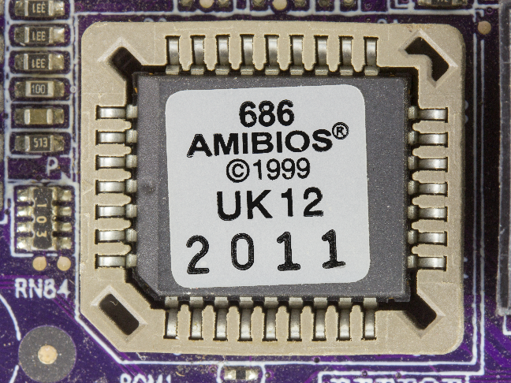

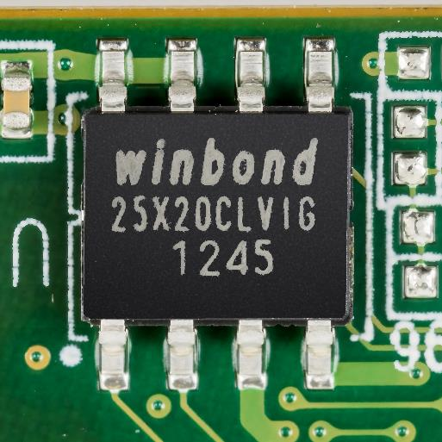
Booting from the Boot Sector
First sector always contains the boot sector
Loads boot sector (sector 0)
and executes code inside
BIOS
UEFI with CSM enabled
(Compatibility Support Module)
Sector zero = boot sector
512 bytes in size
ITFreeTraining.com
© Copyright 2024
Notes:
04:01 Computers use two methods for loading the operating system. The older approach involves reading the first sector of the hard disk, known as the boot sector. All BIOS systems support this method. UEFI, the modern equivalent of BIOS, also supports booting from the boot sector when Compatibility Support Module or CSM is enabled. CSM allows UEFI to work with older hardware, but it may disable newer features like Secure Boot and Fast Boot. Secure Boot is required by Windows 11, thus CSM needs to be disabled to boot from Windows 11.
When using BIOS or UEFI with CSM enabled, the initial step involves loading and executing the code from the boot sector of the storage device. A key limitation of this method is, for compatibility reasons, the boot sector is set to 512 bytes. This small size puts constraints on the amount of code that can be stored and run from the boot sector.
When you boot the computer, if the boot sector cannot be found, you will get a message looking something like this. On different computers, the message may be worded a little differently. However, essentially, it is saying the computer could not boot. 512 bytes is not enough to boot an operating system, but it is enough to load something that can. Let’s have a look at the next step.

Slide 6
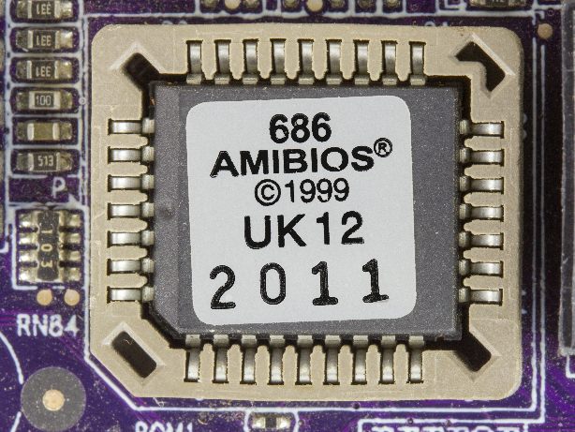

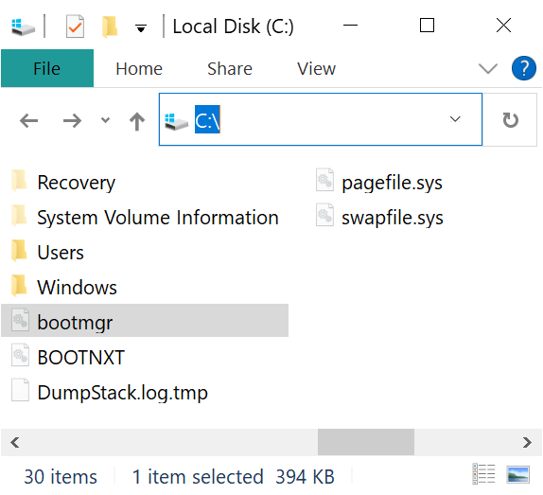
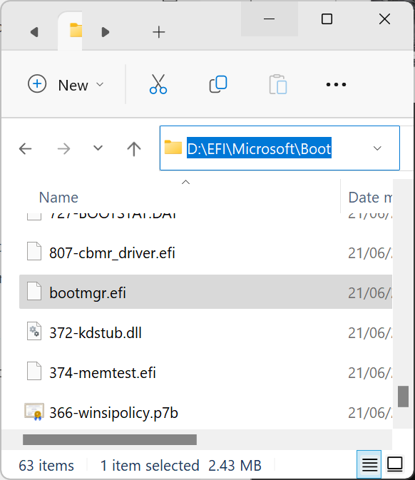
Boot Loader
Small program that loads the OS loader
Can also give you a menu so you can choose which OS to load or other options
BIOS
UEFI with CSM enabled
(Compatibility Support Module)
%SystemDrive%\Bootmgr
UEFI
\EFI\Microsoft\Boot\bootmgfw.efi
ITFreeTraining.com
© Copyright 2024
Notes:
05:28 The 512 bytes in the boot sector are sufficient to load the boot loader, which is a small program that loads the OS. So, the boot sector loads a boot loader. In the case of BIOS and UEFI with CSM enabled, it loads a file BootMGR which is found in the root of the system drive. Thus, the next thing that can go wrong when booting the computer is this file having been deleted or corrupted.
While it's unlikely that CompTIA will ask you specific questions about the boot loader, they might include more general queries on the topic. Understanding how the boot loader works is valuable for troubleshooting boot-related issues.
The boot loader often provides a menu, allowing you to choose which operating system to load or to modify boot options. For instance, the Windows boot loader has an option to press F8 to access various troubleshooting features. This is particularly useful when there's only one operating system installed, as the boot menu might not always be visible. Pressing F8 brings up options like Safe Mode, which starts the computer with essential drivers only. If your computer is not booting, you may be able to boot into Safe Mode and fix the problem. Safe Mode is often essential for fixing problems with faulty device drivers.
In the case of UEFI, it can read files directly from certain partitions. On a UEFI system, there will generally be a partition with the boot loader on it. UEFI can directly read a boot loader, eliminating the need for a traditional boot sector. This capability frees it from the 512-byte limitation.
You can see when you break it down, BIOS and UEFI both load a boot loader. BIOS requires a boot sector to bootstrap the boot loader, whereas UEFI does not.
Let’s now have a look at a problem you could potentially come across and how to fix it.

Slide 7
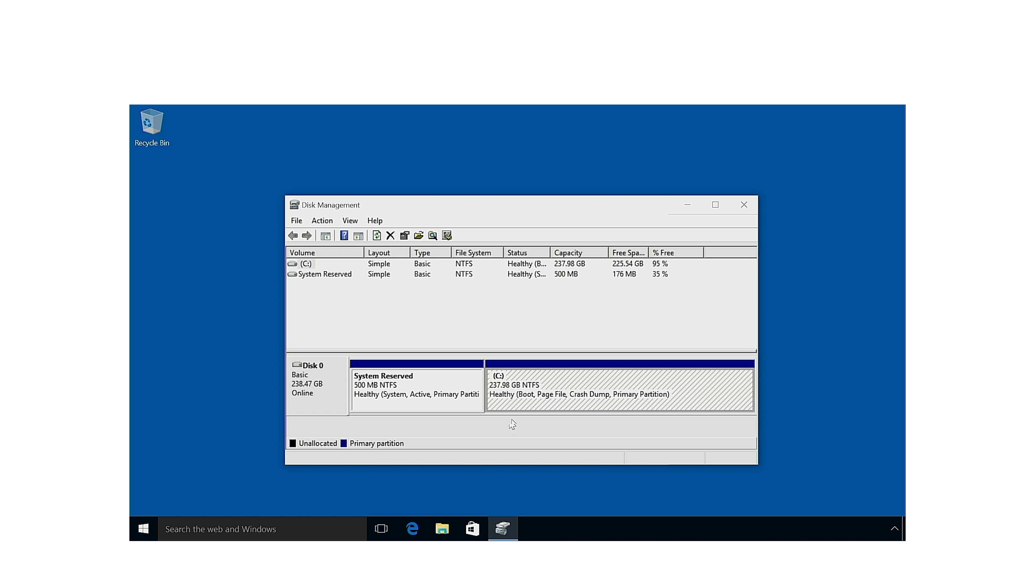
Boot Failure Example
ITFreeTraining.com
© Copyright 2024
Notes:
07:28
In this example, I have a computer running Windows 10. You will notice that, when the computer was set up, two partitions were created. The first partition is system reserved and contains boot configuration, Windows recovery, and reserved space for BitLocker. The second partition, the much larger one, holds all the data for the operating system.
The important point to take away here is that there is no partition which contains the EFI boot loader file. At the moment, the computer is booting using the boot sector, but has no way of booting using the EFI boot loader. It is possible to have the computer set up for both, but more on that later in the video.
In this example, it has been decided to upgrade the computer to Windows 11. In order to do this, some changes will need to be made to the computer setup. So, I will restart the computer and press delete to enter the setup.
Windows 11 has different hardware requirements than Windows 10. In order to upgrade to Windows 11, I will need to go to settings and then select advanced. On your computer, the location of the settings may be different, or they may be named differently, assuming your computer supports the hardware requirements for Windows 11.
I will next select the option “Windows OS Configuration”. You will notice that the computer is set up to use Compatibility Support Module or CSM. CSM allows legacy features like using the boot sector to boot the computer. In order to upgrade to Windows 11, I will need to change this to UEFI.
There are two reasons for this change. Windows 11 requires UEFI and will not install with CSM enabled. Windows 11 also requires Secure Boot, which on this computer won’t run in CSM mode. I will now select “Secure Boot”. Once in Secure Boot, I will enable it. I will get a bit of a cryptic message, basically saying a restart is required before keys can be loaded in the Trusted Platform Module or TPM. When making changes to the computer setup, sometimes a restart may be required.
Before I reboot the computer, I will first make sure the TPM is enabled, which is required by Windows 11. To do this, I will go back to the previous menu and select “Security”. I will next select “Trusted Computing”.
You can see that ‘Security Device Support’ is enabled, which essentially means that the TPM is enabled. Everything is ready, so I will restart the computer.
Since there is no EFI partition to load the boot loader and I have disabled booting from the boot sector, the computer won’t be able to boot. An interesting feature with this particular computer is, that when it does not detect any storage devices it can boot from, it will take you straight into the computer setup. Most computers will not do this, rather they will display an error.
To illustrate this better, I will reboot the computer and press the F11 key to enter the computer’s boot menu. You will notice on the boot menu there is only the option for the computer’s setup. No other bootable devices have been detected.
So, the problem is, we have a storage device that will only work with CSM enabled; however, we need to enable UEFI in order to upgrade to Windows 11. To solve this, I will need to install the UEFI boot files on the drive in order to boot the computer.
I will use a USB stick with Windows 11 installation files on it and restart the computer. The computer will boot into the Windows 11 setup. I could also use a boot disk like Windows PE. Once I get to the first screen, I will press shift F10 to open a command prompt.
I will execute the MBR2GPT command, which converts the existing MBR partition to GPT, and also creates an EFI partition in the process which will hold the boot files. Our booting issue stems from the absence of an EFI partition with a boot loader. It's important to note that while this conversion is generally safe, there's a potential risk of data loss, so ensure you have backed up important data before proceeding.
I will now exit setup and reboot the computer. The computer will restart, and this time Windows will boot, and I will be able to login to Windows.
I will now open Disk Management from the start menu. The disk now has three different partitions on it. The first is the recovery partition. This was there previously. The new partition is the EFI partition, which contains our EFI boot loader.
You can see the difference. Essentially, the tool shrunk the system reserved partition to make space for an EFI partition. Once the EFI partition was created, the required files were copied onto it. Hopefully, if something were to happen to the EFI partition, you would be able to find a tool to re-create it for you. Otherwise, you may have to do the process manually.
Now that we understand how the initial boot process works, let’s look at what else can go wrong during boot up.

Slide 8
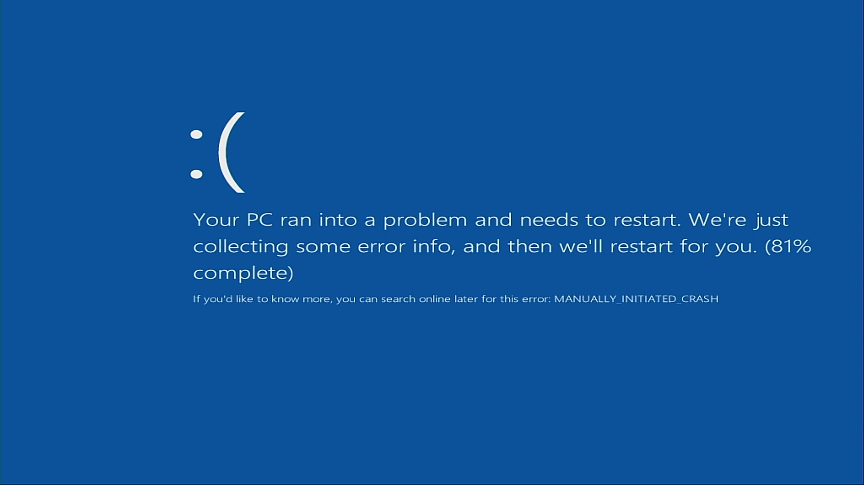
Blue Screen (Stop Error) on Boot
Hardware fault
Find the problem hardware
Remove hardware or disable to find it
Device driver fault
Boot to safe mode
Update or remove device driver
System restore/backup
Restore to a time when it worked
ITFreeTraining.com
© Copyright 2024
Notes:
13:03 When your computer is booting up, hopefully you won’t get a blue screen error. The official name is ‘stop error’. The unofficial name is ‘blue screen of death’. There are many different causes for this kind of error.
The error may be caused by a hardware fault. In order to fix a problem like this, you will need to find the hardware that is causing the problem. In order to do this, remove additional hardware or if that fails you can attempt to disable hardware in computer setup. You are, essentially, removing or disabling hardware until you find the one that is causing the problem.
The problem may be caused by a device driver fault. Device drivers work at a low level of the operating system and often have direct access to hardware. If there is a problem with the device driver, it can cause a stop error.
In order to fix this problem, you can boot the computer up into Safe Mode. Once in Safe Mode, you can update or remove the device driver causing the problem.
If you have recently made a change to the computer which is then causing a problem, you can use System Restore or restore the computer from a backup. Here, you are restoring the computer back to a time when it worked. Hopefully this will fix the problem.

Slide 9
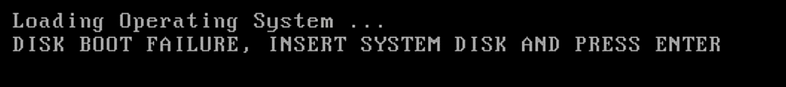
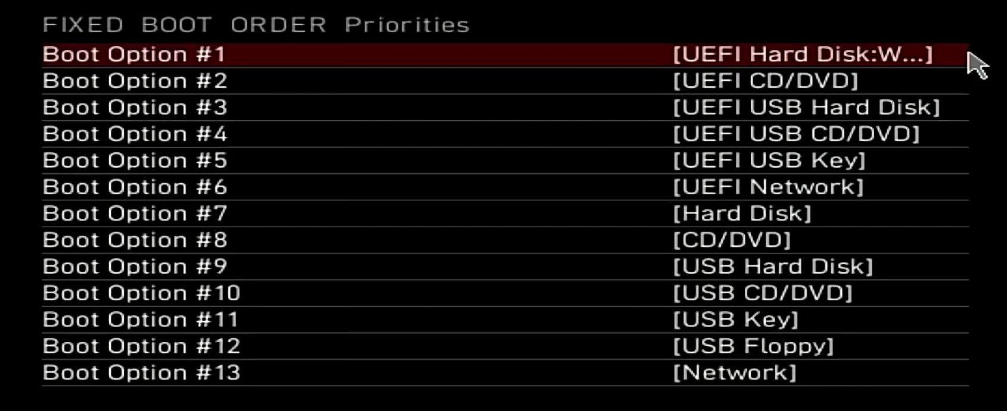
Exam Tip
Computer fails to boot
Check boot order
Boot sector/strap/loader
ITFreeTraining.com
© Copyright 2024
Notes:
14:15 For the exam, if you get a question on boot issues, it will probably be very general in nature. If the question indicates the computer is not loading an operating system, check the boot order to make sure the correct storage device is selected.
If you see anything mentioning boot sector, bootstrap, or boot loader, or something referring to the first step in booting the operating system, they are all referring to the same concept. Look for answers that talk about re-writing the boot loader or correcting it.

Slide 10
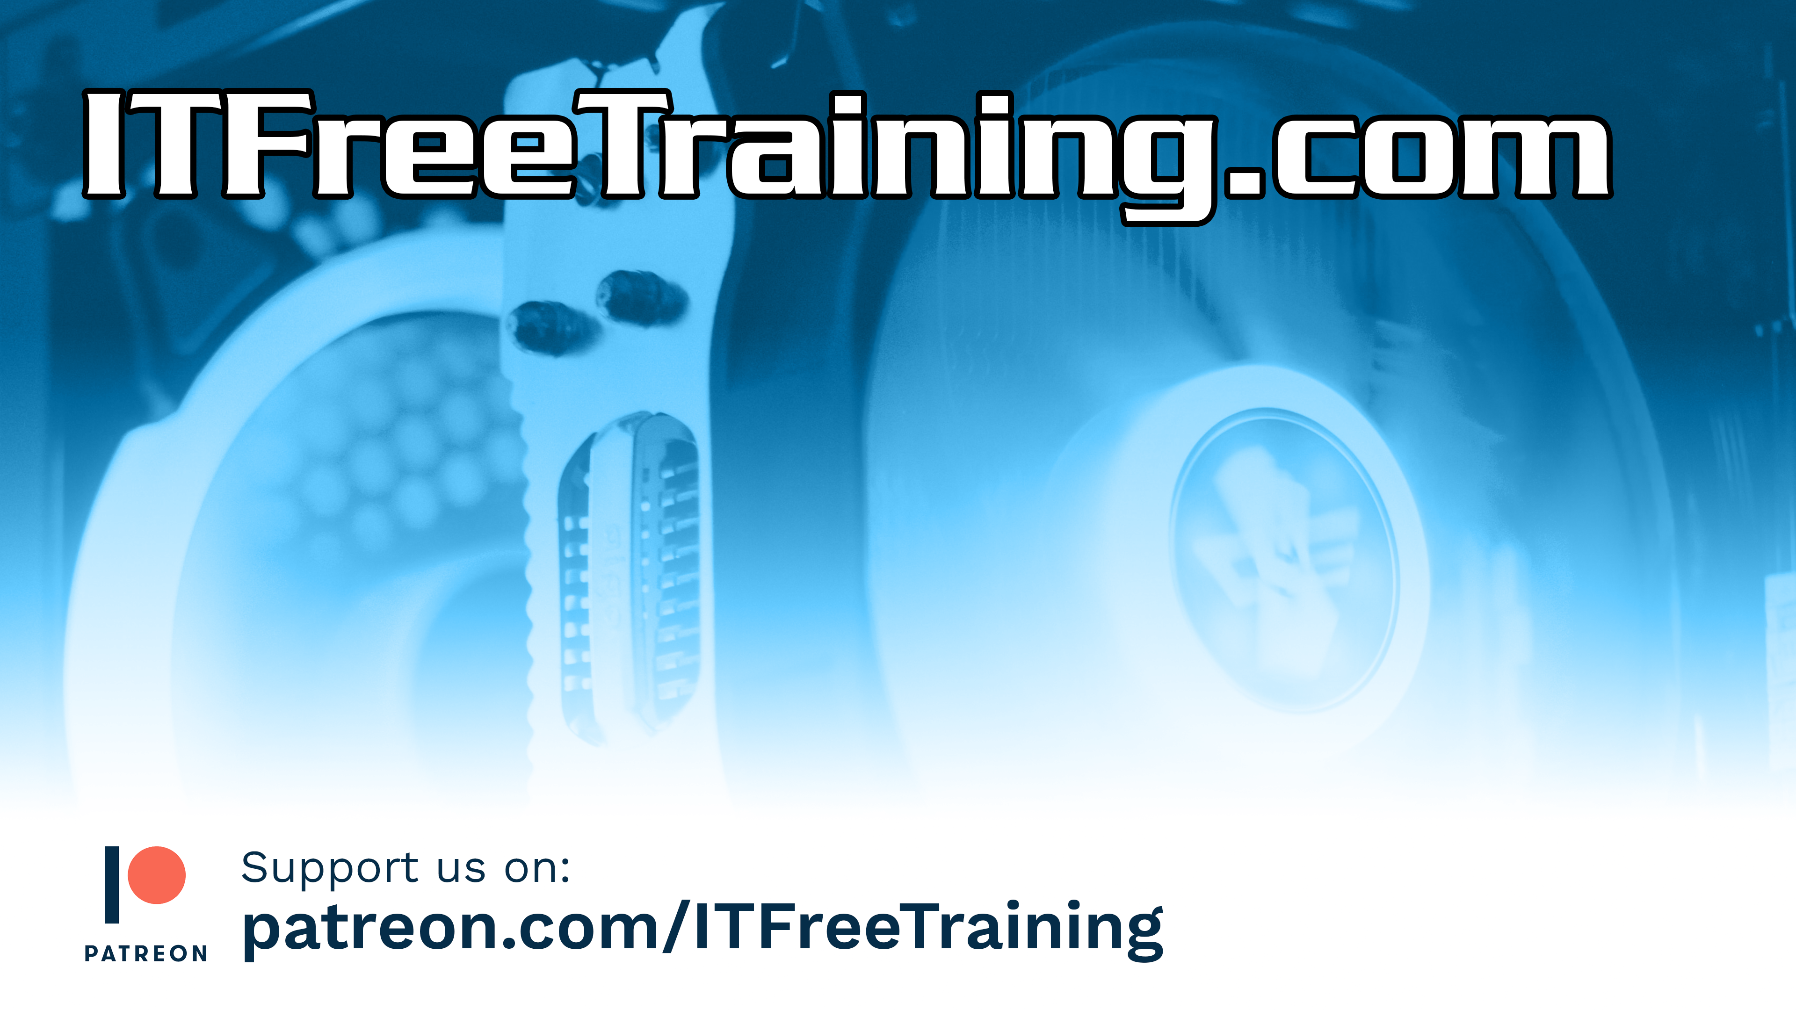
Subscribe
Next video
Video content: https://ITFreeTraining.com/ap11/3c15
© Copyright 2024
Notes:
14:48 That concludes this video on boot problems. I hope that, if you are having trouble booting your computer, this video has helped you. Until the next video from us, I would like to thank you for watching.
References
“The Official CompTIA A+ Core Study Guide (Exam 220-1101)” pages 102 to 202
“Picture: BIOS” https://en.wikipedia.org/wiki/BIOS#/media/File:Elitegroup_761GX-M754_-_AMIBIOS_(American_Megatrends)_in_a_Winbond_W39V040APZ-5491.jpg
“Picture: UEFI” https://en.wikipedia.org/wiki/UEFI#/media/File:WD_Blue_WD5000LPVX_-_controller_-_Winbond_25X20CLVIG-0182.jpg
Credits
Trainer: Austin Mason https://ITFreeTraining.com
Voice Talent: HP Lewis http://hplewis.com
Quality Assurance: Brett Batson https://www.pbb-proofreading.uk

