Slide 1
Notes:
Let’s have a look at BIOS settings.

Slide 2
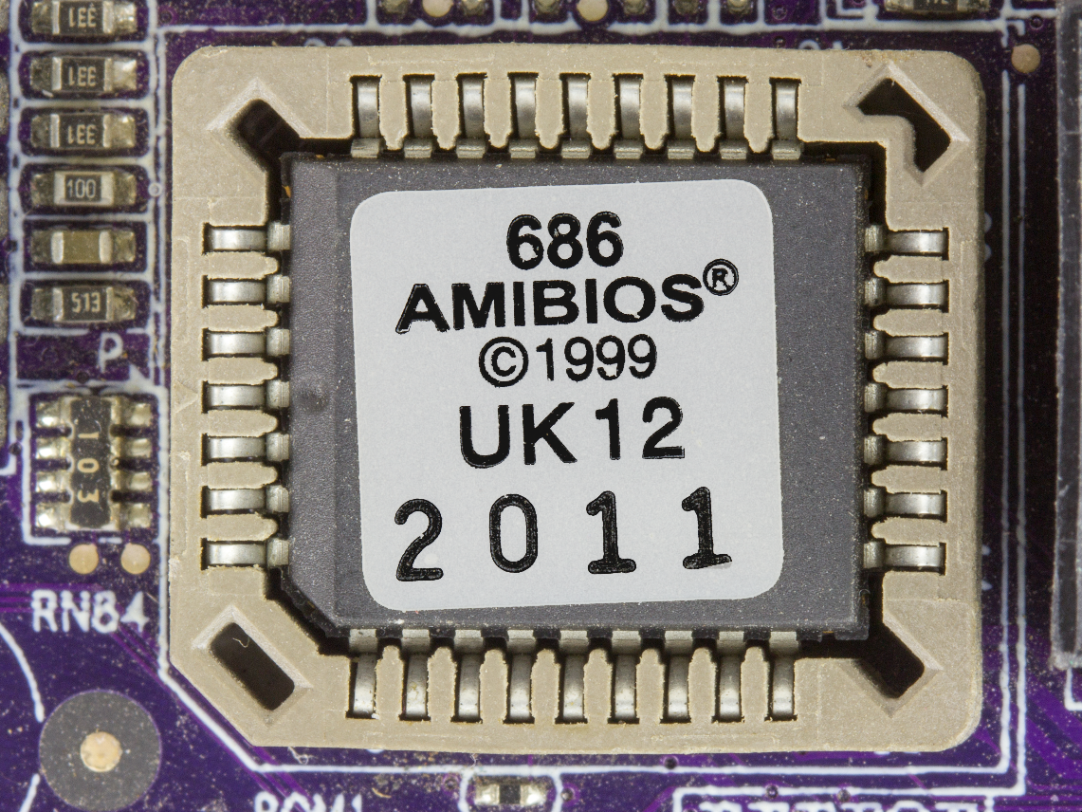
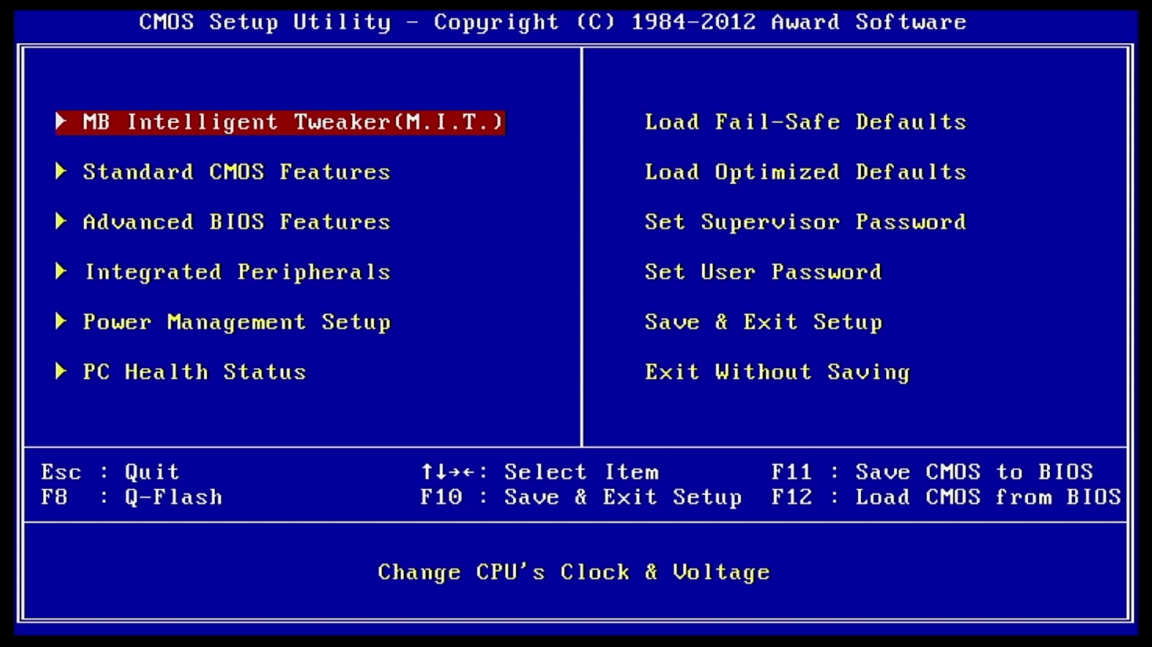
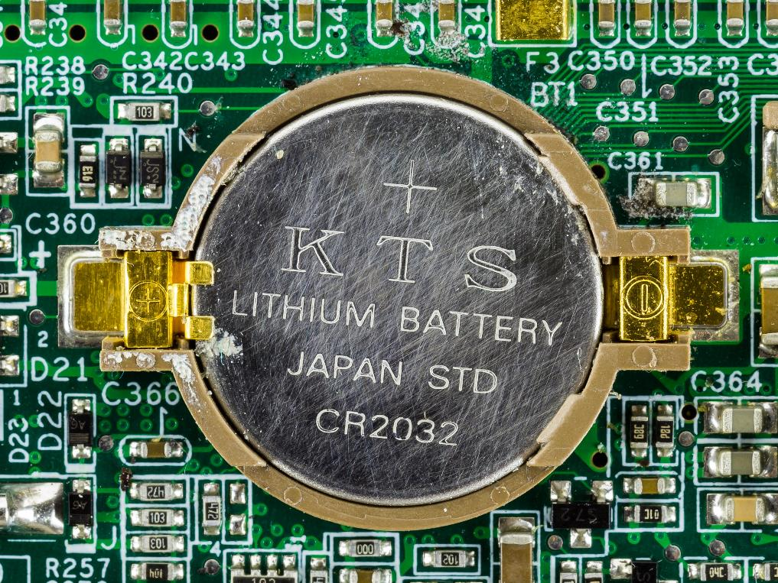
Basic Input/Output System (BIOS)
BIOS
Settings
Battery
Basic code
Basic computer settings
Battery keeps settings
Power-on self-test (POST)
Has internal clock
Keeps time
ITFreeTraining.com
© Copyright 2024
Notes:
00:03 BIOS, or Basic Input/Output System does as the name suggests, provides the code so you can access basic functions of the computer. UEFI is a newer system which is designed to replace BIOS. In another video I will look at how to configure UEFI which you will most likely come across nowadays. BIOS is only used on older computers.
When the computer is switched on, the computer's BIOS initiates a Power-On Self-Test, otherwise known as POST, which conducts a preliminary check of the hardware components to ensure they are functioning correctly.
The BIOS also holds the basic computer configuration. This configuration defines computer settings like the boot order of the computer, what hardware is enabled or disabled and a number of other settings. These settings are not very large. It also has an internal clock which keeps the date and time.
Traditionally, a battery in the computer kept these settings so they were not lost when the computer was disconnected from power. On modern computers, these settings are stored in flash memory and thus do not require power to prevent loss. The battery, however, does still run the internal clock. On older computers, when the battery goes flat, the time will reset and you will lose all your settings. On more modern computers, you will just lose the time.
I will now have a look at some BIOS settings.

Slide 3
Demonstration of BIOS
ITFreeTraining.com
© Copyright 2024
Notes:
01:27 I will start my computer up and press delete to enter the BIOS. In this demonstration, I won’t go through every setting, the ones that I will cover in detail are the ones you are more likely to use.
There are a lot of different types of BIOS out there. I will look at two different ones. This BIOS is text based which was very common in the old days. However, it is possible for BIOS to be graphics based.
To start with, I will select the first option “MB Intelligent Tweaker”. These options allow you to fine tune the clock settings that are used by the computer. In the majority of cases, I would recommend leaving these settings on their defaults. People overclocking their computer would change these settings, or if you are having stability problems with the computer you may want to change them.
There is a section called “DRAM Configuration”. This section allows the timing of the memory modules to be changed. There is an option here which allows the memory modules to be changed from Ganged to Unganged. This option is used when dual-channel memory is used, that is, two memory modules are installed on different channels. Unganged means that each channel can be accessed independently of the other. Ganged mode is when both channels have to be accessed at the same time.
In most applications, Unganged will give you better performance. In some cases, where you are running particular applications or certain server applications, you may get better performance using Ganged.
When I scroll down, there are a lot more settings for memory modules that can be configured. I would leave these on the automatic settings. On one occasion I had a memory module that was causing instability, so I increased the timing which resolved the problem. Unless you have specific reasons to do so, I would leave the settings as is.
I will exit out of here and go to the next menu option, “Standard CMOS Features”. On this screen notice the setting “Halt On”. This option determines when the computer will halt when an error is encountered. When the computer starts up, it will test the keyboard. If the keyboard is not found, it will generate an error and the computer will stop booting. To prevent this from happening, you can select the option “All, but Keyboard” or “No Errors”. When either of these options are selected, the computer will boot without a keyboard connected.
If you set up your computer without a keyboard, also known as headless, you will want to configure the computer to not stop booting on errors. Headless computers are often used for providing services that you would put in the cupboard or under the stairs and forget about. However, if the computer were to crash and restart, you would not want it to stop booting because a keyboard was not attached.
On this screen you can also change the date and time. Modern operating systems will update the date and time automatically, so most of the time you won’t need to change them in the BIOS. However, some security systems, often used for network security, rely on the date and time being close to the correct time. If the date and time is too far away from real time, you may not be able to login to your computer to change them. When this occurs, you may have to change the date and time in computer setup.
I will next go back to the main menu and select the option “Advanced BIOS Features”. Some of these options are pretty advanced and you should not ever need to change them.
In some cases, the “Virtualization” setting may be off. When virtualization was first added, it was common for it to be switched off. Virtualization allows the computer to use CPU hardware virtualization acceleration, assuming it supports it. Hardware assisted virtualization like Hyper-V requires this setting to be enabled in order to operate.
I will next scroll down to “Hard Disk Boot Priority”. One common reason to go into the BIOS is to change the boot order, that is, the order that the BIOS tries to boot the computer in. This option determines if internal storage or add-on cards are tried first. An add-on card allows additional storage to be used. For example, it allows the computer to use a fiber card to access storage using a fiber-optic connection. These add-on cards have their own BIOS, so essentially what the option is saying is, should the storage in this BIOS be used first to try and boot from, or should the computer try to boot from the add-on card first. The BIOS does not have any control of the storage connected to the add-on card, it effectively transfers booting to the add-on card; if that fails, it returns back and tries storage that is connected directly to the computer.
The next option down is whether the optical drive is using EFI or not. EFI is effectively talking about a UEFI compatible optical drive. If you are having problems with the optical drive, you may need to change this. I personally would change this setting to auto. Hopefully, the BIOS will detect what optical drive it is and make the correct choice.
The next option is “First Boot Device”. This BIOS has first, second and third boot options. Essentially, the BIOS will try booting from those devices in order. Each one will have the same options. Your needs will determine what you choose. In this case, I have selected optical drive first, hard disk second, and the third option is disabled.
I will next scroll down to the option “Password Check”. This option configures a password to be requested when attempting to enter the BIOS. The system will ask for a password when the computer is switched on.
The next option I will look at is, “Full Screen Logo Show”. When this option is enabled, the computer will show a graphical logo when it boots up, otherwise it will show a text-based screen. The text-based screen is a lower resolution than the graphical one. Modern computer screens should not have a problem displaying a graphical screen and this will be the default setting. Using a text-based screen, the computer may start up a bit faster.
The next option I will look at is, “Init Display First”. This setting determines which video card will be used as the primary display adapter. If you have multiple video cards installed in the computer, one will need to be the default, which is what gets used to display the startup screen. Once the operating system has booted up, multiple video adapters can then be used. Therefore, choose the one that you want to display the start-up screen on and access the BIOS from.
I will now exit out of here and go to the next menu option, “Integrated Peripherals”. Integrated Peripherals allows configuration of some of the devices and also allows devices to be enabled or disabled.
The option, “OnChip SATA Type” configures how the SATA drives are used by the BIOS. AHCI is the newer standard and nowadays you should set it to this. If you have old hard disks, you may need to set it to native IDE. If your system is already set to native IDE and you have Windows installed, changing it to AHCI will cause Windows not to boot. While there is a workaround for this problem, just be aware that if you suddenly change things, Windows will most likely fail to boot.
The option RAID is for when you want to use the motherboard’s RAID. If you have data on your drives, you won’t be able to access it when RAID is selected. Generally, you would only configure this setting before installing the operating system.
The option, “Onboard LAN Function” will enable or disable the network card. The network card will most likely be enabled by default, so the next option, “Onboard LAN Boot ROM” will probably be disabled by default. This option will need to be enabled if you want the computer to boot from the network.
If you are having problems with devices not being detected, it may be disabled. For example, the audio device on this computer can be disabled. Once a device is disabled, the operating system won’t detect it or know that it exists.
I will now go back to the main menu and select “Power Management Setup”. Most of the power management settings probably won’t need changing and can be left on the defaults. There are some you may want to change, depending on your needs.
The option, “USB Wake Up from S3” allows USB devices to wake the computer from standby mode. Sometimes you may want to disable this option if you have USB devices that are preventing the computer from going into standby mode.
The option, “Power On By Mouse”, when enabled, allows the computer to be woken from sleep by double clicking the mouse. The option, “Power On By Keyboard” allows the computer to be woken from sleep using the keyboard. If these options are disabled, Windows won’t be able to wake the computer using the keyboard and/or mouse. Although modern operating systems have their own code to access hardware, if the hardware is disabled, it won’t be able to get around this and it will need to be enabled in the BIOS. BIOS still effectively acts as the gatekeeper to the hardware in this respect.
I will go back to the main menu and select the option, “PC Health Status”. These options provide alerts when things happen on the computer. For example, “Reset Case Open Status”; if your computer case supports this option and it is configured, a switch will be flipped if the computer case is opened. When this occurs, the BIOS will record it and give you a message on startup. Setting this option clears that the computer case was opened, otherwise, the case was opened message will appear every time the computer starts up.
The next option, “CPU Warning Temperature” will set the temperature at which a warning beep will be made if the CPU goes over this temperature. Below this, an option allows alerts to be configured if a fan is not detected. It is important that if you add fans to your computer, you enable these alerts. If you don’t, you won’t be notified if for any reason one of them stops or fails.
I will now go to the main menu and select, “Load Fail-Safe Defaults”. This option will load BIOS settings that are not aimed at good performance but more towards having a stable system. You would choose this option if your computer is unstable. The next option, “Load Optimized Defaults” will set the BIOS to settings that are aimed more towards performance. These settings will generally work okay if you want to reset your BIOS settings. I would try these settings first. Then if you are still having problems, try the Fail-Safe option.
The next option allows you to configure a supervisor password. This password is required in order to access the BIOS settings. The next option sets a user password which is displayed when the user switches on the computer. Once you have finished making the required settings, make sure you save the changes, otherwise they will be lost when you exit the setup.
This is a fairly common BIOS setup for build it yourself computers. I will now have a look at BIOS from a proprietary computer. Here the BIOS will often have additional features that you don’t find with standard motherboards.
In this example, rather than going straight into the BIOS, we are presented with more options. For example, I could run System Diagnostics if I wanted to. I will press F10 to enter the BIOS.
You will notice that the BIOS is graphical unlike the text-based BIOS I just looked at. Don’t think that because it is running BIOS that it is going to be text based. I won’t go through all the options since some of them are similar to those I just looked at. I will focus on the options that are different. I will first select the option, “System Information”.
You will notice that there is quite a lot of information about the computer here. Non-proprietary systems may have some of the same information, but when it comes to the computer itself, they probably only have basic information such as the baseboard and serial number. This computer includes additional information like product and asset numbers. This information can also be read by the operating system. You can see this is one of the reasons that businesses choose these computers even though they are a bit more expensive. The extra features are very valuable to businesses, as having the ability to simply track their computers effectively is something they want so they can audit them. However, for the home user this is not important.
I will now go back to the main screen. From here I will select the option, “System Diagnostics”. This is a set of tools that will test the hardware on the computer. Each manufacturer will determine what tools you get, if any.
I will now exit out of here. The other settings are similar to the BIOS I previously looked at, so I won’t go through them. I will next select the security tab and then the option, “TPM Embedded Security”.
The TPM is a secure chip that holds encryption keys. It is used with secure boot and BitLocker. The option, “OS Management of TPM” allows the operating system to manage the TPM. You also have the option, “Reset of TPM from OS”. This would allow the TPM to be reset from the operating system. Businesses may not want options like these enabled, as this would allow the TPM to be cleared from the operating system which could potentially be exploited by an attacker.
I will now select, “System Configuration”. These options are similar to those I looked at in the previous BIOS. When I select, “Device Configurations” this will allow me to configure some of the devices and also enable and disable devices.
You will notice the option for “Secondary Battery Fast Charge”. Fast charging will charge your batteries faster but will heat them up and may reduce their lifespan. The point being that your computer may have some extra hardware, so it is worth looking through the options to see what you can configure.
I won’t worry about looking at the other settings because they are essentially enabling or disabling hardware on this computer. They are all pretty self-explanatory.
I have looked at two different types of BIOS. There are many different ones out there, but you will find that most of them are similar to those I just looked at. Some BIOSs will have settings in very different places to others. So, it is worth taking time looking through the settings to see what options you can configure.

Slide 4
Subscribe
Next video
Video content: https://ITFreeTraining.com/ap11/3b20
© Copyright 2024
Notes:
16:27 That concludes this video from ITFreeTraining on BIOS. I hope you have found this video informative and, until the next video from us, I would like to thank you for watching.
References
“The Official CompTIA A+ Core Study Guide (Exam 220-1101)” pages 102 to 108
“Mike Myers All in One A+ Certification Exam Guide 220-1101 & 220-1102” pages 169 to 172
“Picture: BIOS battery” https://commons.wikimedia.org/wiki/File:Yakumo_Notebook_536S_-_CR2032_backup_battery_on_motherboard-4667.jpg
Credits
Trainer: Austin Mason https://ITFreeTraining.com
Voice Talent: HP Lewis http://hplewis.com
Quality Assurance: Brett Batson https://www.pbb-proofreading.uk

