Slide 1

Notes:
Let’s have a look at how to upgrade a computer’s firmware.

Slide 2

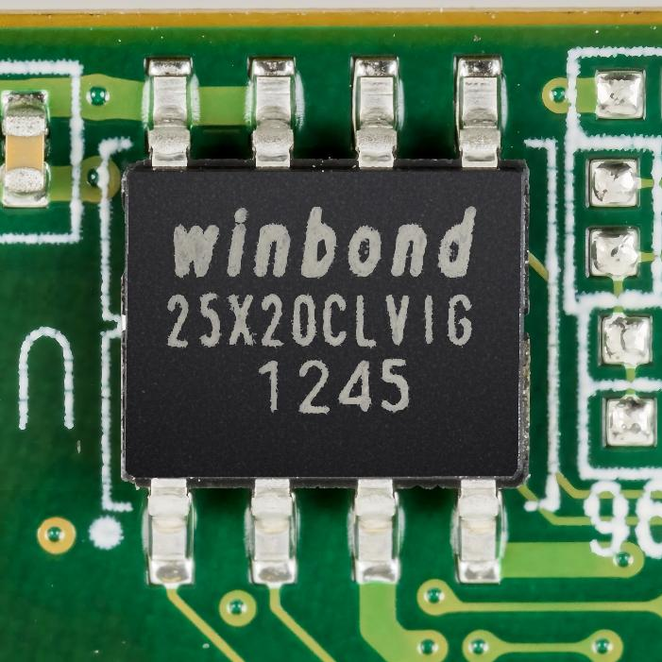
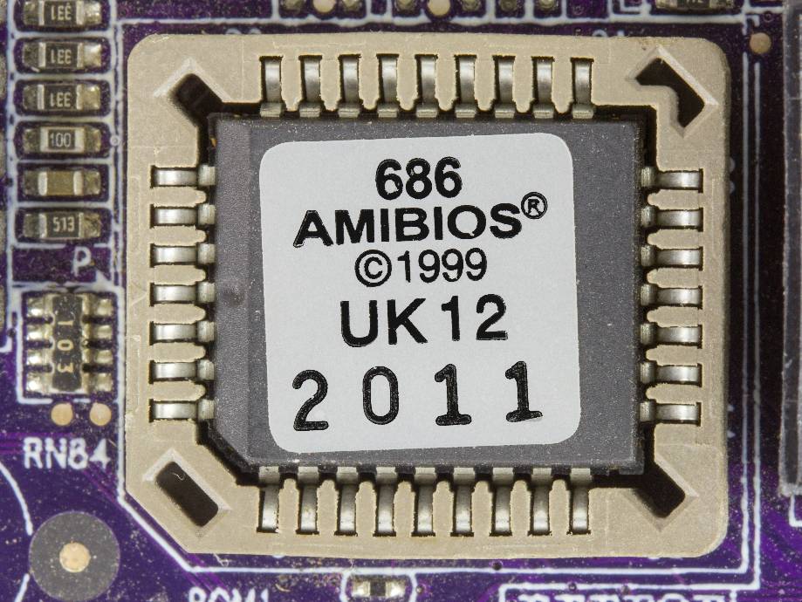
Computer Firmware
Firmware: Software for hardware
Computers run UEFI or older computers run BIOS
UEFI
BIOS
Unified Extensible Firmware Interface
Basic Input/Output System
Requires 32/64-bit hardware
Boot computer in 16-bit
Does not support 64-bit
ITFreeTraining.com
© Copyright 2025
Notes:
00:04 The firmware inside a computer acts as software specifically designed for hardware, providing essential instructions for the hardware to function properly; without it, the hardware would not be able to operate.
Computers run UEFI or on older computers BIOS. Essentially either of them are collectively known as firmware. Computers have a little chip on the motherboard that stores the firmware. You can see an example of a UEFI chip. You will notice the chips are quite small and don’t have too many pins. Even modern computers don’t require a lot of software to get the computer operating, thus the chip is not that big.
In older computers, the BIOS chip was larger and, in some cases, could be removed from the motherboard if required. Nowadays, the chip holding the firmware tends to be soldered to the motherboard.
The main difference between the two is that UEFI requires 32- or 64-bit hardware in order to operate. All modern computers meet this requirement, therefore, you will find that all new computers are running UEFI nowadays.
BIOS in contrast boots the computer in 16-bit mode. This is because the first PC computers used 16 bits so BIOS boots into 16-bit mode to remain compatible with older computers. Once the computer starts up, the operating system can switch to 32-bit or 64-bit mode.
No BIOS supports 64-bit. This means the BIOS itself can’t run 64-bit code. The operating system can, but the BIOS cannot. For this reason, you will find that BIOS is being phased out so the computer can run 32- or 64-bit code as soon as it is switched on. This helps the computer boot faster and also allows the computer to access all the hardware in the computer without an operating system.
When working with UEFI and BIOS, you may sometimes hear UEFI referred to as BIOS. Just be aware that even though they are different, the terminology does get used interchangeably. To make things easier to understand, when I am collectively talking about BIOS and UEFI, I will just refer to it as firmware. Before I look at upgrading the firmware, let’s have a look at what happens when the computer boots up.

Slide 3
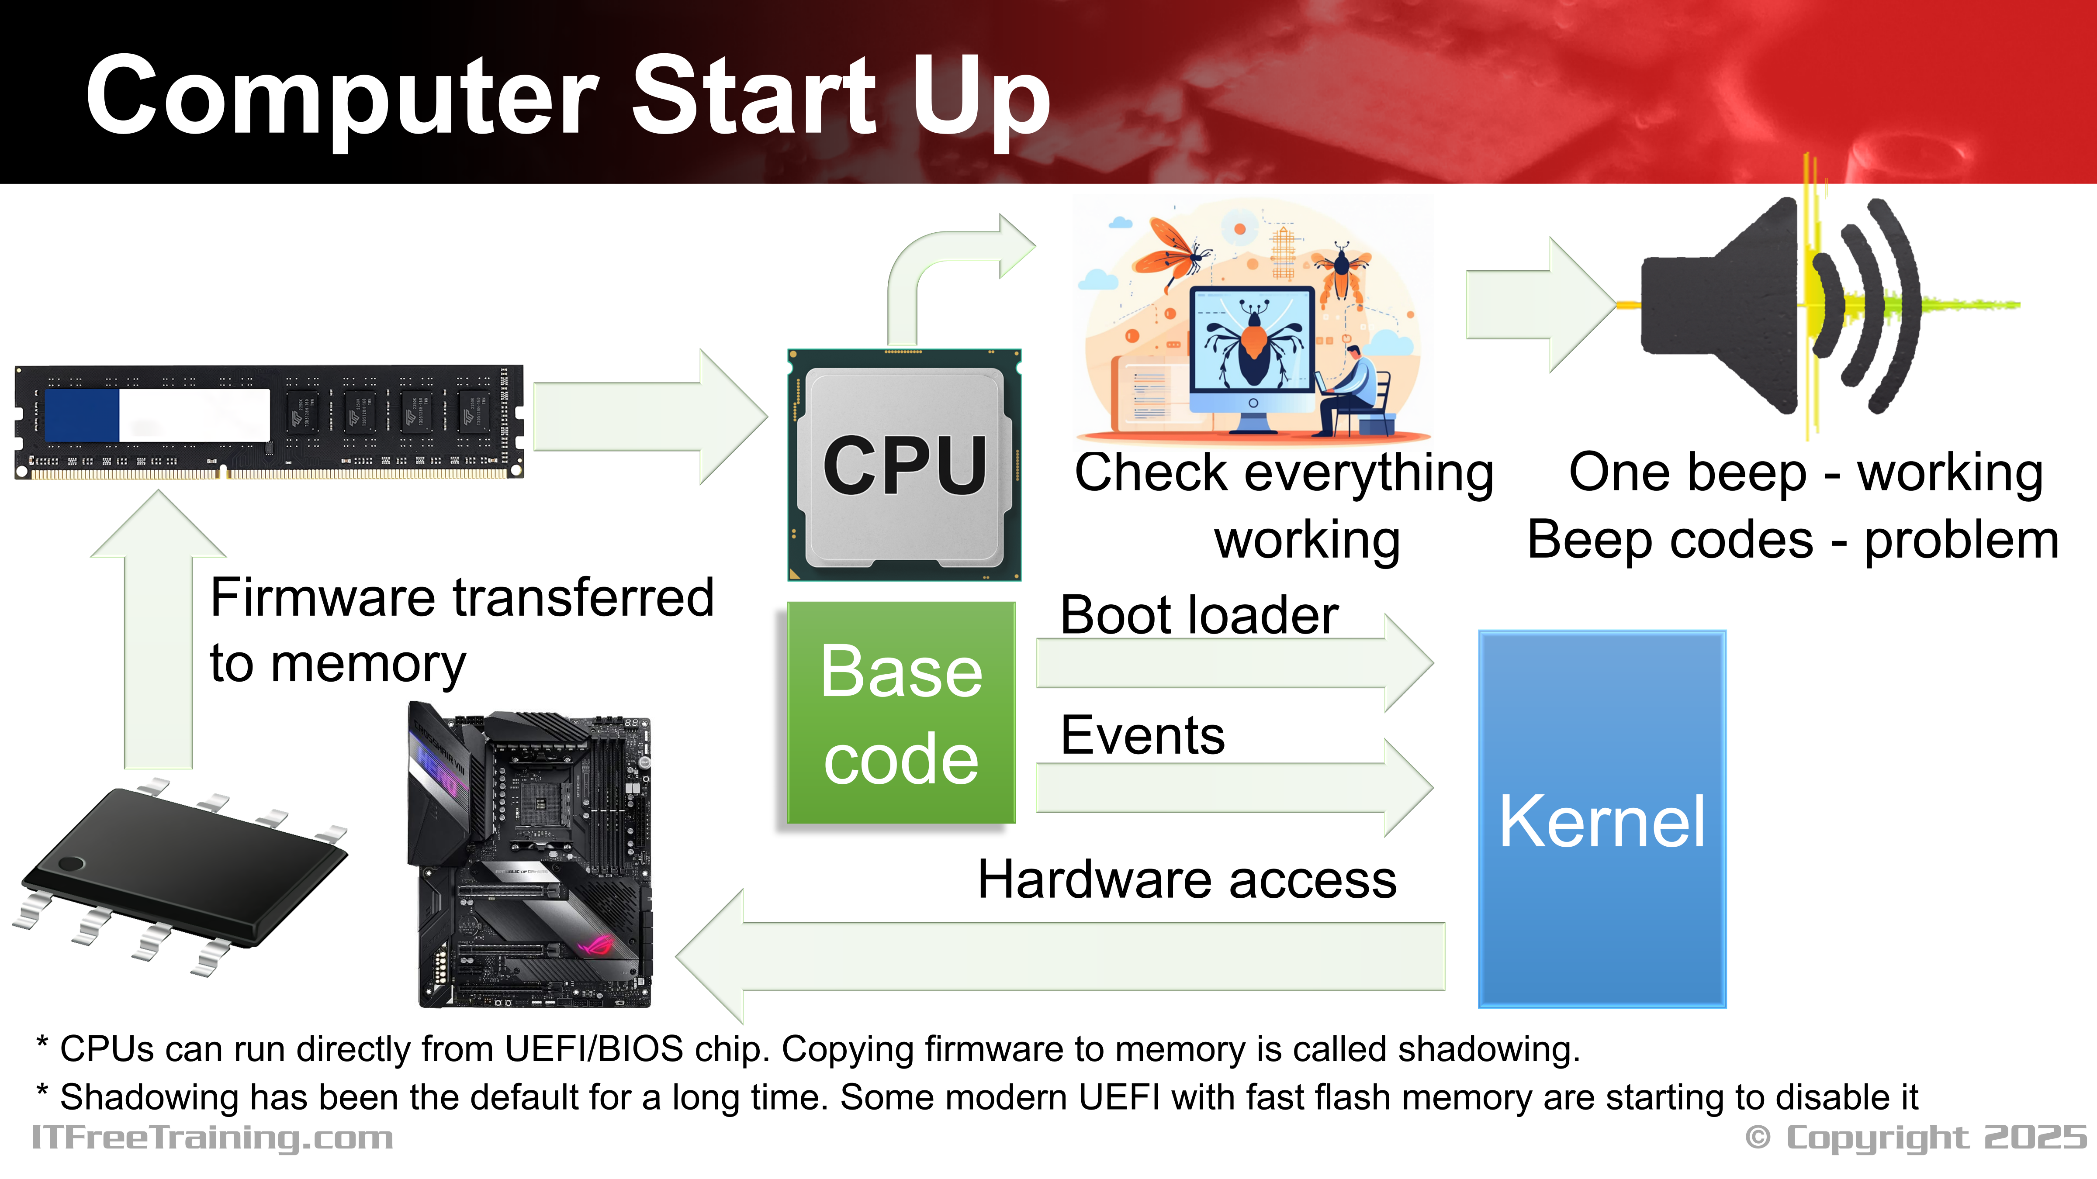
Notes:
02:27 When the computer starts, the firmware is transferred from UEFI or BIOS into memory. From there, the CPU executes the instructions. So essentially, the computer won’t be able to start up without memory and a CPU installed.
The computer will then start checking that everything is working. If everything is okay, the computer will sound one beep. If there is a problem with the hardware, the computer will output a number of beeps. The number and length of beeps will indicate the problem found. For example, if there is a memory problem, it will be a particular sequence of beeps; for a CPU problem, a different sequence of beeps.
There is also some base code that is loaded. This code is used to load the boot loader which is used to load the kernel. Once the kernel is loaded, it has direct access to the hardware on the computer. Older operating systems used BIOS code in order to access the hardware. Modern operating systems don’t tend to use either the BIOS or UEFI code to access the hardware. However, events are still transferred to the kernel. For example, if you were to press the power or reset button on the computer.
In modern computers, the firmware performs some quick testing of the computer’s hardware to see if it appears to be working, then the OS boots up and takes over. Some code may still be used by the kernel, but this is not as common as it once was.
Although firmware is not as important as it once was, if the firmware reports wrong hardware information, it can still cause computer instability. This is why most of the firmware updates (after their initial release) are generally fixing instability issues with hardware or providing support for new hardware. This is one of the big reasons for keeping your firmware up to date. Your computer may work with older firmware, but if there are stability problems, this may cause random crashes or other performance problems.
So, let’s have a look at how to update it.

Slide 4
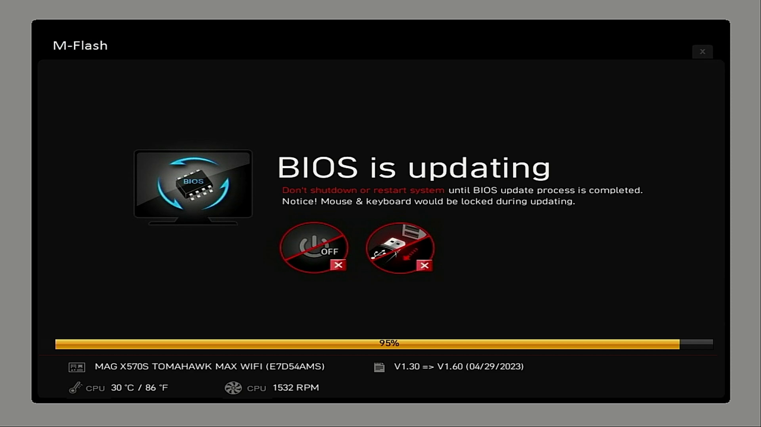
Updating Firmware (UEFI/BIOS)
ITFreeTraining.com
© Copyright 2025
Notes:
04:28 To start with, I will upgrade the UEFI on this computer. You will notice that when the computer starts up, there is a message at the bottom saying that, to enter the update tool, press the control+F5 key. You will notice that it says BIOS even though this computer is using UEFI. Don’t be surprised if, on newer computers, the term BIOS is still used, it is what we are all used to.
In this case, I won’t press control+F5 to access the tool, I will instead press the delete key to go into the BIOS to show you a different way of accessing the update tool.
At the bottom left of the screen, notice there is the option to open M-Flash. When selecting this option, I will be prompted to reboot. Modern computers should have this option to update the BIOS or firmware using a utility. The utility is generally not part of the computer setup, but a separate tool. Sometimes the computer will need to restart to use the tool, while at other times the computer setup will launch the tool and a reboot is not required. In this case, a reboot is required, so I will press yes to reboot it.
The computer will reboot into the flash utility. You will notice that I will get a message about BitLocker. If you are using BitLocker, any detectable changes to the computer’s hardware will put BitLocker into recovery mode. When in this mode, you will need to enter a recovery key to boot the computer. Hopefully you put it in a safe place when you created the BitLocker drive! Unfortunately, when in recovery mode, even if you know the password for the computer, you won’t be able to boot the computer without the recovery key and your data will be lost.
The other option is to temporarily suspend BitLocker. If BitLocker is suspended during the update, it won’t put the computer into recovery mode. If you are using BitLocker, make sure you are aware of the potential problems before you update your firmware. You don’t want to lose all of your data.
I will now press yes to enter the update utility. The utility will expect there to be an update on a USB flash drive. I will next need to download an update and put it on a USB flash drive. In some cases, you may already have the latest version. In this case, you can see in the middle of the screen, the current version is 1.30.
You don’t have to go into the update utility to see the version number. When the computer started up, the version number was listed at the top of the screen. However, in the case of this computer, it was not in an easy-to-understand format. In the middle is 130, which is the version number 1.30. It is easy to miss it. To the right is the date the update was created. This is probably easier to spot than the version number.
The version number was also shown in the computer setup. Once again, the version number is not really clear, but if you see a date that is pretty old, you should see if there is an update.
To get the update, I need to go to the manufacturer’s web site. It is a matter of searching for your motherboard, then going to the download section. On this website, it is under BIOS updates. It may be listed under UEFI or firmware updates depending on what the manufacturer decided to name it.
When I scroll down, I can locate the version that is currently installed. You can see that, as I have to scroll through a few updates to get to this one, updating is a good idea. When I scroll up, notice that there is a beta version. Sometimes a manufacturer may release a beta BIOS to resolve a severe problem; however, the update has not gone through testing. It is up to you if you want to risk installing an untested update. Personally, I would not use these updates unless it resolves a problem I am having and I don’t have a choice. Sometimes you will find on older motherboards the last update will be a beta update and it may be years old if the manufacturer has stopped releasing updates. When this is the case, I feel more confident using the update since it has been available for a long time.
I will scroll up to the most recent update. Whenever possible, you should update to the most recent update. Next, I need to download the update and put it on a USB flash drive. The update will be zipped up. So, once it has downloaded, I will need to decompress it before it can be used. Once it has been extracted, I can remove the flash drive and use it on the other computer that I want to update.
I have put the USB flash drive in the computer, and once I press the retry button it will find the USB flash drive. It is just a matter of navigating through the folders until I get to the file containing the update.
You will notice at the bottom of the screen the current version and the version of update in the file are shown. If the update is the same as the one currently on the computer, the update tool will inform you.
I will now select the file and press yes to start the update. The update does take a few minutes to complete. It is important when the update is being performed, to not switch off the power. If power is lost during the update, it will be incomplete and there is a good chance your computer will not be able to boot. I will now pause the video and return when the update is complete.
Once the update has completed, the computer will restart with the new firmware. You will notice that I will get a message saying that changes have been detected. When you perform an update, generally the previous settings will be kept. However, newer versions may have settings that did not exist in the previous version. Thus, most of the time, this message is saying the computer setup wants to set the new values that did not exist before, at least to their default settings.
I will now enter the computer’s setup. You will notice that the update is shown at the top, thus the computer has been updated. In some cases, the manufacturer may provide software to update the firmware in Windows.
On this computer, there is software from the manufacturer that will update the firmware from Windows. From the manufacturer’s website, I will select support and then select BIOS.
This will show all the updates that are available. Notice that there are two updates for each version, the instant flash version and the Windows version. I will select the Windows version and download it.
You will notice that I get a message saying that once the upgrade is complete you can’t go back and also it is not recommended to update your system if it is running normally. I will press o.k. and download the update.
You will notice in the description of the update, there is a message saying not to update if your system is running normally. Notice all the updates at the bottom do not have this message. When updating your firmware, sometimes it may not be worth updating. In this example, after version 3.3 it appears all the updates are very minor in nature and aimed at particular hardware. There is always a risk, when updating the firmware, that if it fails during the update, your computer will be unusable. Some computers come with dual BIOS or dual UEFI to give you a backup if this occurs; however, not all motherboards have this feature. In a lot of cases, if the update fails, your motherboard will not be usable.
I previously downloaded the update and decompressed it. The update contains the new firmware and the updated software. When I run the update software, it unfortunately fails. Although this update was made to run on Windows 11 and this computer is running Windows 11, updates on the computer have prevented it from running. I have found that tools for updating firmware can be unreliable. Sometimes they work, sometimes they don’t. I have also had one crash during the update which made the computer unusable. Thus, if you decide to update through Windows, I would exercise caution. I have had them work really well, but they tend to be a little riskier than updating the firmware using the previous method that I looked at.
I will now have a look at an old BIOS based computer, although the process is much the same. Once the computer starts up, on the bottom left there is an option to launch the update tool. In this case, however, I will press delete to go into the BIOS.
As with UEFI, there is an option to launch the update utility, in this case F8. Once I press F8, I will be given the option to launch the update tool. The tool works the same as the UEFI version, so I won’t worry about going through the process again.
You can also update the BIOS using Dos; however, modern computers generally support updating the BIOS using a USB flash drive. So, I won’t worry about showing you how to do this, since you are unlikely to have to do it nowadays.

Slide 5

Subscribe
Next video
Video content: https://ITFreeTraining.com/ap11/3b05
© Copyright 2025
Notes:
13:43 That concludes this video on updating the UEFI or BIOS on your computer. I hope you have found this video informative. Until the next video from us, I would like to thank you for watching.
References
“Mike Myers All in One A+ Certification Exam Guide 220-1101 & 220-1102” pages 161 to 162
“Picture: BIOS chip” https://commons.wikimedia.org/wiki/File:Elitegroup_761GX-M754_-_AMIBIOS_(American_Megatrends)_in_a_Winbond_W39V040APZ-5491.jpg
“Picture UEFI” https://en.wikipedia.org/wiki/UEFI#/media/File:WD_Blue_WD5000LPVX_-_controller_-_Winbond_25X20CLVIG-0182.jpg
Credits
Trainer: Austin Mason https://ITFreeTraining.com
Voice Talent: HP Lewis http://hplewis.com
Quality Assurance: Brett Batson https://www.pbb-proofreading.uk

