Slide 1

Notes:
Let’s have a look at the methodology provided by CompTIA to help solve troubleshooting problems.

Slide 2



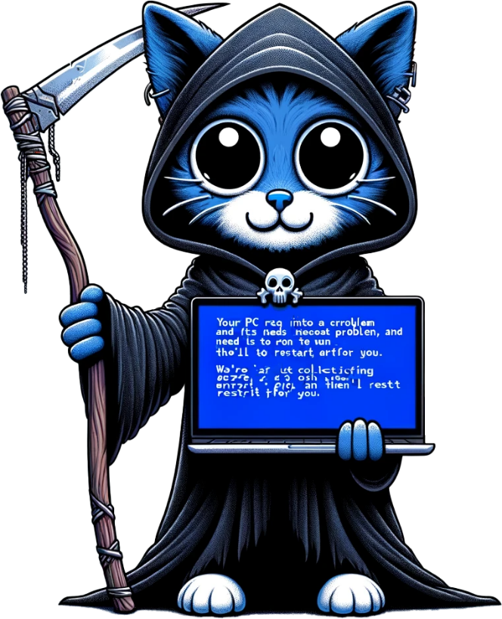
Problem Solving
Problems have causes, symptoms and consequences
Causes
Consequences
The source of the problem
The result of the problem
E.g. Hard disk fault
E.g. Lost time/angry customers
Symptoms
Indication of what the cause is
E.g. Random blue screens
ITFreeTraining.com
© Copyright 2025
Notes:
00:07 One of the first concepts to understand about problem solving is that problems have causes, symptoms, and consequences. The cause is essentially the source of the problem. For example, a hard disk fault. In this example, the hard disk is still working, but has bad sectors on the drive. Thus, it could potentially have problems reading and writing data.
There are symptoms which are an indication of what the causes may be. A hard disk having problems reading and writing can display symptoms in many different ways. In this case, the hard disk is unable to provide reliable data to the computer and thus some of the data has been corrupted. The corrupted data has caused a stop error, otherwise known as a blue screen of death. Many things can cause a stop error; thus, a stop error does not necessarily mean a hard disk problem. Symptoms are an indication of what may be causing the problem and hopefully will lead you to the cause.
Problems also have consequences. These consequences are the result of the problem. This is something new technicians need to understand and appreciate. Consequences are often lost production time which results in angry customers. As a new technician, you may want to take as much time as necessary to fix a problem; however, this may not be beneficial for the business. Sometimes a workaround is the best option so the customer can keep being productive. At other times, replacing something that can be potentially fixed is the fastest solution. You may think it is the more expensive option, but when you start looking at downtime and lost employees’ wages, the real cost to the company racks up pretty fast.
To understand this better, let’s consider what you would do in the real world.

Slide 3


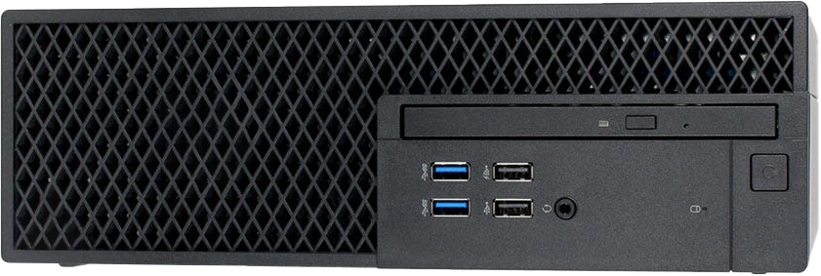
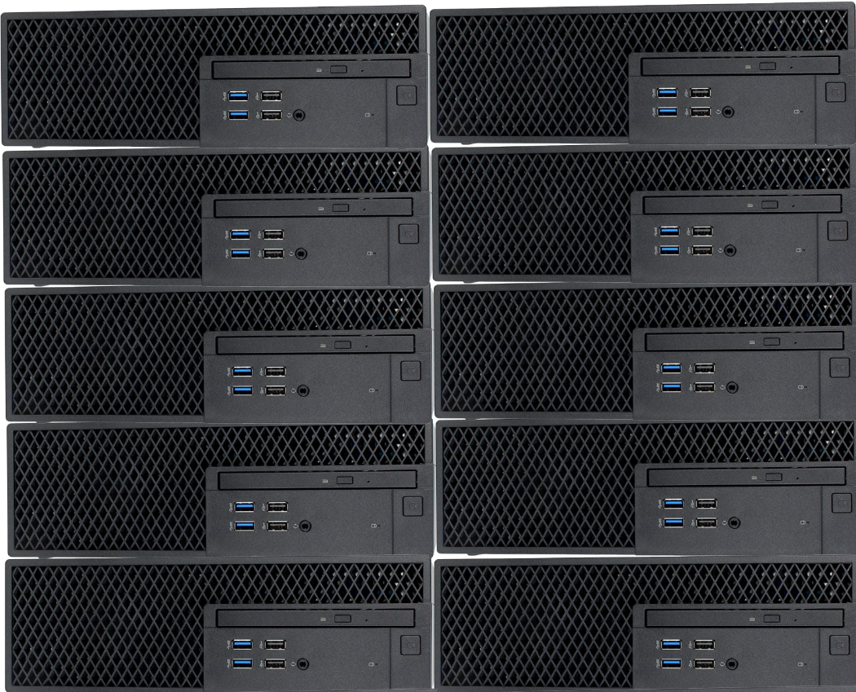
In the Real World
Big business
Standby computers
Same configuration
Data on network
User just logs in
Maybe some extra software installation
Ready to be swapped
ITFreeTraining.com
© Copyright 2025
Notes:
01:53 In the real world, having a computer not working means the company is losing money. The company still needs to pay the wages of the employee who is currently not able to work. The longer the computer is not working, the more money the business will lose.
For this reason, big businesses will have a number of standby computers. When a computer fails or is having problems, the business will simply swap the computer for another one. The new computer will have the same configuration, so should operate the same way that the user is used to. This is possible because a copy of the user’s data is held on the network. The user just needs to login to the new computer.
A lot of businesses have this process pretty streamlined nowadays. You may need to install additional software if the user uses something that is non-standard. Some businesses may have even automated that process.
Replacing the computer does not always fix the problem and may not always be an option. Let’s investigate the troubleshooting model presented by CompTIA to get some ideas on how to troubleshoot and fix problems.

Slide 4


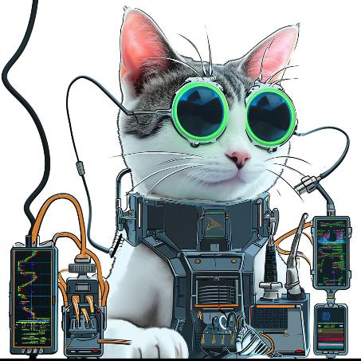
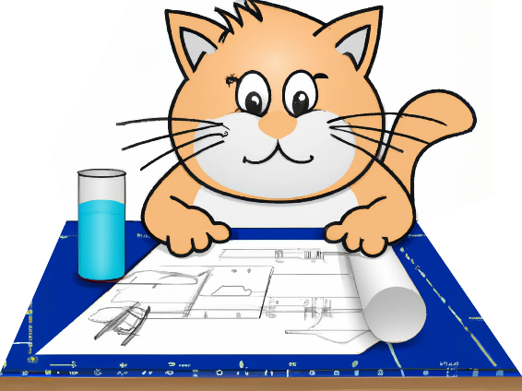


CompTIA Troubleshooting Model
1. Identify the problem
2. Establish a theory
3. Test the theory
4. Establish an action plan
5. Verify full system functionality
6. Document findings
ITFreeTraining.com
© Copyright 2025
Notes:
02:58 CompTIA has created a six-step model to help you troubleshoot. For the exam, make sure you can put these in the correct order, because you may get a question on it. Other questions may give you a scenario and ask you which step to use. If you can’t remember, just think logically about each step and that will help you work out the correct order.
The first step is to identify the problem. I will go through each step in a bit more detail later in the video. Identifying the problem is simply working out why you are there. Something has gone wrong, time to work out what that is.
Once you work out what the problem is, work out a theory about why it is occurring. When you think about it, you can’t work out a theory until you know what the problem is. Thus, identifying the problem is always the first step.
The next step is to test the theory. You can’t test the theory if you don’t have a theory to start with, thus, this step comes next. Once you test the theory, work out an action plan. The way I like to remember this one is, of course, you test changes in a test environment before making them on a production computer. In the real world, you most likely will be making changes directly on a production computer for small problems. The model is designed to be scalable to cover large problems and network changes. When you work with problems that affect a lot of users, you want to make sure you are testing any changes and establishing a plan before you start work.
The next step is, you want to verify system functionality. You don’t want to be that tech that makes changes and leaves without making sure it works. If you do something like that, every so often something you thought was fixed won’t be. You may then get a call from an angry user asking you to come back and fix it, or worse, a call from your boss.
Lastly, document your findings. This helps other techs who come across the same problem to fix it sooner. There is nothing worse than spending a lot of time fixing a problem, only to learn afterwards someone has already fixed it before, and you could have saved yourself a lot of time if you had known earlier.
I will now look at each step in detail, using an example, so we can understand it better.

Slide 5

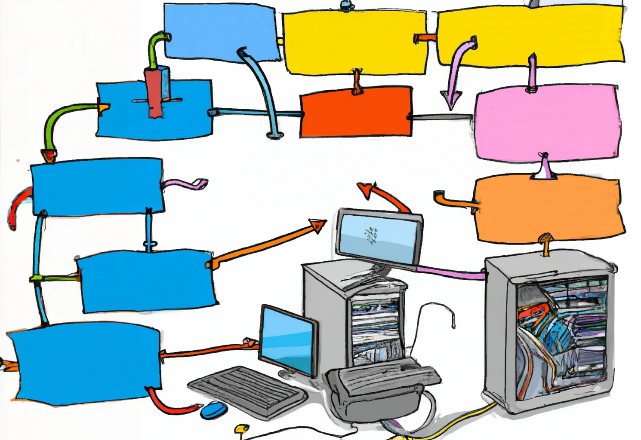

1. Identify the Problem
Gather information from users
Identify user changes
Inquire regarding environmental
or infrastructure changes
Backup data before
making changes
* Make sure you inquire about consequences as this helps determine prioritization and response
ITFreeTraining.com
© Copyright 2025
Notes:
05:14 The first step in identifying the problem is to gather information from the user. You want to identify any changes made by the user. The user will sometimes be quite up front about what has happened, but most of the time they won’t, unless you ask the right questions. Business computers are pretty locked down nowadays, preventing the user changing too much, but they still find ways to change things.
Inquire about environmental or infrastructure changes. Besides changing things like settings on the computer, this also includes moving computers around the office and other changes. For example, the business hiring 20 temporary staff and putting them in the conference room who are all using the same internet-based application – this many new staff added to the same network is probably the reason why you were called to the office to investigate the network suddenly slowing down. Users are not always very technical and don’t think to tell you these things.
For the CompTIA exam, we always backup data before making changes. In the real world, depending on the situation, we may not do this. If there is a chance of losing data, you should back it up. Remember we talked about consequences? Data loss for a company can be disastrous.
When attending jobs, always inquire about the consequences, as this helps determine prioritization and response required. I once had someone submit a helpdesk request saying they did not have access to a file share. I did not think at the time it was that important. Shortly afterwards, I got a phone call asking why it was not fixed. What he did not mention in the helpdesk call was that all the automated machines on the factory floor read new jobs from that file share. Without access to the file share, the machinery would not be able to access new jobs and would stop operating. Effectively production had stopped which was a costly problem. After I fixed it, I just asked him to add the words “Production has stopped” to any future helpdesk calls, so we would know it is top priority rather than just a problem accessing files. He was happy to do this. Users don’t always know what they need to say and may not give you the right information. Sometimes, it is just a matter of a little education.
Now, let’s go through an example to understand how we can apply the model.

Slide 6

1. Identify the Problem (Q1)
So, what is wrong with the computer?
It does not work.
ITFreeTraining.com
© Copyright 2025
Notes:
07:40 The first thing you need to do is to try to identify the problem. To do that, we first need to get some information from the user, so let’s ask the user some questions. So, what is wrong with the computer?
Often you will find the users won’t provide you with a lot of information at first. Try not to get frustrated with them, they often don’t know what you need to know. Therefore, you need to ask the right questions.

Slide 7

1. Identify the Problem (Q2)
Has it ever worked?
I have had it for just over a year and have not had any problems with it.
Not disclosed (It happens)
I did drop it once, but I am not going to tell them that.
ITFreeTraining.com
© Copyright 2025
Notes:
08:07 A good question you can ask is, has it ever worked? If it has never worked, then you are essentially doing an initial installation. If it was working and has now failed, you’re now troubleshooting what the problem may be. Your approach will change depending on what the answer is, so, has it ever worked?
Users may not tell you everything. Sometimes, you may need to ask a different question, while at other times, they may not disclose something for a lot of different reasons. If there is a warranty claim, for example, they are probably not going to want to tell you they broke it as this will mean they won’t get it replaced. I am not saying that is the right thing to do, just that this kind of thing happens. Regardless of whether this is the case, don’t be accusatory or rude to the user. Keep in mind that even if the item looks damaged, they may not be the one who damaged it.
If it is clearly damaged and your management or company won’t allow you to fix it under those circumstances, tell them exactly that. Don’t tell them you won’t fix it, because it’s not your decision at the end of the day. If they want to take it up with your management and they tell you to fix it, well you are going to be fixing it – lucky you were not rude to them about it! Sometimes companies will fix things they would not normally fix for a customer for goodwill or a variety of other reasons.

Slide 8

1. Identify the Problem (Q3)
What are the exact error messages appearing on the screen or coming from the speaker?
When I switched it on the screen stayed black. I did not see any error messages, but I did hear a single beep.
ITFreeTraining.com
© Copyright 2025
Notes:
09:39 We now know that it was working at one stage, but not sure what has happened that has caused it to stop working. Let’s see if we can get some more information. What are the exact error messages appearing on the screen or coming from the speaker?
Now we are starting to get somewhere. Sounds like the computer is starting up normally but something has gone wrong with the video. If the user is not very tech savvy, make the question a little bit simpler. For example, say, did you see or hear anything different? Or, did you see any error messages? A lot of the time the user won’t remember what the error message said, but they will remember seeing one that they just skipped past. At least it gives you an idea where to start looking.

Slide 9
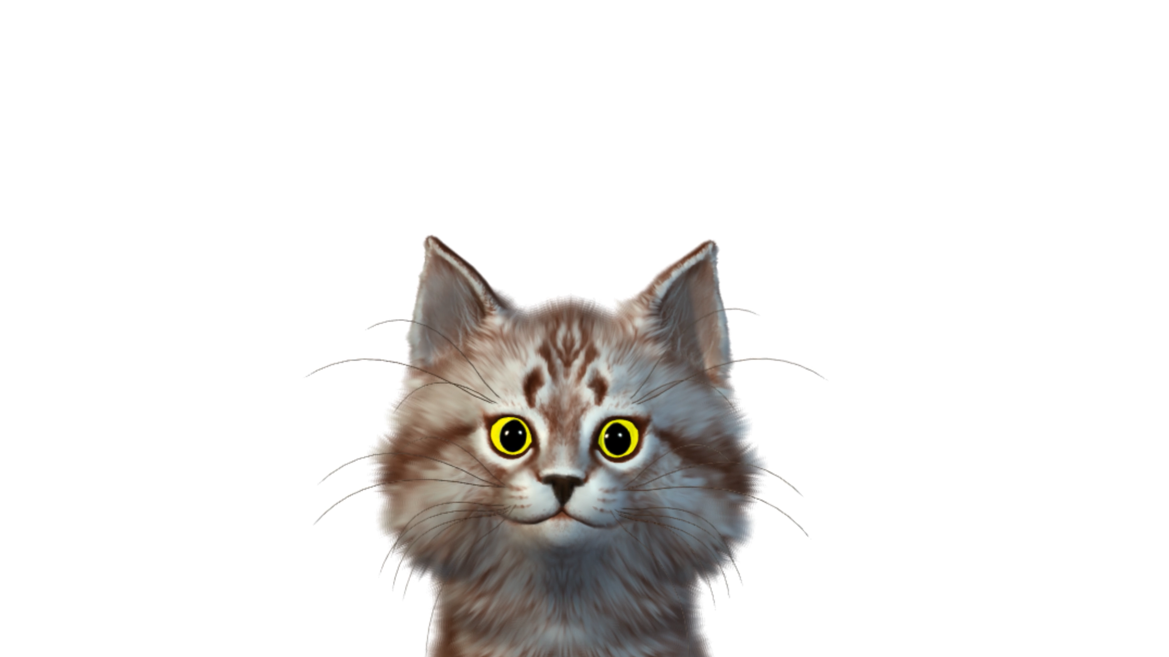
1. Identify the Problem (Q4)
What changes have been made recently to the system?
I have been away for a few weeks on holiday just got back today.
ITFreeTraining.com
© Copyright 2025
Notes:
10:32 One of the most common causes of something going wrong is the last change to the system. So, let’s ask the question. What changes have been made to the system recently?
The user has been away for a few weeks and is not aware of any changes. Let’s dig deeper.

Slide 10

1. Identify the Problem (Q5)
Do you know of any changes performed by anyone else or tech support?
Let me check with Bob.
Well Bob’s in the doghouse now. Bob told me they had a computer in the back that had a video card fail. He took the video card from this computer to replace the failed video card. He said it should still work because this computer has built-in video.
ITFreeTraining.com
© Copyright 2025
Notes:
10:52 Do you know of any changes performed by anyone else or tech support?
Don’t be afraid to ask around the office. Someone may have some information that may help you understand what is going on.
Now we are starting to get somewhere. We have established that a recent change has happened to the computer. Although not always the cause, a recent change is often a good place to start looking. Sometimes users will attempt to fix problems themselves with varying levels of success. Sounds like the users tried to fix the problem themselves. Let’s see if they attempted to fix the existing problem.

Slide 11
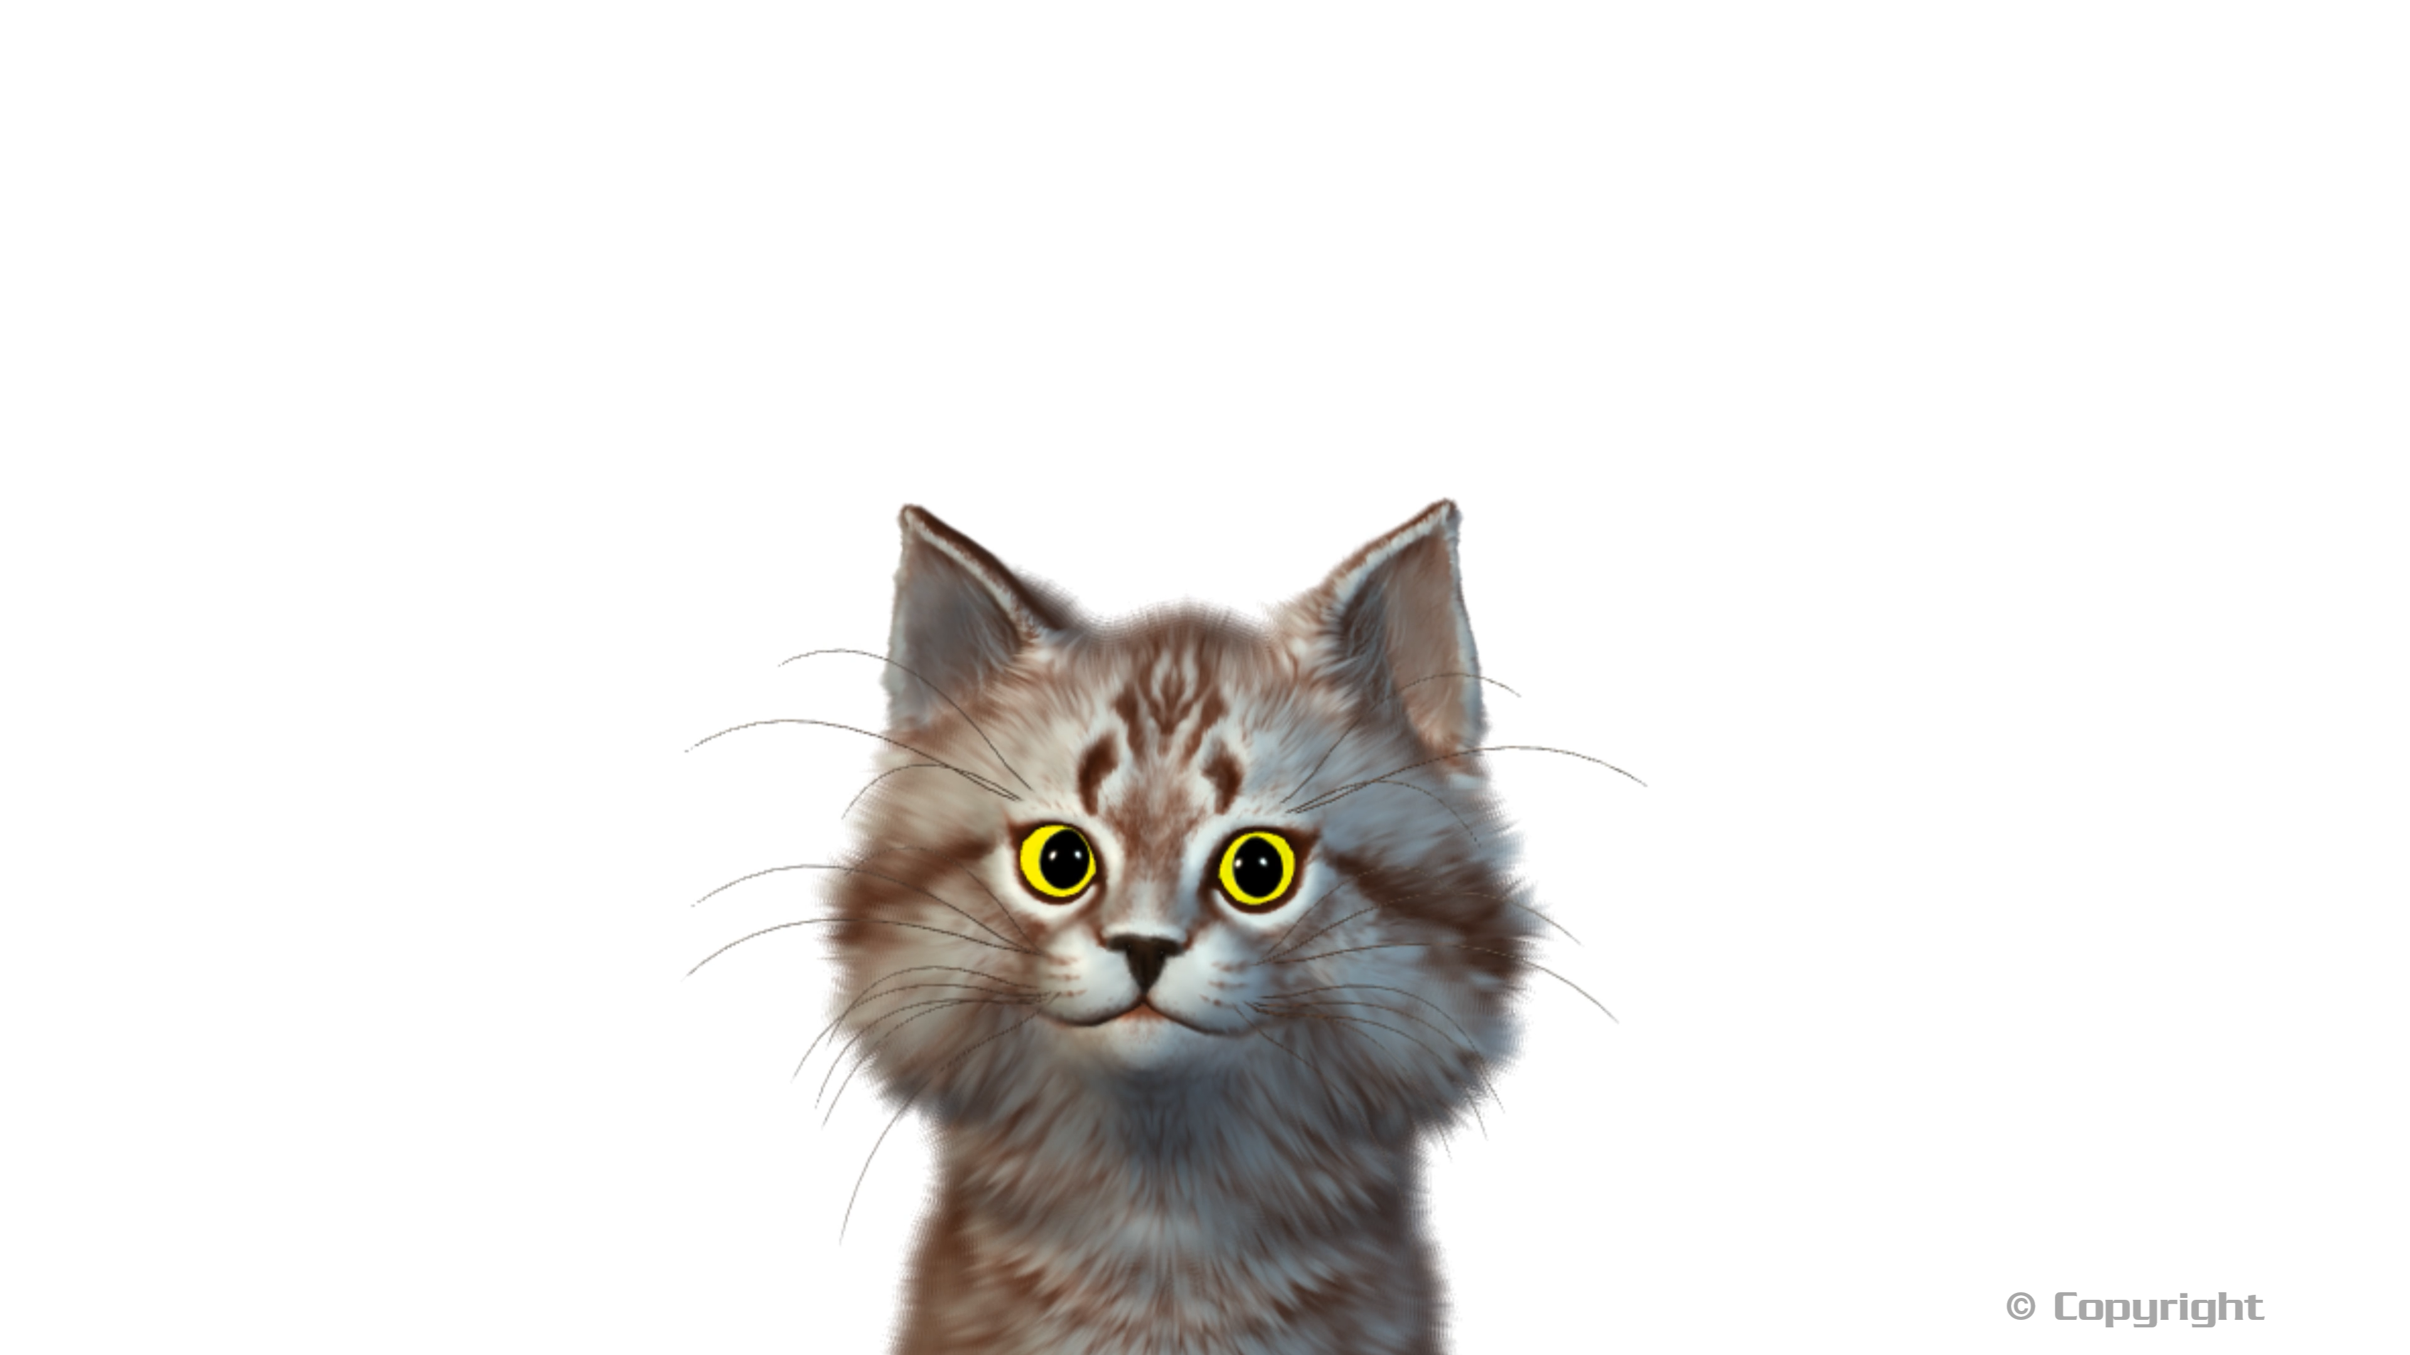
1. Identify the Problem (Q6)
Has anything been tried to solve the problem?
Naaa, looks like Bob broke it and left it for someone else to fix.
ITFreeTraining.com
© Copyright 2025
Notes:
11:46 It is a good idea to ask if anyone else has tried to fix the problem, including anyone from technical support.
I have had cases where an employee has found some broken equipment in a cupboard and tried to use it. You don’t want to spend your time trying to fix something that someone else has tried to fix before and not been able to. Also, if another technician has tried before, you will want to look at their notes or speak to them so you can know what has been tried. Maybe it is not possible to do what the user wants and they just submitted another helpdesk ticket hoping another technician could figure it out. You never know until you ask the question.
Now we have got some information, let’s have a look at what the next step in the process is.

Slide 12
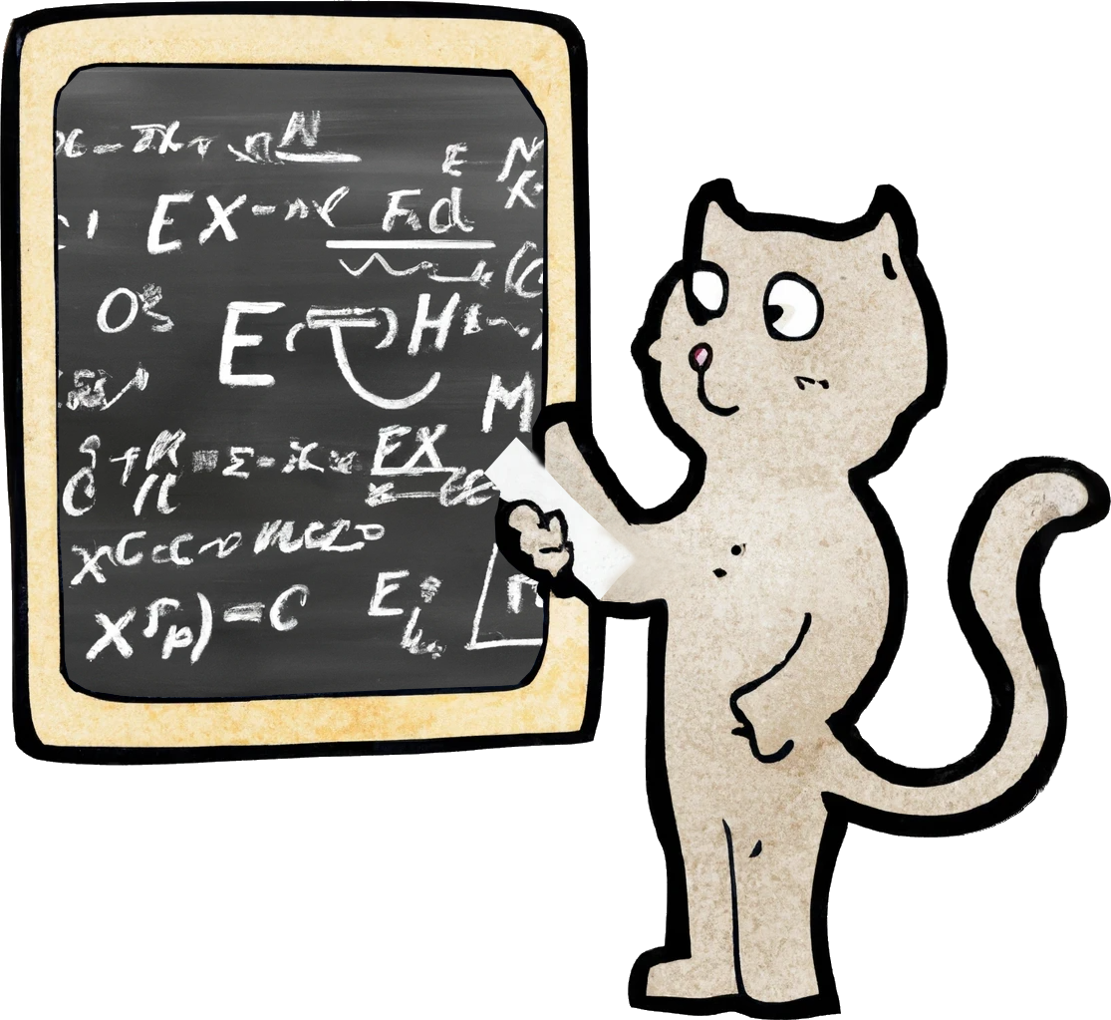
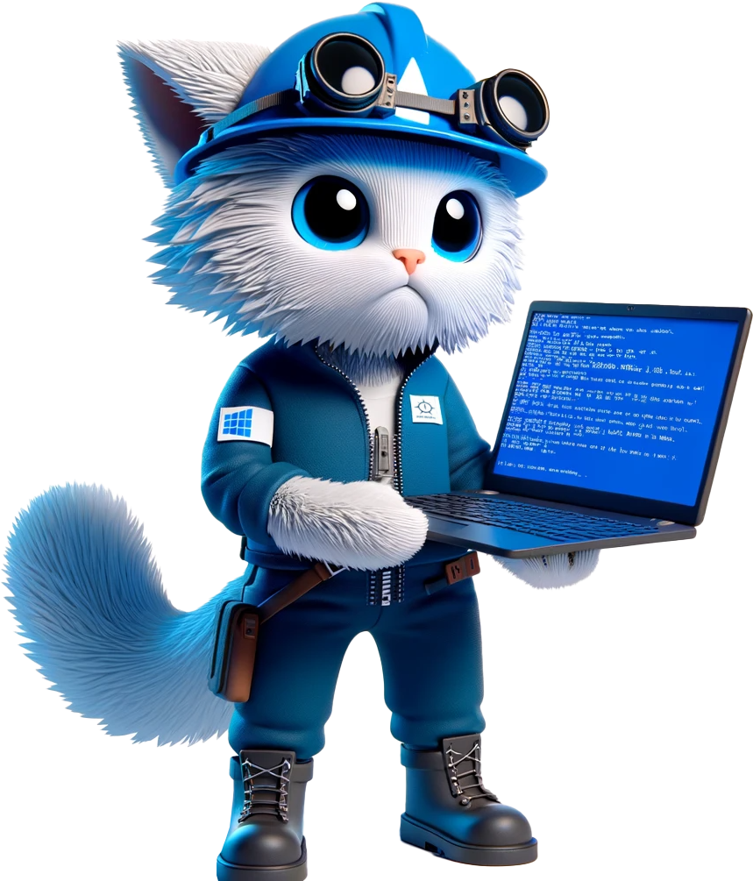


2. Establish a Theory
Establish a theory
Research
Physical inspection
Internal
External
From possible causes
to probable cause
Documentation
Vendor website
Support resources
Forums
ITFreeTraining.com
© Copyright 2025
Notes:
12:31 The next step is to establish a theory. You essentially want to try and go from possible cause to probable cause. To do this, diagnose the problem by identifying symptoms. This will help you determine the probable cause.
To do this, it helps first to do some research. To start with, a physical inspection of the device helps. You want to look for any damage. Use your senses – look, listen, and smell. You are looking for signs of damage including burn marks from electrical damage. You are listening for unusual sounds. For example, fans blocked or devices making clicking noises (in fact, any noise that is not one of the usual sounds the device makes).
If the device has had recent electrical damage, you should be able to smell the smoke from any burnt electronics. You don’t need to put your head in the device and smell around, people will think you are a little strange if you do that, but just be aware these electronic smells exist. When you pick up the device or get close to it, that is close enough.
You should also include internal research. This includes looking through internal documentation and support resources. Talking with other technicians may help as well, since they may have come across the same problem before.
You should also consider external resources. This includes the vendor’s website and forums. A lot of the time, someone has had the same problem you are seeing. If you have an error code, do an internet search for that error code. It is usually one of the best ways to find information on the problem you are having.

Slide 13


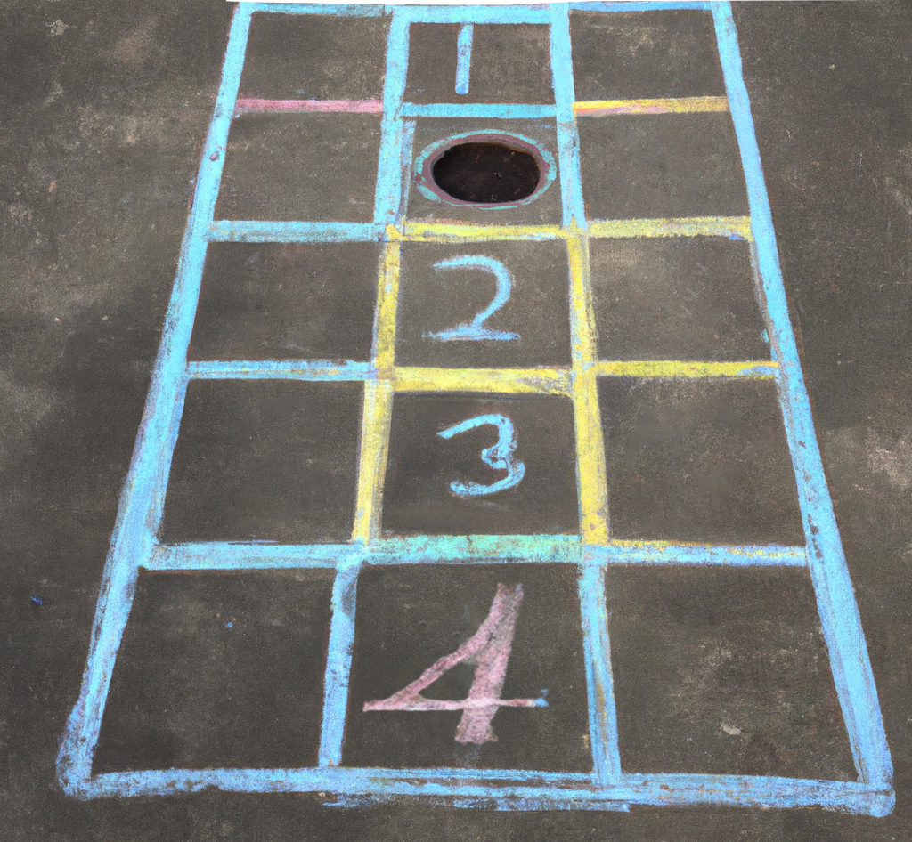

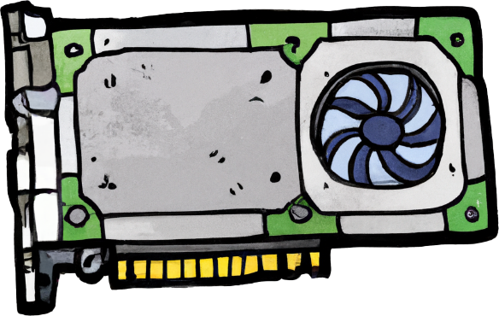

2. Establish a Theory
Question the obvious
Attention to detail
Step through process
Compartmentalize problem
What should happen
Eliminate anything working
ITFreeTraining.com
© Copyright 2025
Notes:
14:05 When you are establishing a theory, make sure you question the obvious. Sometimes problems occur due to the simplest of things. In order to determine what has occurred, paying attention to detail is important. A small thing out of place may lead you to what the problem is.
Diagnosis of the problem also requires the ability to be systematic. Step through the process one step at a time. Ask yourself what should be happening and look at what actually is happening.
What you are attempting to do is compartmentalize the problem. You essentially want to isolate the problem so you can work out what it is. To do this, eliminate anything that is working. Essentially, you are using a divide and conquer approach. Sometimes you may not know where to begin. Start by eliminating what is working and then work on everything else. One of the easiest places to start is working out if it is hardware or software related. If you can eliminate one or the other, you already have reduced what you need to consider to find the solution.
Now that we have gone through a bit more of the model, let’s now use what the user told us and apply the model to see if we can fix the problem.

Slide 14
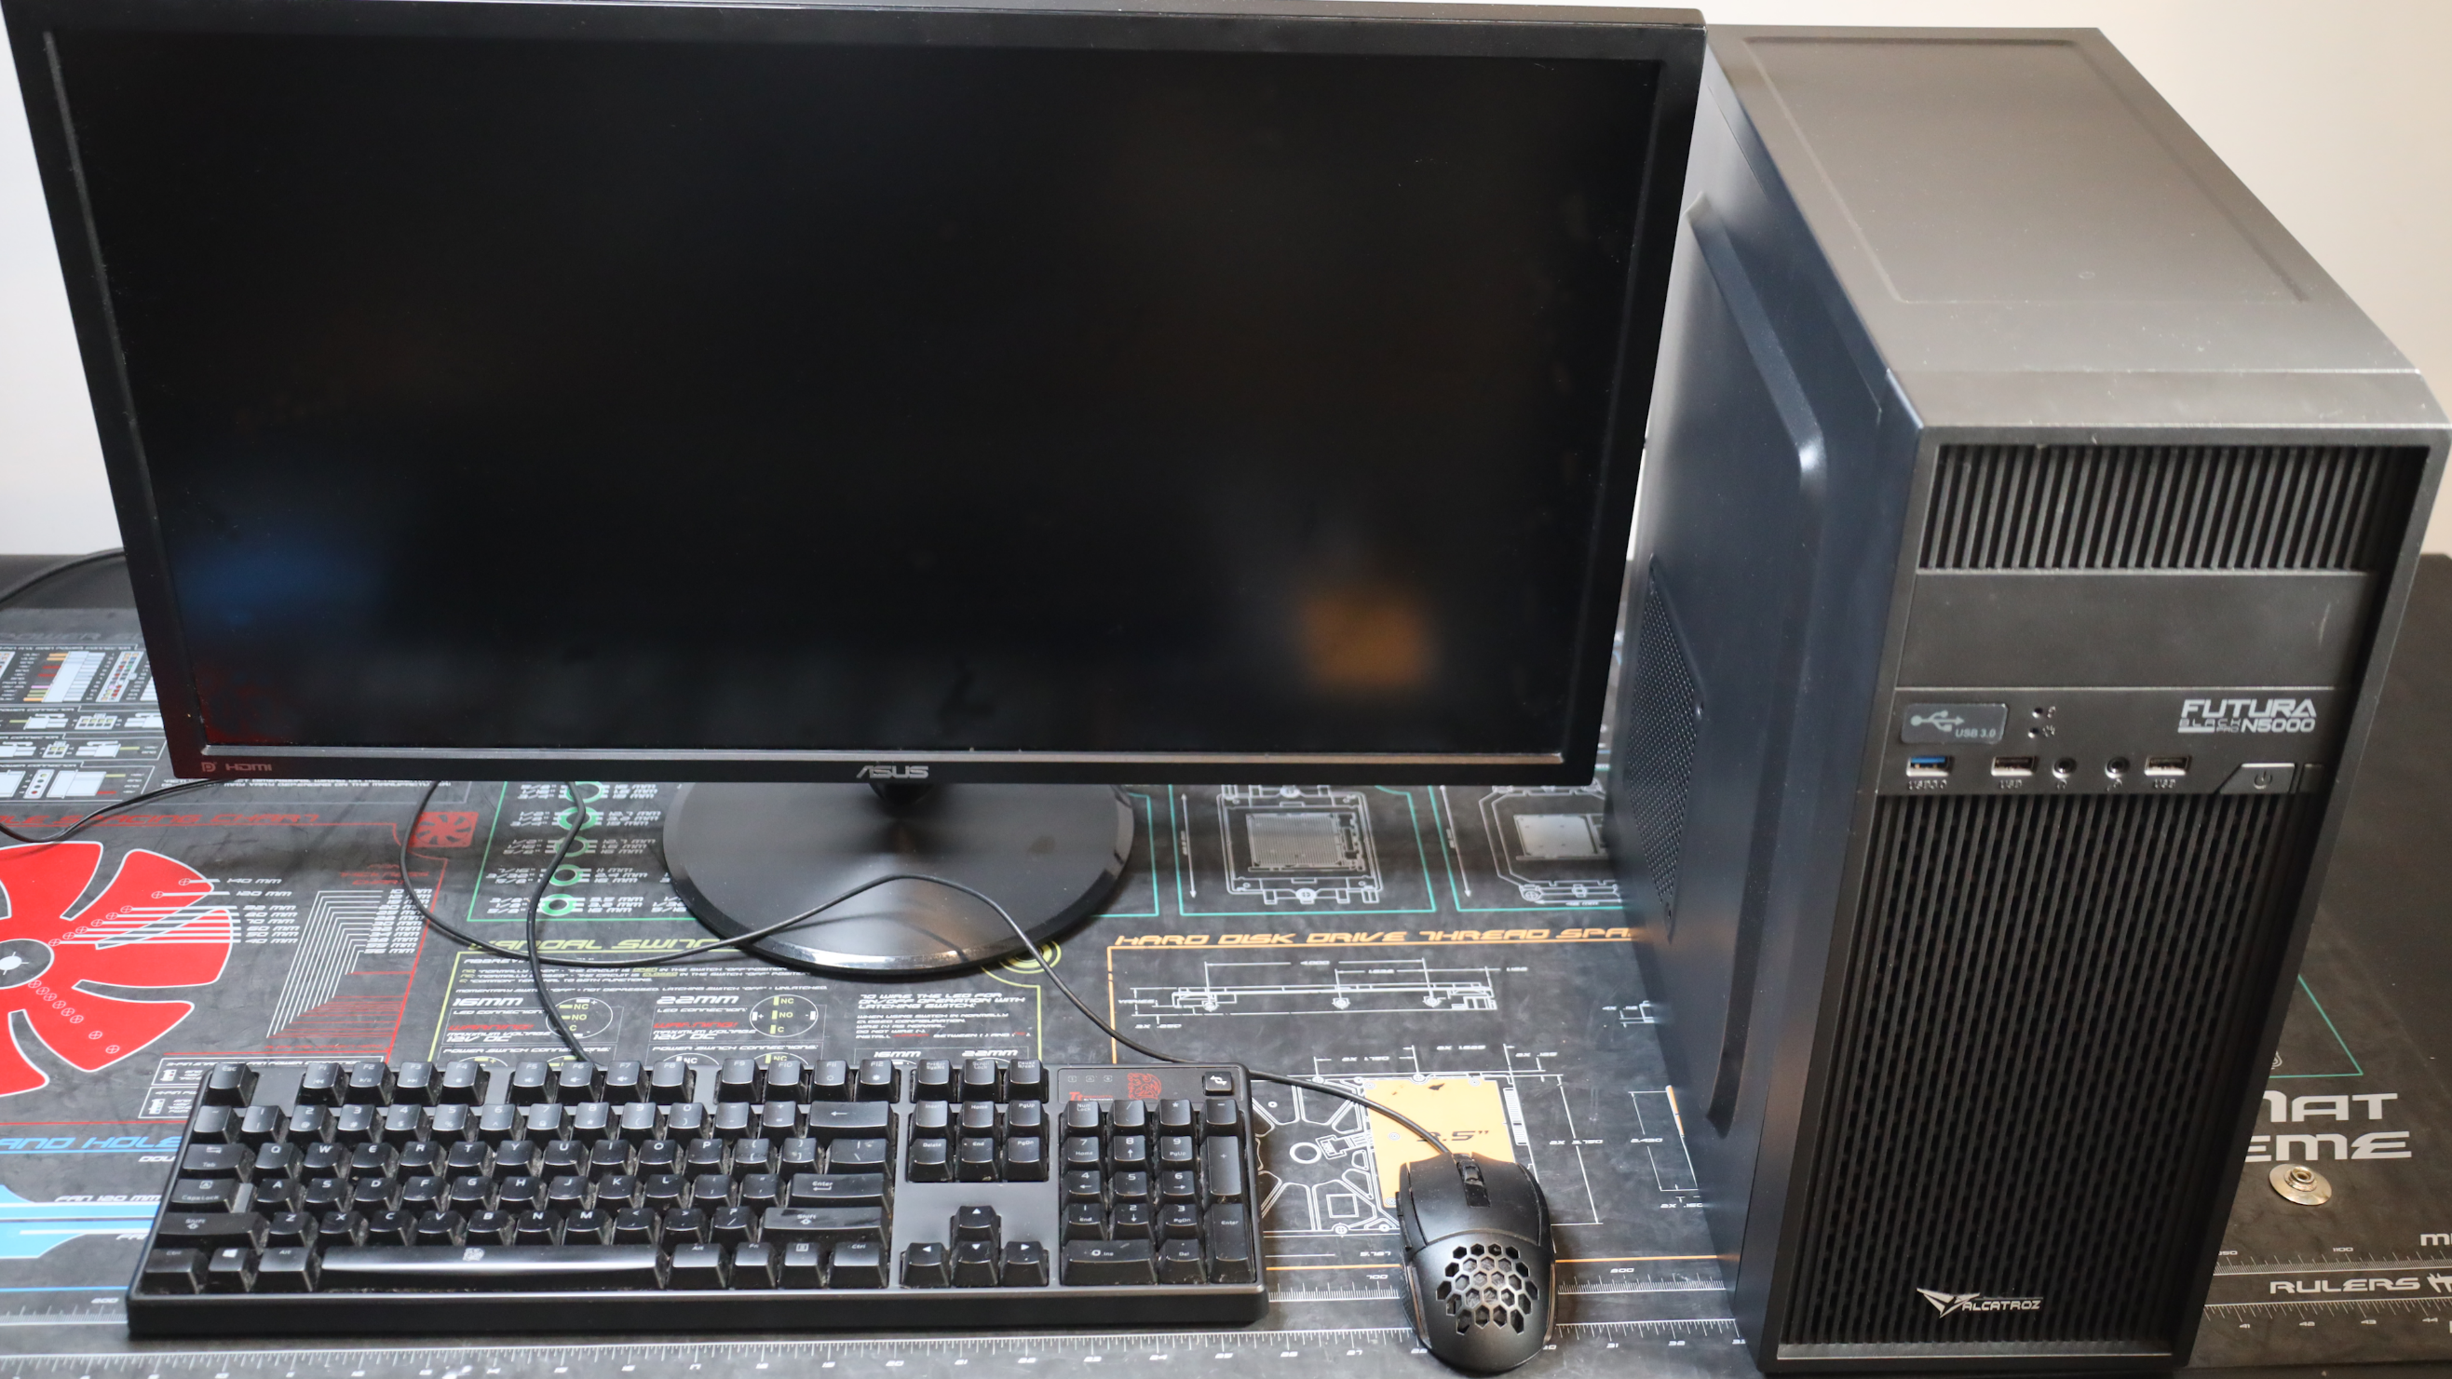
2. Establish a Theory (Example)
ITFreeTraining.com
© Copyright 2025
Notes:
15:18 Firstly, I will have a look at the computer to see if we can get any additional information that may help us. I also want to confirm that what the user told us is correct. Sometimes users get things wrong. This may be for a number of different reasons, but don’t be accusatory if they have got something wrong. Sometimes users won’t tell you the truth, but don’t be surprised if they just got it wrong. Users generally don’t understand computers as well as a technician does, so you just need to show some patience.
I will first have a physical look at the computer. From the front there does not appear to be anything wrong or any damage. I will turn it around and have a look at the back. Everything appears to be in order, but best to check. I will check the power is switched on and the cables are plugged in. Make sure you check all the connectors are plugged in all the way; even if any are slightly out, this can cause the computer to not work correctly.
You will notice the missing blanking plate in the expansion area. Little things like this give us hints as to what may have occurred. In this case, the missing blanking plate was because a video card was installed and later removed.
I will turn the computer back the way it was. I will next check the monitor. I will make sure the power cable is firmly in, but I will unplug the video cable. What I want to know is, which connector is the video cable plugged into? In this case the HDMI one. When troubleshooting, it helps to rule out all the simple things, as often they are the cause of the problem.
I will now plug the video cable in, making sure that it is plugged in all the way. I will now switch on the monitor and check that it is working. The monitor appears to be working and appears to be using the right video connection. I will now switch on the computer. You will notice the power light comes on and we hear a single beep.
After the computer does its initial checks, it will make a single beep to let you know everything is running okay. Notice that the hard disk activity light is flashing. A beep followed by hard disk activity indicates the computer has started up and is booting the operating system. This computer has a Solid-State Drive, but the hard disk activity light will flash for any internal storage, that is, storage that is directly connected to the motherboard.
You will notice that the monitor is still black, although everything seems to be working fine. We can also check the cables and swap the monitor, but for the sake of expediency, I am going to consider that has already been tried. We have now tried all the simple fixes and nothing has worked. So far, we have been able to work out what is working and what is not. Let’s do some more advanced troubleshooting.

Slide 15
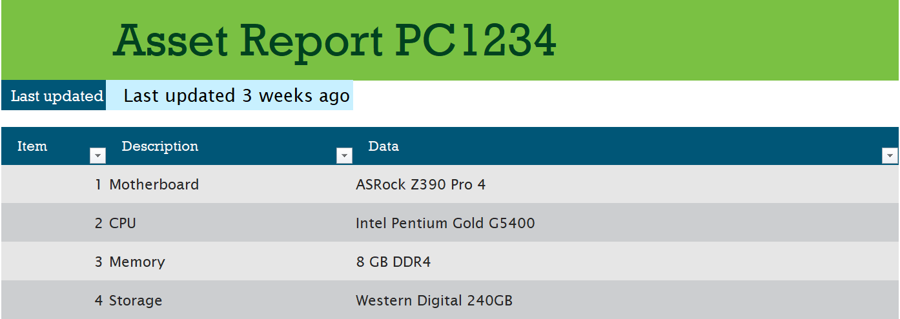
Inventory Management Software
Records inventory and other information
May record previous tickets for that computer
ITFreeTraining.com
© Copyright 2025
Notes:
18:05 Any large business will have some kind of helpdesk system and most likely have inventory management attached or as a separate system. In this example, I want to look at the asset report for the computer I am working on. This will tell me the hardware used in the computer.
These systems may also record previous tickets for that computer. They will allow you to look up what previous technicians did on the computer and also highlight any previous problems. Internal systems like this can be very useful when troubleshooting. In this example, as the video won’t work I can’t access hardware information. I could take the computer apart and get it that way, but it is easier to look it up in the internal system.
In our example, no previous tickets have been created for this computer. However, we did get some useful information. I will now use this to obtain some further information from the vendor.

Slide 16
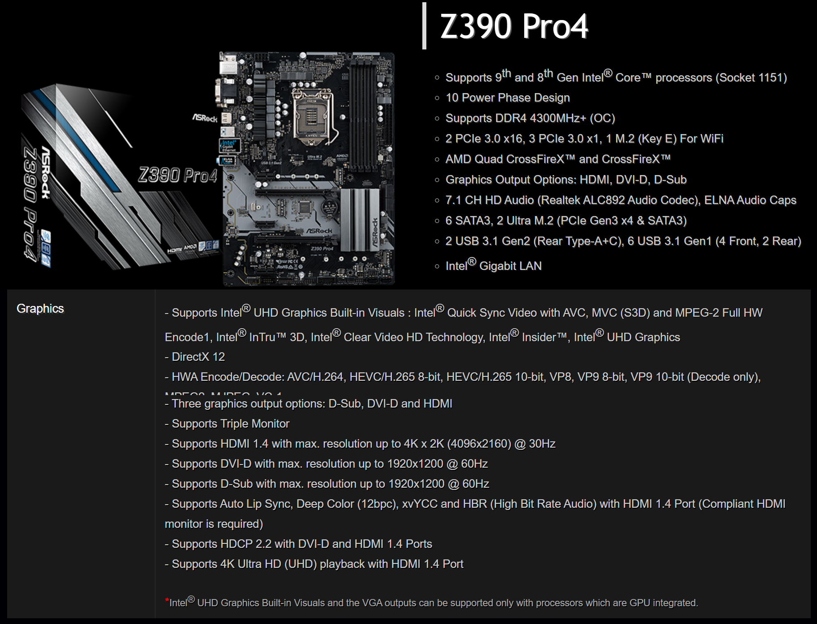
Motherboard Vendor Information
Graphics supported
Requires CPU support
ITFreeTraining.com
© Copyright 2025
Notes:
18:56 I want to have a look at the motherboard information since we know the computer was working before the video card was removed. Perhaps this motherboard does not support video. We can see that graphics are supported; however, it does require a CPU with graphics capability in order to work. If you see video connectors on the motherboard, most likely it won’t work without a CPU that supports graphics. I don’t like to assume anything with computers, and it doesn’t hurt to check. So, the next question is, does the CPU support graphics?

Slide 17
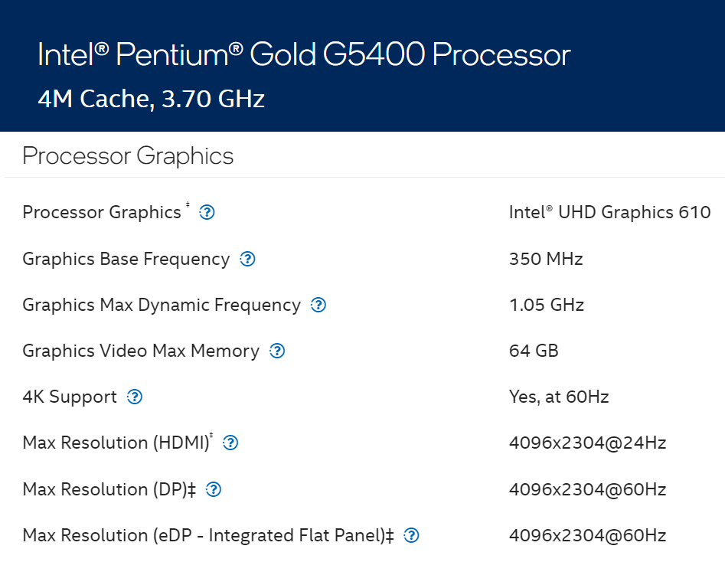
CPU Vendor Information
Graphics supported
ITFreeTraining.com
© Copyright 2025
Notes:
19:27 I went to the Intel web site and got information about the CPU. The CPU does support graphics. So far, we have used internal and external sources to get more information. The information has been helpful, but we have not fixed the problem as yet. So far, we have learned that the computer appears to be working, the monitor is working, the cabling is working, and graphics are supported. I have enough information now that I can establish a theory of what the problem is.

Slide 18


Theory 1
Motherboard graphics are disabled in the computer's setup
Can we get the graphics card back to put in the computer?
Bob says he needs it so won’t give it
back. But, he has gone to lunch so we can use it while he is gone.
Can’t access the
setup without video
ITFreeTraining.com
© Copyright 2025
Notes:
19:58 My theory is, the video graphics are disabled in the computer’s setup, and this is the reason it is not working. This, however, is a chicken and egg problem. I can’t access the computer’s setup without the video card. Let’s see if we can get the video card back. I will ask the user if they still have the graphics card so it can be put back in the computer?
So, we can get the video card back for a little while in order to test our theory. When troubleshooting, you may get the chance to undo a recent change. It is often worth doing this to see if this fixes the problem. If it does, you know the change caused it. If it does not, you can work from there. Let’s look at how we would go about testing our theory.

Slide 19
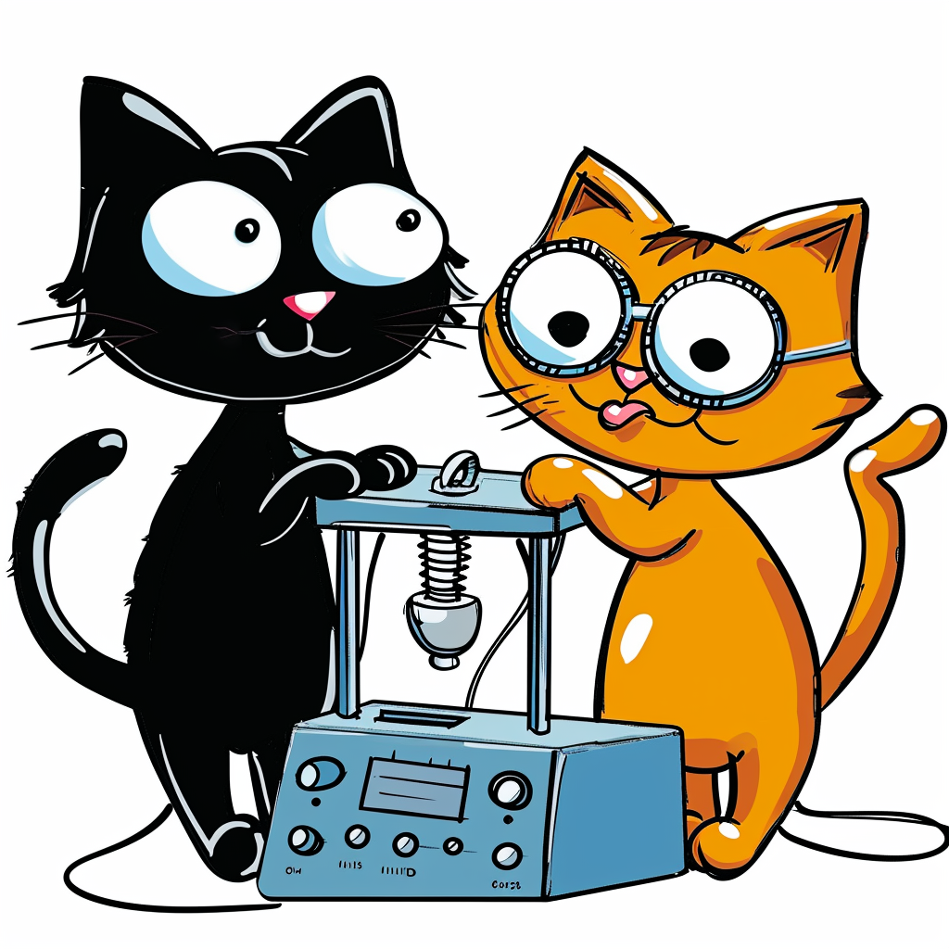
3. Test the Theory
When necessary, test in a test environment
Otherwise, be careful and make sure you have a backup
ITFreeTraining.com
© Copyright 2025
Notes:
20:48 As the name suggests, this is essentially testing your theory to see if it fixes the problem. When possible, test the theory in a test environment. I say, when possible, because sometimes it is not possible. In order to test in a test environment, you need to be able to replicate the problem in such an environment. This is not always possible. With minor help desk problems this is not practical. With larger rollouts that affect a lot of users, it is a good idea to test the theory in a test environment first.
If it is not practical to use a test environment, be careful and make sure you have a backup. You don’t want to lose data. Now, let’s test our theory out.

Slide 20
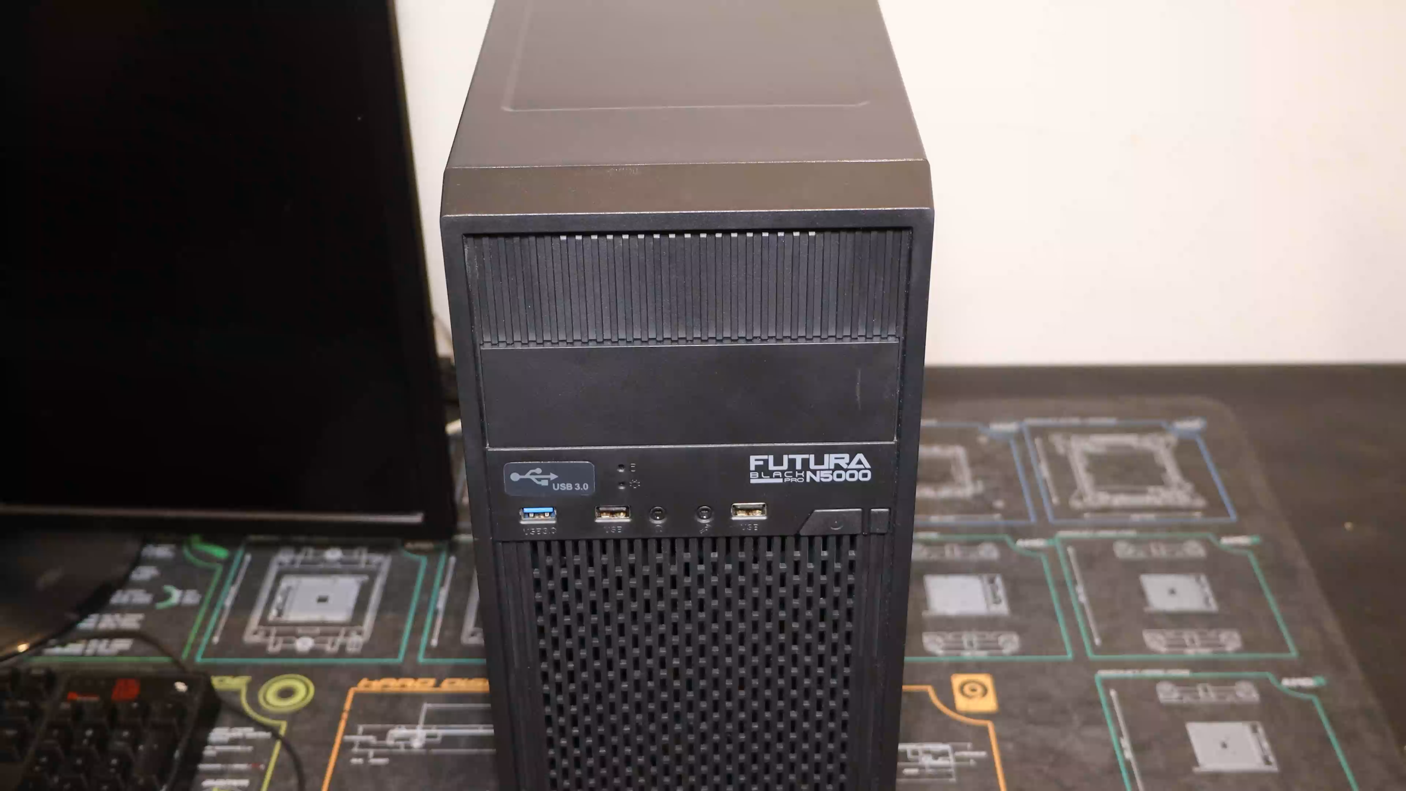
Test Theory 1
ITFreeTraining.com
© Copyright 2025
Notes:
21:27 To test my theory, I will re-install the video card in the computer. By rolling back a change, this can help in the troubleshooting process. If the computer works with the video card installed, I know, since everything is working, there is something wrong with the video on the motherboard.
Since I am doing this work in front of the customer, I will make sure I follow best practice, like unplugging the computer before I start work.
I will next remove the back panel from the computer case. For this computer case, I just need to remove two screws and slide the panel off.
I will next remove the expansion card holding bracket. Once this is removed, I can then install the video card into the computer. This will essentially roll back the change and also allow me to test my theory. Once the video card is installed, I will re-install the expansion card holding bracket. This will hold the video card in place.
Technicians will often cut corners and do things such as not securing an expansion card when working on it for short periods of time. I am not saying it is the right thing to do, just saying it does happen. If the video card is not secured, when I plug the video cable in, it is possible for the video card to pop out of the slot. This can potentially damage the video card. Since I am doing this work in front of a customer, I will undertake the extra steps. The last thing I want to do is damage the customer’s equipment in front of them. If the video card were to pop out of the slot in front of the customer, even if it does not get damaged, it does not look good and is far from appearing professional. So, when doing work in front of a customer, I recommend just taking the extra time to perform these little steps.
I will next plug in the video cable to the video card, plug the power cable back in, and switch the computer on. Notice there is now video on the monitor. I will press F2 to enter the computer’s setup.
With this computer setup, the options I need to access are in the advanced section. To access it, I will press “Advanced mode” at the top right-hand corner of the screen. The settings I am interested in are under “Chipset Configuration”. Your computer setup may be different and you may need to go looking around to try to find these settings.
Notice that the setting “Primary Graphics Adapter” is set to “PCI Express”. This setting will determine which is the primary video card to be used. Essentially, the first video card will be used which means the video card that will show the computer setup and most likely the first login screen for the operating system.
This is just a preference, so if one is not installed, it should default to the other. Since at this stage we want to use the on-board video card and ensure it is the one being used, I will set it to “Onboard”.
There is another setting I want to configure. To get to this, I will scroll down until I get to “IGPU Multi-Monitor”. This option is currently “Disabled”. When disabled, the on-board video card will be disabled if there is a dedicated graphics card in the computer. I will select “Enabled” since I want to test the on-board graphics and make sure it is working.
These are all the settings on this computer related to on-board video cards, so I will now save the settings. There is a change I want to make to the computer, so after I save the settings, I will switch the computer off.
I have connected a second monitor to the computer. This will help me understand what is happening with the on-board video and why it may not be working. I will now switch the computer on.
During start up there is a single beep.
After that, the screen is black and nothing seems to happen. The login screen appears on the monitor plugged into the video card. I will login to the computer; you will notice that one monitor is working while the other is not.
I have now tested my theory that the setup on the computer has disabled the on-board video card. After testing, I no longer believe this to be the case. So, I will now move onto the next step in the model.

Slide 21


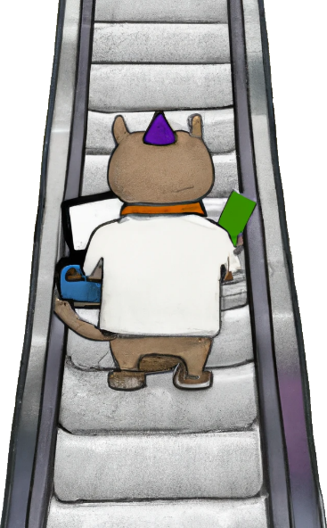



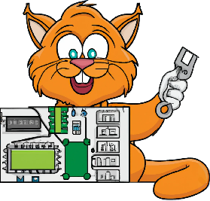



Establish a New Theory or Escalate
New Theory
Escalating
2. Establish a theory
Attempting to resolve at higher level
3. Test the theory
Time and Costs
More testing
Base configuration
Warranty
Social Media
Warranty
Service
Contacts
Obtain authorization first
Don’t disclose proprietary/confidential/personal information
ITFreeTraining.com
© Copyright 2025
Notes:
25:39 The next step is to establish a new theory or escalate. Establishing a new theory is essentially going back to step 2. So, once you establish a new theory, do you go to step 3 and test it? Yes, you do. Thus, you can see that the model becomes a loop at this point. If you test your theory and it does not work, start working on a new theory.
Working out a new theory may require more testing. This could involve using a base configuration and working up from there. If you can get it working and start adding things, you can work out what is causing the failure.
The other alternative is escalating. Escalating is attempting to resolve the incident at a higher level. In business, this may mean passing the problem up to a higher support level, such as second-level support. This may also involve contacting the vendor or sending the device back to them to get it fixed.
When looking at escalating, consider the warranty and service contracts. If the device is still under warranty, it is worth sending it back for repairs. Even if you swap the device out with a replacement, make sure it goes back for repair. You don’t want to find the device a year later in a storeroom gathering dust when it could have been repaired under warranty but now it is too late. Your company may have service contracts to get devices fixed. In some cases, to get the contract, the service company may provide a number of free helpdesk tickets. It is worth asking what services are available, because if you are not using them, they are going to waste.
When considering this step, the most important consideration will often be time and costs. In the business world, often time is considered money. You want to get the problem fixed, but often a workaround will be the cheaper option. I will cover workarounds later in the video, but essentially a workaround is generally finding an alternative way to get the user working again which may not directly fix the problem.
Nowadays, you may also consider using social media, including public forums, to get answers. If you do that, get authorization first. A lot of companies care a lot more about their reputation than fixing a computer problem. A lot of them have strict policies about what you can and can’t do. This may include creating a separate email account not connected to the company to make posts on public forums and not disclosing the company you are working for.
If you do post anything public, don’t disclose proprietary, confidential, or personal information. It may be helpful when solving a problem to post a log file, but if that log file contains information about a customer, well, you will probably be fired. If the breach is bad enough, you may be facing criminal charges. Nowadays, be careful with social media; it can get great results, but can also cause a lot of problems if not used correctly.
In the case of our example, we are going to go back to step 2 and establish a new theory.

Slide 22



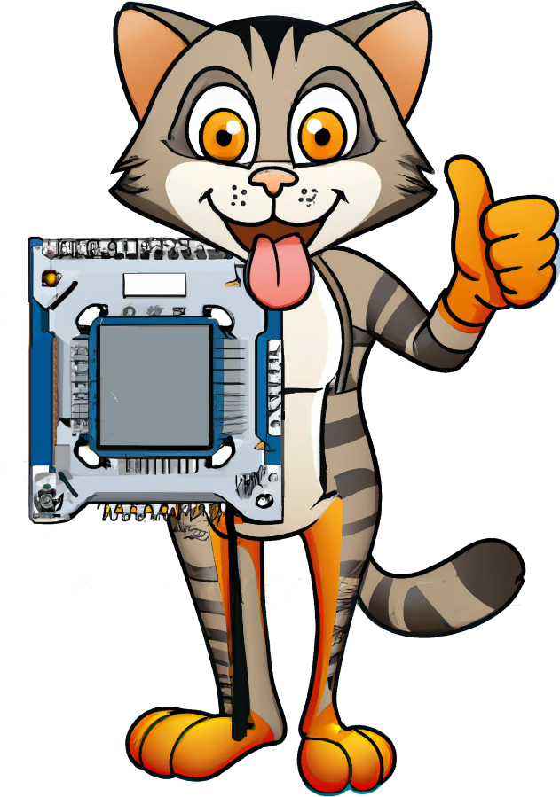

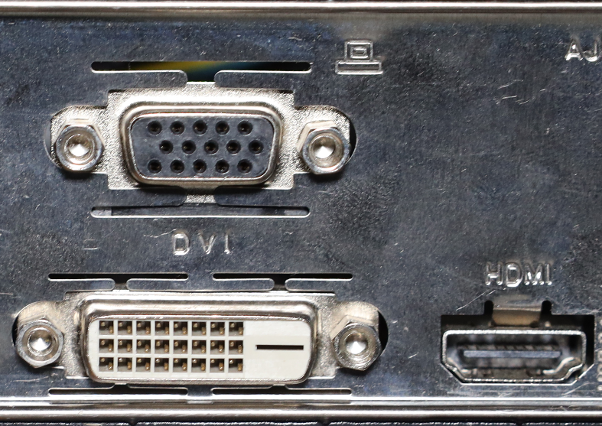
Theory 2
Connector on motherboard is faulty
CPU
Graphics supported
Motherboard
Graphics supported
Does the connector work?
Cable
working
Monitor
working
ITFreeTraining.com
© Copyright 2025
Notes:
28:42 To come up with a new theory, I am going to consider what I have confirmed to be working. Essentially, this eliminates what is working to find out what is not.
I have confirmed the CPU supports graphics. When troubleshooting, try not to assume anything. The CPU does support graphics, but we have not confirmed it is working yet. It is unusual for a CPU to have a single feature fail, but it is possible. Generally, when CPUs fail, they will randomly crash or the computer won’t start up properly.
We have also checked that the motherboard supports graphics. When considering a problem, it sometimes helps to consider all the steps or devices that are involved in the process.
We have also checked that the monitor is working. When checking the monitor, the video cable was also checked as a result.
We have considered all the components that are required to make the video work; is there anything we have missed? What we have missed is the video connector on the motherboard. We have not checked if that is working. So, the new theory or question being asked, is the connector on the motherboard faulty?
This motherboard has three video connectors, so testing this theory is quite simple. I will simply use one of the other video connectors. Let’s give it a try.

Slide 23
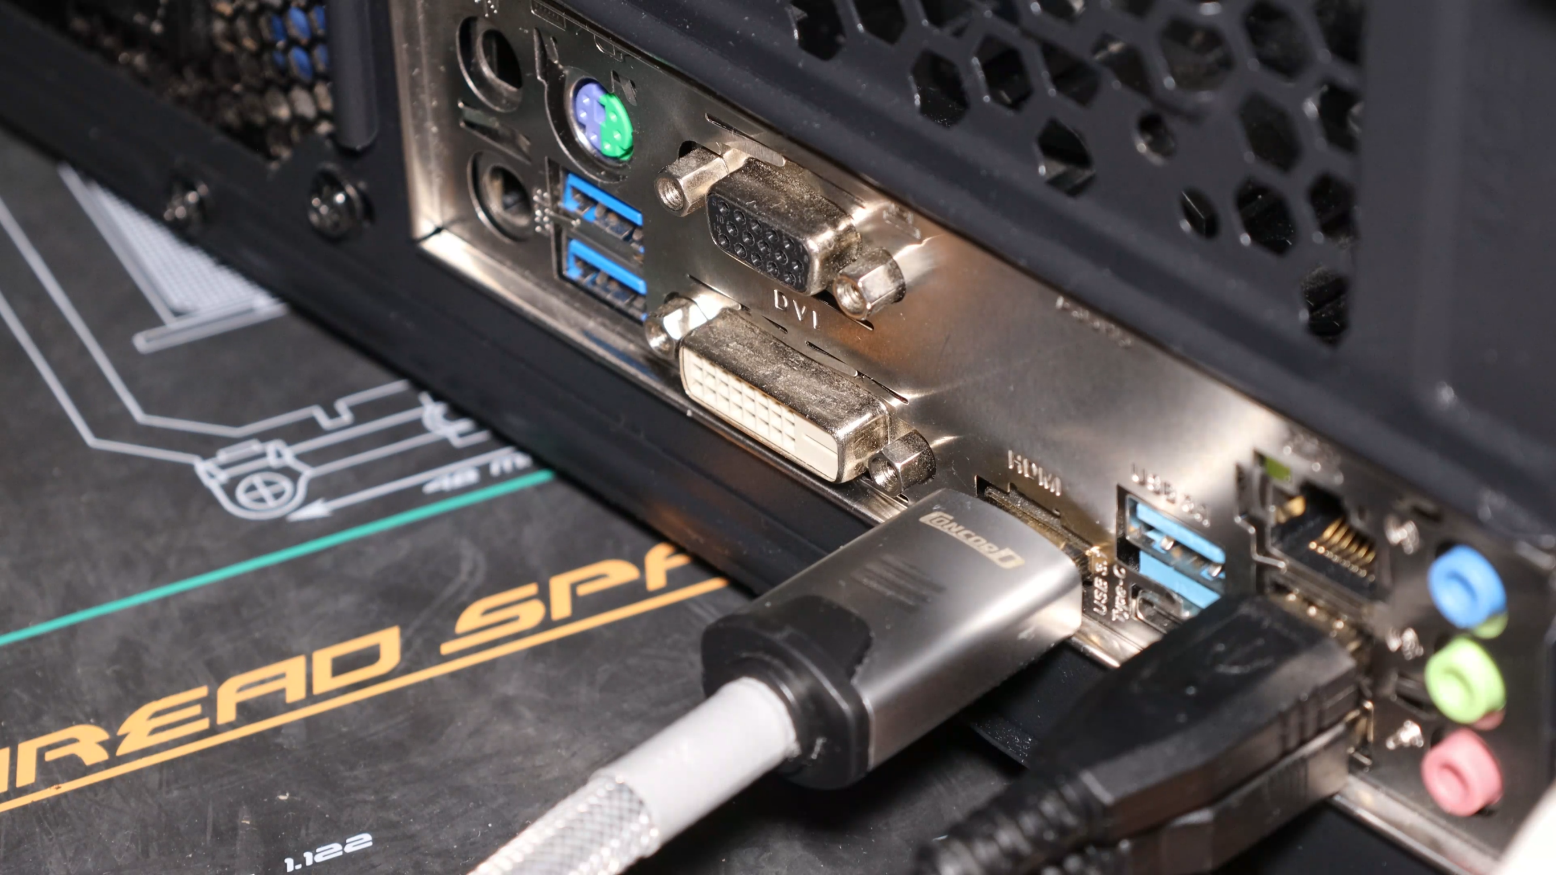
Test Theory 2
ITFreeTraining.com
© Copyright 2025
Notes:
29:56 To test my theory, I will unplug the HDMI connector and plug in the DVI connector. Although DVI is an older standard and does not support high resolutions, it will allow me to test my theory and also test if the graphics in the CPU are working.
I will plug the connector into the small monitor. Thus, the large monitor is plugged into the video card and the DVI into the motherboard. I will now switch on the computer. Notice that the initial startup screen appears on the small monitor. The computer will boot up to the login screen. I will login and you can see that both monitors are now working.
So, through my testing I have been able to find the source of the problem. The problem is that the HDMI connector on the motherboard is not working. However, the in-built graphics are working. Using the model, I have been able to find the source of the problem. However, we are not finished with the model yet!

Slide 24
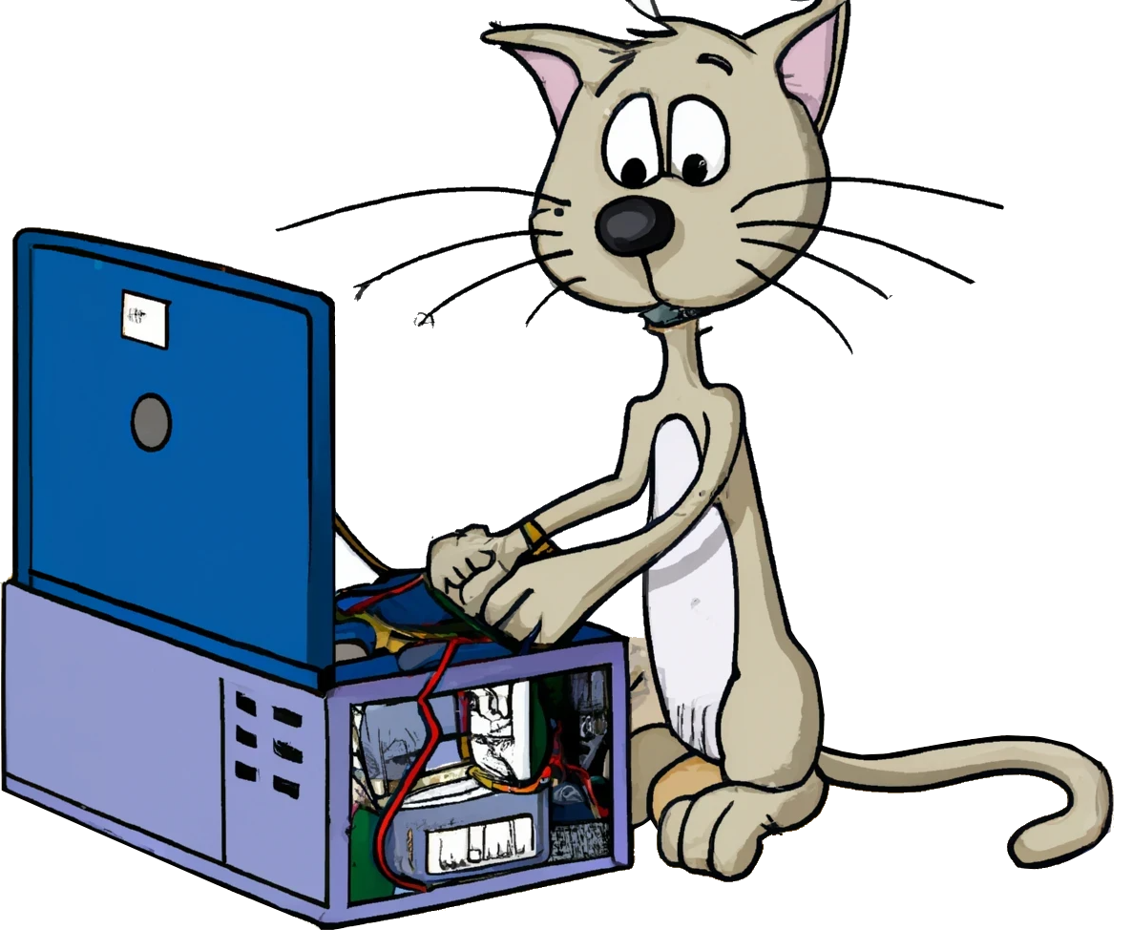

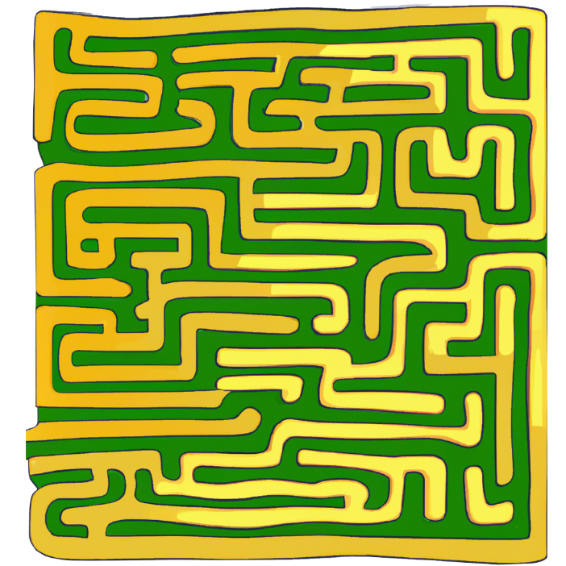
4. Establish an Action Plan
Determine next steps to solve the problem
Repair
Replace
Workaround
ITFreeTraining.com
© Copyright 2025
Notes:
30:57 The next step is to determine the steps required to solve the problem. Generally, this falls into three approaches: the first being repair. This may involve sending it away to be repaired or buying parts to make the repair. With computers, most of the parts are components and thus there are not many repair options other than getting a vendor to make the repair. In a lot of cases, the choice of whether to repair an item will come down to, is it worth repairing or taking the next approach which is to replace it?
Replacing will mean purchasing a new item to replace the old one. Replacing also gives you the option for upgrades and a new warranty period. Thus, the replace option may cost more but it is not without its advantages.
The last approach is a workaround. In some cases, the problem may not be critical and simply using a different approach may get you the same result or at least a similar result. Sometimes, a repair or replacement is just not cost effective, and the business will prefer a workaround. The workaround may not be as efficient, but it is designed to at least get the user working again. The workaround should be documented so that other technicians know what has occurred.

Slide 25

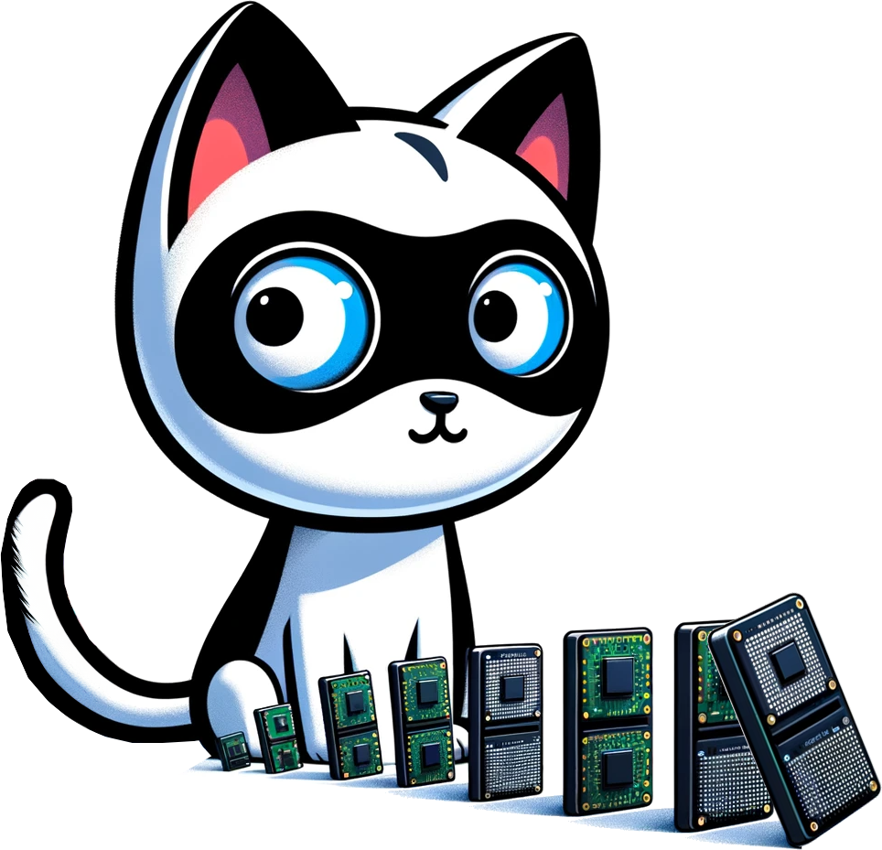


Implement the Solution
Some CompTIA documentation refers to step 4 as
Establish an action plan and implement the solution
Test
Results
If required, get authorization
Test each change
Consider impact
Corporate polices/procedures
Reverse if required
Will it disrupt others?
ITFreeTraining.com
© Copyright 2025
Notes:
32:12 The next part of this step is to implement the solution. Some CompTIA documentation refers to step 4 as “Establish an Action plan and Implement the solution.” If you get a question in the exam, and the wording is a little different, look for the key words and this will tell you which step it is referring to.
When implementing the solution, check to see if you need authorization first. Some businesses, for particular changes, will require you to put a request through first before making the change. In other cases, it may just be a matter of making yourself familiar with corporate policies and procedures.
In a previous job, I was having problems with some software and worked out a fix needed to be installed on all the computers using that software, about 20 in total. I installed the fix, then remembered I had not put through the change request. I put the change request in afterwards and it came back denied. I then put another change request asking for permission to uninstall the fix to return the computers back to the way they were. I got a call from the manager who saw the funny side and just told us to put the change request through first next time. Hopefully, if you make the same mistake, management will see the funny side.
When implementing the change, you want to test each change individually whenever possible. This hopefully will allow you to reverse the change if required. If you apply multiple changes at once, it may be harder to reverse and isolate which change caused the problem.
Lastly, consider the impact on the business. A hot fix on a server that requires a reboot for one user is probably not worth disconnecting the other 100 users currently connected to it. Other changes may fix the problem but disrupt other users. You need to consider the impact the change will have on others. Let’s apply what we have learned to our example.

Slide 26

4. Establish an Action Plan (Example)
Use DVI to provide video (Workaround)
Reduces max resolution
Reduces graphics processing
Will on-board video be enough for
your needs?
Today I’ll just be looking at e-mails so that will be fine.
Tomorrow, however!
ITFreeTraining.com
© Copyright 2025
Notes:
34:07 We currently have video working with DVI. This will get the computer working but will reduce the maximum resolution and also reduce the amount of graphics processing the computer will be able to handle. This is a workaround, since it will allow the user to continue working, but with reduced performance. Depending on the user’s needs, they may not require these extra features, but let’s ask and find out.
Will on-board video be enough for your needs?
So, for today, the user will be fine, but I need to order another graphics card right away. Hopefully it will arrive first thing tomorrow. If you are not able to fix a problem for the user right away, consider a workaround, so you are at least giving them something. Often, a user will be much happier being able to use a workaround than not being able to work at all.

Slide 27



5. Verify Full System Functionality
Perform tests
Obtain user acceptance
Implement preventative measures
Make sure it works
ITFreeTraining.com
© Copyright 2025
Notes:
35:06 The next step is to verify full system functionality. You don’t want to walk away and then get a call saying you need to return because the problem has not been fixed. To do this, perform testing and ensure that it works.
You should also attempt to get user acceptance. If possible, get them to verify everything is working or at least show them everything is working. If a workaround is used, inform them of the limitations of what is occurring.
Whenever possible, it is important to put the results in writing. A lot of modern helpdesks have the ability to provide an update to the user. It is a good idea to put some good notes into systems like this. Particularly if you have not been able to solve the problem or you have management not wanting to pay for replacement parts. When things go wrong, don’t be surprised if the blame for the problem is shifted onto the IT department. When this occurs, those notes can become invaluable. You want to be able to demonstrate that you did your best to try to fix the problem. Also, you want to be able to demonstrate that you kept the user informed. If a computer-related problem starts causing the company to lose money or productivity, people are always going to look for someone to blame. Cover yourself and your department so they are not an easy target for that blame.
Lastly, you want to implement preventative measures. Here, you are essentially trying to prevent the same problems occurring again. For example, if you replace a fuse, you should also check what potentially caused the problem. Perhaps there are power problems in the building that need to be addressed. If you remove a virus from the computer, take the time to make sure that the virus signatures on the computer are up to date and automatically updating.
So now, let’s verify our example computer is working.

Slide 28
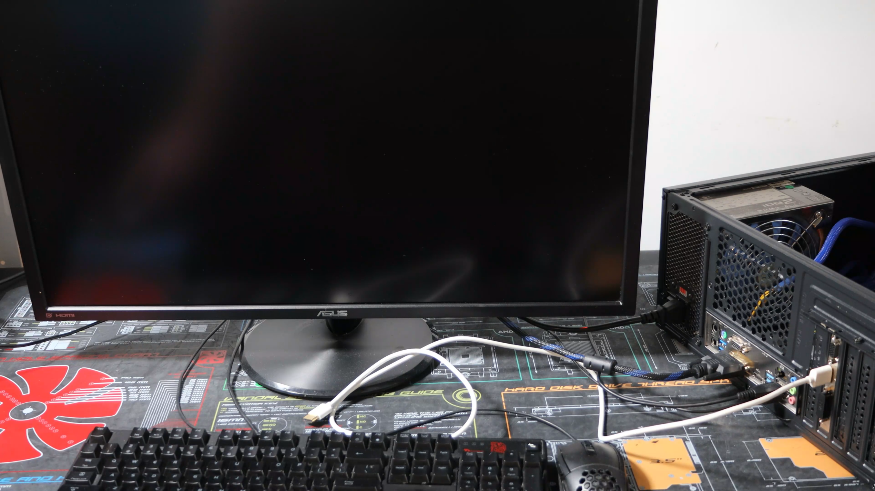
5. Verify Full System Functionality (Example)
ITFreeTraining.com
© Copyright 2025
Notes:
36:55 To verify full system functionality, I am going to need to remove the video card, since it needs to be returned, put the computer back together and test it. I have already plugged the DVI connector into the monitor. I will next unplug the video cable from the video card, switch off the power, and unplug the power.
To remove the video card, I will remove the expansion bracket holder and remove the video card. The workaround will use the on-board video graphics until the new video card arrives, hopefully tomorrow.
This computer case has disposable blanking plates. The missing blanking plate has already been thrown away. Even if I had it, I would not be able to use it since these blanking plates, once removed, cannot be put back in place.
As a preventative measure, to help prevent dust getting into the computer, I will replace the missing blanking plate with another one. Unfortunately, it is not the same color as the other ones, but dust does not know the difference!
I will next put the expansion bracket back into place. Not all computer cases use this design. Your computer case may not have one.
The blanking panel is not very secure and may come loose. For this reason, I will put in a screw to hold it in place. With the video card, this was optional since the expansion bracket holder would be enough to hold the video card in place. For testing I would just use the bracket; however, when the new video card arrives tomorrow, I would use the extra screw to hold it in place. Since it is a customer’s computer I am working on, I would always do these extra steps, even if you would not do them on your own computer. It just looks more professional.
I will now replace the back panel on the computer and put the two screws in to hold it in place. Even though I am going to install a new video card in the computer the next day, I don’t want to leave it in pieces before going. It is a work of moments to put the computer back the way it was.
The computer is now back together. The next step is to switch the computer on. You will notice the computer starts up using the on-board video card. So, I have now verified the computer is working. Normally I would also get the user to login and make sure they can access the applications they need, for example, by asking them to open their email software.
Let’s have a look at the next and last step of the model.

Slide 29


6. Document findings
Update Documentation/Ticket System
Keeps a record of what was done
Acts as reference for later
Broken
Update records
Tag broken items
ITFreeTraining.com
© Copyright 2025
Notes:
39:19 The last step in the model is document findings. Essentially, you update any required documentation and the ticket in your helpdesk system. This keeps a record of what was done. Also, any documentation you create acts as a reference for other technicians in the future.
Most businesses have a helpdesk system and a lot of the modern ones make it easy to document what you have done. Also, these systems make it easy for other technicians to find the information later on.
Part of documentation is also to tag broken items. You don’t want to be in a situation where you attempted to fix something that you have already identified as broken previously. This also helps other technicians know that there is a problem with a specific device. Nobody wants to go through the troubleshooting process to find a fault that was found previously.
This also applies to items you may be working on. If there is any chance of these items being mixed up, it is best to tag them or separate them from anything else. You don’t want to mix up a customer’s items with other items.
Let’s have a look at an example computer and see how we would do the last step.

Slide 30
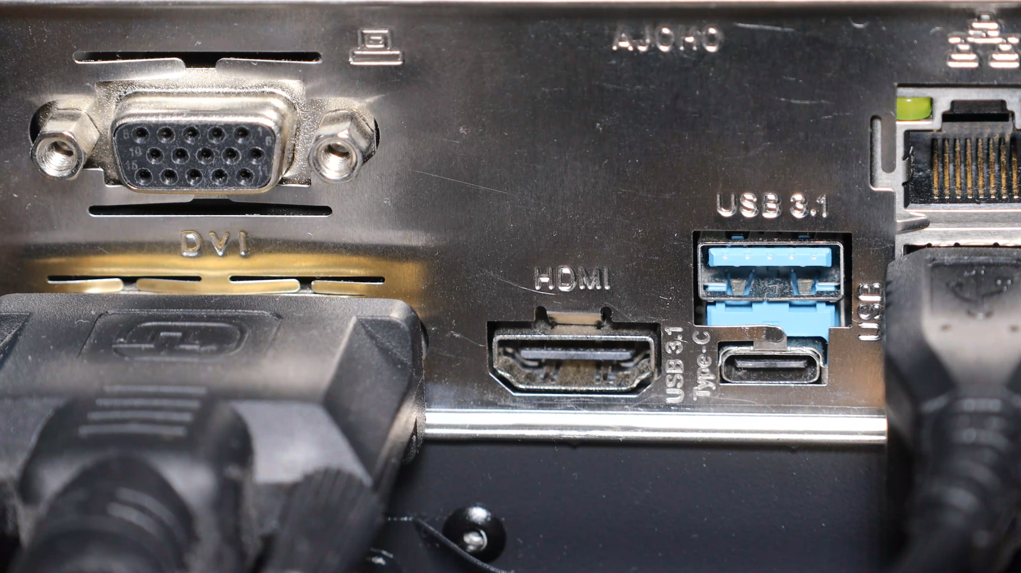
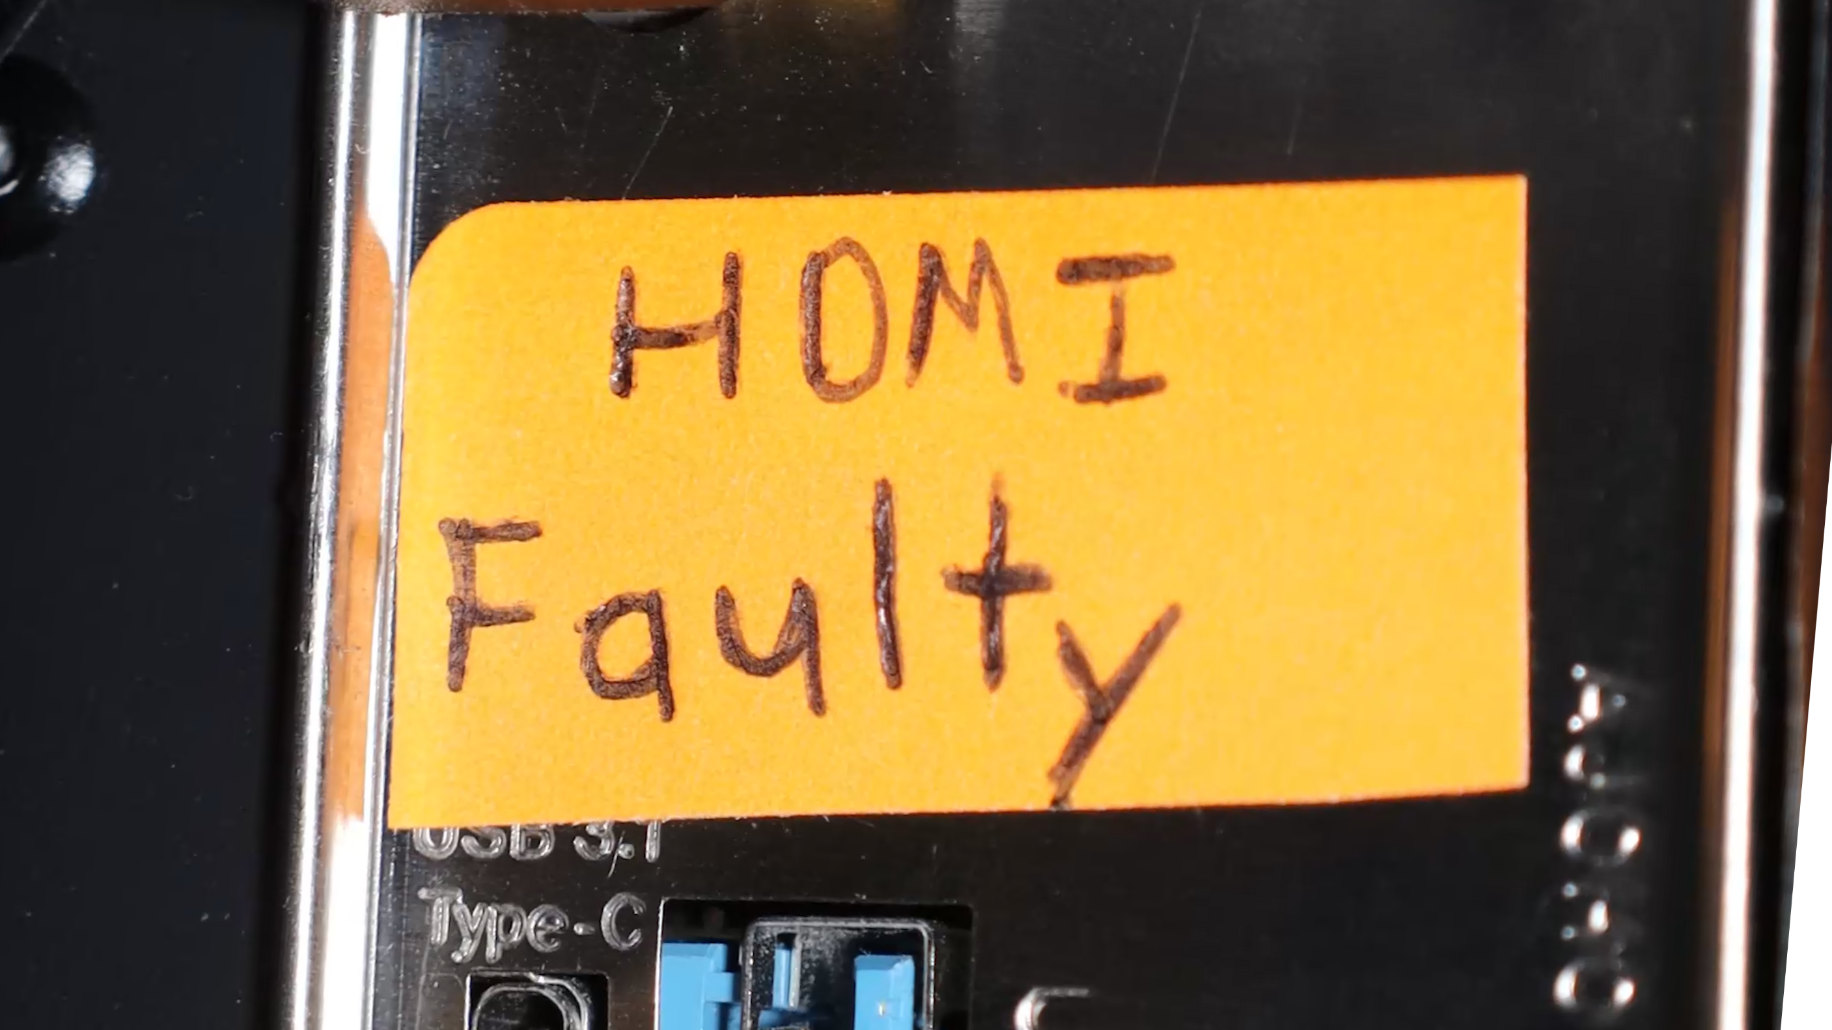
6. Document findings (Example)
ITFreeTraining.com
© Copyright 2025
Notes:
40:27 The business that you work for will have some kind of helpdesk system. At this stage, I would be updating the helpdesk system with what has occurred. I would also comment that another video card has been ordered and needs to be installed. If the job is not complete, make sure that you always add notes explaining what needs to be done. If, for whatever reason, you are not able to make it to work the next day to do the work, at least someone else will know what is happening.
In this example, I will put a sticker on the HDMI connector. This way other technicians know the connector is broken. The computer may get moved to another location. If this occurs, I may not recognize the computer and forget that the HDMI connector is faulty. The last thing I want to do is troubleshoot the same problem again.
Before finishing this video, let’s have one last look at the model.

Slide 31
CompTIA Troubleshooting Model
Make sure you know the order of the steps
Have a basic understanding of what is required for each step
Identify the problem
Test the theory
Establish a theory
Identify the problem
Document findings
Test the theory
Establish a theory
Establish an action plan
Establish an action plan
Verify full system functionality
Verify full system functionality
Be able to sort steps in order
Document findings
ITFreeTraining.com
© Copyright 2025
Notes:
41:19 For the exam, make sure you know the order of the steps. You don’t need to know the steps in any great detail, but at least have a basic understanding of what is required for each step. Usually just reading the name of the step should be enough to trigger your memory of what is involved.
Make sure you are able to sort out the steps in order. The way I like to remember the order is to first start with the problem. You can’t start any troubleshooting unless you know what you are trying to fix. If you apply logic, you should be able to get the order correct.
Next, I put document findings last. When you think about it, you can’t document anything until you are finished and know what you are documenting. Now all I need to do is work out the order for the rest.
Establishing a theory and testing the theory go together. You can’t test the theory before you work out what it is you want to test. Thus, there is only one order they can go in.
Next you need to work out if anything comes before or after the two theory steps. Based on the name only, you could make the mistake that establishing an action plan comes before the theory steps. Think about establishing an action plan as you are making changes. It is a call to action to do something. Think of the word action as, you are going to do something. It is not, prepare a plan. You can't take action until you work out what you are going to do. Thus, it always comes after testing the theory. If you get confused where to put this one, try to remember the key word action, as you are actioning something you have thought about and prepared.
Verifying full system functionality has to be after the action plan and before document findings. Think of it like this, when you verify full functionality, you need to check everything is working. You can’t document these results, in other words your findings, until you have verified full system functionality. If you have trouble remembering, think about the fact that document finding also includes putting your closure notes in the helpdesk ticket. You won’t be closing the ticket until you have verified the results. Surely you would never close the ticket before verifying what you did, worked!
You may or may not get this question in the exam, but it is easy marks if you do; so I would recommend taking the time to learn how to put the steps in the correct order.

Slide 32

Subscribe
Next video
Video content: https://ITFreeTraining.com/ap11/3a05
© Copyright 2025
Notes:
43:49 Thanks for watching this video from ITFreeTraining. Hopefully this video has helped you understand the CompTIA model for troubleshooting. Until the next video from us, I would like to thank you for watching.
References
“The Official CompTIA A+ Core Study Guide (Exam 220-1101)” pages 82 to 88
“Picture: Database” https://pixabay.com/illustrations/database-blue-sql-server-storage-2394312/
Credits
Trainer: Austin Mason http://ITFreeTraining.com
Voice Talent: HP Lewis http://hplewis.com
Additional voice Talent: Stuart Thomas Hall https://www.imdb.com/name/nm12181561/
Quality Assurance: Brett Batson http://www.pbb-proofreading.uk

