Slide 1
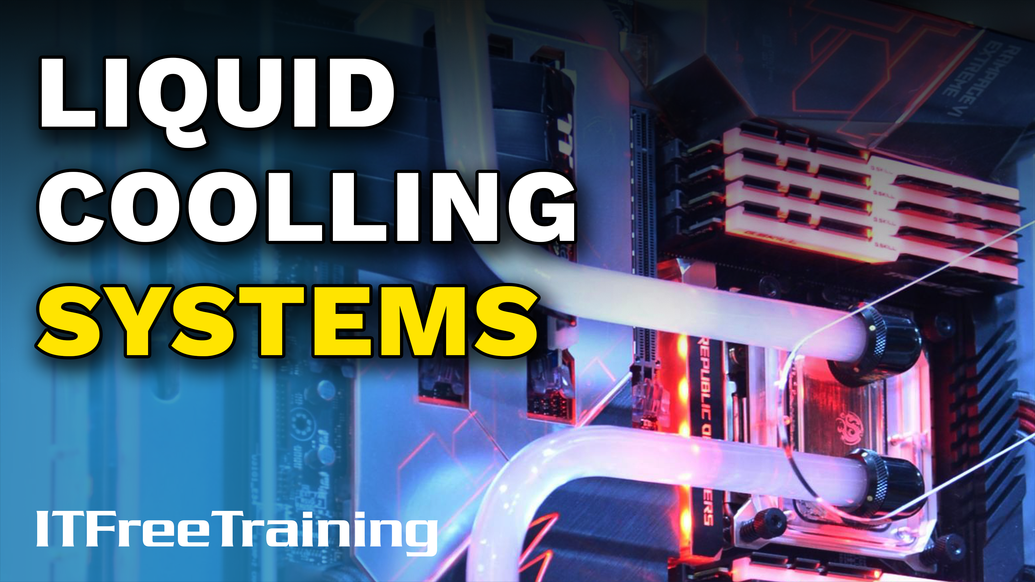
Notes:
Let’s have a look at liquid cooling systems.

Slide 2
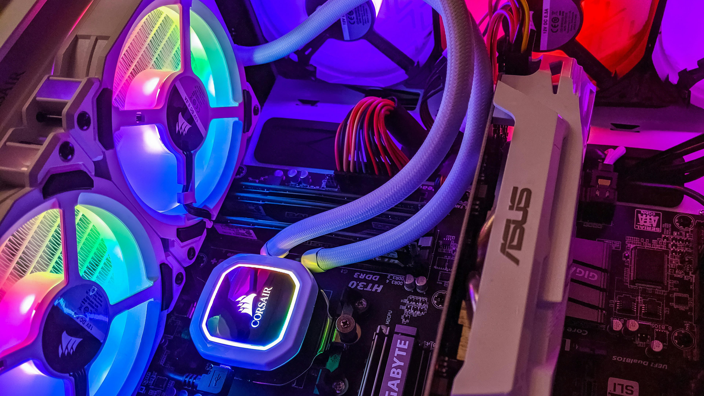
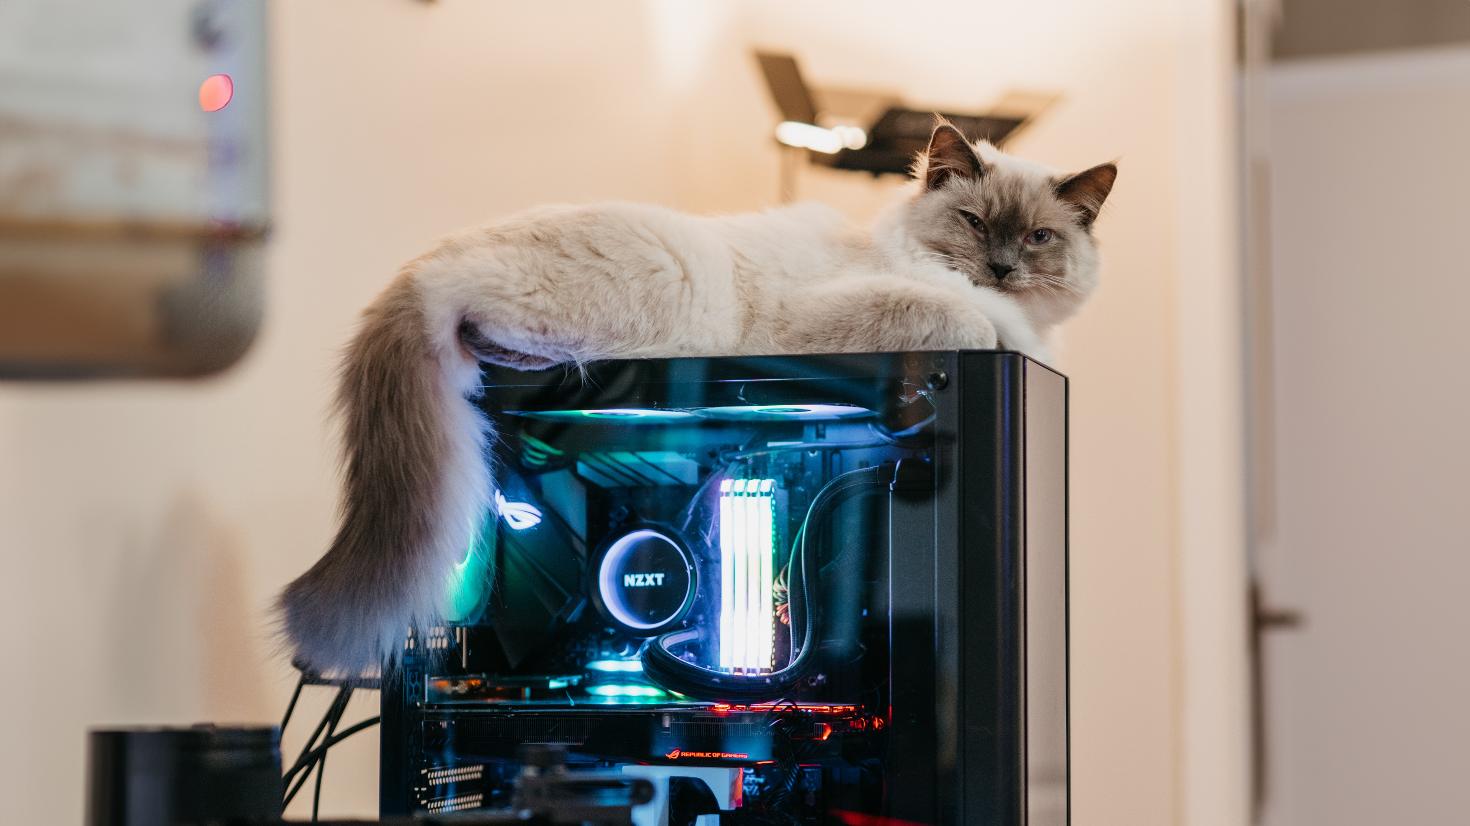
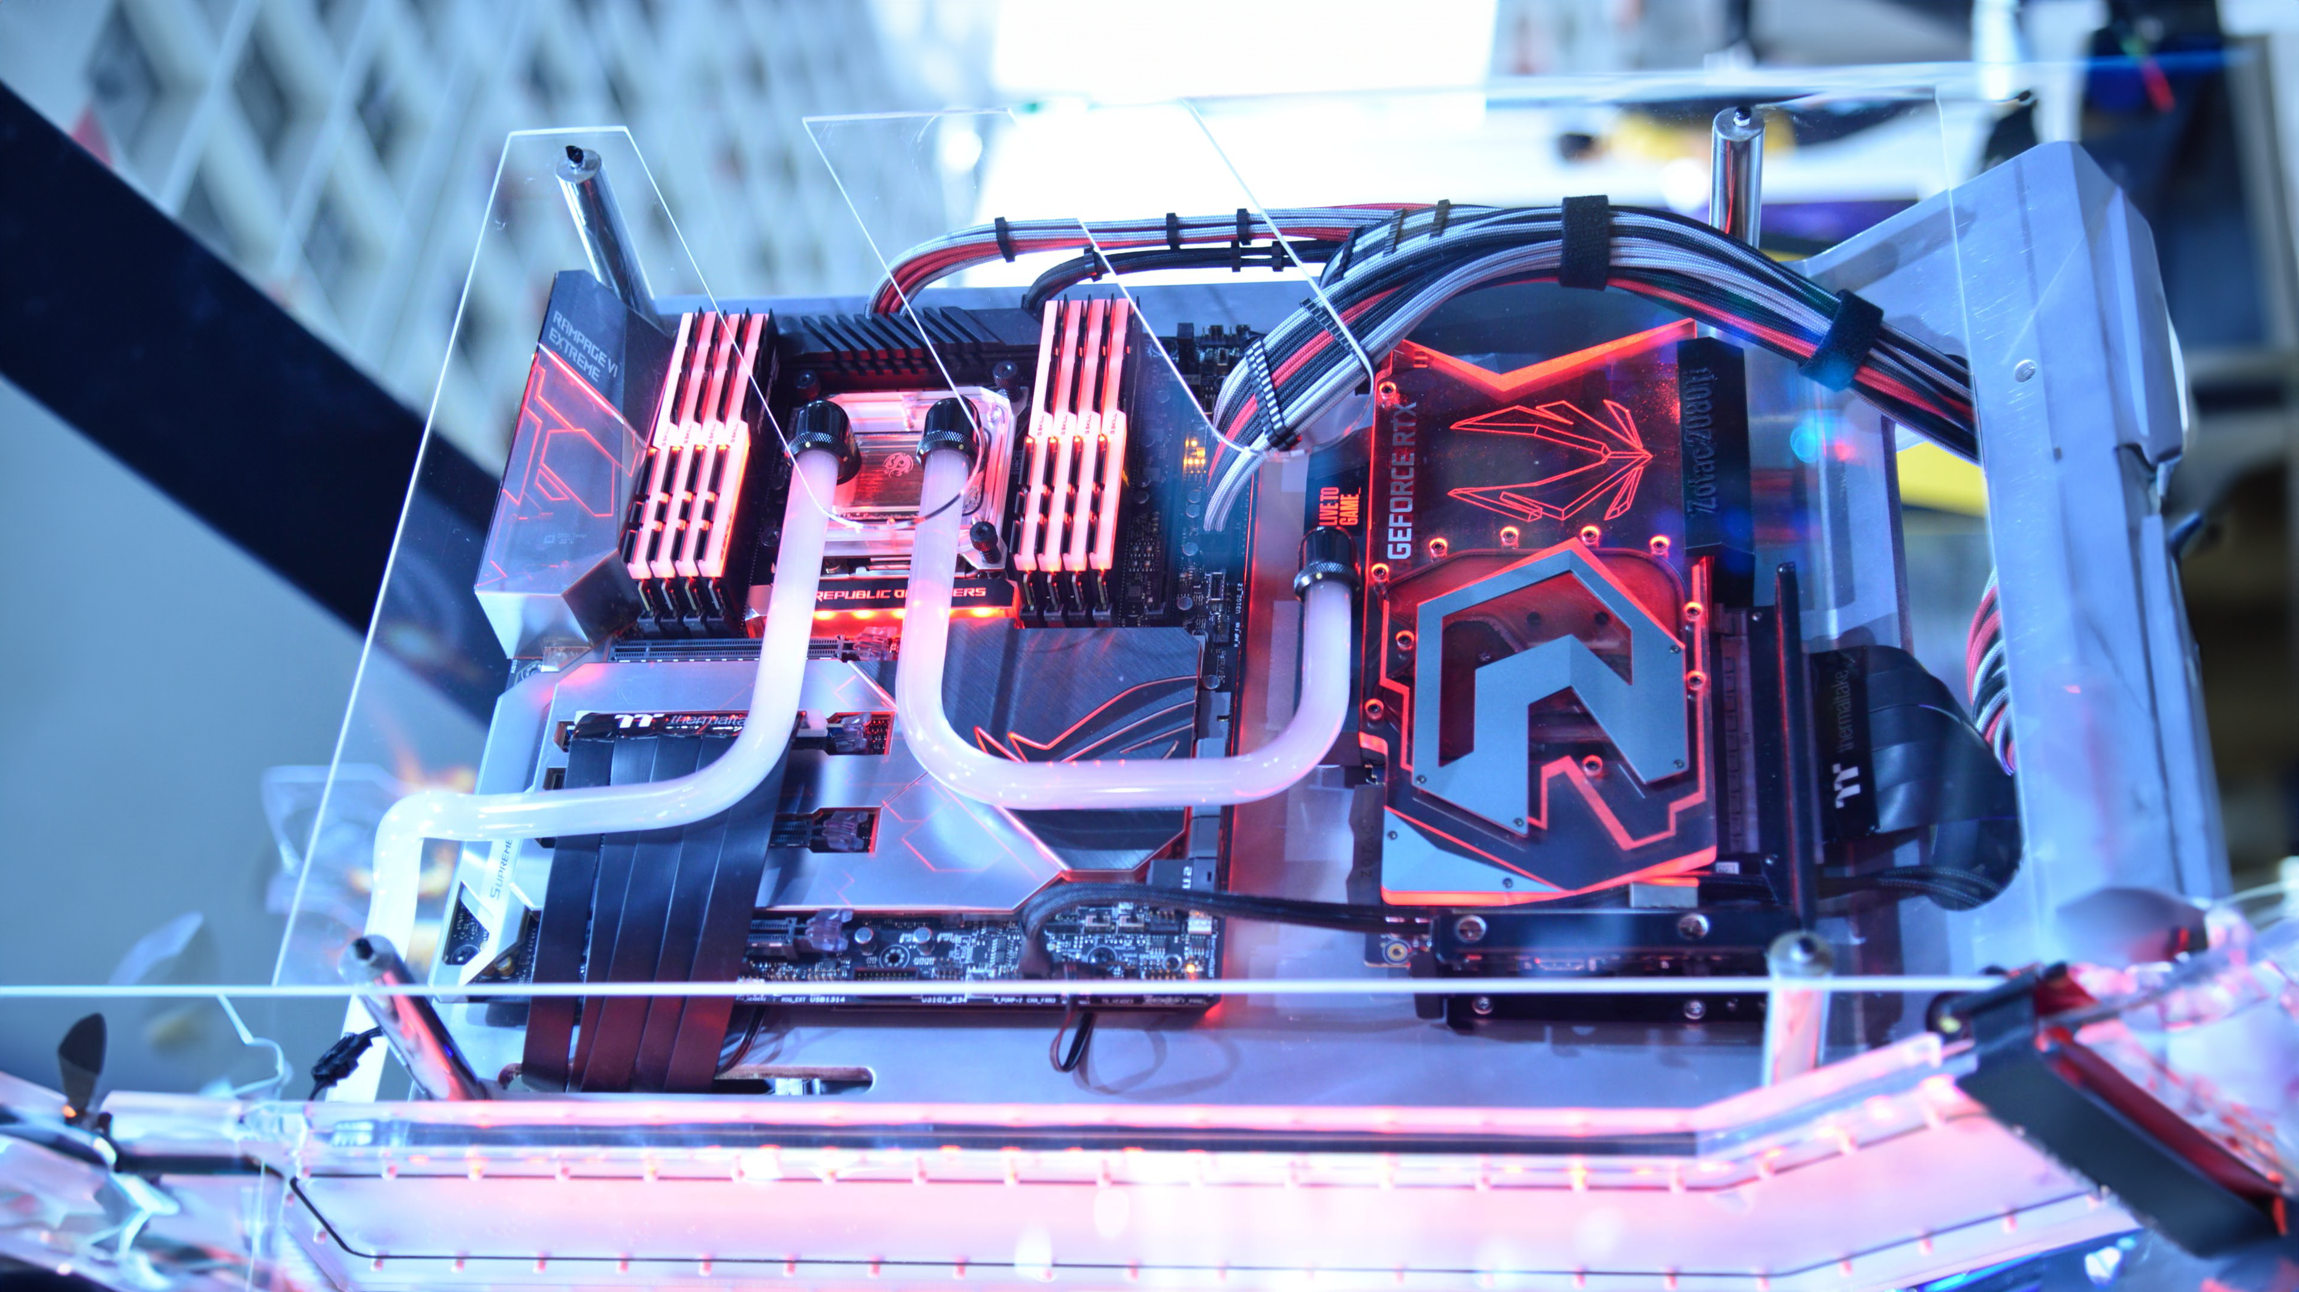
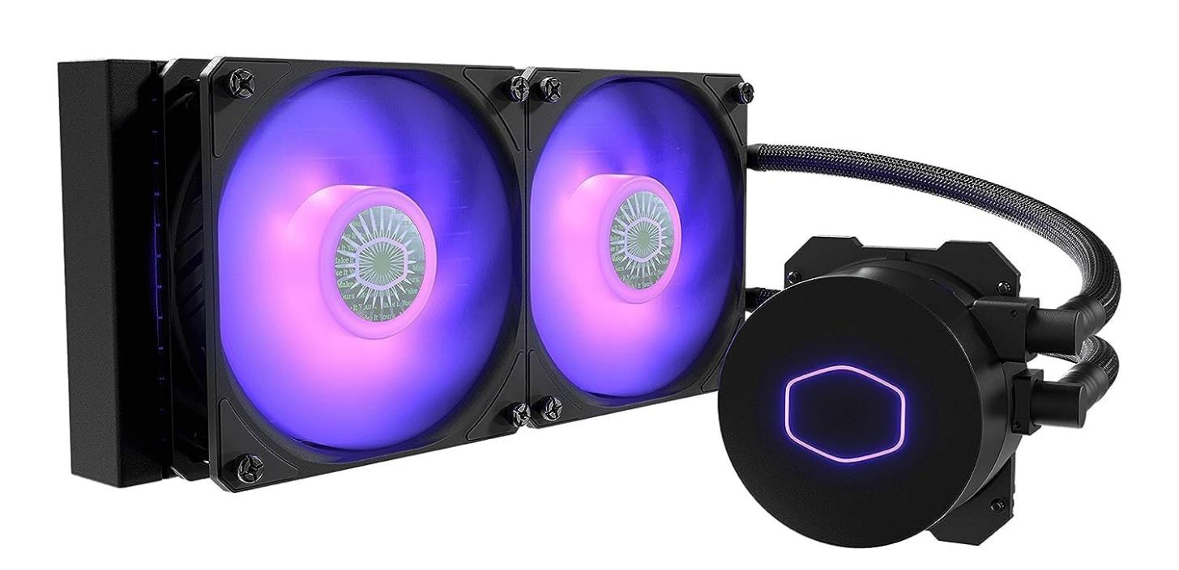
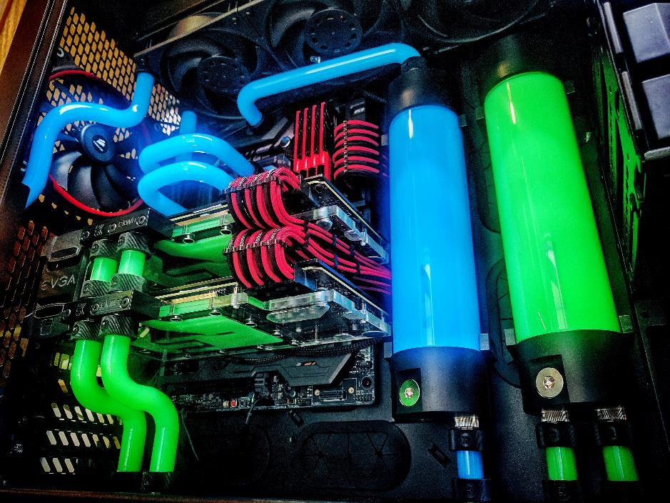
What is a Liquid Cooling System?
Uses a liquid to cool the system
Generally better than air cooling for removing heat
Open looped and closed loop
Closed loop
Open loop
Pre-assembled and sealed
Customizable and not sealed
All-In-One (AIO)
ITFreeTraining.com
© Copyright 2024
Notes:
00:04 So, what exactly is a liquid cooling system? These are cooling systems that use a liquid, typically water, to cool the CPU and can also be used to cool other components like GPUs. Generally speaking, they are better than air cooling for removing heat. However, like most things in computing, you get what you pay for. They come in open and closed versions.
A closed-loop system, often referred to as an All-In-One or AIO, comes pre-assembled and fully sealed, ensuring the coolant remains contained within the unit. This design simplifies installation and reduces maintenance needs, offering a straightforward, reliable cooling solution. While AIO coolers lack options for customization and upgrades, they strike an excellent balance between cost, convenience and performance, making them an appealing choice for users seeking efficiency without the complexity of custom setups.
An open loop system is customizable and is not sealed. This means you can add additional components like extra water reservoirs. However, you will need to add water to them, and they require additional maintenance. For open loop systems, there is potential for higher performance and aesthetics, but as it is not pre-sealed there is also a higher risk of leaks.

Slide 3
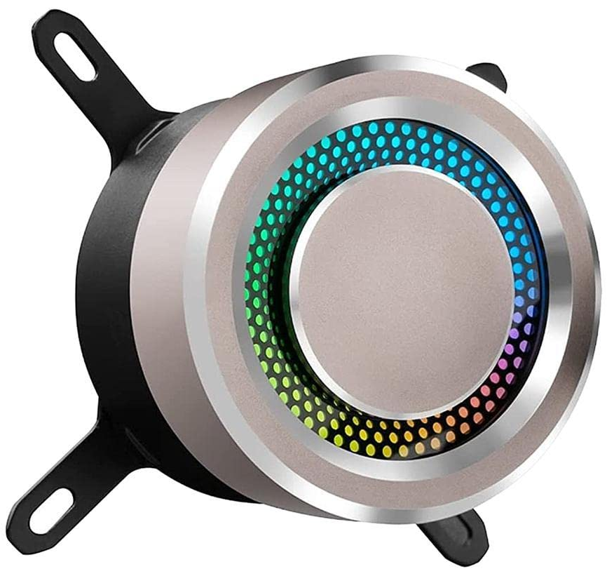
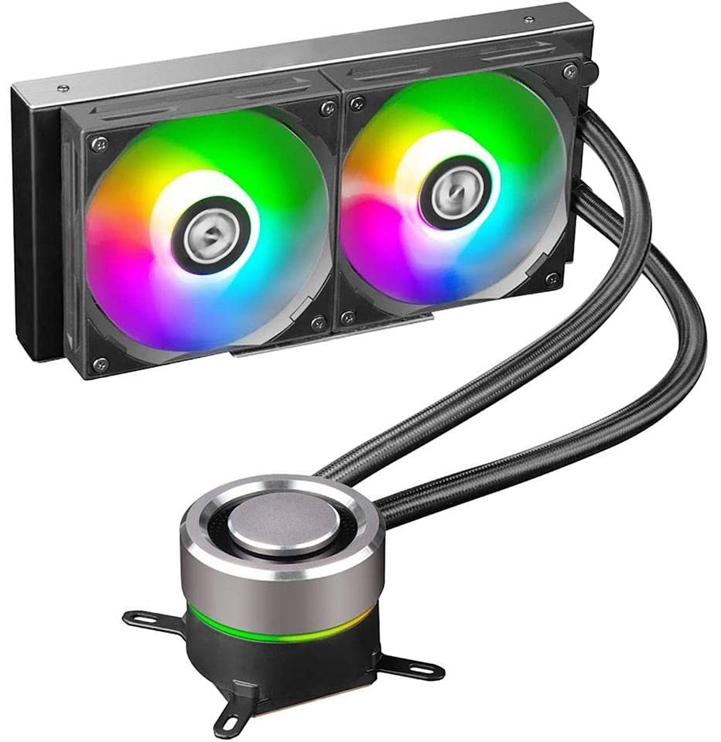
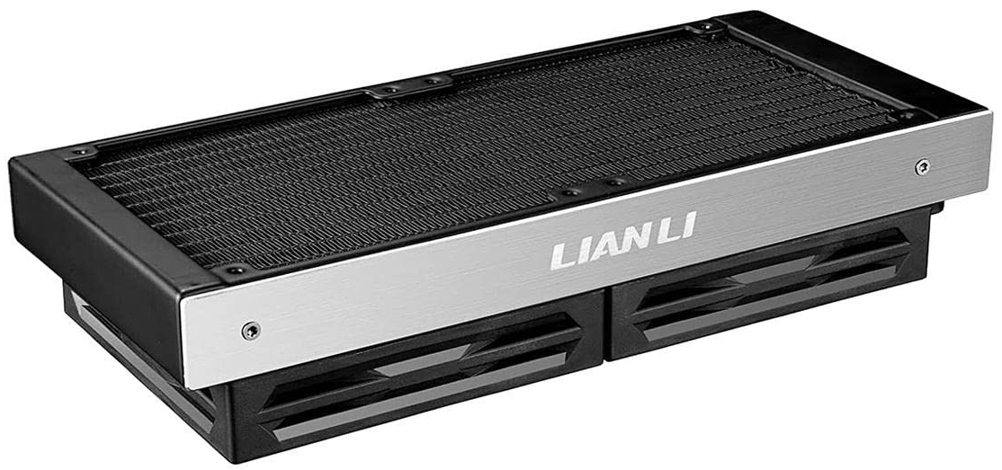
Components of Liquid Cooling
Block
Radiator
Metal block attaches to CPU/GPU
Transfers heat to the air
ITFreeTraining.com
© Copyright 2024
Notes:
01:29 The two main components of liquid cooling systems are the block and the radiator. The block is generally attached to the CPU, but it can also be attached to other components like a GPU. The heat is transferred using the water to the radiator. In an AIO system, the pump is generally always in the block. In other systems it may be elsewhere. The pump is an important component of the system. If the pump were to fail, the water would stop circulating and heat would not be transferred away from the CPU.
The heat is then transferred to the air using the radiator.
For the A+ exam, that is really all you need to know about water coolers. For the rest of this video, I will go through how water coolers work to give you a better understanding if you should wish to purchase one or not. After that, I will demonstrate how to install one. So, if you are just studying for the exam, feel free to end it here and I will see you in the next video.

Slide 4
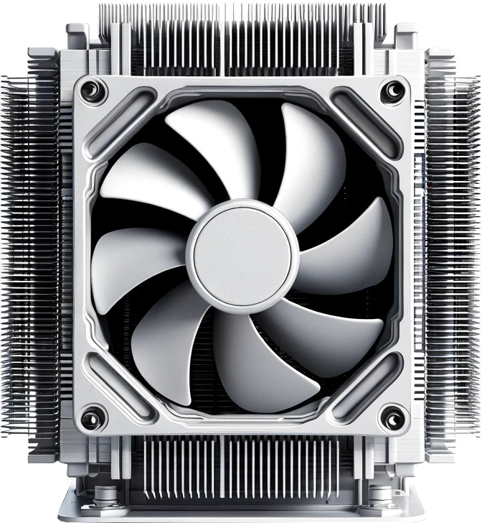
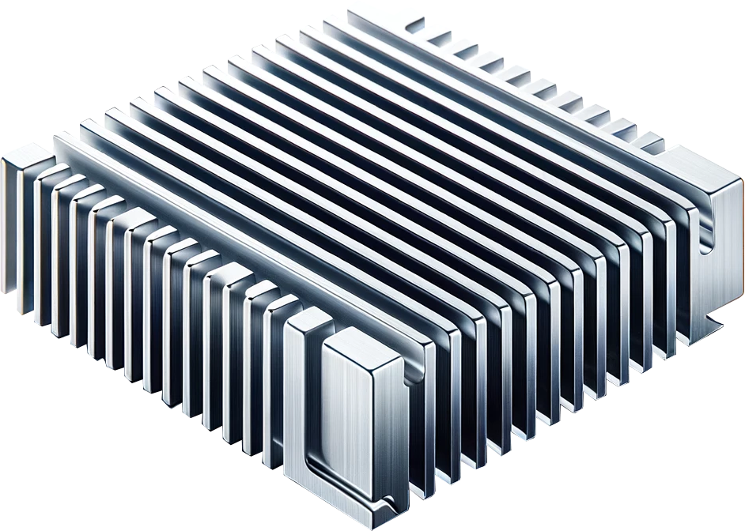
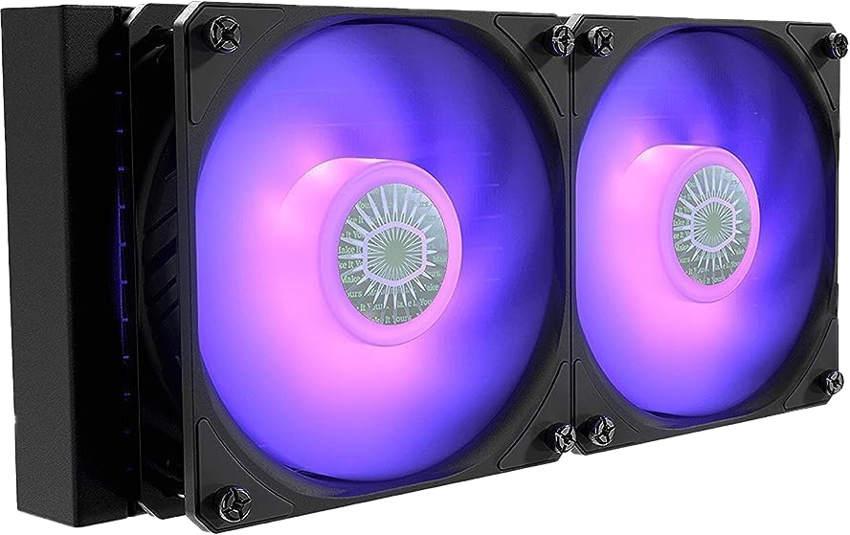
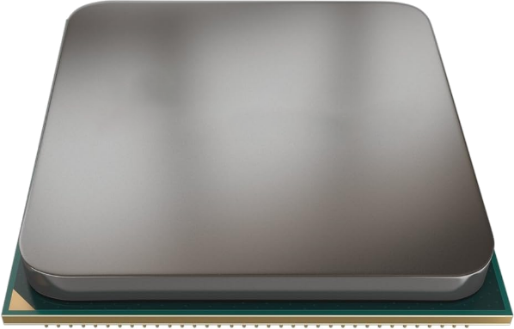
How do Coolers Work?
Water absorbs heat and transfers it better
Generally, keeps the CPU a couple of degrees cooler under heavy load
However, a good CPU cooler will outperform a low-quality water cooler
Transfers heat to air
Transfers heat to air
Heat
ITFreeTraining.com
© Copyright 2024
Notes:
02:26 To understand how a water cooler works, let’s consider that we have a CPU that starts warming up and giving off heat. Modern CPUs generate substantial heat and require effective cooling solutions. To address this, a metal heat sink is placed on top of the CPU to dissipate heat efficiently.
As the heat sink absorbs heat, it becomes crucial to channel this heat away from the CPU. In a typical CPU cooling setup, heat is effectively redirected through heat pipes or a larger heat sink, distancing it from the processor. This heat is then dispersed into the surrounding air, commonly with the assistance of fans, ensuring optimal cooling efficiency.
Now, let’s consider what happens with a water cooler. This time the heat is transferred using water. As before, the heat is transferred to the air. So, what is the difference between the two?
The difference is that water absorbs heat and transfers it better. So, this allows heat to be pulled away from the CPU more efficiently and effectively. Thus, generally speaking, a water cooler can keep a CPU a couple of degrees cooler under heavy loads. However, a good CPU cooler will outperform a low-quality water cooler.
Given that both cooling solutions rely on dissipating heat into the air, it is important to note that operating the computer in a warm environment will reduce cooling efficiency. Without access to cooler air to facilitate heat transfer, the CPU will run hotter potentially reducing its effectiveness.

Slide 5
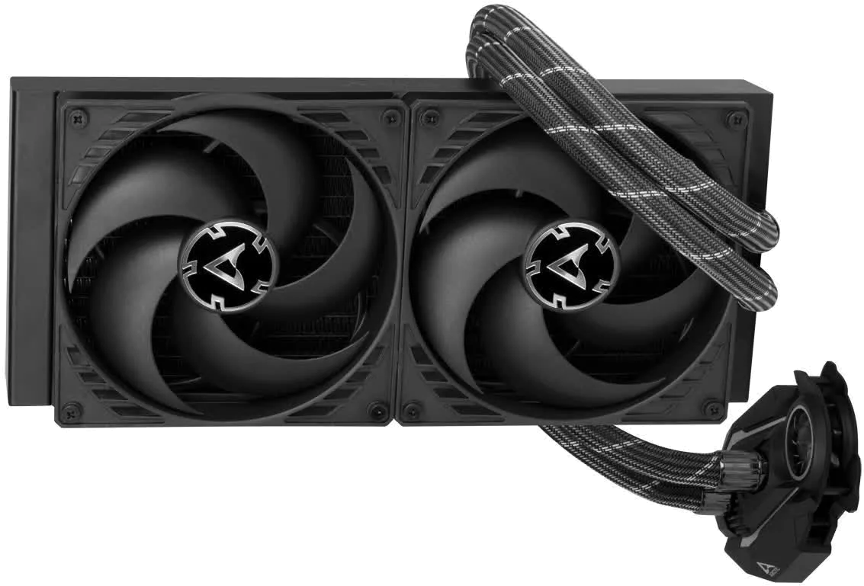
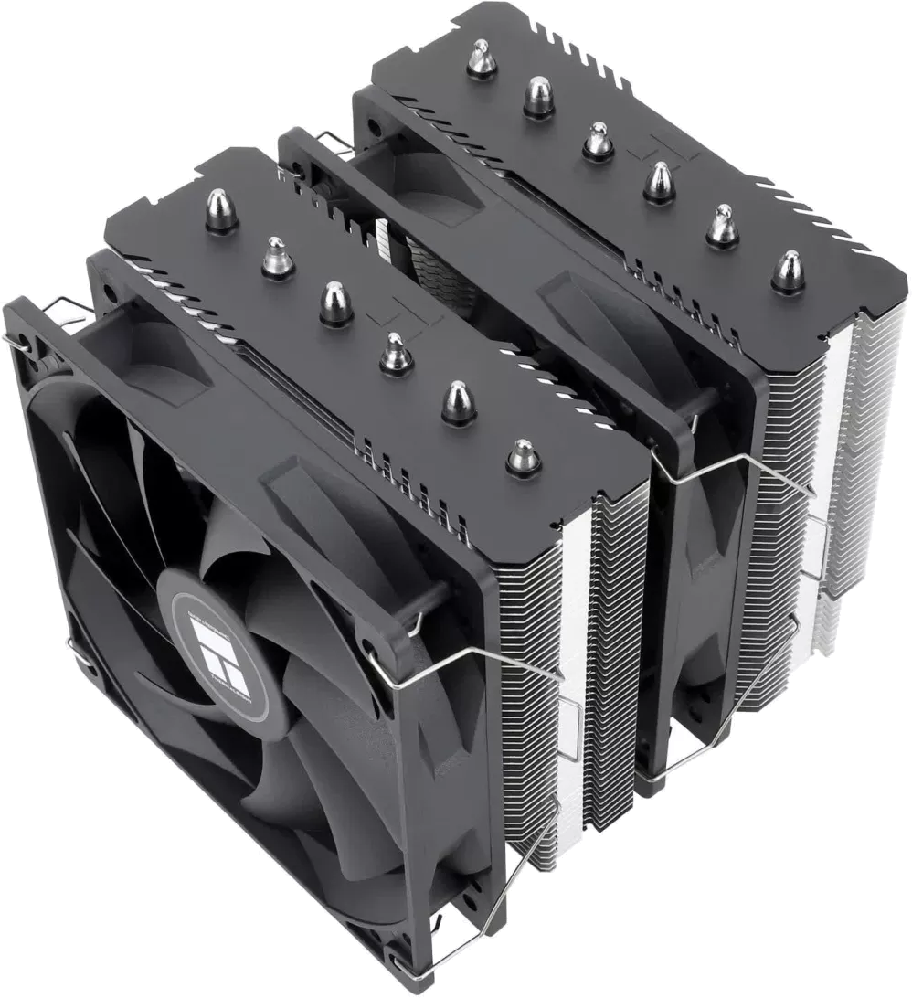
In The Real World
Do some research first
Water coolers have a risk of leaks
Is it worth it for a few degrees less? (Maybe)
ITFreeTraining.com
© Copyright 2024
Notes:
03:53 In the real world, there are some very good CPU coolers on the market. Before purchasing a water cooler, I would do some research first. See what results other people are getting. You don’t want to spend the extra money for a water cooler to find out later that a cheaper good CPU cooler outperforms it.
Installing water coolers can be more complex compared to standard CPU coolers, as there is also a potential risk of leaks. While they might offer an improvement in cooling your CPU, it is worth considering whether the improvement justifies the effort. This is especially true given that a high-quality air cooler can outperform a low-end water cooler.
I will leave it up to you to decide, but let’s face it, the biggest reason that people get CPU water coolers is that they just look good. I will now have a look at how to install one.

Slide 6
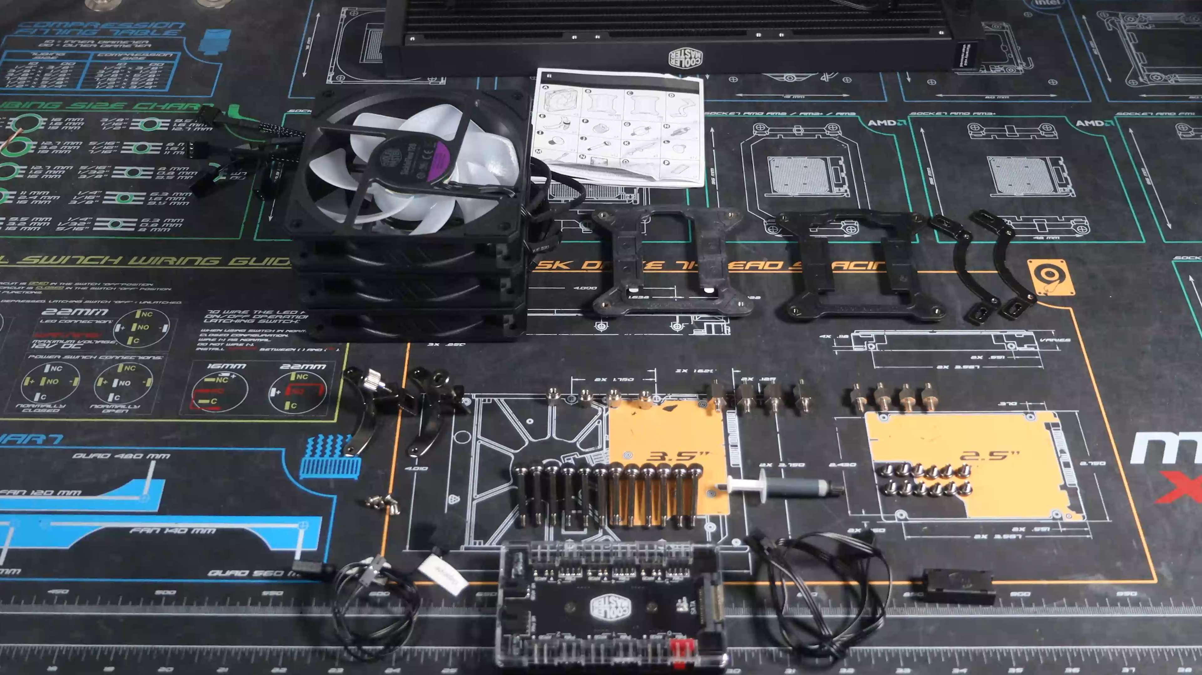
Demonstration
ITFreeTraining.com
© Copyright 2024
Notes:
04:45 Generally, the water coolers on the market will be designed to work for many different CPUs. For this reason, there will be a lot of parts included with the water cooler. Not all of them will be required to be used. Before purchasing the water cooler, make sure that it supports your CPU. You also need to check your computer case supports the water cooler.
The assembly instructions for this water cooler lists the various components included with the unit. If you have ever assembled Ikea furniture, it is the same kind of diagram. Each part is clearly numbered and assigned a letter for easy identification.
In this case, the parts were not labeled. So, I laid them out to match the diagram. Although a picture is provided, if you have parts that look similar, count the number of parts and match it with the number in the diagram.
In this example, the motherboard has an AMD CPU using an AM4 socket. For this particular water cooler, the CPU cooler mounting brackets that come pre-attached to the motherboard can be used.
Most water coolers will come with multiple brackets and backing plates. You will need to have a look at the instructions to determine which ones that you need for your CPU. The water cooler supports a lot of CPUs, so it can be sold to more consumers. Have a look at the instructions to determine what components are required. Ideally, attaching the necessary brackets to the block should be done early on. Reflecting on my experience, I recommend attaching these brackets to the block prior to installing the radiator, a step I later realized would have been more practical to have completed at an earlier stage.
Before installing the water cooler, I will first place it in the computer case. You will notice that if I put it in this way, the hoses from the radiator will hit the case fan. Thus, I will need to put it in the other way.
I will rotate the water cooler and put it in the other way. Given its considerable size, a large computer case is necessary. It is important to note that not all cases are compatible with water coolers, especially those of larger dimensions. Therefore, ensure your computer case can accommodate the water cooler you intend to purchase.
You will notice that the radiator is a snug fit inside the computer case. It is important to make sure it is in the correct spot, so I would line it up with the screw holes in the computer case. I would next take note of where you are going to run the cables for the fans. In this example, I am going to have the cables from the radiator go directly to the back of the computer. So, I need to mount the fans with that in mind.
I will now remove the radiator and get my fans ready to mount to the radiator. When you mount the fans make sure they are facing the correct way. The fans need to be blowing air through the radiator and out of the computer.
I will place the first fan on the radiator. The cable is running downwards which is what I want. However, I am going to rotate the fan 90 degrees. The reason for this is that I want to reduce the distance the cables run and make it look a little tidier. For your setup, you may want to do it a different way.
I will now screw the fans into the radiator. For this you want to use the longer screws. When I put the screws in, I will put the cables behind the screw to help hold them in place. I will now proceed to inserting the remaining screws and securely fastening them into their respective positions.
I will next place the last two fans on the radiator making sure they are rotated correctly to minimize my cabling and making sure the fans are pointing the correct way.
I will next put all the screws in the required positions and tighten them to fasten the fans onto the radiator. I will next place the radiator into the computer case, however, there is a problem. The screws for the fans are hitting the rear case fan preventing the radiator from going in.
I will remove the radiator and remove the rear case fan. Despite my planning, computers love to throw curveballs at you. There was this one time I turned into a tech barbarian and went at a computer with a hacksaw just to accommodate a Godzilla-sized video card. I would recommend just buying a larger computer case, but sometimes you have to improvise to get the job done!
I will now place the radiator back into the computer case. Next, I will start putting the screws in to hold the radiator in place. For this step, if you find it easier, put the computer on its side. I will start by putting opposite corner screws in to hold it, and then put the other two corner screws in.
I will now put the rest of the screws into place. There are a few of them and the radiator plus fan has a bit of weight behind it, so I would put in all the screws if you have them.
I will next pull all the cables through to the back of the case. Since the fans support ARGB, there will be a power and ARGB cable, so make sure both are pulled through. In total, there are six cables, three power cables and three for the LED lights.
This water cooler comes with an ARGB and PWM hub. This allows all the cabling to be plugged into the hub making it easier to manage. If your water cooler does not come with one of these, you can always purchase one. They may be listed under different names, for example, controller or splitter.
There are two cables that go from the hub to the motherboard. The first cable is the power cable. It is just a simple matter of plugging this cable into the hub. It is easier to plug it in now rather than when it is in the computer case.
The next cable is the ARGB cable. This will control the LEDs on the fans. This plugs in next to the power cable. Once both cables are in place, the next step is to put the cooler in the computer case.
This hub features a magnet on the back, allowing me to easily attach it to the computer case. Once I determine its final placement, I would use some cable ties to secure it firmly in position, ensuring it remains stationary. Without this extra step, there's a risk it could become detached.
I will now plug in one of the fans. The connectors are keyed; however, it is noteworthy that the power cable can mistakenly be put into the ARGB connector. I will adjust them, so they are in their correct positions. Make sure you don’t plug the cable in incorrectly, as this could cause damage.
I will now plug in the last fan. In this case, I have used the connectors that are the most convenient given where the cable is. You will notice that the ports are numbered. When using software to manage the fan lights, it's beneficial to connect them sequentially and it is preferable to start from port one. This makes it simpler to identify each fan within the controller software. If the software runs color patterns and the fans are not connected in sequence, the lighting effects may not display as intended, disrupting the visual harmony. Do not use port zero, as this one is for the CPU block.
I will next plug in a SATA cable at the bottom of the hub. This gives the hub extra power to help power everything. If you have a lot of LED lights, it is recommended to have a hub or similar device to provide extra power.
I will next plug the pump power connector and the ARGB connector. If you have trouble finding where to plug them in, have a look in the manual and it should have a diagram of where they go. In the case of this motherboard, the pump header and the ARGB header are in the top right-hand corner.
On this motherboard, there is also an ARGB header in the bottom-right corner. You will find that some motherboards will have two ARGB headers, however, they usually only have one pump header.
On your motherboard, the connector for the pump might be labeled "AIO," which stands for "All-In-One." An AIO unit encompasses all the necessary components within a single, self-contained system. Essentially, an AIO operates autonomously, drawing a fixed amount of power and regulating itself without external intervention. While AIOs are commonly associated with water cooling, the term can technically apply to other types of cooling systems as well. However, non-water cooler AIO solutions are relatively uncommon.
It is recommended to always use the pump or AIO header since it is designed for optimized Power Delivery. If you do not have one of these headers, if your motherboard supports it, a standard fan header may be able to be used.
If you need to use a standard fan header because your motherboard does not have an AIO header, check your motherboard manual to see if it is supported.
To plug the cables into the motherboard, I have turned the computer on its side so it is easy to work on. I will start by plugging in the ARGB cable. You will notice that there are two plugs, a standard plug and a Gigabyte plug. The Gigabyte plug in this case is a 3-pin plug and functionally the same as the ARGB plug, it is just a different plug. There are also newer Gigabyte generations that have more pins, thus use different plugs, which add additional voltages. You can purchase adapters if you need to, but even if you have a Gigabyte motherboard that uses this header, it may also have a standard ARGB header as well.
This motherboard has an ARGB header, so I will plug the cable into that header. Once this is done, the next step is to plug the power cable in. Make sure this is plugged into the header that is for the water pump.
I will next need to attach the two mounting brackets to the block of the water cooler. To do this, I have turned the computer case to make it easier. To attach, there are two screws on either side of the block that need to be screwed into the mounting brackets. In hindsight, it would have been easier to attach these before I put the radiator into the computer case, but if you do need to do this later on, turning the computer case makes it easier.
I will now remove the protective cover from the bottom of the block. Make sure you do this, as leaving the protecting cover on cripples heat transfer, which may cause your CPU to overheat and could void any warranties.
I will put the block down so the bottom is not touching the table. Once you remove it, do your best to stop dirt or dust getting on it as this can affect how well it works. I would recommend not removing the protective cover until you are ready to put the block on the CPU.
This water cooler does not have thermal paste pre-applied, so I will need to apply thermal paste to the CPU. To do this, we recommend the pea method; this is where you put about a pea sized amount of thermal paste on the CPU. If you apply too much, it will spill off the side, while if you put too little, the transfer of heat between the CPU and the block won’t be as good. For some CPUs, usually the larger ones, the manufacturer may recommend different thermal paste application methods, for example, using the cross method.
I will next place the block on the CPU. The mounting bracket needs to clip under the CPU bracket and then screwed into place. You don’t want to screw it all the way in yet, as if you screw it in too far, you won’t be able to get the other side to clip into place.
I next want to screw in the other side. I will first make sure the first side is screwed in a bit, but not all the way in – usually around the halfway mark – if it is too tight, you won’t be able to clip the other side into place, so loosen it and try again. I will clip the other side under the CPU bracket and screw it in place. Again, you don’t want to screw it in all the way, but you can go past the halfway mark.
You next want to tighten both sides up, trying to distribute the pressure evenly across the block, as this helps keep the block straight. If the block is misaligned, it won’t be as effective. For this water cooler, you want to tighten the screws until they are just finger tight.
The next step is to connect the power and ARGB connectors from the block. To do this, I will thread them through the computer case, so I can connect them to the hub.
I will now plug in the power and ARGB plugs. For this water cooler, the block needs to be plugged into port zero. Your water cooler may be different. The water cooler has now been installed, but I am going to make one change to prove a point.
I am going to unplug the ARGB cable and put it back through the computer case. I will plug this into the other ARGB header. Essentially, ARGB sends control signals through all the ARGB headers on the motherboard, so it does not matter which one you use. However, if you have a lot of ARGB devices, it is recommended to spread the power out using different headers or powered ARGB hubs like the one I am using.
The last step is to switch the computer on. You will notice the fans spin up, however, the lights on the fans do not. This motherboard has a switch on the motherboard that controls whether the LEDs are lit up. When doing maintenance on the computer, it is good to switch this off, so that it is easier to see what is going on inside the computer.
In the case of this motherboard, I call this an undocumented feature because it does not appear in the motherboard manual. If your LED lights are not working, have a look around for a switch like this and also check the computer setup to make sure it is enabled.
Once I turn the switch on, the LED lights will come on. Our water pump is now installed and working. Since it is an AIO unit, once installed, you don’t need to do anything else.

Slide 7
Subscribe
Next video
Video content: https://ITFreeTraining.com/ap11/2d20
© Copyright 2024
Notes:
17:38 So, what did the CPU say to the water pump after a long gaming session? Water cooler, you are the most valuable component, you kept me chilled when things got heated! Check out our other videos on A+ content and thank you for watching.
References
“The Official CompTIA A+ Core Study Guide (Exam 220-1101)” pages 49 to 50
“Picture: Water cooled CPU” https://unsplash.com/photos/black-and-blue-computer-tower-EOAKUQcsFIU
“Picture: Water cooler with cat on it” https://unsplash.com/photos/white-and-gray-cat-on-black-and-silver-stereo-component-zGiST_eUAXo
“Picture: Custom Water Cool system” https://commons.wikimedia.org/wiki/File:Refrigeraci%C3%B3n_l%C3%ADquida_en_un_computador.jpg
“Picture: Water cooler” https://www.pexels.com/photo/black-and-red-computer-motherboard-2399840/
“Picture: Water cooler” https://unsplash.com/photos/a-close-up-of-a-computer-motherboard-in-a-dark-room-Q-xGz9NOVOE
Credits
Trainer: Austin Mason http://ITFreeTraining.com
Voice Talent: AR Hellenberg https://humanaudioventures.my.canva.site/
Quality Assurance: Brett Batson http://www.pbb-proofreading.uk

