Slide 1
Notes:
Let’s have a look at optical drives.

Slide 2
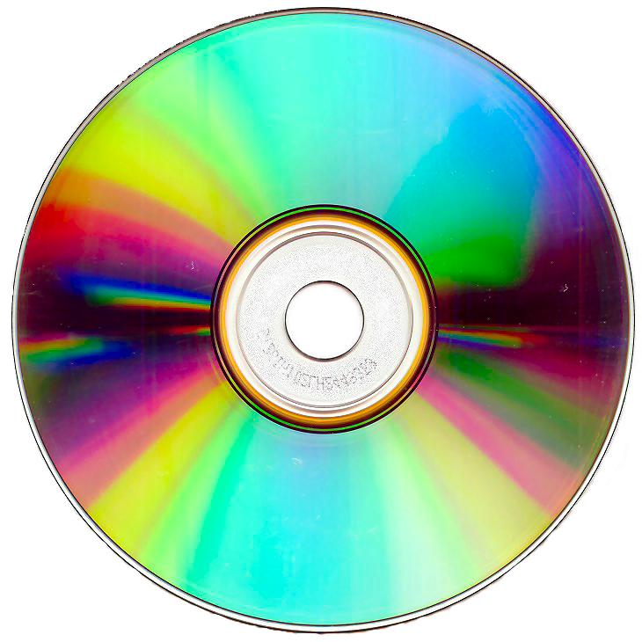
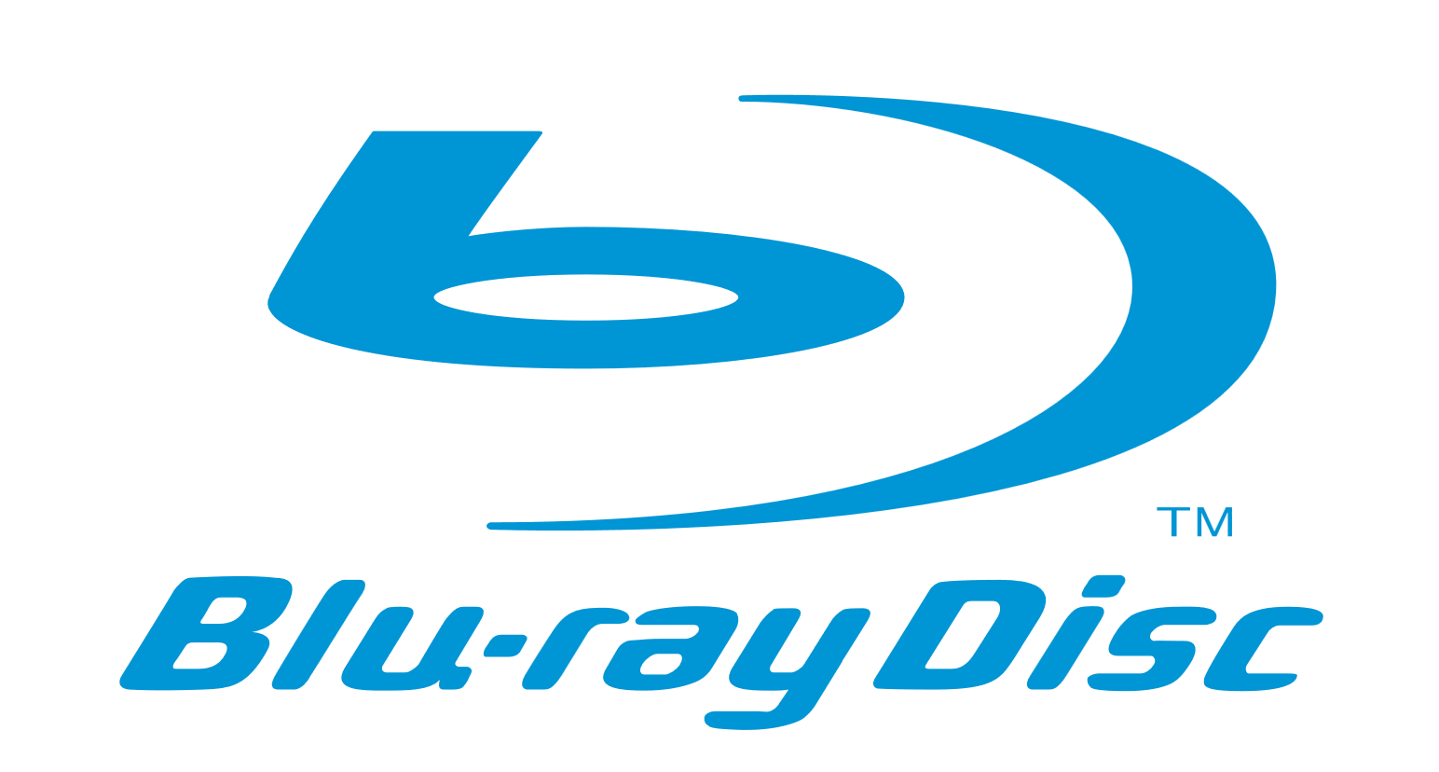
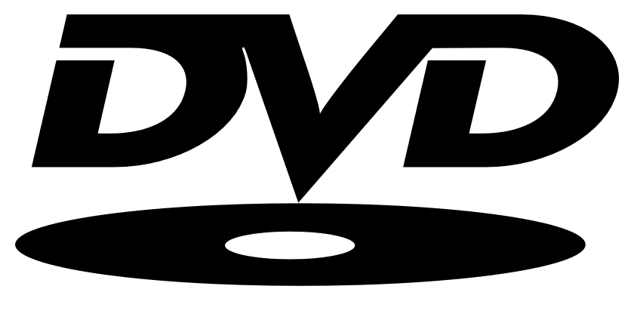
Optical Drives
Became popular in the 80’s
Now a legacy technology
Main ones used today
ITFreeTraining.com
© Copyright 2024
Notes:
00:02 Optical drives use a flat circular disk to encode data. They became popular in the 80’s due to being able to store a lot of data for a relatively cheap price compared with other technologies. Nowadays, it has become a legacy technology with the increased use of network storage and flash media becoming more affordable and easier to use.
There have been many different optical disks over the years, but there are only three that you see commonly used nowadays. The main difference between the different disks is the amount of data that each can hold.
It is unlikely that you will encounter any questions regarding optical media on the A+ Exam, and if you do, they are unlikely to be especially challenging. CompTIA tend to favor newer technology in the exam questions. For the exam, just have a general idea of how optical media works. Even though it is now a legacy technology, in business it is still sometimes used, thus the IT technician needs to have an understanding of how to use it.
To get a better understanding of optical drives, let’s have a look at the media types.

Slide 3
Optical Media Types
R (Read) RW/RE (Rewriteable) DL (Dual Layer)
-R and +R have different writing methods (All modern optical drives support both)
0.65 – 0.90 GB
4.7 GB single layer
25 GB per layer
CD Manufacture
DVD Manufacture
DB Manufacture
CD-R
DVD+R/-R
DB-R
CD-RW
DVD+RW/-RW
DB-RE
DL Doubles storage
DL Doubles storage
ITFreeTraining.com
© Copyright 2024
Notes:
01:11 There are a few different media types available. The main thing to look out for is the abbreviations. R means read only. That is, you can write to the disk once and once only. RW or RE means the disk can be written to many times. That is, you can write data onto the disk and overwrite it later. DL stands for dual layer which is a technology that allows two layers of data to be stored on the optical disk. The way this works is, the laser re-focuses to access the top or the bottom layer, however, only one layer can be accessed at once. The advantage of dual layer is that you double the amount of data stored on the optical disk.
Compact disc allows you to store 650 Megabytes to 900 Megabytes of data. The highest range is called overburn as it burns data outside of the official standard. In the old days this could cause compatibility problems between different optical drives, but is not such a problem nowadays. I will go through the specs so you get an idea what each can achieve, but don’t worry about memorizing them. Later in the video I will go through what you need to know in the real world.
If the CD is manufactured in a factory, it will just be called CD. The write once type will end in R and the rewritable will end in RW.
For DVDs, they will store in a single layer 4.7 Gigabytes. As before, a DVD manufactured in the factory will just be DVD. DVD differs from the others in that there is a -R format and at +R format. -R and +R use different methods to write data to the optical disk. Your media will be labeled as minus or plus. In the old days, optical drives would only read one or the other. As time passed, they supported both. It is nothing to worry about, because that was a long time ago and any modern optical drive will support both.
As before, DVD supports rewriteable disks both in the minus and plus formats. DVD adds DL for dual layer which effectively doubles the amount of storage.
Blu-ray is much the same. Blu-ray supports 25 Gigabytes per layer. For the manufactured optical disks it uses DB. For the write once disks it uses -R and rewriteable uses RE rather than RW. Blu-ray supports dual layer and as before uses DL for this kind of media.
I would not worry too much about remembering all this information. Let’s have a look at what you would do in the real world.

Slide 4
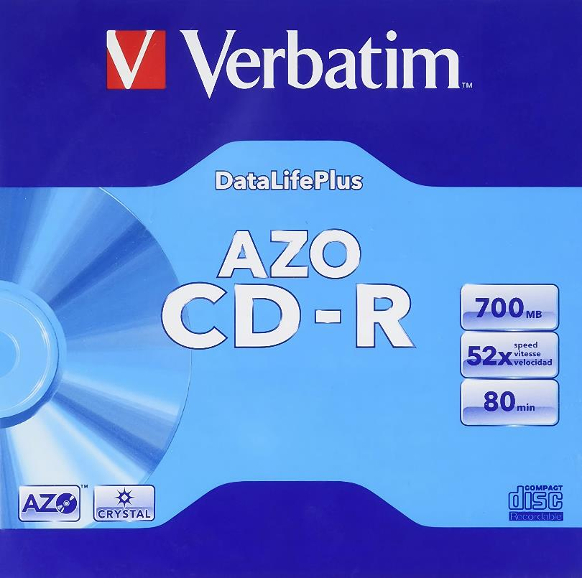
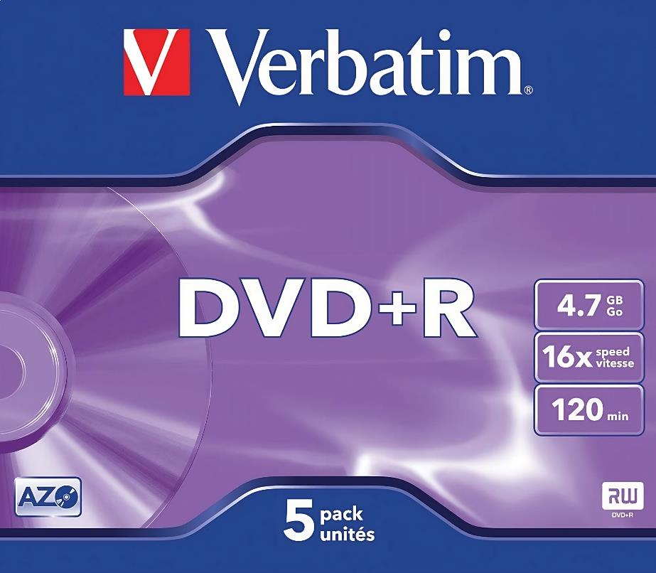
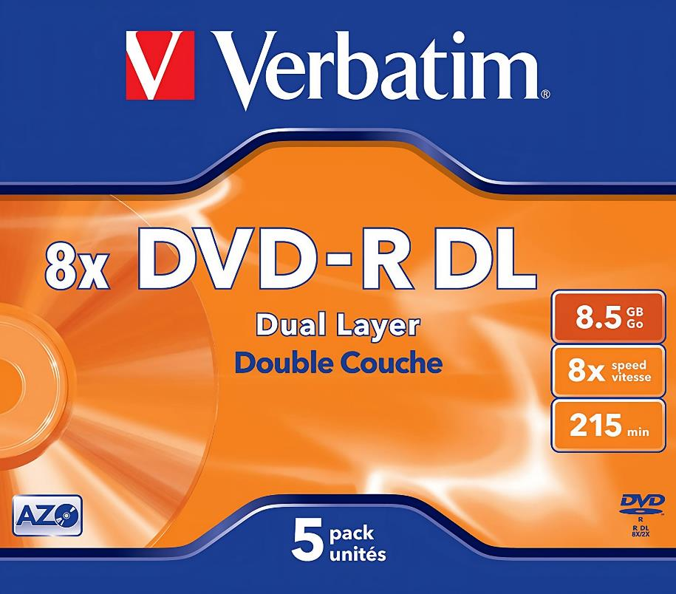
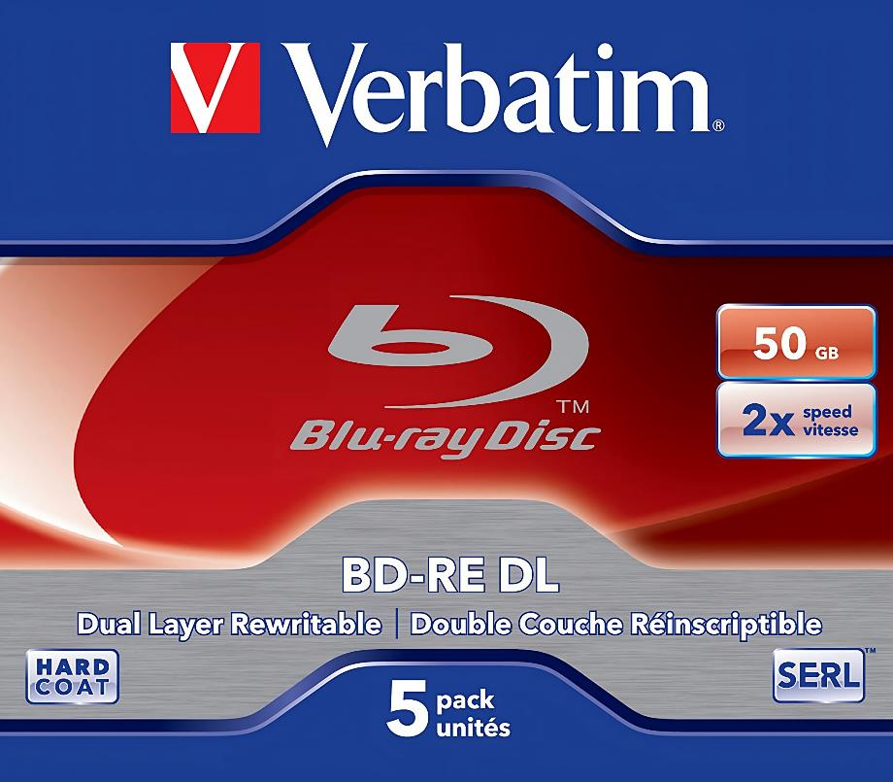
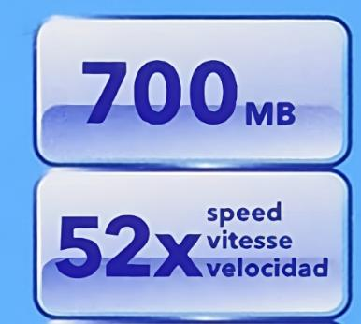
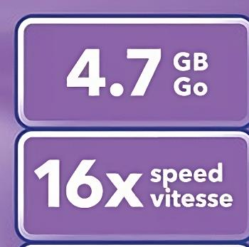
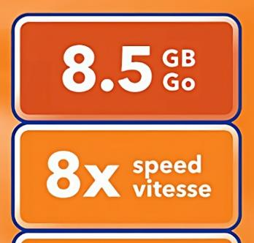
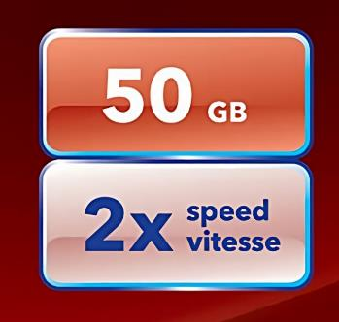
In The Real World
Media selection - look at the storage size
Speed is multiple of lowest speed
* 1x CD 150 kB/s 1x DVD 1352.54 kB/s 1x Blu-ray 4.5 MB/s
ITFreeTraining.com
© Copyright 2024
Notes:
03:55 In the real world, the simplest way to work out which media to use I s to look at the storage size of the media. Since optical media has been around a long time and is not used that much nowadays, the media available is quite mature and there are not too many brands available. You will probably find it hard to find a store that sells it and if they do there will not be much choice.
The media will have marked on it the storage capacity and also the speed the media supports. If you forget everything else, look for the amount of data the media can store. You will also notice a speed will be provided. This is the maximum speed the media will support burning at. The speed is a multiple of the lowest speed. Different media will have a different lowest speed. Since the media is quite mature nowadays, the speed of most media is quite high, so I would focus on the amount of storage you need.
Although rewriteable media is available, since the media is so cheap, most people don’t worry about rewriteable media and just use the write once media. Also, rewriteable media generally costs more. When purchasing DVDs, I would personally not worry nowadays if it is -R or +R media. As we get up to Blu-ray there are some concerns, not with the media but with the hardware.

Slide 5
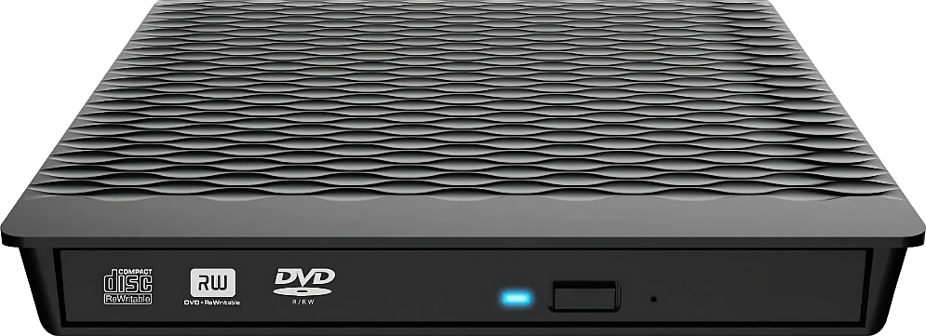
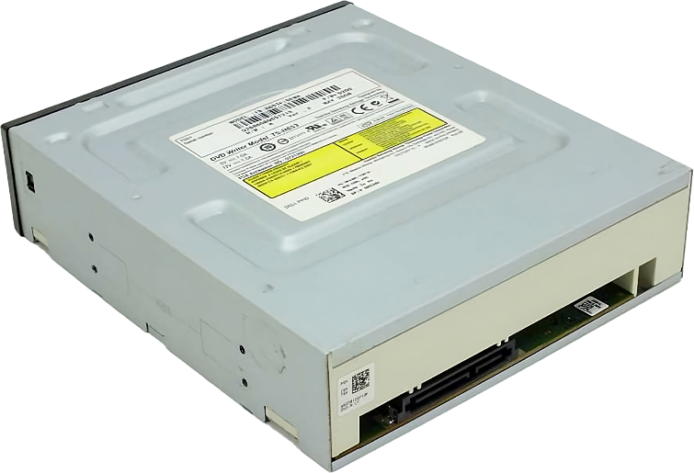
In The Real World
Optical drives support different features
* Maybe called combo drive
DVD
DVD
DVD
Read and write
Read and write
Read and write
Blu-ray
Blu-ray
Read only
Read and write
Look at logos on front or sticker on back for features
ITFreeTraining.com
© Copyright 2024
Notes:
05:18 Different optical drives support different features, but they generally fall into three different categories, the first being basic DVD optical drives. These support reading and writing of DVDs. You generally don’t find optical drives for computers that don’t write DVD disks nowadays. The optical drives support previous media and thus they all support CDs.
The next type is DVD drives that also support reading Blu-ray. That is, they support writing to DVD but only reading from Blu-ray. When optical drives don’t support writing for all the media they read, they may be referred to as combo drives. Thus, don’t assume because it says DVD writer it also supports writing to Blu-ray. Not all of them do.
The last type supports reading and writing to DVD as well as Blu-ray. If you are not sure which one they support, have a look for logos on the front or the sticker on the back of the drive. This should give you some information about what it supports. If it is not clear, you can always look up the model number to see what the optical drive supports.
On some professional workstations, you may see they come with two optical disks. One is generally a combo drive and the other a Blu-ray writer. This may seem strange to have two optical drives with one having less features than the other. The reason this is done is, generally, so you can copy from one optical drive to the other. They could have two optical drives of the same type, but that would increase the cost with little benefit since most people don’t burn two optical discs at once.
Let’s look at the format used by optical disks.

Slide 6
Optical Disc Formats
CD-Digital Audio (CDDA)
Designed for audio but evolved for data
Generally called CD-Audio
ISO-9660 CD File System (CDFS)
Offers more features than CDDA
Not tied to one vendor
Released 1998
Most widely used format today
ITFreeTraining.com
© Copyright 2024
Notes:
06:55 Optical disks use their own format, so they are not tied to one specific vendor. This allows optical disks to be used on PCs, Mac and non-PC related devices. The first format released was CD-Digital audio or CDDA. These were designed for audio but evolved for data. This may also be called CD-Audio. If you purchase a music CD it is most likely in this format.
To improve optical disk use with devices like PCs, ISO 9660 was developed. This had more features than CDDA and was designed more for storing data rather than songs. It was released in 1998 and nowadays is the most widely used format.
Modern operating systems will choose the format for you, so you don’t need to worry about it.
There is one last feature that I want to look at.

Slide 7
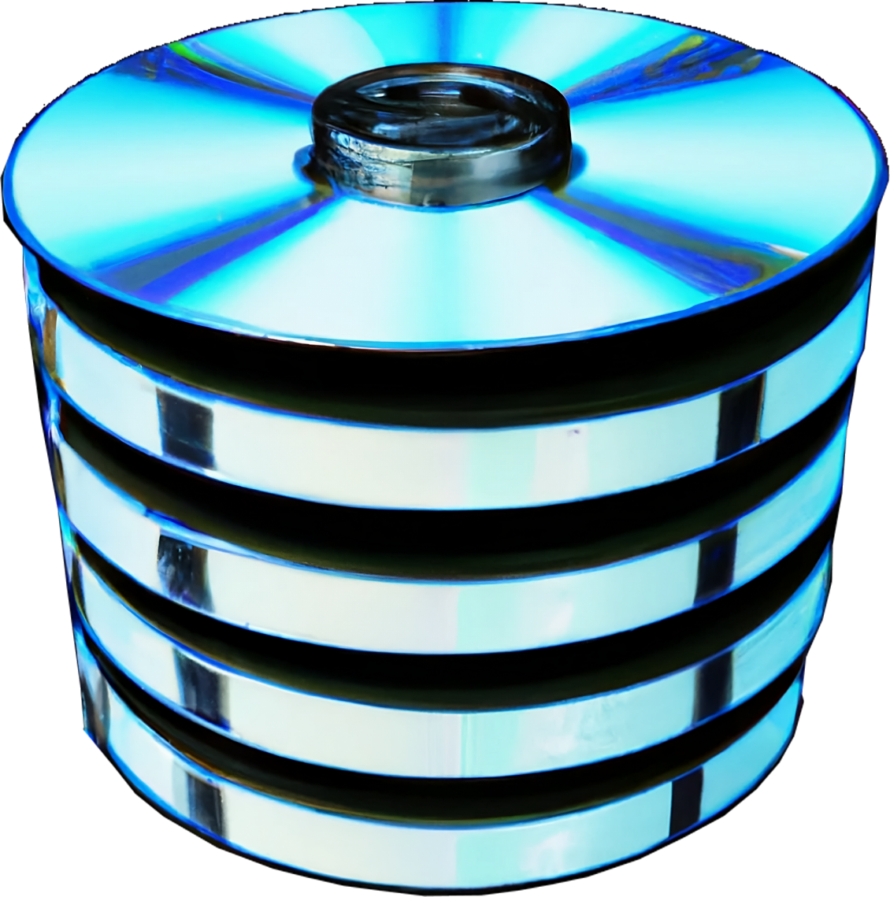
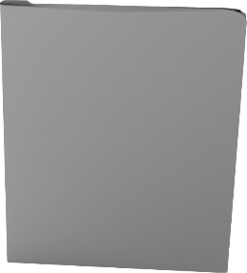
Multi-Session
Allows data to be added incrementally
Session 5
Files can be added/modified
Session 4
Files can be deleted (Sort of)
Session 3
Result
Session 2
Session 1
Session 2
Deleted
Modified
Added
Data from previous sessions
Session 1
can still be accessed using tools
ITFreeTraining.com
© Copyright 2024
Notes:
07:50 If you are using write once optical media, you have the choice to add data incrementally. This is called multi-session. Each time you add new data it is called a session. This means files can be added or modified any time. Files can also be deleted, sort of. Let’s look at an example.
Let’s say the following files are written to the optical disk. These files will be written in a session. Each session on the disk has additional configuration data written with it, so even a session with no data in it will take up space on the disk. Thus, adding a single file is not as simple as adding a file to storage such as a flash drive. Adding anything to the disk will involve creating a new session.
So, let’s now add a second session. This second session will delete a file, modify a file and add a file. The user will see the result of the combined sessions. The important take away from this is, the data is still on the optical disk even if the user can’t see it. The data from the previous session can still be accessed using certain tools. So, even though you can delete items by adding a new session, keep in mind the files are never deleted. They still exist from the previous session. The exception to this is rewritable optical disk. When these optical disks are used, it is possible to erase the previous data on the disk. Just be sure that if you are using one of these disks and you want to delete data, make sure you erase the disk not just add a session. Rewriteable optical media works the same as write once media, you just have the additional option of erasing data or re-writing it. Adding a session does not change the existing data.
Let’s have a look at how to install an optical drive and use it.

Slide 8
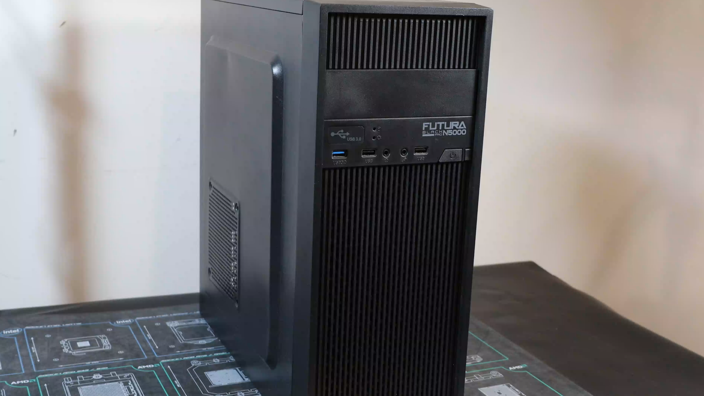
Demonstration
ITFreeTraining.com
© Copyright 2024
Notes:
09:38 For this demonstration, I will be installing a CD-ROM drive into this computer. The CD-ROM drive is a 5¼ inch CD-ROM drive. This will be installed in the 5¼ inch drive bay in front of the computer. This computer has a 5¼ inch drive bay at the front. As optical drives are becoming less common, you will find that less and less computer cases are including a 5¼ inch drive bay.
I will first remove the front and back panels from the computer case. I want to remove both because, as we will see later in the video, the optical drive bay has screws on both sides. Although putting the screws in one side should be enough to hold the optical drive-in place, putting the screws in both sides will keep it more secure.
To install the CD-ROM drive, I first need to remove the blanking panel at the front of the computer case. For this computer case, it is just a matter of pushing the blanking panel out of the computer case.
I next need to slide the optical drive into the computer, but I don’t push it in all the way yet. The next step is to plug the power and data cables in. If I pushed the optical drive all the way in, it would be hard to plug the cables in.
You will notice the power connector is an L-shaped connector. Thus, it can only be plugged in one way. I will now plug it into the back of the optical drive making sure I have it the right way up.
I will next need to plug in the data connector. I will first plug the data cable into the motherboard. As with the power cable, it has an L-shaped connector and thus will only go in the one way. You can plug the data cable into any SATA connector. The other end I will plug into the optical drive.
I will next push the optical drive into the computer case. Make sure that the optical drive is lined up with the computer case and is not sticking out.
To secure the optical drive-in place, there are some screws on the side. There are two vertical screw holes, but you only really need to screw in one of them. Although putting both in would make it more secure, putting both vertical screws in this case will have minimal benefit. You will notice there is another set of screw holes, but this computer case does not have anything to attach to these screw holes.
On the other side of the computer case, I will use both top screw holes to hold the optical drive-in place. I won’t use the bottom ones because, using both top and bottom does not achieve much. Generally putting in four screws in opposite corners is sufficient, although for this computer case I can only put in three.
To complete the install, I need to put the front and back plates back on. It is just a matter of putting the two plates on and screwing in the two screws that hold them in place. The optical drive is a well-known supported SATA device and thus your operating system should detect it without having to install any device drivers.
If the optical drive does not work, check in your computer’s setup to see if it is detecting it. If it is not working, you may need to enable the SATA connector. In some cases, certain SATA connectors may be disabled, for example, on some motherboards, if you have M.2 storage certain SATA connectors will be disabled.
If you are not planning on burning too many CDs or want to move it around between computers, I would personally use a USB optical drive like this one. It is just a matter of plugging it into a USB port.
This optical drive has two USB connectors. If your computer is not able to deliver enough power through the one USB connector, you will need to plug the second one in to give it more power. Nowadays, if I was to purchase an optical drive, I would go for a USB version like this. There are also optical drives available for Thunderbolt. They are easier to install and move around.
Now that I have it installed, I will next have a look at how to use it.

Slide 9
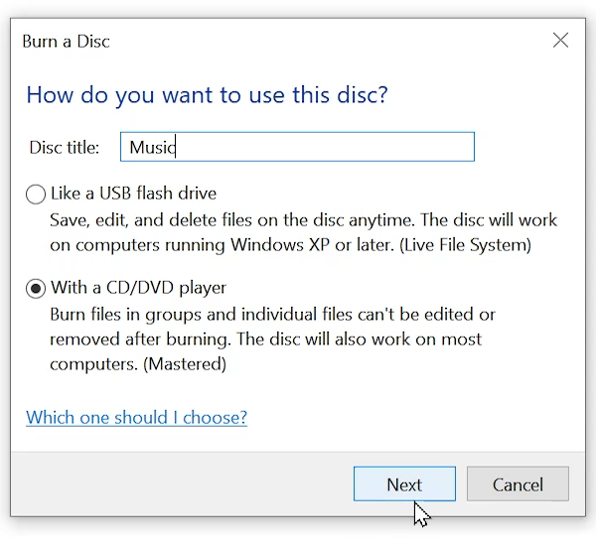
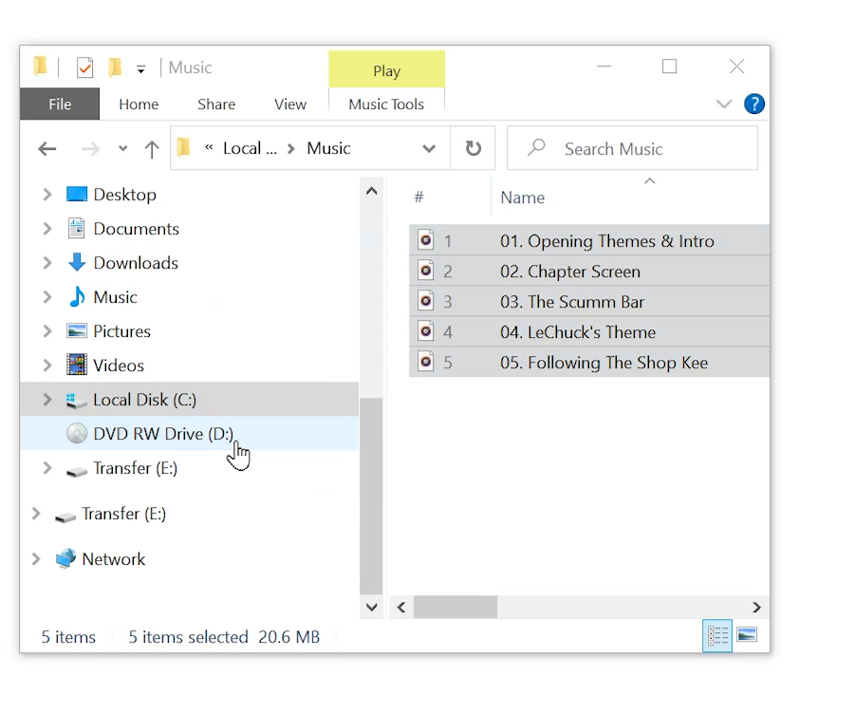
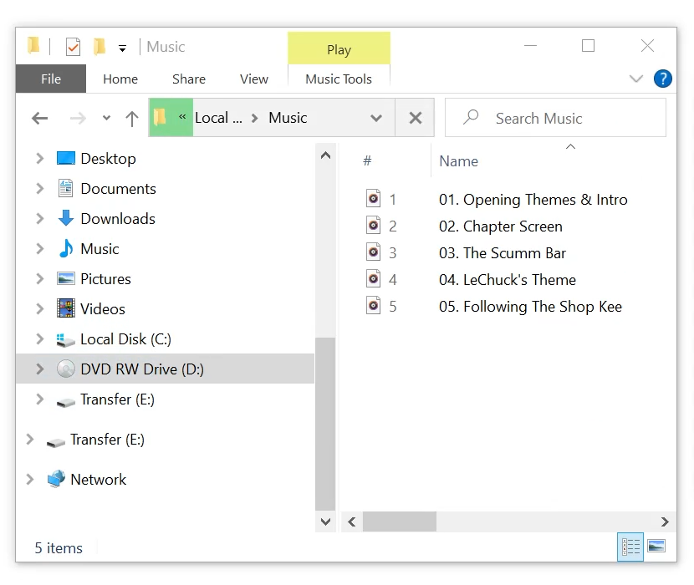
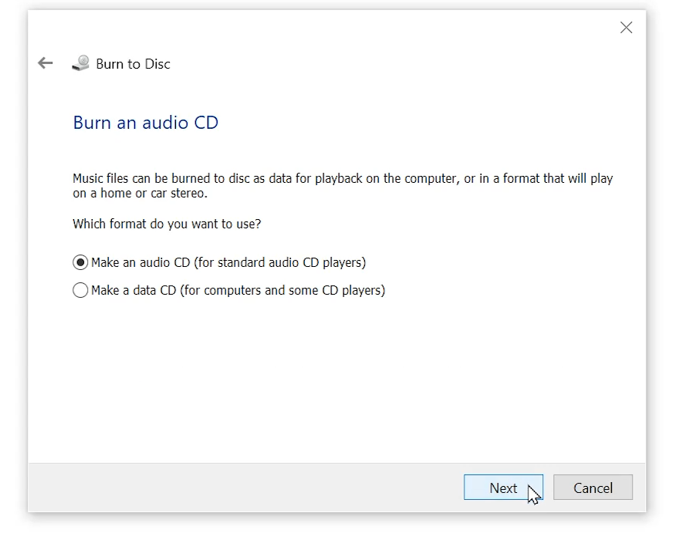
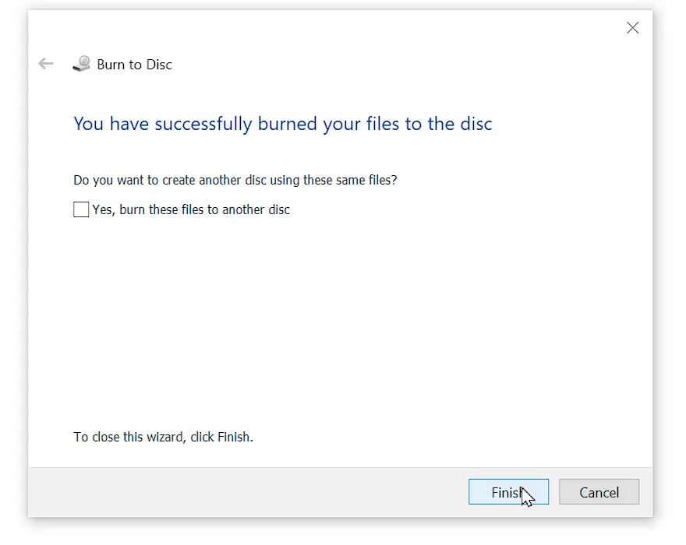
Burning Optical Media
Universal Disk Format
Single session/Mastered
Make audio or leave as data
Audio: Play on CD player
Data: Requires supported device
ITFreeTraining.com
© Copyright 2024
Notes:
13:30 Windows provides the capability to burn optical disks without the need for extra software. However, you can install third-party programs for additional features and options that Windows does not offer.
This computer has a blank optical disk in the drive. When I select the optical drive, you will notice that a window appears asking what I am planning to do with this disk. The first option, “Like a USB flash Drive”, uses Universal Disk Format or UDF. UDF is a standard that allows incremental writing to the optical disk. Although it supports adding, changing and deleting files, it is not multi-session. If you use software that adds sessions to optical disks, you will be able to add a session to a UDF disk. Keep in mind compatibility issues between different systems. If you are using older devices they may not support UDF and if they do, adding multi-session may cause compatibility problems.
The next option is “With a CD/DVD player”. This option essentially burns the optical media as a single session but is mastered. When a session is added to an optical disk, normally it is possible to add additional sessions, however, when the optical disk is mastered, this prevents additional sessions being added. Essentially the optical disk will contain one session and no more sessions can be added. Thus, the optical disk can never be made multi-session.
To put this in simple terms, you want to use this option when you wish to create an optical disk that can’t be changed later. This option is also the most compatible with legacy devices.
I will enter in a title for the optical disk and move on. The next step is to copy files onto the optical disk. This can be done by dragging and dropping them. It is important to understand that this step copies files from their current location to a temporary area. When burning optical disks, if the computer is not able to feed the data to the optical disk fast enough, this may result in the optical disk being lost. With modern computers this is not such a concern as it was in the old days. However, using a temporary area makes it less likely there will be delays when copying the files, particularly if you are copying data from areas such as network locations or attached storage.
In order to burn the files to the optical disk, you need to select an option in Windows Explorer. When files are waiting to be burned to the optical disk, a new menu in Windows Explorer will appear. You need to select this option and then select the option “Finish burning”.
This will start the wizard to finish burning the optical media. Before this point, you are free to add and remove files if you wish. On the first screen you will be asked to choose the burning speed. The burning speed is based on a multiple of the lowest burning speed for that optical media. If you have the time to wait, I generally select a slower option because I tend to find optical disks that are burned at a lower speed are more reliable. If you have a lot of data and choose a very low speed, it is going to take a long time for the media to complete the burning process.
If you have audio files on the disk, you may get the option to create an audio disk rather than a data disk. An audio disk will convert the audio files so the optical disk will play on a CD player. You would also do this if the optical disk was going to be used on a legacy optical disk player.
The second option copies the data as is and does not convert the audio files. This option requires the read device to support reading these files. Most modern optical devices, even if they are designed for audio only, will still read data disks. Optical disks are not new technology. Even the CD player in modern motor vehicles will support data disks. These players simply read the optical disk as a data disk, read the audio files and play them.
Now, all I need to do is complete the wizard and the optical disk will be burned to. Once the optical disk has finished burning, you are free to remove it. Optical disks are cheap nowadays and don’t get used that much due to competing technology like USB storage and cloud storage. For this reason, most people will use the single session mastering option to create optical disks. This is well supported on modern devices and is the simplest to use.

Slide 10
Subscribe
Next video
Video content: https://ITFreeTraining.com/ap11/2b30
© Copyright 2024
Notes:
17:57 That concludes this video on optical disks. I hope this video has been informative. Until the next video from us, I would like to thank you for watching.
References
“The Official CompTIA A+ Core Study Guide (Exam 220-1101)” pages 63 to 64
“Mike Myers All in One A+ Certification Exam Guide 220-1101 & 220-1102” pages 407 to 414
“Picture: Compact Disc” https://commons.wikimedia.org/wiki/File:Compact_Disc_wordmark.svg
“Picture: DVD logo” https://commons.wikimedia.org/wiki/File:DVD_logo.svg
“Picture: Blu-Ray Logo” https://commons.wikimedia.org/wiki/File:Blu-ray_Disc.svg
Credits
Trainer: Austin Mason https://ITFreeTraining.com
Voice Talent: A Hellenberg https://www.freelancer.com/u/adriaansound
Quality Assurance: Brett Batson https://www.pbb-proofreading.uk

