Slide 1
Notes:
In this video I will have a look at removable storage.

Slide 2
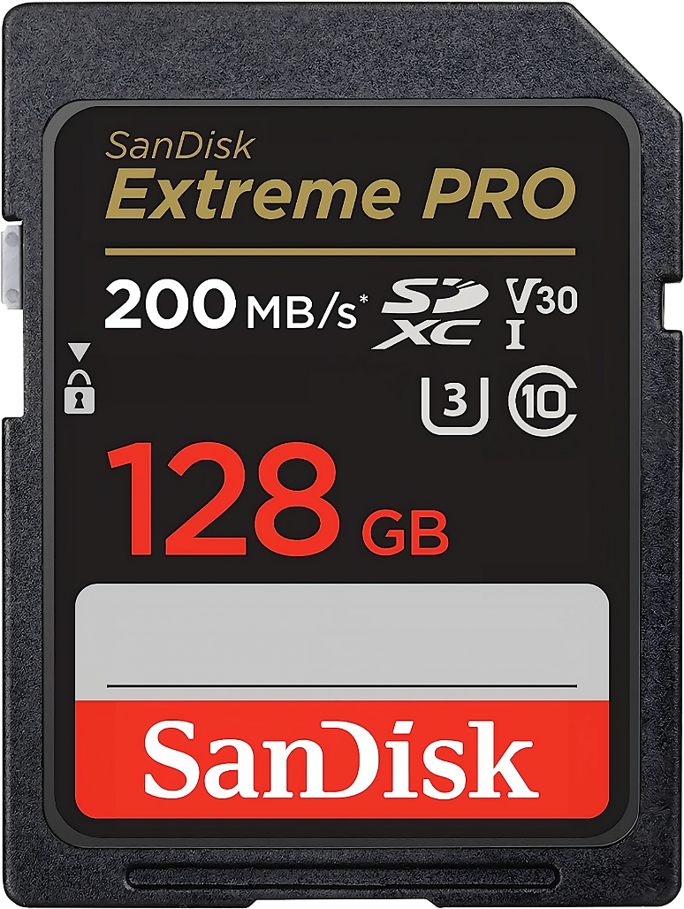
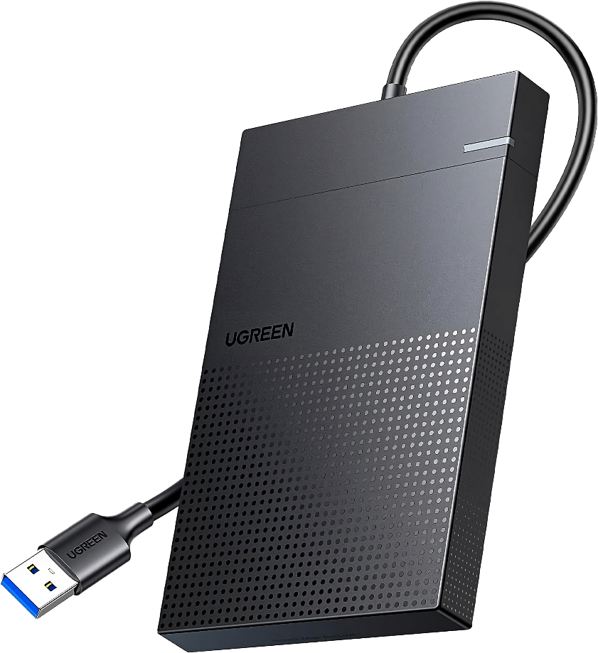
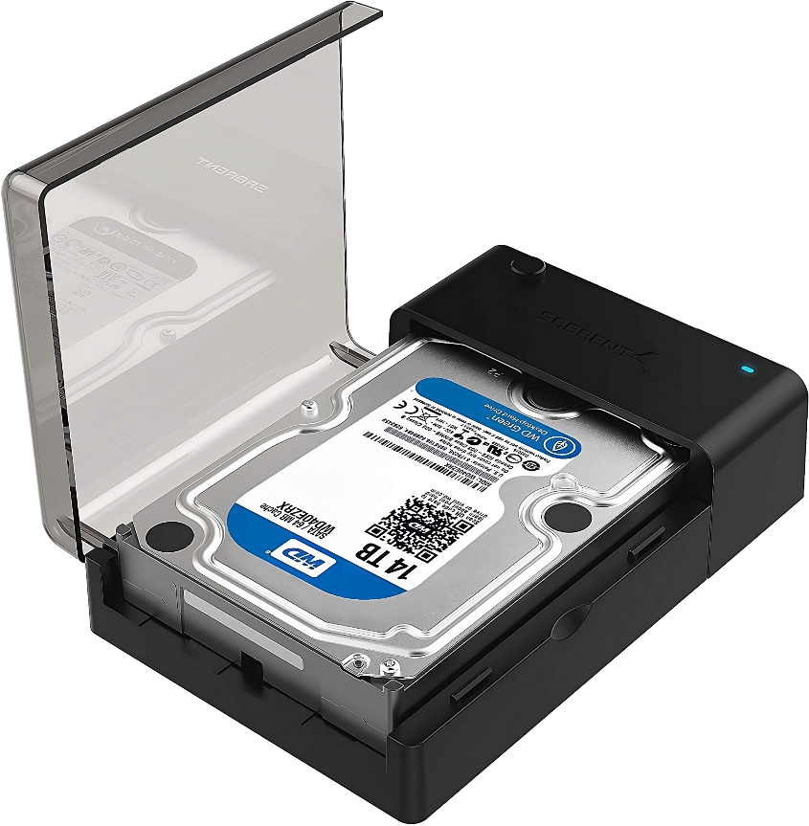
Removable Storage
Flash Drives
Memory Cards
Portable Drives
Drive Enclosures
ITFreeTraining.com
© Copyright 2024
Notes:
00:04 Removable storage refers to portable storage devices or media that can be easily transferred between computers. In this video, I will look at flash drives, memory cards, portable drives and drive enclosures. Since the storage is removable, it can be moved between computers easily without having to shut down the computer or open the computer case.

Slide 3
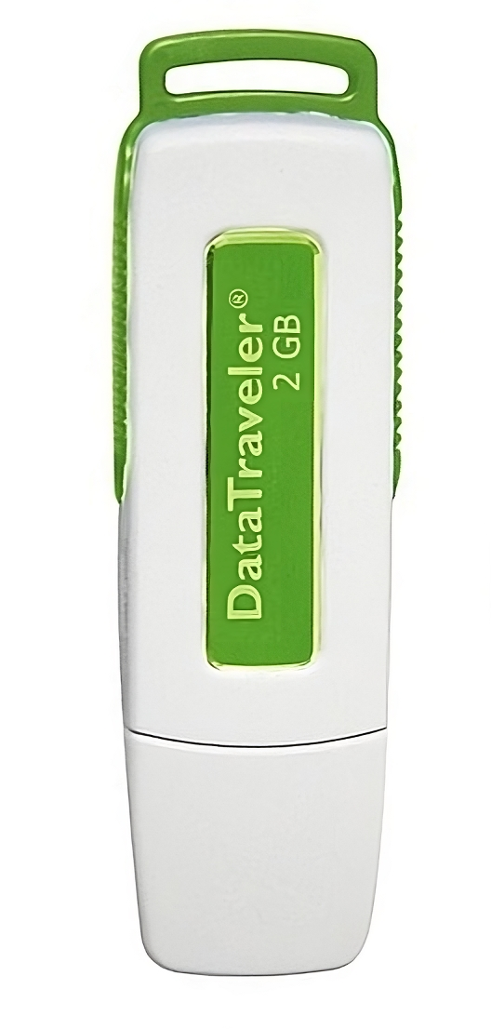
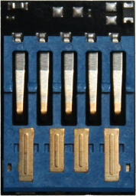
Flash Drives
Also called the following:
USB drive/Thumb drive/Pen drive/Jump drive
Data is saved in a proprietary format on flash memory via a USB controller
Format with exFAT or FAT
ITFreeTraining.com
© Copyright 2024
Notes:
00:22 A flash drive, uses flash memory to store data. It is also known as a USB, Thumb, Pen or Jump drive. The data is saved in a proprietary format on the flash memory and accessed via a USB controller.
With older USB flash drives, this is more noticeable, where there are clearly flash chips and a controller chip, such as in this example. The flash chip is the larger chip at the top and the controller chip is the smaller chip.
Nowadays, you may find the physical contents of a USB flash drive are tiny, so you won’t be able to see the different chips and they could even be combined together. Modern USB flash drives, with their compact circuitry, no longer rely on plastic casings for electronic protection; instead, these casings make the drives easier to handle and use.
When using a flash drive, it is generally best to format it with exFAT or FAT. exFAT is an open standard that is well supported on many devices. FAT is an older standard and has better support on older devices. exFAT was released in 2006 and in 2019 Microsoft made exFAT an open standard. Alternative operating systems such as Apple and Linux support exFAT. Modern devices like TV’s should also support exFAT. Personally, I would use exFAT first, and then if you have problems try FAT.

Slide 4
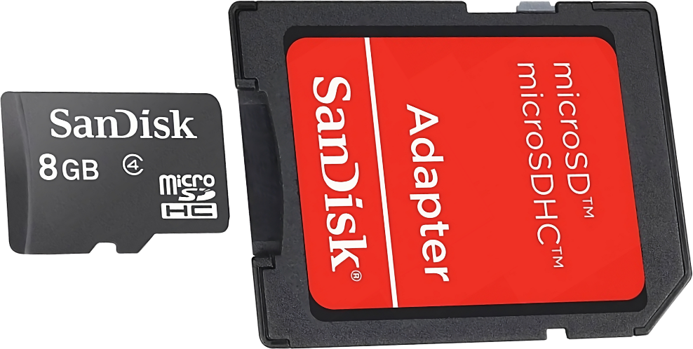
Secure Digital (SD) Cards
Introduced in 1999
microSD to SD Card
Write-protect still works
Only SD cards have write-protect switch
SD Card
Mini SD
Micro SD
ITFreeTraining.com
© Copyright 2024
Notes:
01:35 Introduced in 1999, Secure Digital cards, commonly referred to as SD cards, are available in three sizes: standard SD, miniSD and the smallest, microSD. As flash storage capacities have expanded, the miniSD has mostly disappeared.
The most commonly sold SD card is microSD. Often, the packaging will include a microSD to SD card adapter. At the time of the creation of this video, one Terabyte Micro SD cards were commonly available on the market. With microSD being able to have such a large capacity, it's evident why manufacturers are leaning more towards producing microSDs and including adapters. This approach broadens their compatibility across devices while also meaning they no longer have to make two different products.
The biggest difference between SD cards and other cards is that SD cards come with a write-protect switch. When this is in the locked position, you won’t be able to write to the SD card. If you are using an adapter, the write-protect switch still works.
Since SD cards were introduced, there have been a number of different types released.

Slide 5
SD Card Types
SD
SDHC
SDXC
SDUC
SD Card Type
Minimum Capacity
> 2 GB
>32 GB
>2 TB
Maximum
Capacity
2 GB
32 GB
2 TB
128 TB
FAT12 FAT16
FAT32
exFAT
exFAT
Suggested Format
ITFreeTraining.com
© Copyright 2024
Notes:
02:37 There are currently four distinct types of SD cards available. When you buy a device, it will support a specific SD card type but will also be backward compatible with previous versions. Instead of memorizing the various abbreviations, I suggest focusing on the card's capacity, as each type has a unique storage range.
For instance, if you're buying a dash cam, its packaging will often specify the maximum SD card capacity it can handle. My approach is straightforward: ensure the SD card's capacity doesn't exceed the device's limit.
When formatting an SD card, operating systems such as Windows will suggest a specific format. For larger capacities, exFAT is typically recommended due to its ability to handle files bigger than four gigabytes. In contrast, FAT32 has a four-gigabyte file size limit. Hence, for SD cards exceeding four gigabytes, I prefer using exFAT to benefit from its larger file support regardless of what operating systems like Windows recommend.
When purchasing SD cards, there are some other factors to consider.

Slide 6
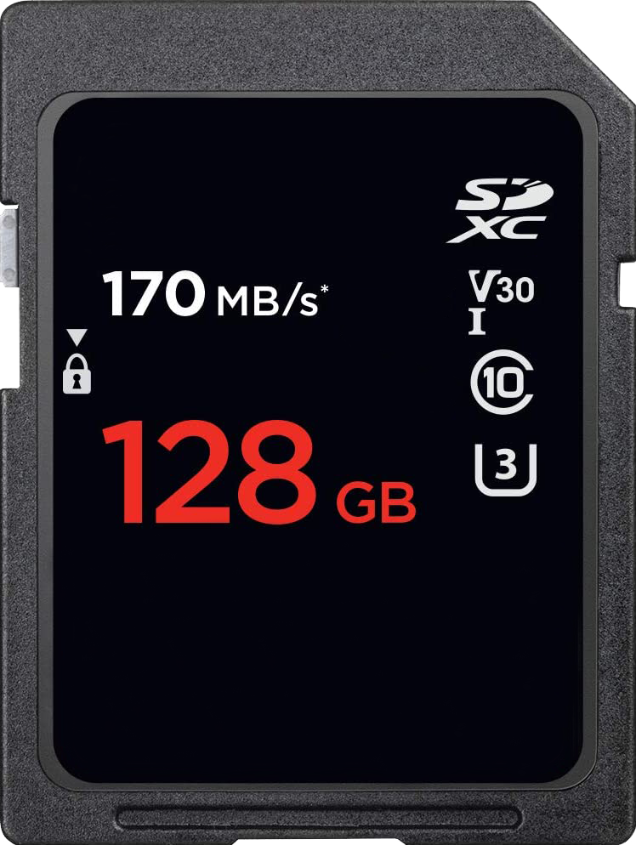
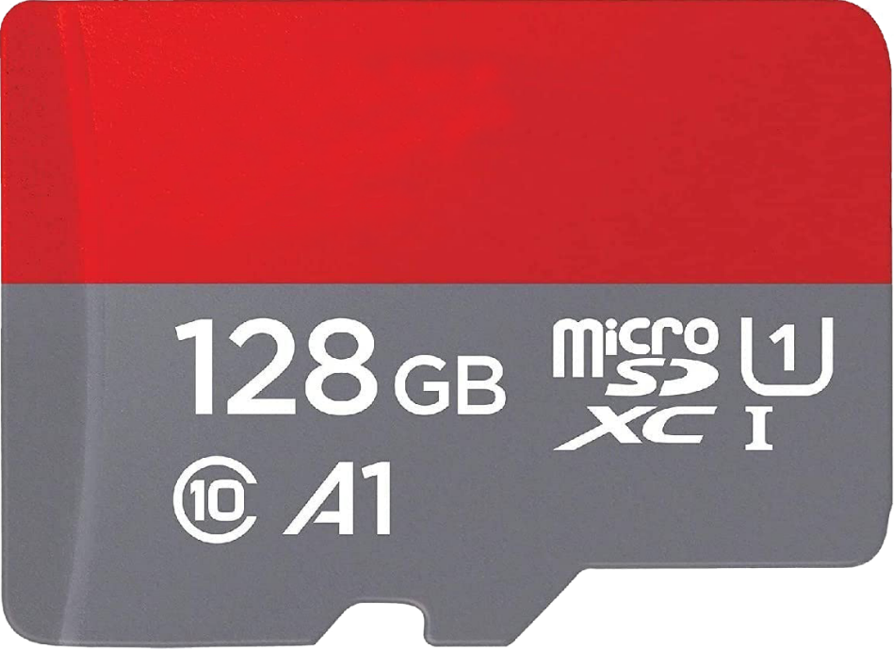
SD Card Ratings
Max read
speed
Standard
Min MB/s sequential writing
Capacity
Bus Interface UHS/I/II/III
Speed Class
Highest 10 (MB/s)
UHS Class Speed
Write (MB/s)*10
Application Class
IOPS/write speed
ITFreeTraining.com
© Copyright 2024
Notes:
03:38 SD cards come in various ratings and types. Looking at the label on the SD card will tell you what speed the SD card will operate and thus what sort of devices you should be using it in. The amount of information can seem overwhelming at first, but I think it helps to understand that there have been many different standards used as SD cards evolved. Not all SD cards will have the same information on them. It is up to the manufacturer to decide what information they put on the SD card and what they leave out.
Most SD cards list their maximum read speed. But remember, this speed represents a peak read speed; the SD card won’t be able to maintain this top speed under heavy use.
Every SD card displays its storage capacity; the example SD cards shown both hold 128 Gigabytes. While our primary focus is on the standard SD card, note that microSD cards also display similar information.
The SD card may have a logo signifying its type. In this example, the SD card uses the SDXC standard. Your device may state that it requires an SD card of a particular type. If you can’t see the type, as I said previously, just use the capacity to determine which SD cards it will use. If your device does not mention the standard it uses, it will generally list within the specifications the largest SD card it can use.
The speed class was one of the first SD card standards, representing the card's minimum sequential write speed. For instance, a class 10 signifies it supports at least 10 Megabytes per second. The problem with this standard is that it only goes up to 10. Thus, you will probably find that modern SD cards have dropped this standard since they are all quite fast and thus will always show 10. In the old days, a device would say something like, requires class 6 SD card. So, if you see a device that requires a particular class of SD card, you will know what it is referring to. Since SD cards are often used in devices that require a constant minimum write speed, for example a video camera, you can see why these standards were developed. Using the standard, you can be assured that if you purchase an SD card that meets the standard for a device like a video camera, you won’t experience problems such as lost frames because the SD card could not keep up with the write speeds required.
To address the limitations of speed class, UHS class speed was added. This is symbolized by a number inside the letter "U" and provides another measure of minimum sequential write speed. The number in the U is multiplied by ten. In this example, we would multiply three by ten to give a minimum sequential write speed of 30 Megabytes per second. This standard only goes to three, thus with faster SD cards another standard was required.
To address the limit of the UHS speed class, a video speed class was added. This is prefixed by V and as before indicates the minimum sequential write speed. So, in this example, the minimum sequential write speed you will get on this SD card will always be 30 Megabytes per second. This standard currently only goes up to 90 and thus if SD cards keep increasing in speed, it will have the same long-term problems as the original speed class. That is, all SD cards will have a video speed class of V90.
The SD card may also include the bus interface speed. This is the speed of the bus to SD card interface. Essentially, this is the maximum speed the SD card could theoretically operate at. In reality the SD card most likely operates at a lower speed than the bus interface.
Micro SD cards may also include an A followed by a number for the application class. Currently, these are the A1 and A2 application classes. Both guarantee a minimum sequential write speed, but A2 has a higher random read and write speed than A1. If you are using the SD card for running applications or heavy workloads, you may want to consider an A2 SD card over an A1.

Slide 7
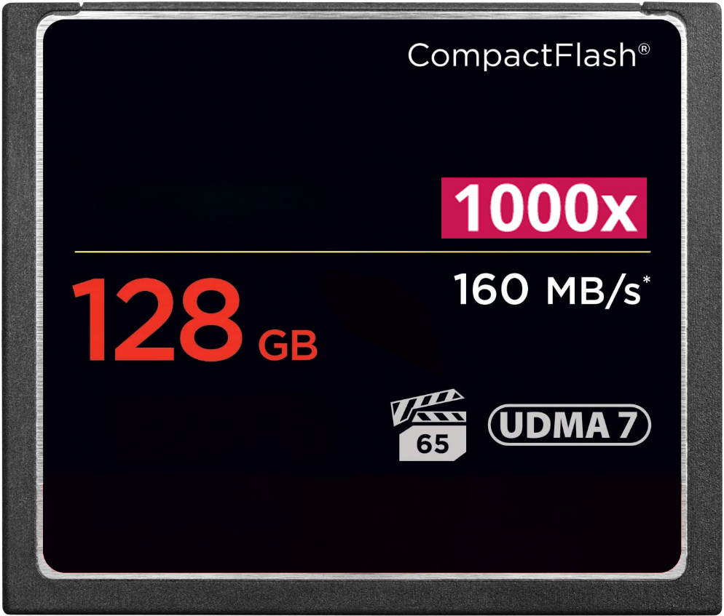
Compact Flash (CF)
Around since 1994
Larger and thus more durable than SD Cards
Lost market share to SD cards but still around
50-pin connector vs 9-pin SD Card (Generally faster)
Multiple of CD read speed (150 KB/s)
Capacity
Max read speed (MB/S)
Max bus read speed (UDMA 167 MB/s)
Minimum write speed in MB/s
ITFreeTraining.com
© Copyright 2024
Notes:
07:28 Compact Flash or CF emerged in 1994, superseding earlier flash storage technologies. While CF cards are bulkier than their modern counterparts, their size lends itself to enhanced durability. Over time, however, the smaller, rapidly improving SD cards captured a significant portion of the market previously dominated by CF. Despite this, CF cards are used by some devices, especially in high-end applications where data integrity and speed are paramount, such as professional film equipment. Often, professionals in such fields prefer CF due to its proven performance and resilience.
CF uses a 50-pin connector rather than a 9-pin connector. This generally makes it faster than SD cards, however, it depends on which cards you purchase.
The markings on CF cards are mostly the same. You will generally have information on how much storage the CF card has.
The CompactFlash (CF) card might display a number followed by an "X", although by today’s standards this is a somewhat outdated method used for comparing its speed relative to the minimum speed of a CD-ROM, specifically when playing audio from a music CD. Similar to SD cards, this older speed indication standard is increasingly being replaced by newer standards on CF cards.
Maximum read speed provides an upper limit for data transfer rates. However, note that this represents a peak speed, and is one which can't be maintained indefinitely.
UDMA, or Ultra Direct Memory Access, indicates the bus speed for data transfer between the device and the CF card. For instance, UDMA7 equates to 167 Megabytes per second. However, this only states the bus speed, not the inherent speed of the flash memory.
The film clapper is the minimum guaranteed write speed. This is important in devices such as video cameras that need to maintain a certain write speed otherwise frames can be dropped.
CF cards are classified into two types: Type I and Type II. While Type I is thinner and compatible with both Type I and Type II slots, Type II is thicker and exclusive to its own slot type. As storage capacities grew, Type I became more prevalent, with many devices discontinuing Type II support.
When investing in CF cards, it's essential to ensure they meet or surpass the specifications required by your equipment.

Slide 8
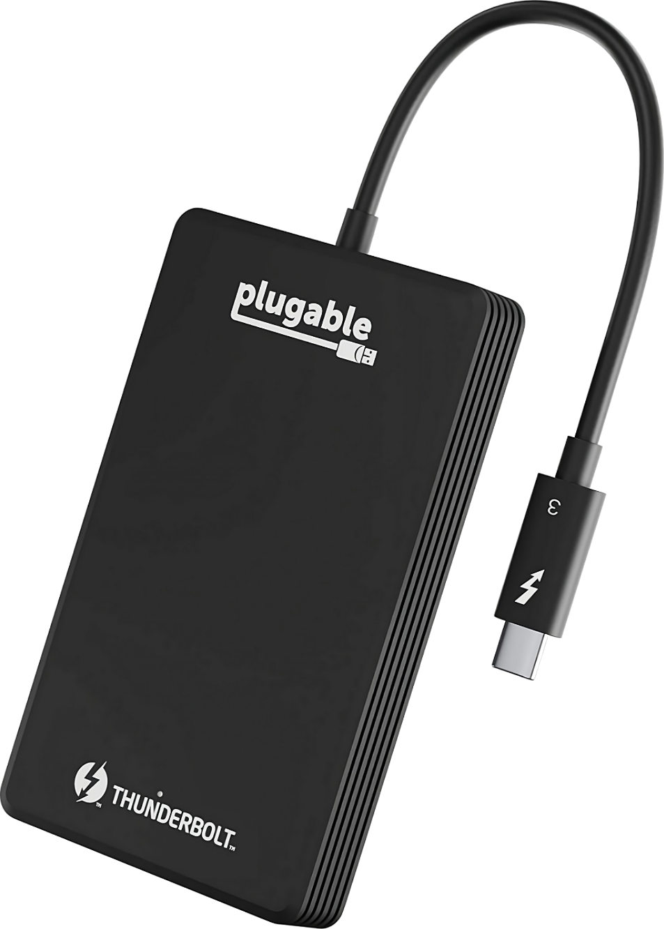
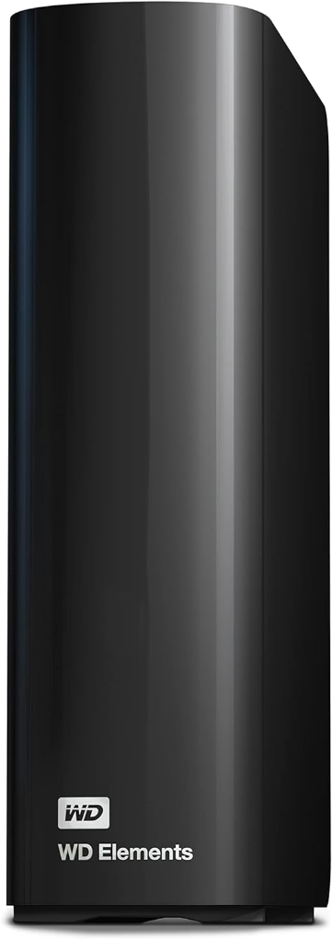
Portable Drives
Easy to move between different computers
Generally, uses hard disks or solid-state-drive
Slower, less durable, cheaper
Faster, more durable, more expensive
ITFreeTraining.com
© Copyright 2024
Notes:
09:48 Portable devices are storage devices designed to be easily moved between different computers and thus are designed to be “plug-and-play”. They generally hold a lot more data than USB sticks or flash cards that we looked at previously at lower price points.
Older portable devices always used hard disk drives, but we are seeing more portable drives using Solid-State-Drives or SSDs. Technically any kind of storage could be used; however, generally portable drives use either hard disks or Solid-State-Drives. Flash memory does not tend to get used, because if you are going to do that, you may as well utilize a USB stick.
Hard disks are slower, less durable but cheaper. Solid-State-Drives are faster, more durable but also more expensive. Some models require an external power source because the USB port's power output is insufficient for those models. Typically, devices with larger hard disks need this additional power due to the energy demands of maintaining rotation of a bigger platter.
While portable drives are larger and weigh more than compact storage solutions like USB flash drives and memory cards, they boast superior storage capacity. Their size remains manageable for travel or as a go-to offline backup option.

Slide 9
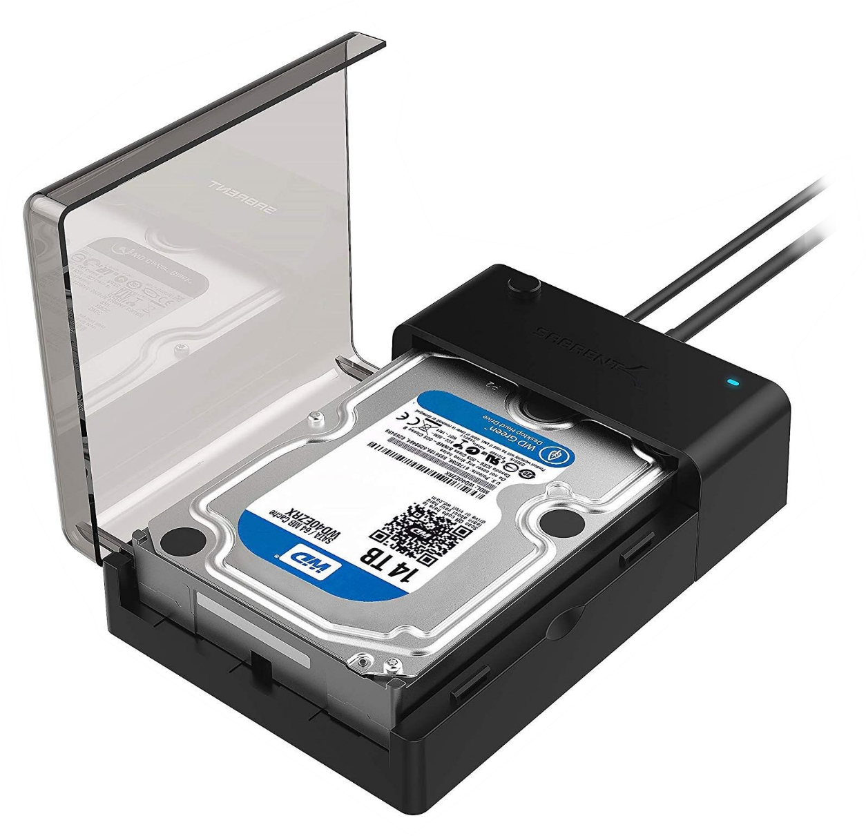
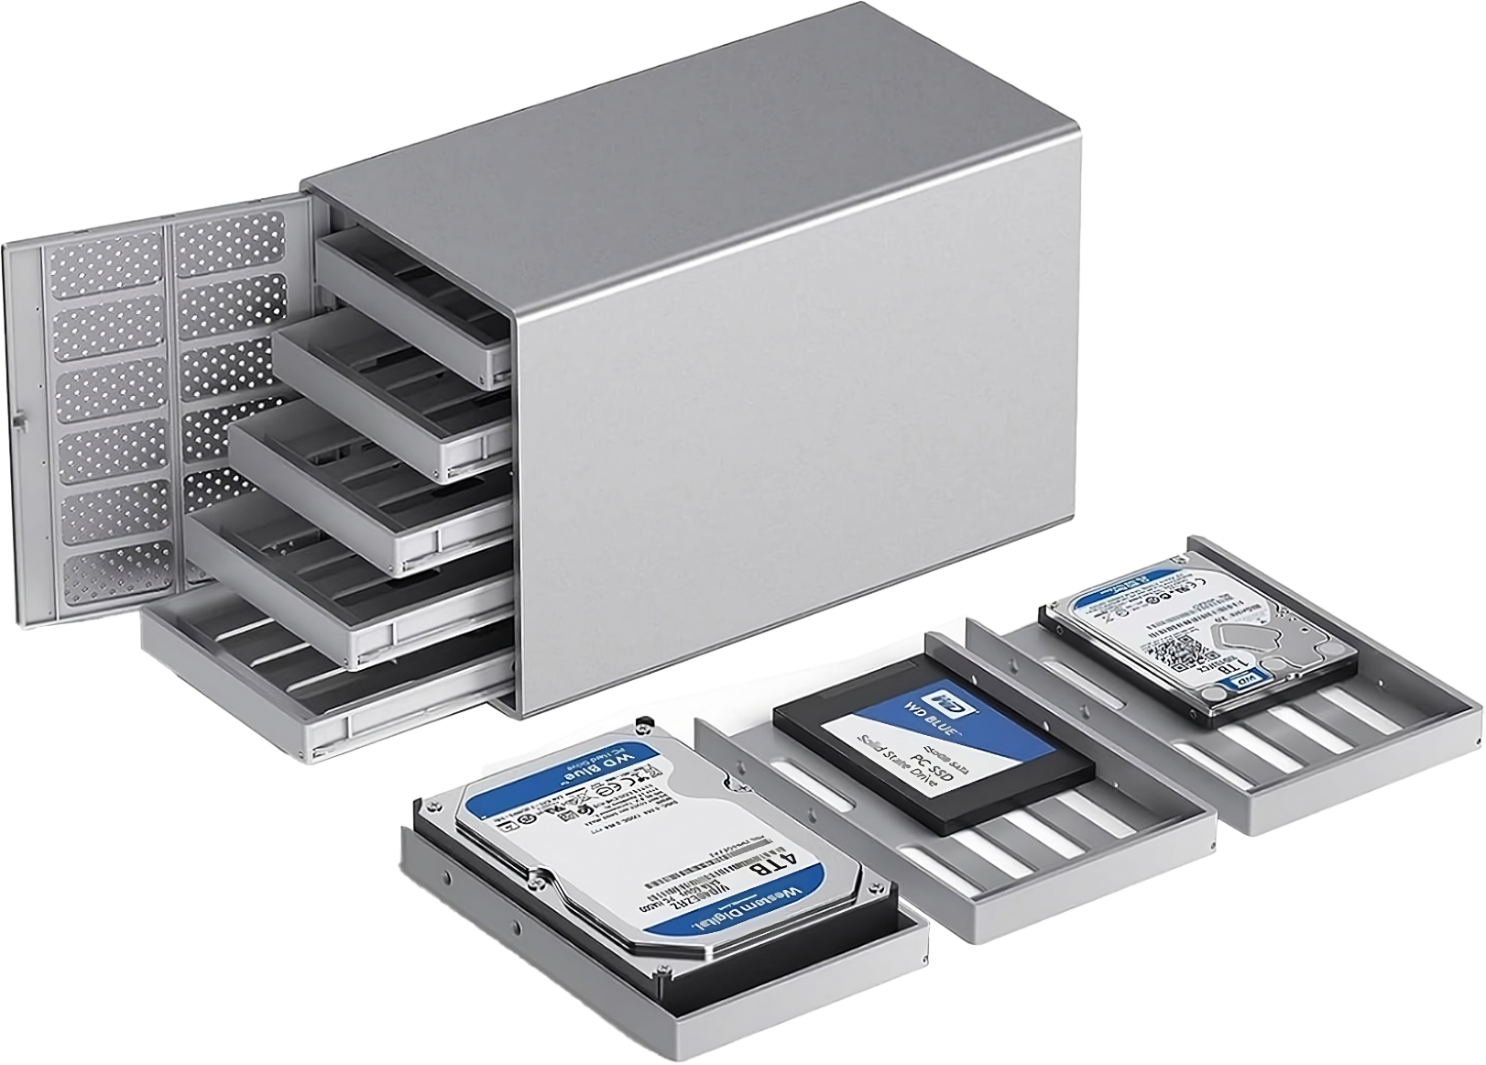
Drive Enclosures
Safeguards the storage and provides an interface
Storage inside can be swapped out
Extra features like networking are available. Network Attached Storage (NAS)
ITFreeTraining.com
© Copyright 2024
Notes:
11:00 Drive enclosures are not part of the A+ syllabus, but they are referenced in the official training, so I'll touch upon them briefly. Drive enclosures are essentially protective casings designed to hold storage drives and provide an interface to access the storage. This allows normal fixed internal storage to be converted into portable storage.
The storage inside the enclosure can easily be swapped out. Some people will use drive enclosures for backups. This is becoming less common because there are so many portable USB storage devices on the market nowadays. If you have any unused storage devices, using them with a drive enclosure can be a cheaper option than purchasing a USB storage device.
Although there are some very basic and cheap drive enclosures on the market, you can also get more expensive ones with a lot more features. For example, extra features like networking. These devices are often called Network Attached Storage or NAS.
Drive enclosures support different interfaces, not just USB. For example, there are ones that support Thunderbolt and eSATA. So, before you purchase something, check what interfaces it supports and if it will meet your needs or not.

Slide 10
Subscribe
Next video
Video content: https://ITFreeTraining.com/ap11/2b25
© Copyright 2024
Notes:
12:03 That concludes this video from ITFreeTraining on removable storage. I hope you have found this video informative. Until the next video from us, I would like to thank you for watching.
References
“The Official CompTIA A+ Core Study Guide (Exam 220-1101)” pages 60 to 62
Credits
Trainer: Austin Mason http://ITFreeTraining.com
Quality Assurance: Brett Batson http://www.pbb-proofreading.uk

