Slide 1
Notes:
Let’s have a look at hard disks.

Slide 2
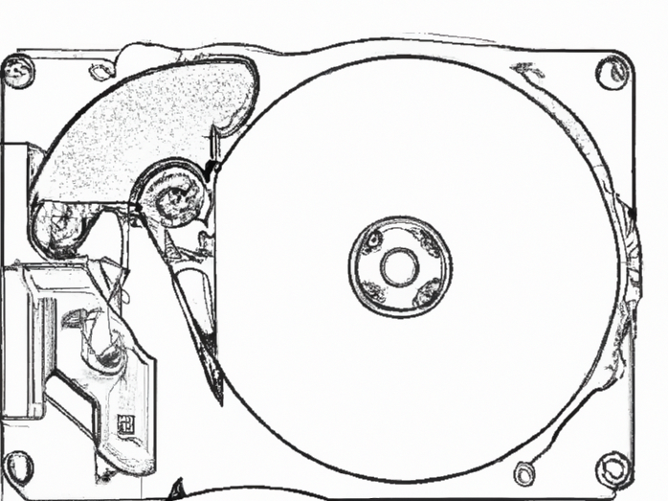
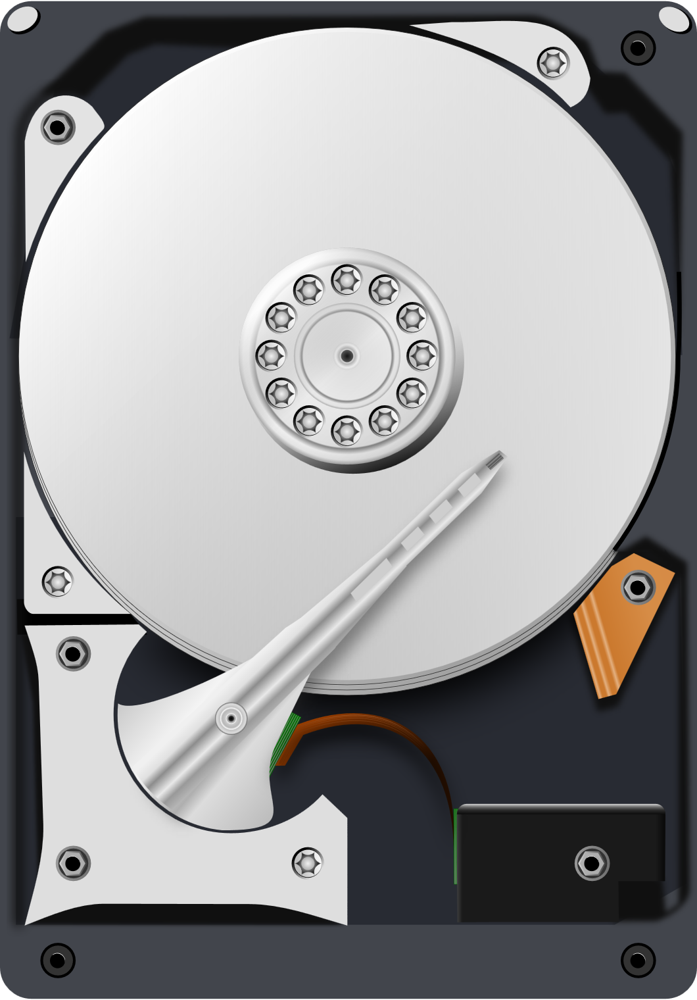
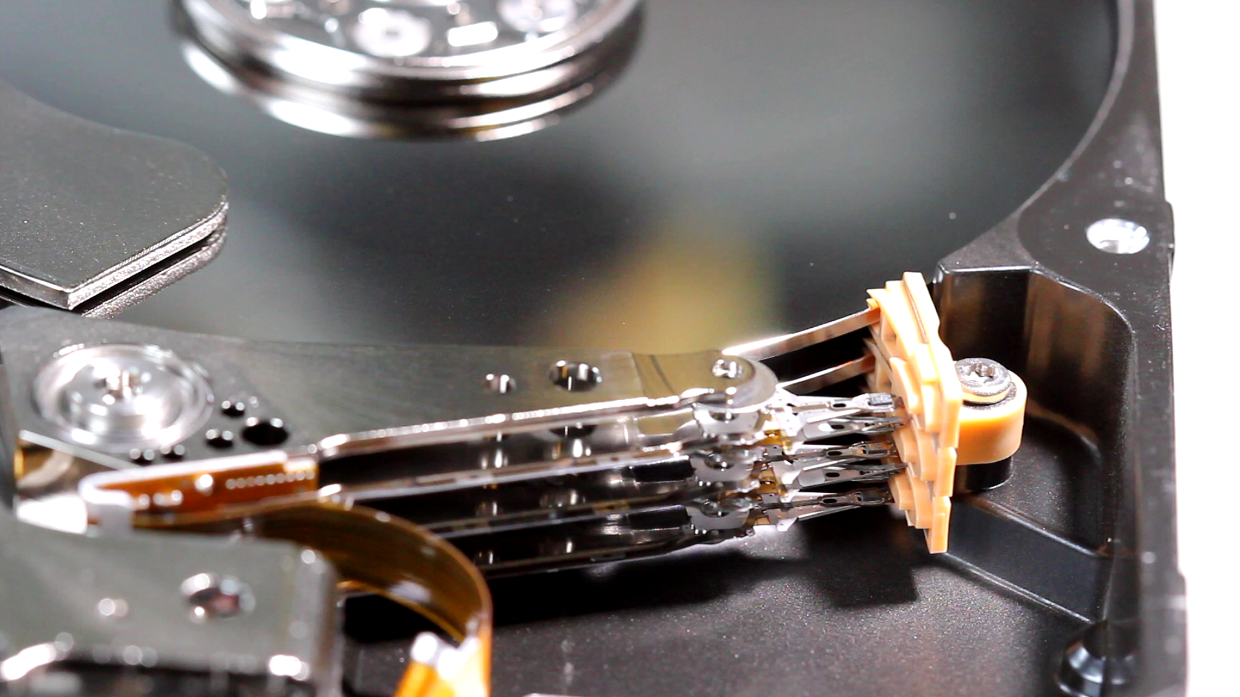
Hard Disk
Electro-mechanical data storage device
Uses magnetic storage on spinning platters
ITFreeTraining.com
© Copyright 2025
Notes:
00:03 A hard disk is an electro-mechanical data storage device. Hard disks have been used with computers since the 60’s. There have been a lot of improvements since the early days, making them faster and able to store more data. Solid-State Drives have taken some of the hard disk market since they offer better performance; however, if you want a lot of storage space the hard disk is still king.
Hard disks use magnetic storage to store data on spinning platters using read/write heads to move over the platters to change the data. Let’s have a closer look at the components.

Slide 3
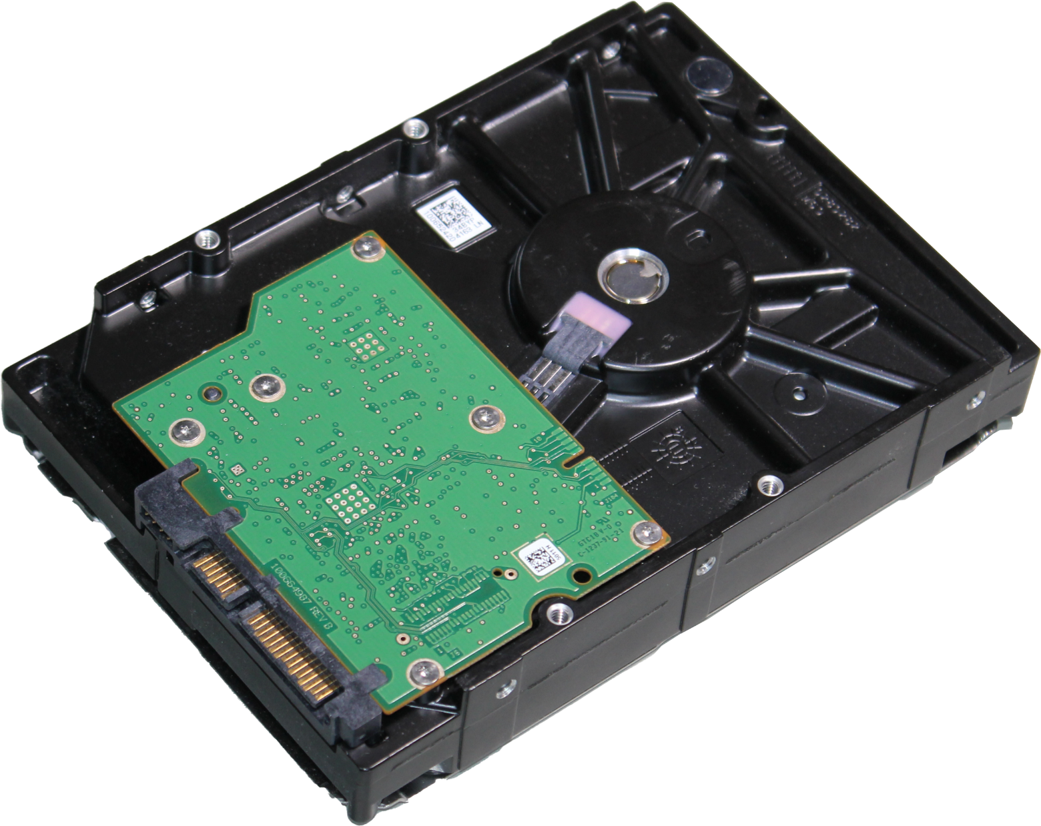
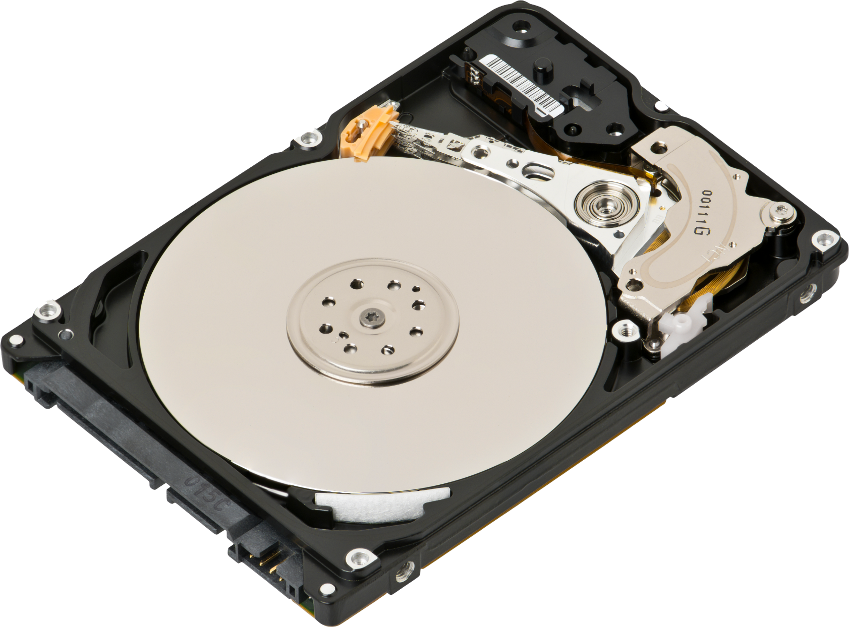
Hard Disk Components
Read/Write heads
Spindle
Circuit board
Platter
Actuator
ITFreeTraining.com
© Copyright 2025
Notes:
00:37 Although the technology of hard disks has improved, the basic parts that make them work have remained the same.
The data is stored on a circular platter. In order to increase the amount of data that can be stored, most hard disks have multiple platters. The platter can be made up of a number of different materials including aluminum alloy, glass and ceramic. This material is coated with a thin layer of magnetic material. This magnetic material is what is used to store your data.
In order to change the magnetic field on the hard disk, a read/write head is used. To read data, the head detects the direction of the magnetic field on the platter. To write data, the head can change the direction of the field. Thus, the direction of the field indicates whether a zero or one is being stored. On very high-capacity hard disks, more complicated methods are used to store data other than just changing the direction of the magnetic field alone, but you get the idea.
In order for the head to access different parts of the platter, a spindle in the middle of the platter is used to spin it. A hard disk will spin at a fixed speed, but the speed can vary between hard disks. Faster speeds give you quicker access to data; however, it reduces the lifespan and the amount of data on the hard disk.
For the head to access different parts of the hard disk, an actuator is used. The actuator is connected to an arm which moves the drive heads across the platter. You can see how fast the heads move across the platters. The actuator has a strong magnet that is used in conjunction with a coil. Electricity is put through the coil, which causes an electromagnetic field that moves the arm, providing speed and precise control.
The last part of the hard disk is the circuit board. This tends to be a single circuit board under the hard disk. The circuit board contains configuration data set during manufacturing; thus, if you replace the board, you most likely will lose all the data on the hard disk. The hard disk may also not work with the new circuit board due to the loss of configuration data.
Let’s now have a look at some of the characteristics of hard disks.

Slide 4
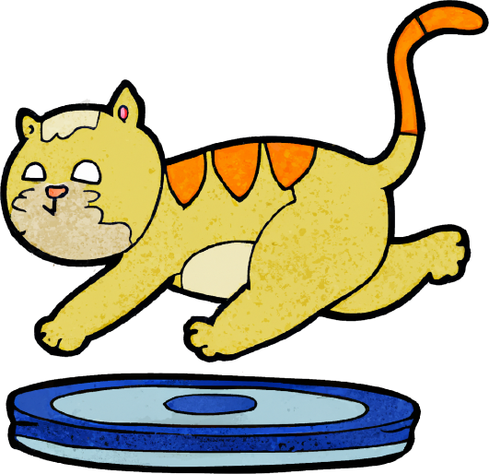
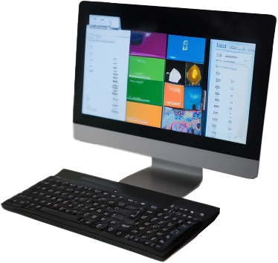
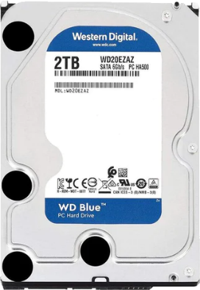
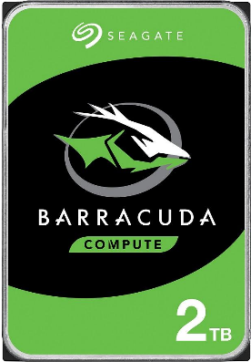
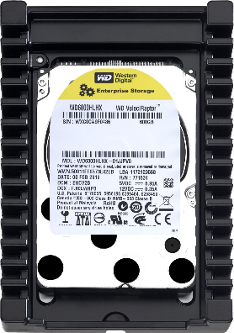
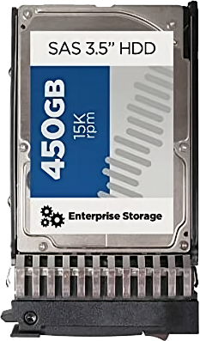
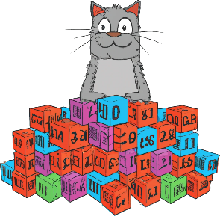
Revolutions Per Minute (RPM)
Number of times the platter spins per minute
User
5400 RPM
7200 RPM
10,000 (10k) RPM
15,000 (15k) RPM
Enterprise
Slower
Data transfer
Faster
More data
Less
heat
Less
noise
Less
cost
Capacity/Heat/Noise/Price
Less data
More
heat
More
noise
More
cost
ITFreeTraining.com
© Copyright 2025
Notes:
02:51 One of the characteristics of hard disks is revolutions per minute or RPM. RPM is essentially the number of times the platter spins per minute. Different hard disks on the market spin at different speeds. The slower hard disks are designed for the individual user whereas the faster hard disks are designed for the enterprise market.
Although different hard disks can perform differently, generally speaking, lower RPM drives have certain features and higher RPM drives have higher features. Usually, the faster the RPM, the faster the data transfer. This is the advantage of higher RPM drives. However, there are also a lot of disadvantages.
Lower RPM hard disks can generally hold more data than higher RPM hard disks. Essentially, when the hard disk’s platters are spinning faster, it is harder to closely pack the data onto the platter. Because the platter is spinning faster, the head needs more area on the platter to get an accurate read.
The slower hard disks tend to generate less heat and, likewise, faster hard disks tend to generate more heat. Generally, enterprise hard disks are put in server rooms with air conditioning, thus managing the extra heat. Increased heat does reduce the lifespan of the hard disk. Generally speaking, higher RPM hard disks don’t last as long. However, if your lower RPM hard disk overheats, the lifespan of that hard disk will also be reduced. Thus, you may get more life from a high-speed drive in a server room over a slower RPM hard disk that is kept in a hot room.
Lower RPM drives make less noise than higher RPM drives. You probably won’t notice that noise if the hard disk is in a computer case. If you have a lot of hard disks together, you generally notice how much louder they are.
The biggest advantage of low RPM drives is they are much cheaper than the higher RPM drives. This is one of the reasons that you see higher RPM drives used in enterprise environments. General users don’t normally want to pay the extra price tag.
Higher RPM drives were more popular in the old days; however, with Solid-State Drives becoming cheaper, we are finding that even low-end users are buying Solid-State Drives over hard disks in general. Solid-State Drives have high performance versions, so even in data centers, Solid-State Drives are getting used more and more. However, you will find that when you want a lot of storage, hard disks are still the king.
Although the RPM will give you an idea of what performance you may get, there are other things to consider when looking at hard disk characteristics.

Slide 5
Rotation Latency/Seek Time
Rotation Latency
Seek Time
Time for data to be under head
Head move and rotation latency
Latency
Head
move
Latency
0
0
ITFreeTraining.com
© Copyright 2025
Notes:
05:37 Another factor in hard disk performance is the rotation latency and seek time. The rotation latency is the time for the data on the platter to get under the head. Thus, the faster the platters are spinning, the less time it takes for the data on the platter to get under the head of the hard disk. The downside is the head has less time to accurately read data on the platter, so the faster the spinning of the hard disk, the more the data needs to be spread out.
The next consideration is seek time. The seek time is the time to move the head plus the time it takes for the platter to rotate so the data is under the head. Hard disks with faster seek times will be able to access random data on the hard disk faster than those with slower seek times. If you are accessing sequential data, that is data that is laid out on the platter in order, this will only require one seek. So, the performance you get will depend on what you are using the hard disk for. Random access will be slower than sequential access. High performance hard disks will generally have a seek time of below three milliseconds while a typical hard disk will have an access time of six milliseconds.
Solid-State Drives can access data anywhere on the storage device significantly faster than any hard disks can. Thus, there is a trend to use Solid-State Drives for the operating system drive. If a lot of storage is required, a hard disk will often be added as it is the cheapest option for mass storage.
Now let’s have a look at some specifications for a hard disk.

Slide 6
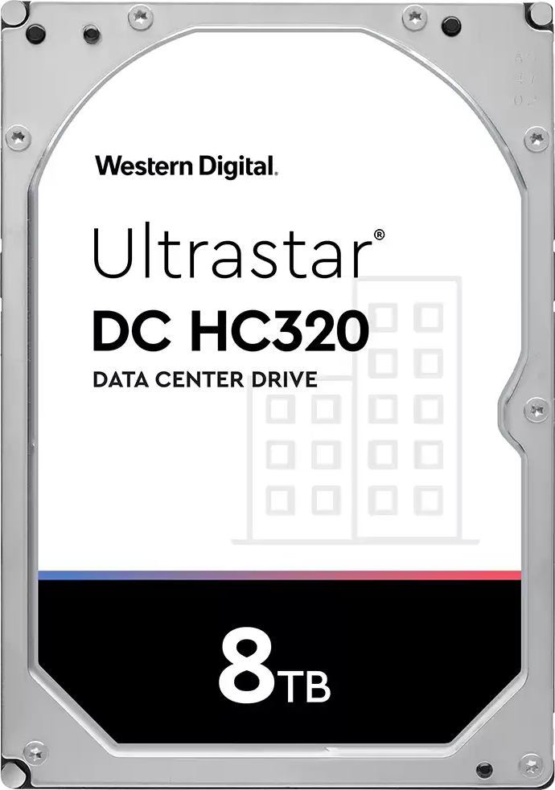
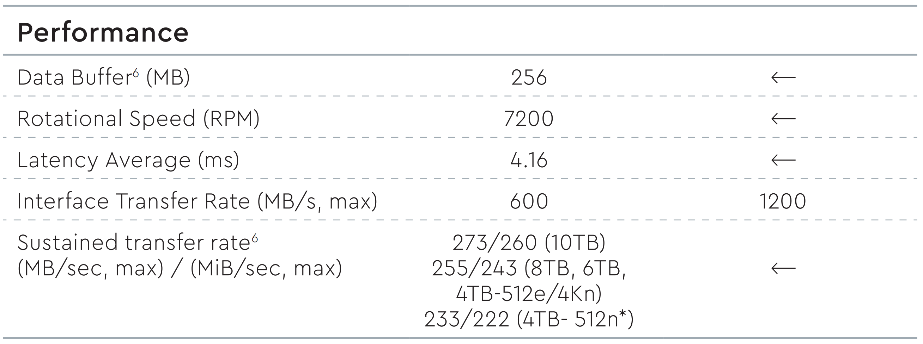
Example Specification
Data Buffer: Cache used to improve performance
Latency Average: This is an average including low and high values (Seek time)
Interface Transfer Rate: Maximum data transfer rate to the circuit board
Sustained transfer rate: The average data rate to expect
ITFreeTraining.com
© Copyright 2025
Notes:
07:15 Shown here are some of the specifications provided by the manufacturer for this hard disk. They provide a page worth of specifications, but the ones shown here are for performance. Different manufacturers will provide different specifications and how they report them can change as well.
In the case of this manufacturer, the first specification is data buffer. This may be referred to as cache. Cache is used to improve performance. For example, if multiple requests arrive around the same time, the cache may be used to optimize writing on the hard disk to minimize the amount the head on the hard disk has to move. It is always important to read the footnotes or explanation for the specification. In the case of this hard disk, the footnote tells us the data is shared with the firmware, that is, the software required to run the hardware. In simple terms, this means not all the data buffer is going to be available for caching. In order to know how much usable data buffer there is, we would need to know how much memory the firmware uses. When it comes to reading hard disk specifications, always read the fine print and understand what the specification is measuring.
I won’t worry about rotational speed or RPM since I believe these are fairly self-explanatory and I have already looked at RPM earlier in the video. The next specification is latency average. This is the average time the head takes to access part of the hard disk for reading or writing. Other manufacturers may refer to this as seek time. Just keep in mind this is an average seek time. This will be dependent on the testing conditions used to create the specification.
The interface transfer rate is the maximum rate of the interface between the hard disk and the computer. I will look at this in more detail later in the video. For the purpose of specifications, treat this as the maximum data transfer rate to the circuit board of the hard disk. This does not tell us a lot, because generally it will match the official maximum transfer rate of the connection specification. In this case, SATA 3 where the maximum transfer rate is 600 Megabytes per second. Thus, if you purchase a SATA hard disk nowadays, it will most likely always be 600 Megabytes per second.
To put what this specification means in simple terms, it is the rate of data transfer you could use to fill the data buffer of the hard disk. Once the buffer gets full, your transfer rate is going to slow down to how fast the hard disk can write data from the buffer to the physical platters. This may be referred to as a burst transfer rate, since you initially get a fast transfer rate which then slows down once the buffer gets full.
To get a better understanding of how your hard disk may perform, specifications like sustained transfer rate will give you a better idea. This specification is an average data rate you can expect to get. This, of course, depends on how the manufacturer measures this based on the testing they did.
Each manufacturer will give you some specifications, but it is up to the manufacturer to decide what to give you. When comparing specifications, beware of comparing high data transfer rates like burst rate with lower data rates like sustained transfer rate. Take some time to understand what the specification is telling you, how the manufacturer came up with it, and if there are any limitations to that specification.
Let’s now look at the interface.

Slide 7
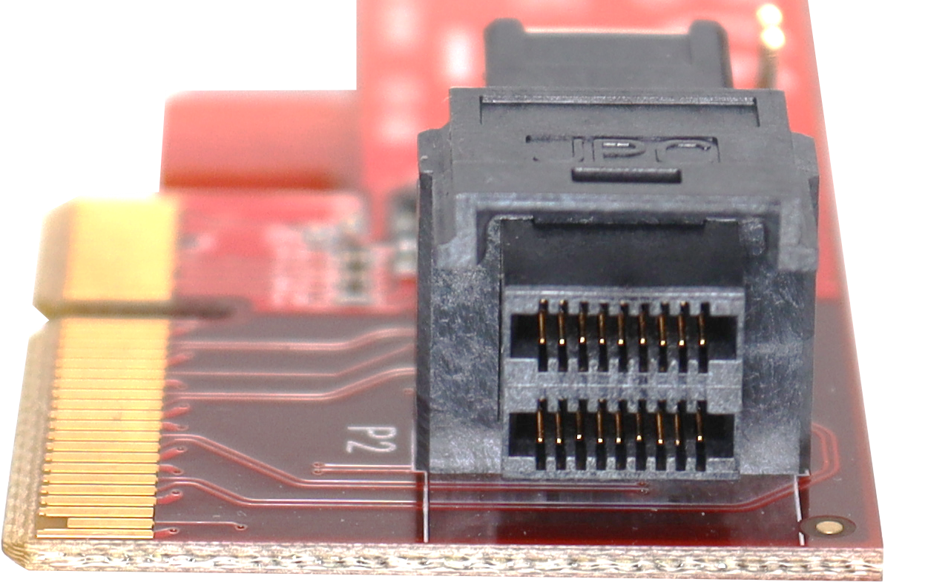
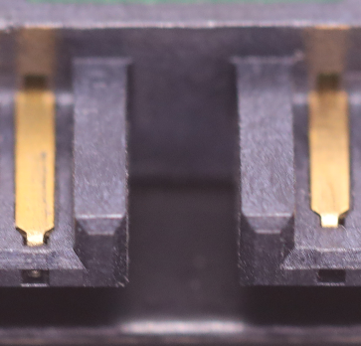
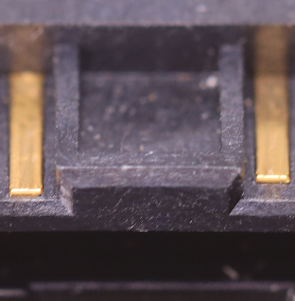
Hard Disk Interfaces
SATA
SAS
Newest version 3 (6 Gbps)
SAS version 4 (22.5 Gbps)
Unlikely to be new versions
Enterprise version (One exception)
Supports more features (E.g., topology)
U.2
Specific SAS connector
Designed for desktop
or Pro computer
Open
Closed
ITFreeTraining.com
© Copyright 2025
Notes:
10:46 The main interface used with non-enterprise hard disks is SATA. SATA is used to connect storage devices such as hard drives and optical drives. SATA supports hot swapping, so you can plug a hard disk into a computer without switching it off. Currently, the newest version of SATA is version 3 which was initially released in 2009. Since it was released so long ago, if you purchase a new hard disk, it is most likely going to be SATA 3.
Due to engineering limitations in improving SATA, it is unlikely there will be any newer versions. SATA 3 has a maximum speed of 6 Gigabits per second. This is too slow for modern Solid-State Drives, but for hard disks it is still high enough. Thus, SATA 3 will probably be used for hard disks for a while yet.
The other connection that is used for hard disks is SAS. SAS drives are typically more expensive than SATA ones. Thus, they tend to be used for enterprise solutions like server rooms or cloud storage. SAS offers a number of advantages, including faster data transfer speeds, better scalability, improved data integrity, and improved reliability.
You can see the connection on a SATA and SAS hard disk are very similar; however, there is one main difference. There is a gap between the power and data connectors on the SATA hard disk. With the SAS connector there is no gap. Effectively one is open and one is closed. This SAS hard disk won’t work with a SATA controller. However, a SATA hard disk can be used with a SAS controller. Most SAS controllers are backward compatible with SATA.
SAS version 4 supports speeds up to 22.5 Gigabits per second. A pretty high speed, but keep in mind this is the connection to the SAS controller, which may have multiple hard disks connected to it. No hard disk currently on the market can transfer data that quickly.
The average IT technician won’t come across SAS unless they are working in a server room. With the decreased cost of Solid-State Drives, professional workstations don’t tend to use SAS anymore. For the CompTIA exam, you most likely won’t get a question involving SAS as it is more enterprise related. For the IT technician, just know that the hard disk has a blocked connector at the back. That way you won’t accidentally try to use a SAS hard disk in a desktop computer.
SAS is targeted for the enterprise market, but there is another hard disk that uses the same connection. This is the U.2 connector. The U.2 connector is essentially a specific SAS connector. Don’t be fooled, however; it may use the same connector, but it uses a completely different protocol, meaning it is not compatible with SAS.
The U.2 connector is designed for the desktop and professional computer. Although I say desktop, desktop computers that use these connectors are high-end desktops. You don’t find these connectors on cheap desktop motherboards. There are some other connectors on the market, but U.2 is the only one so far that has got any market share. Having said that, the market share is small and I think, given enough time, it will disappear from the market, but only time will tell.
The main advantages of the U.2 connector are that it supports hot swapping and high transfer speeds. For hard disks this is not a big concern; however, for Solid-State Drives, you need more speed than interfaces like SATA can offer. Thus, U.2 offers a hot swappable solution for high-speed Solid-State Drives. However, technology such as USB and Thunderbolt also offer high-speed connections and hot swapping. This is another reason why I think that the U.2 connection, given enough time, will disappear from the market.
SAS also supports more features such as topology. Topology is essentially networking for storage devices. Thus, you can understand why it is more of an enterprise product. The average computer user does not need features like that for day-to-day computer activity.
Now let’s look at what sizes hard disks come in.

Slide 8
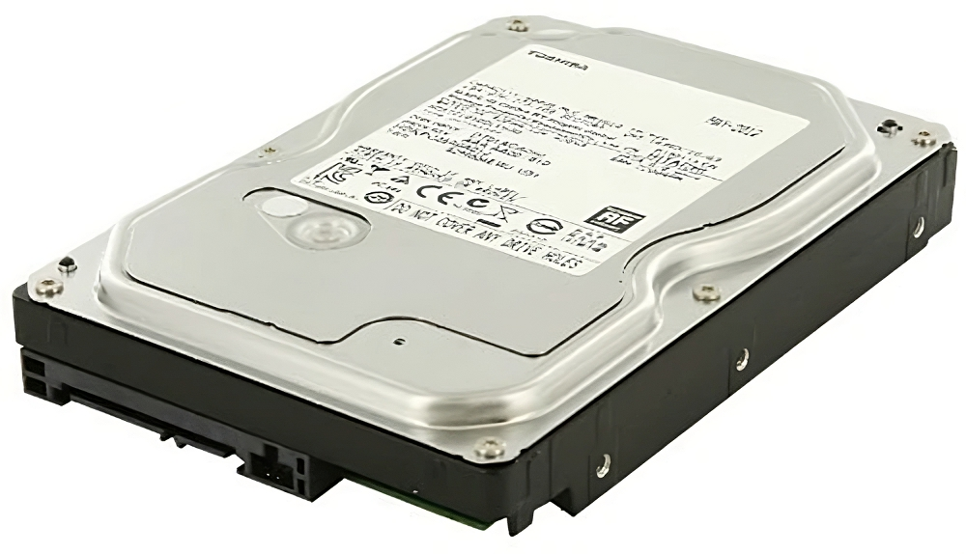
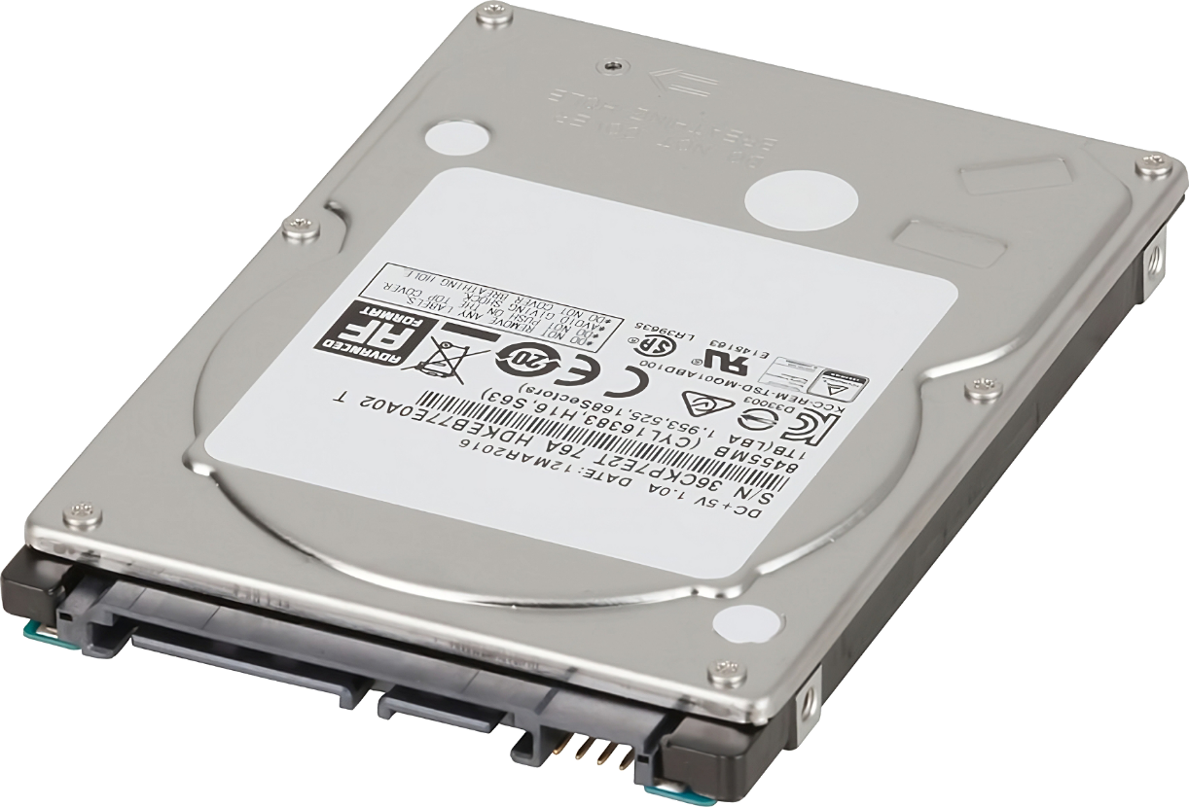
Form Factors
Defines the size of the hard disk
3.5 Inch
2.5 Inch
ITFreeTraining.com
© Copyright 2025
Notes:
15:08 The form factors define the physical dimensions of the hard disk. The manufacturer can’t go outside these dimensions, otherwise the hard disk may not be compatible with computer cases and devices. Shown on the left is the 3.5 inch form factor, commonly used in desktop computers. The 2.5 inch form factor shown on the right is generally used in laptops.
Hard disks use the same protocols and, thus, regardless of which form factor you choose, they will operate the same way. In order to make the hard disk smaller, some sacrifices have to be made. In most cases, the smaller hard disks will always be around 5400 RPM. Also, the smaller hard disks tend to have less storage capacity than the larger hard disks. Generally speaking, when making things smaller, there is generally a trade-off. These smaller hard disks are getting used less and less as Solid-State Drives nowadays have taken most of the market. Most laptops don’t use hard disks anymore and have made the change to Solid-State Drives.
Let’s have a look at some of the different types of hard disks available on the market.

Slide 9
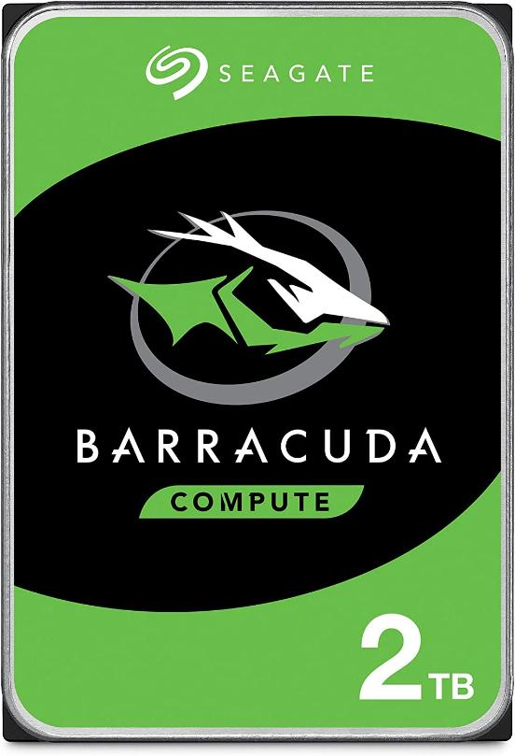
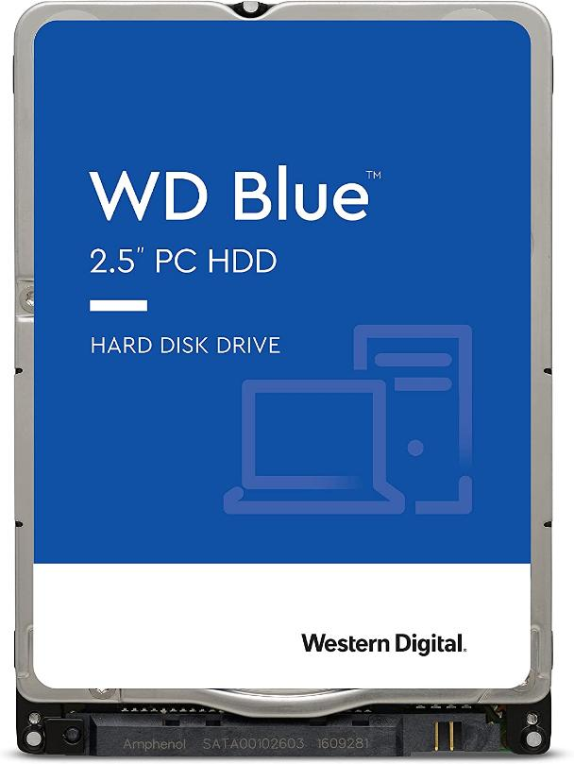
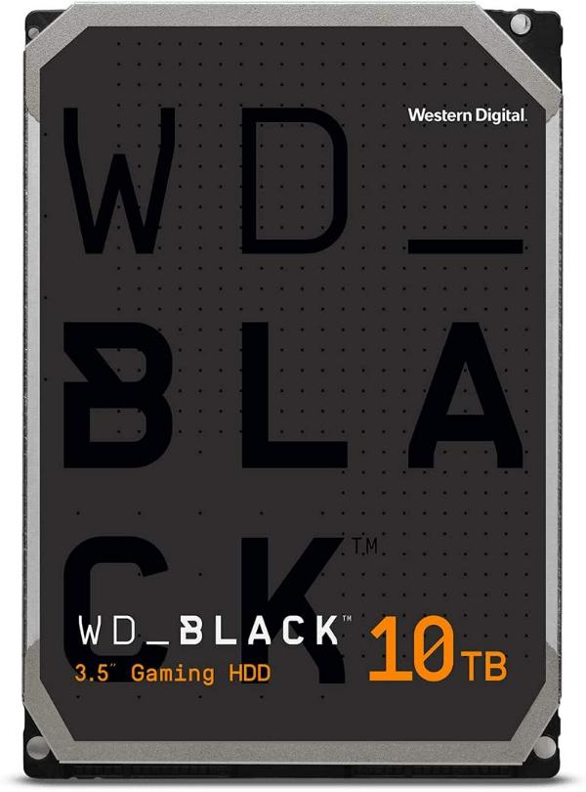
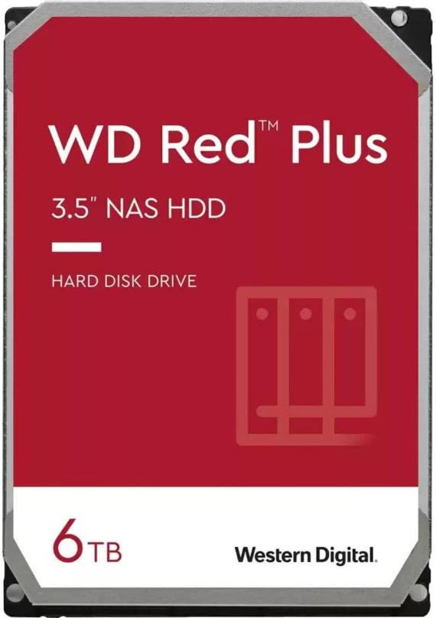
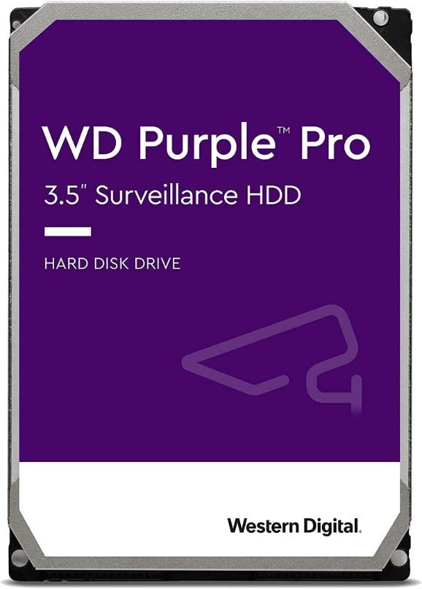
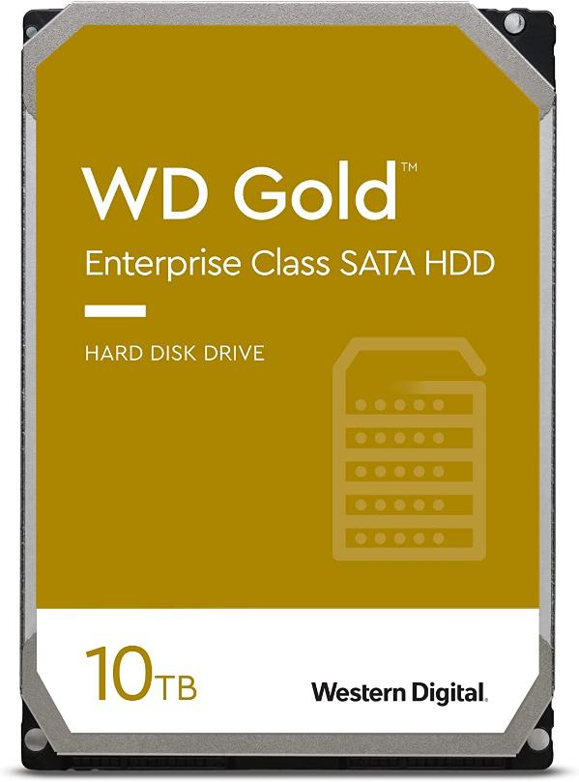
Hard Disk Products
Some hard disk manufacturers use different colors
Optimized for different purposes
Everyday
Capacity
High
Performance
NAS
CCTV
Enterprise
ITFreeTraining.com
© Copyright 2025
Notes:
16:18 Some hard disk manufacturers have different colors for their hard disks to help customers easily identify what purpose the hard disk was designed for. All the hard disks essentially work the same way, but what changes is they are optimized for different purposes. For example, some hard disks may have more cache than others. A Western Digital black hard disk is designed for performance and reliability. As they are of better quality, they cost more to manufacture, thus the higher price tag.
Not all manufacturers use different colors, so you may need to read the specifications of the hard disk to determine if it is the right hard disk for you.

Slide 10
Subscribe
Next video
Video content: https://ITFreeTraining.com/ap11/2b15
© Copyright 2025
Notes:
16:58 That concludes this video on hard disk drives. I hope you have found this informative. Until the next video from us, I would like to thank you for watching.
References
“The Official CompTIA A+ Core Study Guide (Exam 220-1101)” pages 56 to 56
“Mike Myers All in One A+ Certification Exam Guide 220-1101 & 220-1102” pages 273 to 275
“Find Your Color” https://www.westerndigital.com/en-au/solutions/color-drives
“Picture: Hard disk” https://pixabay.com/vectors/hdd-hard-disk-drive-disk-hard-disk-155913/
“Picture: Cheap” https://www.pexels.com/photo/text-of-a-cheap-as-chips-5939122/
Credits
Trainer: Austin Mason http://ITFreeTraining.com
Voice Talent: HP Lewis http://hplewis.com
Quality Assurance: Brett Batson http://www.pbb-proofreading.uk

