Slide 1
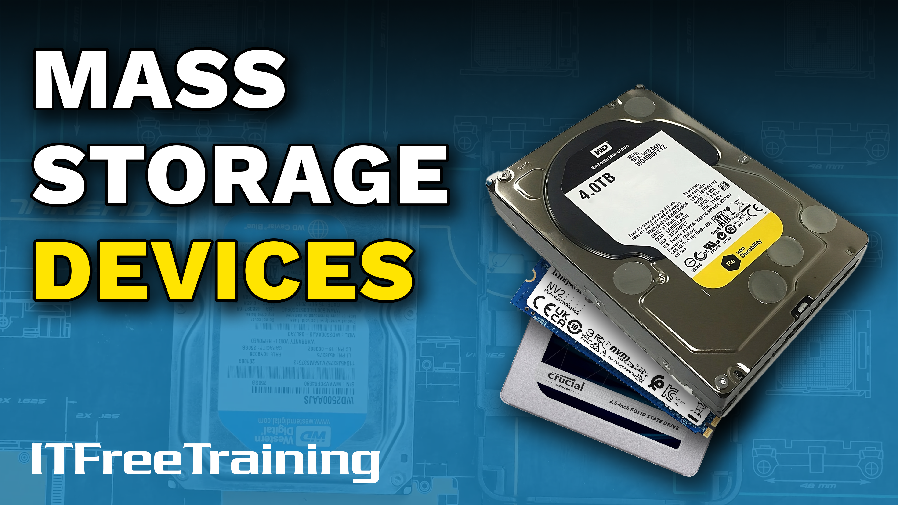
Notes:
Let’s have a look at mass storage devices.

Slide 2
Data vs Equipment Cost
Data is valuable
Equipment is cheap in comparison
ITFreeTraining.com
© Copyright 2024
Notes:
00:03 Businesses, when looking at data, will often look at the data as being extremely valuable but the computer equipment as cheap in comparison. For example, a company will often be more concerned about the data on a laptop than the laptop itself.
In this video, I will be looking at mass storage devices, their reliability and their performance. I won’t be looking at protecting your data from theft. This, I will leave to another video.

Slide 3
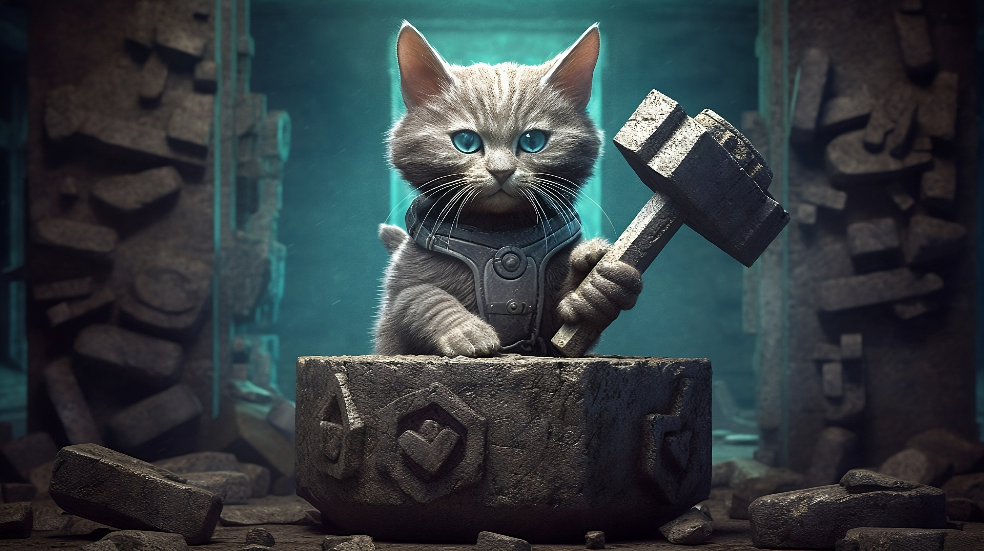
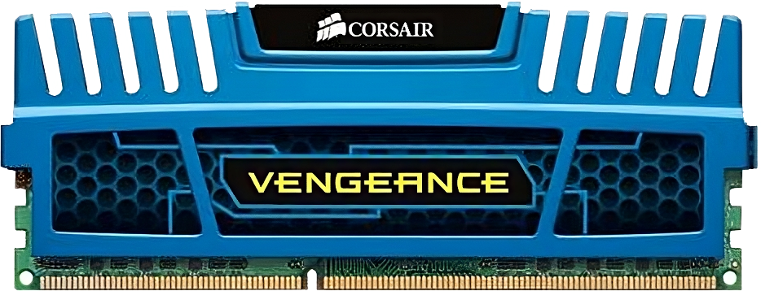
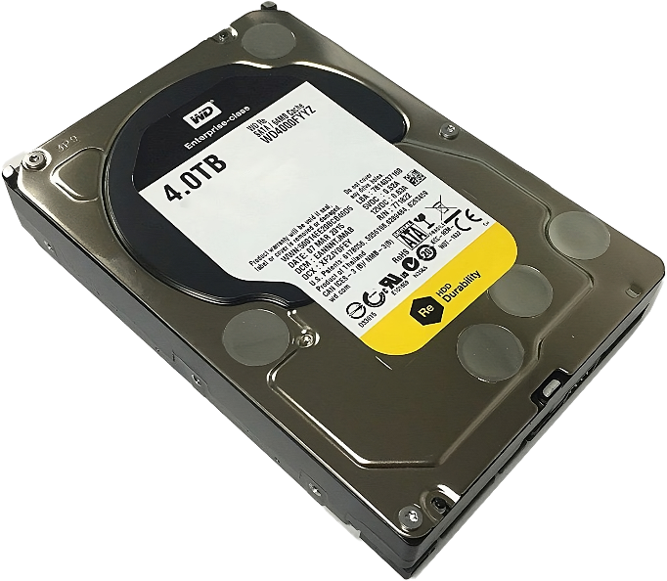
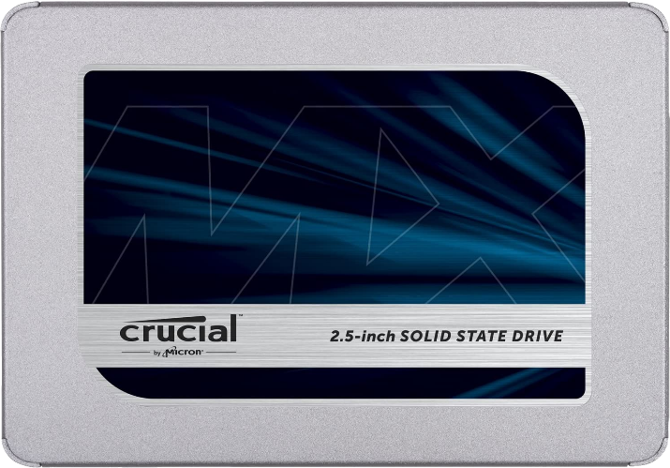
Non-Volatile
Storage that retains information after power loss
Non-Volatile
Volatile
ITFreeTraining.com
© Copyright 2024
Notes:
00:29 Before looking at mass storage devices, I will first go over a term you may hear from time to time about mass storage devices. This refers to them as being non-volatile storage. Non-volatile means storage that retains information after power loss.
Examples of non-volatile storage are M.2, hard disks and Solid-State Drives. Volatile storage generally refers to memory modules. To know if storage is volatile or not, simply ask yourself, is the data lost if you pull the power plug? If it is, it is volatile storage.

Slide 4
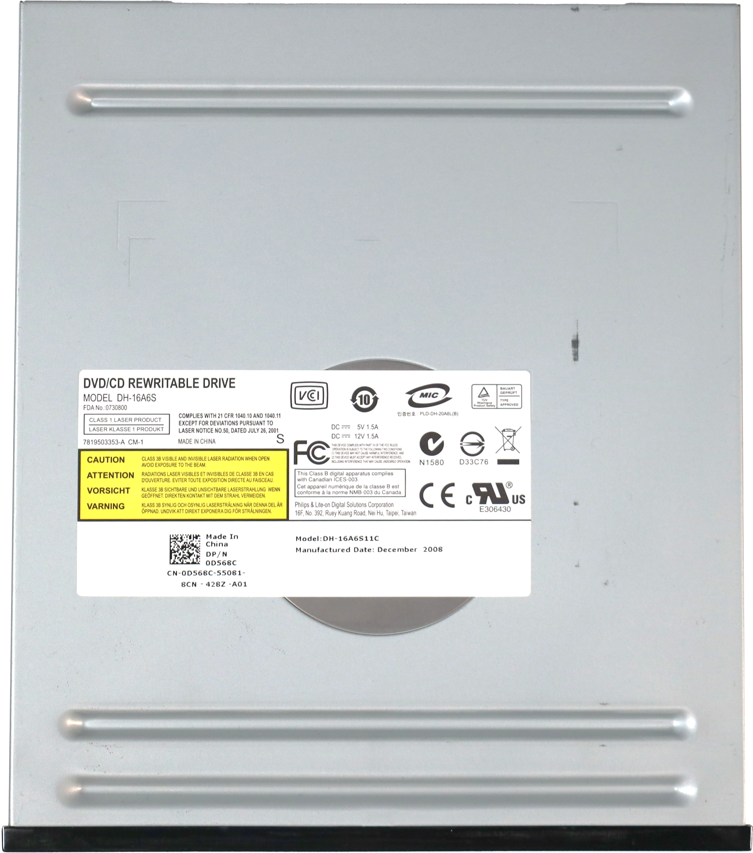
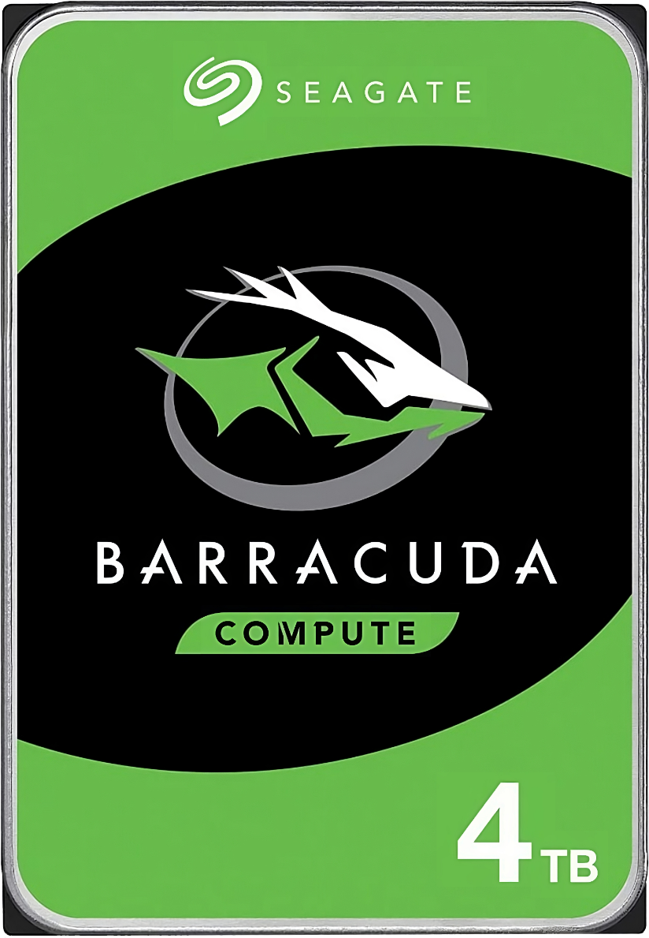
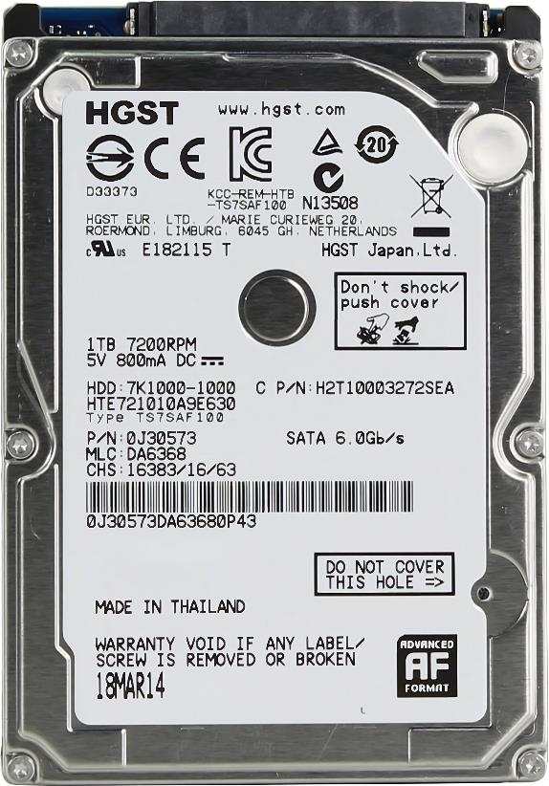
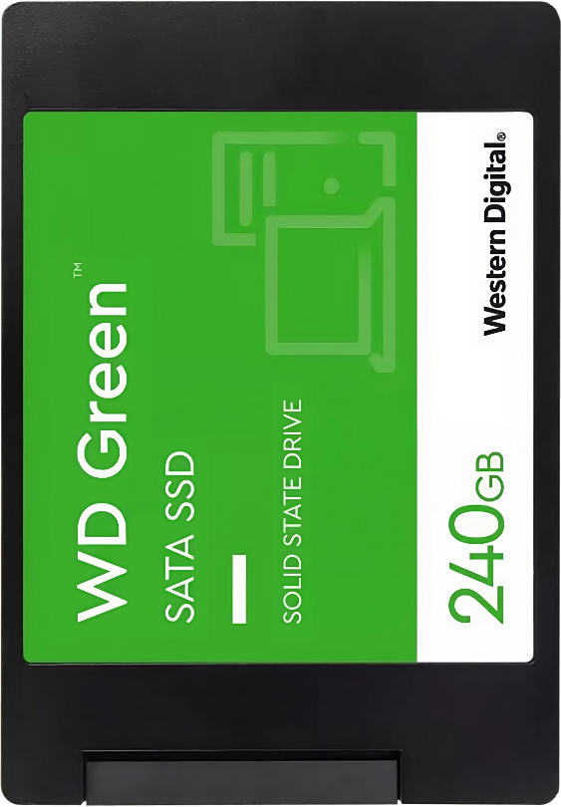
Storage-Standard Sizes
5¼ inches
3½ inches
2½ inches
ITFreeTraining.com
© Copyright 2024
Notes:
01:05 When looking at storage devices, the storage devices that are designed to be put into a computer are manufactured to a specific standard size. These sizes are 5¼ inches, 3½ inches and 2½ inches. Having them a standard size allows the storage devices to be installed in any computer case or device that supports that standard.
Nowadays, 5¼ inch drives are usually used for optical drives, 3½ inches is used for your hard disks and 2½ inches for laptop hard disks or Solid-State Drives. Let’s have a look at how to install some storage devices using these standard sizes.

Slide 5
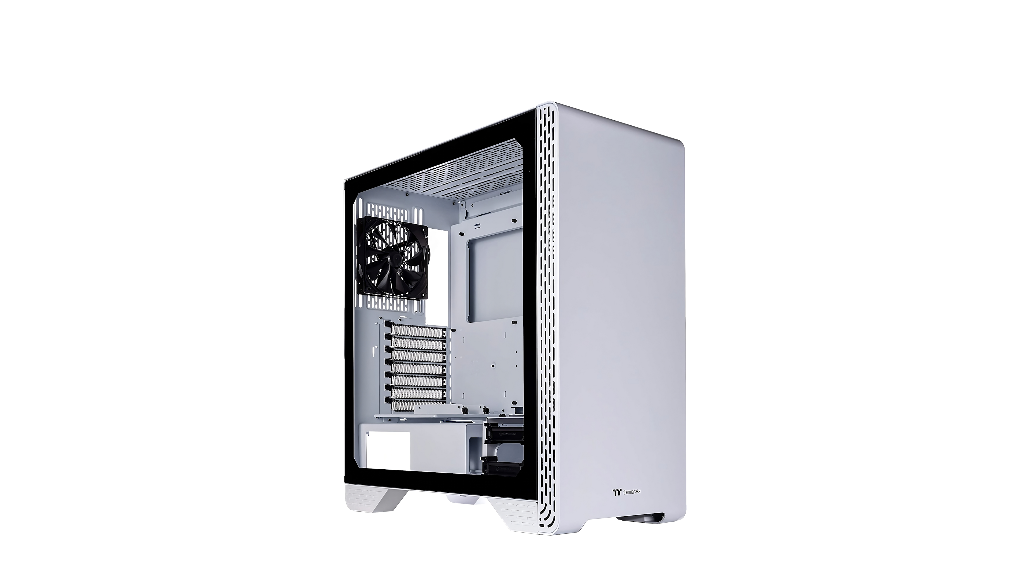
Demonstration
ITFreeTraining.com
© Copyright 2024
Notes:
01:47 In this demonstration, I will install some storage devices in a computer case. To start with, I will turn the computer case onto its side. Computer cases generally have some kind of panel that will need to be removed in order to install a storage device. For this computer case, there are side panels that need to be removed.
The computer case has two screws that need to be removed. Once these two screws have been removed, the side panel can be removed. Once the side panel has been removed, I will be able to install a storage device.
In this computer case, there are two removable drive trays. In some computer cases, these will be fixed, while in others they will be removable. The first step to installing the storage device is to remove the drive tray. The storage device will be screwed into the drive tray to hold it in place. In this example, I will install a 3½ inch hard drive.
The next step is to place the hard disk in the drive tray. For this drive tray, screws will be required to hold the hard disk in place. Some drive trays are toolless, and with these drive trays, you won’t need any screws.
In this example, I will put in four screws to hold the hard disk in place, even though this drive tray supports six screws. Storage locations in the computer case generally come with at least four screw holes. Four is enough in my opinion, as any more adds a debatable amount of benefit. Also, if you ever need to remove the storage device later on, having more screws makes it harder to remove them.
I will now place the drive tray back in the computer. The next step is to connect the cables to the hard disk. In order to do this, I will stand the computer up and remove the back cover. Like the front cover, two screws need to be removed and then the cover can be removed. The back cover needs to be removed so I can plug in the power and data cables. Unfortunately, with these kinds of computer cases, this needs to be done.
Once the back cover is removed, I will turn the computer case so I can access the motherboard. I will next plug a SATA cable into the motherboard and then push the cable through to the back of the computer. Given that this is a demonstration on how to install storage devices, I won’t worry too much about cable management. If I was doing this on a production system, I would spend more time on cable management.
I will now turn the computer case around so I can access the back of it. Now, it is just a matter of plugging in the data cable and power cable to the back of the hard disk. Once the cables are plugged in, the hard disk is now installed. This is just one of the places you can install a hard disk.
When installing storage devices, have a good look around the computer case. You may find there are different locations in the computer case where storage devices can be mounted. On this computer case, notice there is an imprint on the computer case labeled HDD. This indicates screw holes where a hard disk could be mounted.
In this computer case, two hard disks can be mounted inside. Once they are in place, it is just a matter of screwing them in. I will now have a look at the 3½ inch drive bays.
I will remove the drive tray as I did for the hard disk. Any Solid-State Drives use the 3½ inch standard. Notice that there are screw holes for this standard in the center of the tray. It is just a matter of placing the Solid-State Drive over these screw holes and putting some screws in the back to hold it in place.
There may also be other places in the computer case to mount Solid-State Drives. On this computer case, a screw needs to be removed to free the drive tray. Once the tray has been removed, the Solid-State Drive is put on top and can then be screwed to the tray. Then it is just a matter of putting the tray back in the computer.
I will have a look at the 5¼ inch drive bay. For this, I will use this empty computer case. On this computer case, there is one 5¼ inch drive bay at the front that I can use. These drive bays were traditionally used for optical drives. With so much data going on-line and portable storage devices becoming cheaper, the need to use optical media has reduced significantly. Thus, you may find it increasingly difficult to find a computer case with an accessible 5¼ inch drive bay.
I will now install the optical drive. Before I can do this, I need to push out the blanking panel at the front. In some cases, there may also be a metal blanking panel blocking the bay that needs to be removed. If you have trouble getting the panel out, you may need to use a flat head screwdriver to help lever the panel out.
To install the optical drive, it is just a matter of sliding it into the case. If you have trouble getting it to go in, wiggle the drive a little bit. Make sure you line the optical drive up with the computer case, so it is flush.
The computer case will generally have eight screw holes, four on each side. Some will be round and the others elliptical. The elliptical ones are designed to allow for a screw to be in a range of positions. If you use one of these, it is best to use a circular one on the other side to make sure it does not move.
For optical drives, you generally want to use the bottom screw holes. Since the optical drive has a spinning motor, you want to have it secure at the bottom to help prevent vibrations and keep the drive a little more stable.
Although you could hold the drive in with just one screw, it is recommended to use four screws. Two on this side of the computer case and two on the other side of the computer case. Four screws are normally enough to hold the optical drive-in place. You could use up to eight screws, however, in my opinion it is not necessary. Although it may help keep the optical drive slightly more secure than four, if you ever need to remove the optical drive later, it will take longer for you to remove all the screws. Four should be enough.

Slide 6
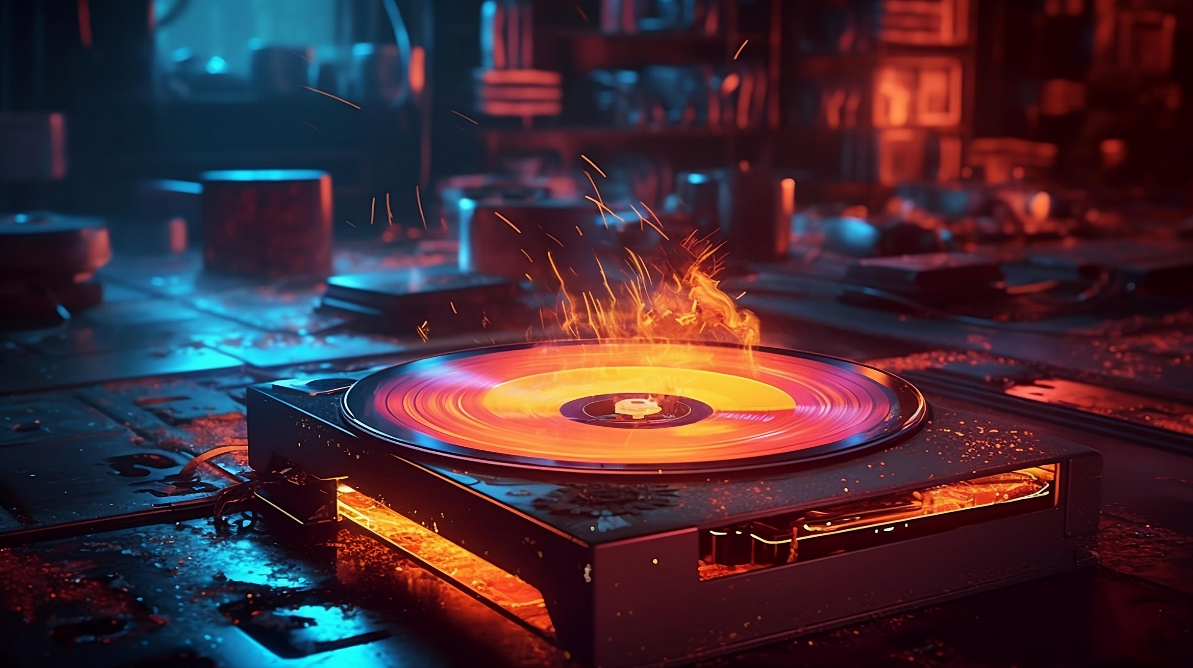
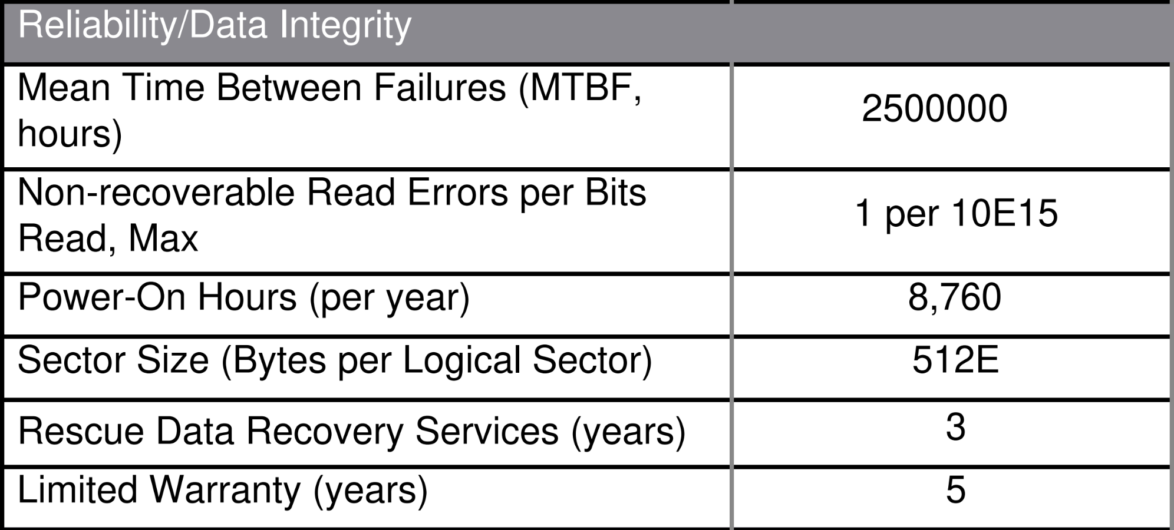
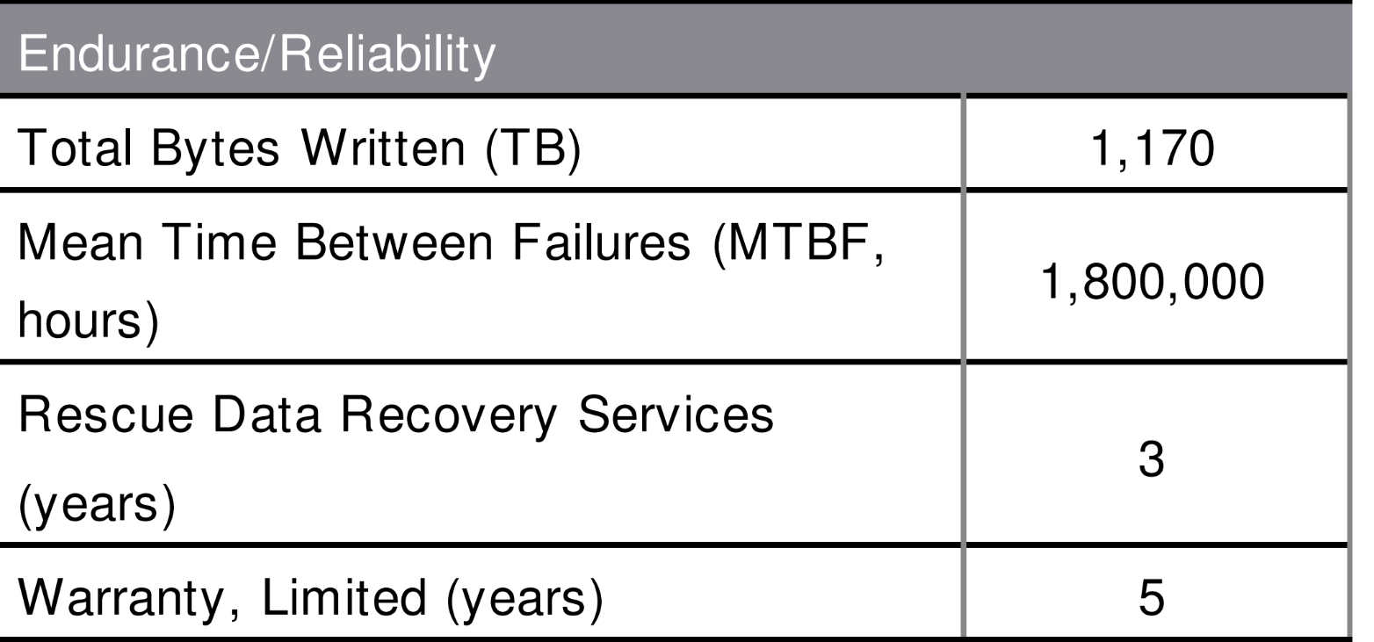
Reliability
The risk of disk failure and risk of data corruption
Solid-State example
Hard disk example
ITFreeTraining.com
© Copyright 2024
Notes:
07:37 When looking at mass storage devices, it is important to look at reliability of the storage. Reliability is the risk of disk failure and risk of data corruption. Shown here are some example statistics of reliability from a storage manufacturer for a hard disk and a Solid-State Drive.
Different manufacturers will release different statistics on performance. Usually, they will provide a time period of mean time between failures. So essentially, the manufacturer has measured the time it took for their storage devices to fail and then took an average. All devices will fail eventually, so you should use these statistics to help you work out when to replace your storage device.
With Solid-State Drives, you will have a figure indicating how many writes the device can do. Although all storage devices wear out over time, Solid-State Drives are different to hard disks in that a single cell will wear out depending on how many times it is written to. The Solid-State Drive will attempt to even out the wear across the drive. Thus, when a single Solid-State Drive cell wears out, the other cells on the drive are probably close to wearing out as well.
A single sector on a hard disk is not a concern as it is with a solid-state cell. Since hard disk writes don’t wear the drive out, mechanical failure and other factors are a bigger concern. Thus, when you use Solid-State Drives, you should also consider how many writes you will be performing on that drive. If you write a lot to the Solid-State Drive, it will wear out faster. For hard disks, consider the number of hours they will be running for.

Slide 7
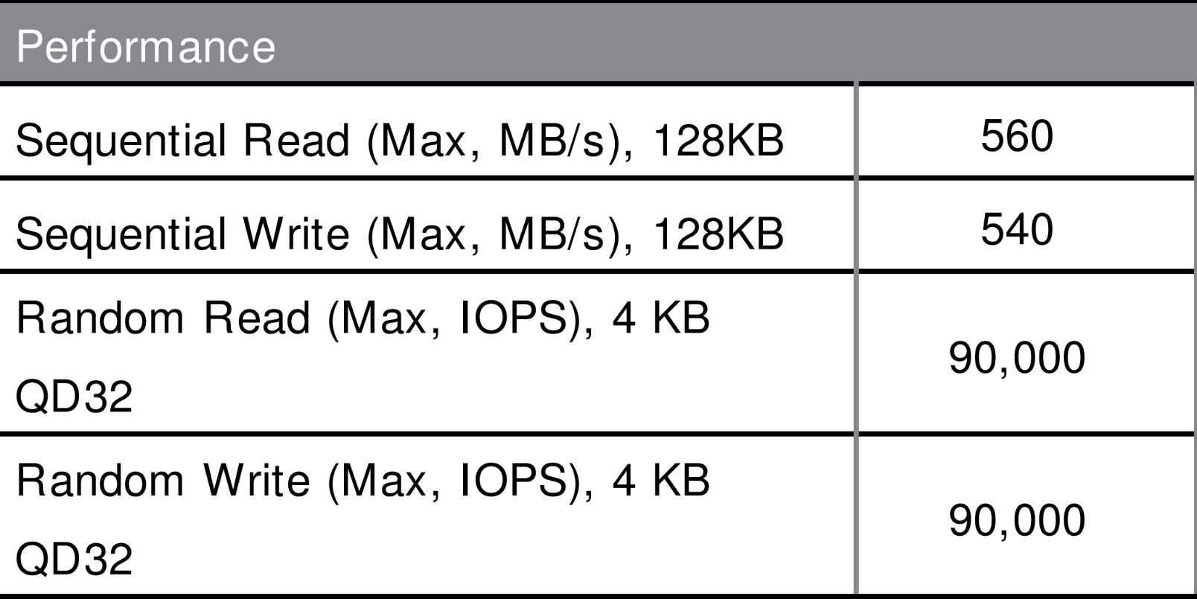
Performance
How fast the device can transfer data
Read and write performance different for Solid-State Drives
Sequential and random access is very different
Hard disk example
Solid-State example
ITFreeTraining.com
© Copyright 2024
Notes:
09:09 Next, I will look at performance. Performance is essentially how fast the device can transfer data. Shown here are performance statistics for hard disk and Solid-State Drives. With hard disks, the disks spin at a set speed.
Solid-State Drives work using flash memory and have no moving parts. For this reason, read and write performance is different for Solid-State Drives. Solid-State Drives will write slower than they read.
When looking at performance, it is important to consider that sequential and random access is very different. Sequential access is when contiguous blocks of data are grouped together, that is data that is adjacent in location, and are either read or written to at once.
The other kind of access is random, where any data on the storage device can be accessed at any time. With hard disks, this requires the hard disk to move to the new location which takes time. In contrast, Solid-State Drives don’t have a drive head to move, and thus random access is very fast.When purchasing storage, have a think about what performance you want to get from it. This will come down to what you want to use it for, and this is something I will have a look at next.

Slide 8
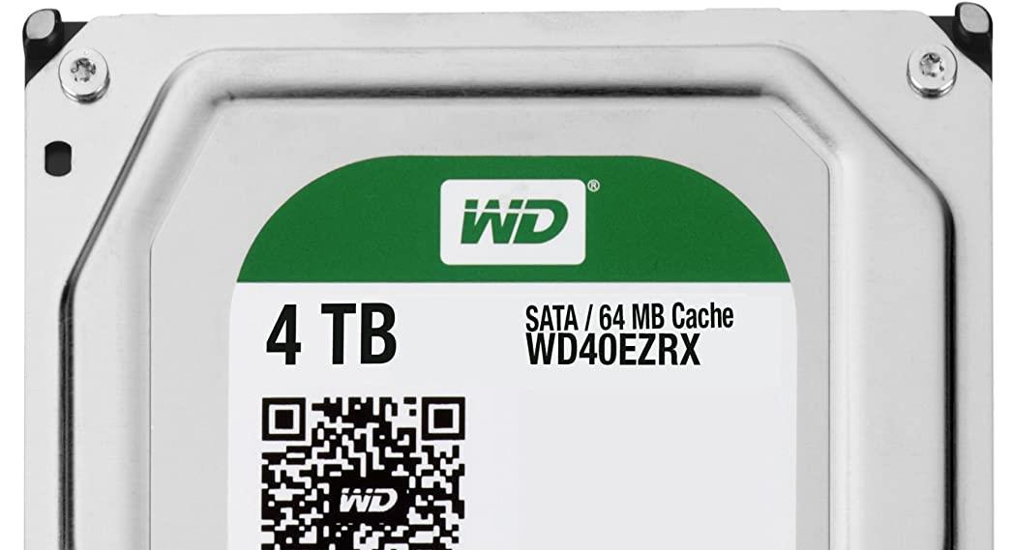
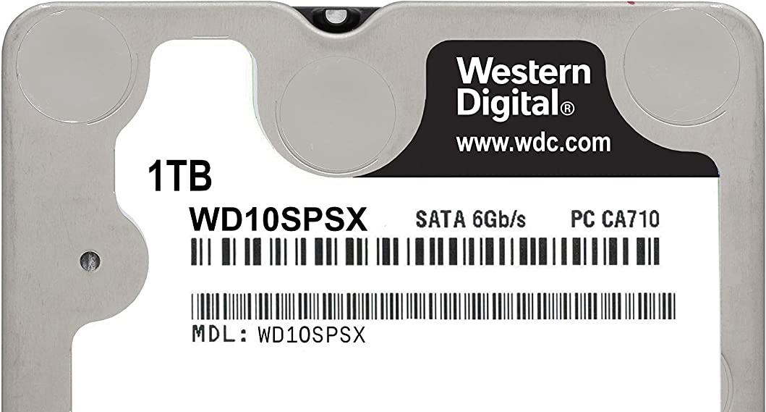
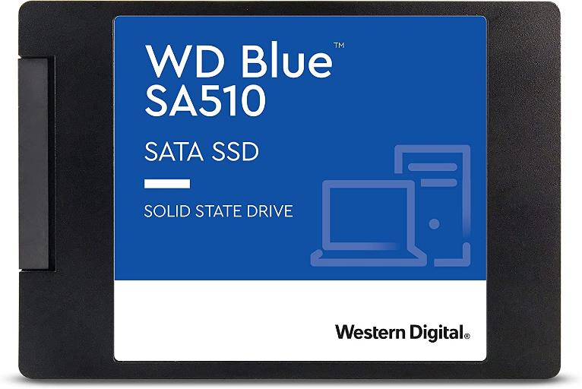
Storage Use
OS
Database
Video
Backup
Power saving
High performance
Capacity focused
ITFreeTraining.com
© Copyright 2024
Notes:
10:19 Depending on what you will be doing, will influence what storage you purchase. For running an OS nowadays, Solid-State Drives are used in most cases. When running an operating system, there are a lot of random accesses, particularly when the operating system is starting up. Using a Solid-State Drive makes the operating system run a lot faster. Thus, this is the reason it is generally always used as the boot drive for the computer.
If you are running a database, an important factor is how large your data is. Solid-State is much faster than hard disks, however, it costs a lot more. Thus, solid-state is not really affordable for large databases. In order to increase performance, large databases will often be spread across multiple hard disks. Even though Solid-State Drives are too expensive for large installations for most people, it may be worth looking into high performance hard disks depending on what your needs are.
For videos, which generally take up a lot of space, hard disks are still king when it comes to storage size. Thus, for large amounts of video you will probably use a hard disk. Solid-State storage has increased in size and dropped in price, so you could purchase one and two terabyte Solid-State Drives if you wanted to. The important point to remember is, regardless of which solution you choose, performance needs to be high enough to transfer the videos. You don’t want to be playing a video which stops or starts stuttering. If you are using 4k videos, your transfer rate needs to be very high.
If you are planning to make backups using this storage, it generally does not need to be that fast. In most cases, backups run during down time and have plenty of time to run.
Some manufacturers will create storage that is optimized for certain purposes. For example, Western Digital produce devices of different colors. Therefore, a green storage device is designed to use less power than the others. Black storage devices are designed to be high performance. These devices are designed to run faster and are made to a higher quality. Blue storage devices are made with capacity in mind.
Not all manufacturers will have color-coded devices. When this is the case, have a look at what the manufacturer is saying the device should be used for. If it has not been manufactured with a specific purpose in mind, have a look at the performance statistics for the device. If you want performance, get a fast device; if you don’t require high performance, you can save some money and get a slower device.

Slide 9
Subscribe
Next video
Video content: https://ITFreeTraining.com/ap11/2b05
© Copyright 2024
Notes:
12:49 That concludes this video on mass storage devices. I hope you have enjoyed this video and I hope to see you in the next one. Until the next video, I would like to thank you for watching.
References
“The Official CompTIA A+ Core Study Guide (Exam 220-1101)” pages 52 to 53
Credits
Trainer: Austin Mason https://ITFreeTraining.com
Voice Talent: HA Hellenberg https://www.freelancer.com/u/adriaansound
Quality Assurance: Brett Batson https://www.pbb-proofreading.uk

